Slide 1
Safe Offline POMDP-Based RL for ICU Treatment
Final End-to-End Workflow & Results

Slide 2
Agenda
Problem Statement & Objectives
Literature & Gaps
System Architecture & Models
Implementation Details
Results & Analysis
Demo & Dashboard
Conclusions & Future Work

Slide 3
Problem Statement
Optimize sequential ICU treatment decisions using offline historical data (MIMIC-III).
Minimize patient deterioration while ensuring clinical safety and explainability.
Challenge: Partial observability, distributional risk, and safety constraints.

Slide 4
End-to-End Workflow
Phase 1: Data Ingestion & Preprocessing — hourly windowing, imputation, SOFA, reward engineering.
Phase 2: Sequential Representation — LSTM encoder (24h) + VAE → 16D belief state.
Phase 3: Safe Offline RL — Conservative Q-Learning (CQL) with quantile regression (QR-CQL).
Phase 4: Clinical Safety Layer — vitals watchdog + drug interaction vetoes.
Phase 5: Real-time Inference & Dashboard — ensemble uncertainty, SHAP explainability, audit logs.

Slide 5
System Architecture
High-level POMDP formulation Observation: vitals & labs (hourly) Belief: 16D latent vector Model Components Policy: CQL (discrete actions: none/low/med/high) Uncertainty: ensemble heads + QR Safety: rule-based veto

Slide 6
Deep Neural Network Architecture
Temporal Encoder: LSTM (input_dim=16 → hidden=64 → embed)
Latent Model: VAE (latent_dim=16) for belief state
CQL: Conservative Q-learning via d3rlpy (discrete setting)

Slide 7
Implementation - Key Modules
Preprocessing: src.preprocessing.process_data -> MIMICPreprocessor
Temporal: src.temporal_model.lstm_encoder -> TemporalEncoder
Latent: src.latent_model.vae -> LatentVAE
Agents: src.rl_agents.cql_agent -> CQLAgent; baselines in baselines.py
Safety: src.safety.safety_constraints -> SafetyLayer
Explainability: src.explainability.shap_explainer -> ICUExplainer
Dashboard: dashboard/app.py (Streamlit)

Slide 8
Implementation - Training
Training orchestration: src.training.train_all.run_pipeline()
Temporal encoder and VAE initialized (hidden_dim=64, latent_dim=16); training skipped in scaffold demo.
CQL configured with batch_size=256 (d3rlpy) — offline fitting on processed parquet trajectories.

Slide 9
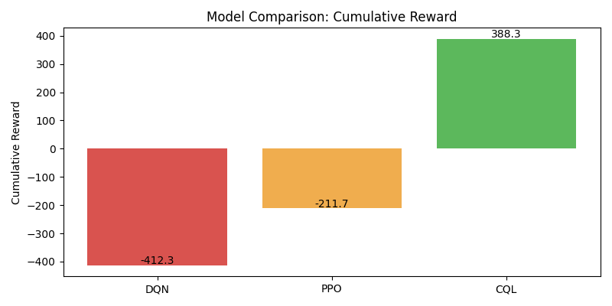
Results - Model Comparison

Slide 10
Results - Key Metrics
DQN: CumR=-412.3, AvgR=-41.23, SofaΔ=2
PPO: CumR=-211.7, AvgR=-21.17, SofaΔ=-1
CQL: CumR=388.3, AvgR=38.83, SofaΔ=0

Slide 11
Training & Hyperparameters
TemporalEncoder: hidden_dim=64, num_layers=2
LatentVAE: hidden_dim=64, latent_dim=16
CQL: batch_size=256, n_steps ~ 1k-10k (research)
Optimization: Adam lr=1e-3 for encoder/VAE

Slide 12
Safety Layer & Explainability
SafetyLayer enforces clinical thresholds (BP, HR, SpO2) and drug interaction vetoes.
Every override increments audit counters and is logged in Safety Audit tab.
Explainability via SHAP: per-decision feature impacts saved to results/plots/explainability/.

Slide 13
Demo - How to Run
Run preprocessing: python -m src.preprocessing.process_data
Train models: python -m src.training.train_all
Launch dashboard: streamlit run dashboard/app.py
SHAP explainers and audit logs are generated during inference flows.

Slide 14
Discussion & Future Work
Discussion: CQL shows strong cumulative reward in offline benchmarks; safety layer ensures clinical constraints.
Limitations: scaffold demo skips heavy training; real deployment needs prospective validation and clinician-in-the-loop testing.
Future: online fine-tuning (with safeguards), richer drug ontology, patient subgroup analysis.

Slide 15
References
MIMIC-III dataset
Kumar et al., Conservative Q-Learning (CQL)
SHAP: Lundberg & Lee
FQE and OPE literature

