Slide 1
METHODOLOGY

Slide 2
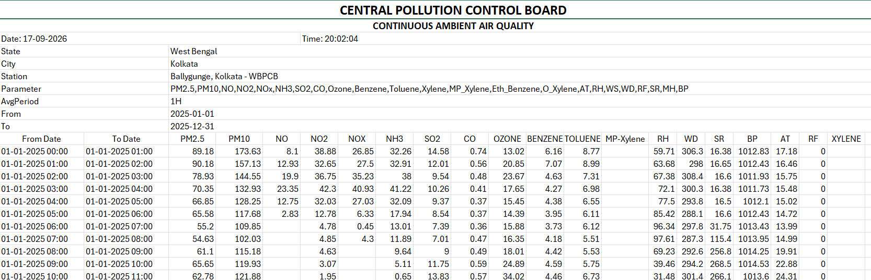
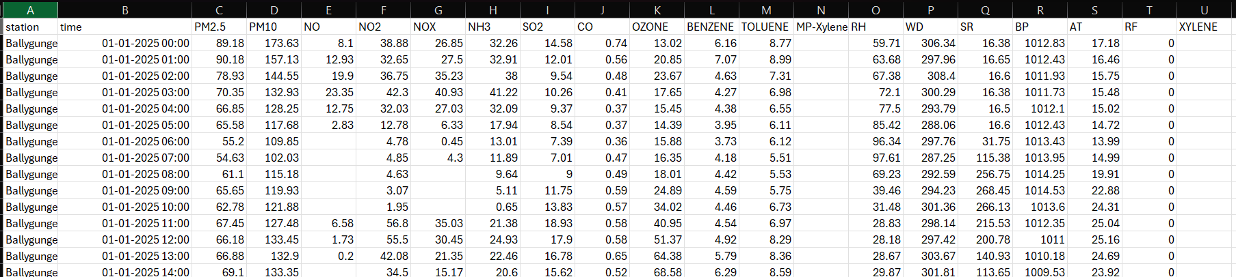
1. READ THE CPCB FILE

Slide 3
2. STACK ALL THE FILES INTO 1 UNIFIED TABLE
ALL THE 21 FILES WE STACKED INTO 1 LARGE CSV FILE STATION WISE YEAR AND YEAR WISE SO NO ROWS GETS INTERLEAVED

Slide 4
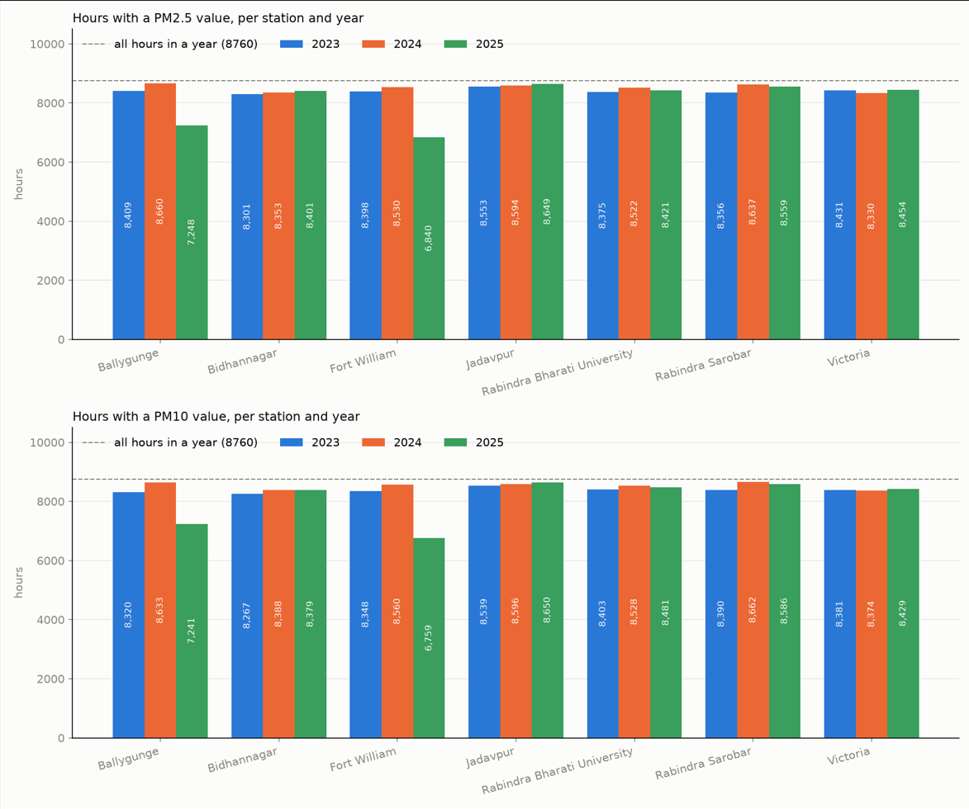
3. PLOT ON THE AMOUNT OF DATA AVALIBILITY ON PM2.5 AND PM10

Slide 5
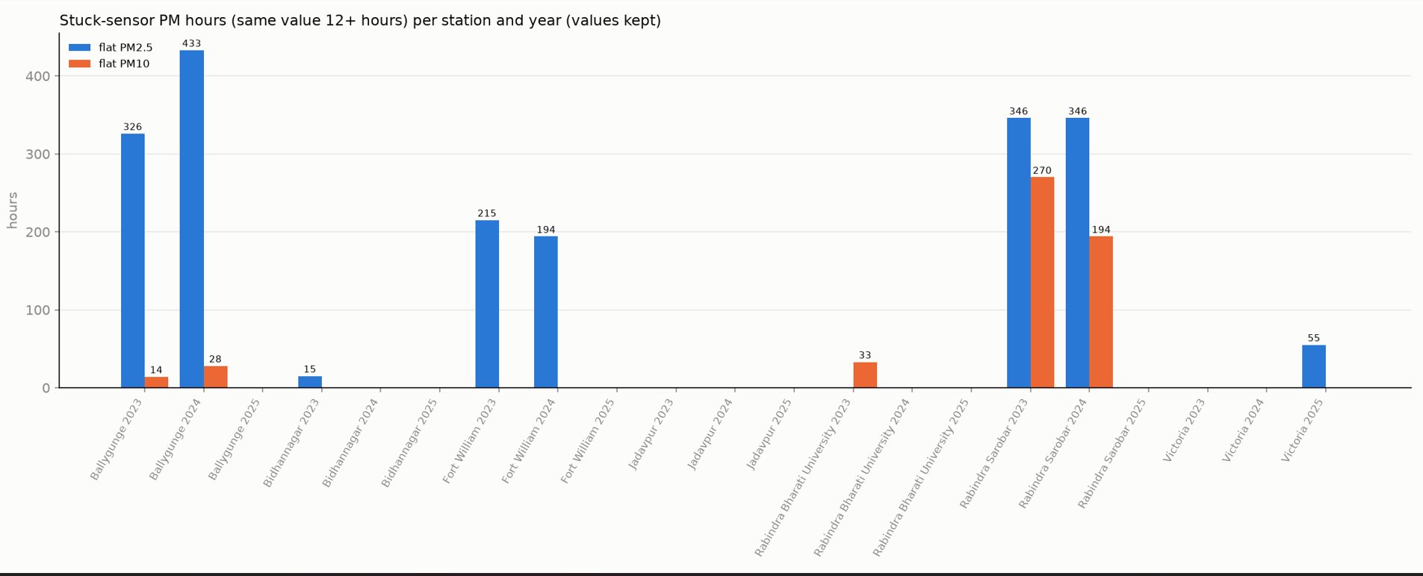
4. DATA PREPROCESSING
  The criteria for preprocessing is:
    PM2.5 or PM10 with the same value for 12 hours or more. Such rows are marked as stuck.
  Remove the XYLENE,MP-XYLENE,BENZENE AND TOULENE are dropped as they are empty.
  RF and CO column was removed as it contain mostly zeroes.

Slide 6
5. FILLING MISSING DATA AND ADDING EXTRA COLUMN
Fill a short gap with the last real value, for at most 6 hours. The fill only looks backwards.
target_pm25, target_pm10: untouched copies of the real PM2.5 and PM10. They are the answers the model learns to predict, so they are never filled.
PM2.5 / PM10 lags (1, 3, 6, 12, 24 h ago): pollution now depends strongly on pollution a few hours earlier and at the same time yesterday.
PM2.5_mean24h, PM10_mean24h: the average of the last 24 hours. It shows the overall level and smooths out short noise.
WD_sin, WD_cos: wind direction as a circle, so 359° and 1° count as neighbours, not opposite ends.
hour_sin, hour_cos: time of day as a circle, so 23:00 sits next to 00:00. This captures daily patterns like rush hour and night build-up.
doy_sin, doy_cos: day of year as a circle, so 31 Dec sits next to 1 Jan. This captures the yearly cycle.
season (Winter, Summer (Pre-monsoon), Southwest Monsoon (Rainy), Post-monsoon (North-east Monsoon / Autumn) ): Kolkata's pollution changes a lot by season, for example high in winter and low in the monsoon.
stuck_pm25, stuck_pm10 (0/1): mark sensor readings stuck at the same value for 12 hours or more, so the model knows the number may not be real.
era5_u10, era5_v10: wind from west to east and from south to north (from ERA5). Wind direction decides where the pollution is carried.
era5_ws: net wind speed. Strong wind spreads pollution and calm air traps it.

Slide 7
6.

