Slide 1



Kolkata
PM Forecast
Reliable
PM Forecasts
Presented by Ratul Pal
PM2.5 + PM10 · range + trust flag · October 2026

Slide 2
01
Data and features
02
Five forecasters
Overview
03
Worker B: the trust flag
04
Worker C and results

Slide 3


The Problem
A forecast alone is not enough
A PM2.5 or PM10 forecast gives one number. People also need to know how far off it can be, and when the model meets an hour it has never seen before. This project adds two things to every forecast: an honest 90% range and a trust flag (Green, Yellow or Red). Data: 7 Kolkata CPCB stations, hourly, 2023–2025.

Slide 4
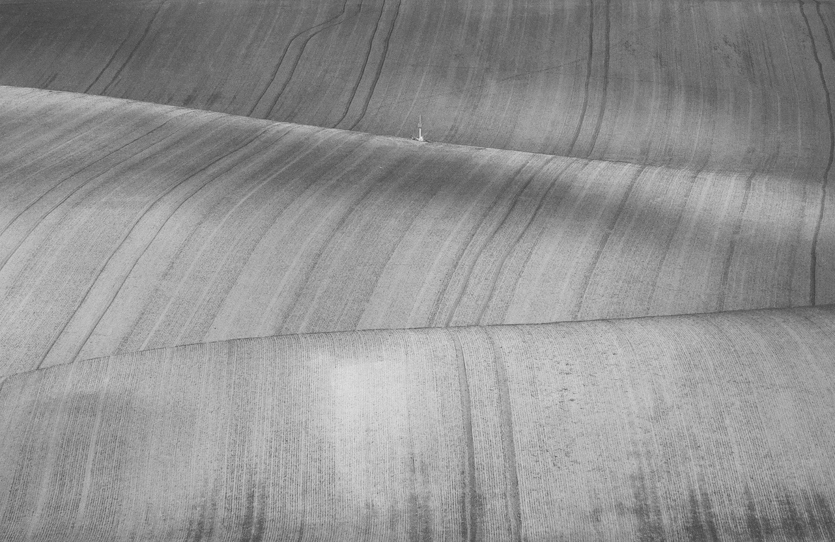

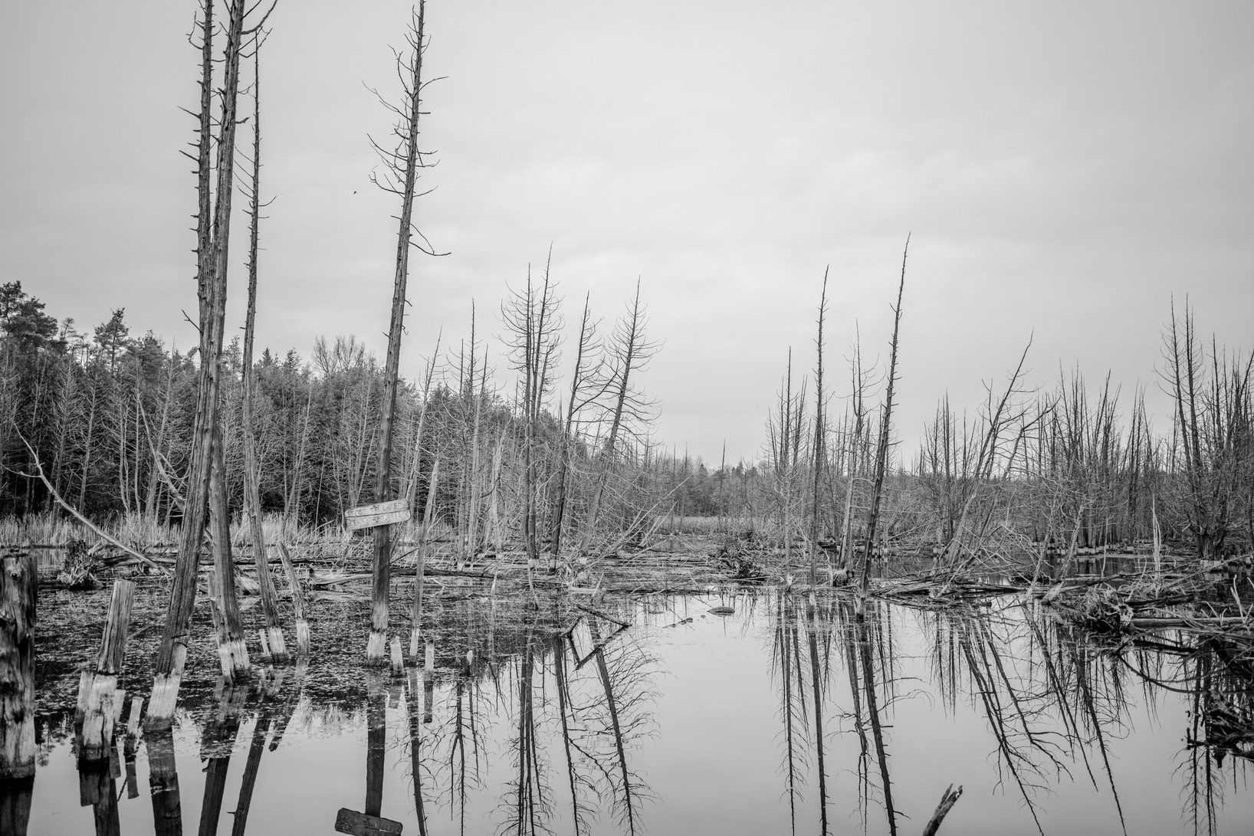

The Pipeline
Step 1
Step 2
Step 3
Step 4
Data
Forecasters
Worker B
Worker C
21 CPCB files become one hourly table (184,128 rows). Problems are marked, never changed. 6 ways to fill gaps.
5 deep models read the last 48 h and forecast PM2.5 and PM10 at +1 to +24 h.
Is this hour normal for its season? The answer is a flag: Green, Yellow or Red.
Builds a range that holds 90% of real values, and adjusts it live after hits and misses.

Slide 5
Trust it, widen it,
or abstain.

Slide 6
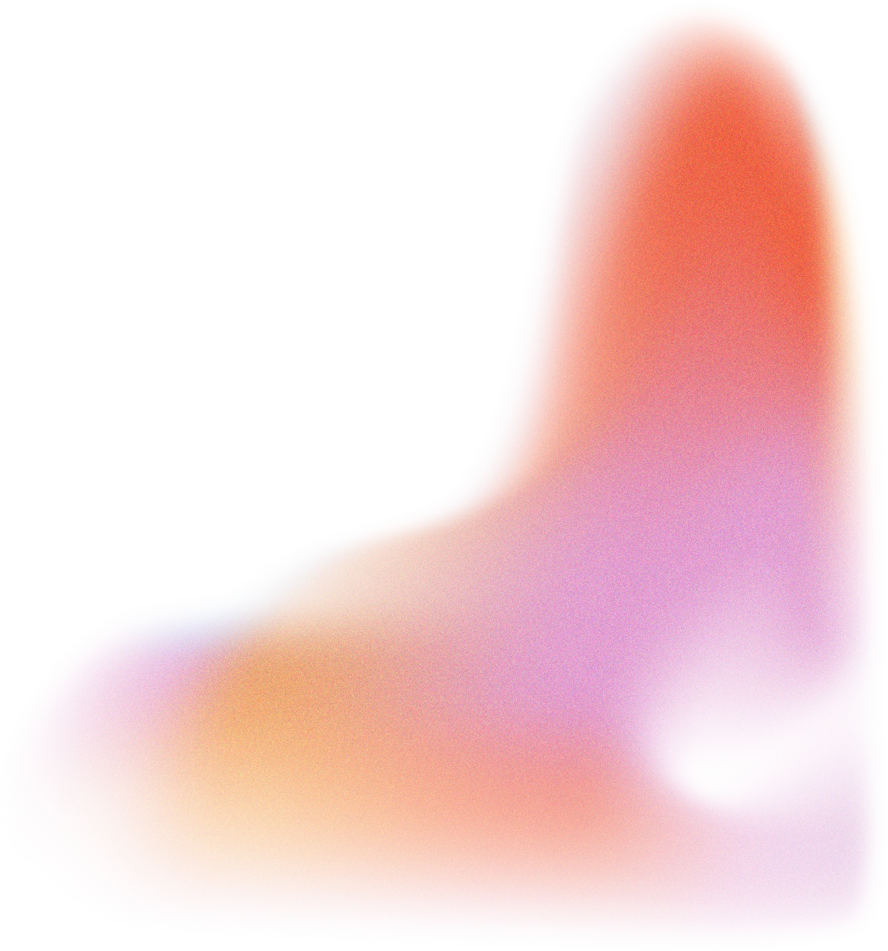


Data and Splits
Clean data
(steps 2.1–2.2)
Split by time
(step 3.1)
7 stations, 2023–2025, 19 parameters, 184,128 hourly rows. Missing and stuck values are counted and marked, never changed. The raw files stay read only. Only XYLENE and MP-Xylene are dropped.
Train: 2023–24 · Validation: Jan–Apr 2025 · Calibration: May–Aug 2025 · Test: Sep–Dec 2025. Anything learned is fitted on train only. Cut-offs are set on calibration. Test is used only at the end.

Slide 7




Inputs and Forecasters
Features (3.2)
Model inputs (3.3)
Lags, rolling means and spreads, sin/cos of wind, hour and day. 50 inputs.
48 h × 50 columns. No missing-value flags. log(1+x), scaled on train only.
5 forecasters (4)
Two outputs
GRU · LSTM · 1D CNN · CNN+LSTM · TFT. Same settings, trained on 2023–24.
A 12-number summary (embedding) and a forecast with a low–high band.

Slide 8

Worker B:
Trust Flag
The colour
s ≤ 0.80 → Green
s ≤ 0.98 → Yellow
above → Red
Same colour for every horizon.
Each hour is compared with the normal hours of its own season (train 2023–24). Distance of the 12-number summary → s_embed. Same test on the raw inputs → s_raw. Score s = the larger of the two.

Slide 9
How the Parts Connect
Worker B: colour
Forecaster
Decision
Evaluation
Worker C: range

Slide 10
Worker C: The Range
01
02
Conformal
Adaptive γ
CQR widens the model's own low–high band by one correction learned on calibration. One group for all hours. Green → 90% range, Yellow → wider 95% range, Red → no range.
The range widens after a miss and narrows after a hit. Step size γ = 0.001, picked on calibration: coverage closest to 90%. Every horizon wanted 0–0.002.

Slide 11
So, does
it work?

Slide 12
90.5%
of real values fall inside the range on normal hours (aim 90%)
Results
44–70%
Test months Sep–Dec 2025, used only once at the end. Mean over 5 models. Best way to fill gaps: forward fill (lowest calibration RMSE, 8.40).
inside the range on the smoggiest 5% of hours (aim 90%)
1.2–1.5×
bigger errors on Red hours than on Green hours: the flag finds risky hours

Slide 13


What Changed
Missing-value flags, β smoothing and MCD + Ledoit-Wolf. With MCD, 72% of hours turned Yellow and Red hours had smaller errors than Green.
Season groups for Worker B, one group for Worker C, and a γ search with checks per horizon and per station.
Removed
Added

Slide 14
Conclusion
01
What works
On normal hours the range holds about 90% of real values, and Red hours carry bigger errors than Green hours.
02
What does not work yet
Smoggiest hours get only 44–70%. Red is 3–5% of hours, not 2%, because 2025 differs from 2023–24.
03
Next steps
Fix the two weak stations (Bidhannagar PM2.5, Ballygunge PM10) and handle the drift between years in Worker B.

Slide 15
Kolkata
PM Forecast
Thank You
Presented by Ratul Pal
Questions welcome

