Slide 1



Kolkata
PM Forecast
Reliable
PM Forecasts
Presented by Ratul Pal
PM2.5 + PM10 · range + trust flag · October 2026

Slide 2
01
Data and features
02
Five forecasters
Overview
03
Worker B: the trust flag
04
Worker C and results

Slide 3


The Problem
A forecast alone is not enough
A PM2.5 or PM10 forecast gives one number. People also need to know how far off it can be, and when the model meets an hour it has never seen before. This project adds two things to every forecast: an honest 90% range and a trust flag (Green, Yellow or Red). Data: 7 Kolkata CPCB stations, hourly, 2023–2025.

Slide 4
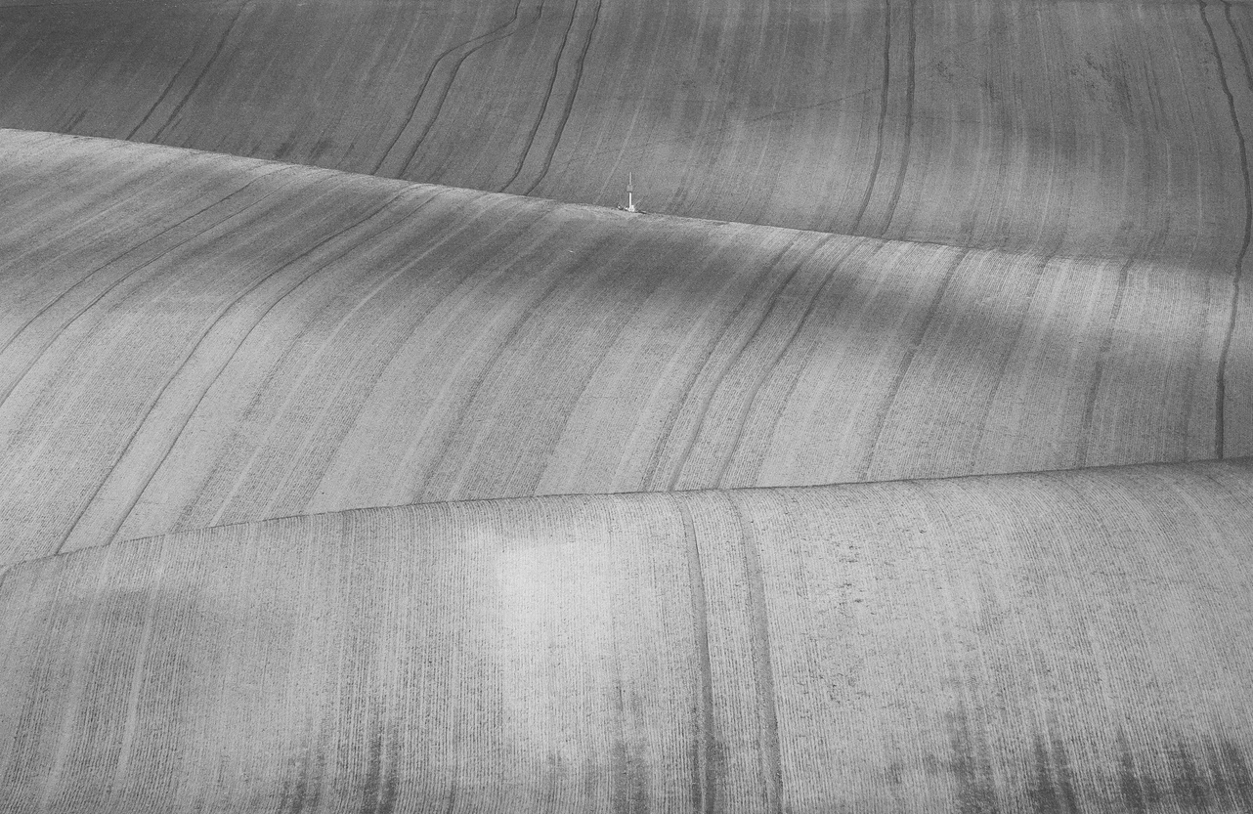
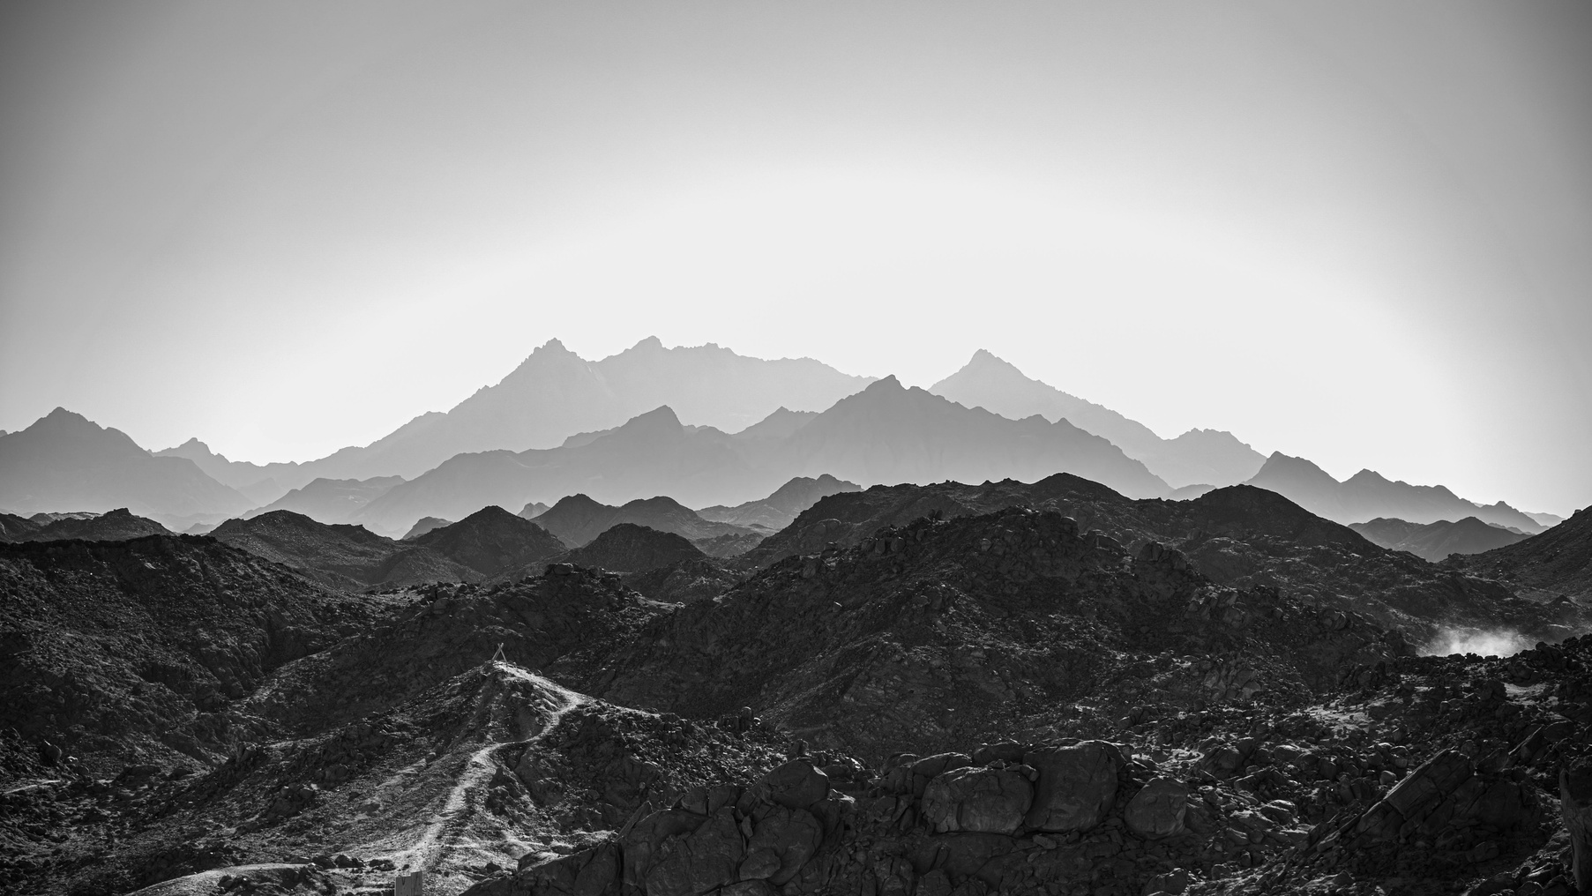
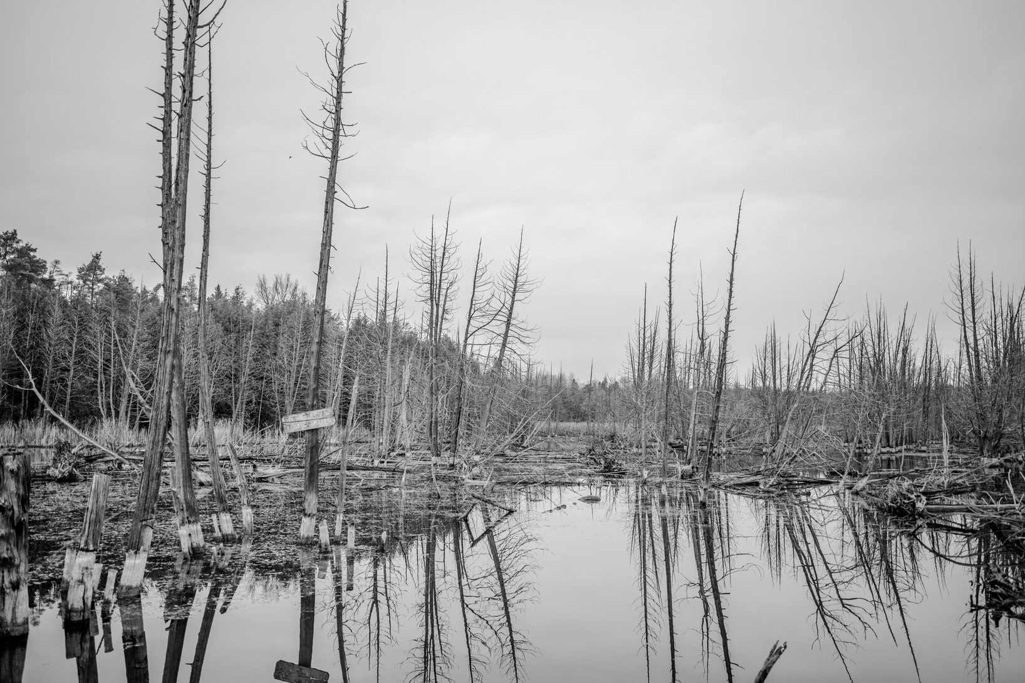

The Pipeline
Step 1
Step 2
Step 3
Step 4
Data
Forecasters
Worker B
Worker C
21 CPCB files become one hourly table (184,128 rows). Problems are marked, never changed. 6 ways to fill gaps.
5 deep models read the last 48 h and forecast PM2.5 and PM10 at +1 to +24 h.
Is this hour normal for its season? The answer is a flag: Green, Yellow or Red.
Builds a range that holds 90% of real values, and adjusts it live after hits and misses.

Slide 5
Trust it, widen it,
or abstain.

Slide 6
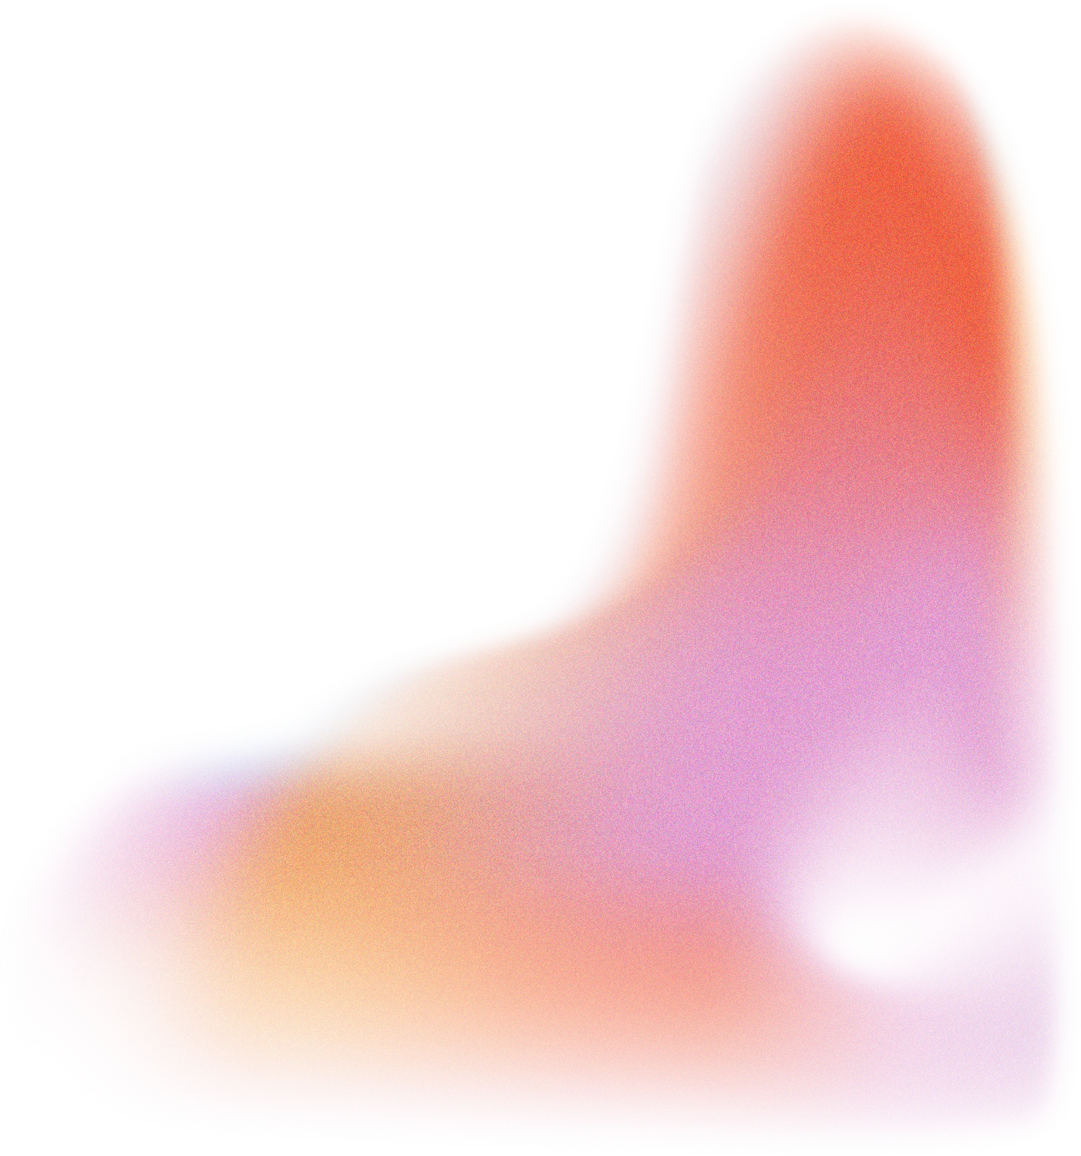


Data and Splits
Clean data
(steps 2.1–2.2)
Split by time
(step 3.1)
7 stations, 2023–2025, 19 parameters, 184,128 hourly rows. Missing and stuck values are counted and marked, never changed. The raw files stay read only. Only XYLENE and MP-Xylene are dropped.
Train: 2023–24 · Validation: Jan–Apr 2025 · Calibration: May–Aug 2025 · Test: Sep–Dec 2025. Anything learned is fitted on train only. Cut-offs are set on calibration. Test is used only at the end.

Slide 7
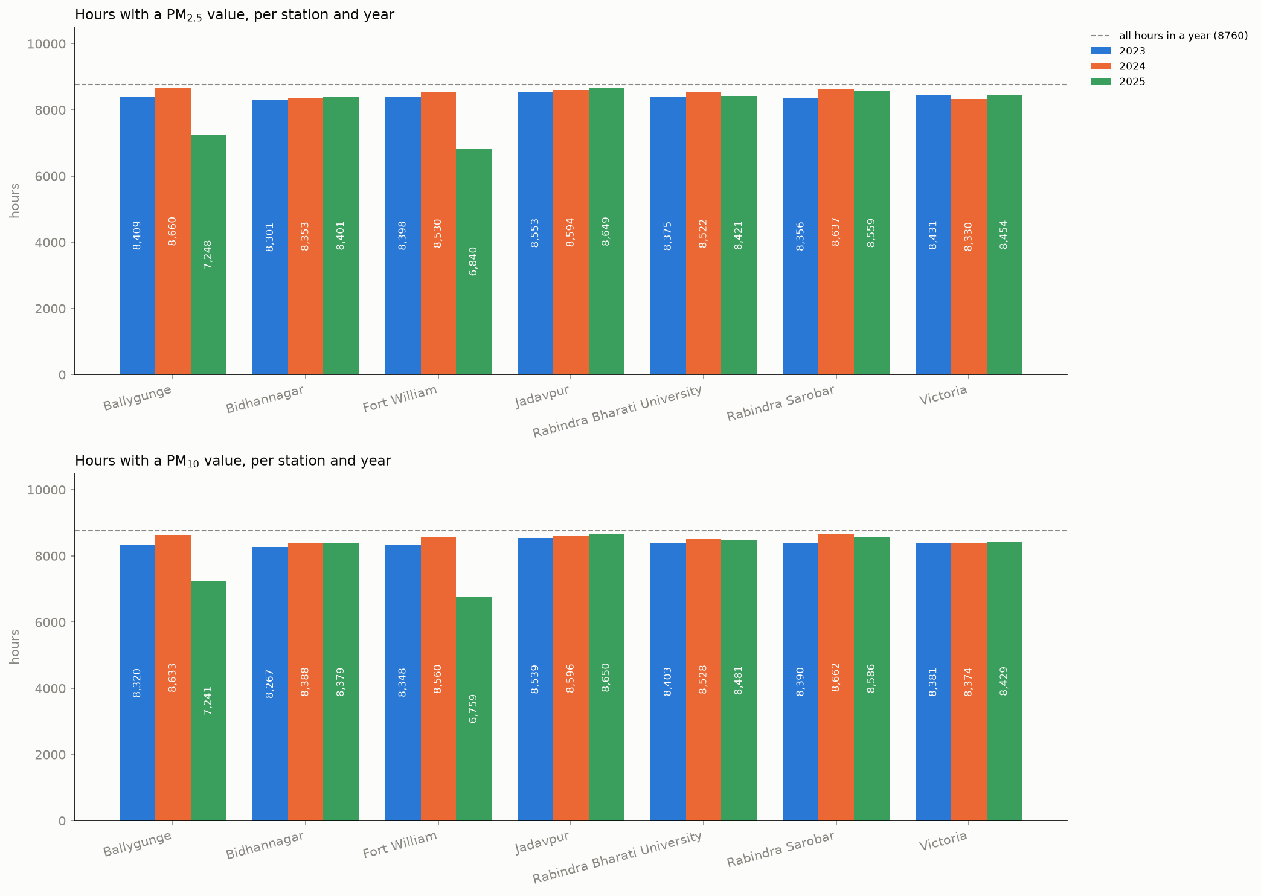
Step 2.2 · Data quality
How Much Data Each Station Has
What to look at
• Share of hours with a PM2.5 / PM10 value, per station and year.
• Most station-years have 95–99% of hours.
• Weak spots: Fort William 2025 (about 78%) and Ballygunge 2025 (about 83%).
Chart (PNG): availability_targets.png Data (CSV): availability.csv
Notes:
Before modelling, I counted how complete the data is. Most stations have almost every hour. Two station-years have big gaps, so filling gaps matters.

Slide 8
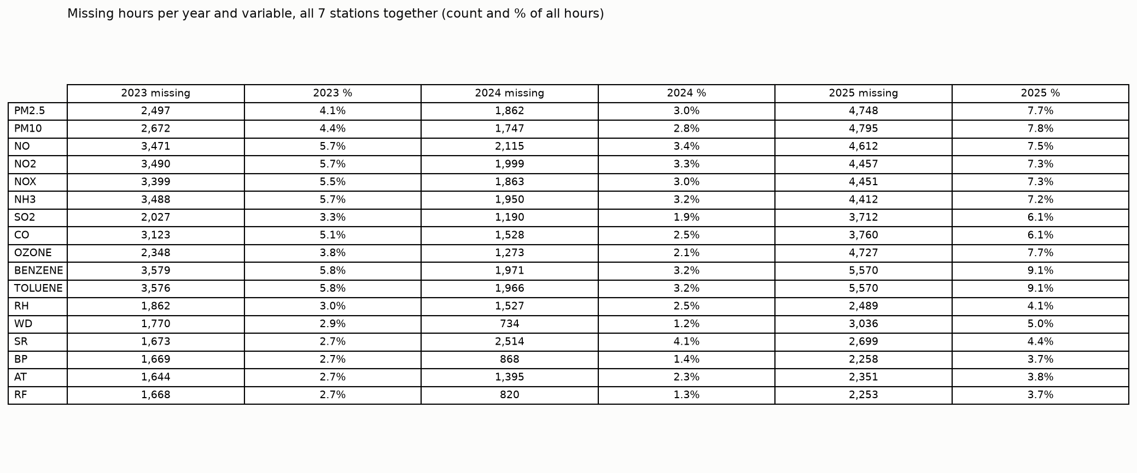
Step 2.2 · Data quality
Missing Values per Column
What to look at
• Each cell = share of hours missing for one parameter.
• XYLENE and MP-Xylene are empty, so they are the only columns dropped.
• All other values are kept exactly as recorded.
Chart (PNG): missing_table.png Data (CSV): missing_table.csv · missing_table_station.csv
Notes:
This table shows missing values for every parameter. Only the two empty xylene columns are removed. Nothing in the raw data is changed.

Slide 9
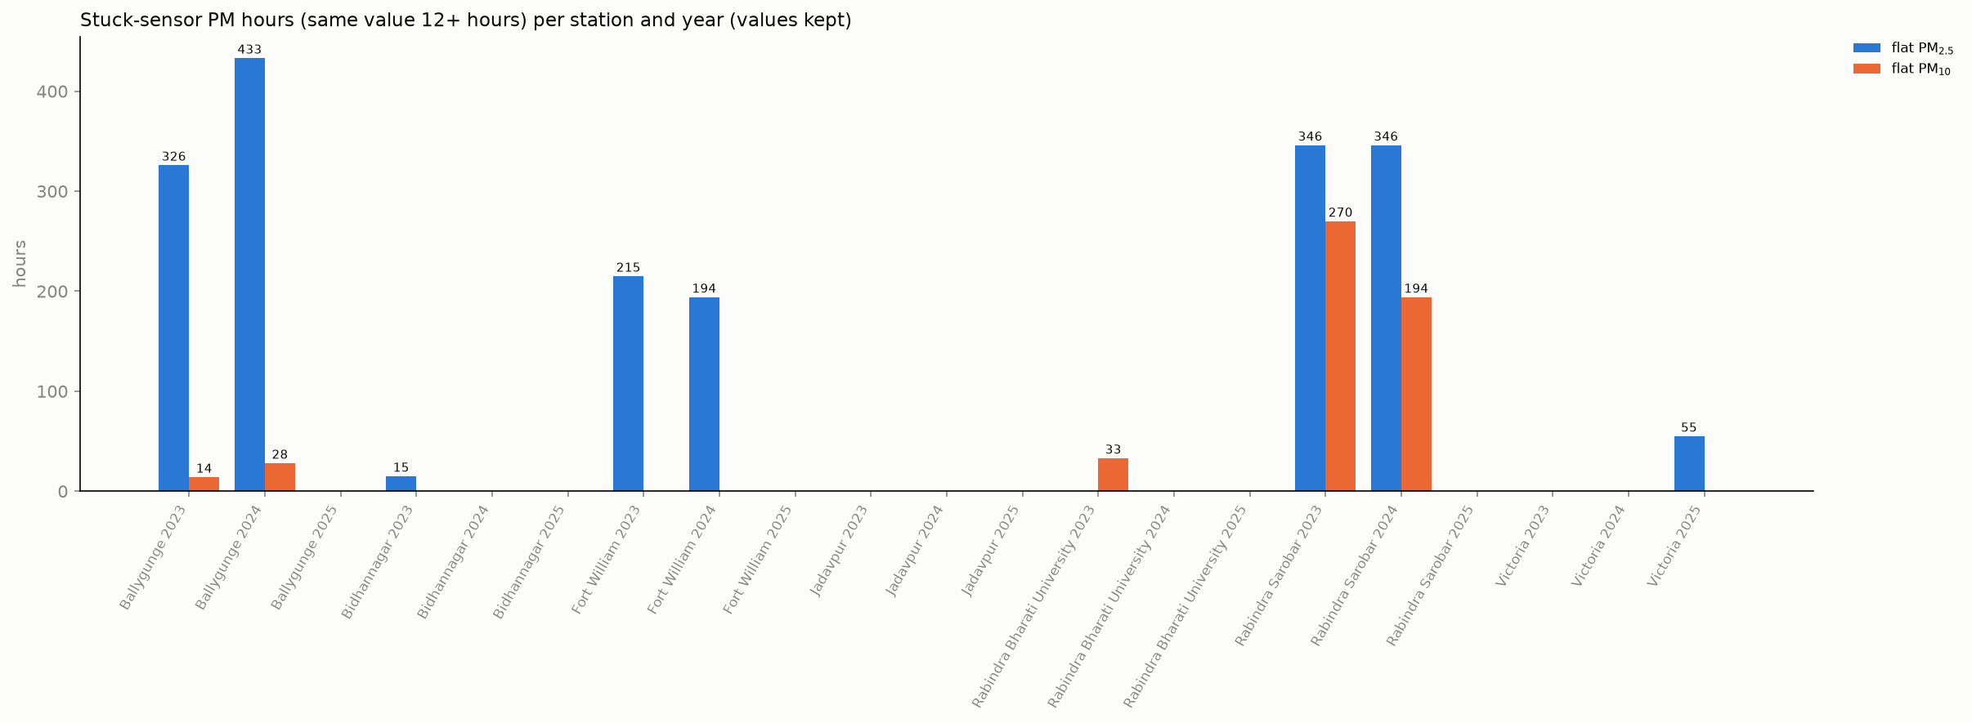
Step 2.2 · Data quality
Stuck Sensor Check
What to look at
• A value that stays the same for 12 h or more is marked as stuck.
• stuck_pm25: 1,930 h · stuck_pm10: 539 h.
• Stuck hours are marked with a flag, never changed.
Chart (PNG): flag_check.png Data (CSV): flat_runs.csv · flag_counts.csv
Notes:
A sensor can freeze and repeat one value. I mark those hours so the model knows, but I do not change the values.

Slide 10




Inputs and Forecasters
Features (3.2)
Model inputs (3.3)
Lags, rolling means and spreads, sin/cos of wind, hour and day. 50 inputs.
48 h × 50 columns. No missing-value flags. log(1+x), scaled on train only.
5 forecasters (4)
Two outputs
GRU · LSTM · 1D CNN · CNN+LSTM · TFT. Same settings, trained on 2023–24.
A 12-number summary (embedding) and a forecast with a low–high band.

Slide 11
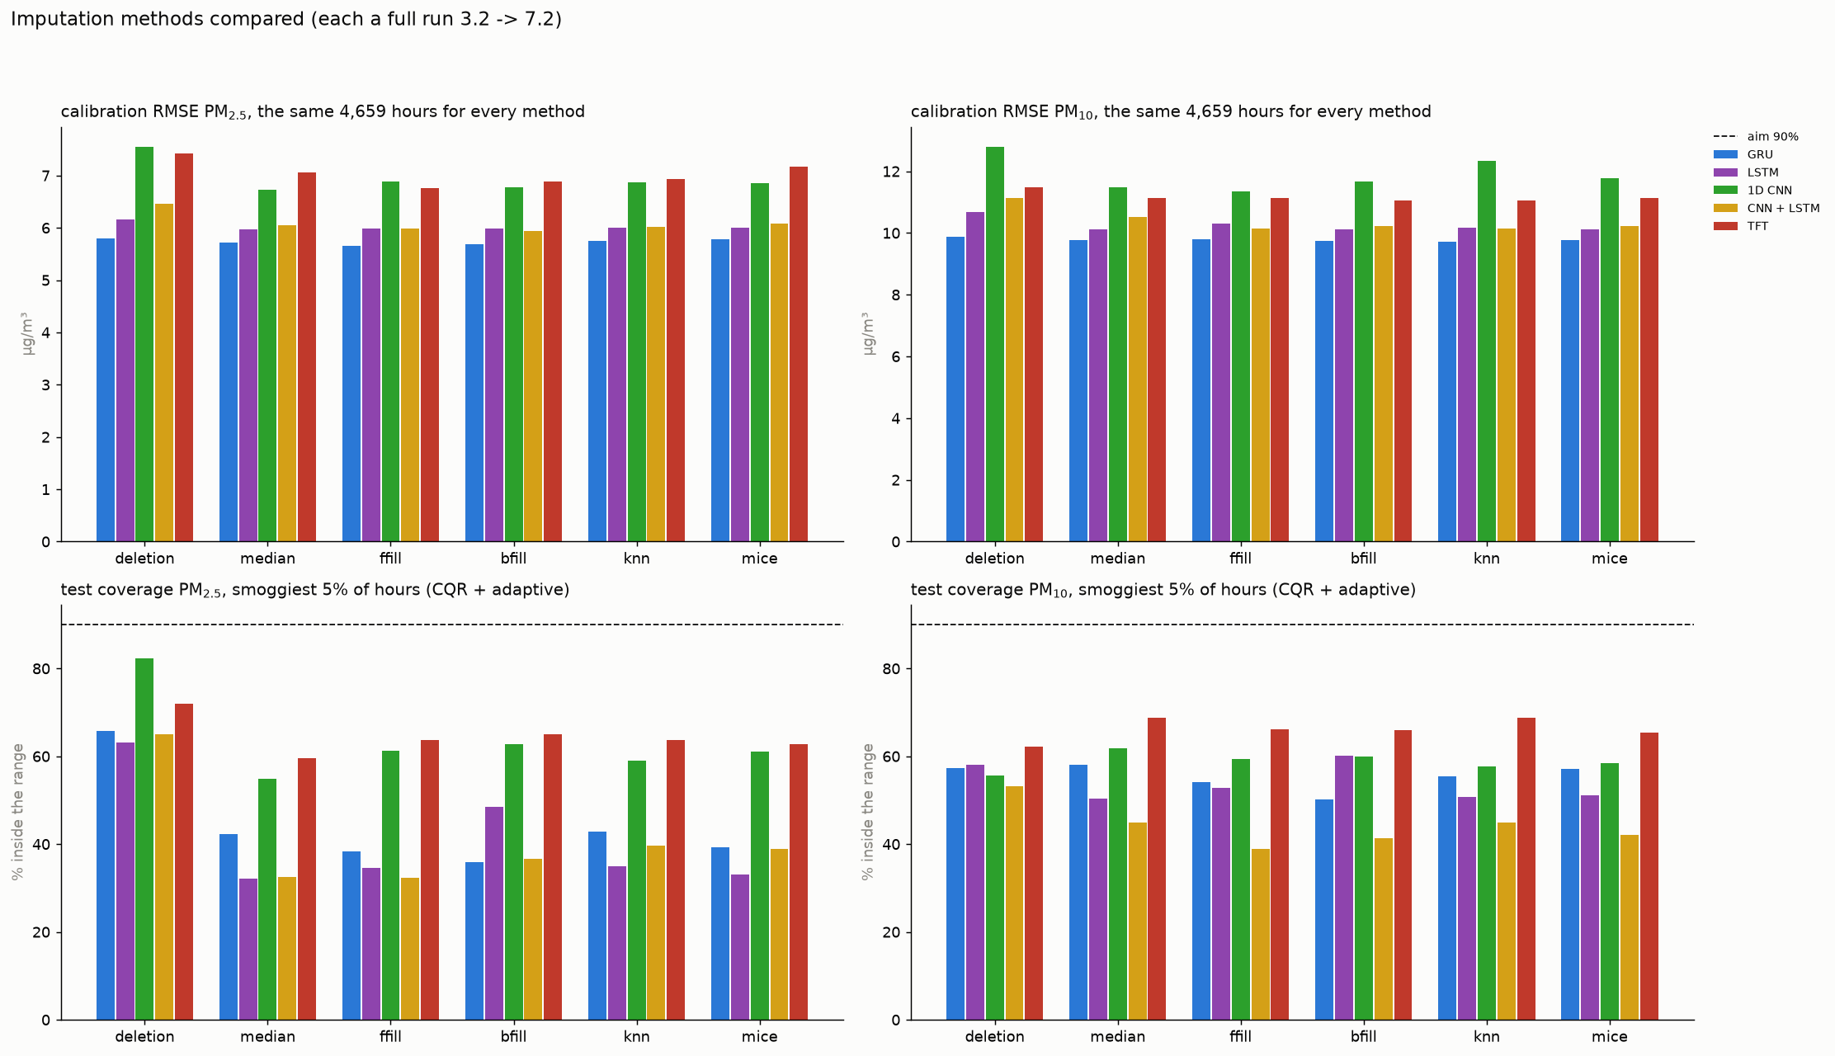
Step 3.2 · Filling gaps
Six Ways to Fill Gaps
What to look at
• Each method is one full run of the whole pipeline.
• Top: forecast error on the same 4,659 calibration hours. Forward fill is lowest (RMSE 8.40).
• Bottom: on the smoggiest 5% of test hours, coverage stays far below 90% for every method.
Chart (PNG): imputation_compare.png Data (CSV): imputation_compare.csv
Notes:
I tried six ways to fill gaps and ran the full pipeline for each. Forward fill gives the lowest calibration error, so it is the main run. Backward fill uses future values, so it is never picked.

Slide 12
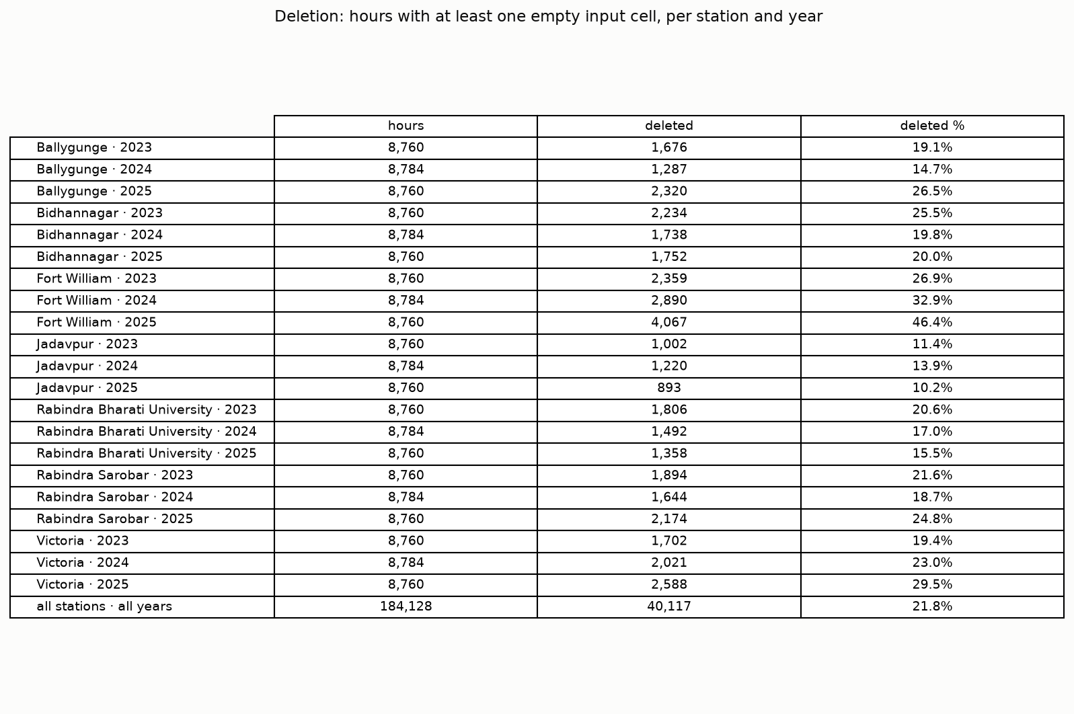
Step 3.3 · Model inputs
What Deleting Gaps Would Cost
What to look at
• Hours with at least one empty input, per station and year.
• In total 40,117 of 184,128 hours (21.8%) would be lost.
• Fort William 2025 would lose 46.4%, so filling is better than deleting.
Chart (PNG): deletion_hours.png Data (CSV): deletion_hours.csv
Notes:
If we simply delete every hour with a gap, we lose more than a fifth of the data. That is why the main runs fill gaps instead.

Slide 13
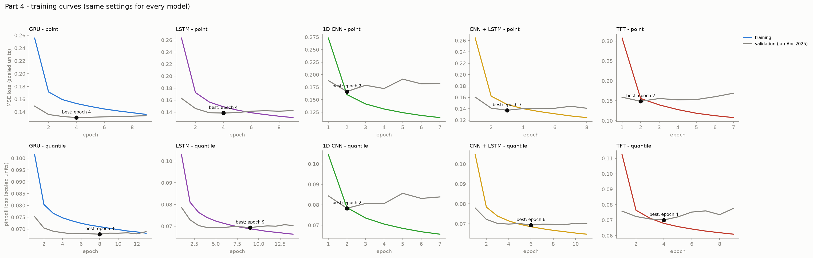
Step 4 · Forecasters
Training Curves
What to look at
• Train and validation loss for each of the 5 models.
• Training stops when the Jan–Apr 2025 validation loss stops improving (patience 5).
• Early stopping keeps the models from over-fitting.
Chart (PNG): forecast_loss.png Data (CSV): gru point/history.csv · gru quantile/history.csv
Notes:
These are the learning curves. Each model stops when it stops getting better on the validation months, which it has never trained on.

Slide 14
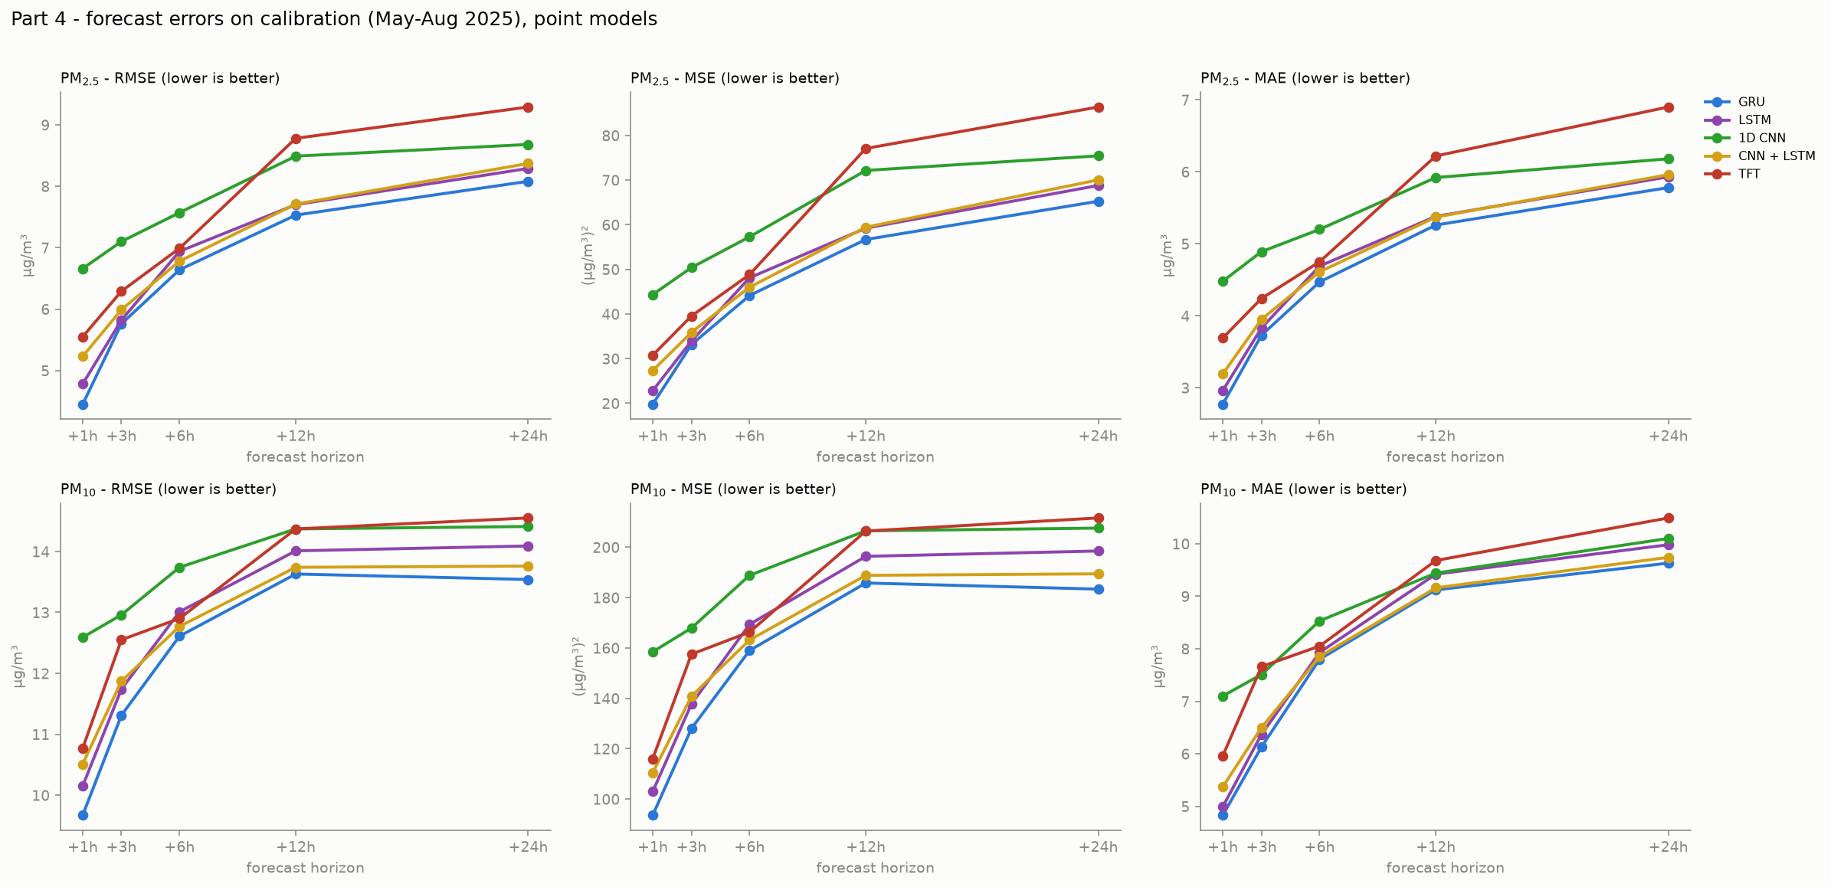
Step 4 · Forecasters
Forecast Error by Horizon
What to look at
• Error (RMSE) on calibration May–Aug 2025, per model and horizon.
• Error grows with horizon: GRU PM2.5 goes from 4.4 to 8.1 µg/m³ (+1 h to +24 h).
• GRU is the most accurate model; 1D CNN is the least accurate.
Chart (PNG): forecast_errors.png Data (CSV): forecast_errors.csv
Notes:
Forecasting further ahead is harder, so the error grows with the horizon. GRU is the best of the five.

Slide 15
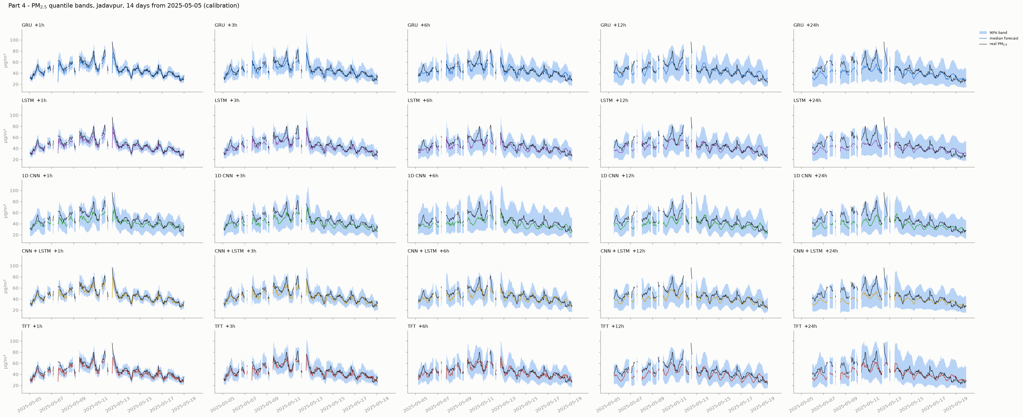
Step 4.2 · Forecast band
Forecast and Its Band (PM2.5)
What to look at
• Real PM2.5 against the forecast and the model's own 90% low–high band.
• The band follows the real values on most days.
• This band is the starting point for Worker C.
Chart (PNG): forecast_band_pm25.png Data (CSV): gru point/calib_pred.csv · gru quantile/calibration.csv
Notes:
Each model also gives a low and a high value. This band is the raw material that Worker C later corrects.

Slide 16
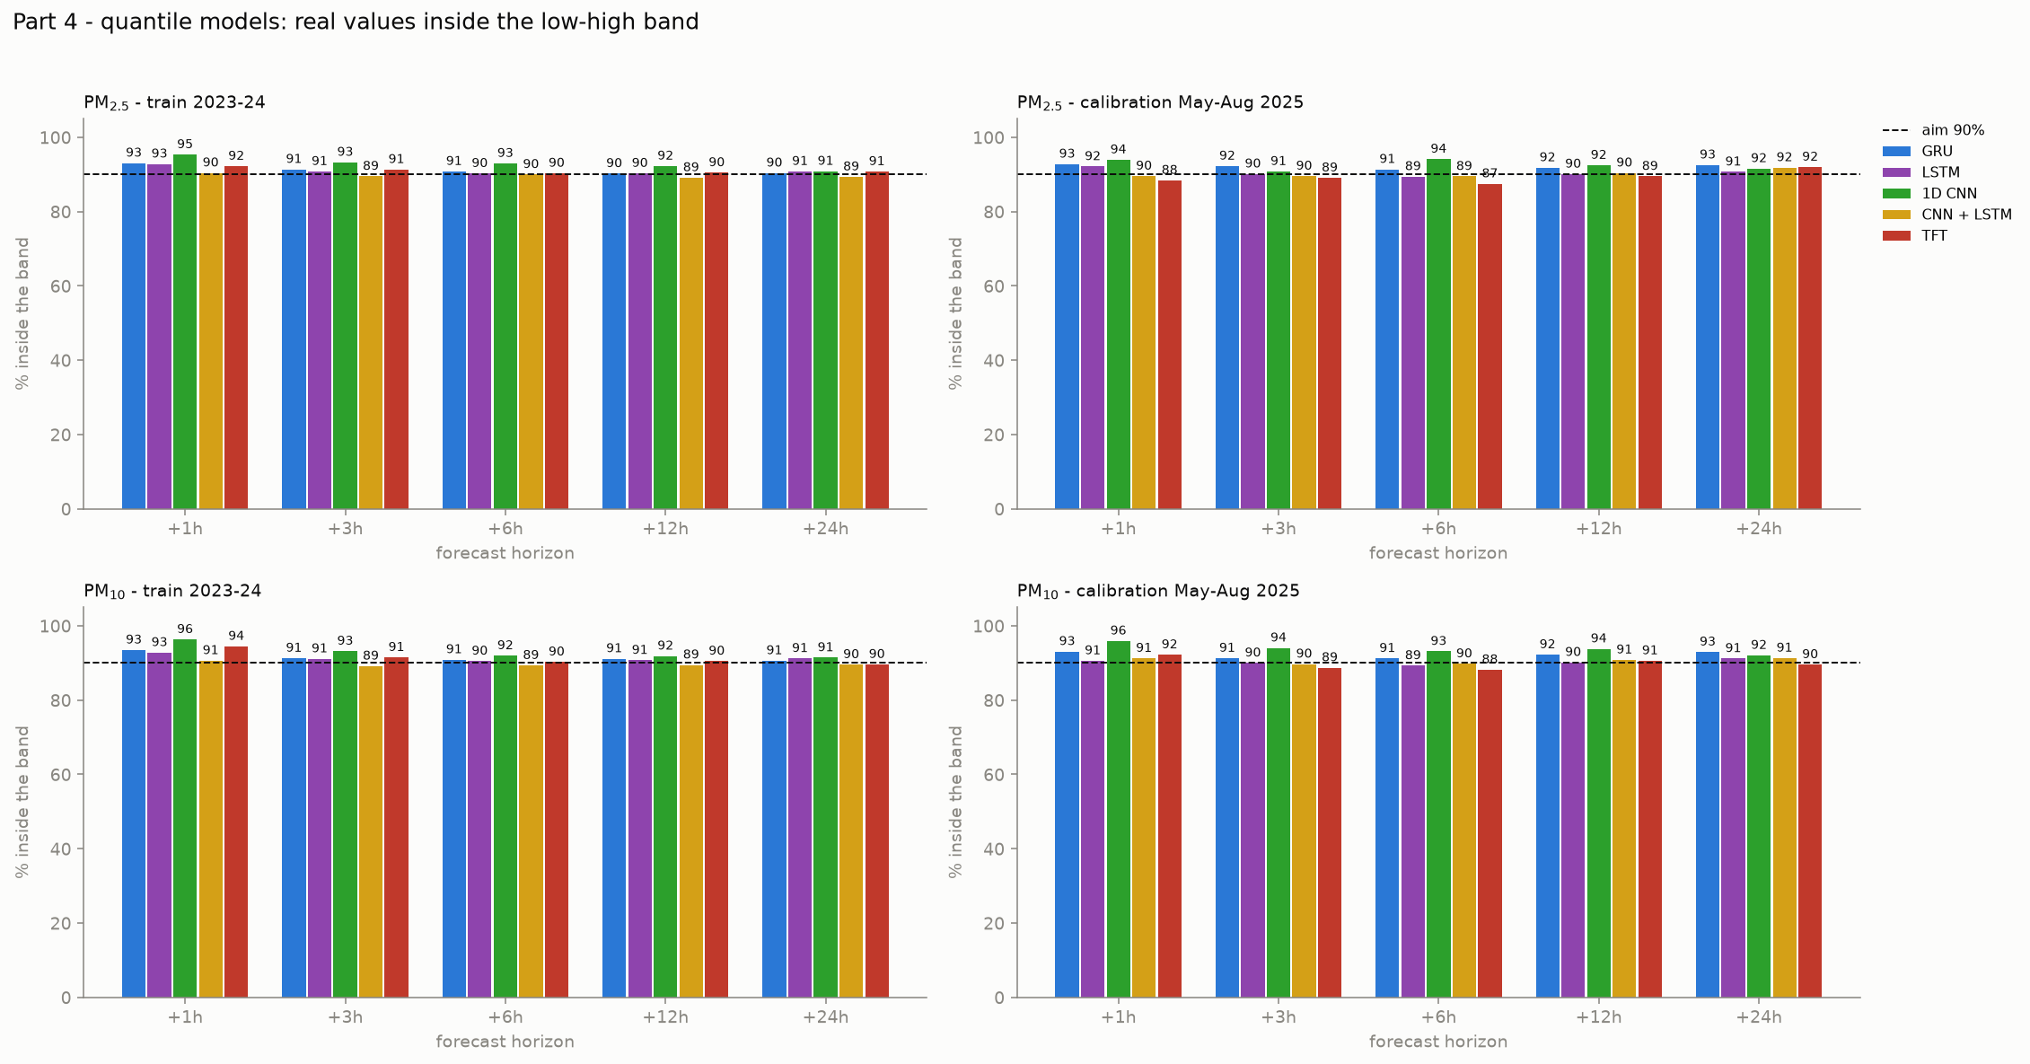
Step 4.2 · Forecast band
Is the Model's Own Band Honest?
What to look at
• Share of real values inside the model's own band, before any correction.
• GRU: 91–93% on calibration, close to the 90% aim on normal months.
• But the band has no guarantee. Worker C adds one.
Chart (PNG): forecast_coverage.png Data (CSV): forecast_quantile.csv
Notes:
The raw band looks fine on normal months, but nothing guarantees it. Conformal prediction in Worker C gives the 90% promise.

Slide 17

Worker B:
Trust Flag
The colour
s ≤ 0.80 → Green
s ≤ 0.98 → Yellow
above → Red
Same colour for every horizon.
Each hour is compared with the normal hours of its own season (train 2023–24). Distance of the 12-number summary → s_embed. Same test on the raw inputs → s_raw. Score s = the larger of the two.

Slide 18
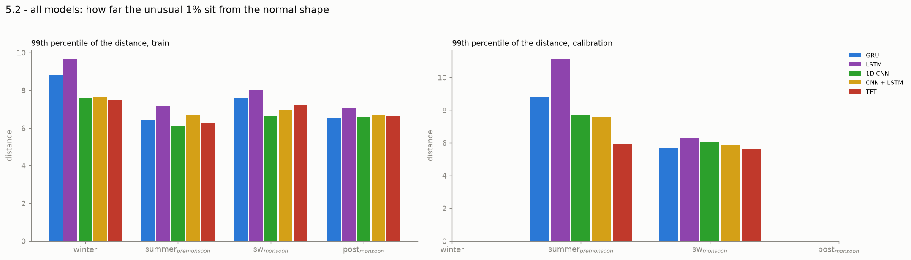
Step 5.1 · Worker B
Distance to the Season's Normal Shape
What to look at
• Distance of each hour's 12-number summary from its season's normal shape.
• Calibration 2025 sits further out than train (pre-monsoon p99: 8.8 vs 6.4).
• This shift between years is why Red is above the 2% aim.
Chart (PNG): worker_b_5.2_distance.png Data (CSV): 5.2_gru_distance_percentiles.csv · gru worker_b/distances.csv
Notes:
Worker B measures how far each hour is from normal for its season. 2025 is further away than the training years, so more 2025 hours look unusual.

Slide 19
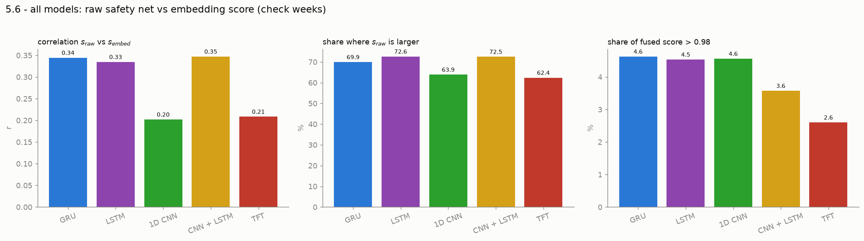
Step 5.3 · Worker B
Raw Score vs Embedding Score
What to look at
• Left: s_raw and s_embed are only loosely linked (r 0.20–0.35), so each catches different hours.
• Middle: s_raw is the larger score in 64–73% of hours.
• Right: 2.6–4.6% of hours have a final score s above 0.98 (Red). s = the larger of the two.
Chart (PNG): worker_b_5.6_raw_vs_embed.png Data (CSV): 5.6_score_compare.csv · gru worker_b/raw_check.csv
Notes:
Two checks: one on the raw inputs and one on the model's summary. Because they disagree often, taking the larger score is a safety net.

Slide 20
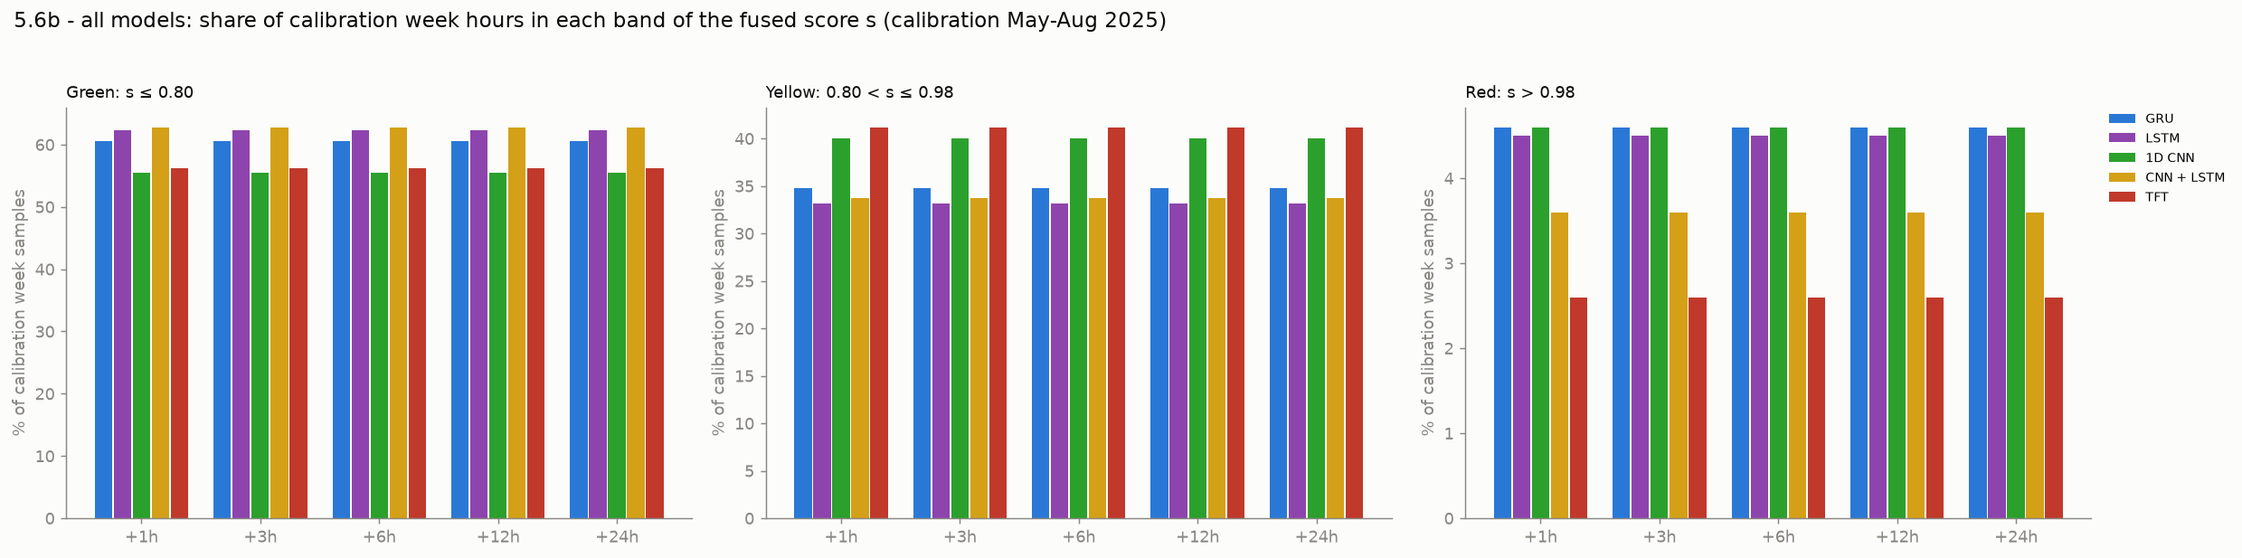
Step 5.4 · Worker B
Green / Yellow / Red Shares
What to look at
• Share of each colour on the calibration check weeks, per model.
• About 60% Green, 35% Yellow, 4–5% Red.
• The aim was 80 / 18 / 2: 2025 looks less normal than 2023–24.
Chart (PNG): worker_b_5.6b_label_shares.png Data (CSV): 5.6b_gru_check_shares.csv
Notes:
This is how often each colour appears. There is more Yellow and Red than planned, because the calibration months differ from the training years.

Slide 21
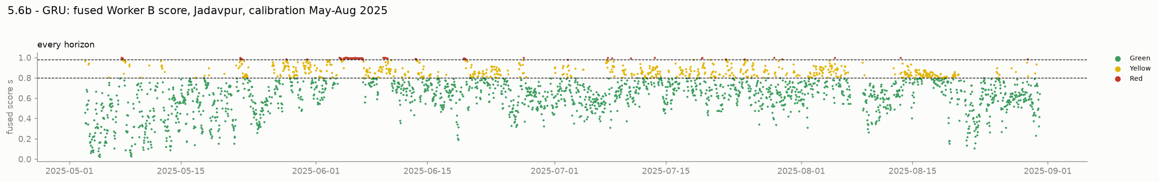
Step 5.4 · Worker B
The Flag Over Time (GRU)
What to look at
• Fused score s for every calibration hour, May–Aug 2025.
• Above 0.98 = Red, 0.80–0.98 = Yellow, below = Green.
• May (pre-monsoon) has the most Red: 11.6%.
Chart (PNG): worker_b_5.6b_timeline.png Data (CSV): gru worker_b/worker_b_calibration.csv
Notes:
Here is the score hour by hour. The colour is the same for every horizon of that hour.

Slide 22
How the Parts Connect
Worker B: colour
Forecaster
Decision
Evaluation
Worker C: range

Slide 23
Worker C: The Range
01
02
Conformal
Adaptive γ
CQR widens the model's own low–high band by one correction learned on calibration. One group for all hours. Green → 90% range, Yellow → wider 95% range, Red → no range.
The range widens after a miss and narrows after a hit. Step size γ = 0.001, picked on calibration: coverage closest to 90%. Every horizon wanted 0–0.002.

Slide 24
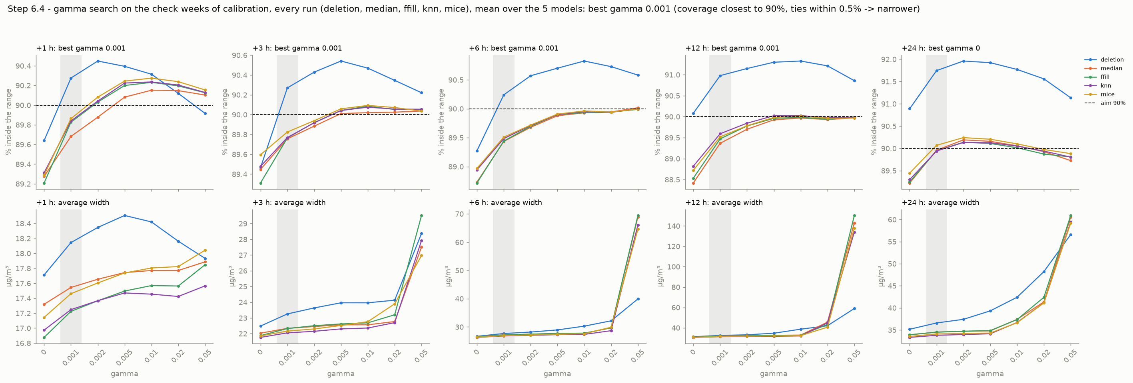
Step 6.3 · Worker C
Choosing γ
What to look at
• Coverage (top) and range width (bottom) for each γ, on calibration check weeks.
• γ = 0.001 gives coverage closest to 90% with a narrow range.
• Large γ (0.02–0.05) makes ranges much wider for no gain.
Chart (PNG): gamma_compare.png Data (CSV): gamma_compare.csv
Notes:
Gamma is how fast the range reacts to misses. I tried seven values on calibration only. 0.001 is the best trade-off.

Slide 25
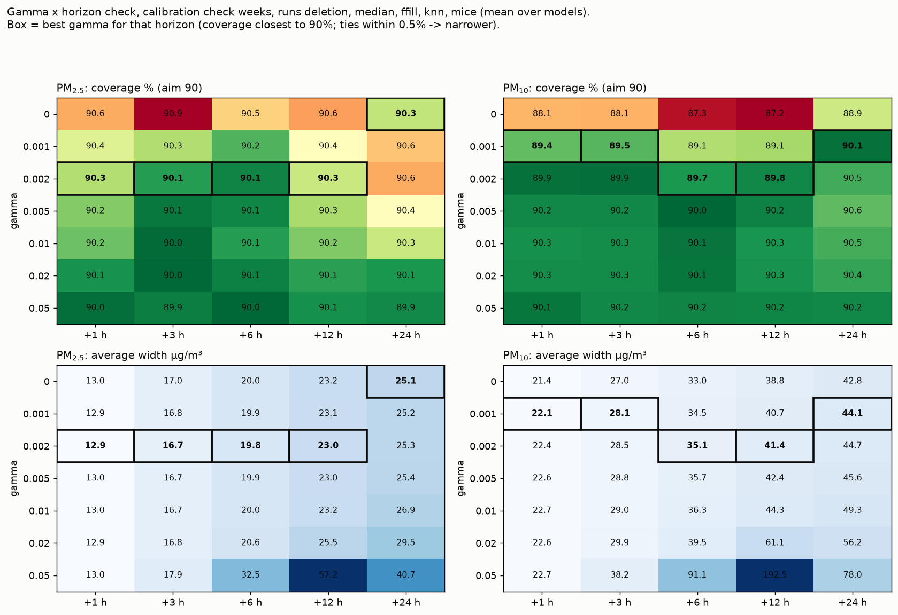
Step 6.3 · Worker C
γ for Every Horizon
What to look at
• Box = best γ for that horizon and target.
• Every horizon wants γ between 0 and 0.002.
• So one shared γ = 0.001 fits all horizons.
Chart (PNG): gamma_horizon_check.png Data (CSV): gamma_compare.csv
Notes:
A side check: would each horizon want its own gamma? No. They all want a small value, so one gamma is enough.

Slide 26
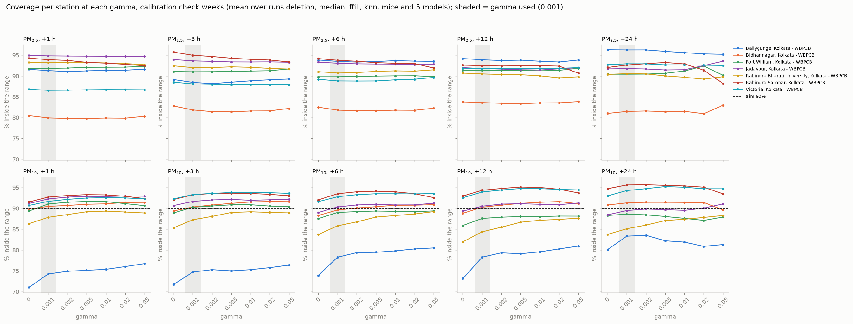
Step 6.3 · Worker C
γ for Every Station
What to look at
• One line per station: coverage at each γ.
• 5 of 7 stations sit near 90% at any γ.
• Bidhannagar PM2.5 (about 82%) and Ballygunge PM10 (about 78%) stay low: γ cannot fix them.
Chart (PNG): gamma_station_check.png Data (CSV): gamma_station_check.csv
Notes:
The range is shared by all stations. Stations with bigger errors get ranges that are too narrow, and changing gamma does not fix that.

Slide 27
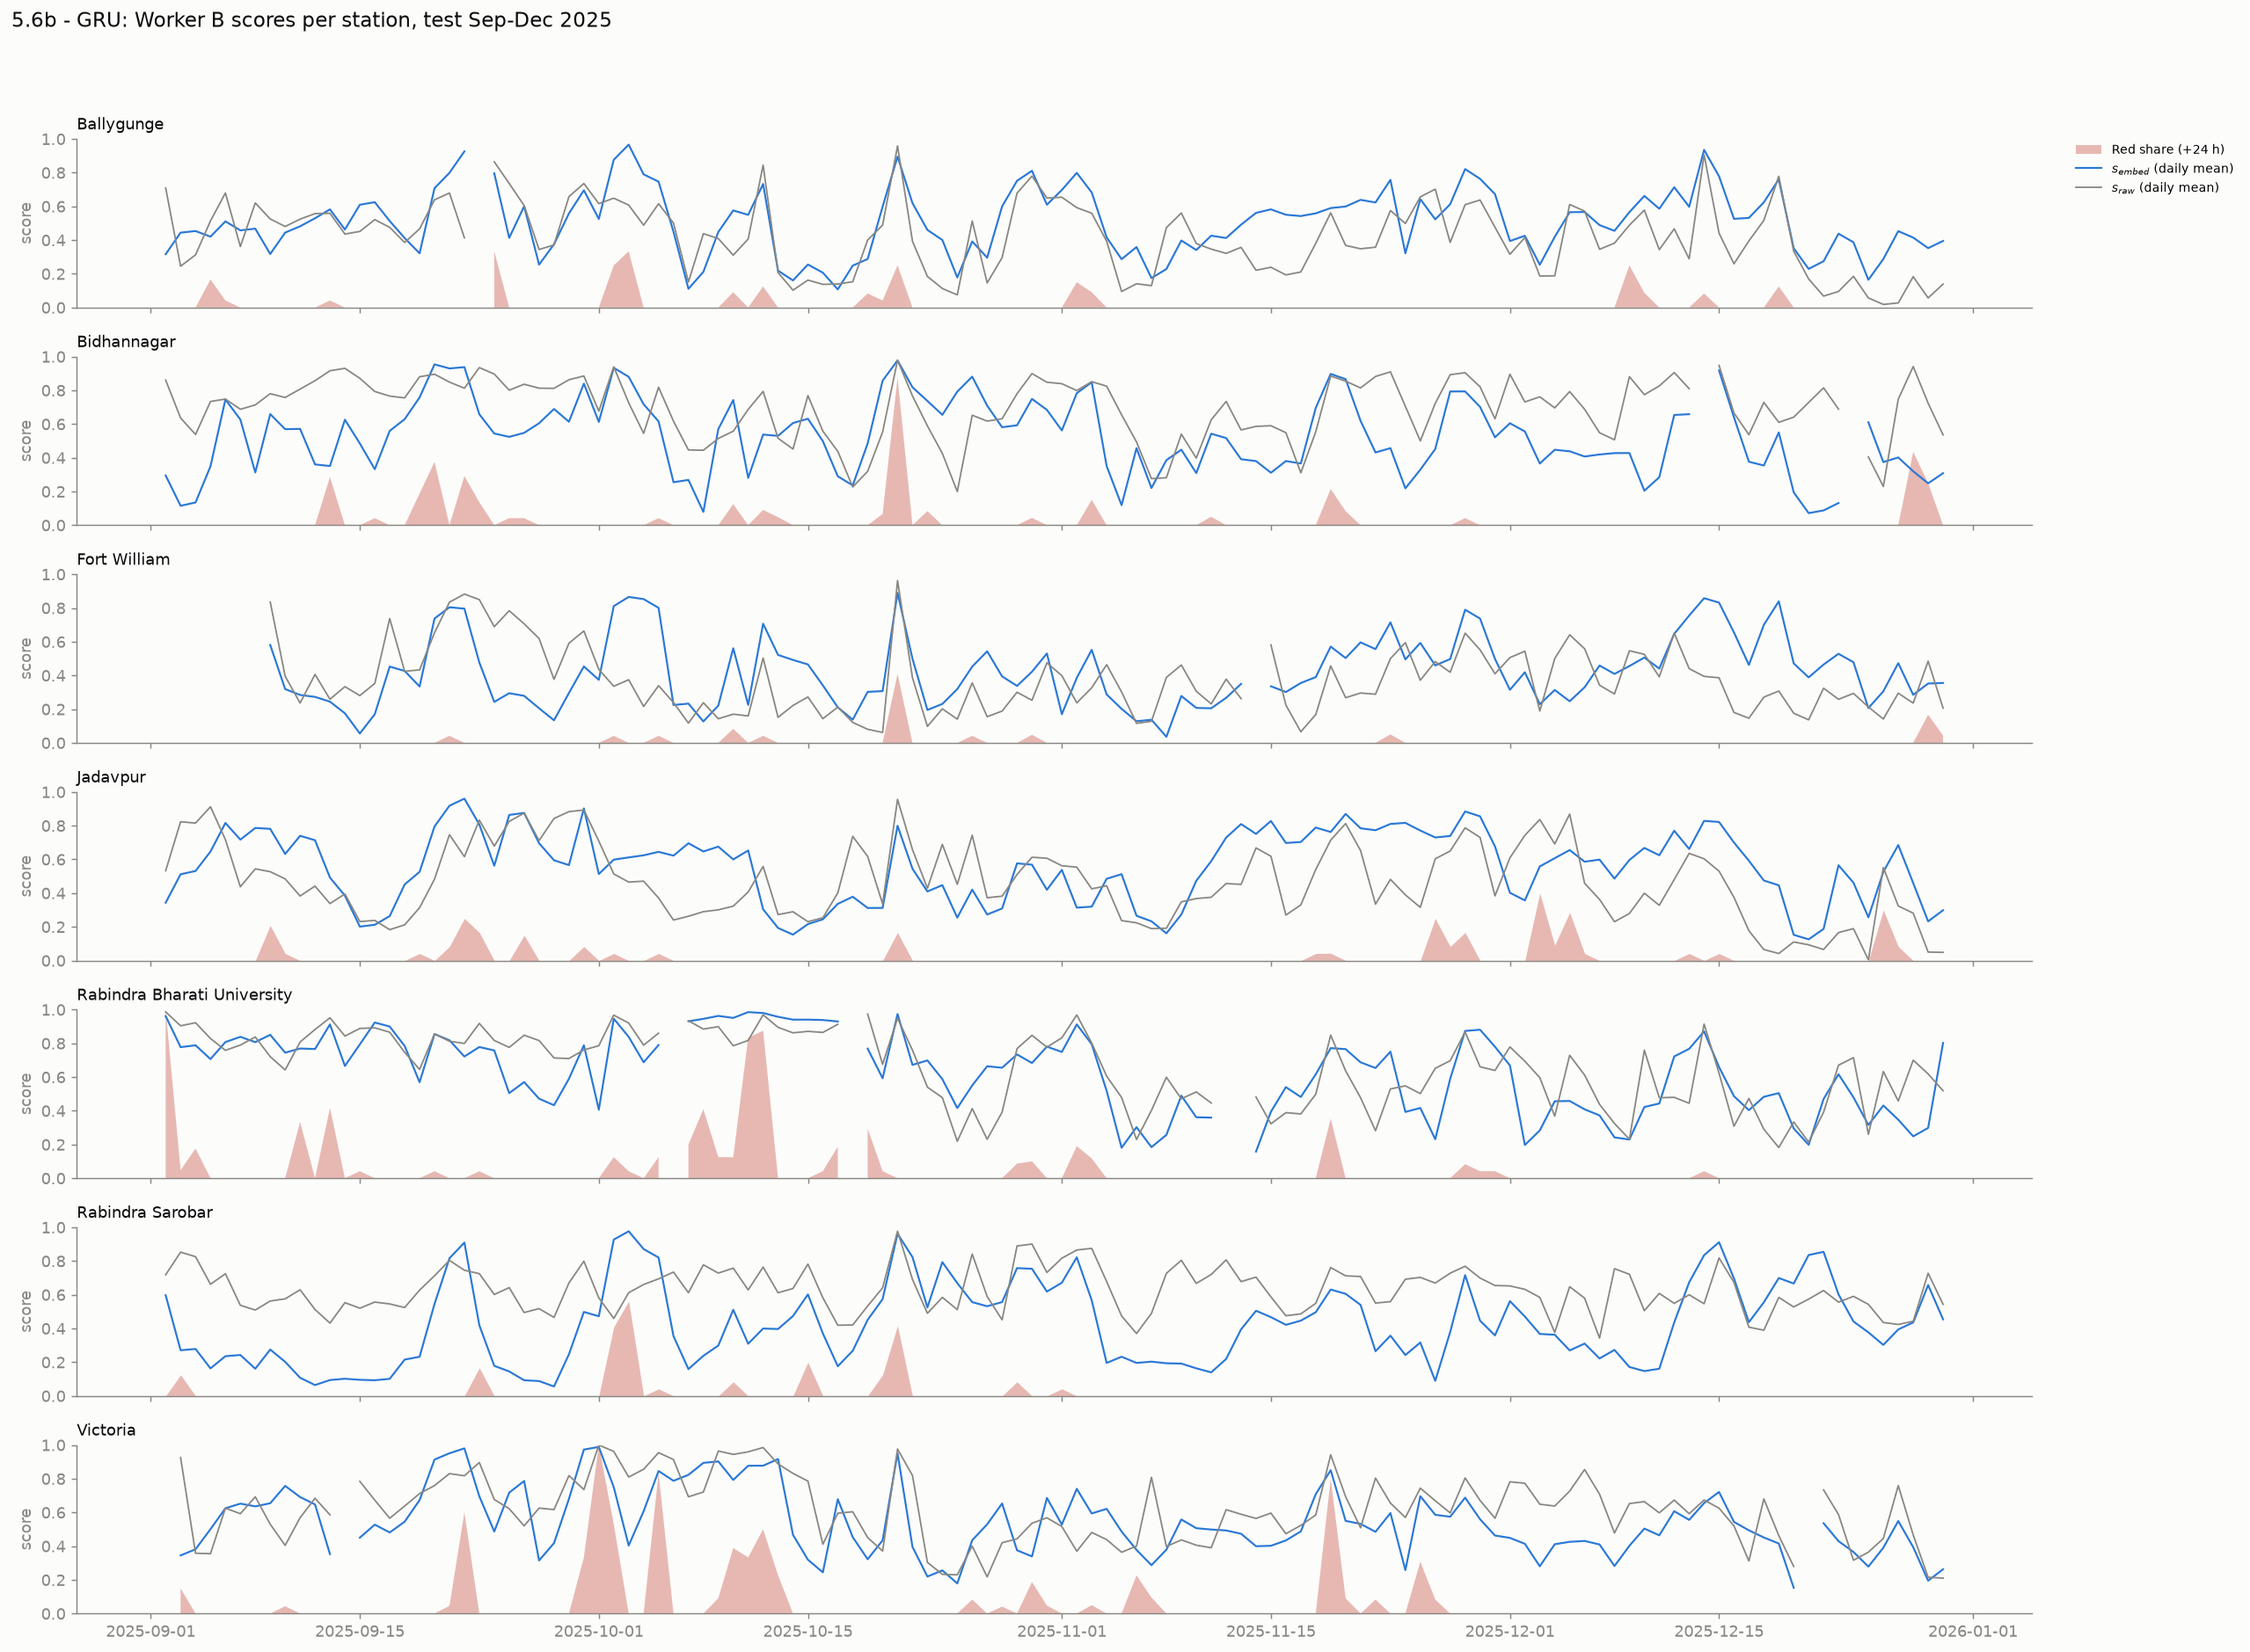
Step 7.1 · Decision
Trust Flag on the Test Months
What to look at
• Daily mean s_embed (blue) and s_raw (grey) per station, Sep–Dec 2025.
• Shaded = share of Red hours. Red comes in bursts on the same days at many stations.
• Green → 90% range, Yellow → wider 95% range, Red → no range, only an alert.
Chart (PNG): worker_b_5.6b_scores_test.png Data (CSV): gru worker_b/worker_b_test.csv
Notes:
On the test months the flag decides what is published. Red days line up across stations, which points to city-wide unusual weather.

Slide 28
So, does
it work?

Slide 29
90.5%
of real values fall inside the range on normal hours (aim 90%)
Results
44–70%
Test months Sep–Dec 2025, used only once at the end. Mean over 5 models. Best way to fill gaps: forward fill (lowest calibration RMSE, 8.40).
inside the range on the smoggiest 5% of hours (aim 90%)
1.2–1.5×
bigger errors on Red hours than on Green hours: the flag finds risky hours

Slide 30
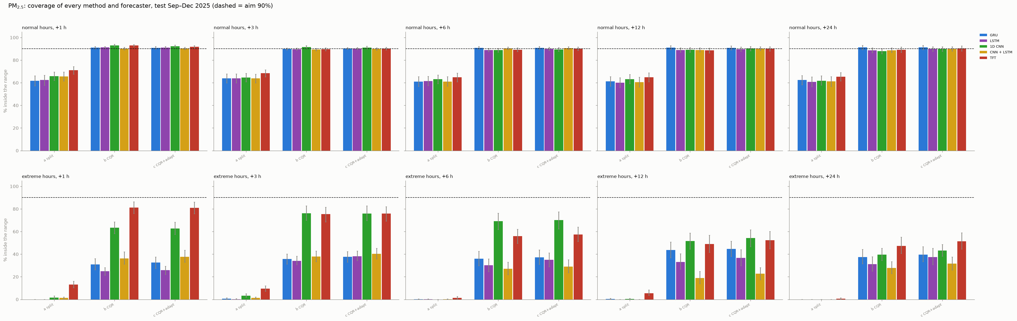
Step 7.2 · Evaluation
Coverage: Normal vs Smoggiest Hours (PM2.5)
What to look at
• Three methods: (a) split conformal, (b) CQR, (c) CQR + adaptive.
• Normal hours: CQR + adaptive about 91% (aim 90%); split conformal only about 62%.
• Smoggiest 5%: split about 0%, CQR + adaptive only 33–45% (GRU).
Chart (PNG): stratified_compare_pm25.png Data (CSV): stratified_table1.csv
Notes:
This is the main test. On normal hours our range keeps its 90% promise. On the smoggiest hours no method does, but ours is far better than the simple baseline.

Slide 31
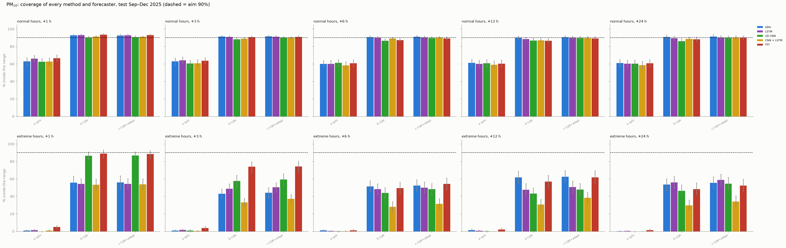
Step 7.2 · Evaluation
Coverage: Normal vs Smoggiest Hours (PM10)
What to look at
• Same test for PM10.
• Normal hours: about 91–93% with CQR + adaptive.
• Smoggiest 5%: about 54% on average: better than PM2.5, still below 90%.
Chart (PNG): stratified_compare_pm10.png Data (CSV): stratified_table1.csv
Notes:
PM10 behaves like PM2.5: honest on normal hours, too narrow on the smoggiest hours.

Slide 32
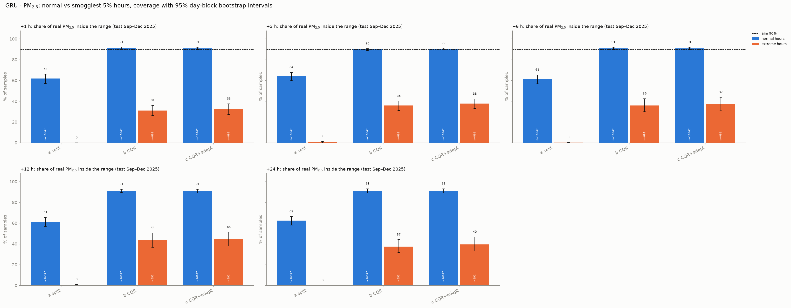
Step 7.2 · Evaluation
Coverage per Horizon (GRU, PM2.5)
What to look at
• Error bars = 95% bootstrap band (1,000 day-block resamples).
• Normal hours (blue) sit on the 90% line at every horizon.
• Smoggiest hours (orange) stay at 31–45% at every horizon.
Chart (PNG): stratified_coverage_pm25.png Data (CSV): stratified_table1.csv
Notes:
The error bars show the result is stable, not luck. The gap on smoggy hours is real.

Slide 33
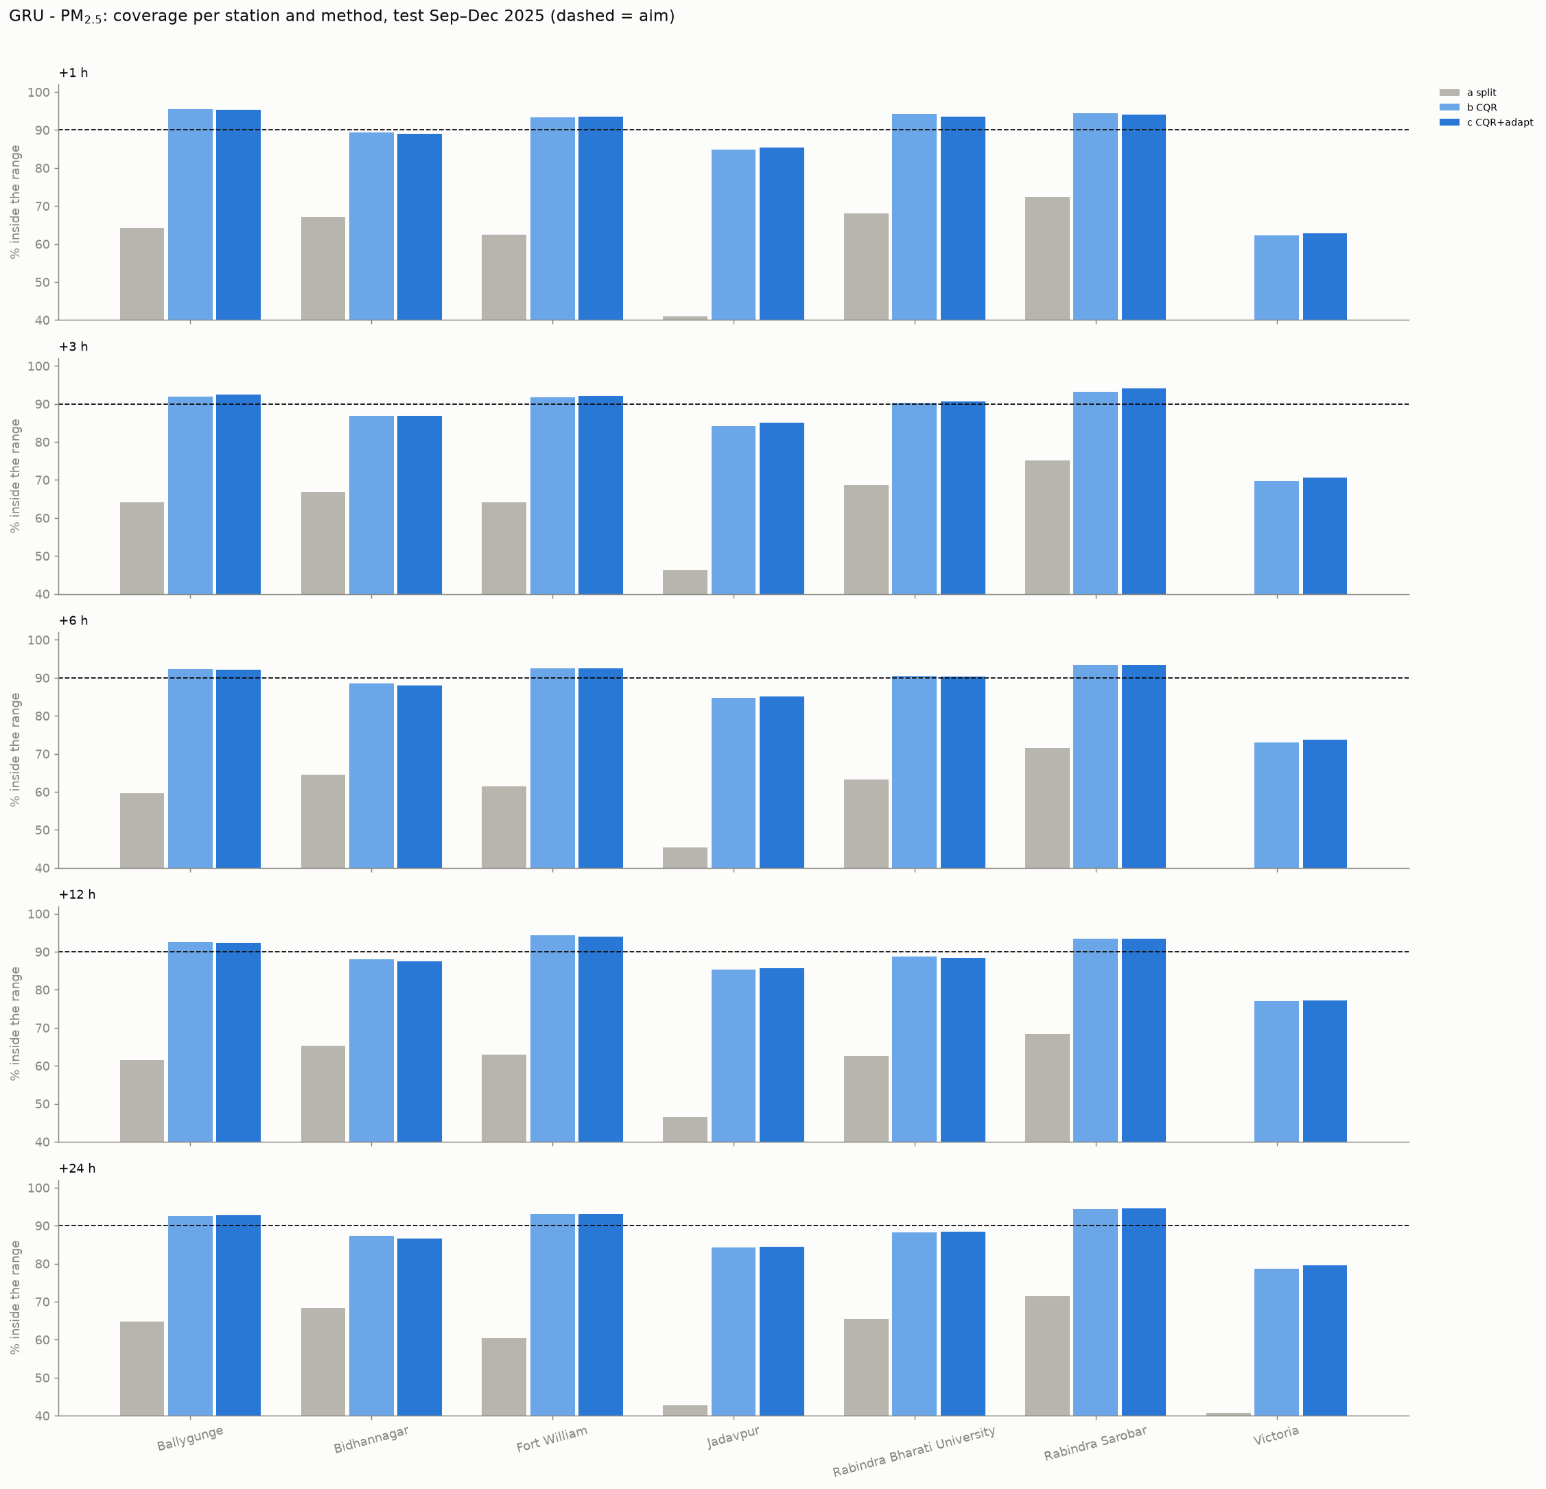
Step 7.2 · Evaluation
Coverage per Station (GRU, PM2.5)
What to look at
• Coverage per station, horizon and method on the test months.
• Ballygunge, Fort William and Rabindra Sarobar: about 92–95%.
• Jadavpur about 85% and Victoria 63–80% are below the aim.
Chart (PNG): stratified_station_pm25.png Data (CSV): stratified_table3.csv
Notes:
Coverage is not equal across stations, because one shared range is used for all of them. This is a next step to fix.

Slide 34


What Changed
Missing-value flags, β smoothing and MCD + Ledoit-Wolf. With MCD, 72% of hours turned Yellow and Red hours had smaller errors than Green.
Season groups for Worker B, one group for Worker C, and a γ search with checks per horizon and per station.
Removed
Added

Slide 35
Conclusion
01
What works
On normal hours the range holds about 90% of real values, and Red hours carry bigger errors than Green hours.
02
What does not work yet
Smoggiest hours get only 44–70%. Red is 3–5% of hours, not 2%, because 2025 differs from 2023–24.
03
Next steps
Fix the two weak stations (Bidhannagar PM2.5, Ballygunge PM10) and handle the drift between years in Worker B.

Slide 36
Kolkata
PM Forecast
Thank You
Presented by Ratul Pal
Questions welcome

