Slide 1

Technalytics
Predictive analysis
28 February, 2024
Saran S
Rajamari R
Nithin SS

Slide 2
Introduction
Social media, especially Twitter, plays a crucial role in shaping market sentiment.
This problem focuses on extracting key financial entities, analyzing their sentiment, and uncovering relationships using NLP techniques like Named Entity Recognition (NER) and dependency parsing.
By constructing semantic graphs and training machine learning models, the goal is to predict how sentiment influences stock categories, helping investors make informed decisions.

Slide 3
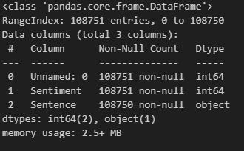
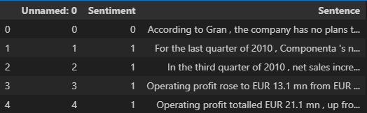

About Dataset
The dataset contains 2 columns, there are:
Sentiment and Sentence. It had around 100000+
rows

Slide 4



Approach(Baseline):
Analyze Text:
Analysis Text and extract entities and its dependencies
Calculate sentiment scores:
Find the sentiment score and categorize based on its score
(for creating target variable)
Classification:
Classify the scores by High growth potential, stable, High risk by defining threshold in sentiment scores.
How?
We use spaCy English language model (en_core_web_sm) for Natural Language Processing (NLP) tasks.
How?
Text Blob
Determines whether a text is positive, negative, or neutral
Returns polarity (-1 to 1) and subjectivity (0 to 1)

Slide 5
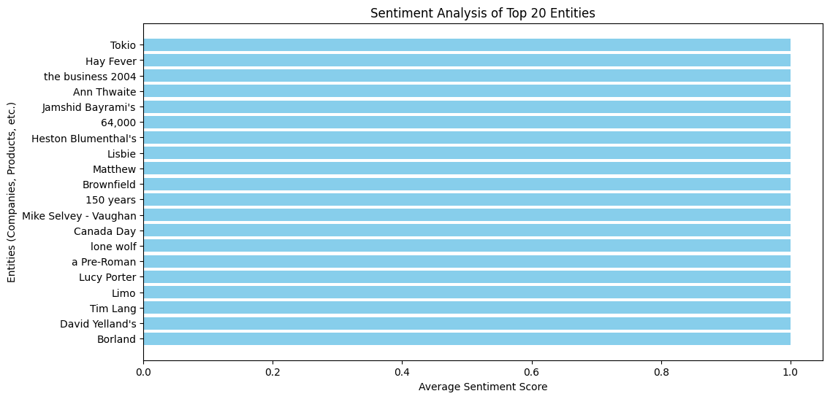


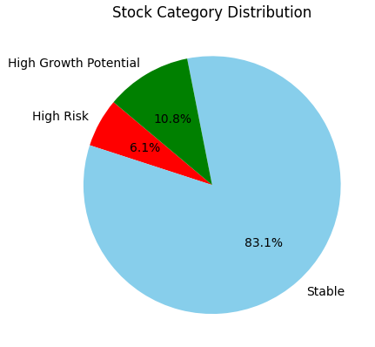
EDA
Visualizing Sentiment Insights
Top 20 Entities
Stock Category Distribution
We visualize the average sentiment score for the top 20 entities, highlighting the most influential entities in the dataset.
We present a pie chart showing the distribution of stock categories, providing a clear overview of the overall sentiment landscape.

Slide 6
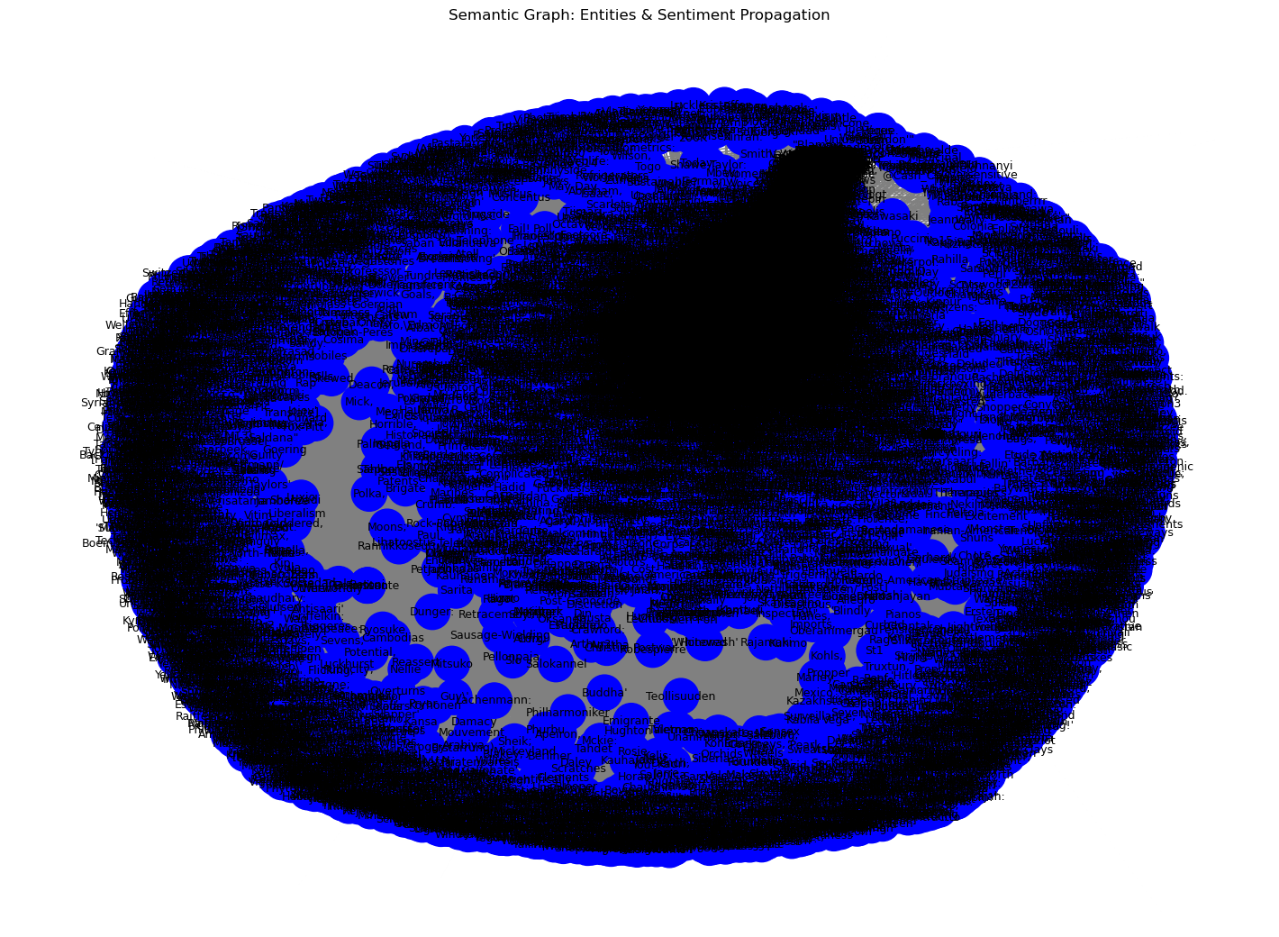
Semantic Graph: Entities and Sentiment Propagation
EDA
Visualizing Sentiment Insights
1
Entity Extraction
We extract entities from each sentence, focusing on capitalized words that likely represent entities like companies or products.
2
Graph Construction
Top 20 Entities
Stock Category Distribution
We build a directed graph where entities are connected to sentiment nodes, reflecting the influence of entities on sentiment.
We visualize the average sentiment score for the top 20 entities, highlighting the most influential entities in the dataset.
We present a pie chart showing the distribution of stock categories, providing a clear overview of the overall sentiment landscape.
3
Co-occurrence Analysis
We analyze the co-occurrence of entities, adding edges between entities to represent their relationships and potential influence on each other.

Slide 7
Advanced model: LSTM
X=> Sentence
Y=> Stock category
Sentence:["The stock market is volatile", "Investors are watching market trends"]
Tokenization:{ "the": 1, "market": 2, "stock": 3, "is": 4, "volatile": 5, "investors": 6, "are": 7, "watching": 8, "trends": 9}
Train test split
Model
[ [1, 3, 2, 4, 5], # "The stock market is volatile" [6, 7, 8, 2, 9] ] # "Investors are watching market trends"
[0, 0, 0, ..., 1, 3, 2, 4, 5], # Padded with 95 zeros
[0, 0, 0, ..., 6, 7, 8, 2, 9] # Padded with 95 zeros
]

Slide 8
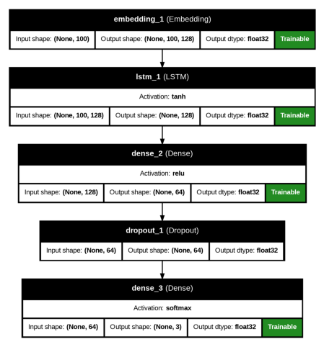
LSTM Model Architecture:

Slide 9
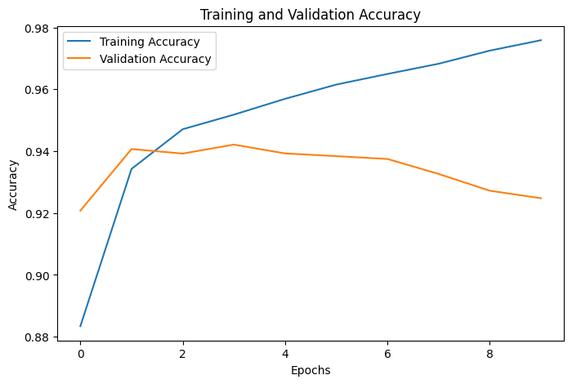
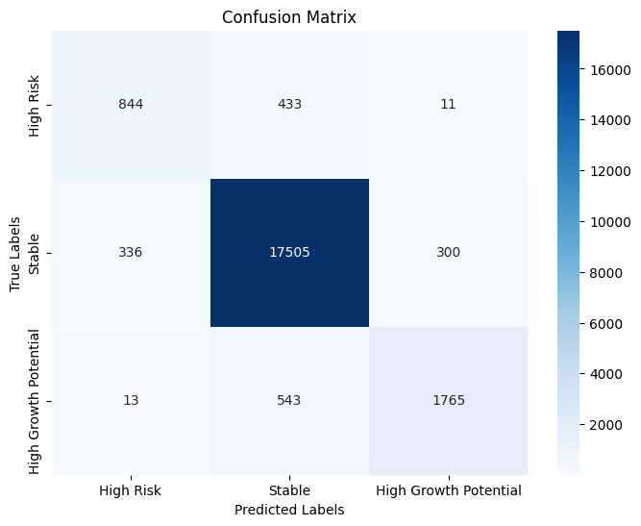
Results

Slide 10
Conclusion
This study demonstrates the effectiveness of Natural Language Processing (NLP) techniques in extracting relevant financial information, analyzing sentiment, and understanding semantic relationships within textual data.
By utilizing Named Entity Recognition (NER) and dependency parsing, key financial entities and their contextual associations can be identified with precision.
The integration of these insights into machine learning models enables the accurate classification of stock categories based on predicted market reactions.
This approach offers a systematic and data-driven method for financial analysis, contributing to more informed decision-making in stock market investments.

Slide 11
Thank you

