Slide 1
EE4218 MLP NEURAL NETWORK PROJECT
Chan Xu Hui, R Ramana

Slide 2
Design Choice
To calculate number of clock cycles in the various implementations, we have the following formula: (M/z * N) + ADDITIONAL_CLOCK_CYCLES + (M * O) + ADDITIONAL_CLOCK CYCLES
Where,
M: Number of Input Matrix Rows
N: Number of Input Matrix Columns
O: Number of Output Matrix Columns
z: Number of Ports
ADDITIONAL_CLOCK_CYCLES: 2
We did a full sequential implementation (1-port) and it resulted in 580 clock cycles
We then tried to optimize with 8-port RAMs
96 cycles
Not possible as we do not have a 8-port RAM
With dual-port RAM: 292 clock cycles
Notes:
Read: 469 cycles
Write: 66 cycles

Slide 3
Design Choice
Previous implementation of 8-port RAM could be circumvented by having 4 copies of dual-port RAM.
This however adds a fixed overhead of 128 cycles for every matrix_multiply instance to write to intermediate RAM.
In 8 cores:
128/(56 + 128 + 2 + 16 + 2) = 62.7% of clock cycles spent on writing to intermediate RAM (resource wasted)
To save 88 clock cycles, it is not worth such parallelism as we need more registers to store 4 copies of the same intermediate matrix
We opted to go for dual-port instead since our NN implementation is not computationally expensive
In a computationally expensive implementation, the overhead from writing may be insignificant and it will make more sense to do more calculations in parallel.

Slide 4
Hardware Implementation
Dual Port Memory
Concurrent Matrix Calculations
64 x 7 input split into 2 32 x 7 Matrix
Bias stored in a separate RAM
A * B, where A = 32 x 7 matrix; B = 7 x 2 matrix
After each row and column is completed, bias is added
Intermediate matrix is simultaneously written by both partial matrix
Then do a sigmoid lookup

Slide 5
HLS vs HDL vs Software
 | HLS (Non-Optimized) | HLS (Optimized) | HDL | Software
Clock Cycles | ~5591 | ~3863 | 827*
LUTs | ~1086 | ~1177 | 764
FF | ~826 | ~860 | 312
DSP | ~6 | ~6 | 0
Time Taken (AXI) | 29869 | 28163 | 25365 | 13132
* 827 clock cycles computed as below:
292 (from slide 2) + 64*7 (input matrix) + 8*2 (hidden layer) + 2 (additional clock cycles) + 3*1 (output layer) + 2 (additional clock cycles) + 64*1 (output matrix)

Slide 6
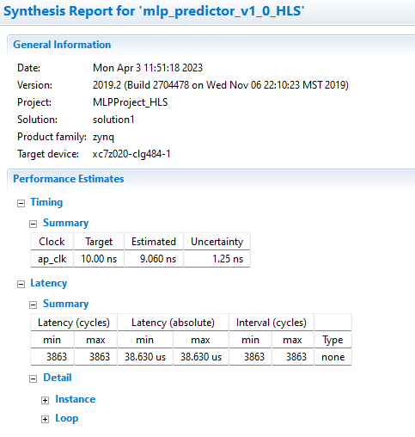
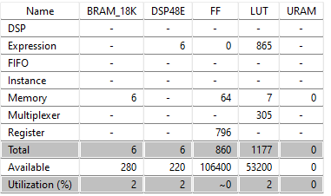
Appendix (HLS Optimized)

Slide 7
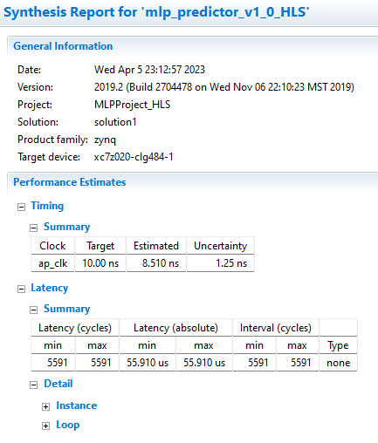
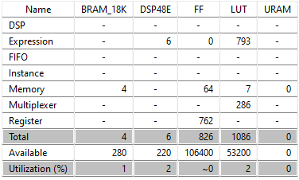
Appendix (Non optimization)

Slide 8
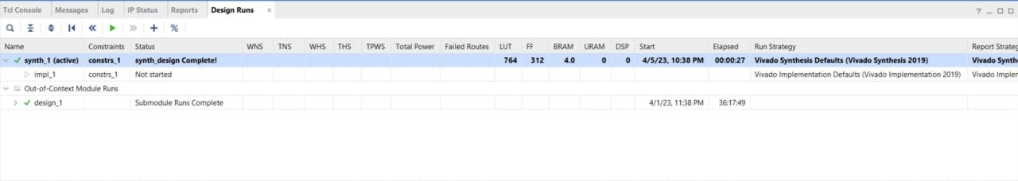
Appendix (HDL)

