Slide 1

Global vs. Local pMOR
Hritik Singh, Raúl San Miguel Peñas
Supervisor: Sebastian Schopper
TUM School of Engineering and Design
Chair of Structural Mechanics
Munich, 13 February 2023

Slide 2
Motivation
Complex and large numerical models require substantial computational power and large amount of memory
Model Order Reduction techniques allow to reduce these requirements at the cost of an approximation of full system
However, the reduced model becomes invalid when parameters of the original model such as material properties, the geometry or boundary conditions are changed
Some applications like optimization, navigation, etc. require repeated model evaluations over a large range of such parameter values

Slide 3
Motivation
A naïve approach would be to generate a reduced order model (ROM) at each queried point in the parameter space
However, this is a costly task requiring large computations with full order system, thus generally unfeasible
Parametric Model Order Reduction (pMOR) helps in overcoming these problems

Slide 4
Parametric Model Order Reduction (pMOR)
Instead of generating ROMs at each point, a sampling at different parameter combinations is done to generate a database of reduced quantities
Two main techniques – Global pMOR and Local pMOR
In global pMOR, the reduced bases obtained at sampling points are combined into one global basis matrix
This is easy to implement but the parametric reduced model grows with the number of samples
Also, it requires reduced bases to be on the same mesh as sample points

Slide 5
Local pMOR
In local pMOR, interpolation of the reduced matrices is done to avoid full order systems
However, a straightforward interpolation of the reduced matrices is not meaningful because the reduced matrices relate to different reduced bases
Therefore, a generalized coordinate system is computed first, followed by the transformation of reduced matrices to this system
The evaluation efficiency is higher than global pMOR since the parametric reduced model doesn’t grow with the number of samples
But the reduced bases still need to be generated on the same mesh as sample points

Slide 6
Methodology
Generate a FEM model of the cantilever beam at different parameter samples (e.g. different beam lengths and thicknesses)
Perform model order reduction at each parameter sample using SO-IRKA
Collect reduced model bases together to obtain a parametric model
Reduce the parametric model using either global or local pMOR technique
Solve the reduced system model at required parameter value
Obtain the frequency response for a sweep of frequencies

Slide 7
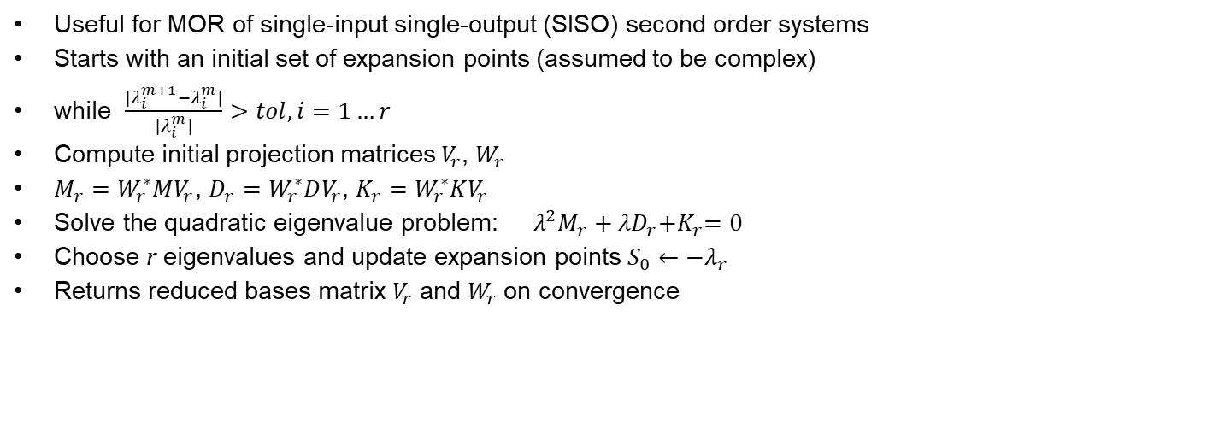
Second Order Iterative Rational Krylov Alogrithm (SO-IRKA)
Useful for MOR of single-input single-output (SISO) second order systems
Starts with an initial set of expansion points (assumed to be complex)
while $\frac{|λ_{i}^{m+1}−λ_{i}^{m}|}{|λ_{i}^{m}|}>tol, i=1…r$
Compute initial projection matrices $V_{r}$, $W_{r}$
$M_{r}=W_{r}^{∗}MV_{r}$, $D_{r}=W_{r}^{∗}DV_{r}$, $K_{r}=W_{r}^{∗}KV_{r}$
Solve the quadratic eigenvalue problem: $λ^{2}M_{r}+{λD}_{r}{+K}_{r}=0$
Choose r eigenvalues and update expansion points $S_{0}←{−λ}_{r}$
Returns reduced bases matrix $V_{r}$ and $W_{r}$ on convergence

Slide 8
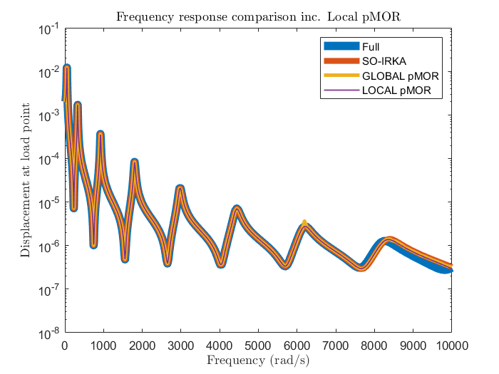
Results
Parameter – Length
All models give the same results
Accuracy of reduced-order models decreases at high frequencies

Slide 9
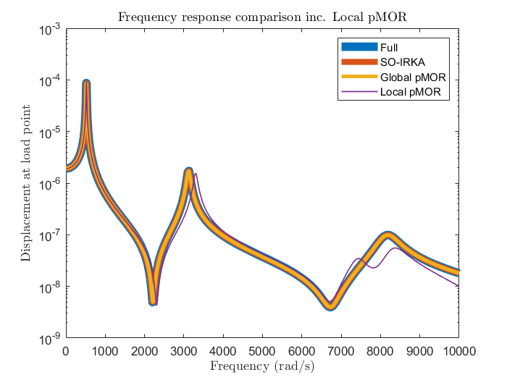
Parametric Study
Parameter – Thickness of the beam

Slide 10
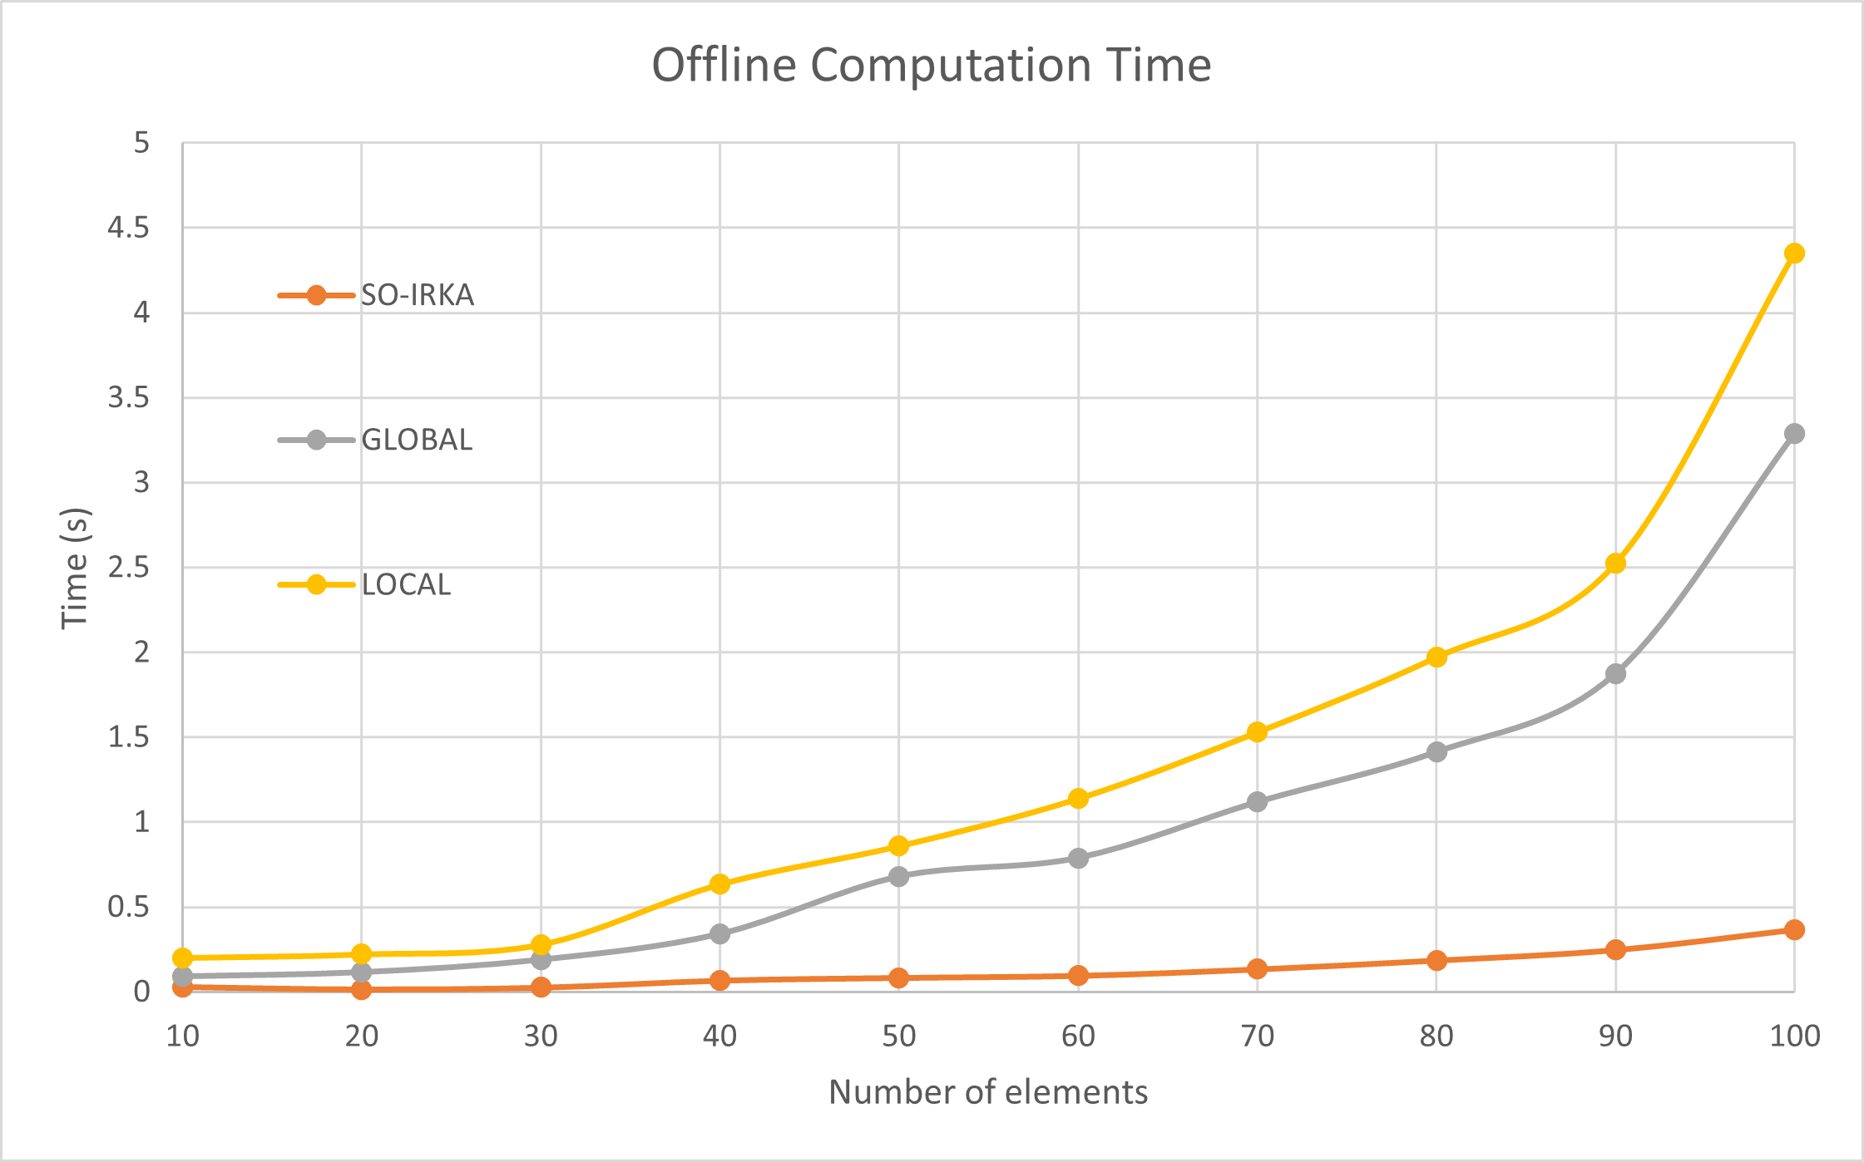
Performance Study
Offline times

Slide 11
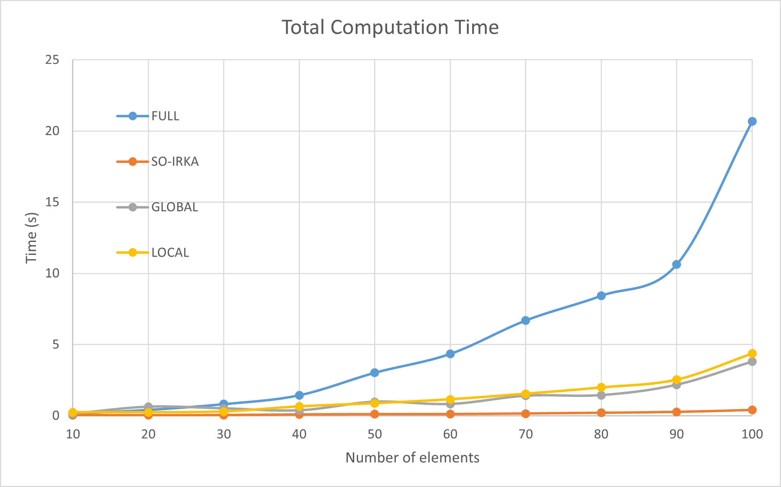
Performance Study
For small-sized systems, solving the full order system takes less time compared to pMOR techniques due to overhead involved in setting up the MOR
But as the number of elements increase, both local and global pMOR take considerable less time compared to full order system
Local pMOR is taking more time than global pMOR but with large number of parameters, it would be other way round
SO-IRKA takes least because it is performing MOR for just a single parameter

Slide 12
Thank You

