Slide 1

Global vs. Local pMOR
Hritik Singh, Raúl San Miguel Peñas
Supervisor: Sebastian Schopper
TUM School of Engineering and Design
Chair of Structural Mechanics
Munich, 13 February 2023

Slide 2
Motivation
Complex and large numerical models require substantial computational power and large amount of memory
Model Order Reduction techniques allow to reduce these requirements at the cost of an approximation of full system
However, the reduced model becomes invalid when parameters of the original model such as material properties, the geometry or boundary conditions are changed
Some applications like optimization, navigation, etc. require repeated model evaluations over a large range of such parameter values

Slide 3
Motivation
A naïve approach would be to generate a reduced order model (ROM) at each queried point in the parameter space
However, this is a costly task requiring large computations with full order system, thus generally unfeasible
Parametric Model Order Reduction (pMOR) helps in overcoming these problems
In pMOR, instead of generating ROMs at each point, a sampling at different parameter combinations is done to generate a database of reduced quantities
Two main techniques – Global pMOR and Local pMOR

Slide 4
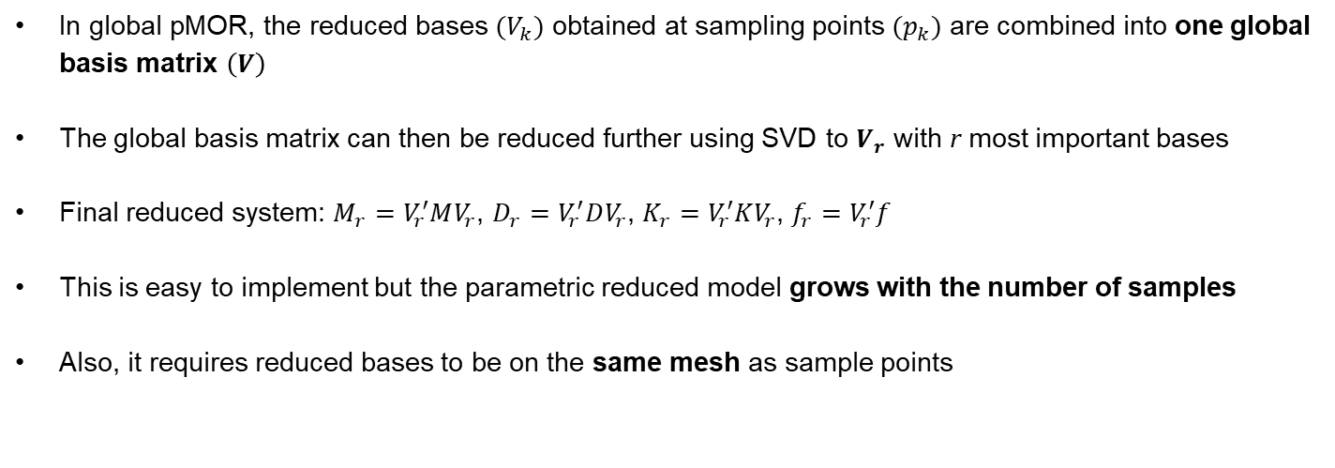
Global pMOR
In global pMOR, the reduced bases $(V_{k})$ obtained at sampling points $(p_{k})$ are combined into one global basis matrix $\left(V\right)$
The global basis matrix can then be reduced further using SVD to $V_{r}$ with r most important bases
Final reduced system: $M_{r}=V_{r}^{′}MV_{r}$, $D_{r}=V_{r}^{′}DV_{r}$, $K_{r}=V_{r}^{′}KV_{r}$, $f_{r}=V_{r}^{′}f$
This is easy to implement but the parametric reduced model grows with the number of samples
Also, it requires reduced bases to be on the same mesh as sample points

Slide 5
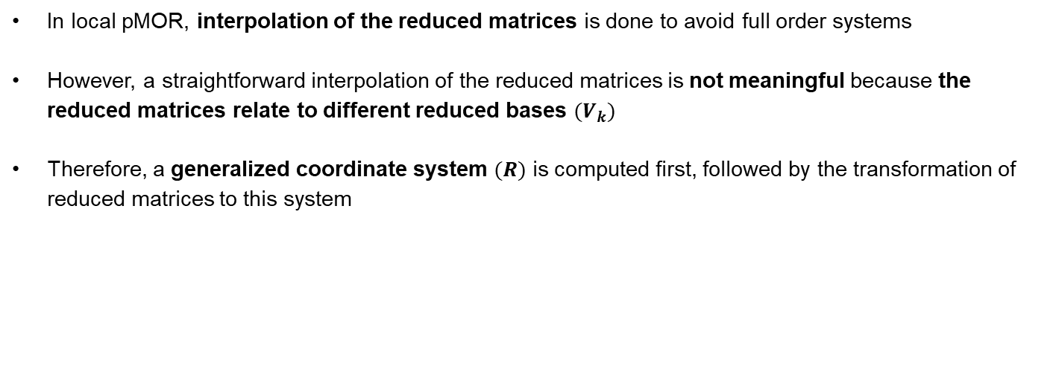
Local pMOR
In local pMOR, interpolation of the reduced matrices is done to avoid full order systems
However, a straightforward interpolation of the reduced matrices is not meaningful because the reduced matrices relate to different reduced bases $(V_{k})$
Therefore, a generalized coordinate system $(R)$ is computed first, followed by the transformation of reduced matrices to this system

Slide 6
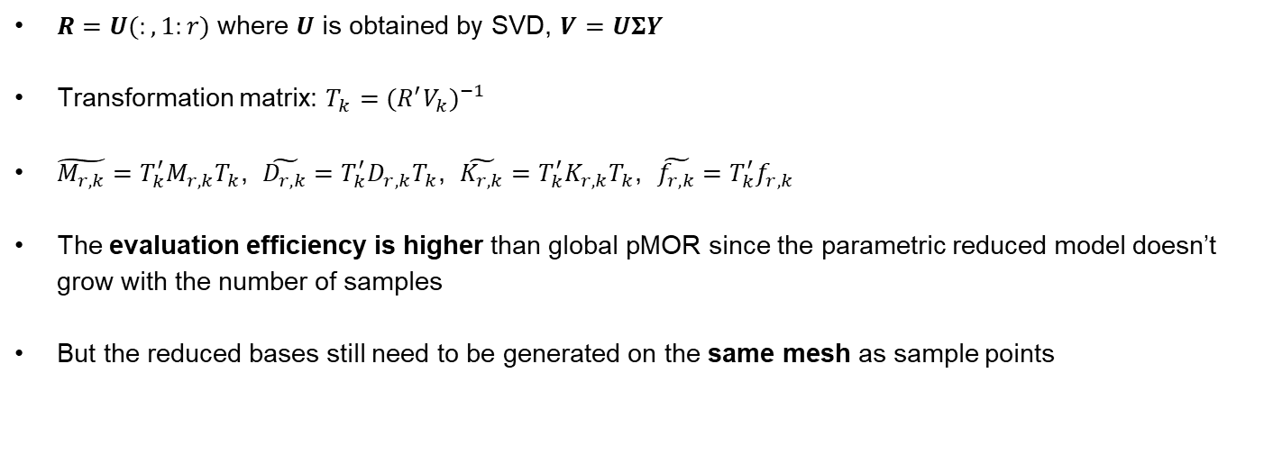
Local pMOR
$R=U(:,1:r)$ where $U$ is obtained by SVD, $V=UΣY$
Transformation matrix: $T_{k}={(R^{′}V_{k})}^{−1}$
$\tilde{M_{r,k}}=T_{k}^{′}M_{r,k}T_{k}$, $\tilde{D_{r,k}}=T_{k}^{′}D_{r,k}T_{k}$, $\tilde{K_{r,k}}=T_{k}^{′}K_{r,k}T_{k}$, $\tilde{f_{r,k}}=T_{k}^{′}f_{r,k}$
The evaluation efficiency is higher than global pMOR since the parametric reduced model doesn’t grow with the number of samples
But the reduced bases still need to be generated on the same mesh as sample points

Slide 7
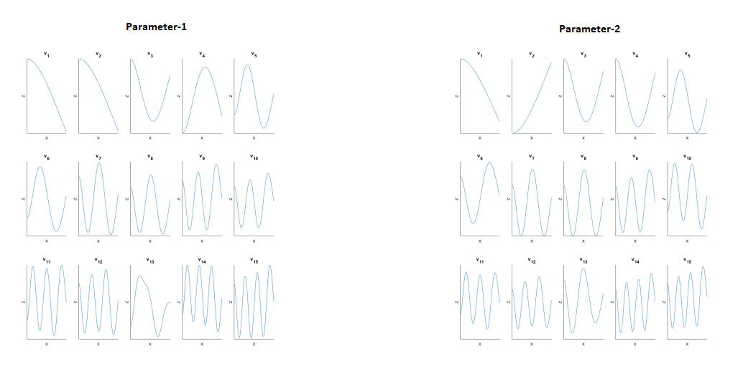
Local pMOR Interpolation

Slide 8
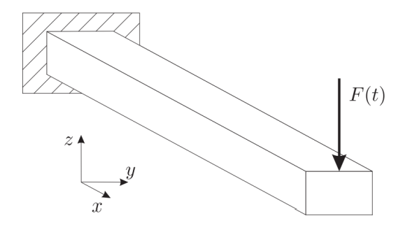
Methodology
Generate a FEM model of the Timoshenko cantilever beam at different parameter samples (e.g. different beam lengths and thicknesses)
Perform MOR at each parameter sample using SO-IRKA
Collect reduced model bases together to obtain a parametric model
Reduce the parametric model using either global or local pMOR technique
Local pMOR interpolation done using cubic splines
Solve the reduced system model at required parameter value
Obtain the frequency response for a sweep of frequencies

Slide 9
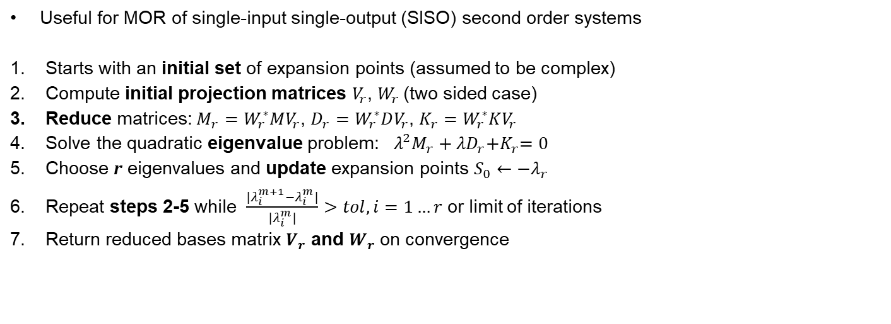
Second Order Iterative Rational Krylov Alogrithm (SO-IRKA)
Useful for MOR of single-input single-output (SISO) second order systems
Starts with an initial set of expansion points (assumed to be complex)
Compute initial projection matrices $V_{r}$, $W_{r}$ (two sided case)
Reduce matrices: $M_{r}=W_{r}^{∗}MV_{r}$, $D_{r}=W_{r}^{∗}DV_{r}$, $K_{r}=W_{r}^{∗}KV_{r}$
Solve the quadratic eigenvalue problem: $λ^{2}M_{r}+{λD}_{r}{+K}_{r}=0$
Choose r eigenvalues and update expansion points $S_{0}←{−λ}_{r}$
Repeat steps 2-5 while $\frac{|λ_{i}^{m+1}−λ_{i}^{m}|}{|λ_{i}^{m}|}>tol, i=1…r$ or limit of iterations
Return reduced bases matrix $V_{r}$ and $W_{r}$ on convergence

Slide 10
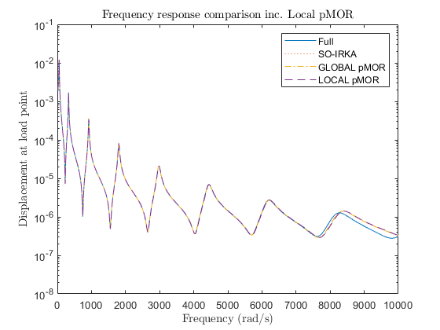
Results
Parameter – Beam length
Parameter range, P = [0.214 0.3 0.4 0.5 0.6 0.75 0.9 1.25]
Models evaluated at L = 1m and 100 elements
All models give approximately the same results
Accuracy of reduced-order models decreases at high frequencies

Slide 11
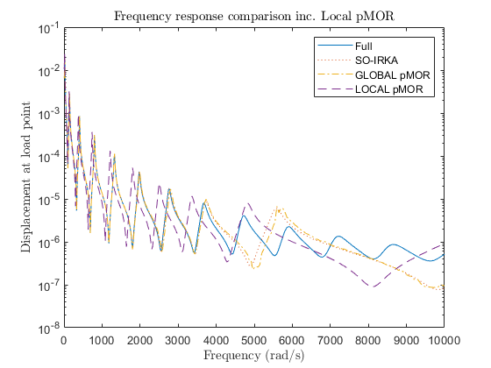
Extrapolation Results
Models evaluated at L = 1.5m and 100 elements
Accuracy of all reduced-order models is worse than the interpolation case before
Accuracy of reduced-order models decreases even further at high frequencies (>4000 rad/s)
Accuracy of local pMOR is the worst since it is based on interpolation and thus, is unable to extrapolate the results

Slide 12
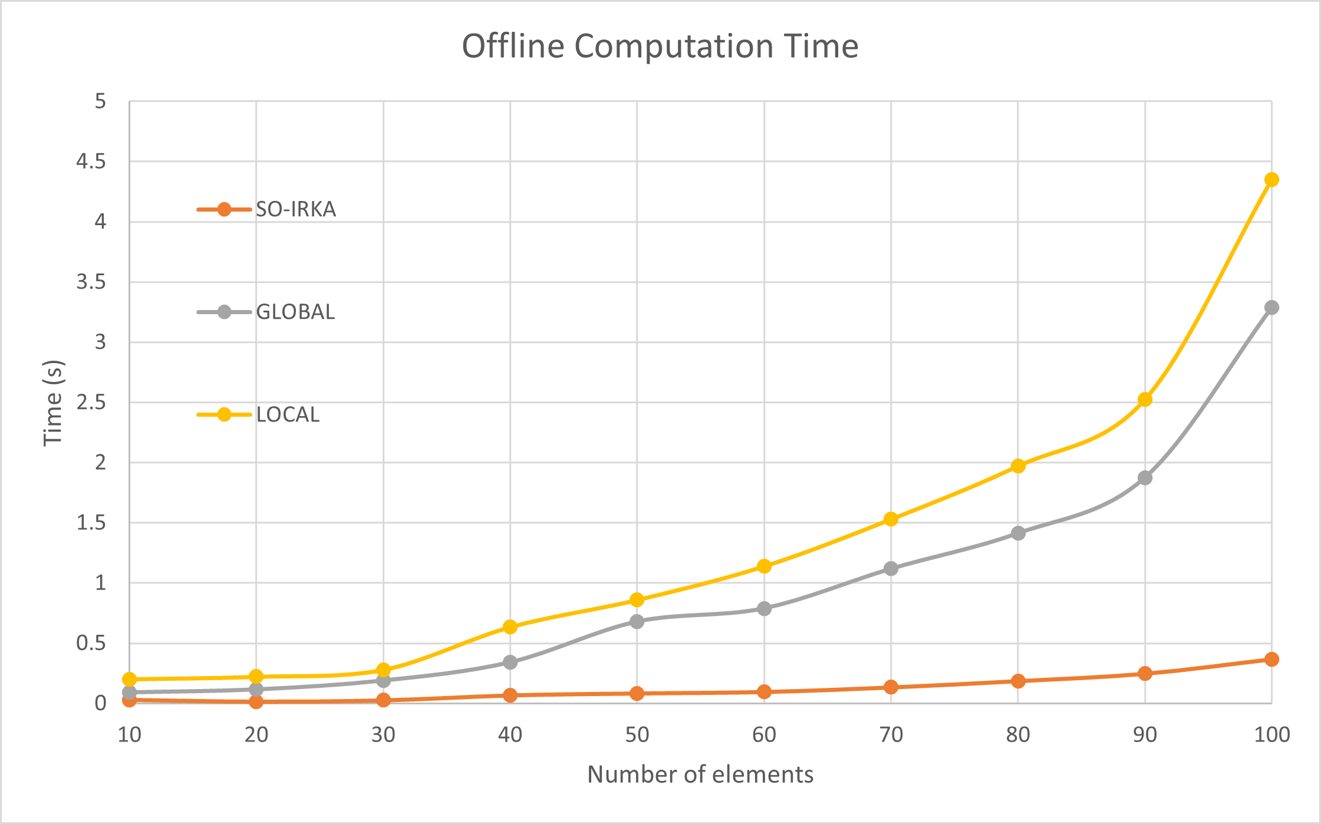
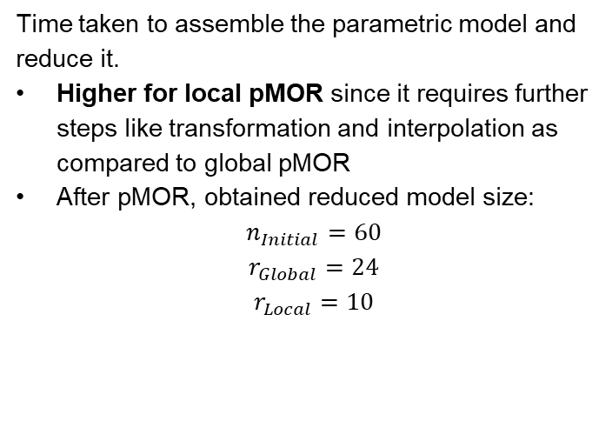
Performance Study – Offline Computation Time
Time taken to assemble the parametric model and reduce it.
Higher for local pMOR since it requires further steps like transformation and interpolation as compared to global pMOR
After pMOR, obtained reduced model size:
$$n_{Initial}=60$$
$$r_{Global}=24$$
$$r_{Local}=10$$

Slide 13
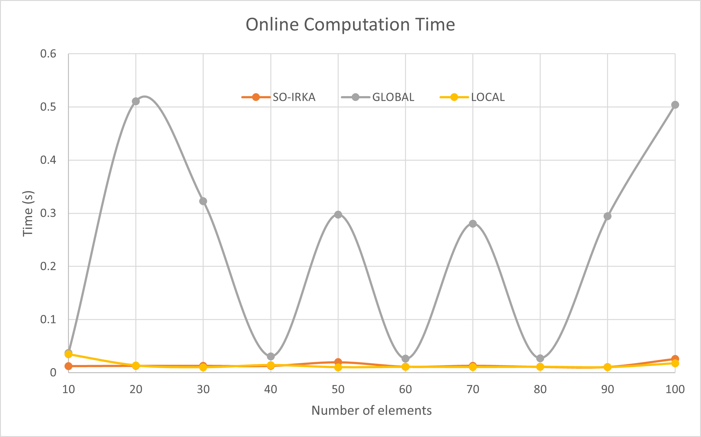
Performance Study – Online Computation Time
Time to solve and compute the frequency response of the reduced system.
Higher for global pMOR since the size of reduced system is more as compared to local pMOR
Number of elements doesn’t affect the size of reduced system and thus, it doesn’t affect online times as well
Variations in global pMOR online time are probably due to processor usage by other processes

Slide 14
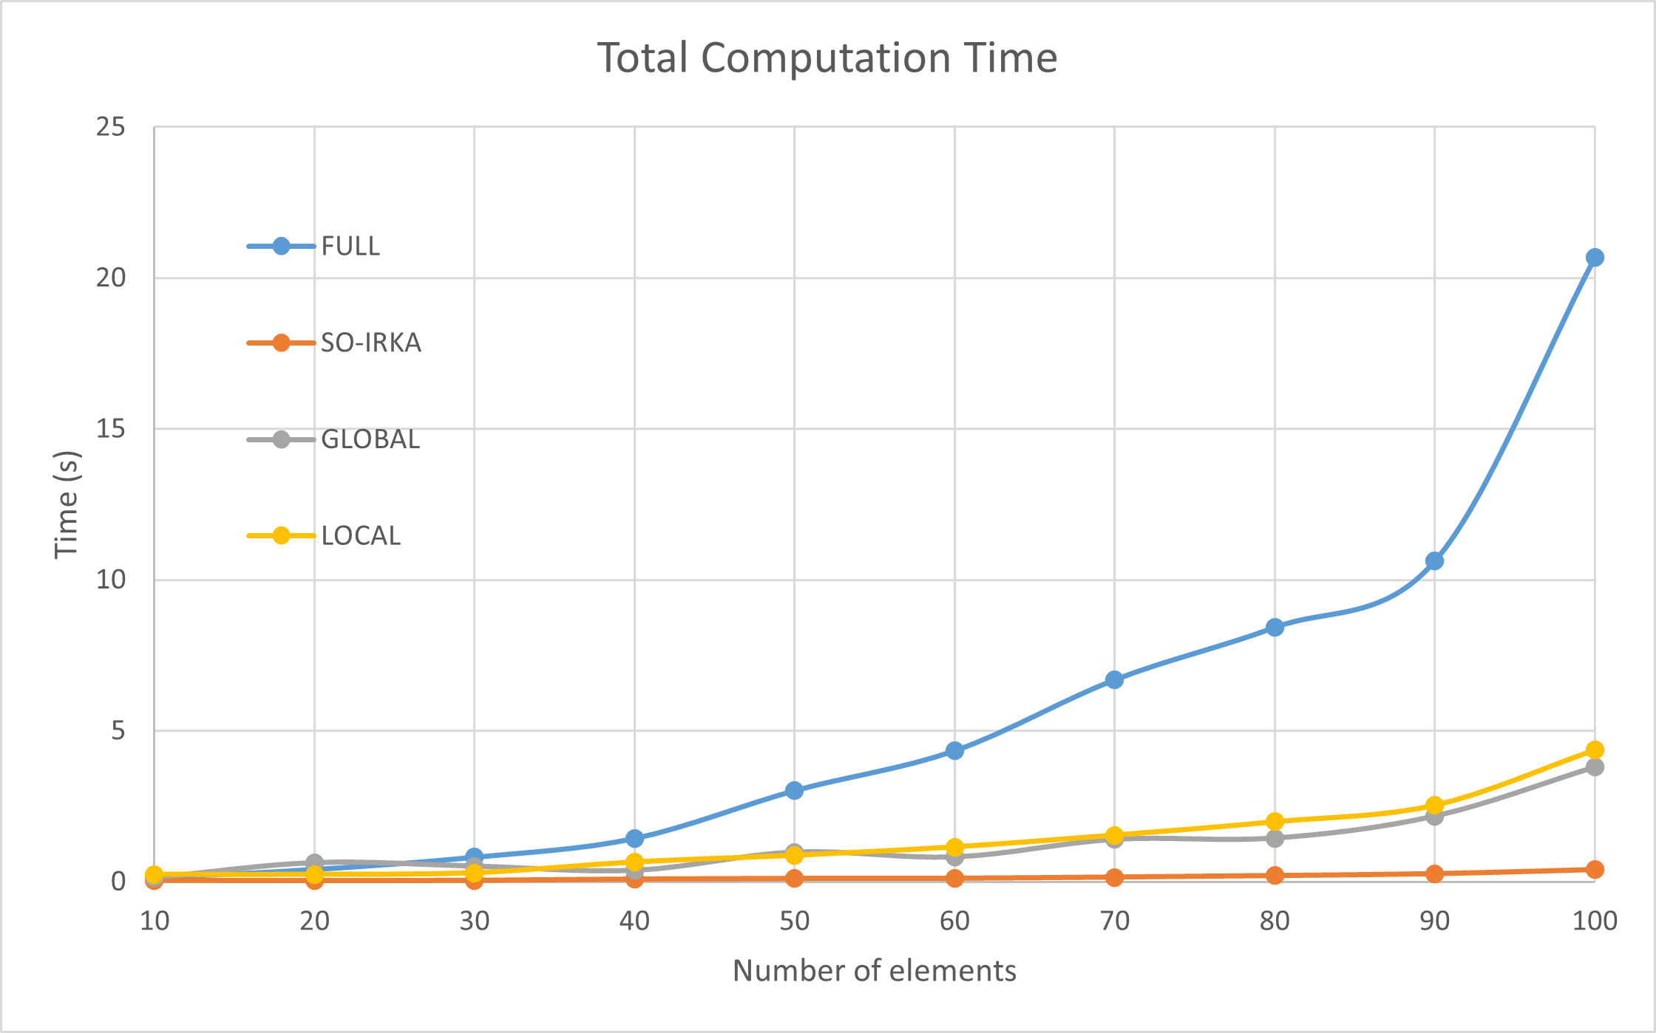
Performance Study – Total Computation Time
For small-sized systems, solving the full order system takes less time as compared to pMOR techniques due to overhead involved in setting up the MOR
But as the number of elements increase, both local and global pMOR take considerable less time as compared to the full order system
Local pMOR is taking more time than global pMOR because only one online computation performed.
SO-IRKA takes least because it is performing MOR for just a single parameter (not easily scalable)

Slide 15
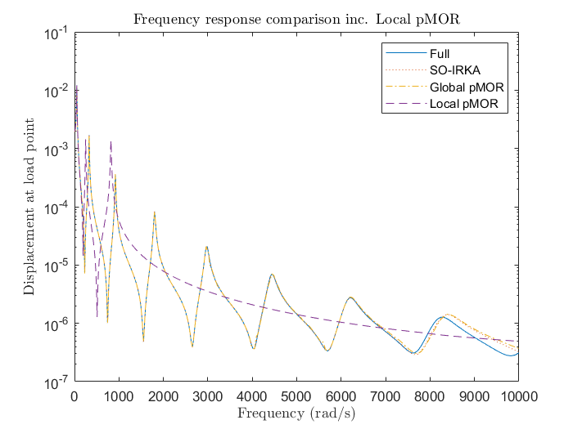
Reduced base and stiffness
H = 0.01 m to reduce stiffness
Many modes (peaks) represented
Global pMOR accurate because r based on SVD
Local pMOR with r = 5 can only represent 5 modes

Slide 16
Conclusions
Both pMOR techniques have been successfully implemented
pMOR techniques are quite effective and result in considerable resource-saving specially if the parameter range is chosen appropriately
Local pMOR is the best MOR technique for applications like optimization, navigation, etc. that require repeated model evaluations in online phase
This is true specially if extrapolation isn’t involved
FUTURE WORK: Different interpolation methods, sampling of parameter space.

Slide 17
Thank You

