Slide 1
Employee Data Analysis using Excel
STUDENT NAME : R.SAAI ANUPRIYA
REGISTER NO AND NMID : 312209345 AND asunm1353312209345
DEPARTMENT : BCOM COMMERCE
COLLEGE : ANNA ADARSH COLLEGE FOR WOMEN

Slide 2
PROJECT TITLE
Employee Type Analyses Using Excel

Slide 3


AGENDA
Problem Statement
Project Overview
End Users
Our Solution and Proposition
Dataset Description
Modelling Approach
Results and Discussion
Conclusion
3/21/2024 Annual Review

Slide 4

PROBLEM STATEMENT Employee type analyses using excel which help us to know how many employees are working in Fixed, Temporary and Permanent in different countries. This analyses will help us to know which type of employee is more in different countries. Based on this employee will be provided promotion and transfer.

Slide 5

PROJECT OVERVIEW
The employee type analyses using excel is that analyses of type of employee whether they are Fixed Term, Temporary and Permanent different countries such as India, New Zealand and USA.
This type of analyses considered the data such as Gender, Employee type and Countries.

Slide 6




WHO ARE THE END USERS?

Slide 7
OUR SOLUTION AND ITS VALUE PROPOSITIONS 1.Conditional Formatting - Highlight the Missing Value 2.Filter - Remove the Missing value 3.Condtional Formatting - Highlight the cell that contain Permanent 4.Pivot Table - Summery 5.Graph - Data Visualization

Slide 8
Dataset Description 1.Empolyee data set –Kaggle http://www.kaggle.com/datasets/ravindrasinghrana/employeedataset 2.Total 8 features are there in this set 3.3 features are used for analyses Three features are: a, Gender- Male and Female –Text Format b, Employee type -Text Format c, Country -Text Format

Slide 9

THE "WOW" IN OUR SOLUTION
Applied Text to Column and Delimited to show the separate feature for City and Country.
3/21/2024 Annual Review

Slide 10
MODELING
DATA COLLECTION
For analyzing the Employee data set collected the data set from the source Kaggle.
In Kaggle taken the Employee Data Set of http://www.kaggle.com/datasets/ravindrasinghrana/employeedataset.
FEATURE COLLECTION
From the collected data set there are 8 features
Name vi FTI
Gender vii Employee type
Department viii City
Salary
Starting date
21

Slide 11
DATA CLEANING
Date of start some values are missing applied data cleaning.
Applied Conditional Formatting for missing value and filter that to get the values.
EMPLOYEE TYPE
Applied Conditional Formatting by using the rule which contain the text “Permanent”.
To show the City and Country as a separate feature applied Text To Column and Delimited.
SUMMERY
Working on Employee Type Analyses consider the factor such as Gender- Male and Female, Employee Type, Country.
Used Pivot Table to show Type of Employee in different countries and filter it by Gender.

Slide 12
From the Pivot table concluded the analyses by stating that Fixed term is more in New Zealand ,Permanent is more in India and Temporary is more New Zealand.
VISUALISATION
Depict the Pivot Table using Pivot Chart.
In Pivot Chart used the Column to represent the data
Inserted Slicer to visualize particular set of data.

Slide 13
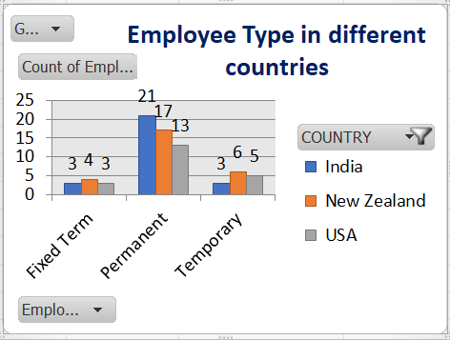
RESULTS

Slide 14
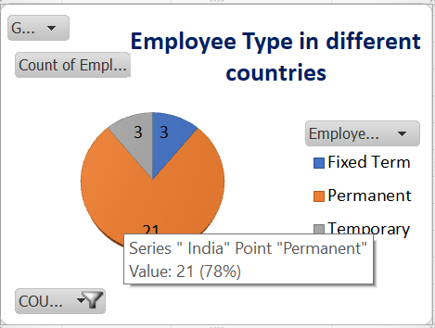
EMPLOYEE TYPE IN INDIA

Slide 15
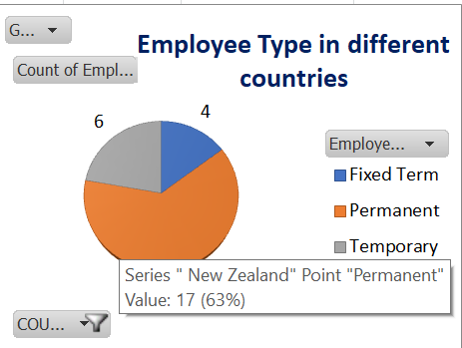
EMPLOYEE TYPE IN NEW ZEALAND

Slide 16
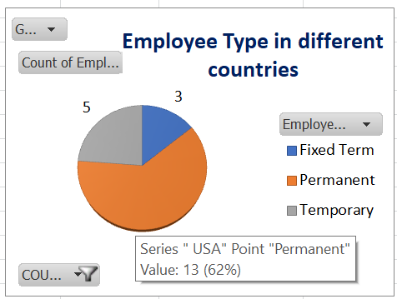
EMPLOYEE TYPE IN USA

Slide 17
CONCLUSION Employee type analyses in excel provides you the result of employee type in different countries such as India, New Zealand and USA. As overall India and New Zealand as high value of employee type with total 27 followed by that USA with total employee type of 21. The employee type high in each country Fixed term is more in New Zealand ,Permanent is more in India and Temporary is more New Zealand.

