Slide 1
Power BI
Banking Dashboard

Slide 2
ABOUT THE PROJECT
The project is a banking project where we have used a banking dataset. Here in this dashboard we are going to show features like Loan analysis and Deposit Analysis and summary of the overall dataset.

Slide 3
Total Clients
3000
Some important KPI’s
Total Engagement Account
$18.26K
Total CC Account
$135

Slide 4
Financial Goals
Total Loan
$139.9M
Total Deposit
$111.49M
Total Fees
$5.17M

Slide 5
Bank Numbers
$55.5M
$60.18M
$83.52M
Bank Loan
Bank Deposit
Business Lending

Slide 6
19.85
Saving Account (in Millions)
Checking amount and Saving amount
Foreign Currency Amount (in millions)
2.71

Slide 7
$ 2.71 M
FOREIGN CURRENCY AMOUNT

Slide 8
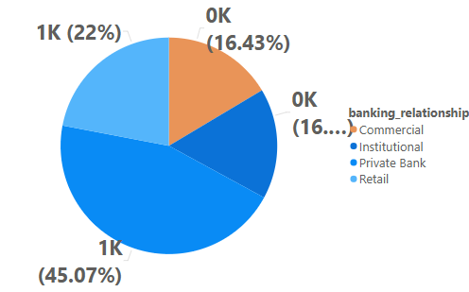
Clients by Banking Relationship
What we observe?
The number of clients availing bank loans is highest among the Mid Income band and lowest among the High Income band, indicating stronger loan-based banking relationships in the Mid Income group.

Slide 9
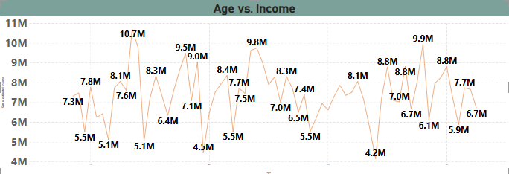
Age vs. Income
What we observe?
Highest features are observed among individuals in the Middle Age–High Income group, followed by the Young Age–High Income group.
The lowest features are seen in the Senior Age–Low Income group, followed by the Young Age–Low Income group.

Slide 10
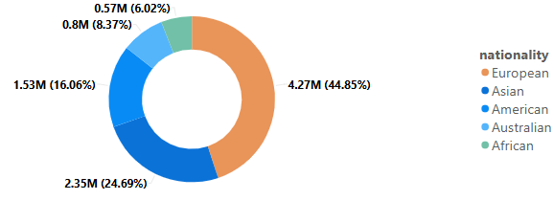
Credit Card Balance by Nationality
What we observe?
Credit card balance is highest among European nationals and lowest among Australian nationals.

Slide 11
THANK YOU !

