Slide 1

B.M.S. College of
Engineering
[Course Name] | [Course Code]
[Project Title]
[Project Subtitle]
[Student One (USN)] • [Student Two (USN)]
[Student Three (USN)] • [Student Four (USN)]
Guide: [Name], [Designation]
HOD: [Name]
Department of CSE (Data Science), BMSCE
AY [Academic Year]
Notes:
Reusable BMSCE template. Replace topic-specific headings, all placeholders, evidence and notes before submission. Preserve institutional branding; confirm current faculty and academic details.

Slide 2

B.M.S. College of
Engineering
Table of Contents
[Replace with project-specific content and evidence]
Department of CSE (Data Science) | [Academic Year]
Notes:
Reusable BMSCE template. Replace topic-specific headings, all placeholders, evidence and notes before submission. Preserve institutional branding; confirm current faculty and academic details.

Slide 3
B.M.S. College of
Engineering
Introduction to Optimization Problems
[Replace with project-specific content and evidence]
[Replace with project-specific content and evidence]
[Replace with project-specific content and evidence]
Department of CSE (Data Science) | [Academic Year]
Notes:
Reusable BMSCE template. Replace topic-specific headings, all placeholders, evidence and notes before submission. Preserve institutional branding; confirm current faculty and academic details.

Slide 4
B.M.S. College of
Engineering
What are Nature-Inspired Algorithms?
[Replace with project-specific content and evidence]
[Replace with project-specific content and evidence]
[Replace with project-specific content and evidence]
Department of CSE (Data Science) | [Academic Year]
Notes:
Reusable BMSCE template. Replace topic-specific headings, all placeholders, evidence and notes before submission. Preserve institutional branding; confirm current faculty and academic details.

Slide 5
B.M.S. College of
Engineering
Classification of Nature-Inspired Algorithms
[Replace with project-specific content and evidence]
[Replace with project-specific content and evidence]
[Replace with project-specific content and evidence]
Department of CSE (Data Science) | [Academic Year]
Notes:
Reusable BMSCE template. Replace topic-specific headings, all placeholders, evidence and notes before submission. Preserve institutional branding; confirm current faculty and academic details.

Slide 6
B.M.S. College of
Engineering
Problem Statement
[Replace with project-specific content and evidence]
[Replace with project-specific content and evidence]
[Replace with project-specific content and evidence]
Department of CSE (Data Science) | [Academic Year]
Notes:
Reusable BMSCE template. Replace topic-specific headings, all placeholders, evidence and notes before submission. Preserve institutional branding; confirm current faculty and academic details.

Slide 7
B.M.S. College of
Engineering
Dataset and Preprocessing
[Replace with project-specific content and evidence]
[Replace with project-specific content and evidence]
[Replace with project-specific content and evidence]
Department of CSE (Data Science) | [Academic Year]
Notes:
Reusable BMSCE template. Replace topic-specific headings, all placeholders, evidence and notes before submission. Preserve institutional branding; confirm current faculty and academic details.

Slide 8
B.M.S. College of
Engineering
Implementation and Results
[Replace with project-specific content and evidence]
[Replace with project-specific content and evidence]
[Replace with project-specific content and evidence]
Department of CSE (Data Science) | [Academic Year]
Notes:
Reusable BMSCE template. Replace topic-specific headings, all placeholders, evidence and notes before submission. Preserve institutional branding; confirm current faculty and academic details.

Slide 9
B.M.S. College of
Engineering
Differential Evolution: Explicit Operators
[Replace with project-specific content and evidence]
[Replace with project-specific content and evidence]
[Replace with project-specific content and evidence]
Department of CSE (Data Science) | [Academic Year]
Notes:
Reusable BMSCE template. Replace topic-specific headings, all placeholders, evidence and notes before submission. Preserve institutional branding; confirm current faculty and academic details.

Slide 10
B.M.S. College of
Engineering
Performance Metrics and Benchmarking
[Replace with project-specific content and evidence]
[Replace with project-specific content and evidence]
[Value] | [Value] | [Value] | [Value]
[Value] | [Value] | [Value] | [Value]
[Value] | [Value] | [Value] | [Value]
[Value] | [Value] | [Value] | [Value]
[Replace with project-specific content and evidence]
Department of CSE (Data Science) | [Academic Year]
Notes:
Reusable BMSCE template. Replace topic-specific headings, all placeholders, evidence and notes before submission. Preserve institutional branding; confirm current faculty and academic details.

Slide 11
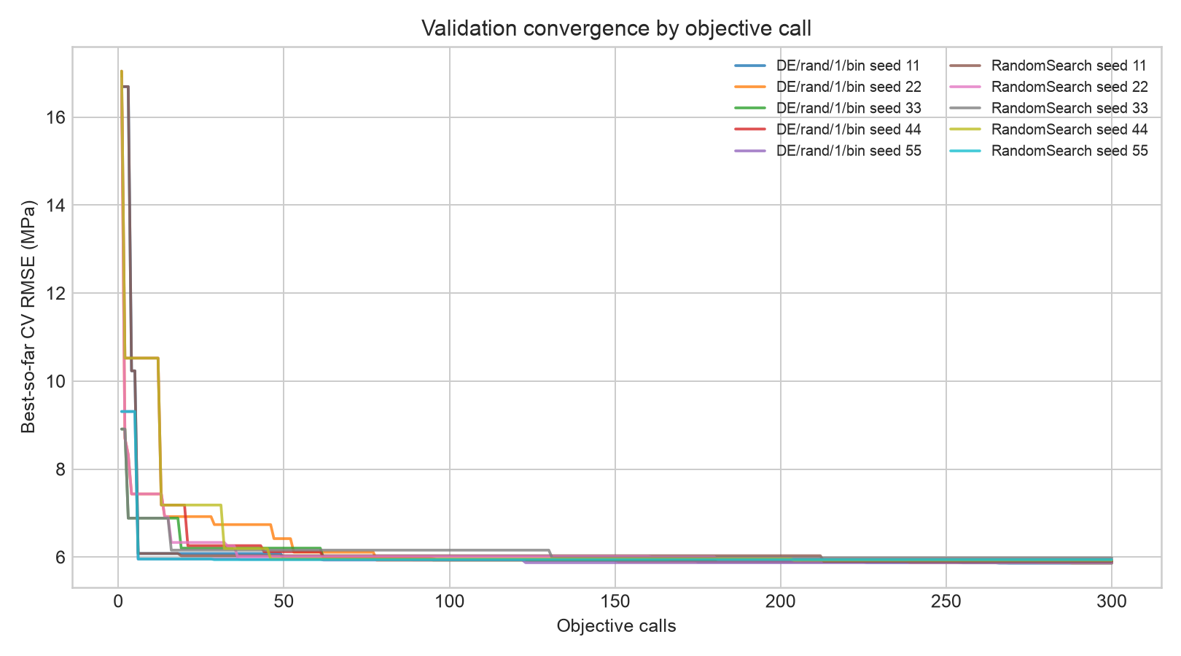
B.M.S. College of
Engineering
Development Validation Convergence
[Replace with project-specific content and evidence]
[Replace with project-specific content and evidence]
Department of CSE (Data Science) | [Academic Year]
Notes:
Reusable BMSCE template. Replace topic-specific headings, all placeholders, evidence and notes before submission. Preserve institutional branding; confirm current faculty and academic details.

Slide 12
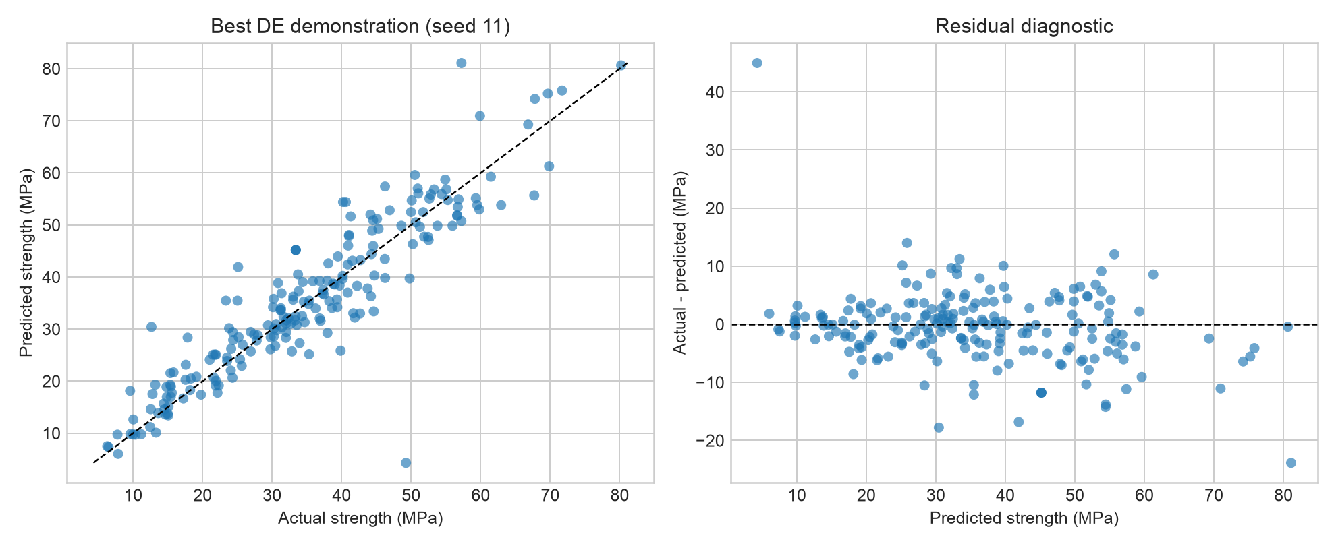
B.M.S. College of
Engineering
Predictions and Residuals
[Replace with project-specific content and evidence]
[Replace with project-specific content and evidence]
Department of CSE (Data Science) | [Academic Year]
Notes:
Reusable BMSCE template. Replace topic-specific headings, all placeholders, evidence and notes before submission. Preserve institutional branding; confirm current faculty and academic details.

Slide 13
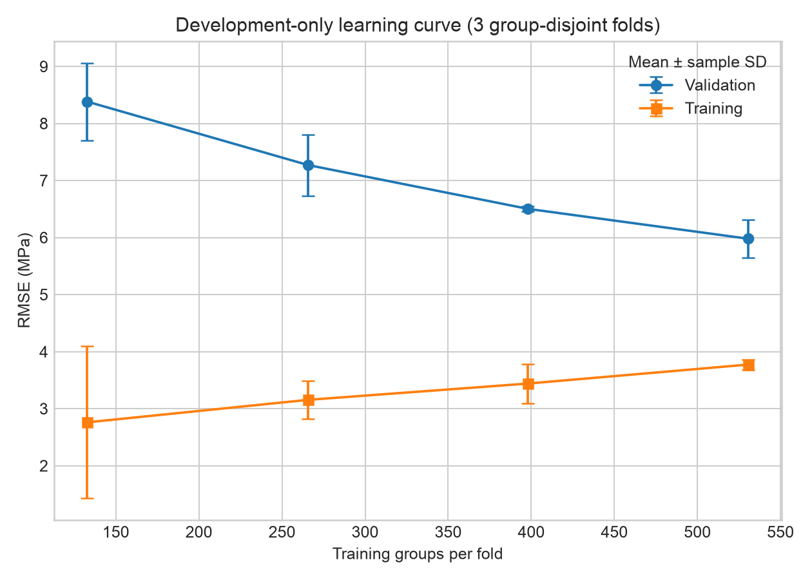
B.M.S. College of
Engineering
Learning-Curve Diagnostic
[Replace with project-specific content and evidence]
[Replace with project-specific content and evidence]
Department of CSE (Data Science) | [Academic Year]
Notes:
Reusable BMSCE template. Replace topic-specific headings, all placeholders, evidence and notes before submission. Preserve institutional branding; confirm current faculty and academic details.

Slide 14
B.M.S. College of
Engineering
Advantages
[Replace with project-specific content and evidence]
[Replace with project-specific content and evidence]
[Replace with project-specific content and evidence]
Department of CSE (Data Science) | [Academic Year]
Notes:
Reusable BMSCE template. Replace topic-specific headings, all placeholders, evidence and notes before submission. Preserve institutional branding; confirm current faculty and academic details.

Slide 15
B.M.S. College of
Engineering
Limitations
[Replace with project-specific content and evidence]
[Replace with project-specific content and evidence]
[Replace with project-specific content and evidence]
Department of CSE (Data Science) | [Academic Year]
Notes:
Reusable BMSCE template. Replace topic-specific headings, all placeholders, evidence and notes before submission. Preserve institutional branding; confirm current faculty and academic details.

Slide 16
B.M.S. College of
Engineering
Future Scope
[Replace with project-specific content and evidence]
[Replace with project-specific content and evidence]
[Replace with project-specific content and evidence]
Department of CSE (Data Science) | [Academic Year]
Notes:
Reusable BMSCE template. Replace topic-specific headings, all placeholders, evidence and notes before submission. Preserve institutional branding; confirm current faculty and academic details.

Slide 17
B.M.S. College of
Engineering
References
[Replace with project-specific content and evidence]
[Replace with project-specific content and evidence]
[Replace with project-specific content and evidence]
Department of CSE (Data Science) | [Academic Year]
Notes:
Reusable BMSCE template. Replace topic-specific headings, all placeholders, evidence and notes before submission. Preserve institutional branding; confirm current faculty and academic details.

Slide 18
B.M.S. College of
Engineering
THANK YOU
[Replace with project-specific content and evidence]
[Replace with project-specific content and evidence]
Department of CSE (Data Science) | [Academic Year]
Notes:
Reusable BMSCE template. Replace topic-specific headings, all placeholders, evidence and notes before submission. Preserve institutional branding; confirm current faculty and academic details.

