Slide 1







Pega-Based Insurance Claims Processing System
Company: Cognizant Technology Solutions
Institution: K L Deemed to be University
Name: Reddy Venkat Kalyan
Designation: Genc Intern
Regd. No: 2100030959
Project Lead: Ghosh Gourab

Slide 2
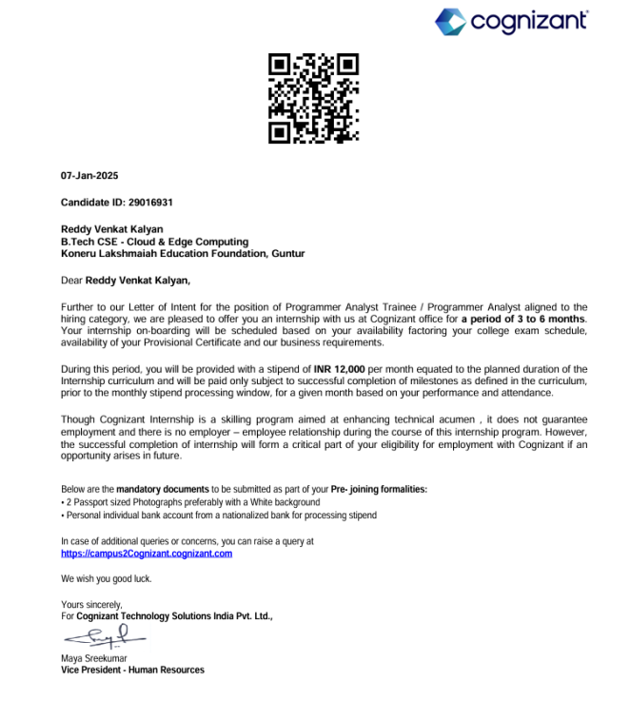
Approval of Internship

Slide 3

Abstract
During my three-month internship, I had the opportunity to work on a live project focused on insurance claim management using Pega. The internship began with foundational training on web services, where I was introduced to high-level concepts of SOAP and REST APIs. Following this, I received intensive hands-on training on Pega System Architect topics, which included both theoretical sessions and real-time implementation tasks. Our trainer monitored our progress through scenario-based exercises, ensuring I could apply the concepts in practice.

Slide 4
About Cognizant
Global Leader: Technology and business services.
Focus: Digital transformation, agility, competitiveness.
Technological Excellence: Investments in cloud, automation, AI, low-code platforms (PEGA).
Client Solutions: Customized, scalable, secure solutions for complex challenges.
Trusted Partner: Emphasis on client satisfaction, foresight, operational excellence.

Slide 5
Commitment to Innovation & Employee Empowerment
Technology-Driven: Modern tools for workflow streamlining, customer engagement, rapid application delivery (PEGA).
Employee Growth: Continuous learning, hands-on experience, mentoring, certifications.
Work-Life Balance: Flexible arrangements, professional and personal growth opportunities.
Global Presence: 35+ countries, 300+ delivery centers, major development centers in India.
Domain Expertise: Banking, healthcare, retail, insurance, manufacturing, energy, telecom, public sector.

Slide 6
Hardware and Software Specifications
Hardware: Laptop with minimum 8 GB RAM, i5 processor.
Software: PEGA Platform, Postman, MySQL, Java SDK, SoapUI, Eclipse, Chrome, Tekstac Platform.

Slide 7
Introduction
Project: Implementation of Insurance claims management case life cycle in PEGA.
Subjects Learned: Java Collections, MySQL, REST/SOAP Web Services, PEGA Tool.
Tools Used: PEGA, Postman, Eclipse, MySQL, Tekstac, Udemy.

Slide 8
Project Introduction
Introduction of the Project Carried Out Project Title: Automation of Customer Case Management System using PEGA
Platform: PEGA Low-Code Application Development
Objective: To design and implement a workflow-based solution for managing customer service requests
Key Focus Areas:
Creation of case types with defined stages and processes
Integration with external systems using SOAP and REST APIs
Implementation of business rules and decision logic
Role-based access control and case flow automation
Outcome: Improved process efficiency, traceability, and reduced manual intervention

Slide 9
Latest Tools Learned
Tekstac (Cognizant's Official Learning Platform): Hands-on modules in Java, Spring Boot, MySQL, and web services.
Udemy Courses: Enrolled in courses like RESTful APIs, Spring Boot and Full Stack Web Development.
PEGA Documentation & Academy: Learned PEGA rules, connectors, and app studio features.
Postman: API testing for REST/SOAP integration.
SQL: Practiced via GFG tutorials.

Slide 10
Future Scope
1. Enhance knowledge of PEGA Dev Studio.
2. Explore deployment and CI/CD integrations for low-code platforms.
3. Learn PEGA Decisioning and Robotics.
4. Contribute to large-scale automation projects.

Slide 11
Conclusion
Internship helped bridge academic concepts with real-world applications.
Improved my backend and rule-based programming skills using PEGA.
Strengthened my workflow understanding in enterprise environments.

Slide 12
Acknowledgements
Special thanks to my mentors and team at Cognizant for their constant guidance.
Appreciation to K L University and faculty for facilitating this internship program.

Slide 13
References
1. PEGA Academy & Documentation
2. Tekstac Learning Modules
3. Udemy Course Materials
4. Postman Documentation
5. SQL Tutorials – GeeksForGeeks
6. Java & Web Services – Oracle Docs

Slide 14

Queries
Feel free to ask any questions regarding my internship experience or project.

Slide 15

Thank You
Thank you for your time and attention!

