Slide 1
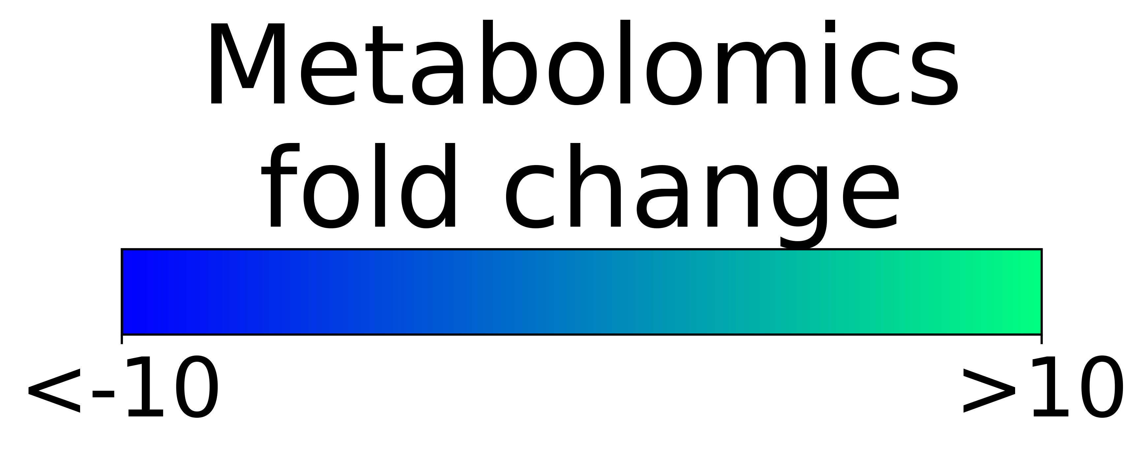
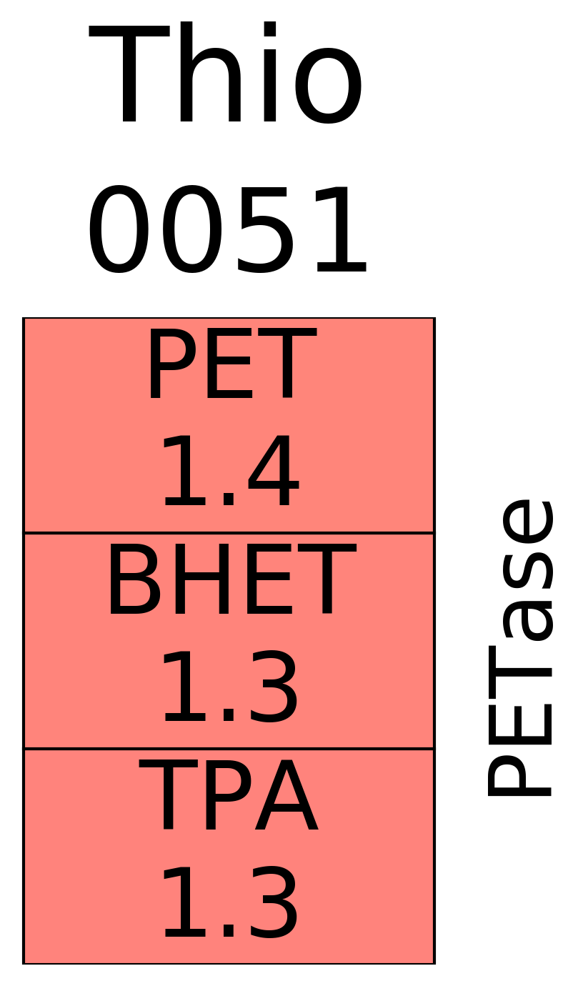
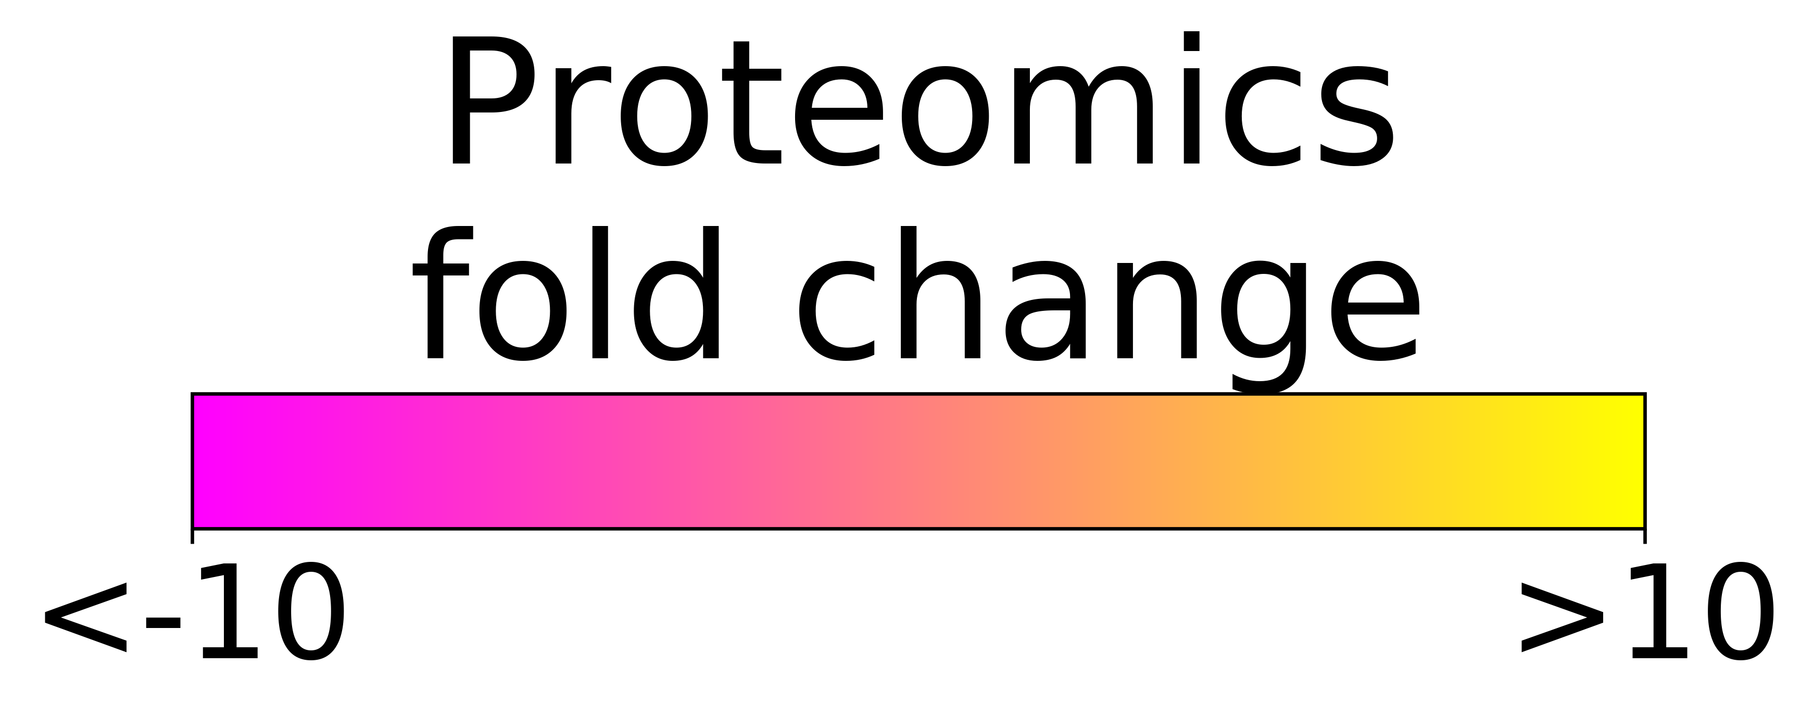
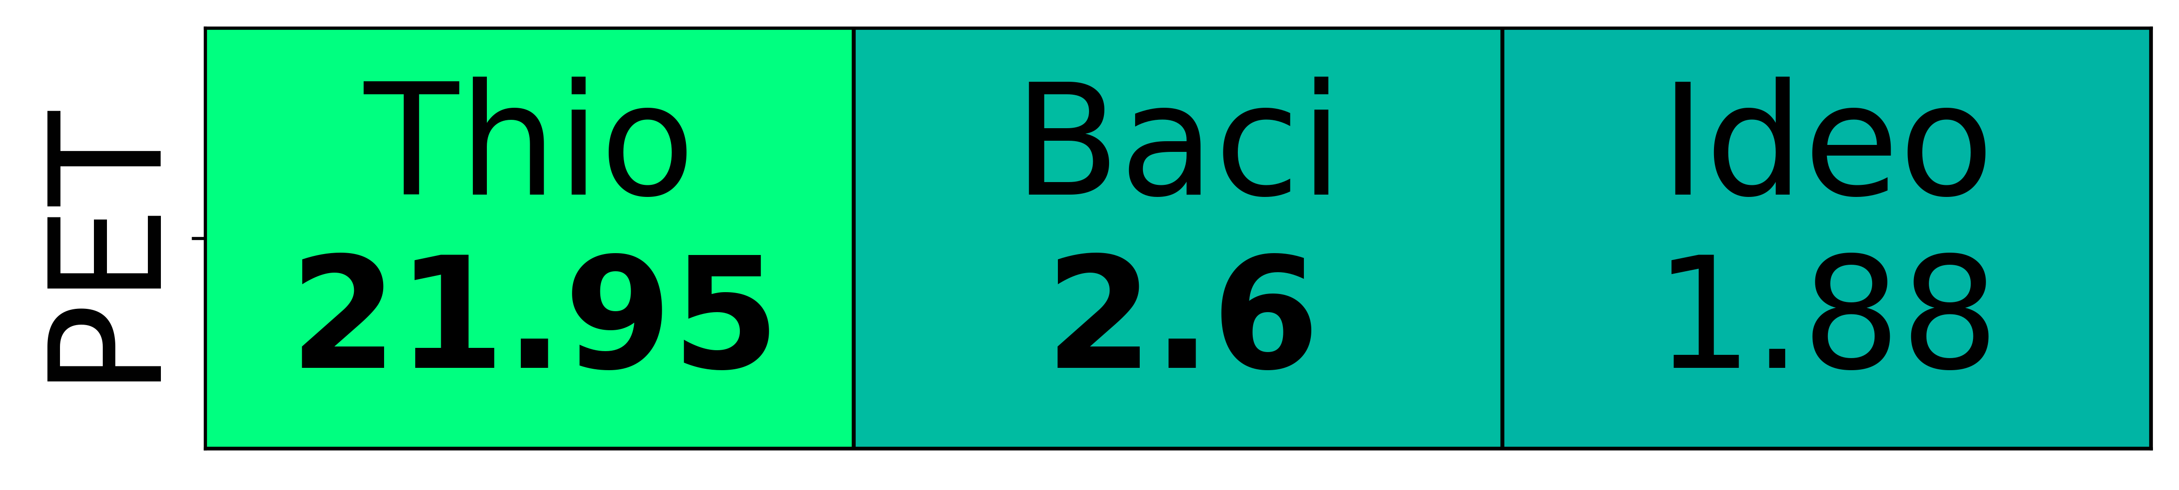
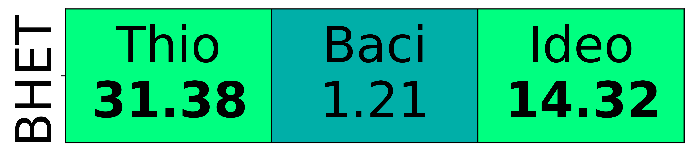
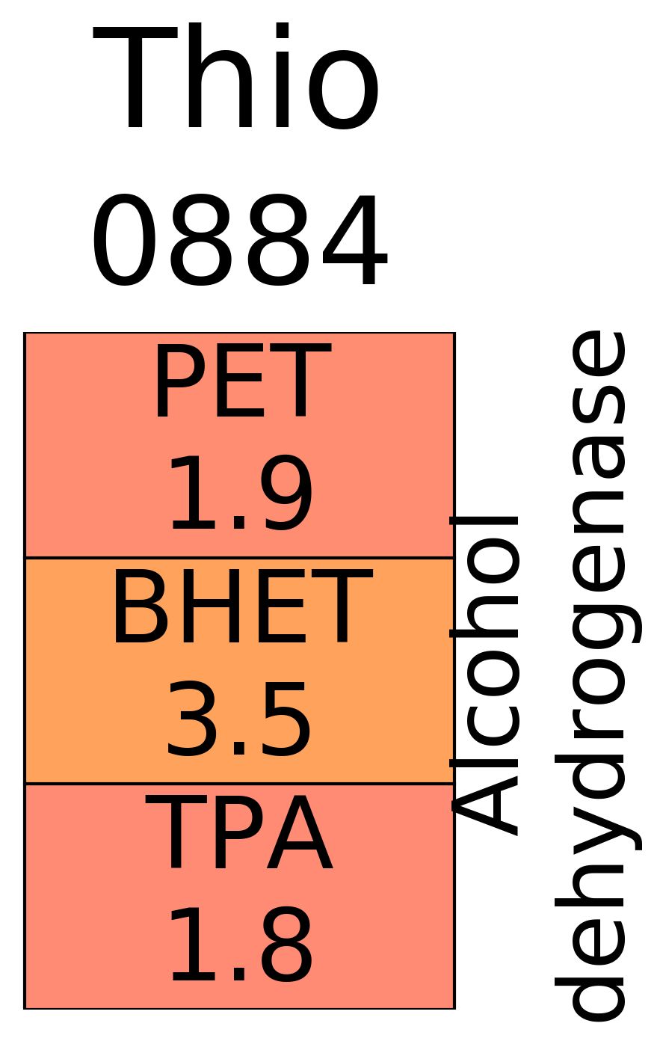

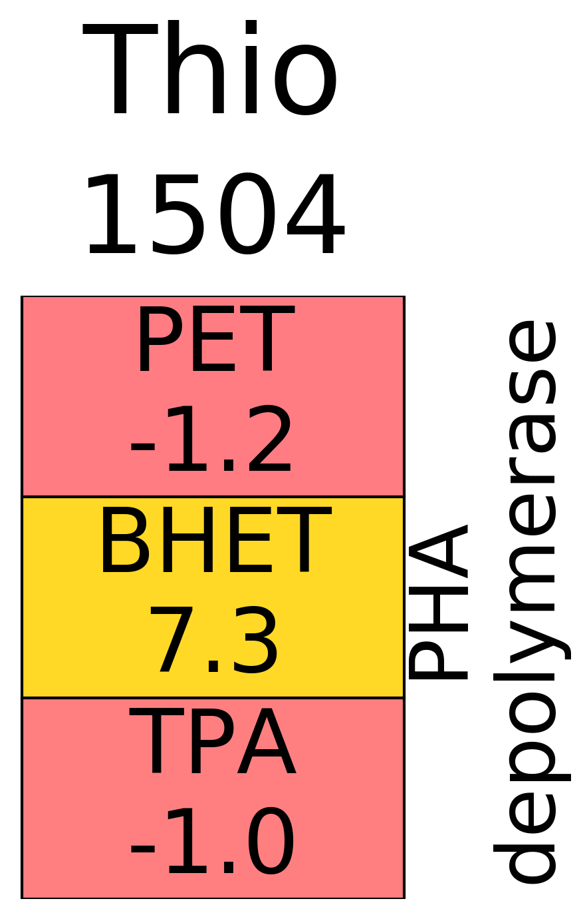
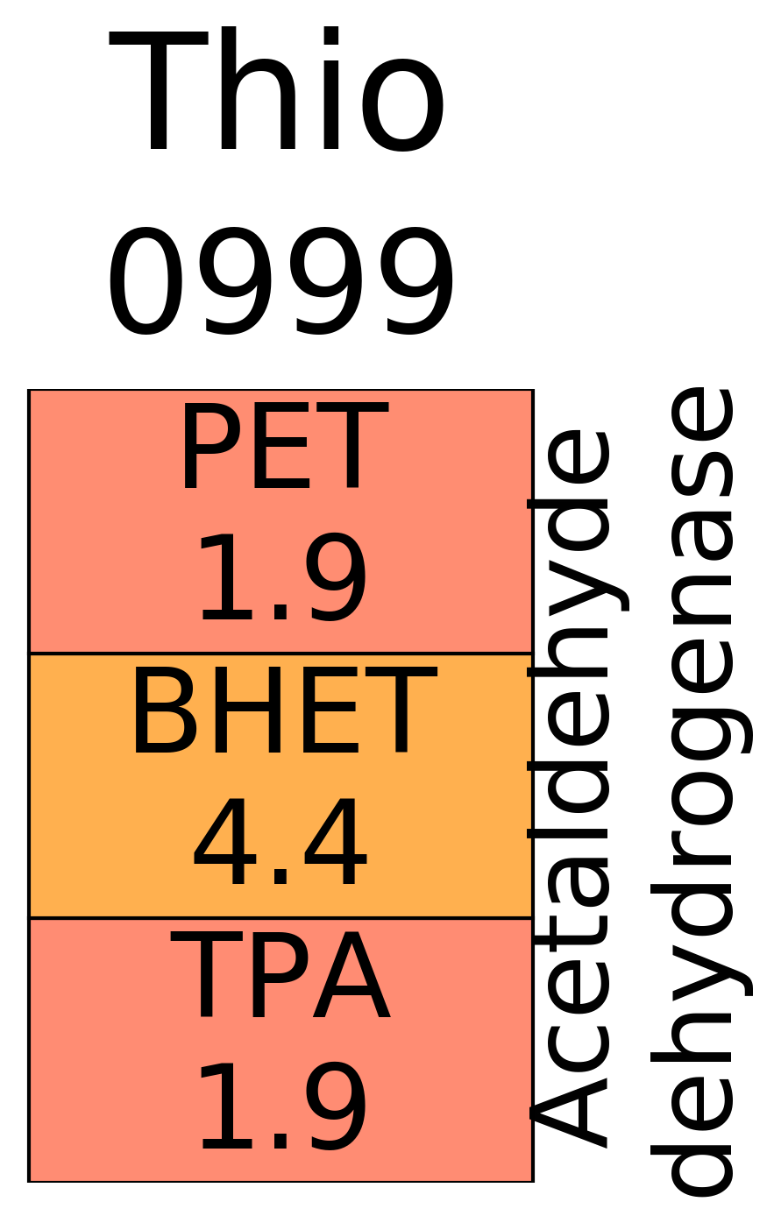
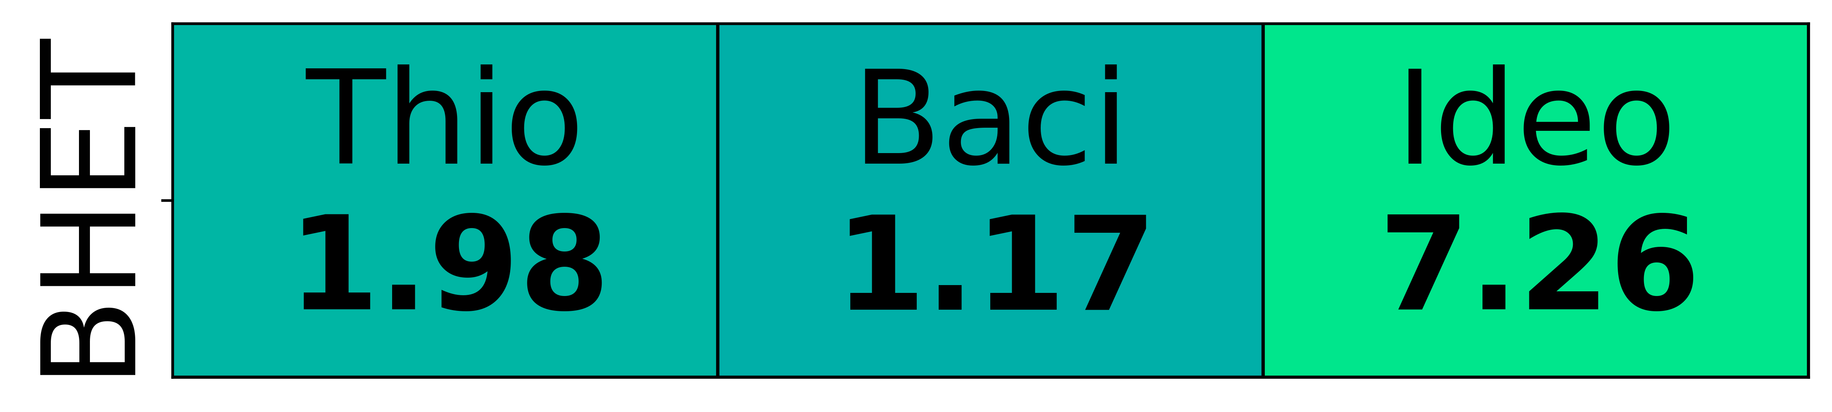
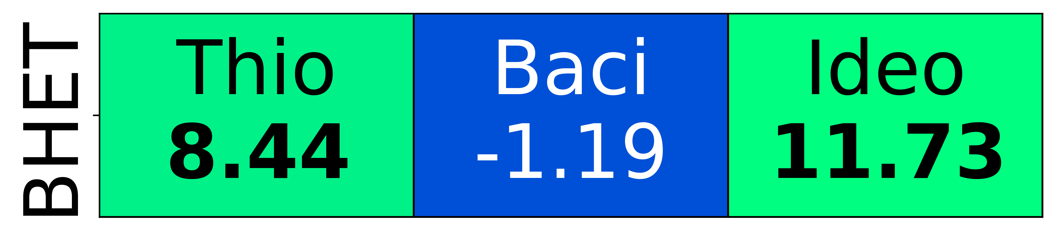
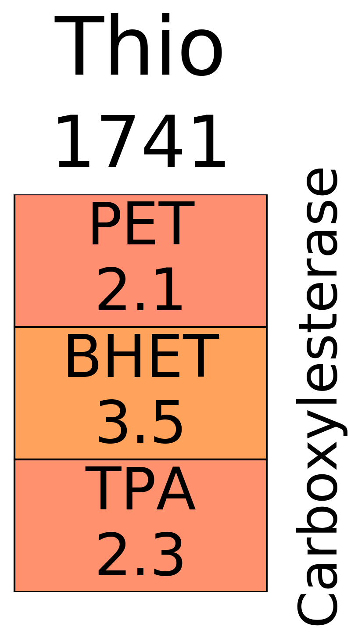
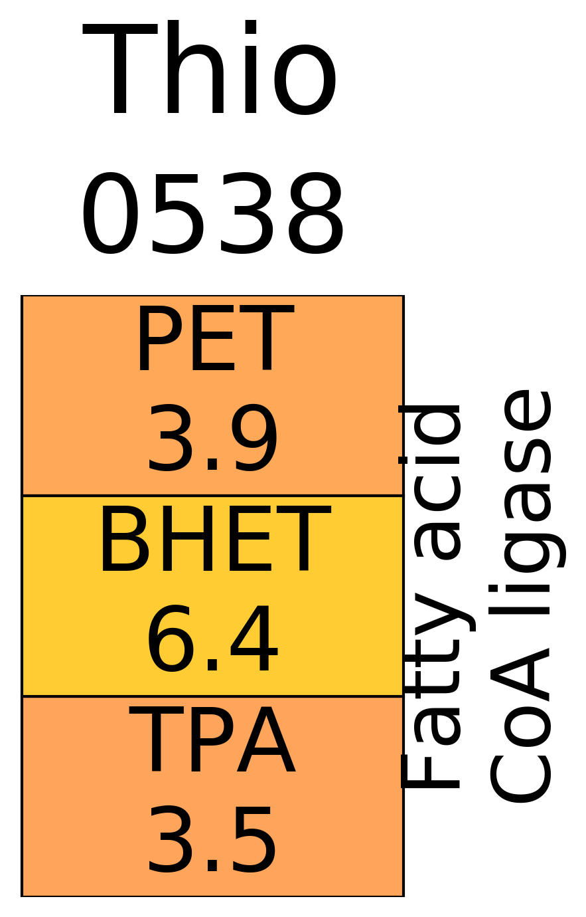

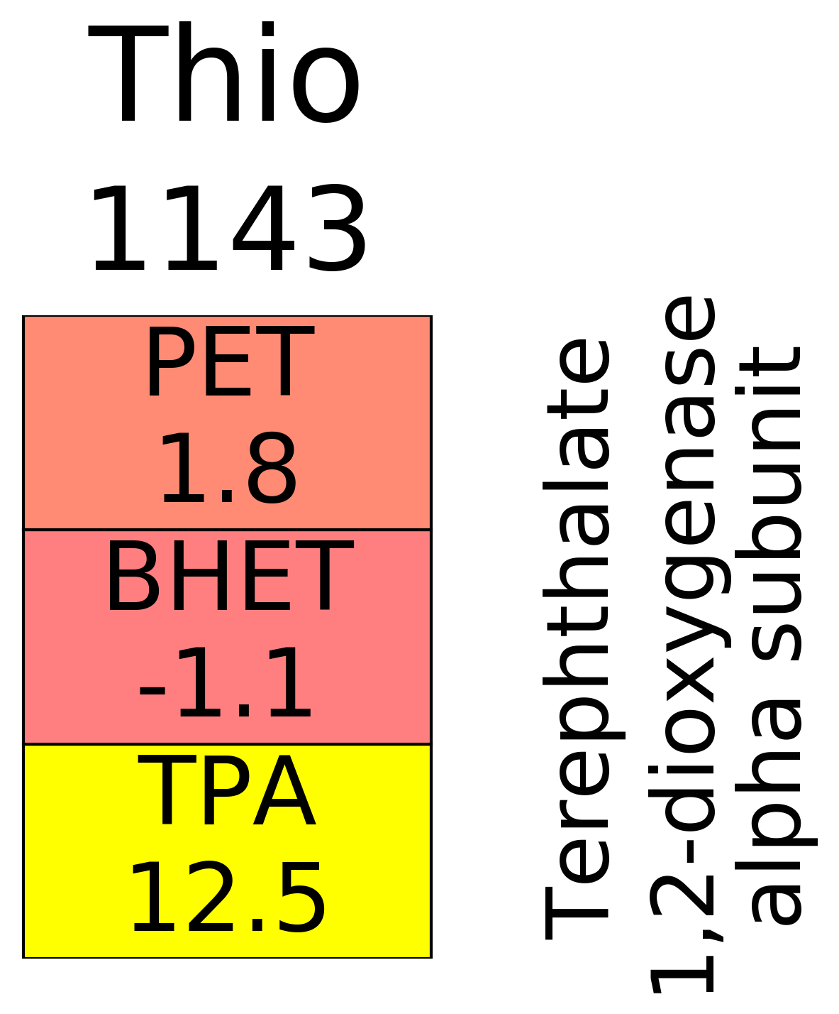
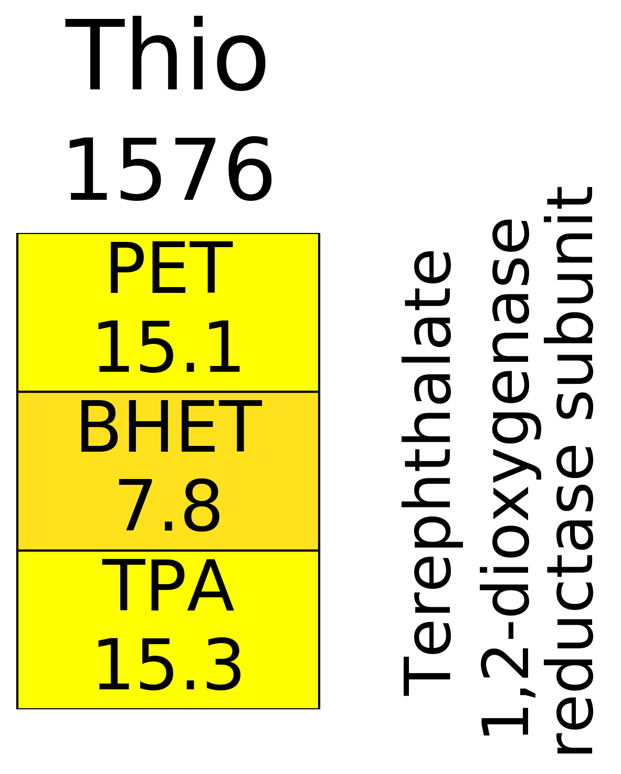
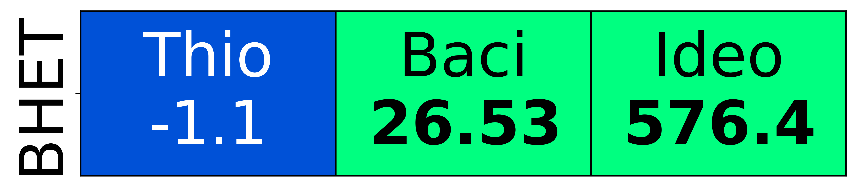
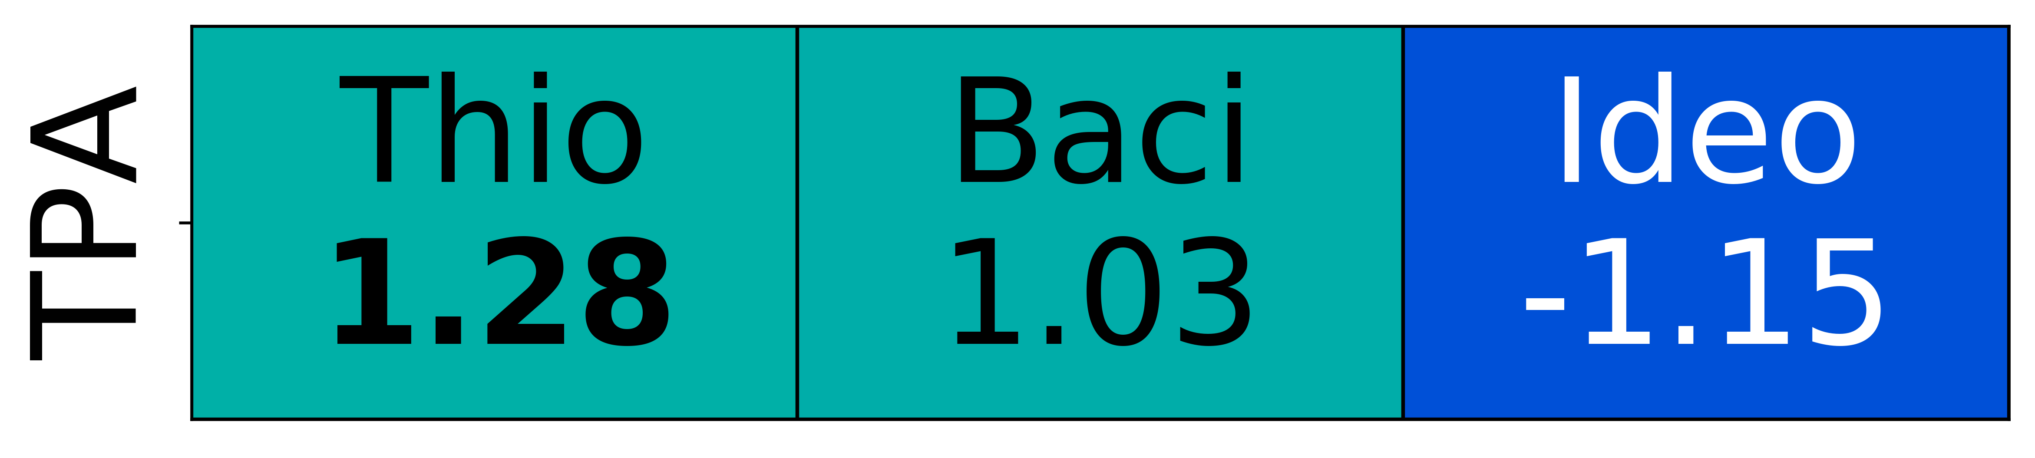
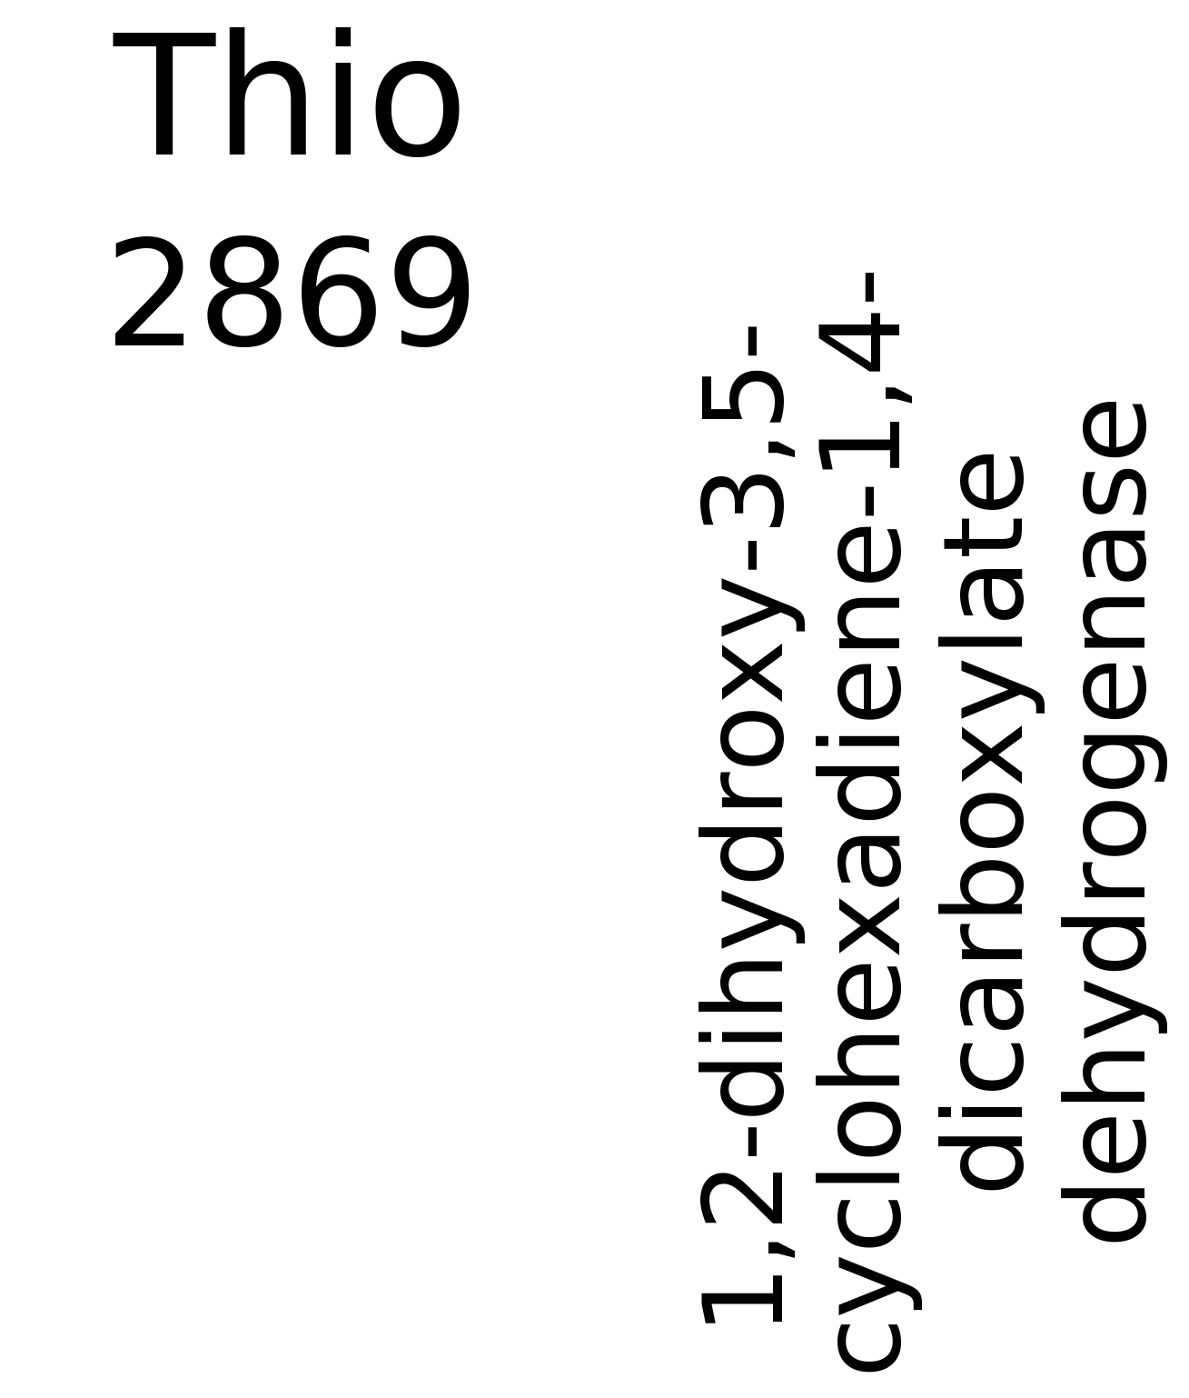
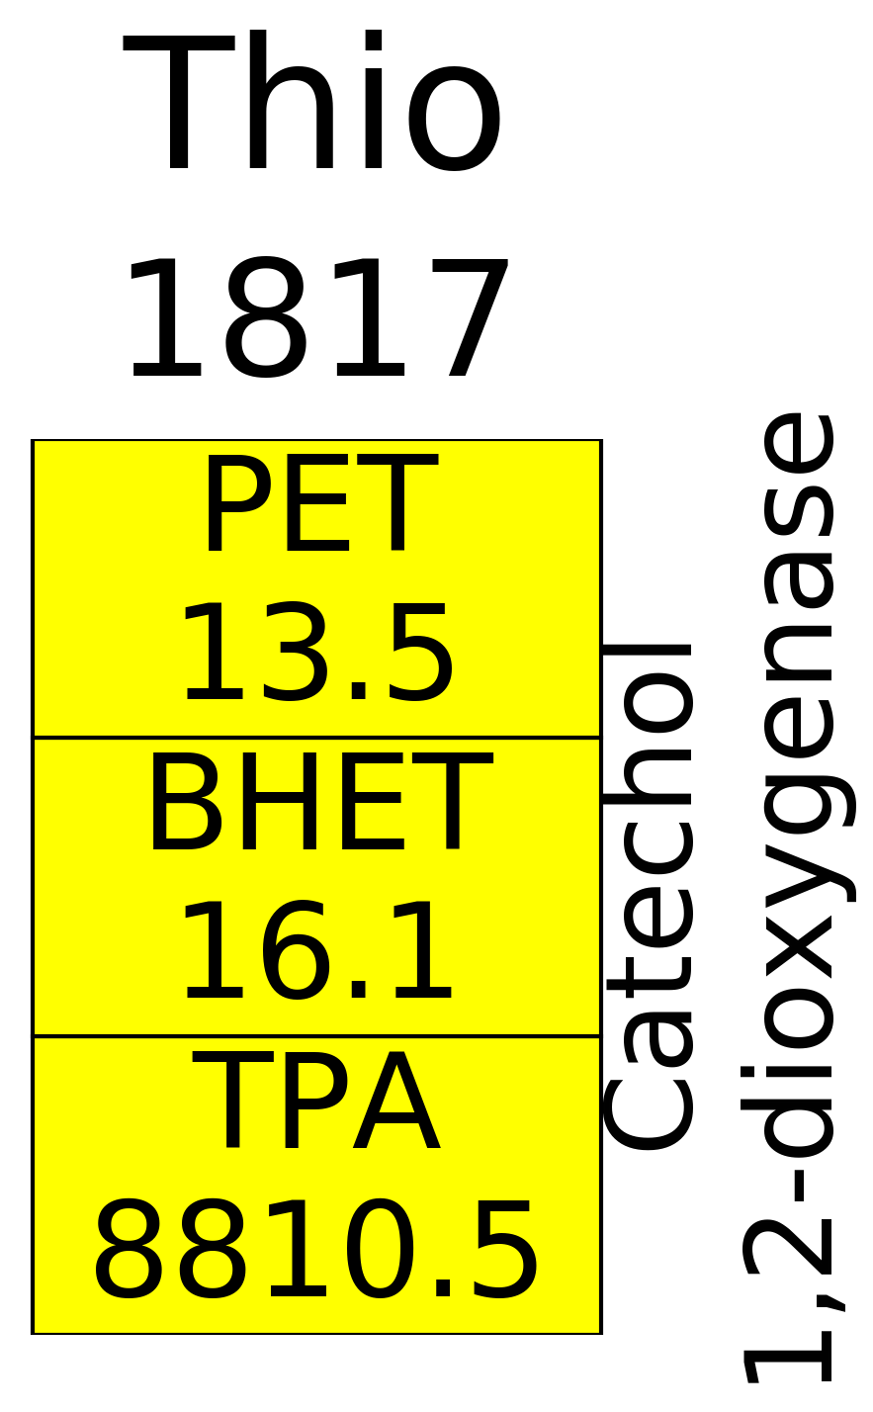
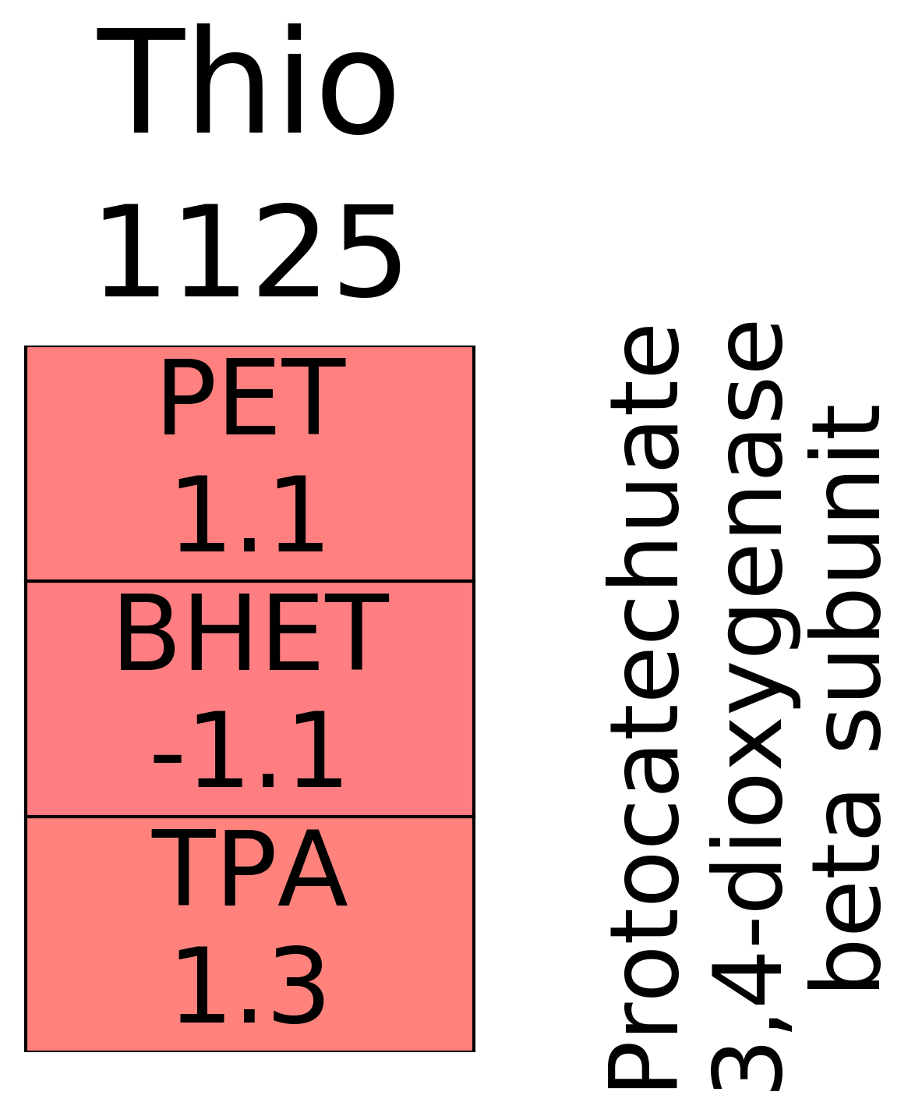
PET
EG
BHET
Acetaldehyde
MHET
TRAP
transporter
Acetate
TPA
TPA
Acetyl-CoA
﻿1,6-dihydroxycyclohexa-2,4-diene-dicarboxylate
TCA cycle
Protocatechuate
𝛃 -ketoadipate pathway
𝛃 -carboxy muconate
Notes:
PET treatment:
BHET accumulates in all bugs, but this is only significant for Bacillus (close to detection limit)
MHET is not detected
TPA is approximately the same as in the no inoculum controls for all bugs
BHET treatment:
Lower BHET concentration in Ideonella (significant), but not much difference for Thioclava and Bacillus
MHET accumulates in Thioclava and Ideonella (significant), not a lot of change for Bacillus
TPA accumulates a lot for Bacillus and Ideonella (significant)
Two other intermediates (C2 and C3) accumulate significantly in Thioclava and Ideonella
TPA treatment:
TPA is at similar levels to no inoculum control in all

