Slide 1
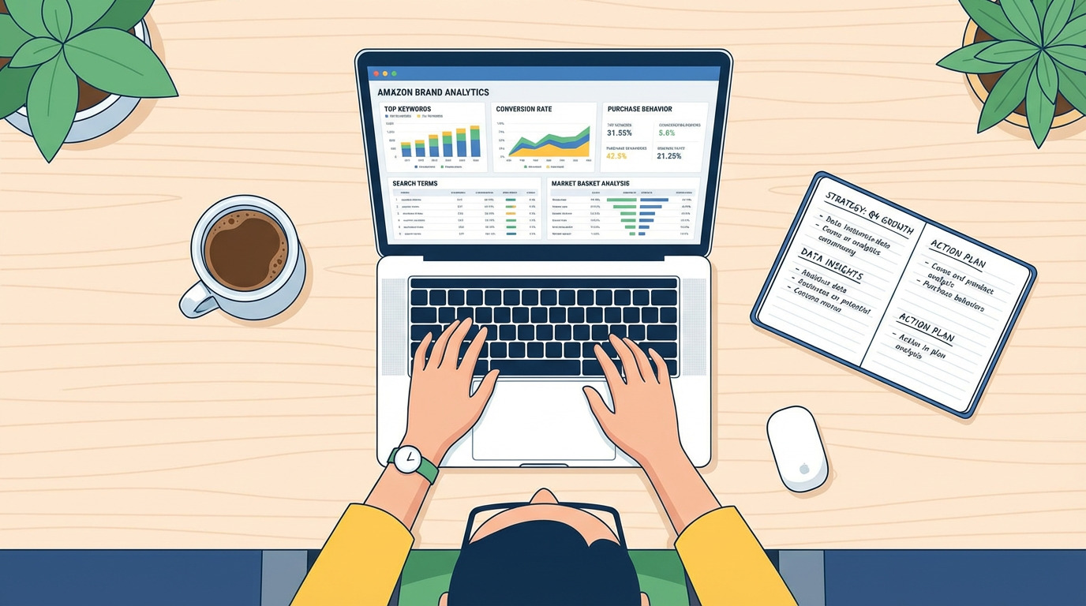
Smart Sales Analytics
Using Python & Tableau – Data to Decision
Presented By: Bhoomika R
[P05CC24S126002]

Slide 2
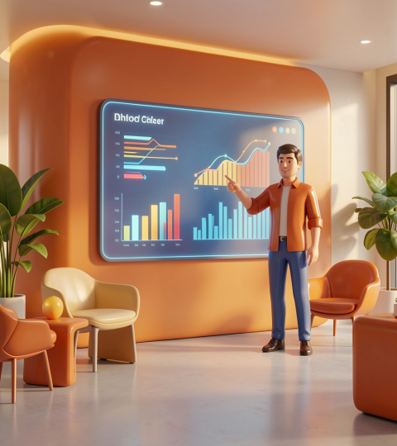
Introduction

Slide 3
Introduction
This project presents the Smart Sales and Customer Analytics System that transforms business data into actionable insights. The system uses Python for data preprocessing and machine learning tasks such as sales forecasting, customer segmentation, and product recommendation. The processed data is visualized through Tableau dashboards for interactive business intelligence

Slide 4
Project overview
Smart Sales Analytics is an end-to-end BI platform that ingests CSV/Excel sales data, performs preprocessing, modeling, and presents results via interactive dashboards.
Key modules: data processing, analytics & modeling (forecasting, K‑Means), and visualization for real-time business insight.

Slide 5
Motivation & scope
Organizations rely on descriptive reports and lack predictive insight. This project addresses demand forecasting, customer value segmentation, and product recommendation to improve inventory and production decisions.
Scope includes Python model development, Tableau dashboards, and validation through experiments.

Slide 6

Key objectives
Calculate KPIs (Sales, Profit, Orders)
Forecast future sales using ML
Segment customers automatically
Recommend best-selling products
Create interactive Tableau dashboards
Analyze sales performance

Slide 7

Literature Review

Slide 8
Literature Review
S.No | Author(s) | Year | Existing Work / Implementation | Limitation | How Proposed System Overcomes
1. | S. K. Sharma et al. | 2026 | Used ML models in Python for sales forecasting and churn prediction | Focus only on prediction, no visualization or recommendation | Integrates forecasting with Tableau dashboards , product recommendation, customer segmentation
2. | R. Patel & M. Shah | 2025 | Built Tableau dashboards for sales performance and KPI tracking | Only visualization, no predictive analytics or AI | Adds Python-based forecasting and intelligent analytics along with dashboards
3. | L. Chen & Y. Wang | 2023 | Implemented Python ETL and Tableau visualization for analytics | Limited automation and no complete decision support system | Provides end-to-end system with forecasting, clustering, and decision-making insights
4. | D. Kumar et al. | 2022 | Used forecasting models with dashboards for startup analysis | Focused only on forecasting and growth metrics | Extends system with customer segmentation + product recommendation + KPI dashboards

Slide 9

System Requirements

Slide 10
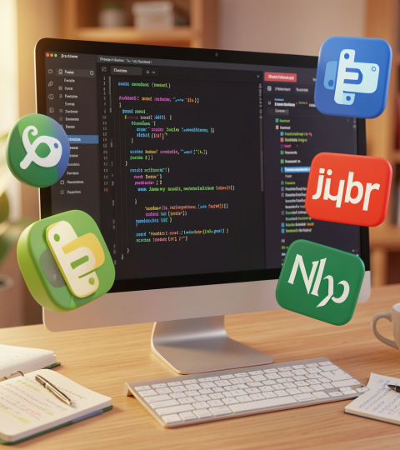
System Requirements
[ Software & libraries ]
Windows/macOS,
Python 3.9
Jupyter, Tableau Desktop/Public.
Key libraries: Pandas, NumPy, Matplotlib, scikit-learn.

Slide 11
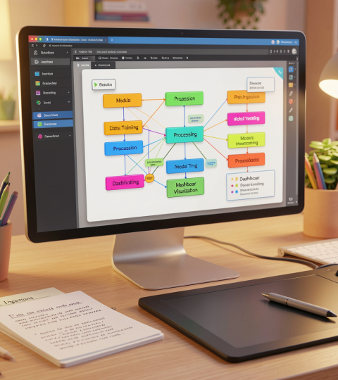
Design & Implementation

Slide 12
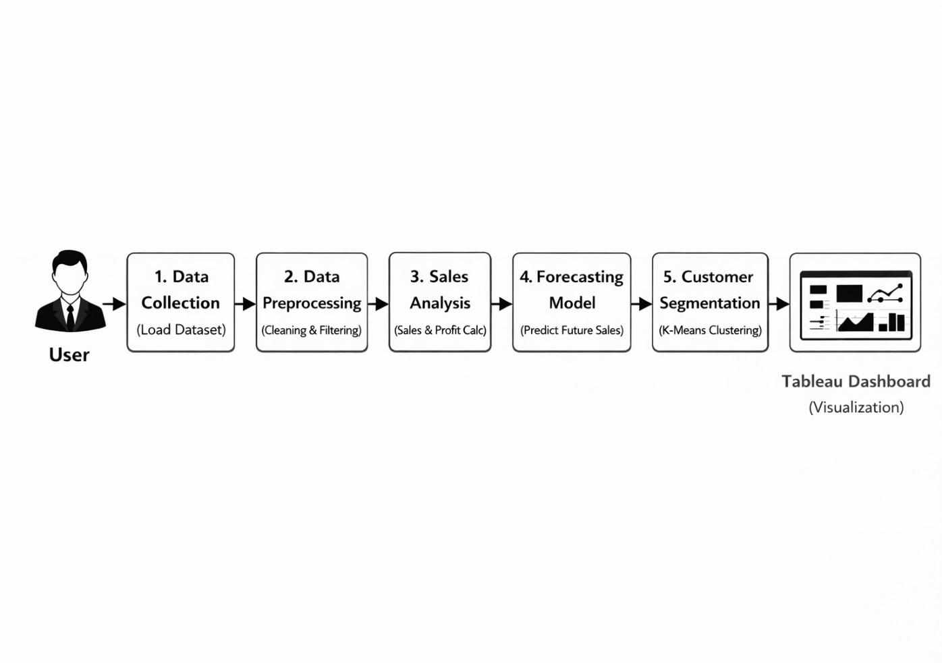
Design & Implementation
Flowchart :
3-layer architecture: Data Processing → Analytics & Modeling → Visualization.
Workflow: Upload dataset → preprocess in Python → apply models → publish outputs to Tableau dashboards for interactive analysis.

Slide 13
Algorithms & models (K‑Means, forecasting)
🔹 Regression Model (Sales Forecasting)
Uses historical sales data to predict future sales trends. Helps businesses plan inventory and production effectively.
🔹 K-Means Clustering (Customer Segmentation)
Divides customers into groups based on sales, profit, and behavior. Helps identify high-value and low-value customers.
🔹 Ranking Algorithm (Product Recommendation)
Sorts products based on total sales in descending order. Identifies top-performing products for better decision-making.

Slide 14
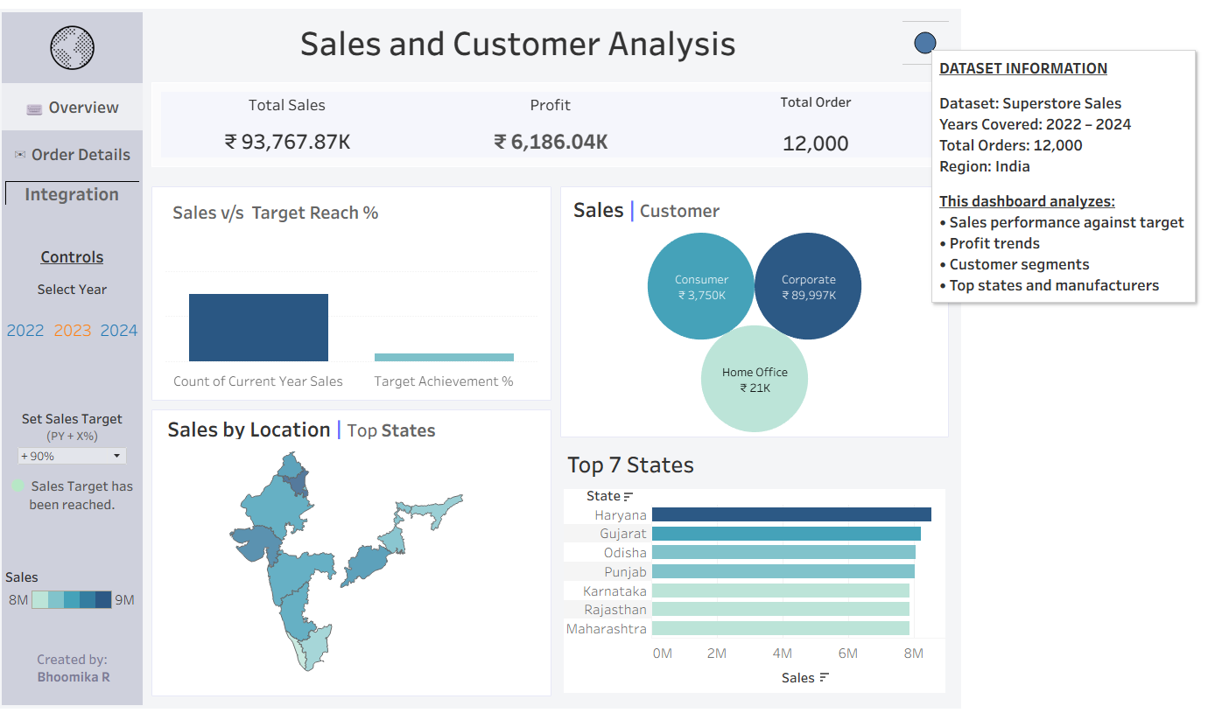
Data Visualization using Tableau :
Tableau makes your data look good and easy to understand. It creates interactive dashboards that help you spot trends and track sales metrics in a flash. Being able to see the data visually makes decision-making faster and more intuitive for everyone.

Slide 15
Conclusions
Using Smart Analytics and smart dashboards together makes sales forecasting a lot easier and more accurate. Python handles the heavy lifting behind the scenes, while Tableau helps your team see and understand data clearly. Together, these tools help businesses stay ahead and make smarter, faster decisions.
Future enhancements: Real-time data connectivity, advanced recommenders (collaborative filtering/market-basket), and web/mobile dashboard access.

Slide 16
Thank You..!

