Slide 1

DW Assignment 2
By: Ryan Liam
Notes:
Good morning Mr Joey, I am Ryan Liam and today I will be presenting on my Data Wrangling Assignment 2.

Slide 2
Problem Statement
To predict whether a driver will be in the Top Half
Hypothesis on feature importance:
Grid position is very important
Weather should play a role
Competing in their own country
Notes:
The first thing I did was to create a draft problem statement to work with which is to predict who will win the F1 race. From there, I created some hypothesis on which features are important. For example, grid position, weather and whether they are competing in their own country.

Slide 3
Datasets
Results
Race information
Driver information
Constructor information
Circuit information
Qualifying information
Weather (Web Scraped from the races URL)
Notes:
So the datasets that I am currently working with are the results, races, drivers, constructors, circuits, qualifying and weather.

Slide 4
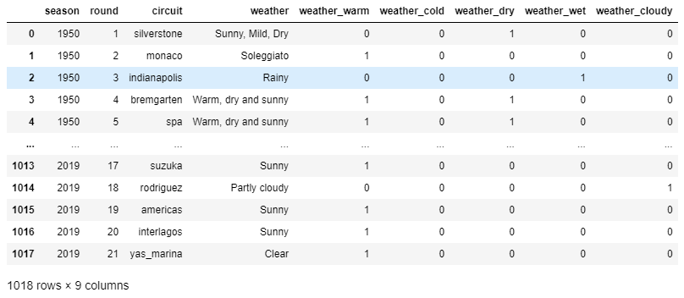
Weather dataset
Notes:
The weather dataset, I got it from web scraping the races URL. The last 5 columns were derived from a dictionary with the values based from the weather column. So I added this dataset because I think weather is an important factor in F1 races.

Slide 5
Incorrect Values
Problem #1
- Date of the race has incorrect values (e.g. 01/01/12022)
Problem #2
- Position has incorrect value of 99
Problem #3
- \\N in multiple columns
- Solution: Slice the date column
- Driver’s with position 99 have the highest points within their race
- Solution: Replace position 99 with 1
- Solution: Replaced it with null values
Notes:
There were also some incorrect values within the dataset. The date of the race has 1 infront of some of its year value. So To fix this I just slice the date column. The Position column has incorrect values of 99, and I discovered that all the driver’s with position 99 have the highest points within their race. So to fix this I just replace 99 with 1. Lastly, there were a lot of \\N in multiple columns, so I realized it just represented missing data. Therefore, I just replaced it with null values.

Slide 6
Missing Values
Altitude
Q_best, Q_worse, Q_avg
Weather
0.219% missing
No information about the Losail International Circuit altitude
Solution: Complete Case Analysis
Most of the null values were removed from the qualifying time columns by creating these columns
Still has 1.577% missing
One race with all the qualifying time missing
All of the other missing values are at the last positions
Solution: Complete Case Analysis
6.04% missing
Tried replacing with mode weather based on weather OHE by location
But Complete Case Analysis performed better generally
Solution: Complete Case Analysis
Notes:
OHE-One hot encoded (generalized weather)

Slide 7

Outliers
There are outliers in altitude, Q_best, Q_worse and Q_avg columns
All the methods worsens the model performance, so I did not use any of them
Winsorization
- Worsens ML model performance
Trimming based on boundaries found via Standard Deviation Method
- Trimming loses 1/8th of the data
Trimming based on boundaries found via Arbitrary Percentile Method
- Trimming loses 1/8th of the data
- Worsens ML model performance
- Worsens ML model performance

Slide 8
Categorical Encoding
We have two categorical columns to encode
One of which is Circuits which has 41 unique values
Another is Constructors which has 46 unique values
Ordinal and label encoding makes no sense
Target mean encoding will cause target leakage
One Hot Encoding better than Rare Encoding+OHE
Thus, I use One Hot Encoding
One Hot Encoding
Rare Encoding + OHE
Creates a lot of features
Consume a lot of memory
But performed the best
Encodes the values that have observations below 5% as Rare
Makes model less prone to overfitting
Led to test accuracy being better than train accuracy(Should not happen)

Slide 9
Numerical Transformation
Transform Distribution To Normal
Discretization/Binning
Q_best, Q_worse and Q_avg distribution is slightly right-skewed
Transforming it to normal may improve the model
Log Transformation, Reciprocal Transformation, Square Cube Root, Yeo Johnson, and Box-Cox.
All made the Linear Regression model perform worse
None of the transformation methods are used
Discretize or Bin Q_best, Q_worse and Q_avg to reduce impact of outliers
All made the Logistic Regression model perform worse
None of the transformation methods are used

Slide 10

Feature Engineering (Create new Columns)
Season (Derived from cleaned date column)
Driver’s Full Name
Driver’s Age
Driver’s home (boolean)
Constructors’ home (boolean)
Best, worse and average qualifying time
Top Half (target)
Notes:
So from the merged dataset I have also created new features. Season, Driver’s full name, Driver’s age, whether it’s the driver’s/constructor’s country and lastly the target column which is whether they won the race.

Slide 11

Scaling
To have features within a similar scale
Tried Standardization, Mean Normalization, MInMax Normalization, Mean Absolute Scaling and Robust scaling
MinMax Normalization performed the best
Thus, I use MinMax Normalization

Slide 12

Models Performance
Naïve Baseline
Logistic Regression

Slide 13
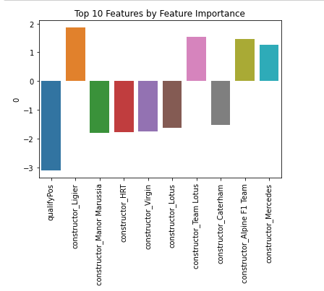
Feature Importance
Most important feature is Qualifying Position
Most of the constructors mentioned in the Top 10 Feature by importance have very little observations.

Slide 14
Possible Improvements
Further experiment with different combinations of encoding or transformation methods
01
Find better methods of imputing the missing values instead of just removing them
02
Look into the availability of more granular hourly weather data, which we can use.
03
Investigate why the constructors with lesser observations have high feature importance
04
Notes:
\

Slide 15

The End
This Photo by Unknown Author is licensed under CC BY-NC-ND
Notes:
Thank you for your time.

