Slide 1
Documentation EOD Shiny App
Franck Theeten, RMCA
v.0.1 2021 09 25

Slide 2
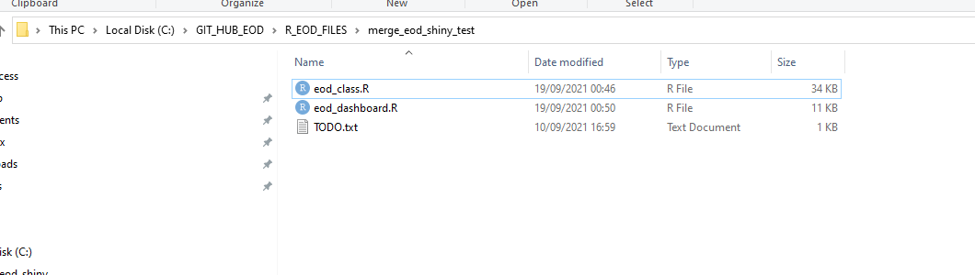
Loading
Put
eod_class.R (object oriented package)
eod_dasboard.R (runnable Shiny interface)
…in the same folder

Slide 3
Loading
eod_class.R contains two classes written in the RC object-oriented paradigm of R
Eod
Main class for EOD
Extract metadata
Normalize
Using the "changepoint" package for inflexion point
Or abitrary threshold
Identify landmarks
0-time on higher peak, lower peak or halfway
Shift normalized signal to left and right
Generate GG plot graphs
Some code for the Fourier transform

Slide 4
Loading
eod_class.R contains two classes written in the RC object-oriented paradigm of R
EodCluster
Cluster of several files
Create a consolidated file from several Mormyroscope files (using SpecimenTag number to identify a single specimen)
Read this consolidated file
Access each EOD individually and access them via the public interface of "Eod"
Superimpose plots and save as ".png" file
Average the signal and export it into a new consolidated file

Slide 5
Loading
Note
Currently, EodCluster only recognizes (reads and write ) the format "v1" or Mormyroscope (12 metadata lines)

Slide 6
In R Studio
Lauch "eod_dashboard.R" as a Shiny app

Slide 7
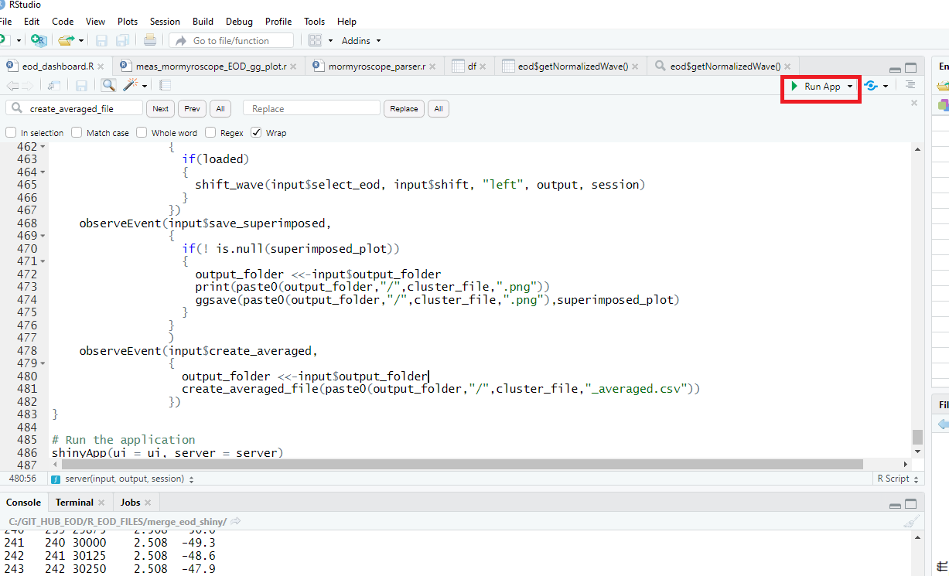
In R Studio
Lauch "eod_dashboard.R" as a Shiny app

Slide 8
In R Studio
Note
In Shiny, your computer acts as a web server, while this app is intended as a desktop one
Technical complexity:
the input files must be uploaded to the app before being read + Shiny rename the uploaded files with an arbitrary name and out them in a a TEMP folder !
Two file names to handle (original and physically uploaded)
Hence the field keeping the source folder, as the destination to write new files

Slide 9
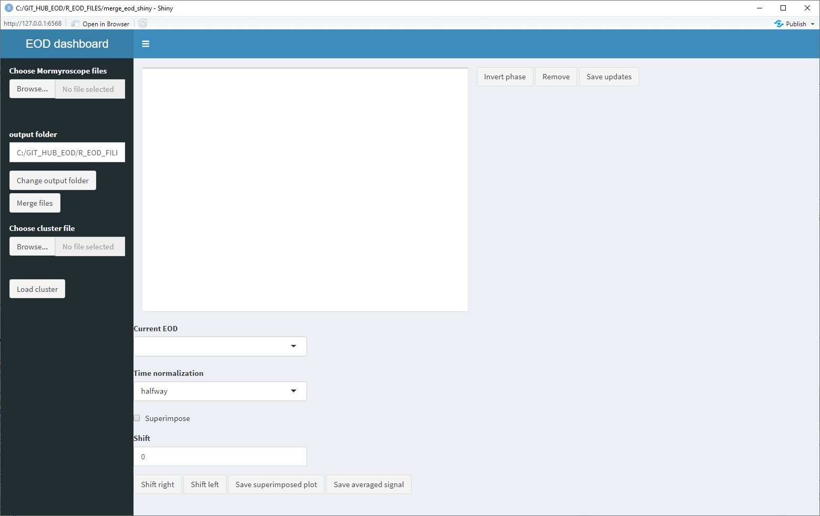
The Dashboard…

Slide 10
A. Create a consolidated file from several Mormyroscope file
Select the Mormyroscope file via
Choose Mormyrsocope file/ browse
(first input of the side panel)

Slide 11
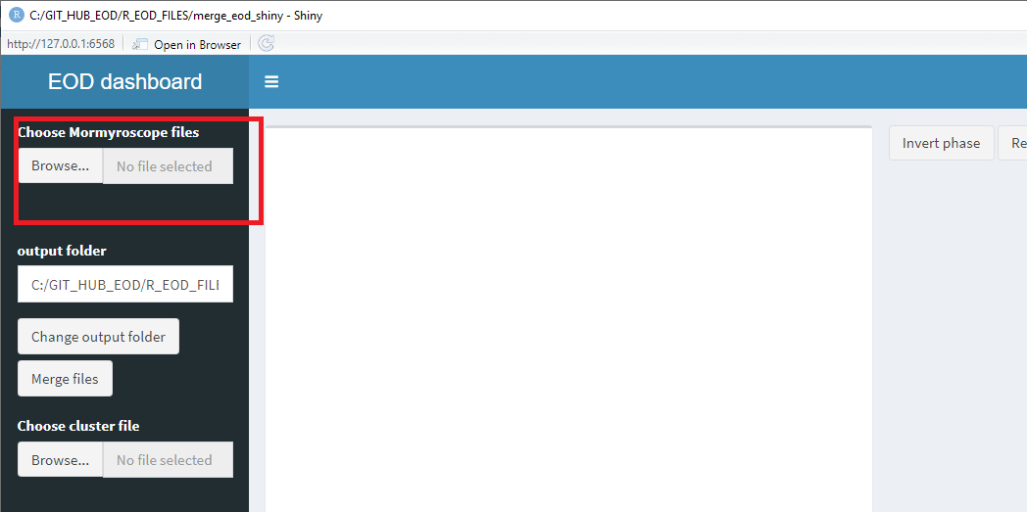
A. Create a consolidated file from several Mormyroscope file

Slide 12
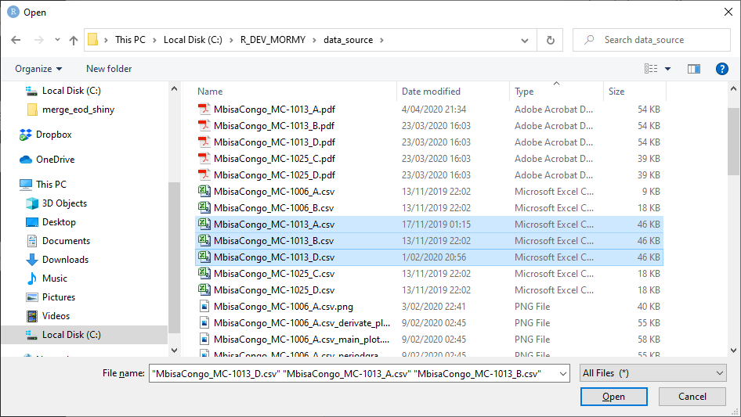
A. Create a consolidated file from several Mormyroscope file
… a file explorer should appear

Slide 13
A. Create a consolidated file from several Mormyroscope file
… a file explorer should appear
Tip: use the left "ctrl" key to select several file
You can choose input files corresponding to everal fishes with different TagNo
One merged file will be created for each tag number

Slide 14
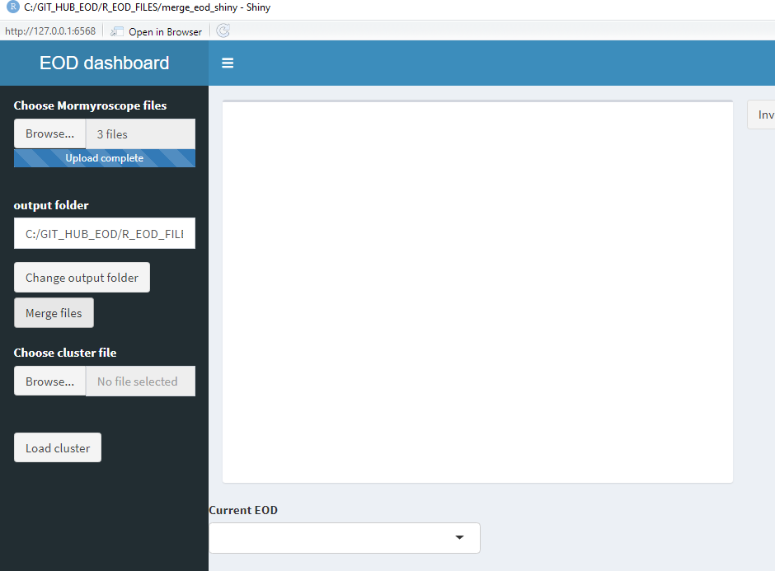
A. Create a consolidated file from several Mormyroscope file
The merged filed are stored in this folder (should be the folder containing the source by default)
Click on "merge files" button to generate the files

Slide 15
A. Create a consolidated file from several Mormyroscope file
If the file already exists this pop-up appears to specify whether the user wants to re-create it or append new data to an existing cluster…

Slide 16
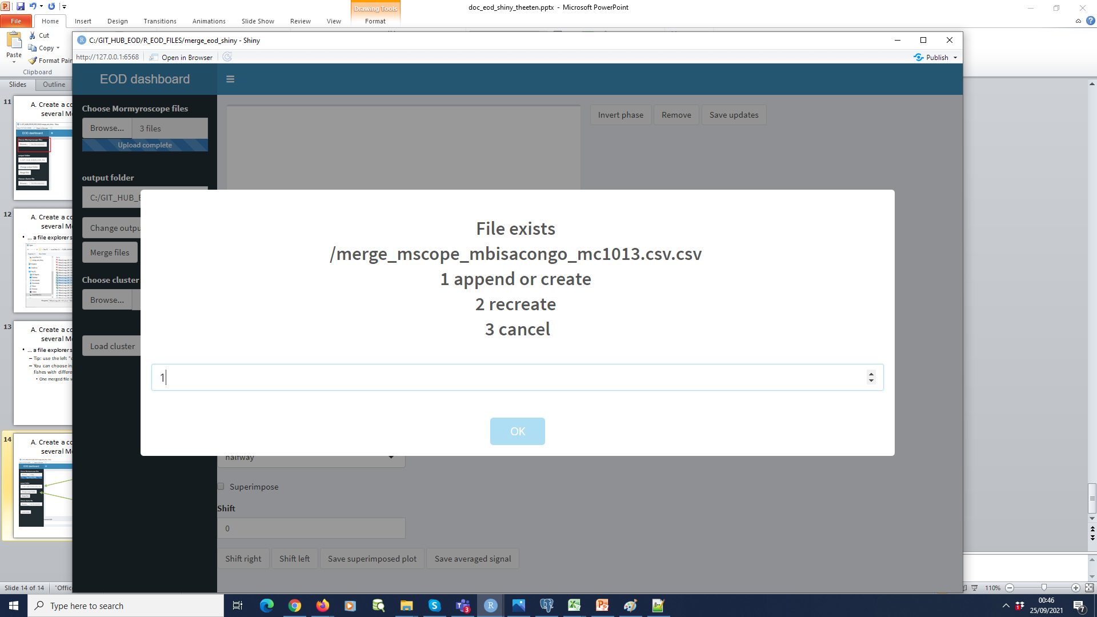
A. Create a consolidated file from several Mormyroscope file

Slide 17
A. Create a consolidated file from several Mormyroscope file
If the file already exists this pop-up appears to specify whether the user wants to re-create it or append new data to an existing cluster…

Slide 18
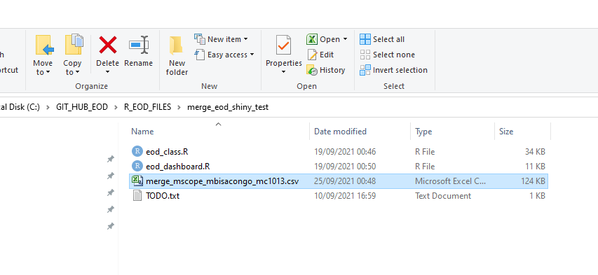
A. Create a consolidated file from several Mormyroscope file
The file should be generated in the ouput folder…

Slide 19
A. Create a consolidated file from several Mormyroscope file
Pattern in filename:
"merge_mscope"+ project_name + shared_tagno+ ".csv"

Slide 20
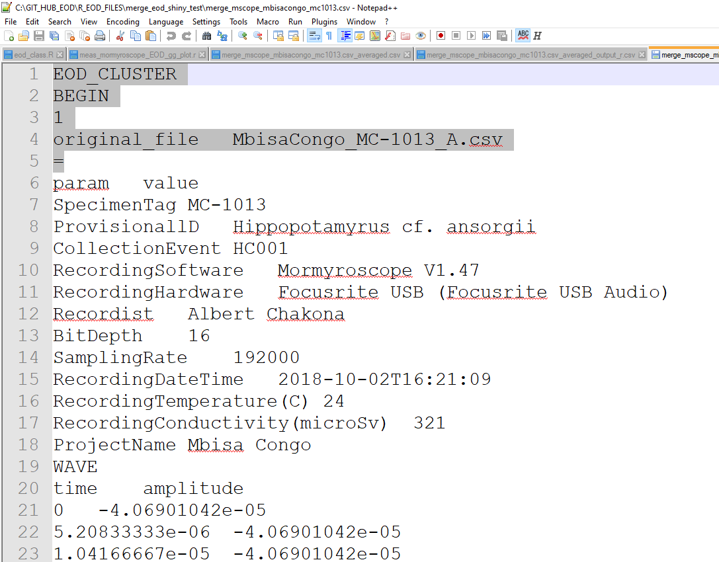
File structure
1 EOD_CLUSTER at the begining of the file
2 Start of EOD record
3 Index of EOD record
4 original file (note the tab) for the record
5 row with "="
6 metadata with header (v1)

Slide 21
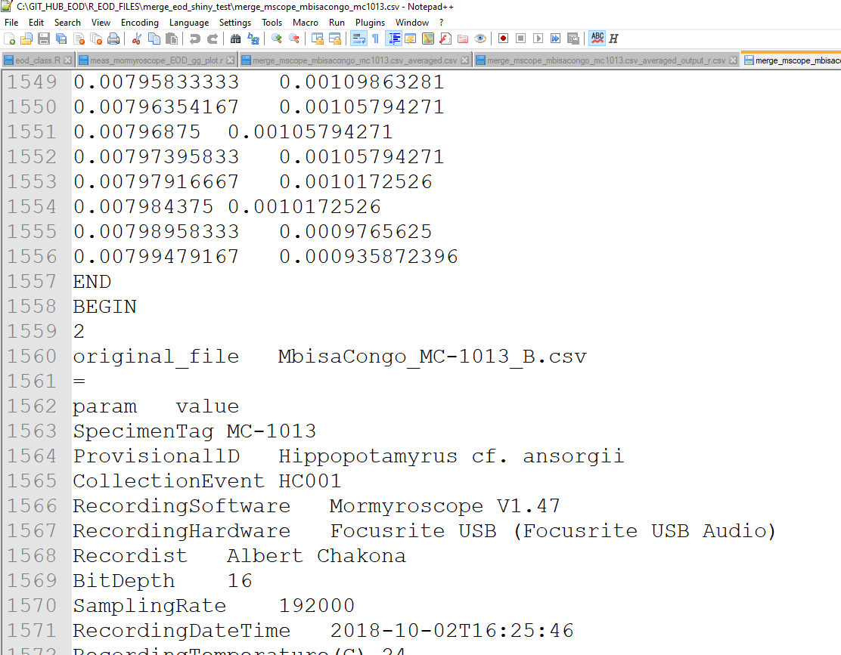
File structure
9 END after "WAVE"
2 BEGIN of a next ew wave
3 index of next wave

Slide 22
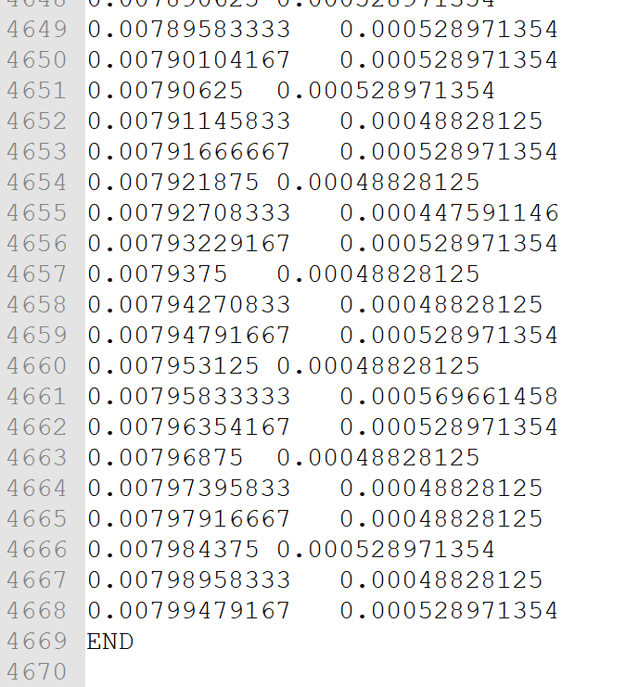
File structure
No specific keyword at the end of the cluster file (to ease further appending operations) but not the END keyword for the termination of the wave

Slide 23
File structure
IMPORTANT :
File is in UTF-8 encoding
Beware of diacritics and accents in the metadata
(Don't forget that Ms Excel works with extended ASCII and may lose them)

Slide 24
Load cluster file
Select the merged file via
Choose Cluster file/ browse
(second input of the side panel)

Slide 25
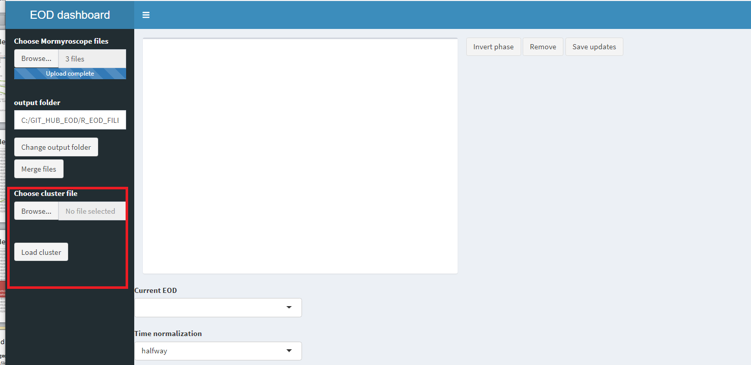
Load cluster file

Slide 26
Load cluster file
Note
Only one cluster file can be loaded at a time (in principle should be specific to one fish)

Slide 27
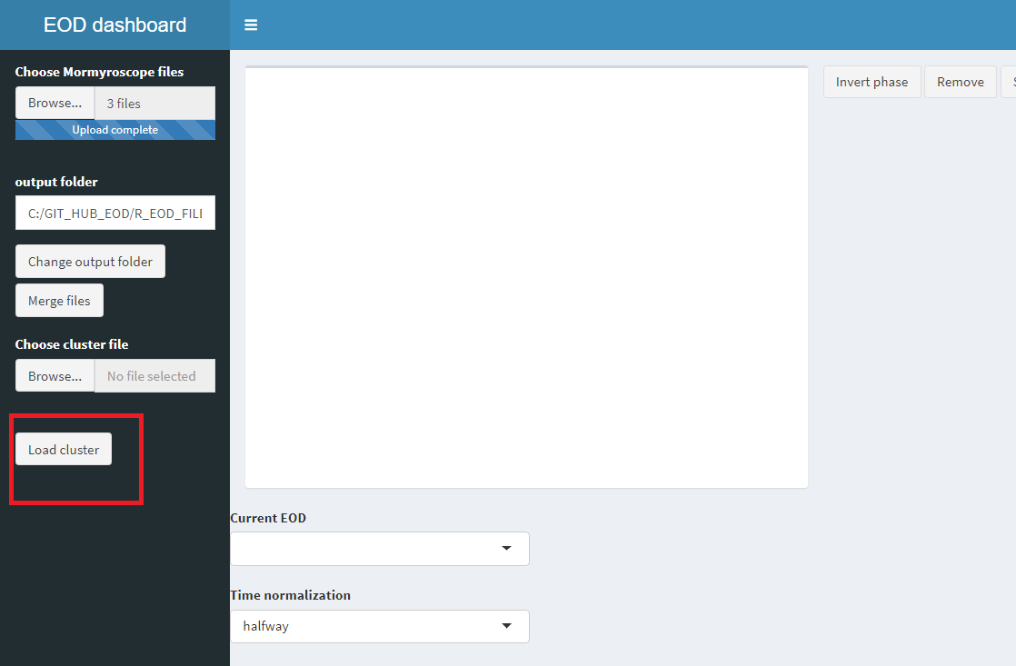
Load cluster file
…and then click on "load cluster"

Slide 28
Load file
The normalized wave appear in the central pane

Slide 29
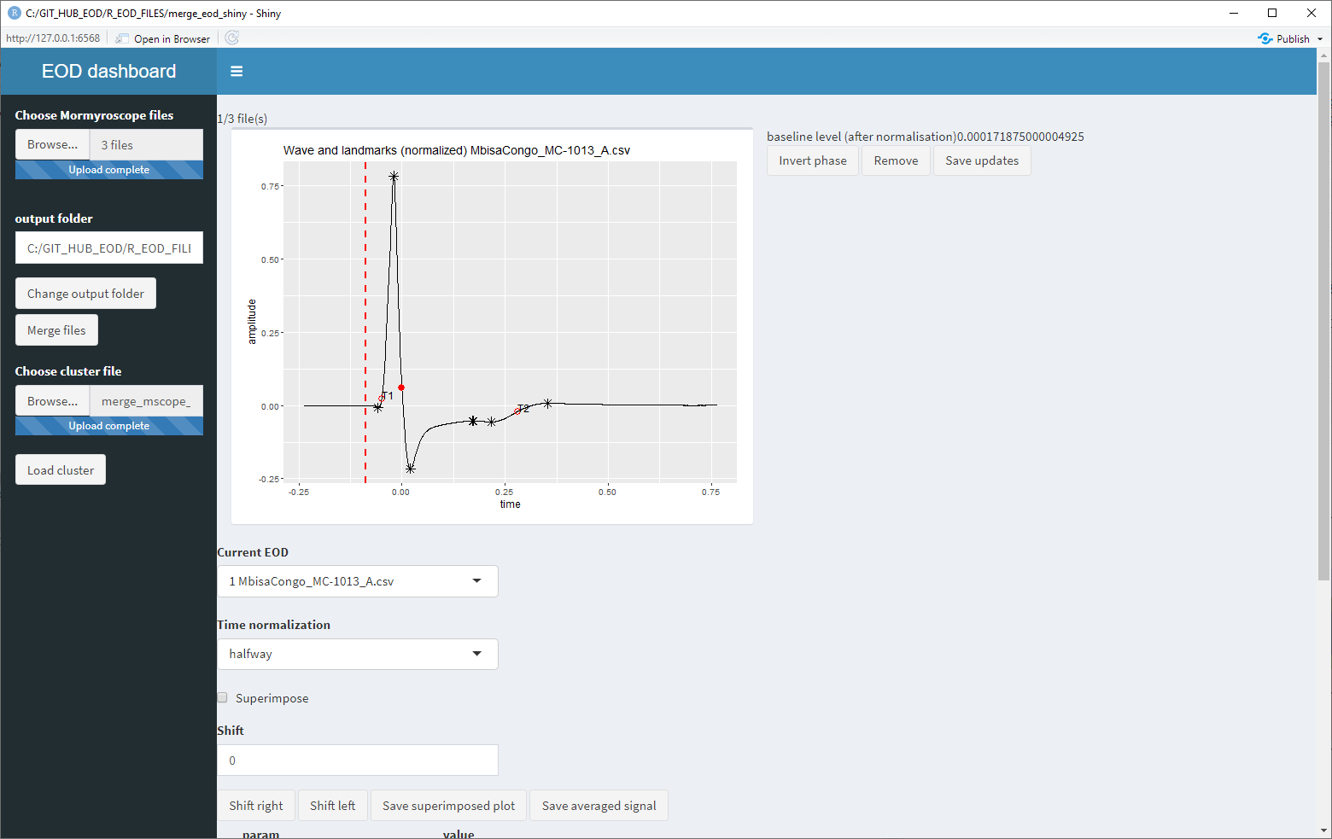
Load file

Slide 30
Navigate from one wave to another

Slide 31
Chose X axis for time 0
Minpeak
Max peak
Halfway between the two

Slide 32
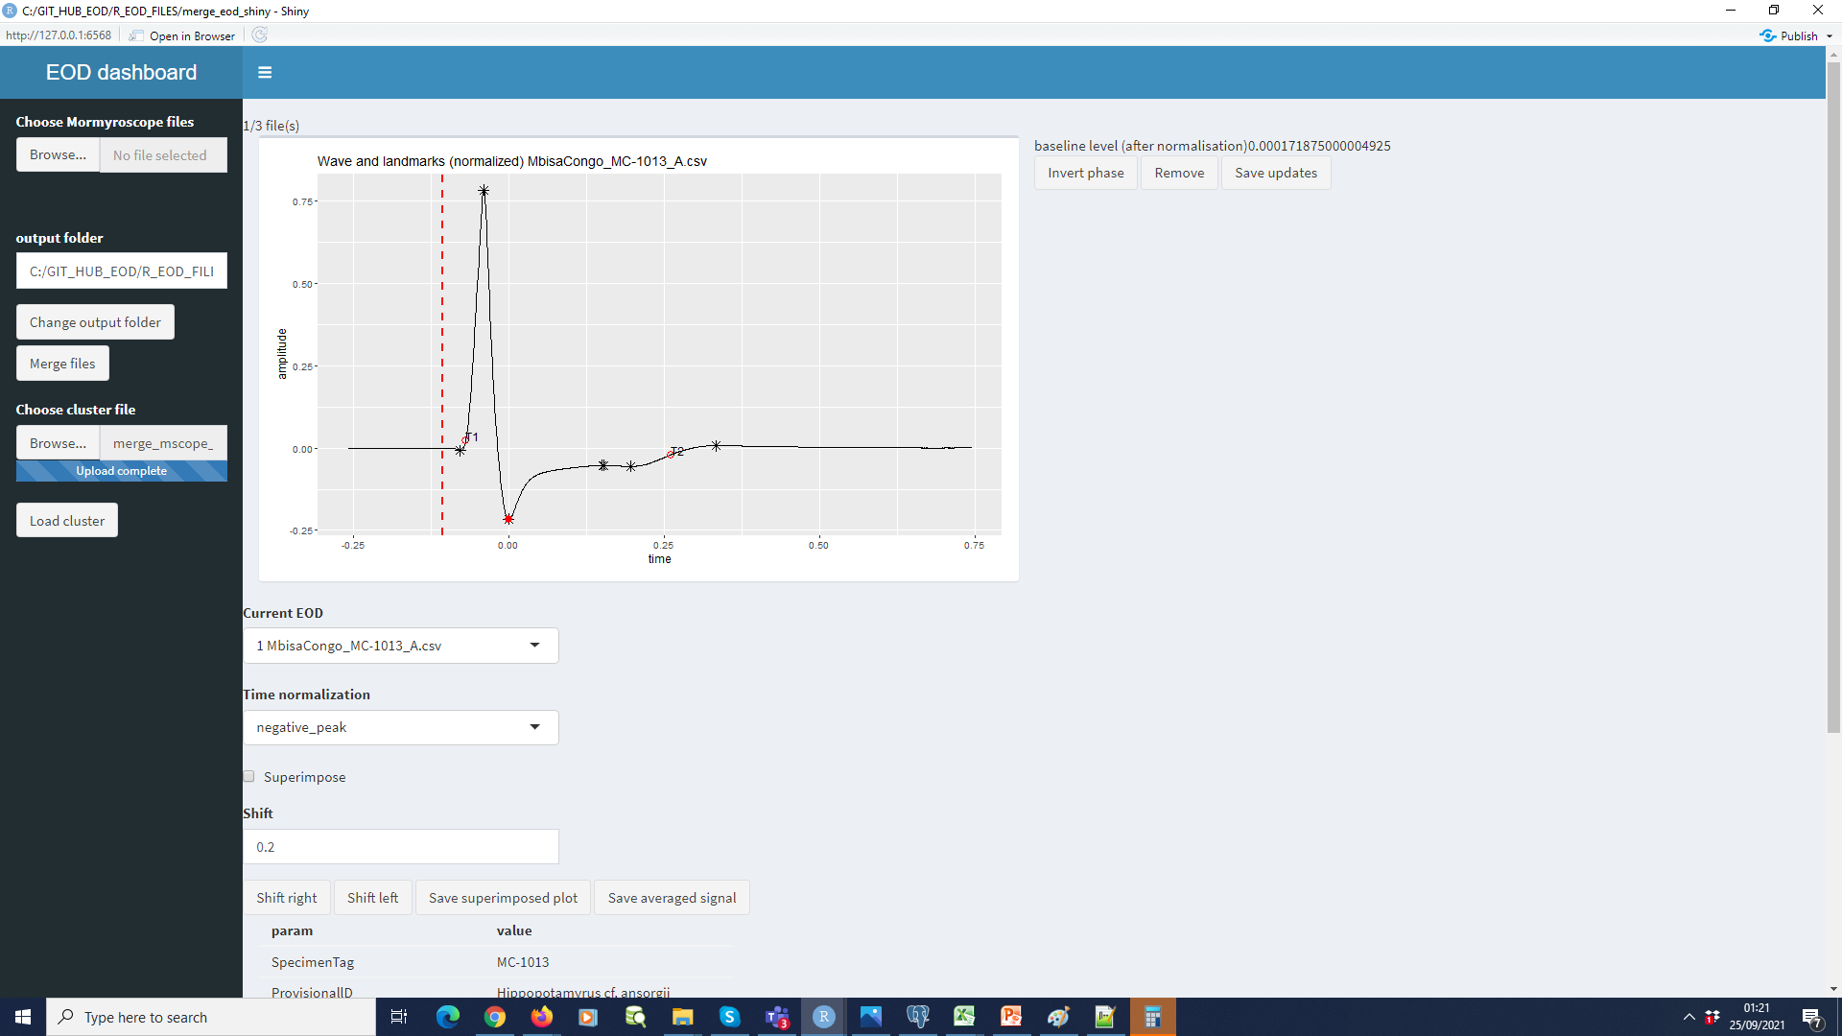

Slide 33


Slide 34
Note the metadata of each wave below

Slide 35
Possibility to inverse a phase

Slide 36
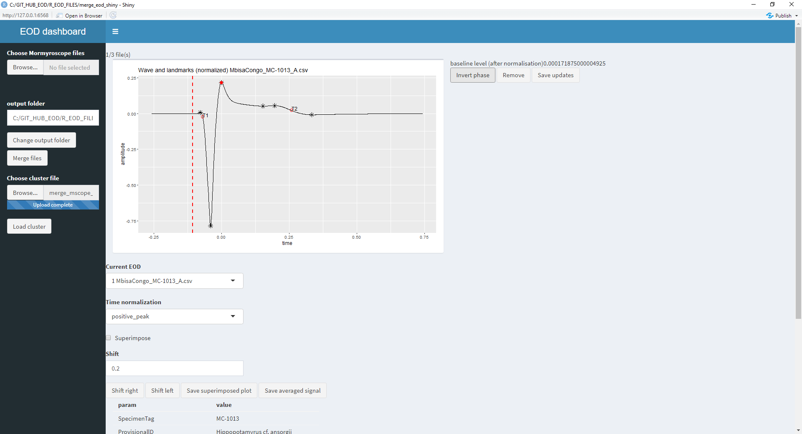
Possibility to inverse a phase

Slide 37
Discard the current wave from the set

Slide 38
Save the modifications (phase and discarded data)

Slide 39
Save the modifications (phase and discarded data)c
Important : saves the original signal (not the normalized form)

Slide 40
Save the modifications (phase and discarded data)
Original file is kept with " .bck" suffix

Slide 41
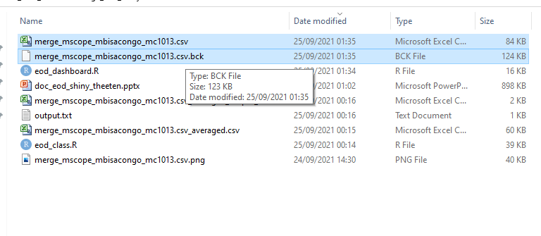
Original file is kept with " .bck" suffix

Slide 42
Superimpose the plots of the cluster

Slide 43
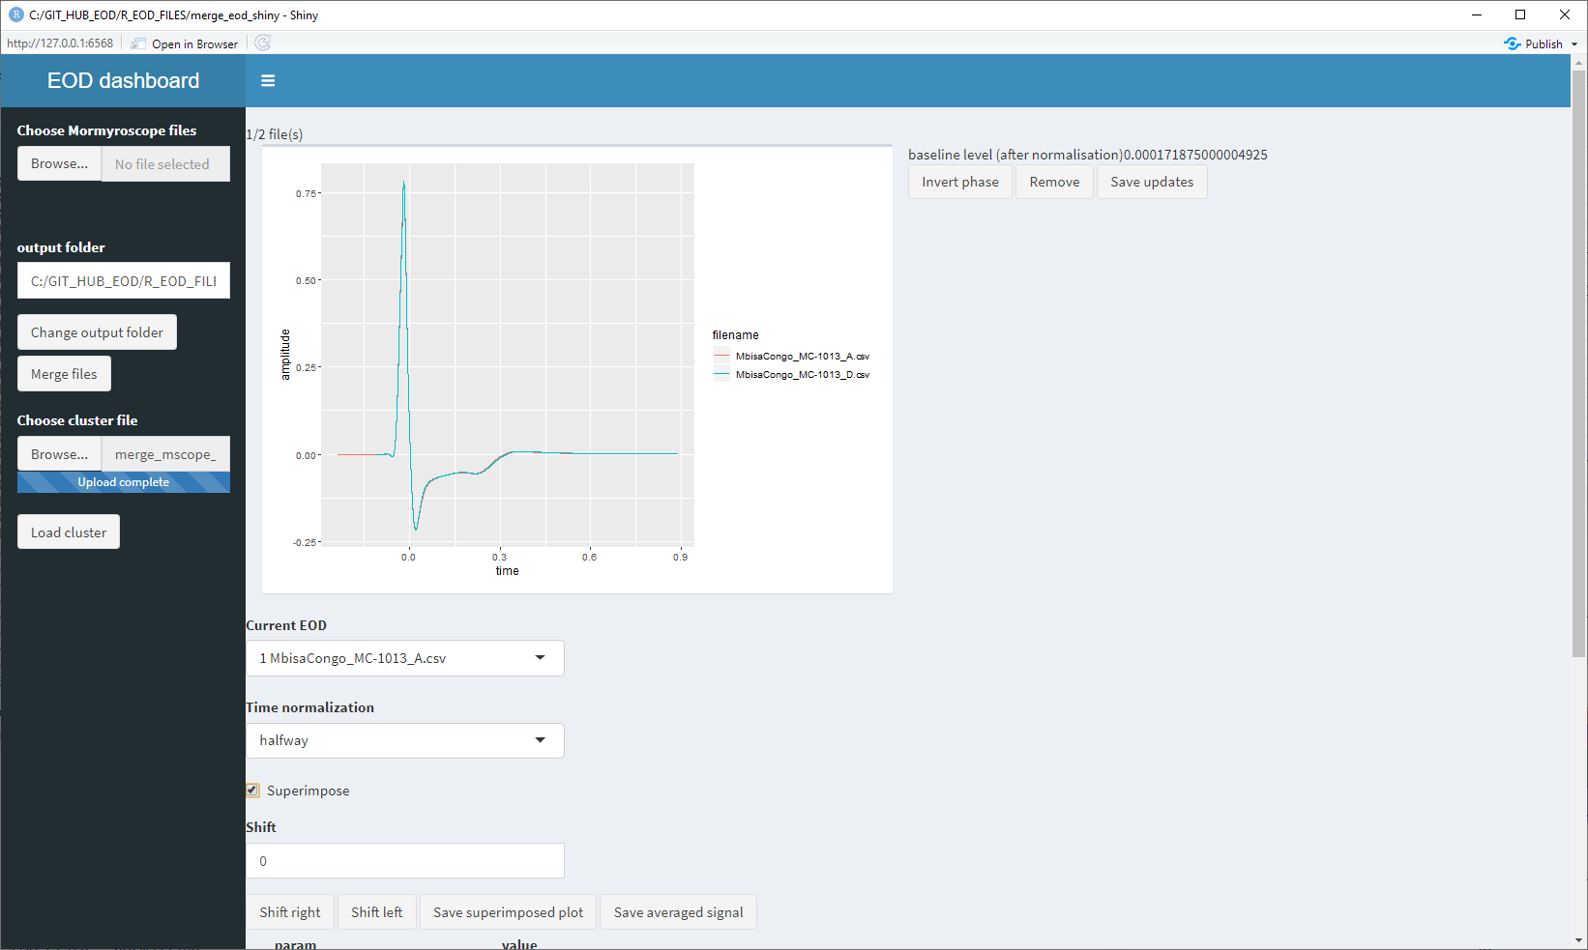
Superimpose the plots of the cluster

Slide 44
Save the superimposed plot (by using GGplot) in the project output folder

Slide 45
Superimposed plot
Template name for the superimposed pplot

Slide 46
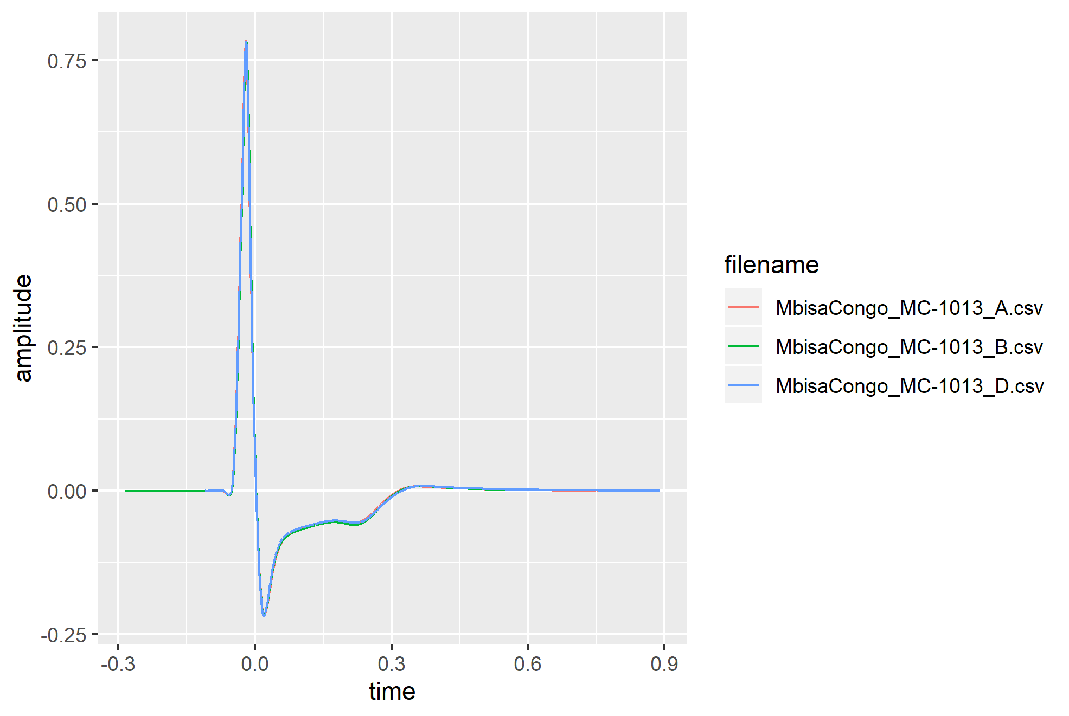
Superimposed plot

Slide 47
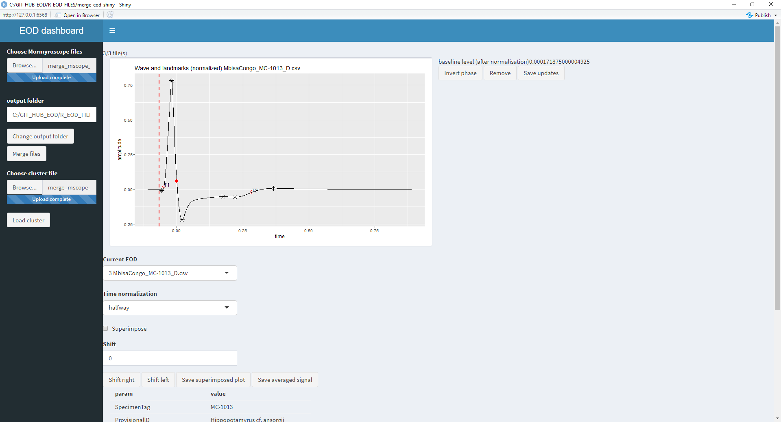
Shift the averaged signal left or right

Slide 48
Note : maximal value is 1.0

Slide 49
Note : baselien level for the head (shift right) or tail (shift left) is given there

Slide 50
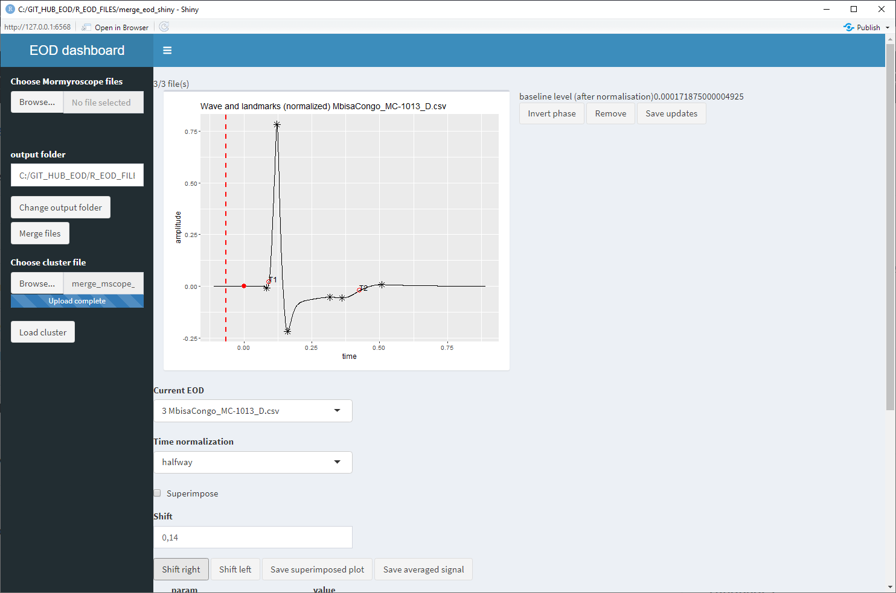
Applying a t= 0.14 delay on the previous signal

Slide 51
Average the nomalized signal (with phase correction, removal and shift) and save to a new file in Mormyroscope V1 format

Slide 52
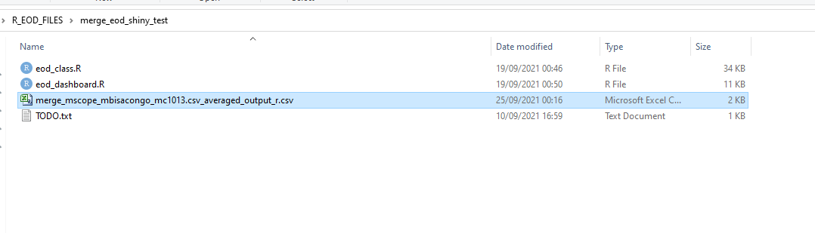
Averaged file
Template for the averaged file (note the "_averaged_output_r.csv" suffix)

Slide 53
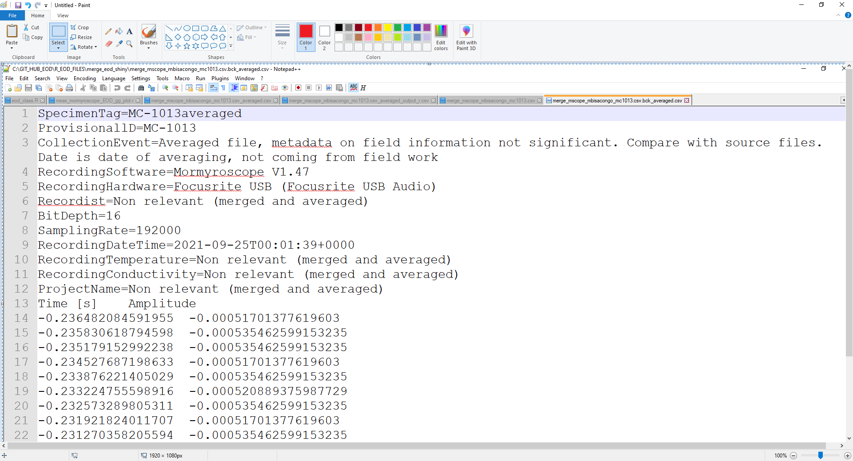
Averaged file
Note the auto-generated metadata to indicate that field data are not relevant

Slide 54
Averaged file
This file should be usable in any sofwtare able tr ead Mormyroscope V1 files !

