Slide 1
Preliminary
Shark Attack Analysis
Rui
Jose
Antonio
Carlos
Notes:
Carlos

Slide 2
Hypothesis
United States Lifesaving Association requires information to assist in prevention of shark attacks throughout the country. As a preliminary research, to find which areas need further research and discovery, we will:
Analyze shark attacks in a global scale compared to the USA.
Analyze shark attacks within the USA compare between states.
Recommendations for shark attack prevention, response and measures.
Notes:
Carlos - The USLA has contracted us to initialize research in shark attacks throughout the country. As a first step in this research we provide some insights on the information readily available without going further into it. The result will guide us in which areas to focus when starting our research.

Slide 3
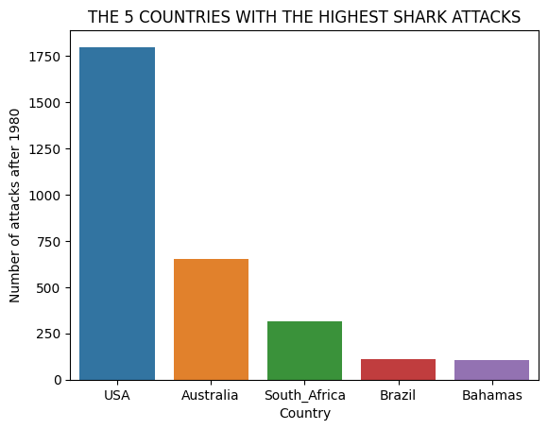
Global Analysis of Shark Attacks
USA leads in number of cases of Shark attacks.
Reporting
Awareness
Preventive Measures
Shark Population Distribution
Notes:
Antonio - The USA leads in the number of reported cases of shark attack, this could be due to the amount of information readily available to us. It could also indicate poor preventative measures in the USA and an opportunity to learn from other countries.

Slide 4
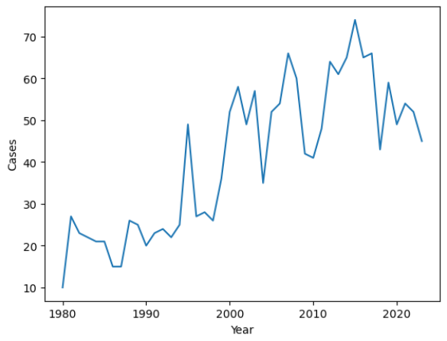
Shark Attacks within USA
USA since 1980
Reported Cases: 1798
Deaths: 57
Average per year
Reported Cases: 43
Deaths: 1.4
Notes:
Antonio - Within the last 40 years the average number of shark attacks per year have been below 50 with less than 2 of them resulting in death. These results are quite good in terms of death causes but there are always ways to improve.

Slide 5
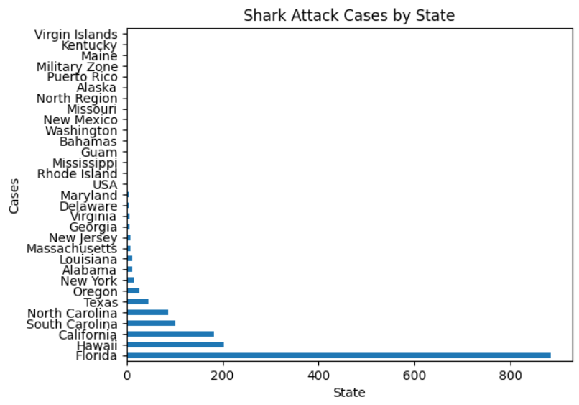
Shark Attacks within USA
Most Reported cases were found in Florida:
Florida is better equipped to deal with shark attacks
Most accurate reporting
Opportunity to share knowledge with other states
Notes:
Rui - Within the USA shark attacks are focused in certain areas of the country, being California, Hawaii and Florida. Florida has a much higher number of cases which could be a very important source of information.

Slide 6
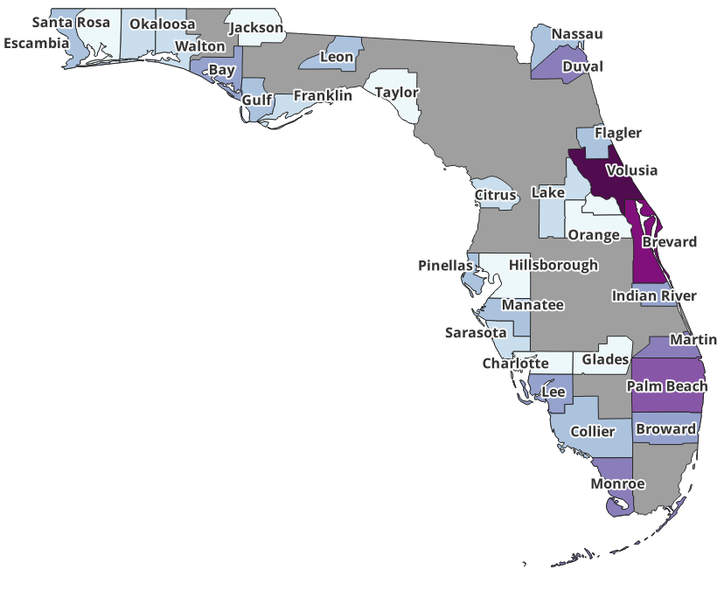
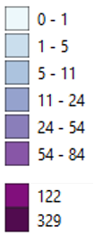
Shark Attacks within USA
Attacks in Florida Counties
Mostly localised in western coast
Volusia and Brevard counties are the locations with more attacks
(200 km coast line)
Notes:
Rui -

Slide 7
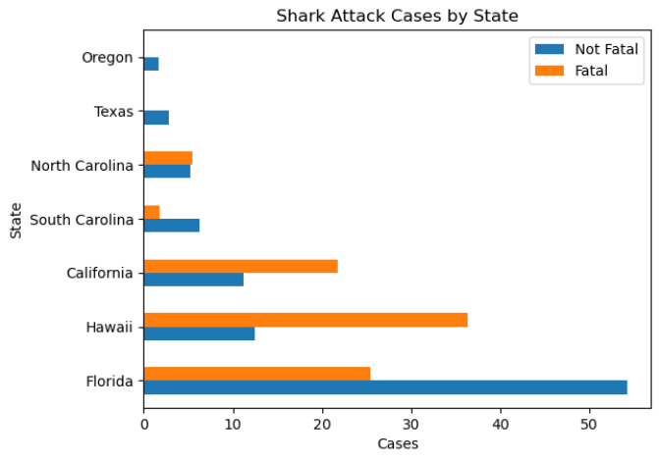
Medical Assistance Recommendations
Death Prevention:
Just over 1 death per year in all of USA
States to focus on medical response and first aid knowledge to be gathered:
Chart only shows states with higher than 1% of the country cases.
Hawaii
Florida
California
Notes:
Jose - With just over 1 death per year in all of USA while looking back in the previous 40 years, we found that Hawaii has a higher number of deaths than Florida, and considering the amount of cases in Florida, California’s death rate is also surprising. We will focus on death prevention information in these 3 states.

Slide 8
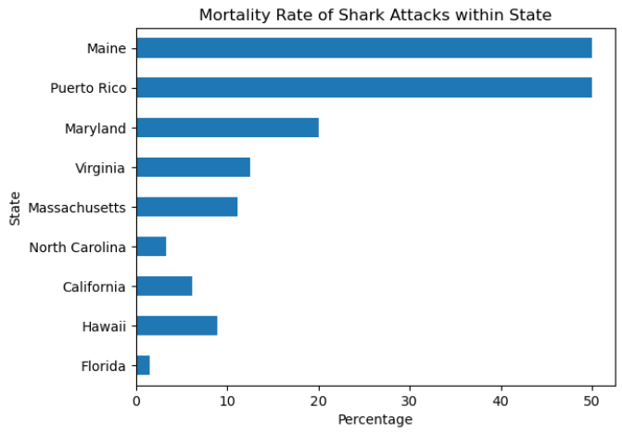
Medical Assistance Recommendations
Death Prevention:
States with less cases also need assistance.
Less cases may lead to more deaths
Notes:
Jose - Though we have seen some states leading in the figures we have looked at. When observing death ratios within each state we find that some places with less cases have a higher mortality rate. This suggests that lack of experience or preventative measures could be the cause and adopting measures from more experienced states may assist with this issue.

Slide 9
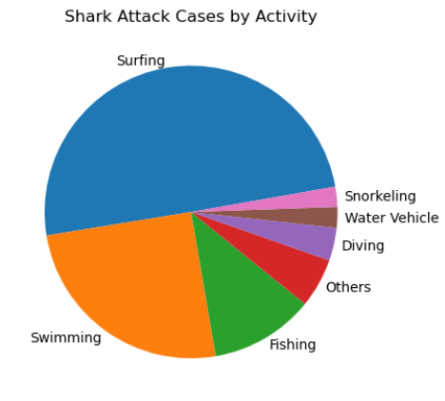
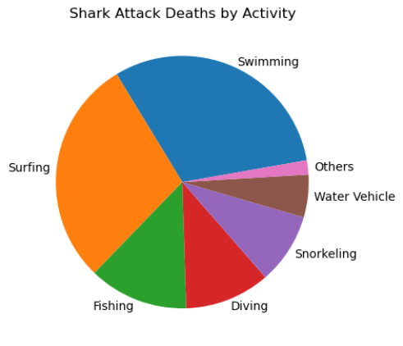
Prevention Recommendations
Notes:
Jose - In a general look throughout the country we can also observe that although most of the cases happen to people practicing surf related activities, swimming may be the one in which people are most at risk of death. Further research may determine causes and assist in finding preventive measures.

Slide 10
Summary
More accurate reporting is needed for a better analysis of the entire country.
States with less cases may require assistance, or adopt measures from states with more cases to improve results.
Florida is a great model state to gather information, due to the number of reported cases and death ratio.
Notes:
Carlos

