Slide 1
Quantum Qubit Simulator
Final Project Report
Submitted By
Ranveer Rajput
Roll Number: 241220045
Department of Electronics and Communication Engineering
National Institute of Technology Delhi
Supervisor: Prof. Jyoteesh Malhotra

Slide 2
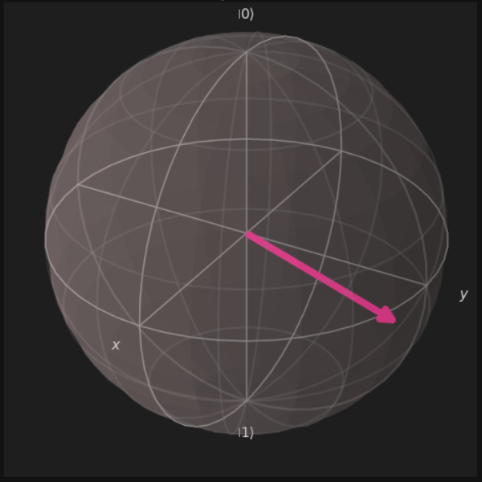
Introduction
Quantum computing is revolutionizing how we approach complex computational problems by utilizing quantum mechanical phenomena. A fundamental concept in quantum computing is the qubit, which can exist in a superposition of states. This project presents a graphical simulation tool to visually explore the behavior of a single qubit using quantum gates and measurements.

Slide 3





Objective
Initialize a qubit with custom α and β values
Apply quantum gates like X, Y, Z, H to observe their effects
Visualize the state of the qubit using the Bloch Sphere
View the simulated measurement results
Generate a detailed report of the qubit evolution

Slide 4
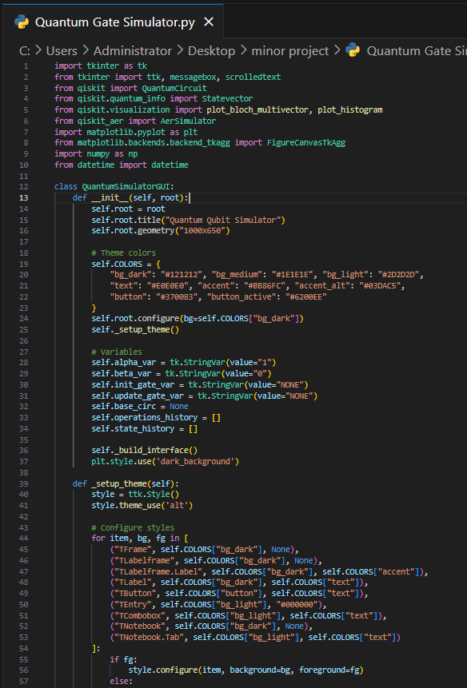
Tools and Technologies Used
Tool/Library
Purpose
Python
Programming language
Tkinter
GUI development
Qiskit
Quantum circuit simulation
Qiskit Aer
Statevector simulation and measurements
Matplotlib
Visualization (Bloch Sphere, Histograms)
NumPy
Mathematical operations

Slide 5






System Architecture
GUI Layer (Tkinter)
Handles user input, layouts, and visualization tabs
Quantum Layer (Qiskit)
Manages quantum circuit creation, statevector simulation, and measurement
Visualization Layer (Matplotlib)
Generates Bloch Sphere, histogram plots, and renders circuit diagrams
The application is built using object-oriented programming in Python. These three key components work together to create a comprehensive quantum simulation environment.

Slide 6





Functionalities Implemented
Qubit Initialization
Users enter complex values for α and β to define the initial qubit state. The app normalizes the state and applies optional initial quantum gates.
Quantum Gate Application
Available gates: H (Hadamard), X (NOT), Y, Z. Users can apply these gates interactively and see changes in the qubit state.
Measurement and Simulation
The AerSimulator performs measurement over 4096 shots. Both theoretical and measured probabilities are displayed.
Visualization Tabs
Bloch Sphere, Measurement Histogram, Circuit Diagram, and Report tabs display all aspects of the quantum state.
Report Generation
Summarizes initialization, gates applied, final qubit state, theoretical & experimental probabilities, and uncertainty analysis.

Slide 7
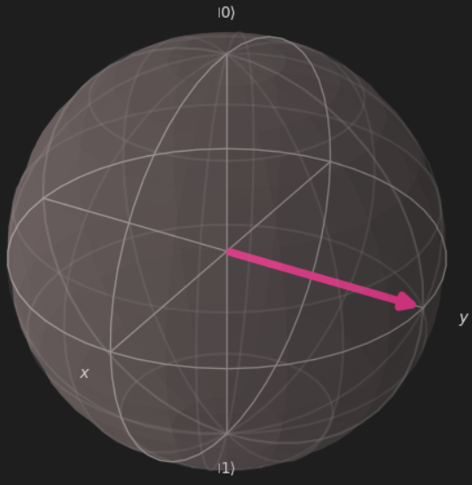
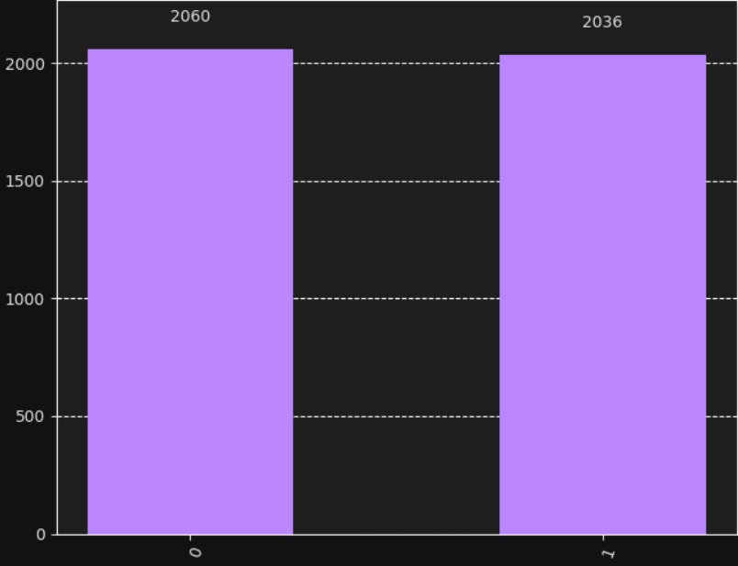
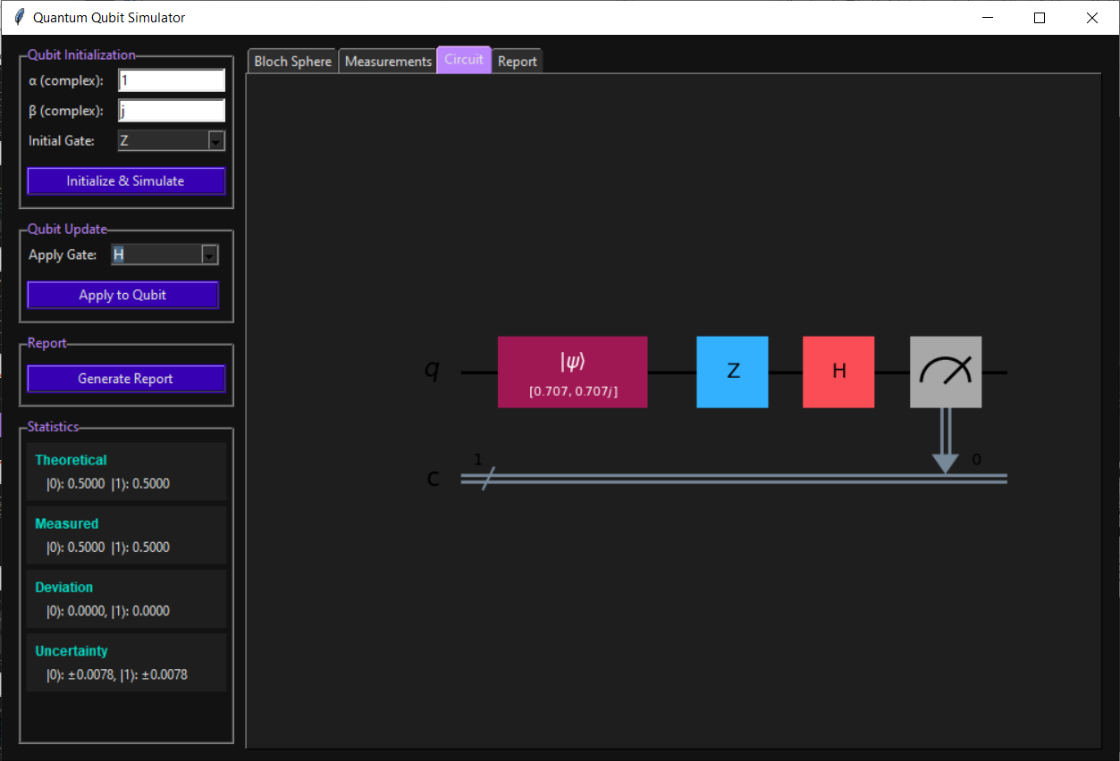
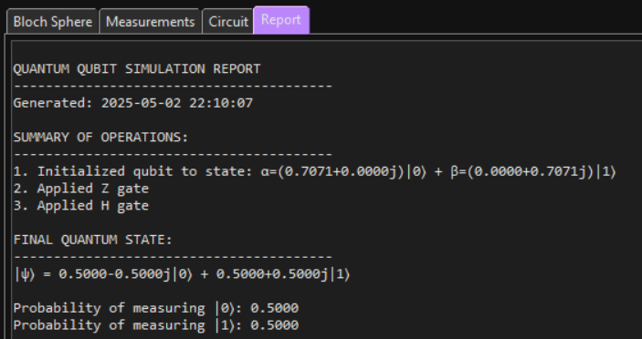
Sample Output Screenshots

Slide 8
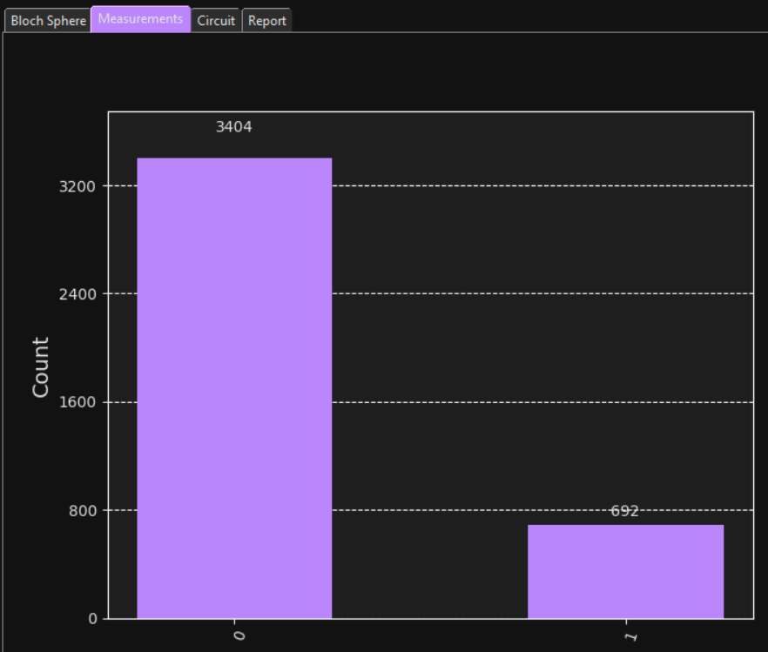
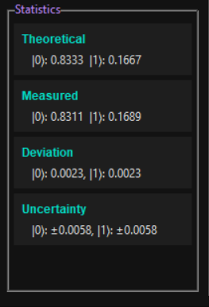
Result Analysis
After running the simulation and measurements, we compare the theoretical predictions against the observed frequencies to assess the simulator's accuracy and statistical consistency.
State
Theoretical Probability
Measured Probability
Absolute Deviation
Statistical Uncertainty (±)
|0⟩
0.8333
0.8311
0.0023
0.0058
|1⟩
0.1667
0.1689
0.0023
0.0058
Sample Output
Screenshot
Close agreement: Both measured probabilities lie within one standard deviation of the theoretical values, indicating the AerSimulator produces statistically reliable results.
Deviations: The maximum absolute deviation (0.0063) remains well below 1%, reflecting minimal sampling error over 4096 shots.
Uncertainty estimates: Calculated as σ = √(p(1-p)/N), this accurately capture the fluctuations observed in the histogram.
Conclusion: The simulator faithfully reproduces the expected quantum behavior. Minor discrepancies are attributable solely to finite‑shot statistical noise, not to any implementation error.

Slide 9








Applications and Future Scope
Teaching Tool
Research Potential
Visual aid for understanding quantum mechanics and quantum gates
Basis for developing multi-qubit simulators or quantum logic experiments
IBM Integration
Multi-Qubit Support
Connect with IBM Quantum Experience for real quantum hardware
Add support for 2 or more qubits and implement entanglement
This project successfully simulates and visualizes the evolution of a single qubit in a user-friendly interface. It integrates the power of Qiskit with a modern GUI design, offering both educational value and research potential.

Slide 10
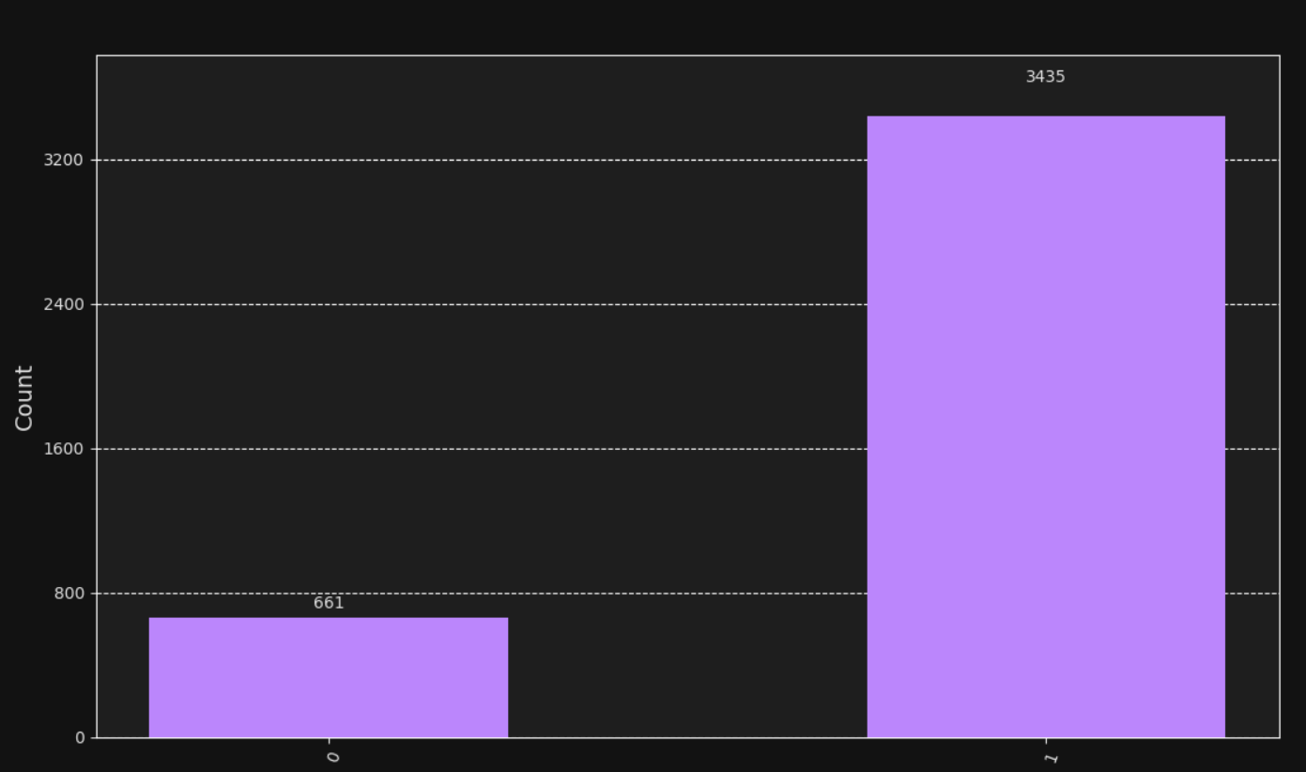
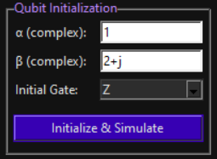
Appendix: GUI Screenshots
Qubit Initialization Interface
Bloch Sphere Visualization
Measurement Results
Users can enter complex values for α and β to define the initial qubit state.
3D representation of the qubit state as a vector on the Bloch sphere.
Histogram showing the frequency of |0⟩ and |1⟩ measurements over 4096 shots.
Libraries Installation: pip install qiskit qiskit-aer matplotlib

Slide 11
Thank You

