Slide 1
Package development for PMDA Oncology inquiries
PHUSE OST Shunsuke Goto Hiro Kosako
Tomoyuki Namai
Hiroki Yamanobe
Yuichi Nakajima

Slide 2
本日の発表のゴール
PHUSE OSTの活動の一環である{anaume} packageについて知っていただく
{anaume}を例に、一般的なPackageの構成要素について理解を深める
Notes:
勉強会ということで、PHUSEの取り組みだけではなく、一般的な知識も共有したい。

Slide 3
Introduction of {anaume}
Notes:
はじめに穴埋めについて

Slide 4
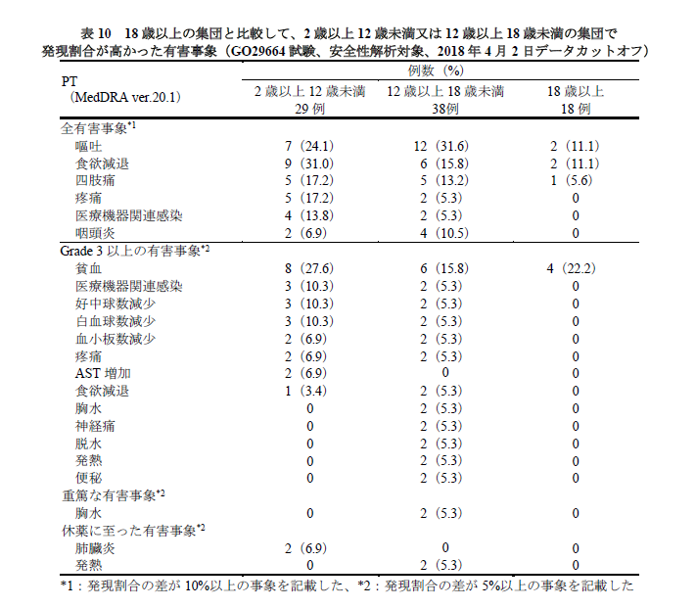
Challenges regarding to AE analysis of PMDA queries in oncology
Age group
A large number of similar-format reports are required within a short period.
No standardized format like those defined by the FDA.
-> This leads to challenges in preparation and streamlining.
ALL AE
AE with Grade >=3
Serious AE

Slide 5

Package to solve this challenge: {anaume}
Analysis Utility for AE Mapping & Embedding
Package to accelerate table generation for query from PMDA
Using ARD to generate table

Slide 6
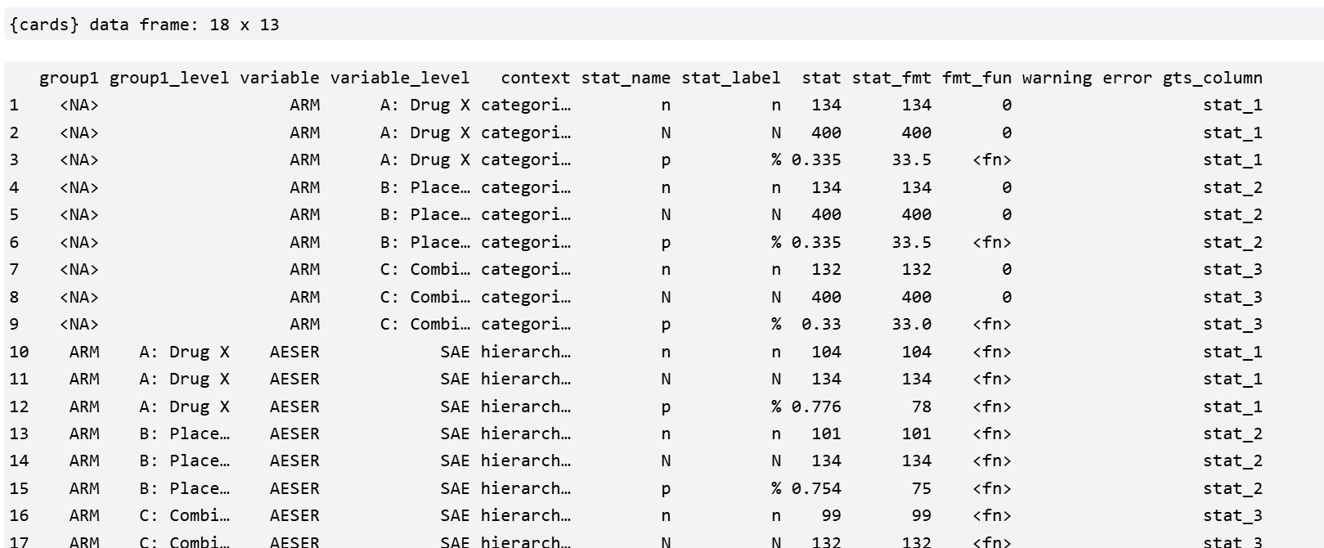
Analysis Results Data (ARD) is structured dataset that represents the outputs of statistical analyses.
CDISC-AnalysisResultsLogicalModel-Presentation-FINAL.pdf
Analysis Results Datasets – Analysis Results Datasets Using Open-Source Tools from the {pharmaverse}

Slide 7
Strong points of using ARD
Standardization
Uniformity of summary table aggregation units, column names, and results between analyses
Efficiency
Quick tabulation and re-formatting
Reproductivity
The same analysis logic can be easily applied to other study or subgroup.
Enable QC easier
ARD can be used in a variety of ways, such as in tables, R Shiny, figures, etc.

Slide 8





Working flow from data to reports using ARD
ADaM
ARD
Reports

Slide 9
jpn_query_overview() To create ARD for summary information
make_ae_type()
To create event flag
Inquiry # 1
AE1
ARD -
Summary
For AE1
Analysis Results (summary)
For AE1
ｊpn_query_summary_pt
To create ARD for PT summary
ARD -
PT summary
For AE1
Analysis Results (PT summary)
For AE1
ADAE
make_ae_type()
To create event flag
jpn_query_overview() To create ARD for summary information
Inquiry # 1
AE2
ARD -
Summary
For AE2
Analysis Results (summary)
For AE1

Slide 10
Step1: Define the event
Step3: Generate outputs from ARD
jpn_query_overview() To create ARD for summary information
make_ae_type()
To create event flag
Inquiry # 1
AE1
ARD -
Summary
For AE1
Analysis Results (summary)
For AE1
ｊpn_query_summary_pt
To create ARD for PT summary
ARD -
PT summary
For AE1
Analysis Results (PT summary)
For AE1
ADAE
make_ae_type()
To create event flag
jpn_query_overview() To create ARD for summary information
Step2: Create ARD
Inquiry # 1
AE2
ARD -
Summary
For AE2
Analysis Results (summary)
For AE1

Slide 11
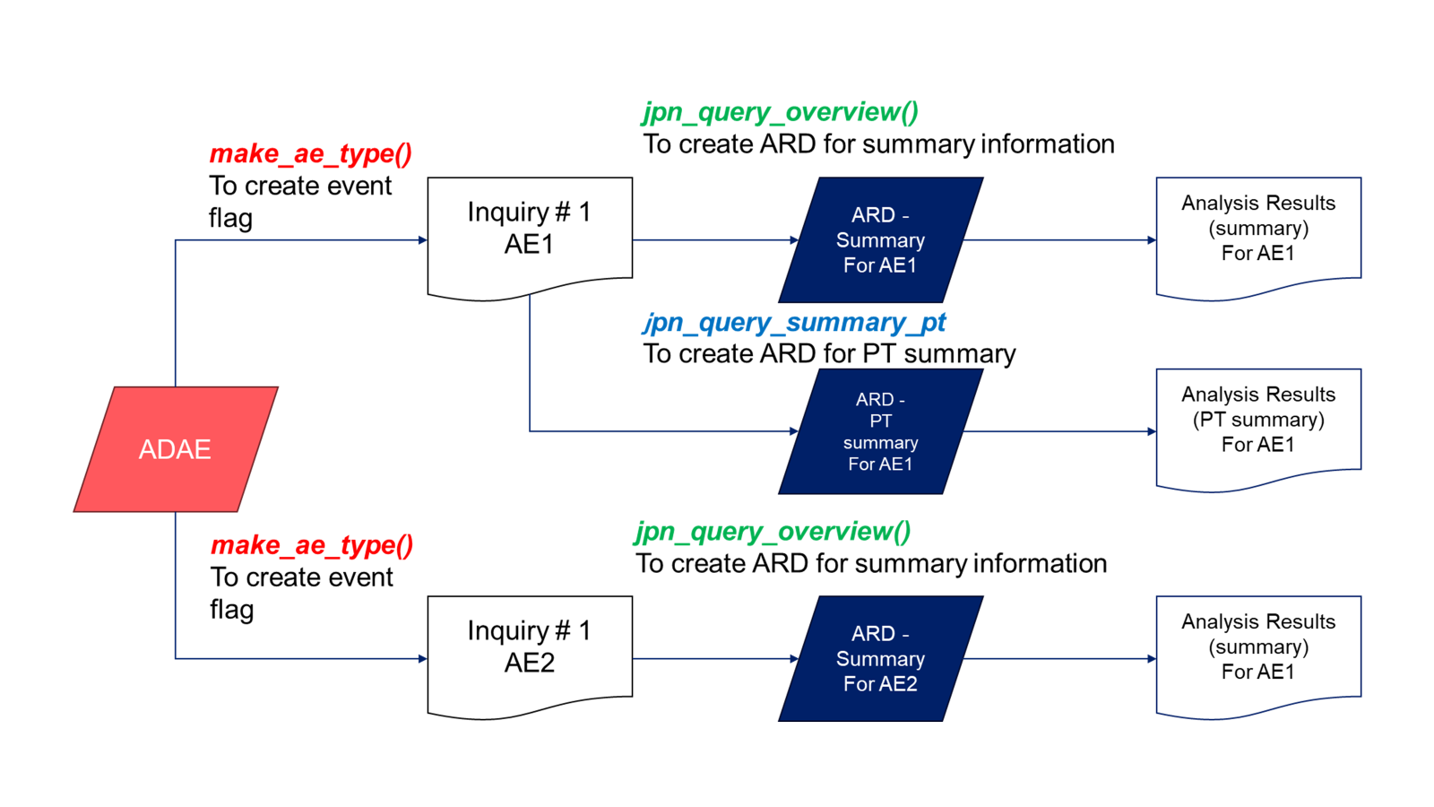
Step1: Define the event make_ae_type
Define conditions for target AEs and display labels for tables
Create an object of class ae_type (essentially a list)
Pass this object as an argument to subsequent functions for flexible analysis
> make_ae_type("aeg3", "AE >= Grade 3",expr(AEGRD == "Y"))
ae_type
id: aeg3
label: AE >= Grade 3
condition: AEGRD == "Y"
Label to be displayed
Condition for this ae type
> ae_types <- list(
+ make_ae_type("any_ae", "Any AE", expr(TRUE)),
+ make_ae_type("aeg3", "AE >= Grade 3", expr(AEGRD == "Y")),
+ make_ae_type("sae", "Any SAE", expr(AESER == "Y")),
+ make_ae_type("fatal", "Fatal SAEs", expr(AESER == "Y" & AEFAT == "Y")),
+ make_ae_type("disc", "AE leads drug withdraw", expr(AEDISCON == "Y")),
+ make_ae_type("itrr", "AE leads drug interrupt", expr(AEITRR == "Y")),
+ make_ae_type("redu", "AE leads to dose reduction", expr(AEREDUCE == "Y"))
+ )

Slide 12
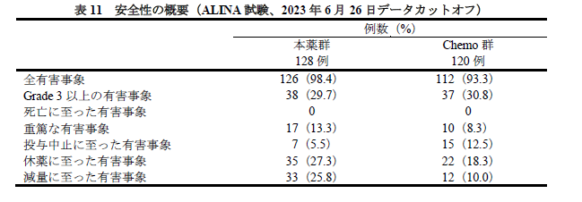
Step2: Create ARD jpn_query_overview/ｊpn_query_summary_pt
jpn_query_overview()
Function to Generate ARD for AE Overview
ｊpn_query_summary_pt()
Function to Generate ARD for AE by PT
Both functions internally use {cards}.

Slide 13
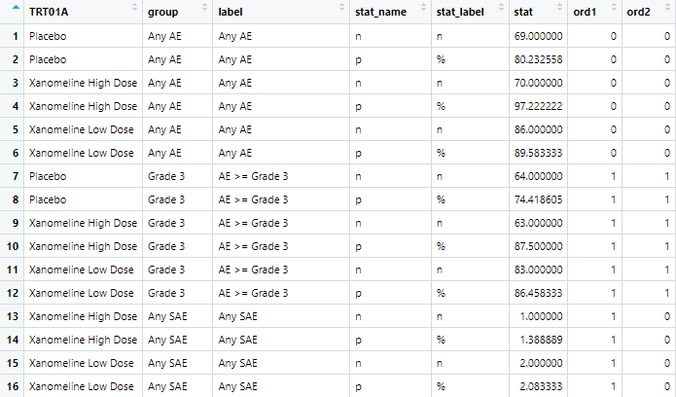
Step2: Create ARD ex) jpn_query_overview
jpn_query_overview()
> jpn_query_overview(
+ data = adae,
+ denominator = adsl,
+ ae_types = ae_types,
+ by = TRT01A
+ )

Slide 14

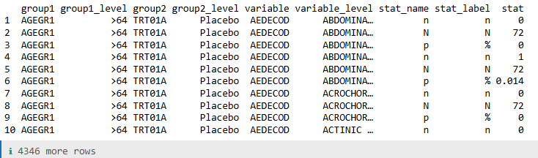
{cards} package
Part of Pharmaverse
R package to create ARD
ard_categorical(
data = adae,
by = c('AGEGR1','TRT01A’),
variables = AEDECOD,
denominator = adsl
)

Slide 15
Step3: Create outputs from ARD
Provide template program to generate table from ARD instead of functions for flexible modification in actual queries.
Generate Output from ARD using:
{gt}
{gtsummary}
{tfrmt}

Slide 16
Structure of R package

Slide 17
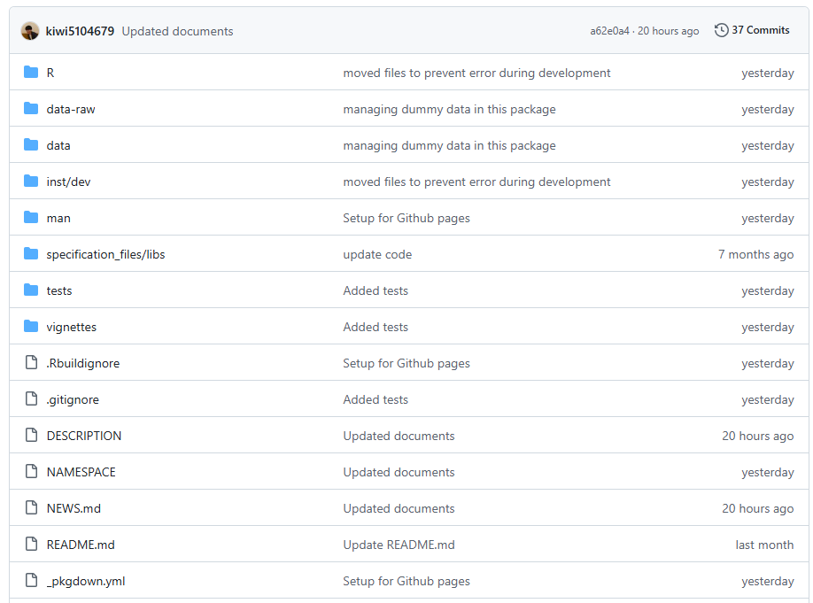
Basic components of R Package
DESCRIPTION
NAMESPACE
R
README
man
Vignettes
_pkgdown.yml
tests

Slide 18
Basic components of R Package
Packageに必須となるMetadata
DESCRIPTION
NAMESPACE
R
README
man
vignettes
_pkgdown.yml
tests
Packageに含まれるR pgm
Document
PackageのValidation用のUnit test

Slide 19
Basic components of R Package
Packageに必須となるMetadata
DESCRIPTION
NAMESPACE
R
README
man
vignettes
_pkgdown.yml
tests

Slide 20
DESCRIPTION
Metadata
パッケージ名、概要、作者、ライセンス、依存関係（Depends/Imports/Suggests など）といった 全体情報を宣言
Package: anaume
Title: Adverse Event Analysis Utilities for Clinical Trials
Version: 0.0.0.9000
Authors@R:
person("First", "Last", , "first.last@example.com", role = c("aut", "cre"))
Description: Provides utilities for summarizing adverse events in clinical
trials following Japanese regulatory conventions. Includes helpers for
defining AE type filters, binding datasets by AE type, and generating
ARD (Analysis Results Data) objects.
License: MIT + file LICENSE
Encoding: UTF-8
Roxygen: list(markdown = TRUE)
RoxygenNote: 7.3.2
Depends:
R (>= 3.5)
Imports:
cards,
cli,
dplyr,
purrr,
rlang,
Suggests:
testthat (>= 3.0.0)
Config/testthat/edition: 3
URL: https://github.com/yourname/anaume
BugReports: https://github.com/yourname/anaume/issues

Slide 21
NAMESPACE
Metadata
どの関数・クラス等をPackageから参照できるようにするかを決める
他パッケージの関数等を自パッケージからどう参照するかを決める（imports）
通常Manualでは編集しない
S3method(format,ae_type)
S3method(print,ae_type)
export(ae_condition)
export(ae_id)
export(ae_label)
export(jpn_query_aggregate)
export(jpn_query_base)
export(jpn_query_overview)
export(make_ae_type)
export(merge_ae_types)
importFrom(cards,ard_stack_hierarchical)
importFrom(dplyr,all_of)
importFrom(dplyr,filter)
importFrom(dplyr,group_vars)
importFrom(dplyr,mutate)
importFrom(dplyr,select)
importFrom(purrr,map_dfr)
importFrom(rlang,enquo)
importFrom(rlang,eval_tidy)
importFrom(rlang,quo_is_null)
importFrom(tidyselect,eval_select)

Slide 22
Basic components of R Package
DESCRIPTION
NAMESPACE
R
README
man
vignettes
_pkgdown.yml
tests
Packageに含まれるR pgm

Slide 23
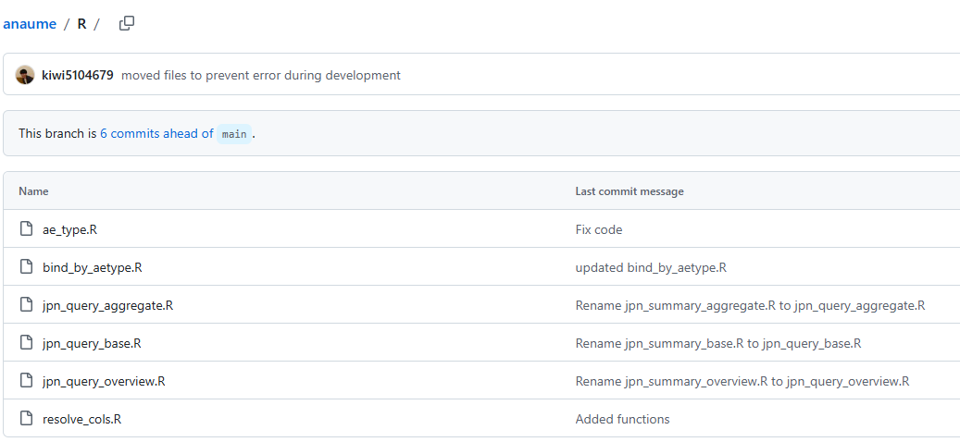
R pgm
Programs
関数などの R コードを格納する。
.R ファイルは、パッケージ読み込み時に自動的にソースされる。
外部に公開されるかどうかは NAMESPACE によって制御される。

Slide 24
Basic components of R Package
DESCRIPTION
NAMESPACE
R
README
man
vignettes
_pkgdown.yml
tests
Document

Slide 25
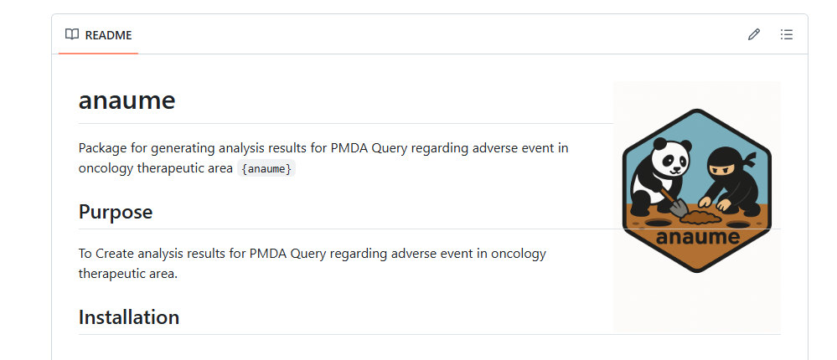
README
Document
GithubやGithub pagesのTop pageに表示される内容

Slide 26
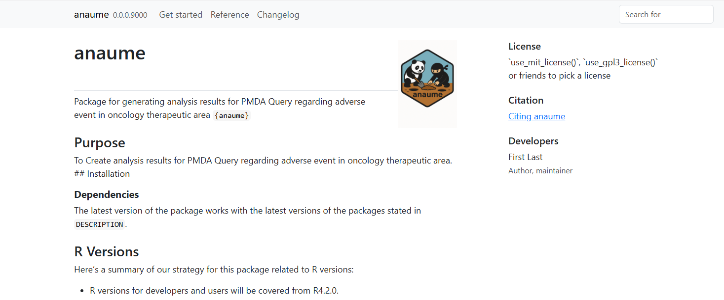
Github pagesとは？？
GitHub のリポジトリ内容から、Webサイト（HTML/CSS/JS）を公開できる機能
Packageの使い方などの情報を掲載するために使用されることが多い

Slide 27
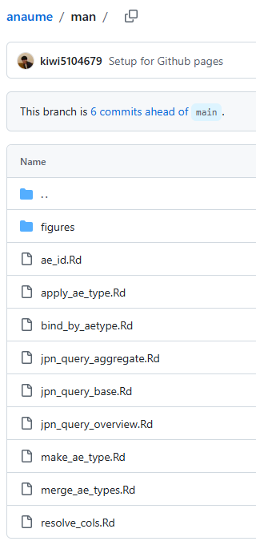
man
Document
各関数のDocumentを格納したFolder
各関数のDocumentはGithub pagesやRstudioのHelp画面に表示される。
Manualでは編集しないことが多く、roxygenに よって記載した内容がDocumentとなる

Slide 28
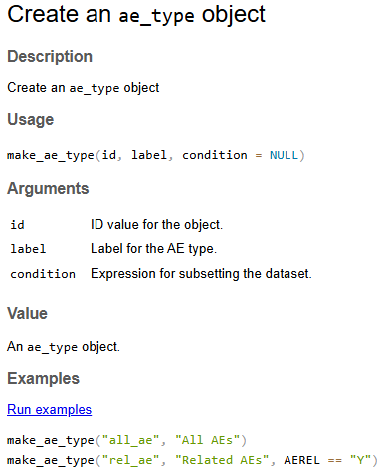
roxygen
R コード中のコメントから、ドキュメント（man/*.Rd）やNAMESPACE を自動生成する仕組み。
コードとドキュメントを同じ場所で管理することで、保守性を高める。
#' Create an `ae_type` object
#'
#' @param id ID value for the object.
#' @param label Label for the AE type.
#' @param condition Expression for subsetting the dataset.
#'
#' @returns An `ae_type` object.
#' @export
#'
#' @examples
#' make_ae_type("all_ae", "All AEs")
#' make_ae_type("rel_ae", "Related AEs", AEREL == "Y")
make_ae_type <- function(id, label, condition = NULL) {
. . .
}

Slide 29
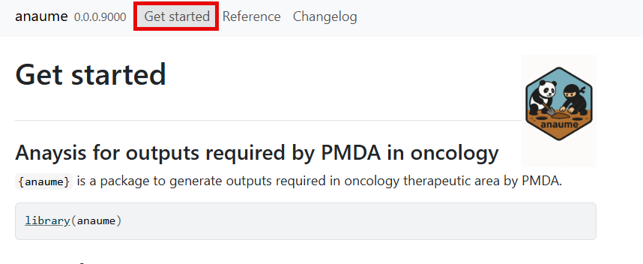
vignettes
Document
関数横断的な内容としてDocumentを格納したFolder
Github pages上で、関数横断的な内容をArticlesに相当することが多い。

Slide 30
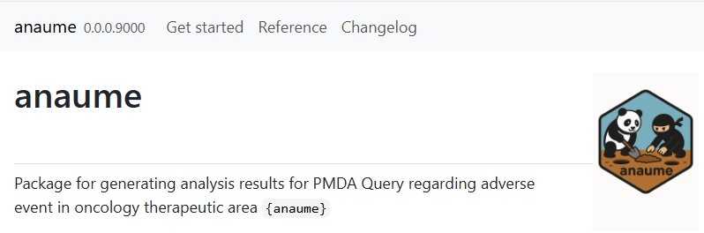
_pkgdown.yml
Document
Github pages生成時の設定ファイル
サイトの見た目・構成・表示内容をYAML形式で制御する。
url: https://yuichi-nakaima.github.io/anaume/
template:
bootstrap: 5
lang: en
title: anaume
description: "{Package documentation for anaume}."
repo:
url:
home: https://github.com/yuichi-nakaima/anaume
issue: https://github.com/yuichi-nakaima/anaume/issues
どの項目に何のDocumentを 配置するか等を設定

Slide 31
Basic components of R Package
DESCRIPTION
NAMESPACE
R
README
man
vignettes
_pkgdown.yml
tests
PackageのValidation用のUnit test

Slide 32
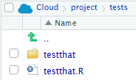
Unit test
Test
Packageでは関数やFeatureが意図通り機能しているかをDevloperがテストしている。
R CMD check 時に自動実行されるため、関数修正時に意図しない挙動の変化を防ぐ。
個別のTESTはtestthat folder内に保管されることが多く、testthat内の全てのtestを testthat.Rで実行する構造を持つことが多い。
# This file is part of the standard setup for testthat.
# It is recommended that you do not modify it.
#
# Where should you do additional test configuration?
# Learn more about the roles of various files in:
# * https://r-pkgs.org/testing-design.html#sec-tests-files-overview
# * https://testthat.r-lib.org/articles/special-files.html
library(testthat)
library(anaume)
test_check("anaume")

Slide 33
Unit testの例
Test
test_that("make_ae_type creates ae_type object without condition", {
obj <- make_ae_type("all_ae", "All AEs")
expect_s3_class(obj, "ae_type")
expect_equal(obj$id, "all_ae")
expect_equal(obj$label, "All AEs")
expect_true(rlang::quo_is_null(obj$condition))
})
test_that("make_ae_type creates ae_type object with condition", {
obj <- make_ae_type("rel_ae", "Related AEs", AEREL == "Y")
expect_s3_class(obj, "ae_type")
expect_equal(obj$id, "rel_ae")
expect_equal(obj$label, "Related AEs")
expect_false(rlang::quo_is_null(obj$condition))
})
test_that("make_ae_type errors when id is not a string", {
expect_error(make_ae_type(123, "label"))
expect_error(make_ae_type(c("a", "b"), "label"))
})
意図した値が返ってくるかを確認
条件を変えて動作確認
意図したErrorが出ることを確認

Slide 34
本日の発表のゴール（再掲）
PHUSE OSTの活動の一環である{anaume} packageについて知っていただく
{anaume}を例に、一般的なPackageの構成要素について理解を深める

Slide 35
End of slides

Slide 36
BU

Slide 37
Overview of PMDA’s Requests
# | Target studies | Request
1 | All studies | Summary of AE overview All AEs AEs with grade 3+ Fatal AEs Serious AEs AEs leading to treatment discontinuation AEs leading to dose interruption/delay AEs leading to dose reduction
2 | All studies | Summary of AEs and drug-related AEs The summaries for AEs and drug-related AEs need to be displayed on the one table. The displays for following AEs are needed: Fatal AE, SAE, AE leading to treatment discontinuation of any treatment, AE leading to dose interruption/delay of any treatment, AE leading to dose reduction of any treatment
3 | Studies including JPN | Summary of AE overview for Japanese and non-Japanese AE overview for Japanese and non-Japanese needs to be displayed on the one table.
4 | Pivotal studies | Summary of important AEs by time windows The number and percentage of patients with each important AE needs to be summarized by time windows from study start.
… | … | …

Slide 38
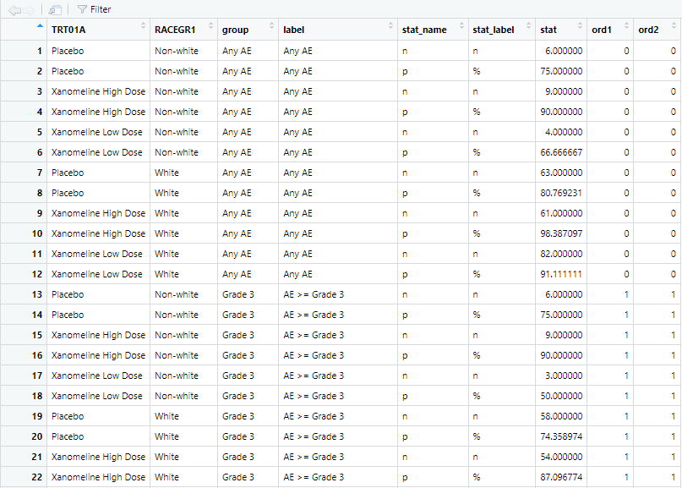

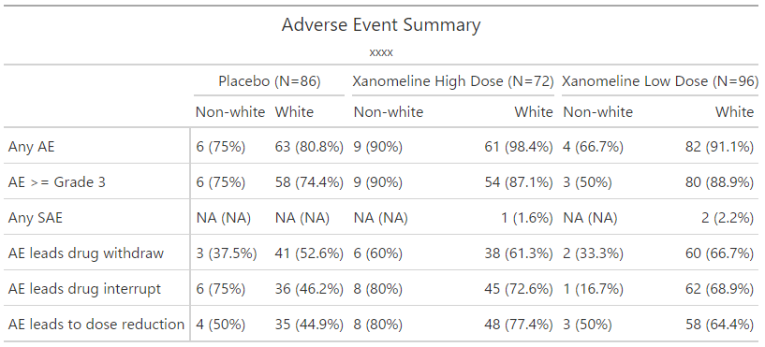
Structure of ARDs for PMDA queries
Sample ARD for “summary of AE overview”

