Slide 1
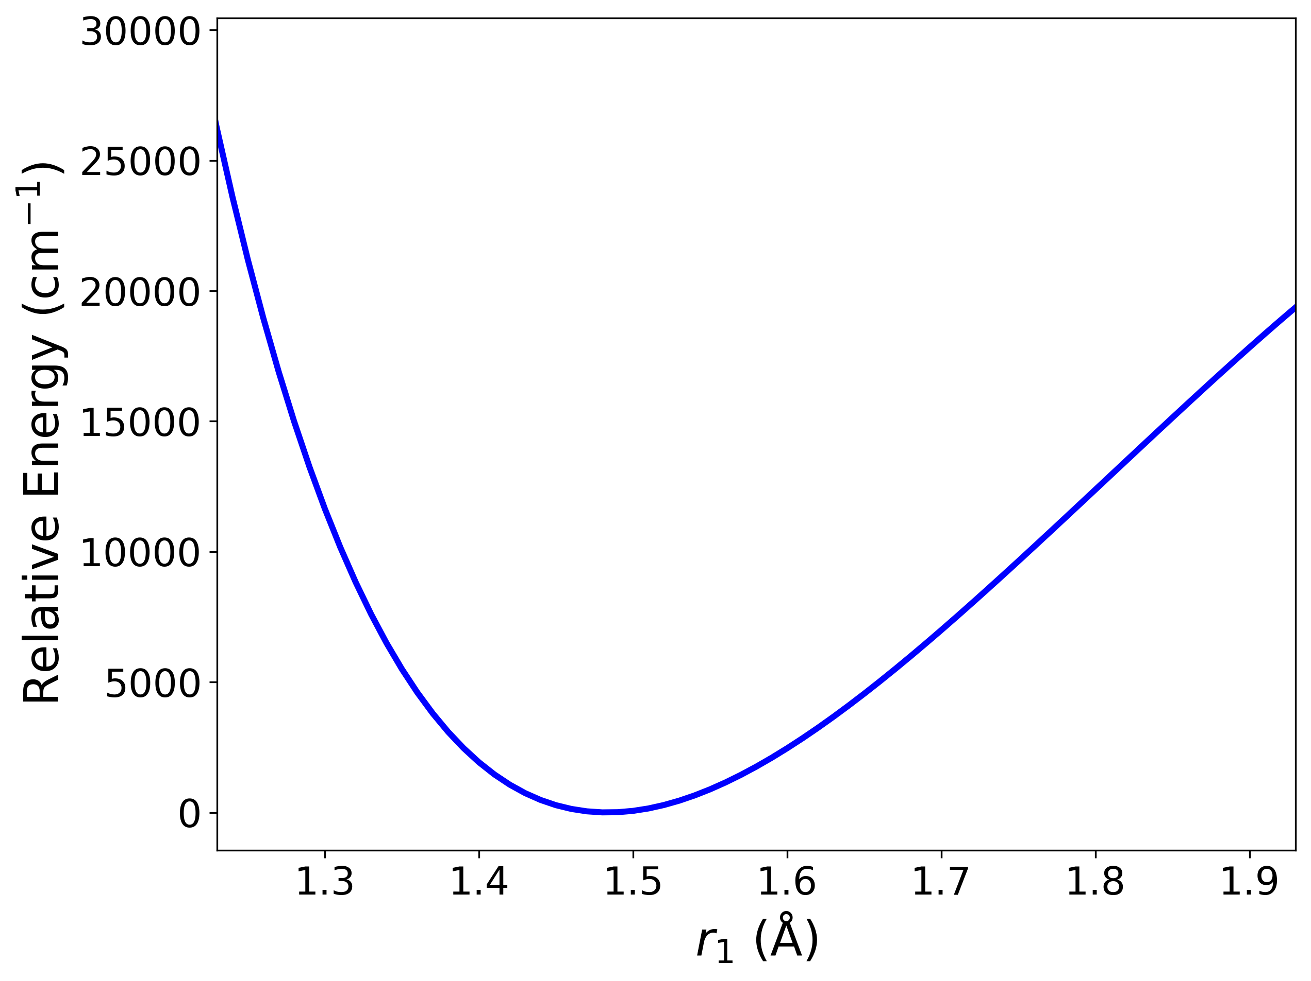
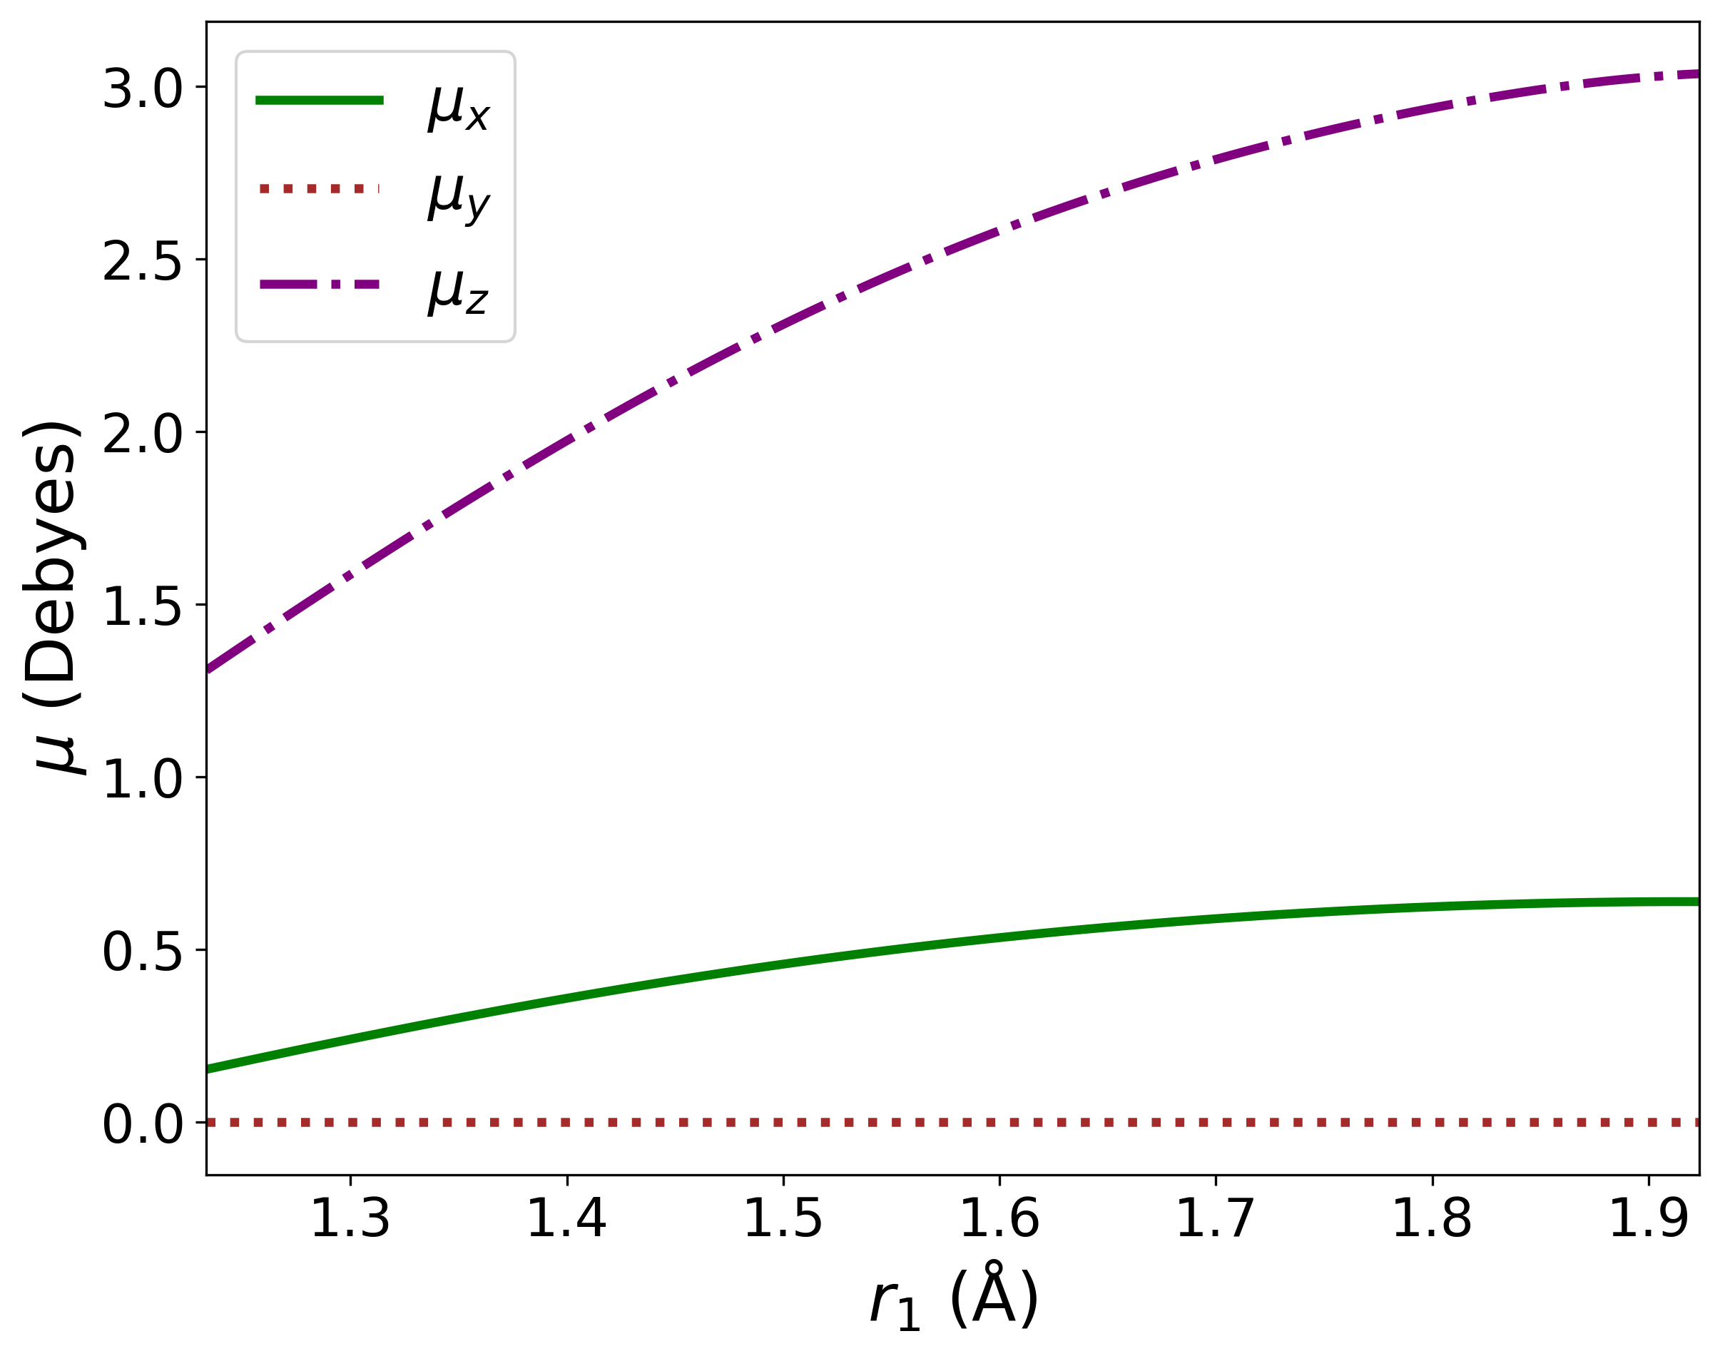
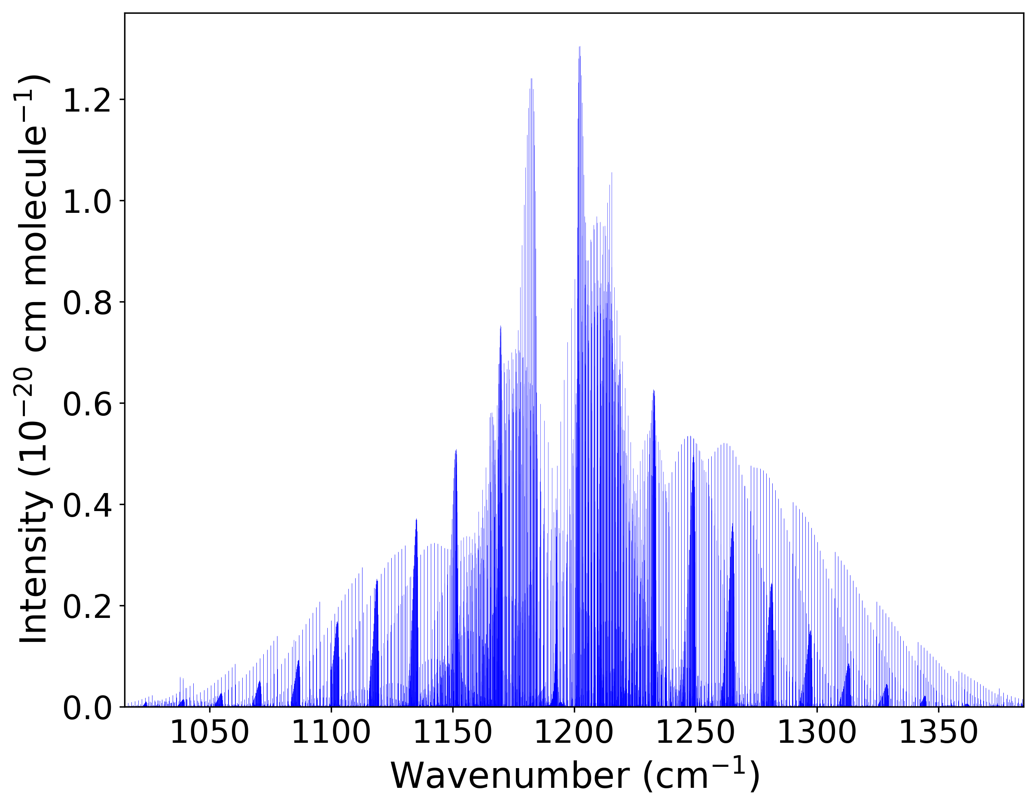
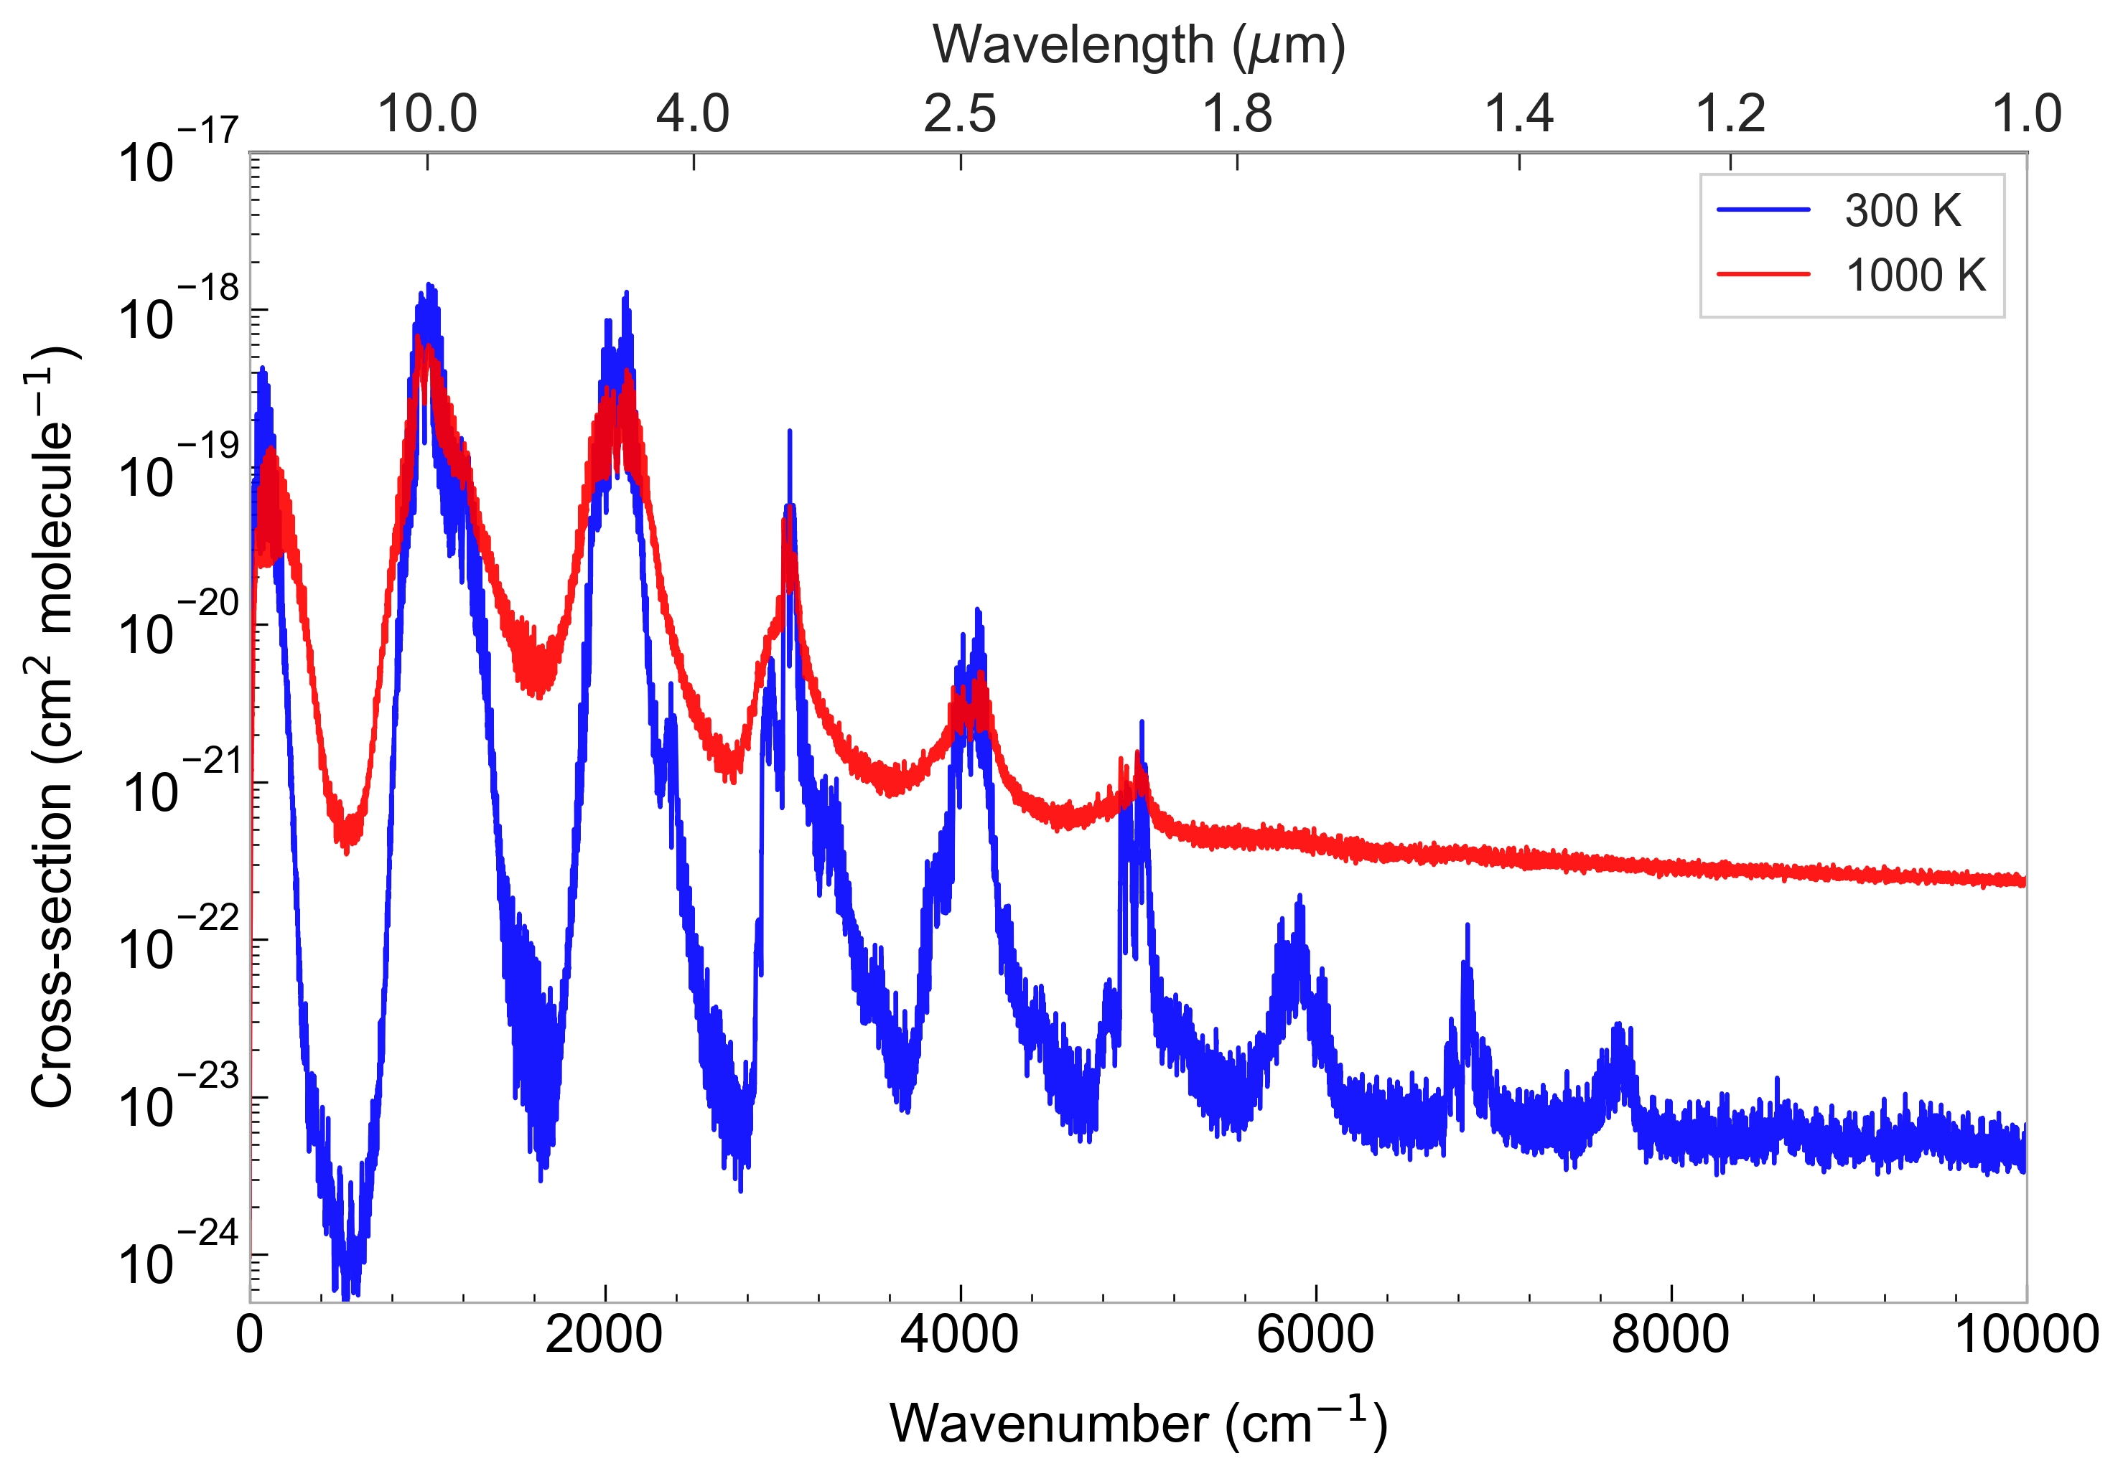
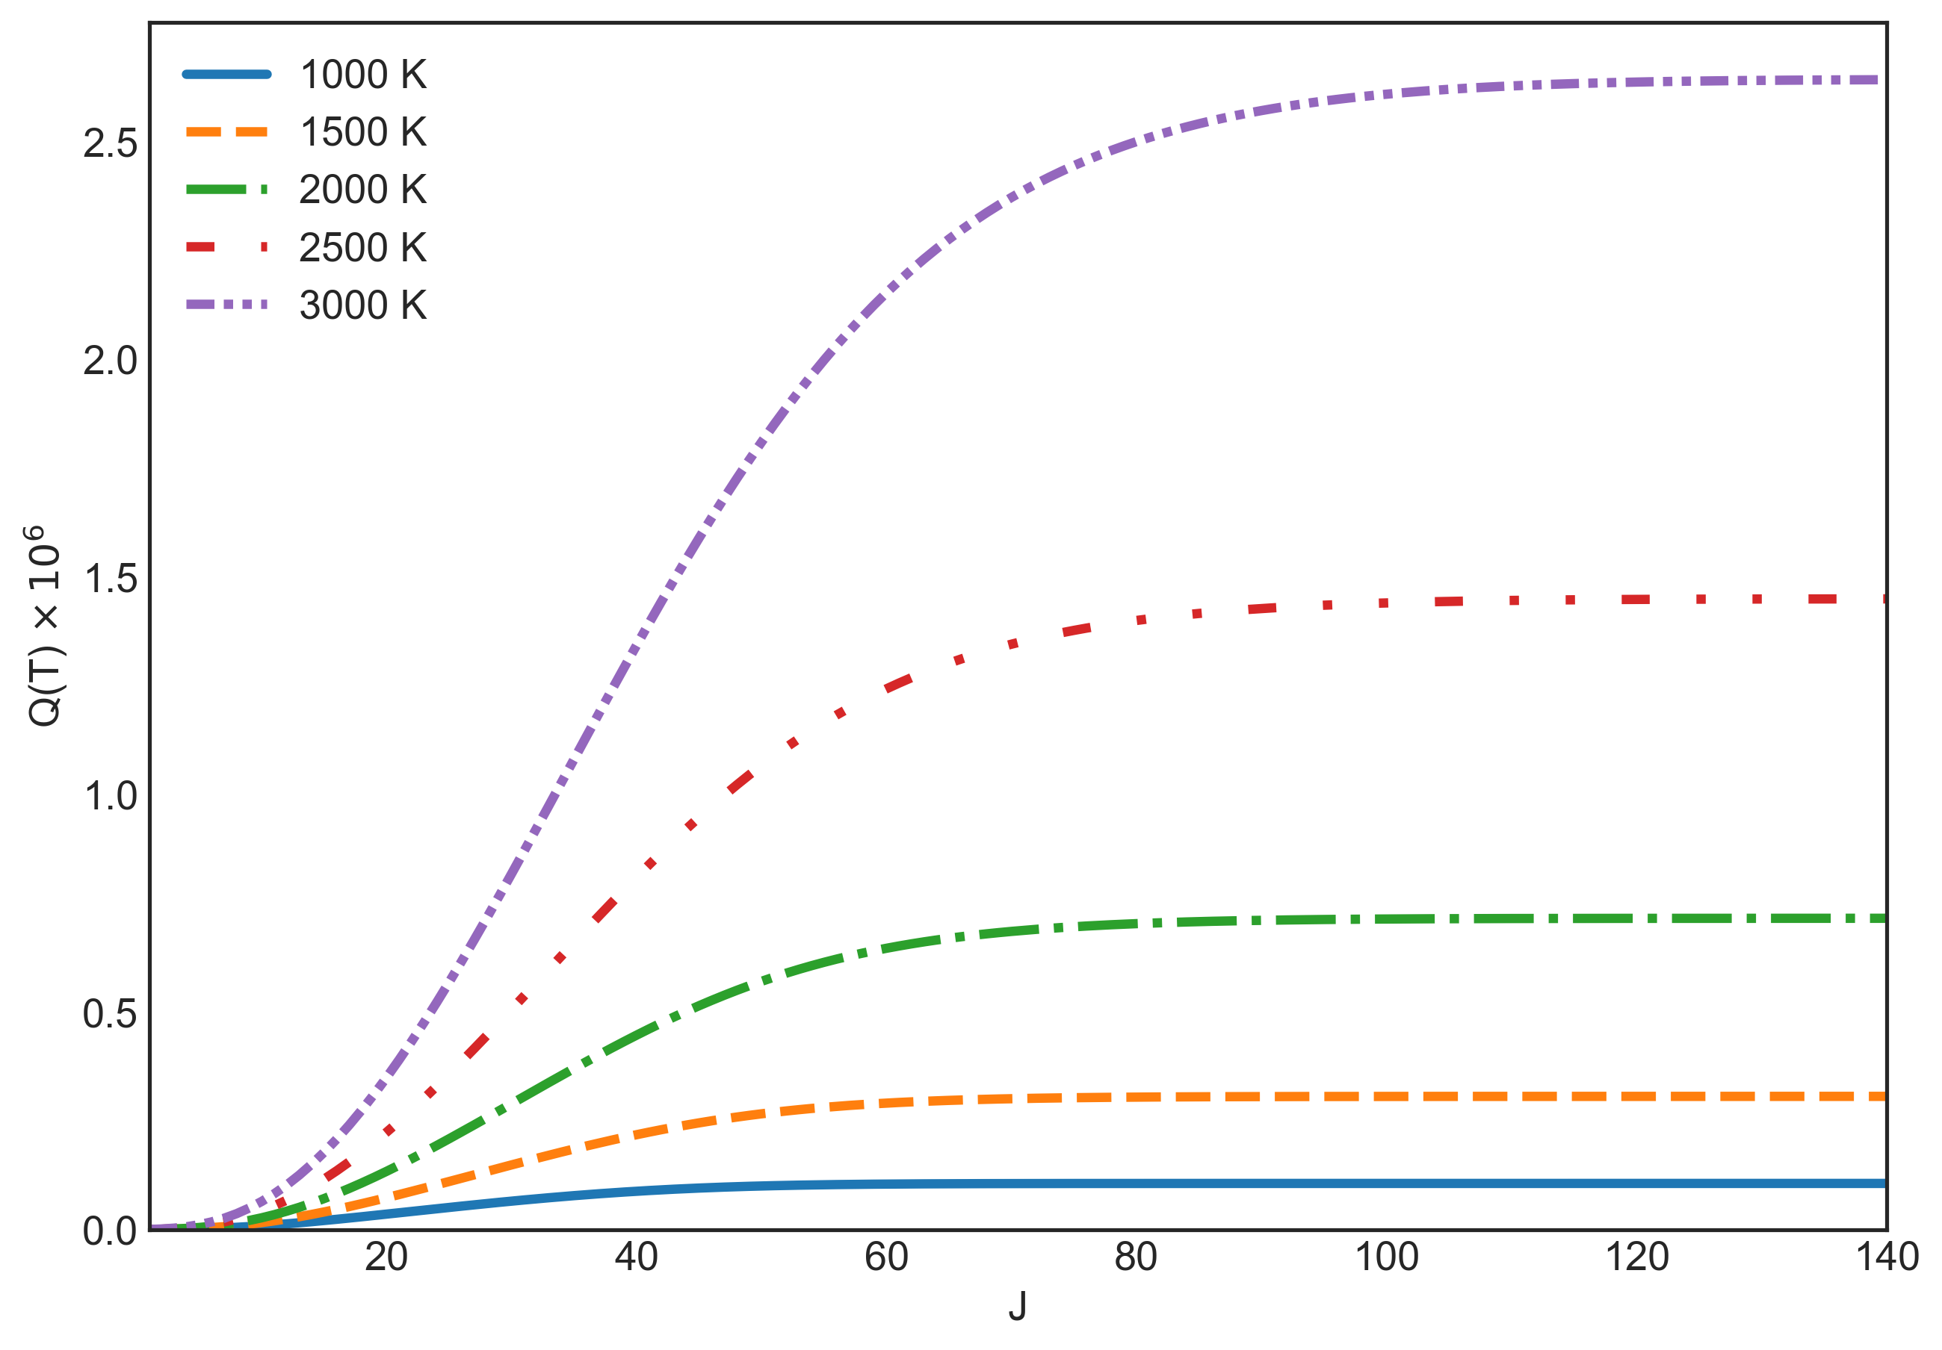
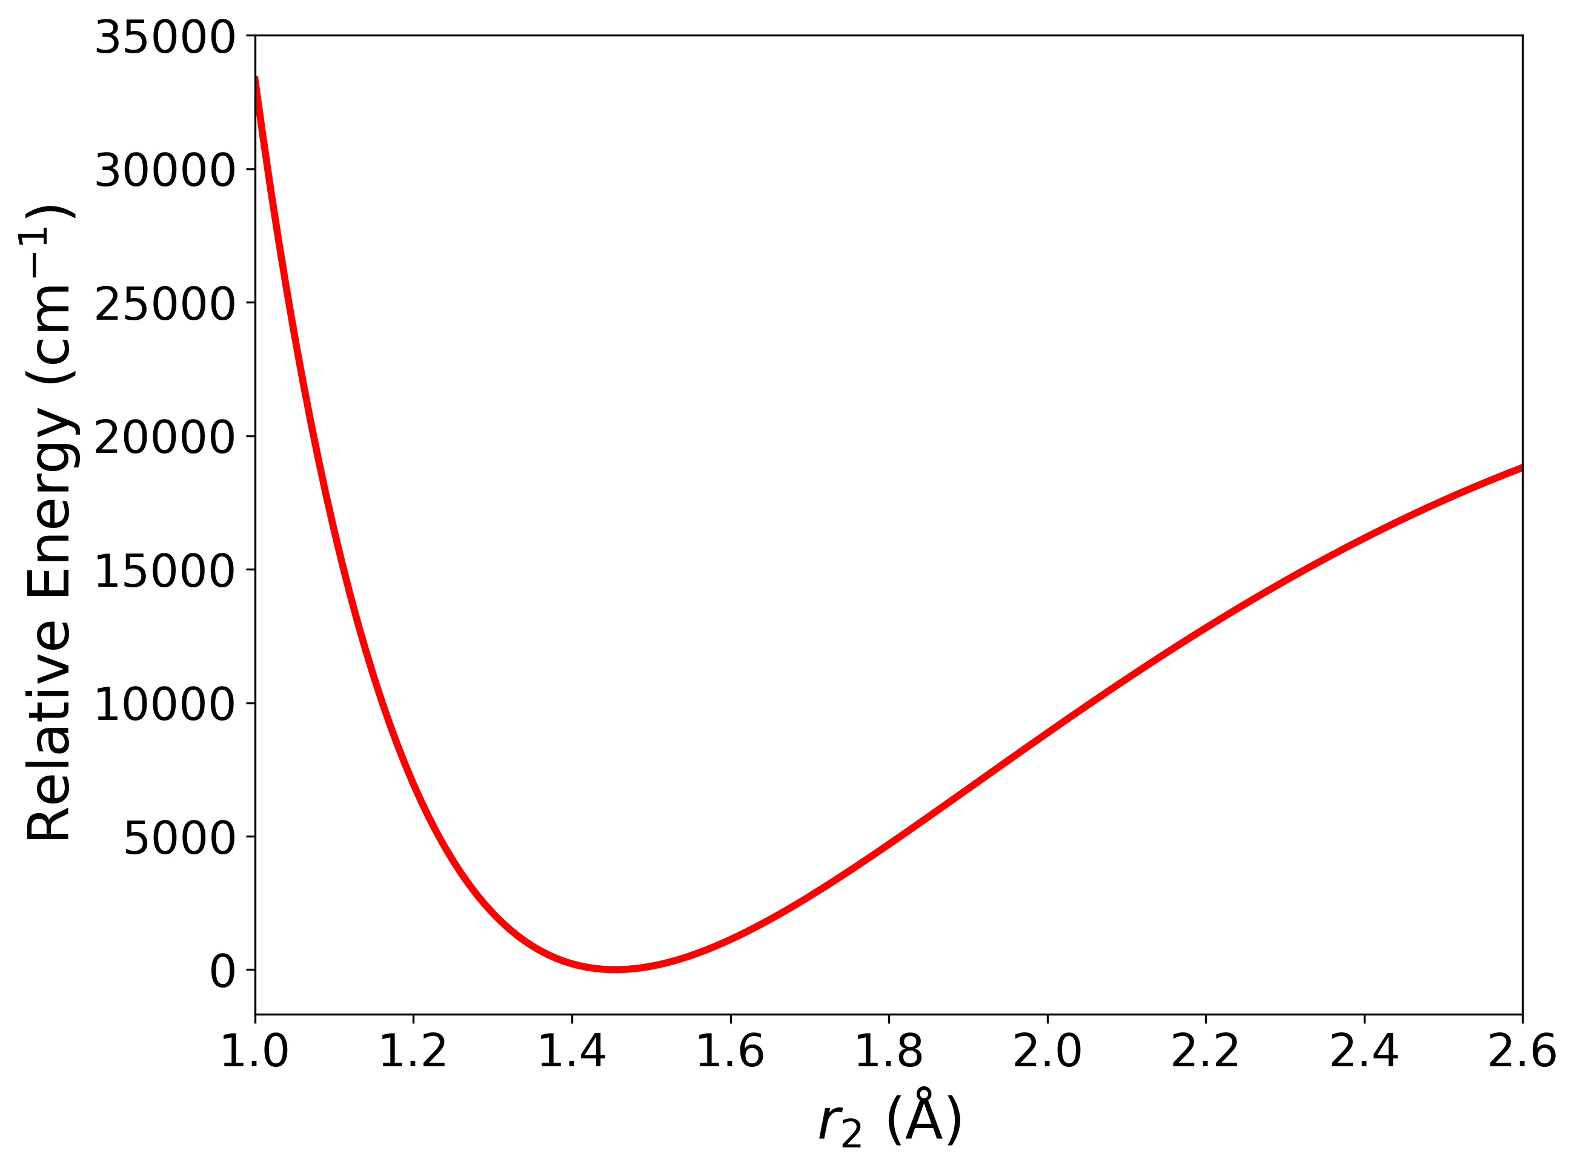
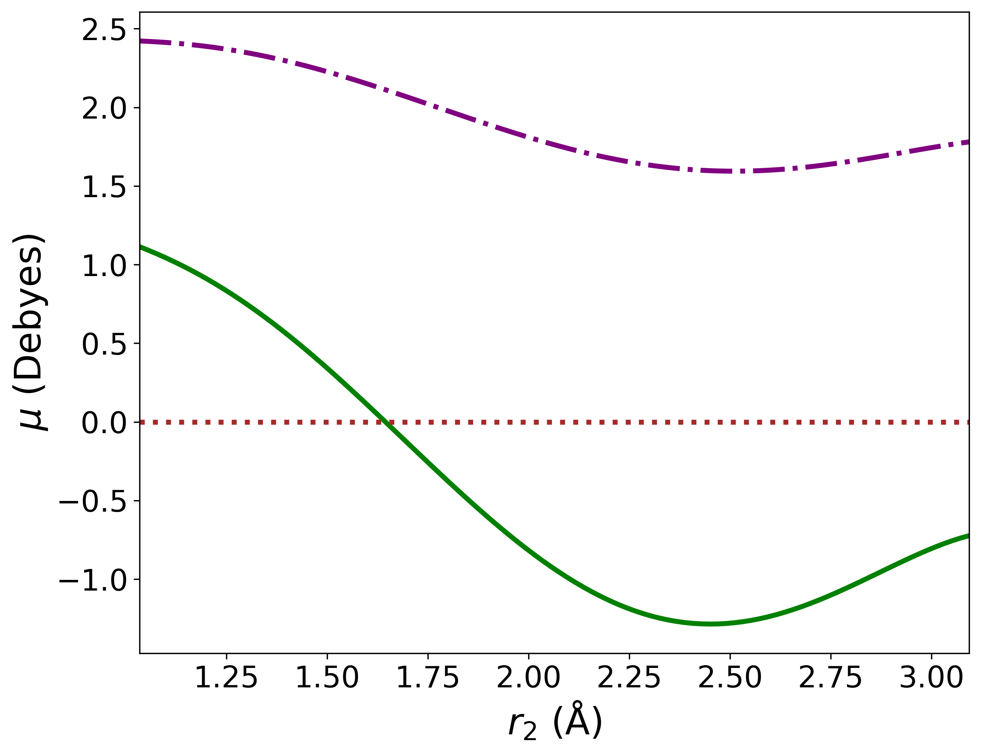
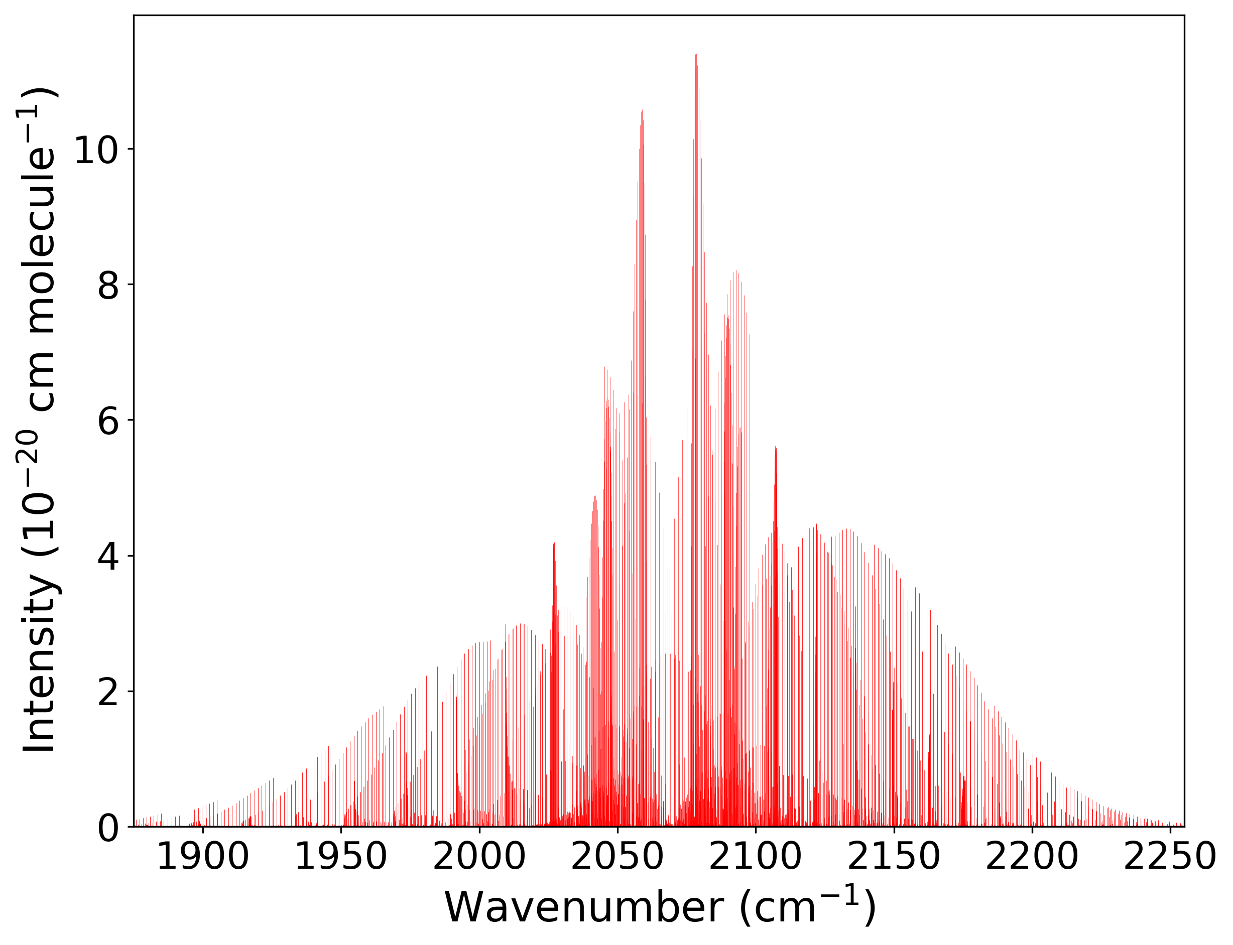
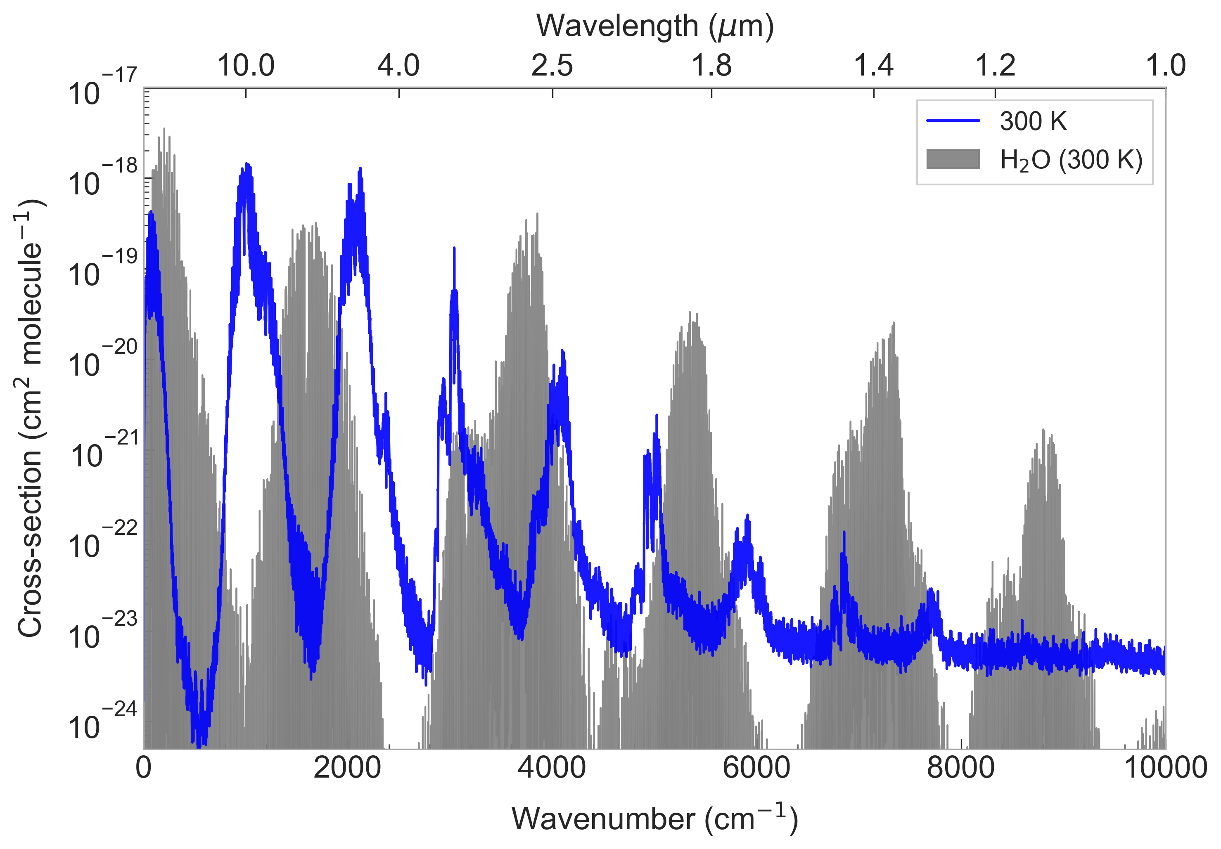
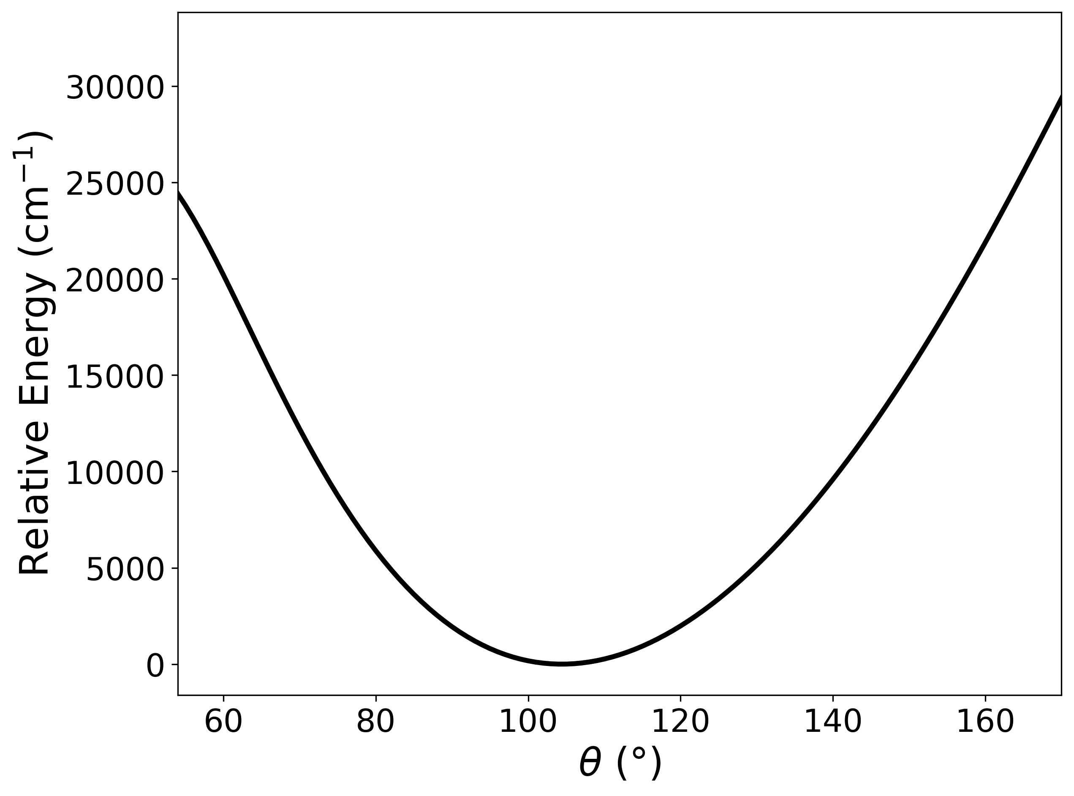
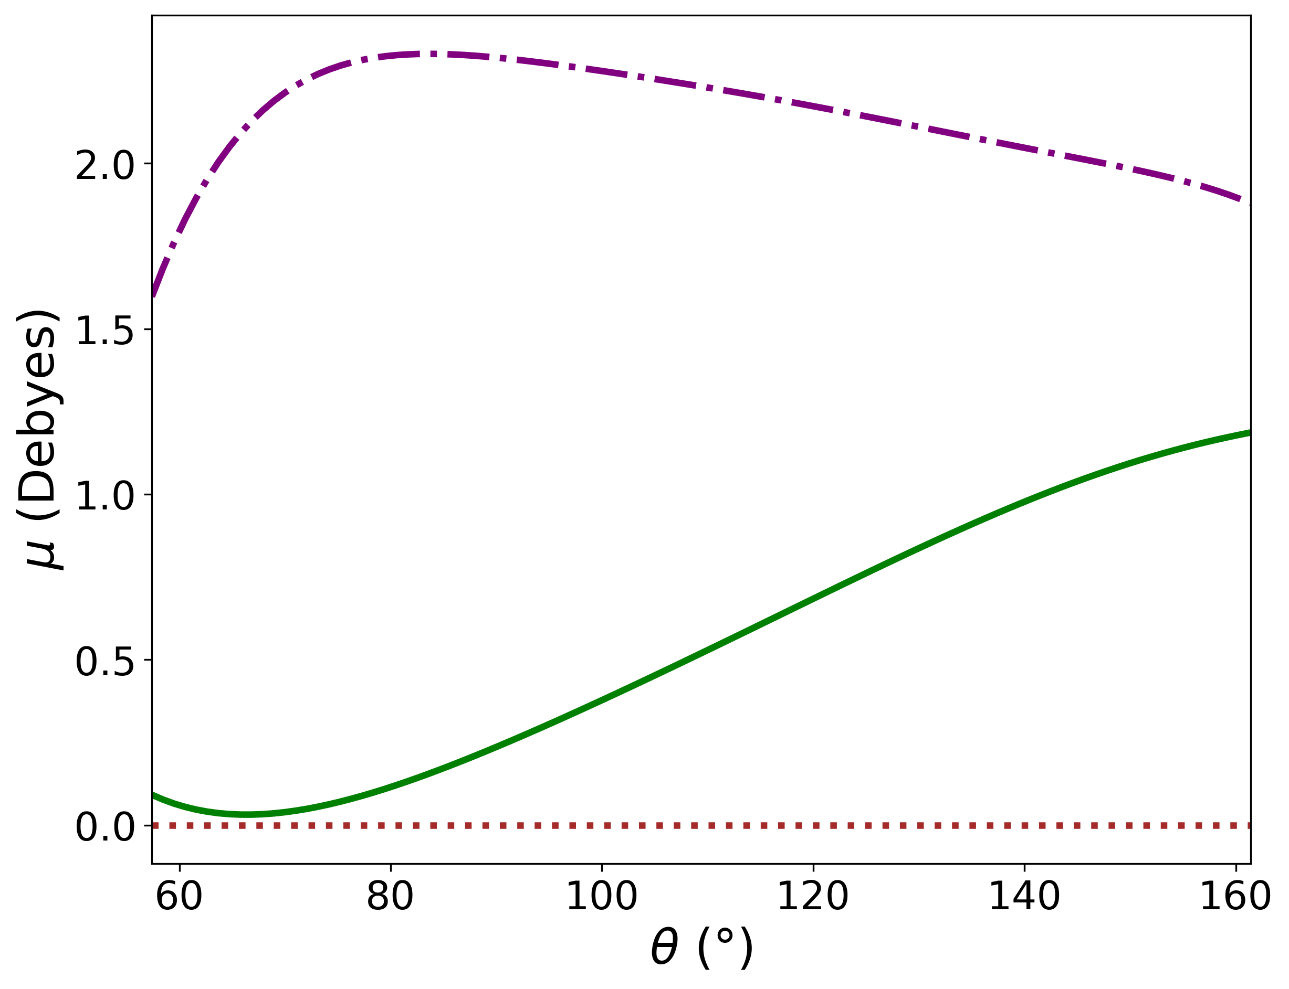
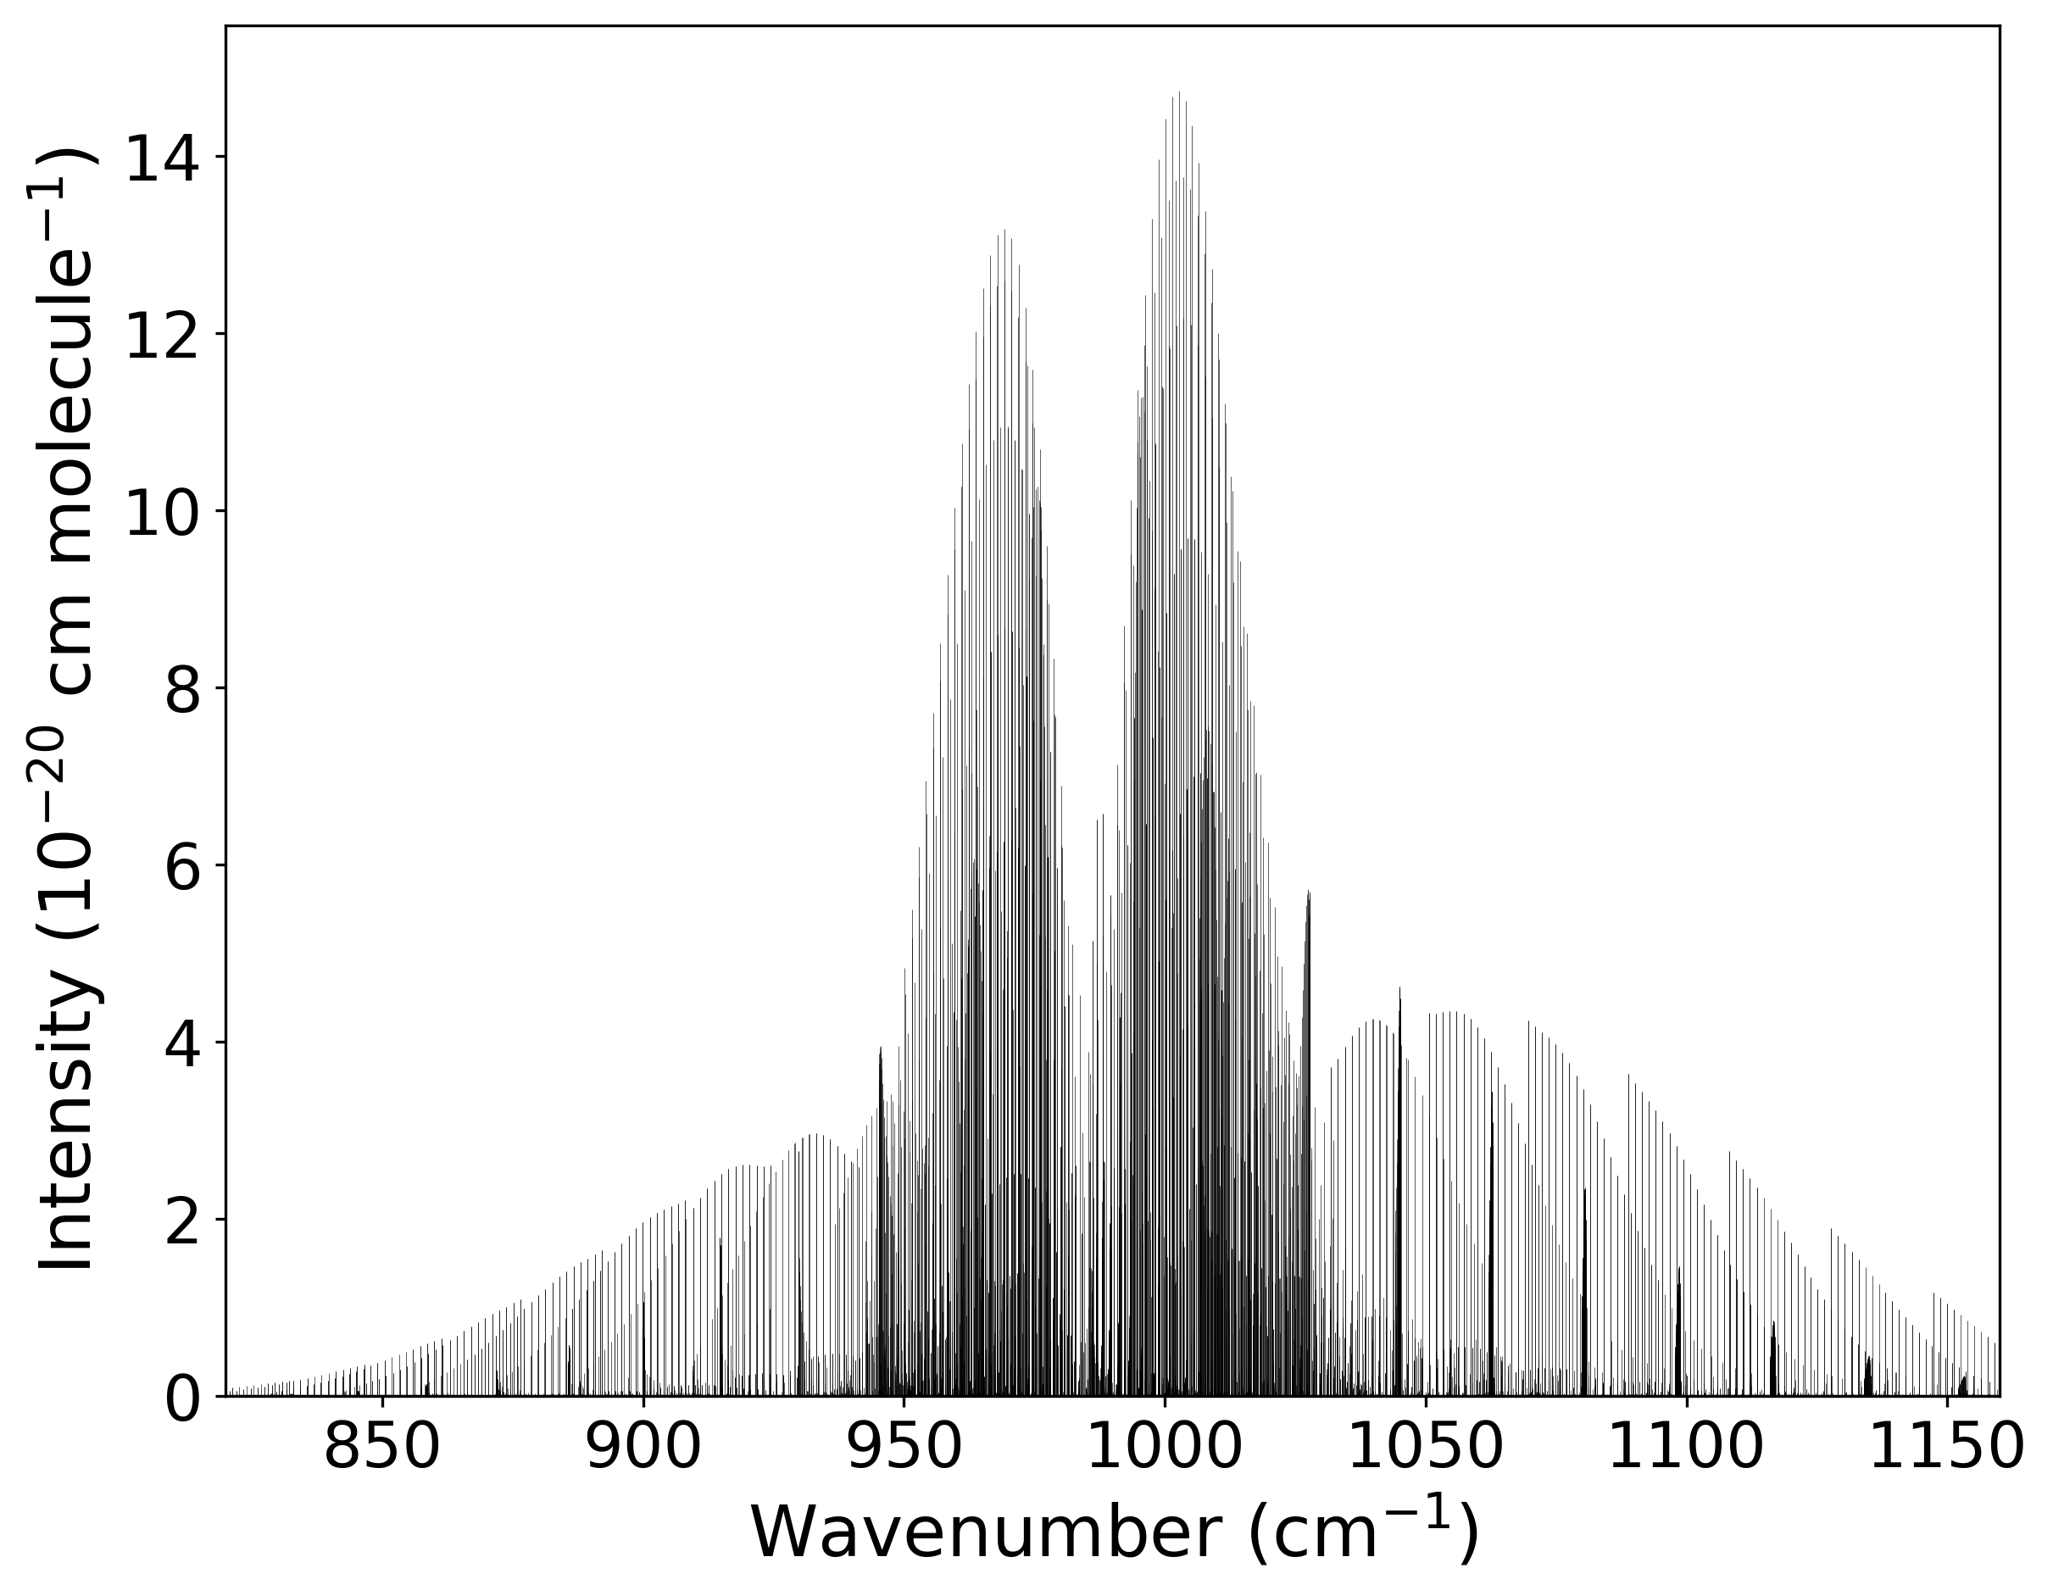
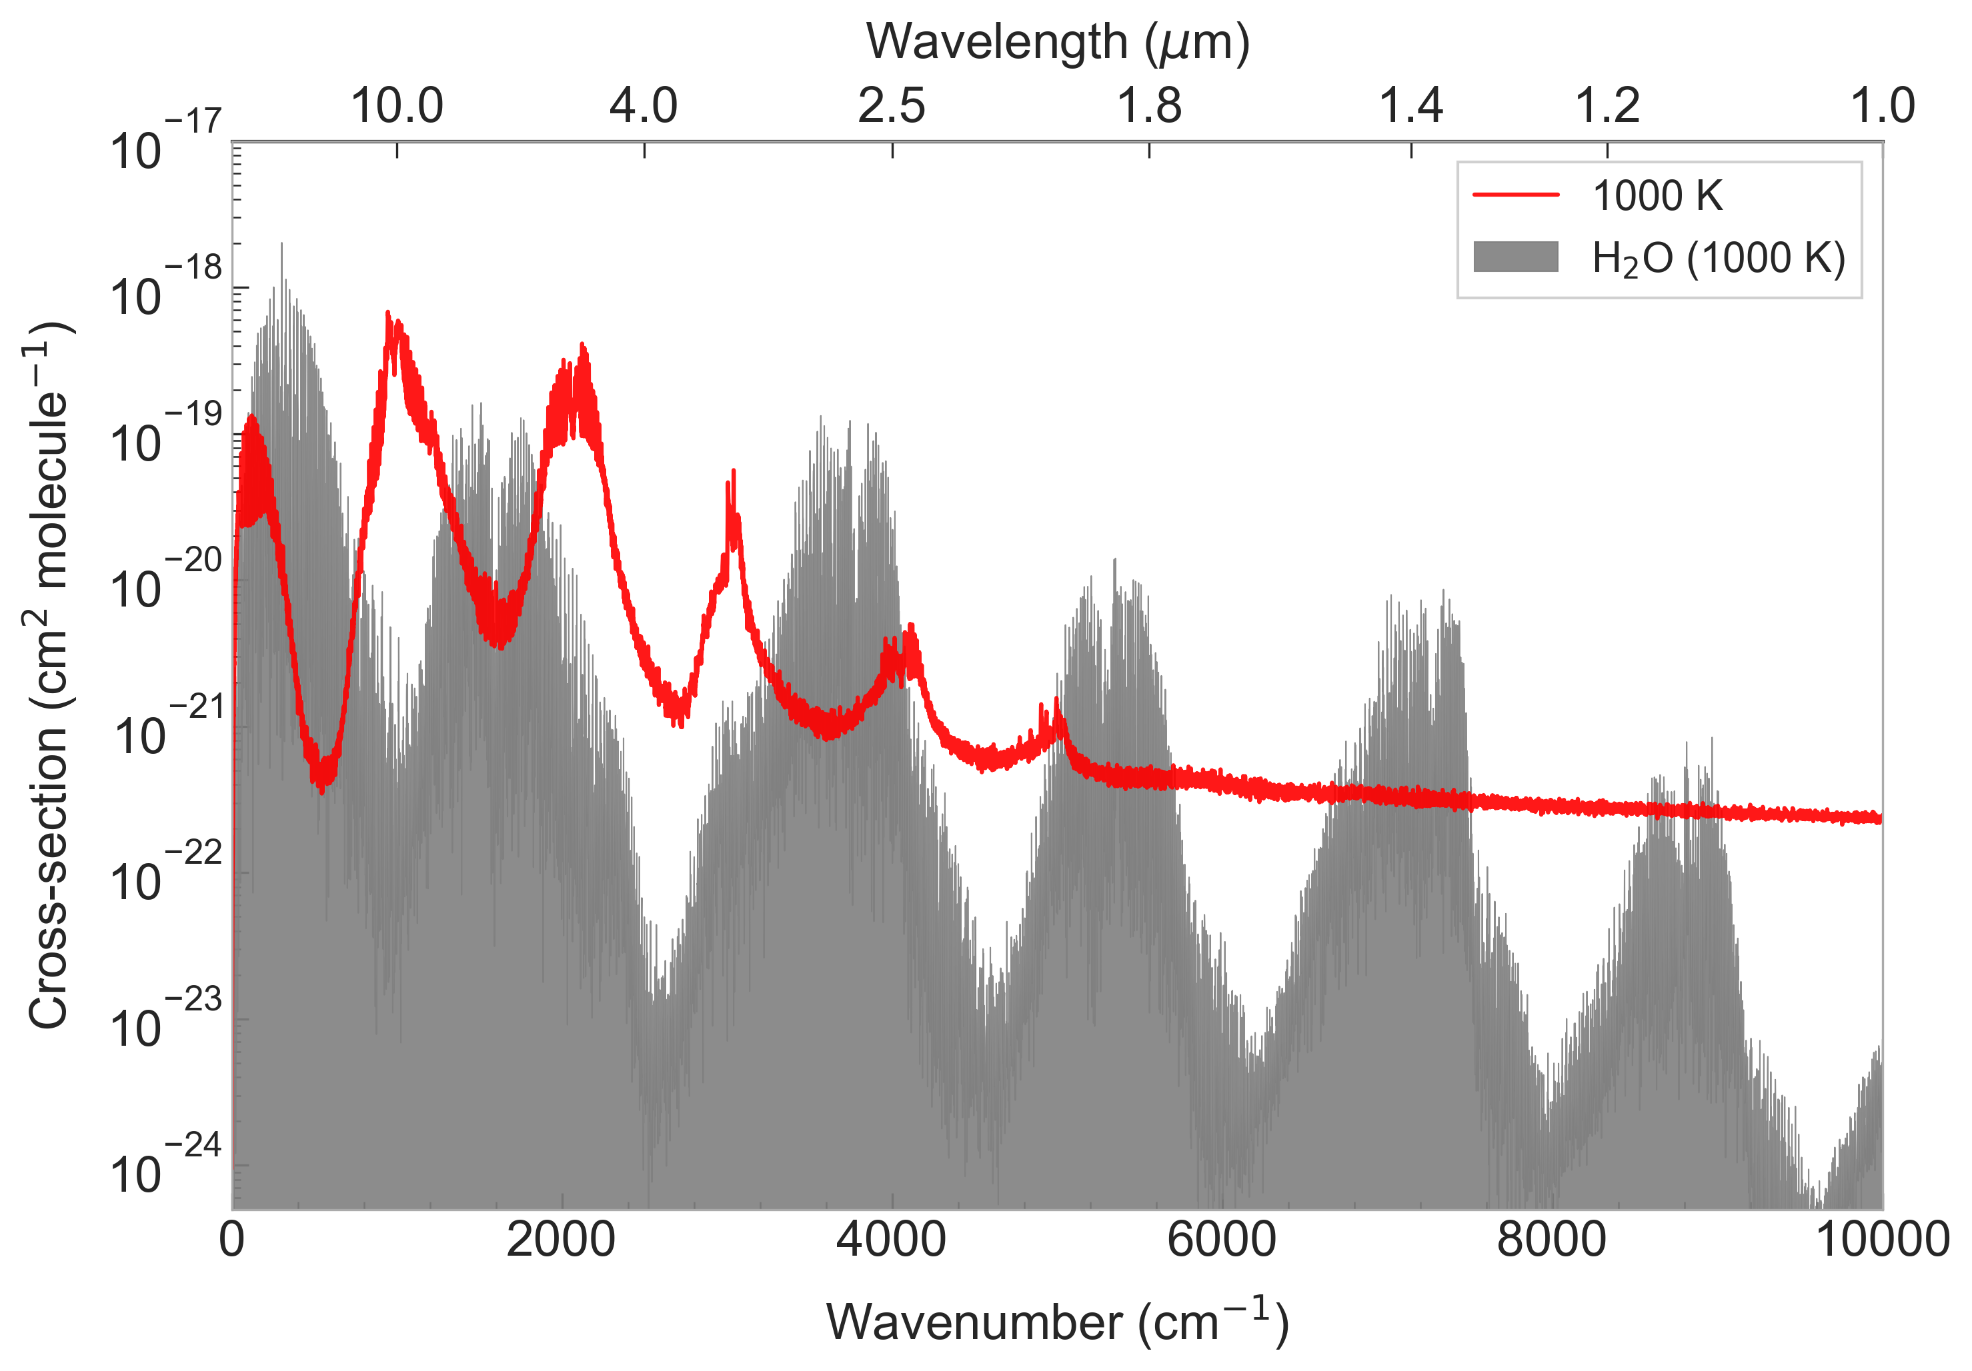








An Ab Initio Rovibrational Linelist for HPO
Ryan Mok, Fangping Liu, Sergei N. Yurchenko
Department of Physics and Astronomy, University College London, WC1E 6BT, London, UK
Motivation: Why HPO?
Potential Energy Surface
Dipole Moment Surfaces
Stick Spectra
Cross-sections
HPO appears as a precursor molecule in proposed abiotic mechanisms to form phosphine on Venus. It was predicted to be detectable in the interstellar medium.
Can HPO play a role on lava or rocky exoplanets?
7770 ab initio points computed with CCSD(T)-F12/cc-pVQZ-F12a
Same grid as the PES computed with CCSD(T)/aug-cc-pV(5+d)Z
Rotational stick spectra of the fundamental vibrational modes
Rovibrational energies and wavefunctions are computed with variational nuclear motion program TROVE, then used to compute stick spectra and cross sections.
Aims
Produce a rovibrational linelist for HPO (electronic ground state only).
Evaluate potential for HPO detection on exoplanets/planets.
Cross-section plot computed with states up to J=141. Partition function convergence suggests J=120 could be sufficient.
Equilibrium bond lengths and angles at the electronic ground state:
P
Exoplanet
Detection
$$1.455 Å$$
$$1.484 Å$$
The fundamental bands of HPO do not overlap with water. This makes detection more feasible.
Detection appears more likely for cooler planets.
H
$${104.4}^{∘}$$
O
We use the internal coordinates and Cartesian axis as presented:
H
Conclusion
P
$$r_{2}$$
Rovibrational spectra of HPO is easier to compute to due rigid bending of the molecule.
Can be of interest for studying exoplanets and the planetary chemistry of phosphorus.
$$r_{1}$$
$$θ$$
$$z$$
$$x$$
Fit PES has root-mean-square error of 2 cm⁻¹ for energies under 18,000 cm⁻¹ .
Molecule appears relatively rigid (stiff bending), we can use non-singular methods to perform variational calculations.
Dipole values calculated oriented with respect to the Cartesian axis given.
Fitted to a Taylor-series type expansion.
The first and third fundamental modes have been experimentally measured, but not the second, despite intensity seeming higher.
O

