Slide 1
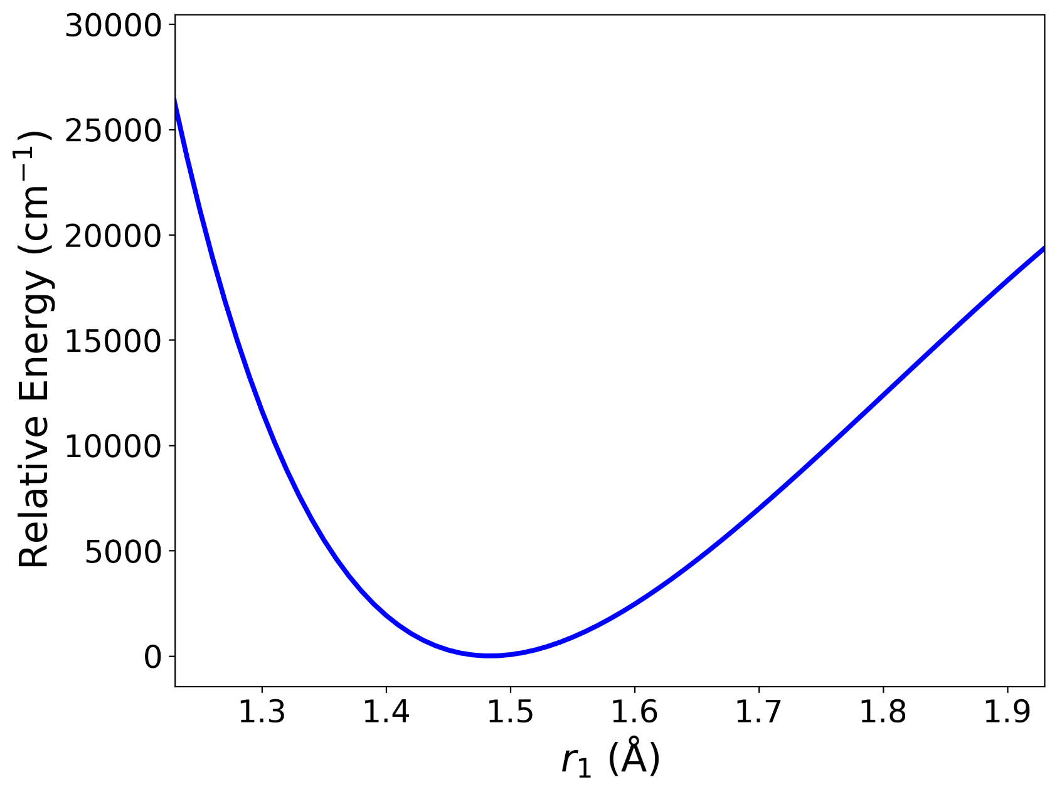
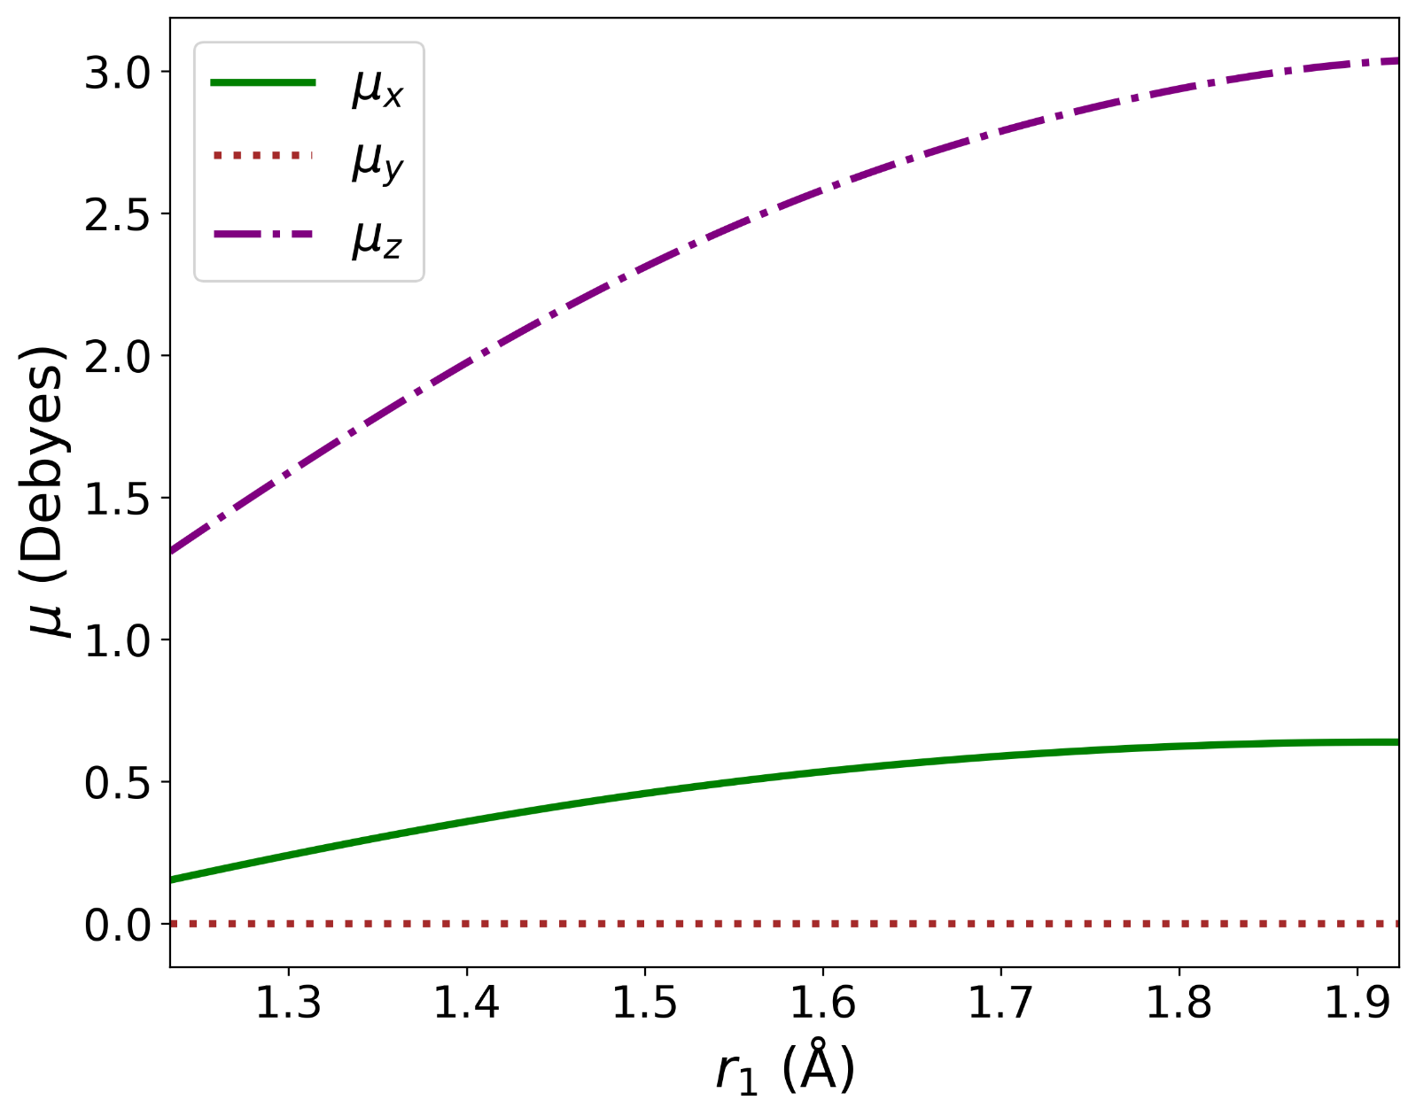
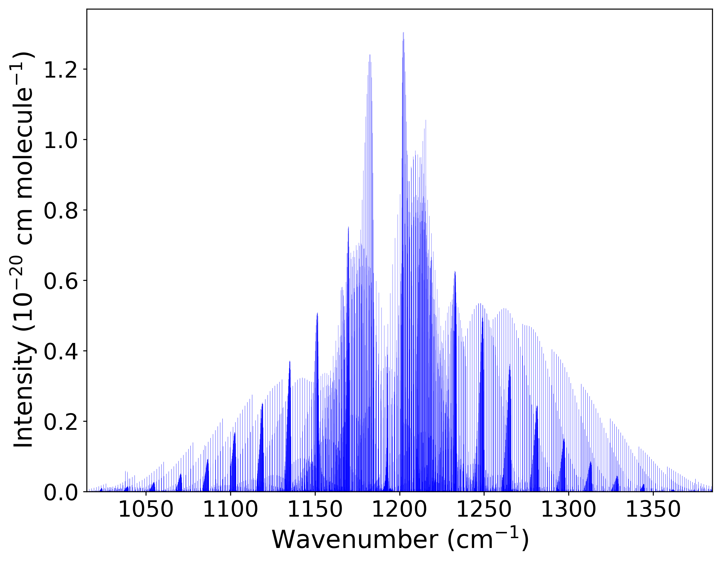
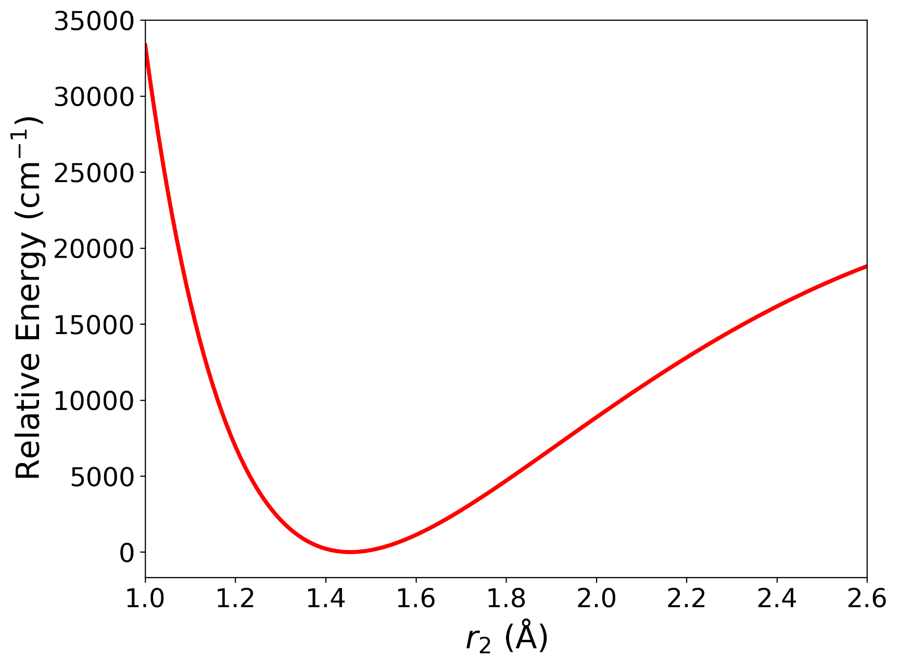
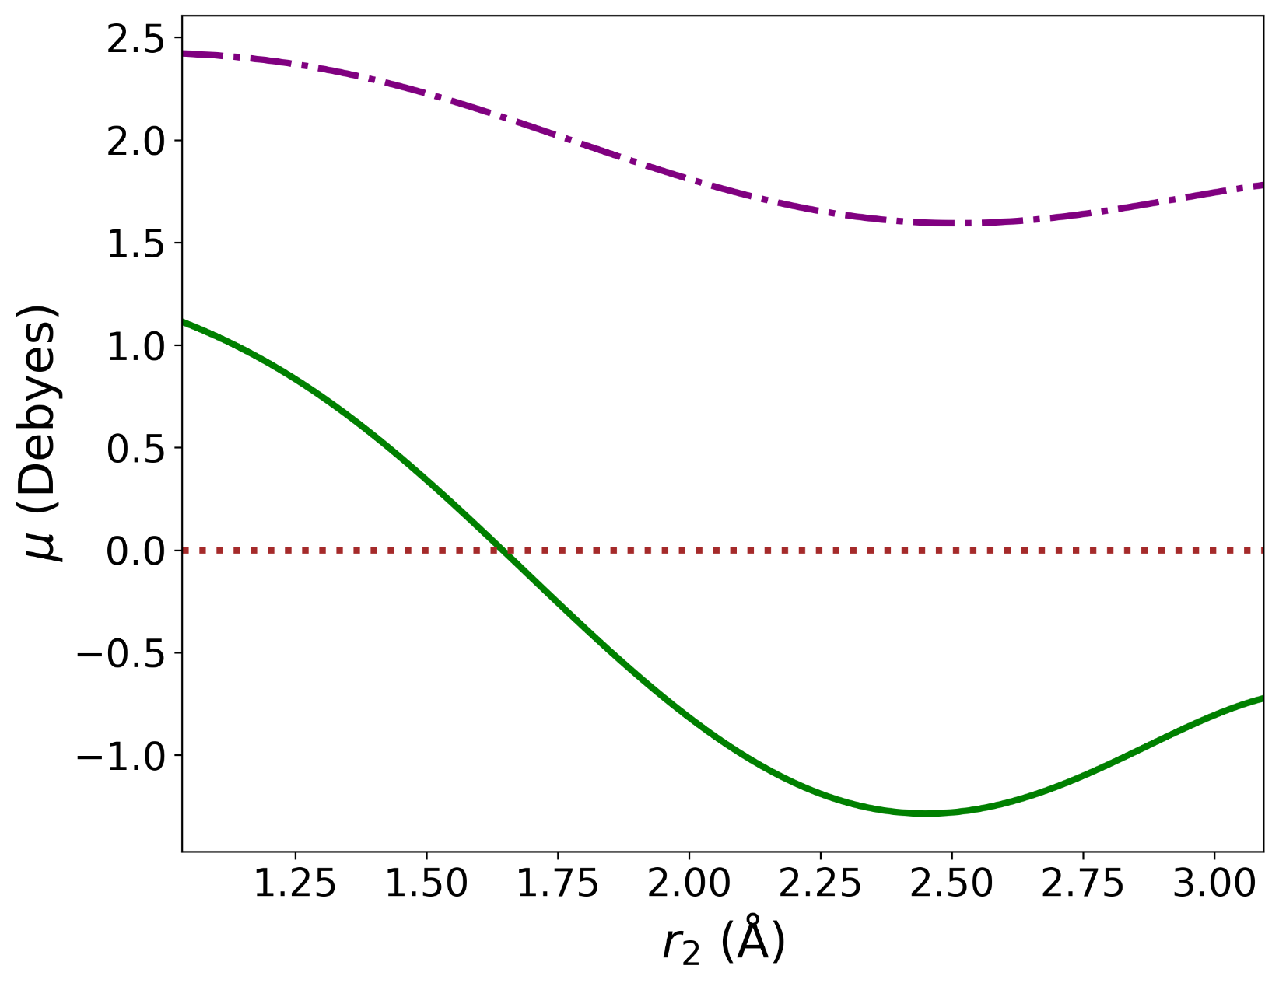
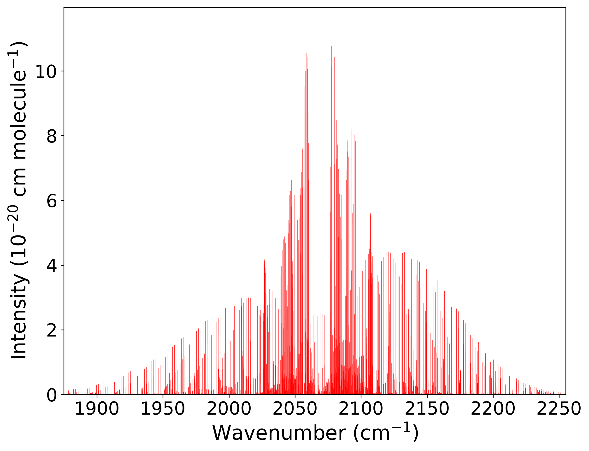

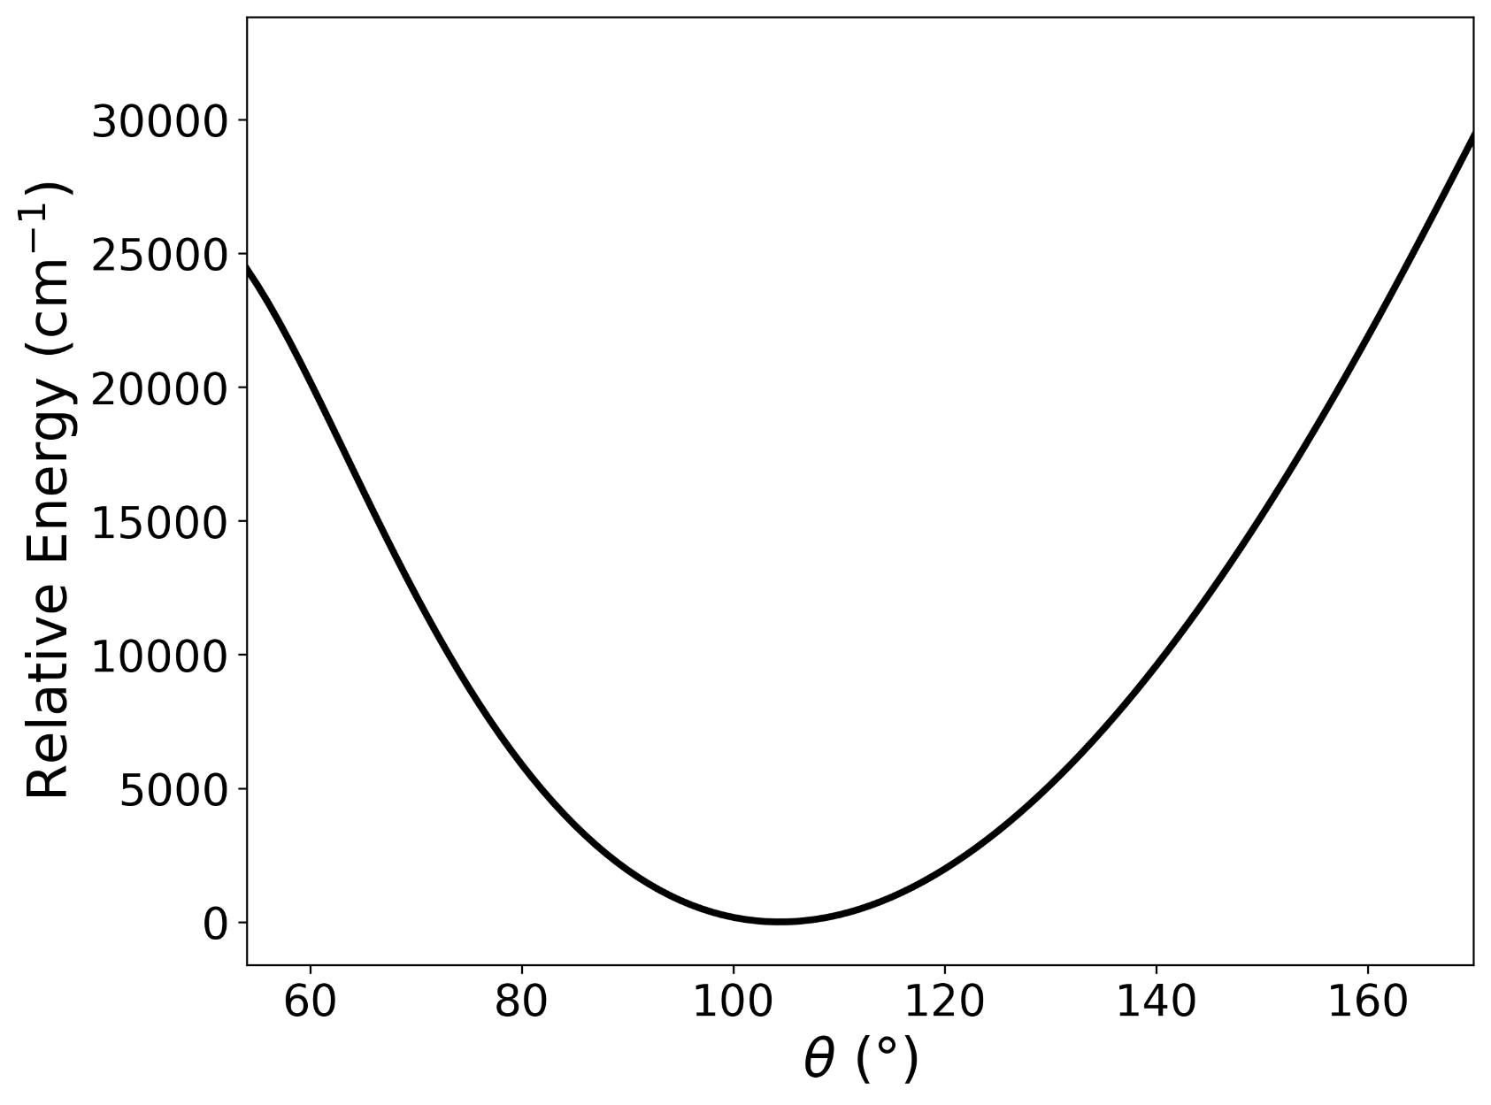
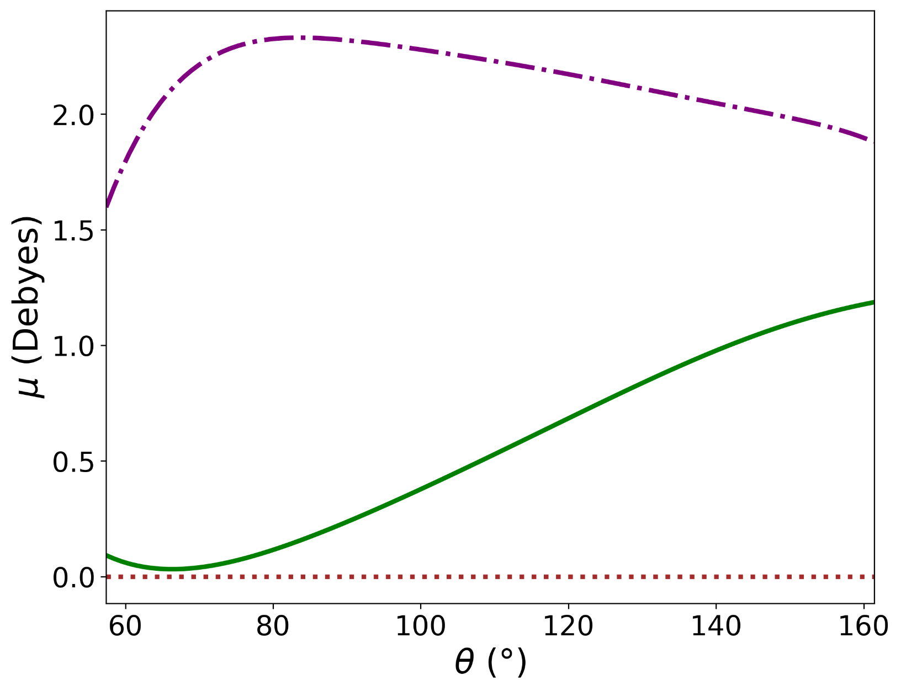
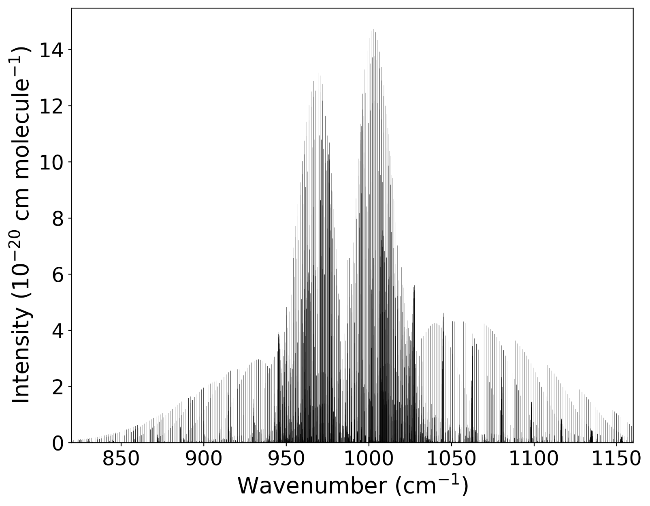
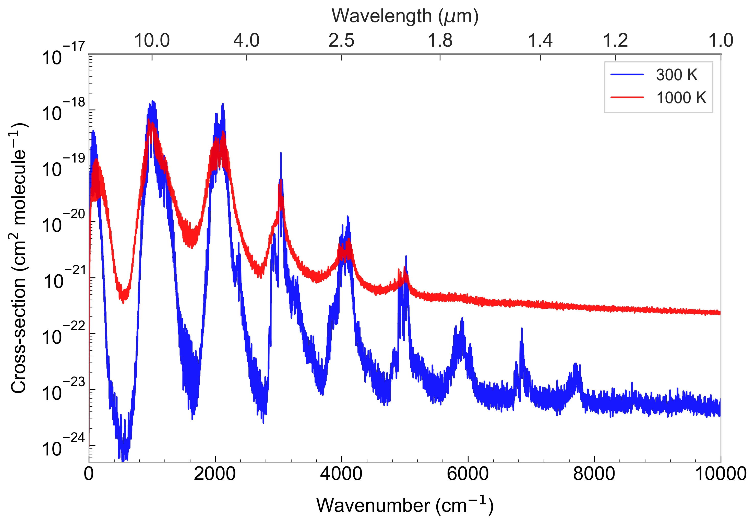
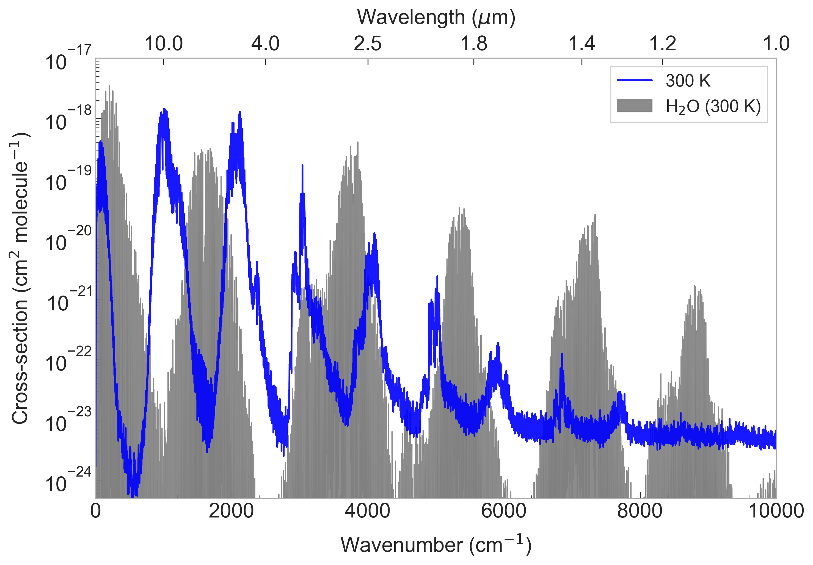
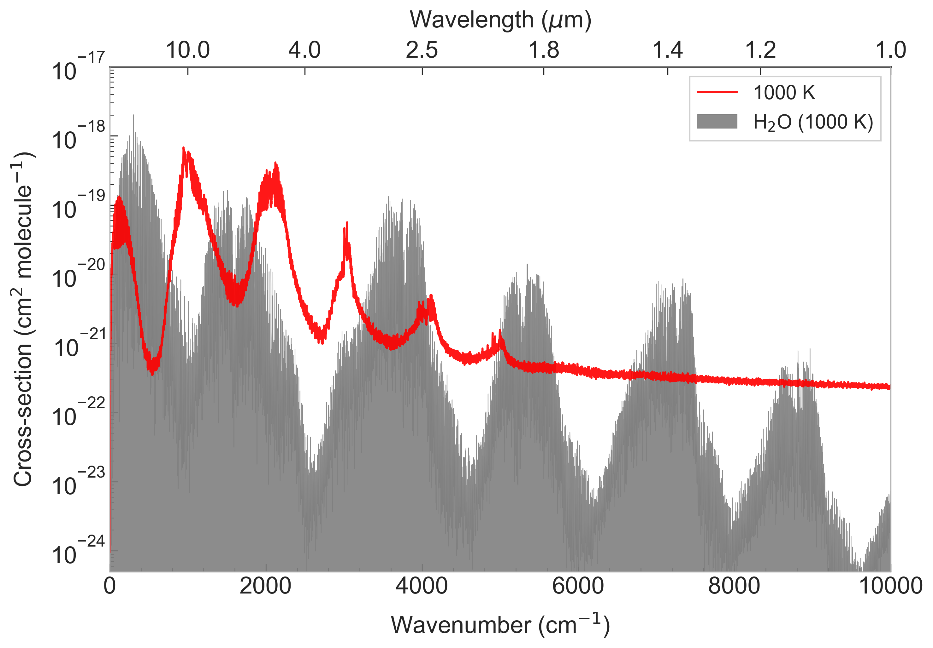
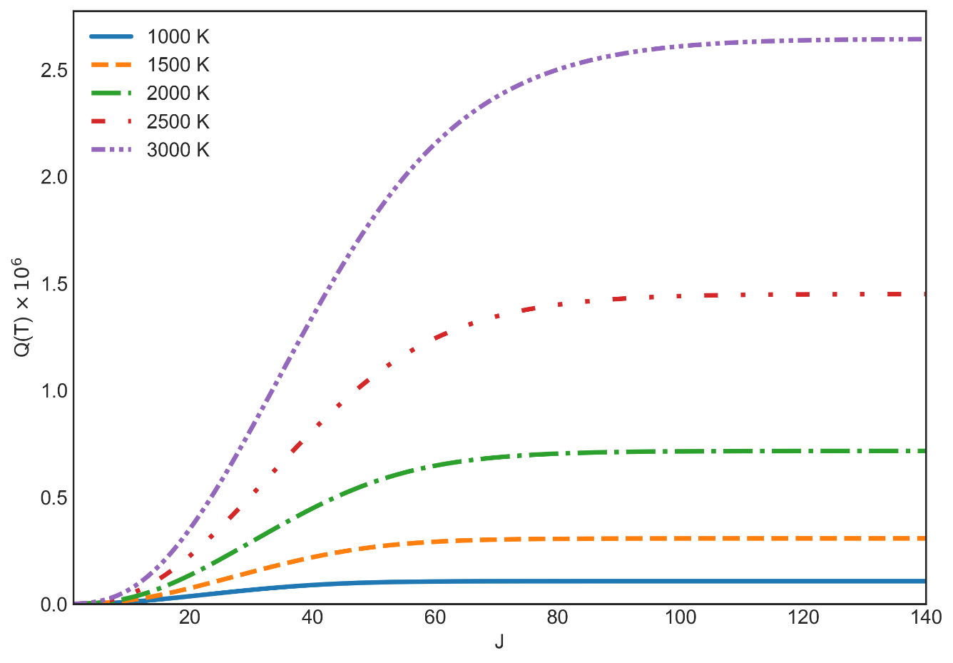








An Ab Initio Rovibrational Linelist for HPO
Ryan Mok, Fangping Liu, Sergei N. Yurchenko
Department of Physics and Astronomy, University College London, WC1E 6BT, London, UK
The fundamental bands of HPO do not overlap with water. This makes detection more feasible.
Motivation: Why HPO?
Potential Energy Surface
Dipole Moment Surfaces
Stick Spectra
HPO appears as a precursor molecule in proposed abiotic mechanisms to form phosphine on Venus. It was predicted to be detectable in the interstellar medium.
Can HPO play a role on lava or rocky exoplanets?
7770 ab initio points computed with CCSD(T)-F12/cc-pVQZ-F12a
Same grid as the PES computed with CCSD(T)/aug-cc-pV(5+d)Z
Rotational stick spectra of the fundamental vibrational modes
Aims
Produce a rovibrational linelist for HPO (electronic ground state only).
Evaluate potential for HPO detection on exoplanets/planets.
Equilibrium bond lengths and angles at the electronic ground state:
P
$$1.455 Å$$
$${104.4}^{∘}$$
$$1.484 Å$$
H
O
We use the internal coordinates and Cartesian axis as presented:
$$r_{2}$$
H
P
$$r_{1}$$
$$θ$$
$$z$$
Fit PES has root-mean-square error of 2 cm⁻¹ for energies under 18,000 cm⁻¹ .
Molecule appears relatively rigid (stiff bending), we can use non-singular methods to perform variational calculations.
Dipole values calculated oriented with respect to the Cartesian axis given.
Fitted to a Taylor-series type expansion.
The first and third fundamental modes have been experimentally measured, but not the second, despite intensity seeming higher.
O
$$x$$
Cross-sections
Rovibrational energies and wavefunctions are computed with variational nuclear motion program TROVE, then used to compute stick spectra and cross sections.
Lower states are selected between 0 to 14,000 cm⁻¹ while upper states are between 0 to 24,000 cm⁻¹. Includes 2.4 million rovibrational states and 2.2 x 10¹⁰ transitions.
Exoplanet Detection?
The fundamental bands of HPO do not overlap with water. This makes detection more feasible. The fundamental band at 985 cm⁻¹ would be particularly visible.
We suggest HPO can be of interest for studying exoplanets and the planetary chemistry of phosphorus.
Cross-sections computed with states up to J = 141. Partition function plots as a function of J suggests J = 120 could be sufficient instead.
Cross-sections and partition functions were computed with the program ExoCross.

