Slide 1
Sugeno Fuzzy inference system
Exercise and Solution
Dr. Sushitha Susan Joseph

Slide 2
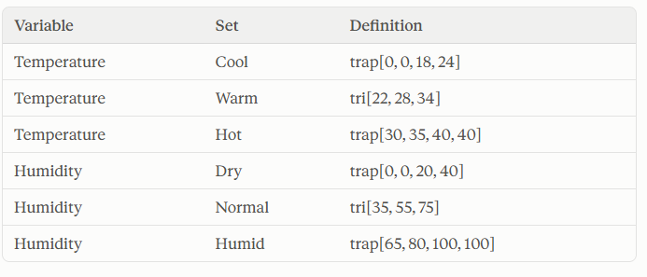
Exercise
Design a Sugeno-style fuzzy inference system to adjust fan speed based on Room Temperature and Relative Humidity.
Universes of discourse: Temperature (°C): 0–40; Humidity (%): 0–100; Fan Speed (% of maximum): 0–100.
Input fuzzy sets.
Trapezoid is trap[a, b, c, d]: membership rises from 0 at a to 1 at b, stays 1 until c, and falls to 0 at d.
Triangle is tri[a, b, c]: membership is 0 at a, 1 at b and 0 at c.

Slide 3
Output (fuzzy singletons): Low = 10, Medium = 50, High = 90.
Rule base:
IF Temperature is Cool AND Humidity is Dry THEN Fan Speed is Low
IF Temperature is Warm AND Humidity is Normal THEN Fan Speed is Medium
IF Temperature is Hot AND Humidity is Humid THEN Fan Speed is High
IF Temperature is Hot AND Humidity is Dry THEN Fan Speed is Medium
IF Temperature is Cool AND Humidity is Humid THEN Fan Speed is Medium
For Temperature = 31 °C and Humidity = 70 %:
(a) Fuzzify both inputs, sketching the membership functions and marking the readings.
(b) Compute the firing strength of each rule, using min for AND.
(c) Sketch the aggregated singleton output and compute the crisp fan speed by the weighted-average method.

Slide 4
Zero-order Sugeno fan-speed controller
Temperature (°C), universe 0–40
Cool = trap[0, 0, 18, 24]
Warm = tri[22, 28, 34]
Hot = trap[30, 35, 40, 40]
Humidity (%), universe 0–100
Dry = trap[0, 0, 20, 40]
Normal = tri[35, 55, 75]
Humid = trap[65, 80, 100, 100]
Fan speed singletons (% of max)
Low = 10 · Medium = 50 · High = 90
Rule base
1. IF Cool AND Dry THEN Low
2. IF Warm AND Normal THEN Medium
3. IF Hot AND Humid THEN High
4. IF Hot AND Dry THEN Medium
5. IF Cool AND Humid THEN Medium
Inputs: T = 31 °C, H = 70 %
(a) Fuzzify both inputs
(b) Evaluate each rule (AND = min)
(c) Aggregate and compute the crisp output

Slide 5
(a) Fuzzification at T = 31 °C and H = 70 %
μ
Cool
Warm
Hot
μ
Dry
Normal
Humid
1
1
0.5
μ = 0.5
0.5
μ = 0.33
μ = 0.2
μ = 0.25
0
0
0
10
20
30
40
0
20
40
60
80
100
Temperature (°C)
T = 31 °C
Humidity (%)
H = 70 %
Cool(31) = 0 (31 > 24)
Warm(31) = (34 − 31) / (34 − 28) = 0.5
Hot(31) = (31 − 30) / (35 − 30) = 0.2
Dry(70) = 0 (70 > 40)
Normal(70) = (75 − 70) / (75 − 55) = 0.25
Humid(70) = (70 − 65) / (80 − 65) = 0.33

Slide 6
(b) Rule evaluation (AND = min)
Rule | Antecedent | min of memberships | Output k | Firing strength w
R1 | Cool AND Dry | min(0, 0) | Low = 10 | 0
R2 | Warm AND Normal | min(0.5, 0.25) | Medium = 50 | 0.25
R3 | Hot AND Humid | min(0.2, 0.33) | High = 90 | 0.2
R4 | Hot AND Dry | min(0.2, 0) | Medium = 50 | 0
R5 | Cool AND Humid | min(0, 0.33) | Medium = 50 | 0
Only R2 and R3 fire (w > 0). R1, R4 and R5 contribute nothing.
Fuzzification and rule evaluation are identical to Mamdani. Only the consequent differs.

Slide 7
(c) Aggregation: collect the (k, w) pairs
w
0.4
Each rule gives a singleton at its constant k, with height equal to its firing strength w.
R2 gives (k = 50, w = 0.25)
R3 gives (k = 90, w = 0.2)
R1, R4, R5 have w = 0, so no visible spike.
No shapes to union: the spikes keep their own heights, and the next step uses them.
0.3
k=50, w=0.25
k=90, w=0.2
0.2
0.1
R1: w = 0
0
0
10
20
30
40
50
60
70
80
90
100
Fan speed (% of max)

Slide 8
(c) Defuzzification: weighted average
z = Σ (w × k) / Σ w
w
z = 67.78 %
0.4
= (0.25 × 50 + 0.2 × 90) / (0.25 + 0.2)
= (12.5 + 18) / 0.45
= 30.5 / 0.45 ≈ 67.78 %
Sanity checks
z lies between 50 and 90 ✓
z is closer to 50 because w of R2 (0.25) is larger than w of R3 (0.2) ✓
Dividing by Σ w normalises the result. Without it we would get 30.5, which is not a valid fan speed.
0.3
k=50, w=0.25
k=90, w=0.2
0.2
0.1
R1: w = 0
0
0
20
40
60
80
100
Fan speed (% of max)

