Slide 1

Kettoo
Team Codio
Private communication and coordination for event teams
Notes:
Kettoo is a native Android app, browser console and organisation-hosted backend for event communication and coordination. The implementation includes live push-to-talk, messages, venue check-ins and issue workflows. Source: PROJECT_SUMMARY.md and README.md in the Kettoo project, reviewed 10 October 2026. Team name: Codio, as supplied by the presenter. Team number omitted at the presenter's request.

Slide 2

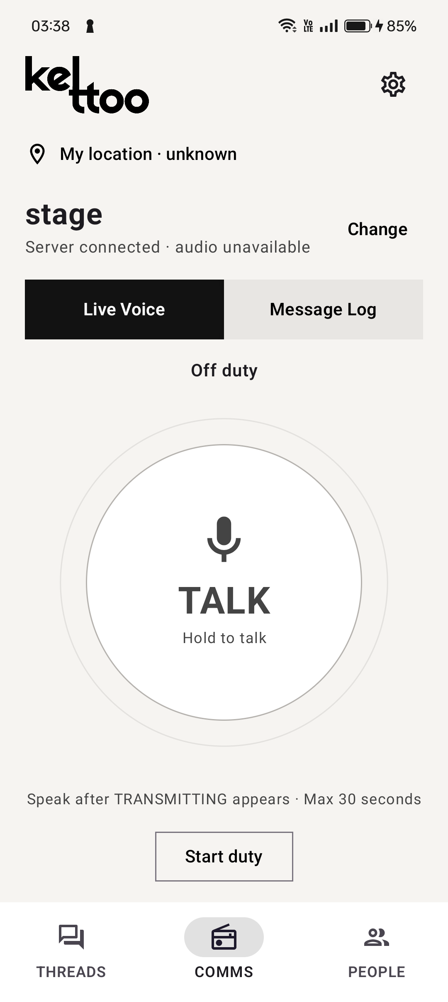
Introduction
A private communicator
on staff members’ phones
Teams in conferences, hackathons, malls and hospitals need quick coordination. Staff phones can bring text and media sharing alongside walkie-talkie voice.
Kettoo combines push-to-talk, chat, photo/video sharing and private calls in an Android app and browser console. Admins approve access, manage channels and broadcast to everyone.
The organisation hosts its server, media and history. Local queues and direct Android Nearby links support outage recovery.
Kettoo Android app
Notes:
The supplied challenge identifies conferences, hackathons, malls and hospitals as use cases. Kettoo currently has a development/demo implementation with event-oriented venue operations. These sectors are intended applications, not established customers or validated hospital deployments. Core capabilities: PTT, text/media, private voice/video calls, approved organisational membership, admin controls, broadcast and local infrastructure. Direct Nearby is Android-only fallback. Sources: user-supplied problem statement; README.md; PROJECT_SUMMARY.md; docs/nearby-failover.md.

Slide 3
Problem Statement
Large conferences, hackathons, malls, and hospitals still rely on walkie-talkies for team coordination, which require cost, charging, and maintenance while supporting only voice communication.
Build a communicator app that runs on staff members’ phones, providing instant push-to-talk for individuals or team channels, along with chat, photo/video sharing, and voice/video calls in a familiar messaging interface.
The system must operate as a closed organisational network, where only authorised members can join and admins manage teams and channels. Provide an admin view to monitor online users and active channels, with the ability to broadcast to everyone.
Prefer direct device-to-device communication where possible, while handling network congestion, patchy connectivity, and locked phones. All messages and media must remain within the organisation’s own infrastructure.
Notes:
Exact problem statement supplied by the user. Paragraph breaks added for readability. The brief sets requirements, not verified findings about current customers or cost savings. Smartphones also need charging. Kettoo online media uses organisation-hosted LiveKit, with direct Nearby fallback on Android. Private PTT has permission restrictions; it is not arbitrary one-to-one PTT for every approved pair. Locked-screen receive has historical device evidence, while guaranteed locked-screen hardware transmission and congestion performance still need acceptance. Source: user-supplied challenge in this conversation.

Slide 4
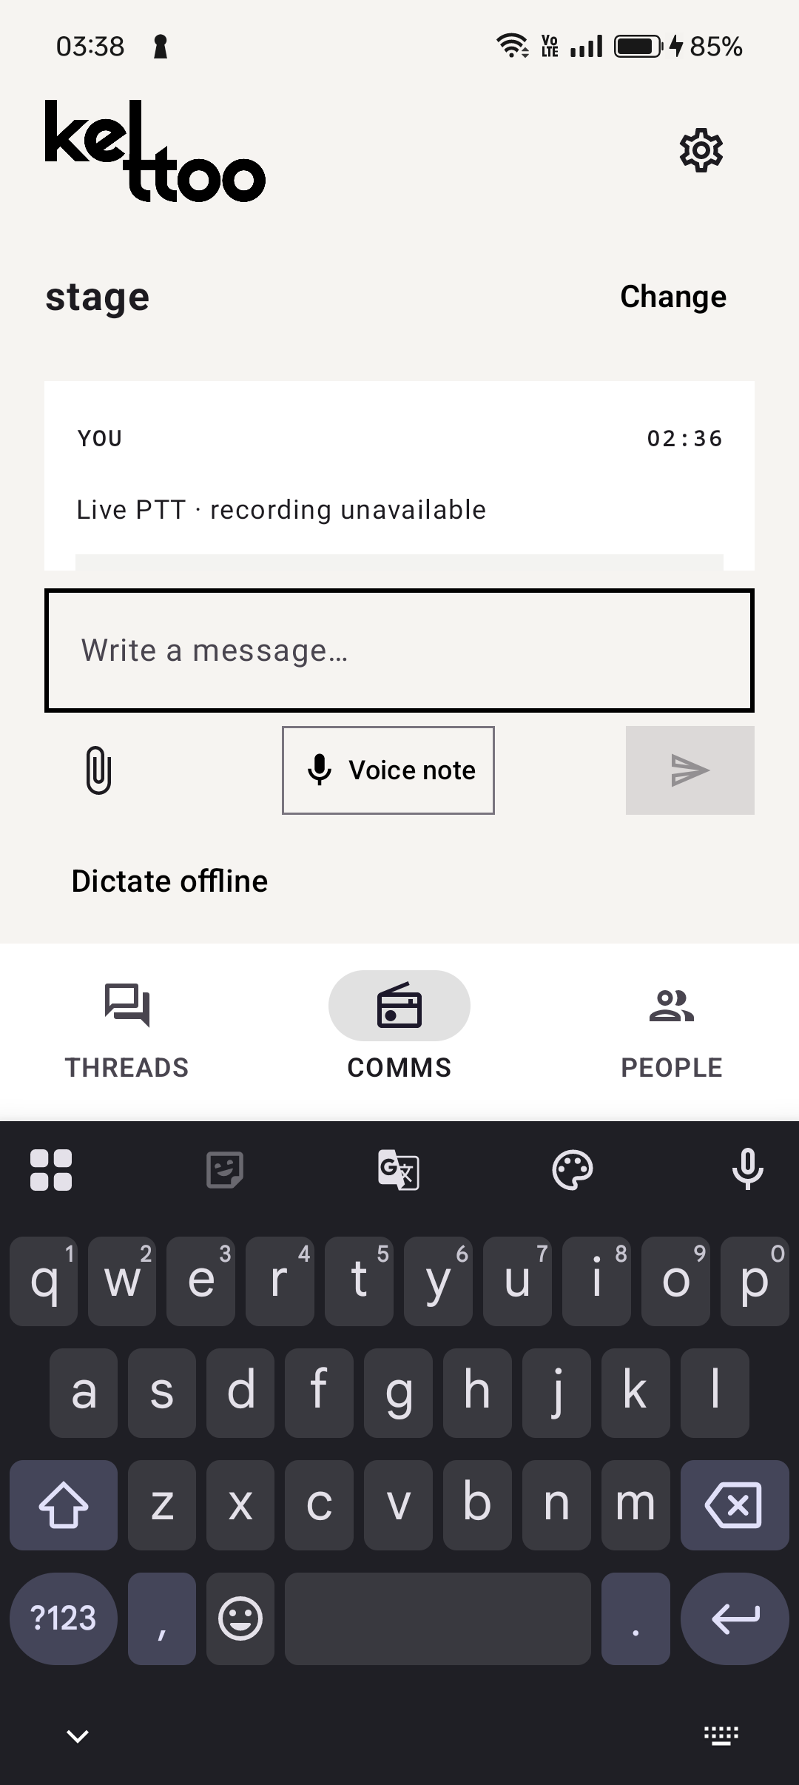
Proposed Solution
A closed organisation network
with a familiar messaging interface
Staff communicate through the Android app. Admins manage access, presence and channels in the browser console.
Push-to-talk and private calls
Use permitted team/private PTT, voice/video calls and broadcasts to everyone.
Chat and media sharing
Send text, photos, videos and voice notes. Keep saved PTT bursts available for replay.
Organisation control and recovery
Approve members and devices, restrict channel access and recover through local queues and Nearby.
Android Message Log
Notes:
The workflow links immediate communication to a durable operational record. Private calls, attachments, messages and archive complement PTT. Ownership changes and acknowledgements need server confirmation. Vosk provides recorded-message English transcription, not live captions. Screenshot is an actual historical installed-app capture and shows the message composer above the keyboard.
Sources: PROJECT_SUMMARY.md sections 3.2–3.5, 3.9 and 3.10; docs/ui-ux-review-comms.md; image: artifacts/ui-review/2026-10-10/cph2613-message-log-keyboard-final.png. Project records reviewed 10 October 2026.
Alignment with supplied challenge: authorised membership, admin channel/presence controls, all-staff broadcast and private organisational infrastructure. Private live PTT requires eligible teammate or duty-admin access, while approved private text/calls have separate rights. Device-to-device communication currently acts as outage fallback, rather than the primary online path. No measured congestion or universal locked-phone guarantee.

Slide 5
Technical Architecture and Tech Stack
Organisation-hosted services
with local recovery on each client
Layer | Technology | Responsibility
Android app | Kotlin, Compose, Room | Field controls, local cache and queued work
Browser console | React, TypeScript, IndexedDB | Communication, operations and administration
API and storage | Fastify, WebSocket, SQLite | Approval, permissions, issue state and history
Live audio / video | Self-hosted LiveKit | PTT, broadcasts and private calls
Speech and failover | Vosk, FFmpeg, Nearby Connections | Local English recognition and direct Android links
The organisation hosts the API, database, attachments and LiveKit media service.
Nearby provides direct Android fallback. No cloud chat or speech API is required.
Notes:
The API derives media room grants and manages speaking leases. SQLite and private files store server state. Android Room and browser IndexedDB preserve pending operations. Nearby is an Android-only direct transport, not a replicated venue database or multi-hop mesh. Vosk runs on-device and in a local server worker, with FFmpeg handling uploaded audio formats. Deployment uses a Node application service, LiveKit and Caddy HTTPS.
Sources: PROJECT_SUMMARY.md section 5; README.md; server/package.json; web/package.json; docs/nearby-failover.md; server/speech/README.md. Project records reviewed 10 October 2026.

Slide 6
Key Features and Implementation
Implemented features through version 0.3.0
Live communication
Offline continuity
Hold-to-talk with a 30-second limit, duty-admin exchanges, targeted broadcasts and private voice/video calls.
Local queues and direct Nearby TALK/media on approved Android phones, with later server sync.
Chat, media and history
Local speech tools
Text, photos, videos and voice notes, with saved PTT replay, delivery states and personal archive.
English transcripts of saved audio and editable offline dictation, without a cloud speech API.
Venue operations
Admin and field controls
Floor plans, named zones, staff check-ins and issue claims, replies, reassignment and resolution.
Approve accounts/devices, manage channels and view presence. Optional hardware PTT and Pocket Mode.
The backend and browser also support volunteers in multiple operational channels.
Notes:
All groups describe implemented capabilities. Acknowledgement, calls and issue ownership need the server. Nearby requires approved phones, permissions and unexpired credentials. Locked-screen key behaviour remains device dependent. The current backend/browser multi-channel model supersedes the original single-team rule; full Android multi-channel acceptance remains open.
Sources: PROJECT_SUMMARY.md sections 3.1–3.11; README.md; docs/nearby-failover.md; docs/ui-ux-review-settings.md; server/src/phase2.ts; server/src/db.ts. Project records reviewed 10 October 2026.

Slide 7
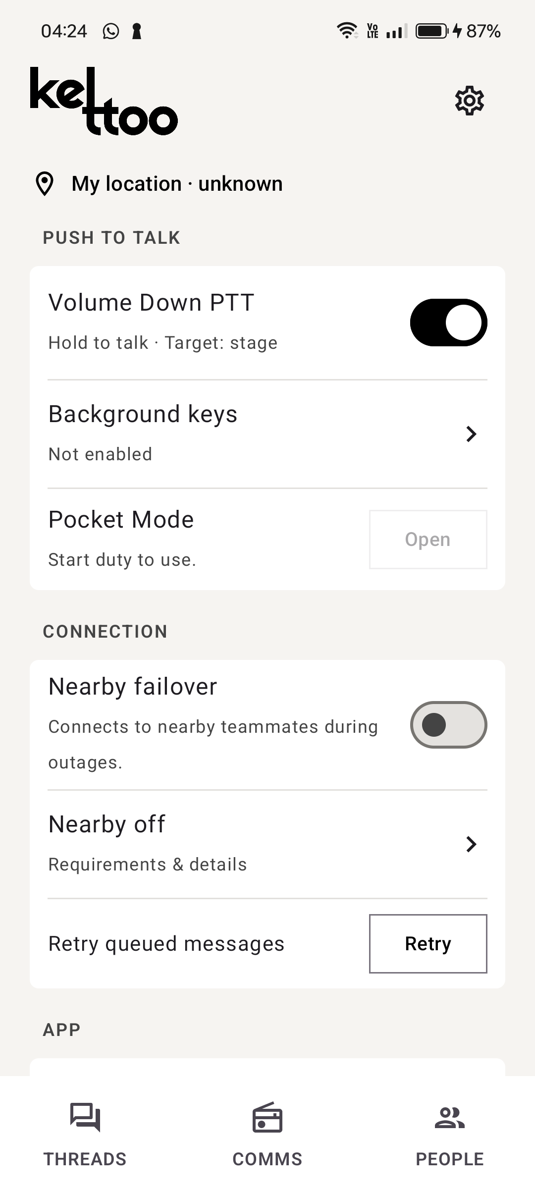
Live Demo
Demo: communicate, share media
and manage a closed team
01 Prepare the team
Approve two phones, assign channels and inspect online presence.
02 Talk, message and share
Use PTT, send text and a photo, then inspect the saved replay.
03 Call and broadcast
Show a private call and an admin broadcast to everyone.
04 Demonstrate recovery
With Nearby enabled, pause the API, exchange direct TALK/text, restore it and verify sync.
Hardware PTT and Nearby
Notes:
This is a proposed live demonstration sequence using implemented features, not a claim that this presentation session performed it. Before presenting, approve all devices, configure a real floor/zone, connect the media service and confirm the English model. Use a designated duty admin if demonstrating private exchanges. Enable Nearby on both approved phones and keep credentials valid. Controlled API-outage testing must keep the access point and radios available. Restore the API after the demonstration. The selected screenshot shows the feature controls with Nearby off and the phone off duty, so enable these before a real demo. The power issue and hall are illustrative.
Sources: PROJECT_SUMMARY.md sections 3 and 6; overview_phase3.md demo sequence; docs/nearby-failover.md; image: artifacts/ui-review/2026-10-10/cph2613-settings-installed-final-middle.png. Project records reviewed 10 October 2026.
Revised core demo aligns with the supplied challenge. Show message/video attachment and voice/video call eligibility, then admin presence and All Staff broadcast. End any call or reserved exchange before competing audio. For issue operations, use an optional extension after the core communication demo. Locked-phone receive should be checked on the actual phones. Do not imply guaranteed locked-screen PTT.

Slide 8
Impact, Feasibility and Scalability
A working prototype with evidence
and a clear path to venue acceptance
Intended operational impact
Feasibility and scalability
Use staff phones for communication.
Share text, photos and video.
Keep access under administrator control.
Store data on organisation infrastructure.
34/34 backend tests passed in the recorded verification run.
Two physical Android phones completed direct Nearby outage/recovery tests.
Android, browser and server components have build and device evidence.
Congestion, venue-scale load, radio range and locked-phone behaviour need further acceptance. Direct Nearby is Android fallback, not multi-hop mesh.
Notes:
Impact statements are expected benefits, not measured improvements. The 34/34 result comes from the backend suite run while preparing PROJECT_SUMMARY.md on 10 October 2026, not a fresh run for this deck. Earlier verification counts belong to separate snapshots and must not be summed. Nearby physical tests involved OnePlus CPH2613 and Samsung SM-A356E with the local API paused while the Wi-Fi access point remained available. Playback counters confirm audio output delivery, not subjective intelligibility. Historical builds/lint and specific phone checks do not prove production acceptance. No deployment cost estimate, performance benchmark or maximum volunteer count is established.
Sources: PROJECT_SUMMARY.md sections 4, 6 and 7; VERIFICATION.md; overview_till_phase2.md; docs/nearby-failover.md; docs/ui-ux-review-settings.md. Project records reviewed 10 October 2026.

Slide 9
Conclusion
Kettoo brings private staff
communication onto existing phones
Kettoo combines PTT, chat, media sharing and private calls with administrator-controlled membership and broadcasts, on organisation-owned infrastructure.
Core strengths
Voice and messaging in one interface.
Closed access and organisation-hosted storage.
Local queues and direct Android Nearby fallback.
Next milestone: validate congestion, patchy connectivity and locked-phone behaviour, then prepare a signed release and organisation deployment.
Notes:
Close with the complete workflow: reach a team, retain the report, associate it with a place, confirm responsibility and record resolution. The current project is a development/demo implementation through Phase 3 with selected real-device evidence. Future work is broader device, venue load/range, noise/accent, long-session and deployment acceptance. Nearby remains direct peer-to-peer, and no venue-wide mesh guarantee is claimed.
Sources: PROJECT_SUMMARY.md sections 1, 4, 7 and 8; README.md. Project records reviewed 10 October 2026.

