Slide 1

Kettoo
Team Codio
Private communication and coordination for event teams
Notes:
Kettoo is a native Android app, browser console and organisation-hosted backend for event communication and coordination. The implementation includes live push-to-talk, messages, venue check-ins and issue workflows. Source: PROJECT_SUMMARY.md and README.md in the Kettoo project, reviewed 10 October 2026. Team name: Codio, as supplied by the presenter. Team number omitted at the presenter's request.

Slide 2

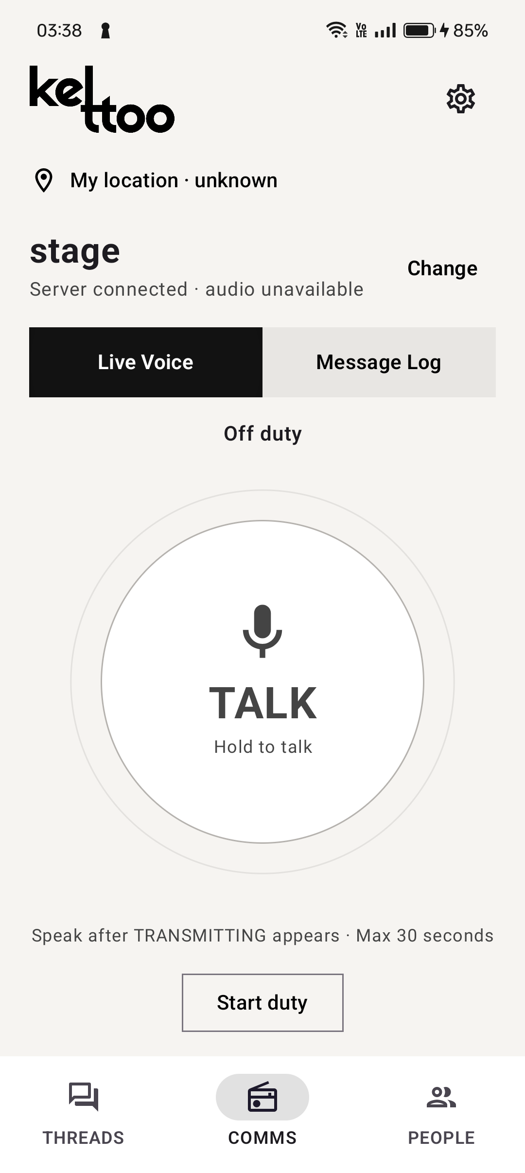
Introduction
Communication and coordination
for event teams
Event teams work across different floors and zones. They need to reach the right people quickly and know who is handling each reported issue.
Kettoo is a private platform for organisers and volunteers. It combines walkie-talkie voice and messaging with venue check-ins and issue tracking in an Android app and a browser console.
Local queues and direct Nearby communication help approved Android phones continue during outages.
Kettoo Android app
Notes:
Kettoo serves event organisers and volunteers working across venue zones. This introduction establishes the operating context before the next slide explains the coordination problem in more detail. Explain that Kettoo connects quick voice communication with persistent messages, zone check-ins and issues that have a confirmed owner and status. The Android app supports direct Nearby communication among approved, permitted phones during outages. Reach depends on direct connectivity, and this is not multi-hop mesh. Issue and check-in operations queue for server recovery. The browser does not implement Nearby.
Sources: PROJECT_SUMMARY.md sections 1, 3.3, 3.6, 3.7, 3.8 and 3.9; README.md; docs/nearby-failover.md. The event scenario describes the intended use case, not findings from a user study.
Image: actual installed Android screenshot, artifacts/ui-review/2026-10-10/cph2613-comms-installed-final.png. This historical screenshot shows the app off duty. It is not a generated mockup.

Slide 3
Problem Statement
A spoken request still needs
a location, an owner and a record
During an event, volunteers work in different zones. A request for help needs to reach the right team and remain visible until someone resolves it.
Reaching the right people
Separate conversations can make urgent updates difficult to route.
Keeping track of responsibility
A voice exchange alone does not show who owns an issue or whether it is resolved.
Working through an outage
Loss of the server connection can interrupt communication and delay updates.
Notes:
Frame these as the coordination challenges Kettoo is designed to address. We have not conducted a user survey or measured response-time savings. Example: a volunteer reports a power issue in a hall. An organiser needs the location, an accountable owner and a later resolution update. The next slide maps these needs to the implemented workflow.
Sources: PROJECT_SUMMARY.md sections 1, 3.8 and 3.9; overview_till_phase2.md. Project records reviewed 10 October 2026.

Slide 4
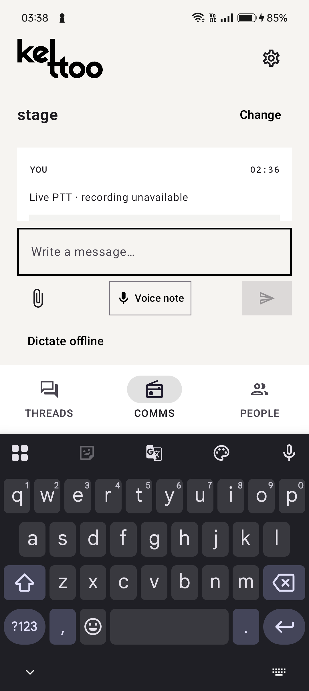
Proposed Solution
One workspace for communication
and follow-through
Kettoo connects volunteers in the Android app with organisers in the browser console, using an organisation-hosted server.
Talk to the right team
Use channel PTT, duty-admin exchanges and targeted broadcasts.
Keep each report actionable
Add a zone and photo, confirm an owner, then track replies and resolution.
Retain the communication record
Replay saved voice, read local English transcripts and acknowledge your own copy.
Android Message Log
Notes:
The workflow links immediate communication to a durable operational record. Private calls, attachments, messages and archive complement PTT. Ownership changes and acknowledgements need server confirmation. Vosk provides recorded-message English transcription, not live captions. Screenshot is an actual historical installed-app capture and shows the message composer above the keyboard.
Sources: PROJECT_SUMMARY.md sections 3.2–3.5, 3.9 and 3.10; docs/ui-ux-review-comms.md; image: artifacts/ui-review/2026-10-10/cph2613-message-log-keyboard-final.png. Project records reviewed 10 October 2026.

Slide 5
Technical Architecture and Tech Stack
Organisation-hosted services
with local recovery on each client
Layer | Technology | Responsibility
Android app | Kotlin, Compose, Room | Field controls, local cache and queued work
Browser console | React, TypeScript, IndexedDB | Communication, operations and administration
API and storage | Fastify, WebSocket, SQLite | Approval, permissions, issue state and history
Live audio / video | Self-hosted LiveKit | PTT, broadcasts and private calls
Speech and failover | Vosk, FFmpeg, Nearby Connections | Local English recognition and direct Android links
HTTP and WebSocket carry application state. LiveKit carries online media.
Nearby connects permitted Android peers directly during outages.
Notes:
The API derives media room grants and manages speaking leases. SQLite and private files store server state. Android Room and browser IndexedDB preserve pending operations. Nearby is an Android-only direct transport, not a replicated venue database or multi-hop mesh. Vosk runs on-device and in a local server worker, with FFmpeg handling uploaded audio formats. Deployment uses a Node application service, LiveKit and Caddy HTTPS.
Sources: PROJECT_SUMMARY.md section 5; README.md; server/package.json; web/package.json; docs/nearby-failover.md; server/speech/README.md. Project records reviewed 10 October 2026.

Slide 6
Key Features and Implementation
Implemented features through version 0.3.0
Live communication
Offline continuity
Hold-to-talk with a 30-second limit, duty-admin exchanges, targeted broadcasts and private voice/video calls.
Local queues and direct Nearby TALK/media on approved Android phones, with later server sync.
Durable message history
Local speech tools
Text and attachments, saved PTT replay, delivery states and personal acknowledgement/archive.
English transcripts of saved audio and editable offline dictation, without a cloud speech API.
Venue operations
Access and field controls
Floor plans, named zones, staff check-ins and issue claims, replies, reassignment and resolution.
Account/device approval, channel permissions, optional Volume Down PTT and Pocket Mode.
The backend and browser also support volunteers in multiple operational channels.
Notes:
All groups describe implemented capabilities. Acknowledgement, calls and issue ownership need the server. Nearby requires approved phones, permissions and unexpired credentials. Locked-screen key behaviour remains device dependent. The current backend/browser multi-channel model supersedes the original single-team rule; full Android multi-channel acceptance remains open.
Sources: PROJECT_SUMMARY.md sections 3.1–3.11; README.md; docs/nearby-failover.md; docs/ui-ux-review-settings.md; server/src/phase2.ts; server/src/db.ts. Project records reviewed 10 October 2026.

Slide 7
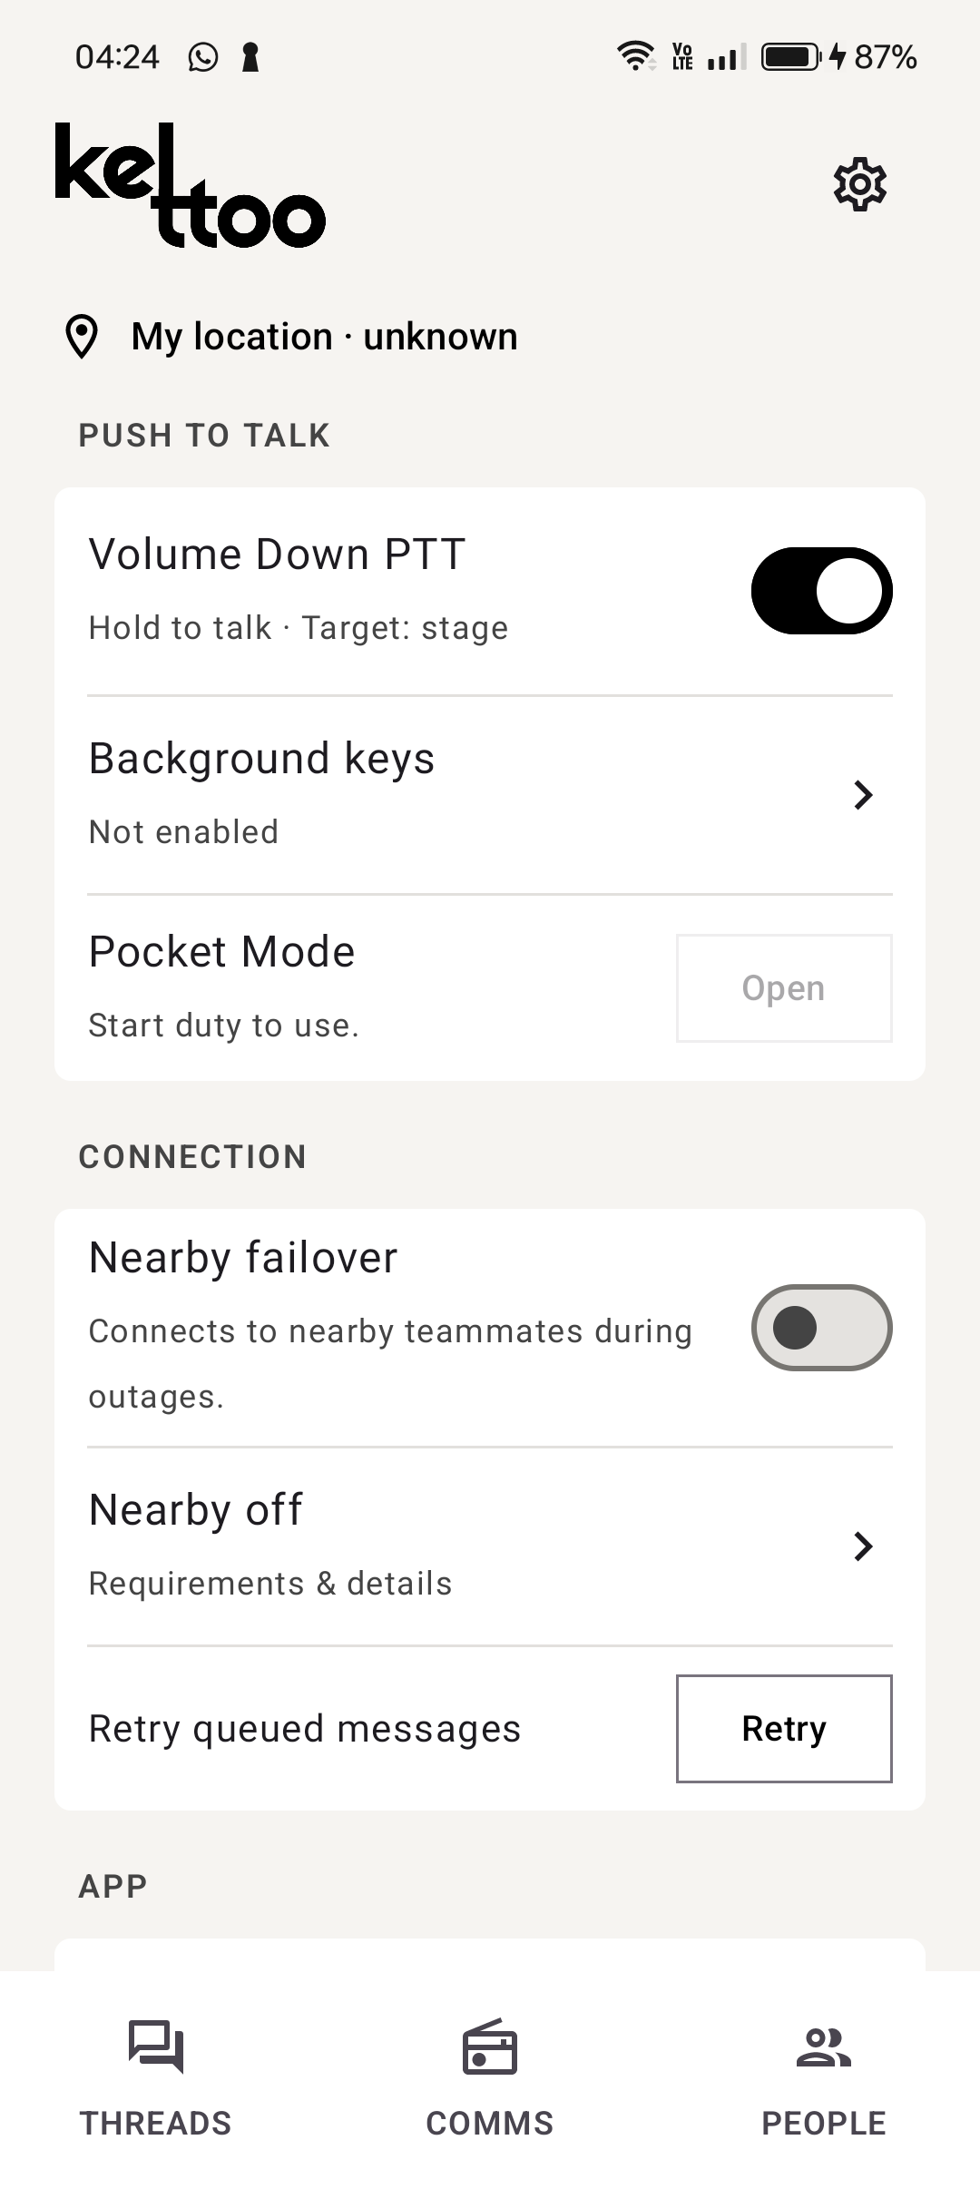
Live Demo
Demo scenario: a volunteer reports
a power issue in a hall
01 Prepare the team
Approve two phones, select a channel and start duty.
02 Report and record
Hold TALK, then inspect the saved replay and transcript.
03 Coordinate the response
Check in, create an issue, claim it, reply and resolve it.
04 Demonstrate recovery
With Nearby enabled, pause the API, exchange direct TALK/text, restore it and verify sync.
Hardware PTT and Nearby
Notes:
This is a proposed live demonstration sequence using implemented features, not a claim that this presentation session performed it. Before presenting, approve all devices, configure a real floor/zone, connect the media service and confirm the English model. Use a designated duty admin if demonstrating private exchanges. Enable Nearby on both approved phones and keep credentials valid. Controlled API-outage testing must keep the access point and radios available. Restore the API after the demonstration. The selected screenshot shows the feature controls with Nearby off and the phone off duty, so enable these before a real demo. The power issue and hall are illustrative.
Sources: PROJECT_SUMMARY.md sections 3 and 6; overview_phase3.md demo sequence; docs/nearby-failover.md; image: artifacts/ui-review/2026-10-10/cph2613-settings-installed-final-middle.png. Project records reviewed 10 October 2026.

Slide 8
Impact, Feasibility and Scalability
A working prototype with evidence
and a clear path to venue acceptance
Intended operational impact
Feasibility and scalability
Route requests to permitted teams.
Give each issue a visible owner and status.
Keep voice reports available for replay and acknowledgement.
Let organisations host their data and services.
34/34 backend tests passed in the recorded verification run.
Two physical Android phones completed direct Nearby outage/recovery tests.
Android, browser and server components have build and device evidence.
Venue-scale load, radio range, longer duty sessions and deployment acceptance remain to be tested. No staff-capacity or response-time claim yet.
Notes:
Impact statements are expected benefits, not measured improvements. The 34/34 result comes from the backend suite run while preparing PROJECT_SUMMARY.md on 10 October 2026, not a fresh run for this deck. Earlier verification counts belong to separate snapshots and must not be summed. Nearby physical tests involved OnePlus CPH2613 and Samsung SM-A356E with the local API paused while the Wi-Fi access point remained available. Playback counters confirm audio output delivery, not subjective intelligibility. Historical builds/lint and specific phone checks do not prove production acceptance. No deployment cost estimate, performance benchmark or maximum volunteer count is established.
Sources: PROJECT_SUMMARY.md sections 4, 6 and 7; VERIFICATION.md; overview_till_phase2.md; docs/nearby-failover.md; docs/ui-ux-review-settings.md. Project records reviewed 10 October 2026.

Slide 9
Conclusion
Kettoo connects event communication
with accountable issue handling
We have built an Android app, a browser console and a private backend for event teams to communicate, report their zone and manage issues through resolution.
Core strengths
Immediate voice with a durable history.
Permission-controlled access and local speech.
Queued recovery and direct Android Nearby fallback.
Next milestone: complete acceptance testing under realistic venue conditions, then prepare a signed release and organisation deployment.
Notes:
Close with the complete workflow: reach a team, retain the report, associate it with a place, confirm responsibility and record resolution. The current project is a development/demo implementation through Phase 3 with selected real-device evidence. Future work is broader device, venue load/range, noise/accent, long-session and deployment acceptance. Nearby remains direct peer-to-peer, and no venue-wide mesh guarantee is claimed.
Sources: PROJECT_SUMMARY.md sections 1, 4, 7 and 8; README.md. Project records reviewed 10 October 2026.

