Slide 1

Kettoo
Team Codio
Private communication and coordination for event teams
Notes:
Kettoo is a native Android app, browser console and organisation-hosted backend for event communication and coordination. The implementation includes live push-to-talk, messages, venue check-ins and issue workflows. Source: PROJECT_SUMMARY.md and README.md in the Kettoo project, reviewed 10 October 2026. Team name: Codio, as supplied by the presenter. Team number omitted at the presenter's request.

Slide 2

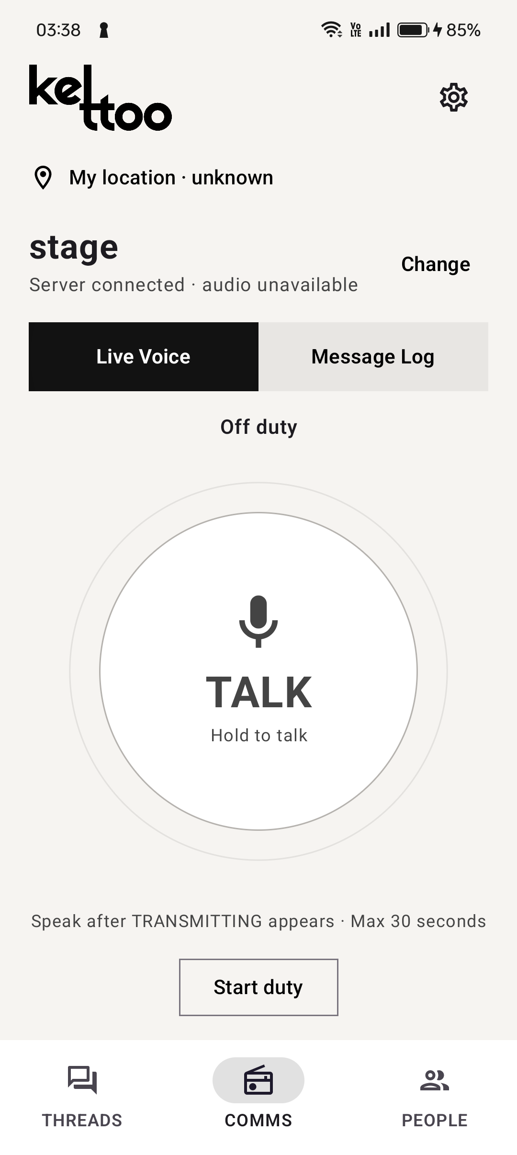
Introduction
Communication and coordination
for event teams
Event teams work across different floors and zones. They need to reach the right people quickly and know who is handling each reported issue.
Kettoo is a private platform for organisers and volunteers. It combines walkie-talkie voice and messaging with venue check-ins and issue tracking in an Android app and a browser console.
Local queues and direct Nearby communication help approved Android phones continue during outages.
Kettoo Android app
Notes:
Kettoo serves event organisers and volunteers working across venue zones. This introduction establishes the operating context before the next slide explains the coordination problem in more detail. Explain that Kettoo connects quick voice communication with persistent messages, zone check-ins and issues that have a confirmed owner and status. The Android app supports direct Nearby communication among approved, permitted phones during outages. Reach depends on direct connectivity, and this is not multi-hop mesh. Issue and check-in operations queue for server recovery. The browser does not implement Nearby.
Sources: PROJECT_SUMMARY.md sections 1, 3.3, 3.6, 3.7, 3.8 and 3.9; README.md; docs/nearby-failover.md. The event scenario describes the intended use case, not findings from a user study.
Image: actual installed Android screenshot, artifacts/ui-review/2026-10-10/cph2613-comms-installed-final.png. This historical screenshot shows the app off duty. It is not a generated mockup.

Slide 3
Problem Statement

Slide 4
Proposed Solution

Slide 5
Technical Architecture and Tech Stack

Slide 6
Key Features and Implementation

Slide 7
Live Demo

Slide 8
Impact, Feasibility and Scalability

Slide 9
Conclusion

