Slide 1
1-D FDTD propagation
Group 2
莫松恩 R06945043
黃亮瑜 R07941005
王鵬瑞 F03941016
余育修 R07941039
Date: 2018.11.21

Slide 2
Outline
Goal
Methods
Outcome
Most Challenging Parts
Solution
Time Spent
Summary

Slide 3
Goal
Our goal is to simulate one-dimensional electromagnetic waves based on Maxwell’s equations and FDTD.

Slide 4
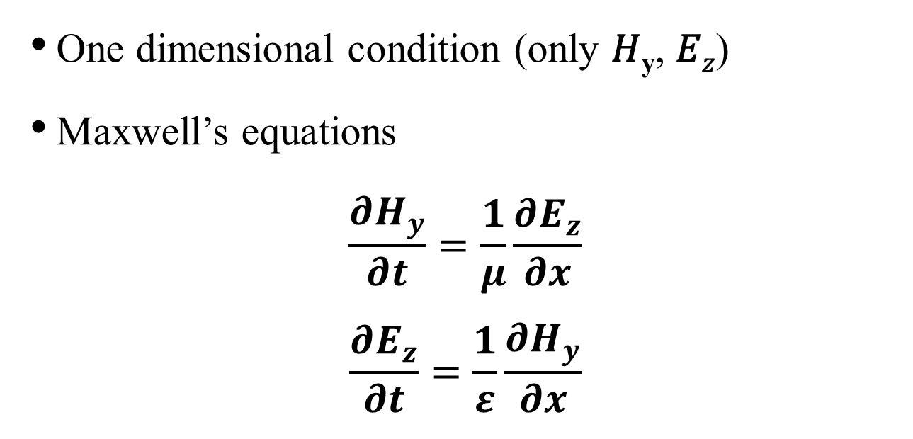
Methods -1
1D-FDTD
One dimensional condition (only 𝐻_{y}, 𝐸_{𝑧})
Maxwell’s equations
$$\frac{∂H_{y}}{∂t}=\frac{1}{μ}\frac{∂E_{z}}{∂x}$$
$$\frac{∂E_{z}}{∂t}=\frac{1}{ε}\frac{∂H_{y}}{∂x}$$

Slide 5
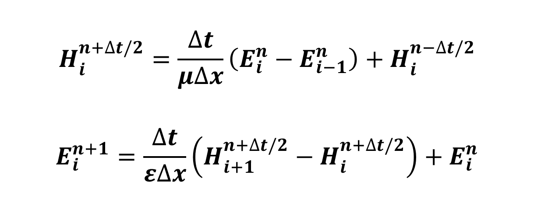
Methods -2
Dispersive equation
1D-FDTD governing equations
$$H_{i}^{n+∆t/2}=\frac{∆t}{μ∆x}\left(E_{i}^{n}−E_{i−1}^{n}\right)+H_{i}^{n−∆t/2}$$
$$E_{i}^{n+1}=\frac{∆t}{ε∆x}\left(H_{i+1}^{n+∆t/2}−H_{i}^{n+∆t/2}\right)+E_{i}^{n}$$

Slide 6

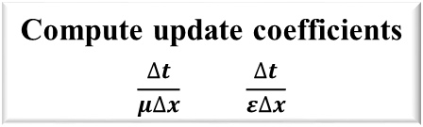

The Basic 1D‐FDTD Algorithm
Compute update coefficients
$$\frac{∆t}{μ∆x} \frac{∆t}{ε∆x}$$
Initialize fields to zero
E = H= 0
Done?
yes
Finished!
Loop over time
t
no
Update H from E
Loop over all values of x
x
$$H_{i}^{n+∆t/2}=\frac{∆t}{μ∆x}\left(E_{i}^{n}−E_{i−1}^{n}\right)+H_{i}^{n−∆t/2}$$
Update E from H
Loop over all values of x
x
$$E_{i}^{n+1}=\frac{∆t}{ε∆x}\left(H_{i+1}^{n+∆t/2}−H_{i}^{n+∆t/2}\right)+E_{i}^{n}$$

Slide 7
Outcome -1
Go left and right respectively

Slide 8
Outcome -2
Go left only

Slide 9
Outcome -3
Go right only

Slide 10
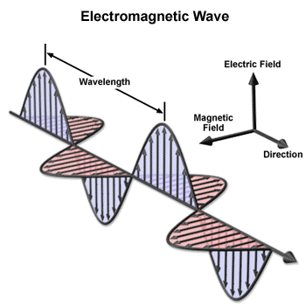
Outcome -4
Physical meaning
The direction of an EM wave = E_{z} x B_{y}

Slide 11
Outcome -5
Physical meaning
In the first case, the source function is added to E_{z} field at the center of simulated region.
Therefore, the value of H_{y} can be positive or negative causing wave splits into two waves that go left and right respectively.
In the other cases, the source functions are added to both E_{z} and H_{y}. The wave can only go left or right depending on the values of E_{z} and H_{y}.

Slide 12
Outcome -6
Physical meaning
Eliminates backward propagating waves
100% of power injected by the source is incident on the object being simulated.
Scattered Field
Total Field
Scattering Object

Slide 13
Most challenging parts
Equations → MATLAB Code

Slide 14
Time spent
莫松恩 3 hours
黃亮瑜 4 hours
王鵬瑞 4 hours
余育修 3 hours

Slide 15
Summary
We learn basic knowledge and principle about FDTD methods.
We use dispersive equations of 1-D wave equations to simulate propagating waves in different situations.

Slide 16
Thanks for your attention!

Slide 17
References
http://learning-sky.blogspot.com/2014/08/matlab-gif-1.html
ELECTROMAGNETIC ANALYSIS USING FINITE-DIFFERENCE TIME-DOMAIN- The University of Texas at El Paso
http://emlab.utep.edu/ee5390fdtd/Lecture%206%20--%20Implementation%20of%201D%20FDTD.pdf

