Slide 1


BRAND PARTNERSHIP PROPOSAL
VETO × Bisleri
Refreshing Every Moment
Building meaningful brand connections through content, entertainment & digital experiences.
Bisleri Portfolio + Veto OTT

Slide 2



THE OPPORTUNITY
VETO × Bisleri
From Products to Moments
Bisleri is not just hydration — every product owns a different consumer emotion.
Everyday Life
Premium Wellness
Social Moments
Youth Culture
BISLERI × VETO
02

Slide 3
CONTENT STRATEGY
VETO × Bisleri
One Brand. Multiple Stories.
Bisleri Water
Everyday Refreshment
Vedica
Premium Lifestyle
Bisleri Soda
Food & Celebrations
Limonata & Pop
Youth & Entertainment
BISLERI × VETO
03

Slide 4

VETO × Bisleri
BISLERI WATER
Hydrate Your Day
STORY DIRECTION
Everyday moments where hydration matters.
CONTENT
Fitness
Travel
Daily Life
PLATFORM
BRAND ROLE
Veto Stories (2-3min)+ Social Media Shorts(20-60 sec)
Everyday Refreshment Partner
BISLERI × VETO
04

Slide 5
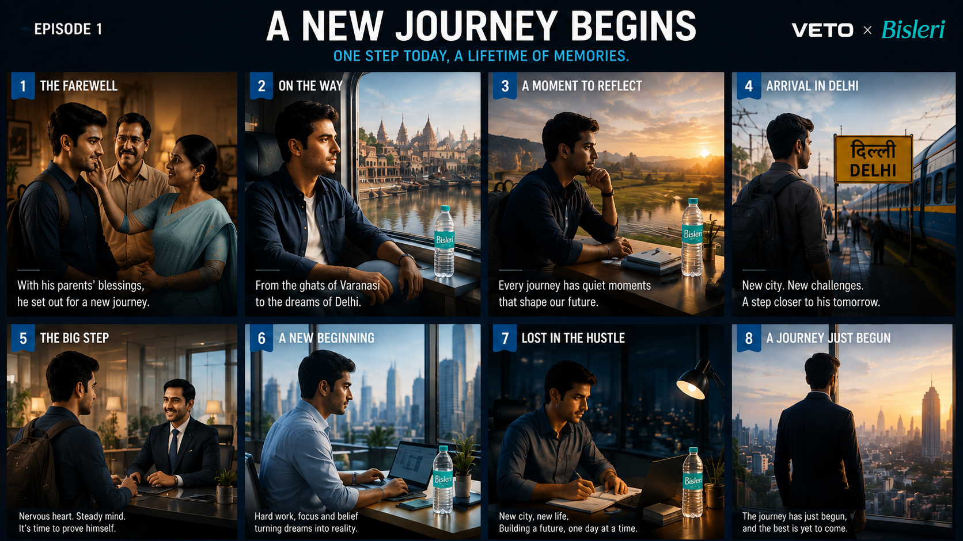

Slide 6

VETO × Bisleri
VEDICA
Pure Luxury
STORY DIRECTION
Premium experiences inspired by nature.
CONTENT
Wellness
Lifestyle
Nature
PLATFORM
BRAND ROLE
Lifestyle Content on Veto
Premium Hydration Choice
BISLERI × VETO
05

Slide 7
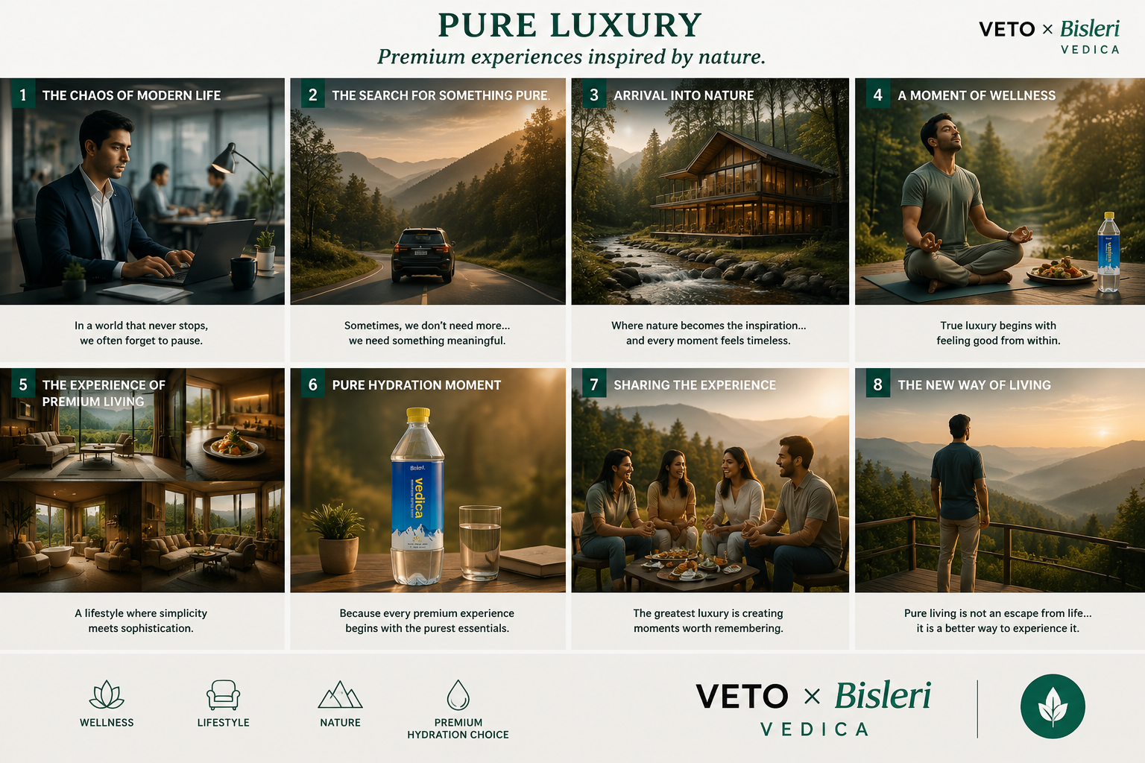
EPISODE 1

Slide 8

VETO × Bisleri
BISLERI SODA
Mix The Moment
STORY DIRECTION
Celebrating food, flavours & occasions.
CONTENT
Food Stories
Recipes
Celebrations
PLATFORM
BRAND ROLE
Food & Lifestyle Content on VETO
Perfect Social Companion
BISLERI × VETO
06

Slide 9
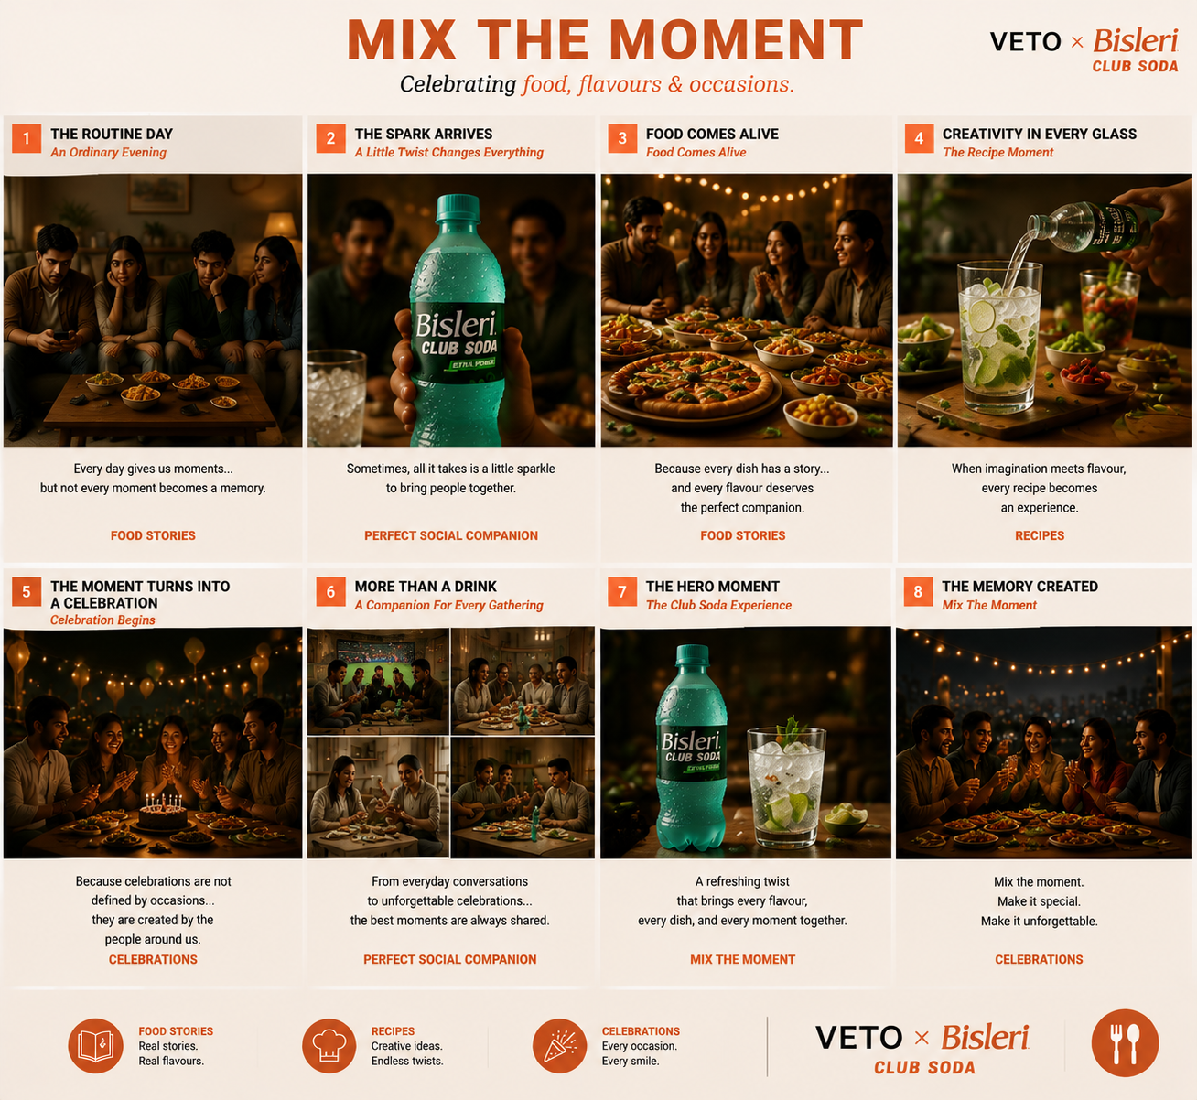
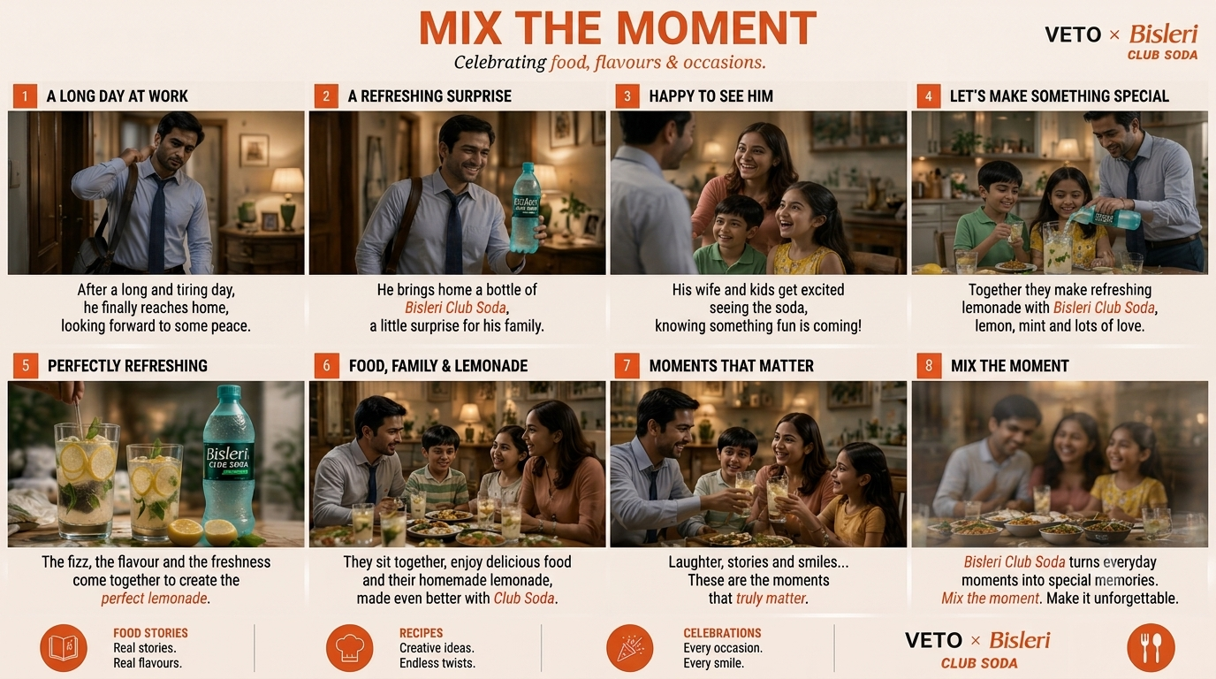
EPISODE 1
EPISODE 1

Slide 10

VETO × Bisleri
LIMONATA & POP
Refresh Your Mood
STORY DIRECTION
Connecting with young audiences through energy and fun.
CONTENT
Music
Gaming
Creator Culture
PLATFORM
BRAND ROLE
Entertainment Content ON VETO
Youth Refreshment Brand
BISLERI × VETO
07

Slide 11
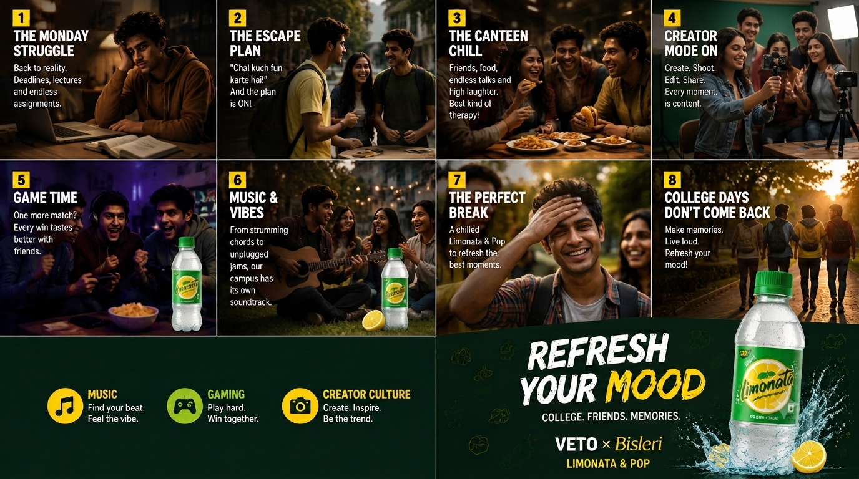

Slide 12



THE VETO ECOSYSTEM
VETO × Bisleri
Content → Connection
Original Content
Platform Visibility
Social Amplification
Shorts | Shows | Stories
Homepage | Featured Placement
Reels | Shorts | Creator Content
BISLERI × VETO
08

Slide 13



WHY VETO?
VETO × Bisleri
A Platform Built For Brand Stories
Beyond advertisements.
Content First
Subscription-Free Reach
Create stories consumers want to watch.
Connect with wider audiences.
Engagement Driven
Digital Amplification
Turn viewers into brand followers.
Extend stories beyond OTT.
BISLERI × VETO
09

Slide 14

DISTRIBUTION STRATEGY
VETO × Bisleri
Reaching Consumers Everywhere
Veto OTT
Social Media
India TV Digital Network
Homepage banners
Short videos
YouTube ads
Featured content
Creator collaborations
Social promotions
Branded experiences
BISLERI × VETO
10

Slide 15



CONSUMER JOURNEY
VETO × Bisleri
From Discovery To Preference
1
2
3
4
5
See
Watch
Engage
Remember
Choose Bisleri
BISLERI × VETO
11

Slide 16
EXPECTED IMPACT
VETO × Bisleri
Creating Stronger Brand Connections
Brand Impact
Business Impact
Higher recall
New audiences
Product discovery
More consumption occasions
Emotional connection
Stronger preference
BISLERI × VETO
12

Slide 17
VETO × Bisleri
Turning Refreshment Moments Into Stories.
A content ecosystem that helps every Bisleri product connect with the right audience, at the right moment.

