Slide 1
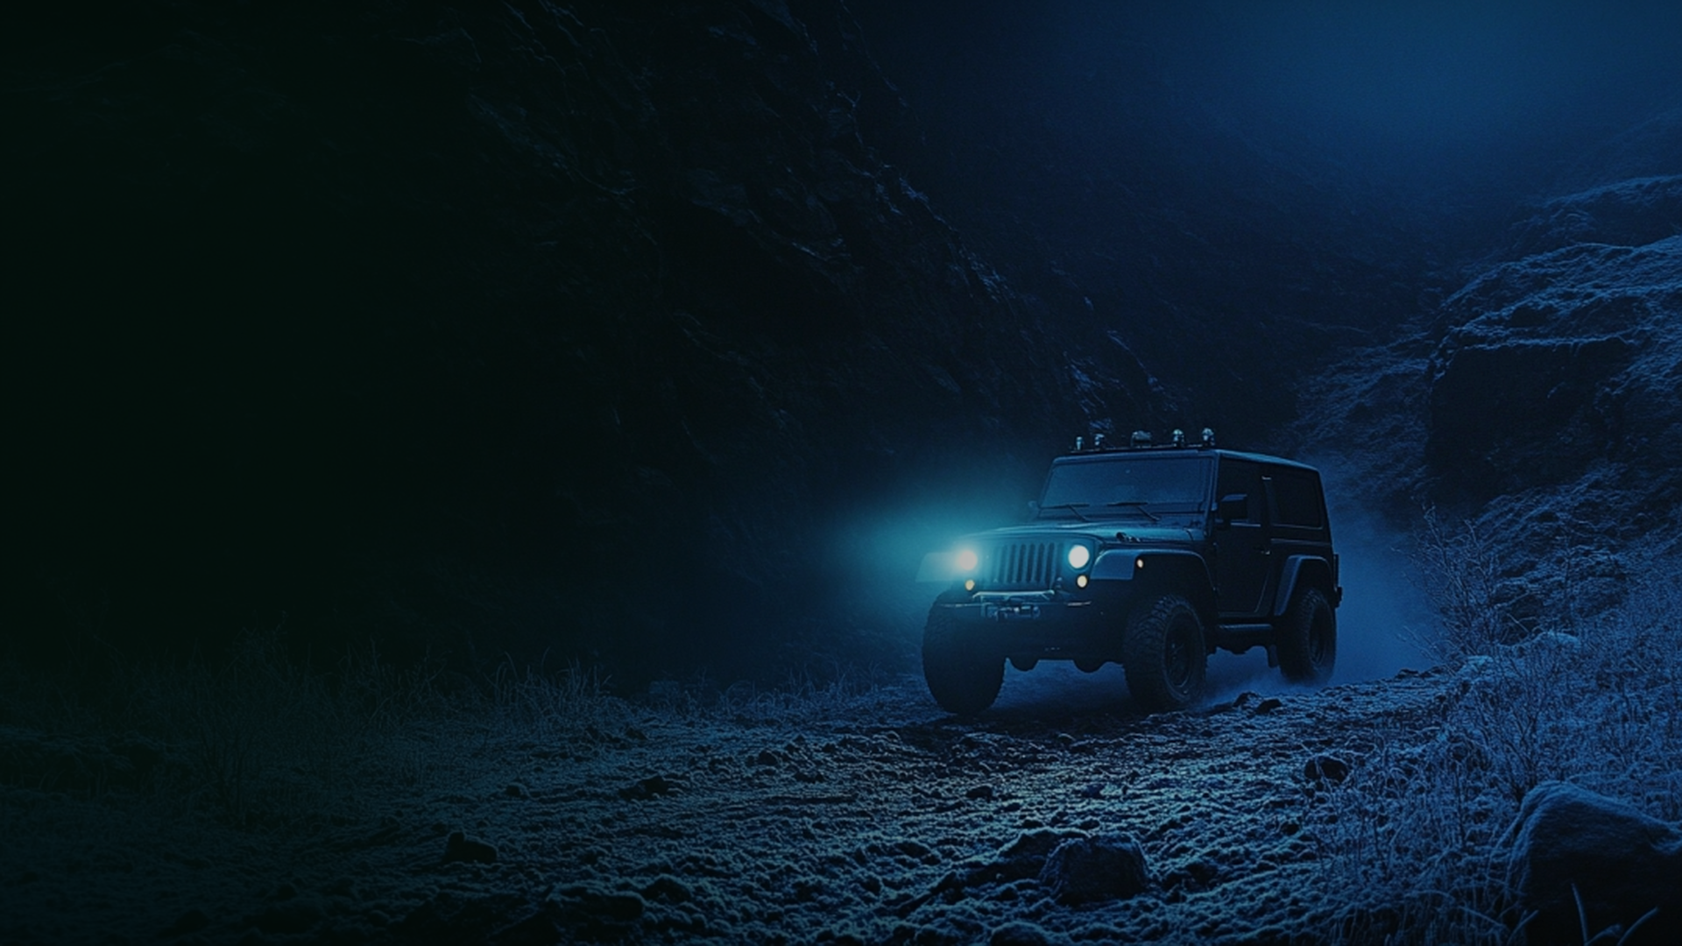
MAHINDRA THAR ROXX
×
VETO
Go Beyond The Last Road
✦
BRAND
INTEGRATION
PROPOSAL
✦
Branded Content & Integration Proposal
Adventure. Luxury. Attitude.
HIGHWAY RIDE × OFF-ROAD EDGE

