Slide 1
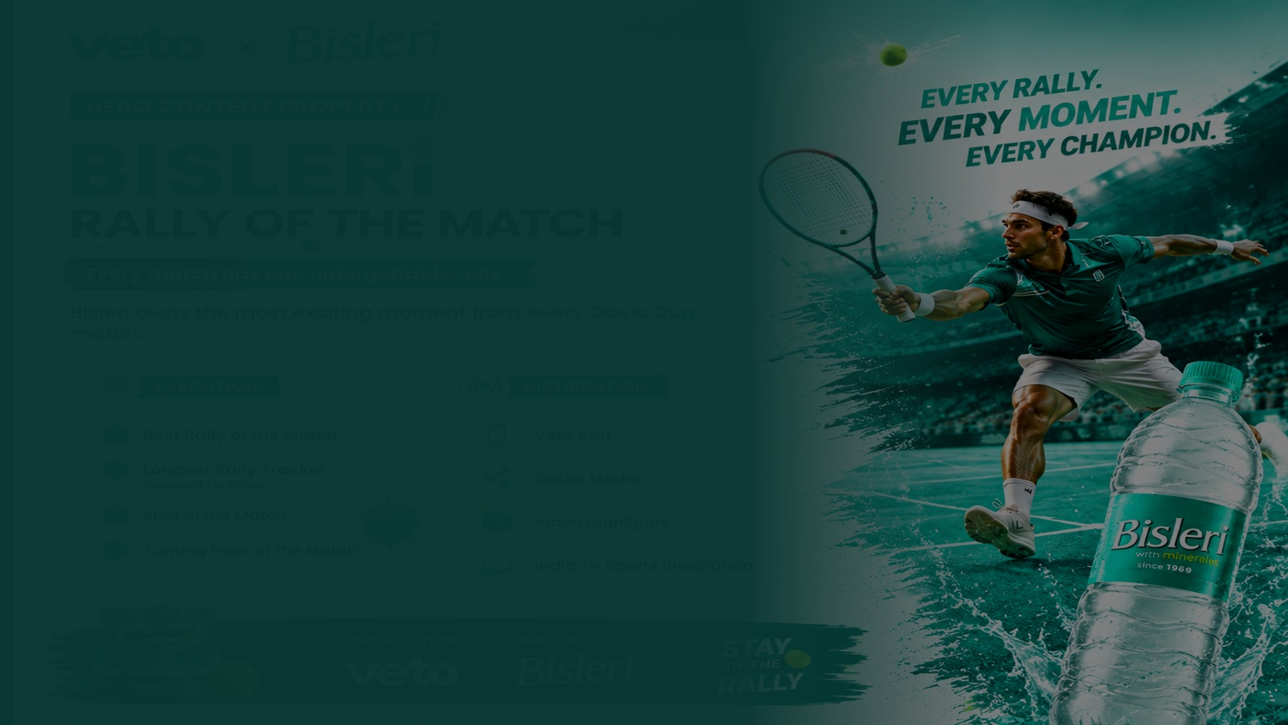
01
VETO × Bisleri
THE PARTNERSHIP
OPPORTUNITY
From First Serve to Final Highlight.
VETO brings the game. Bisleri brings the refreshment.
Davis Cup · Exclusively on VETO · Presented by Bisleri

Slide 2

02
Why This Partnership Works
Because tennis naturally creates refreshment moments
📺
💧
🎾
+
=
VETO
BISLERI
TENNIS
Viewing Platform
Refreshment Partner
High-Intensity Sport
A natural fit — hydration + high-intensity sport + live streaming
VETO × Bisleri · Hydrate the Game

Slide 3

03
BIG IDEA
HYDRATE
THE GAME
Play. Pause. Refresh. Return.
Bisleri becomes the brand that keeps the game moving.
This becomes the umbrella idea for all integrations.
VETO × Bisleri · Hydrate the Game

Slide 4
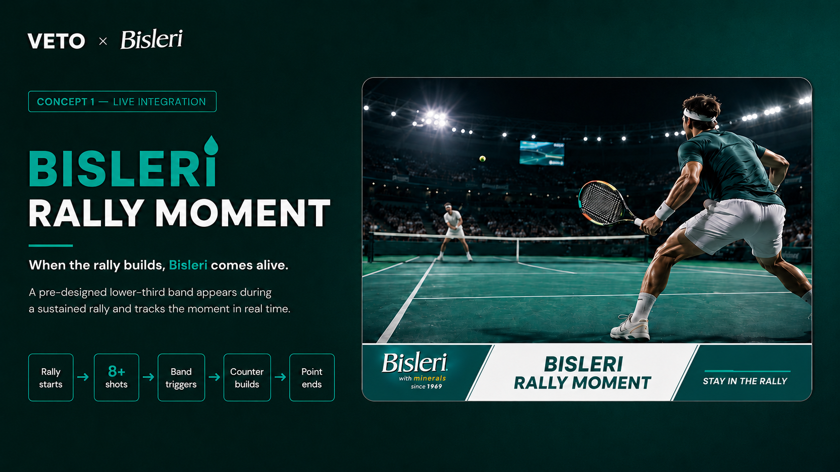

Slide 5
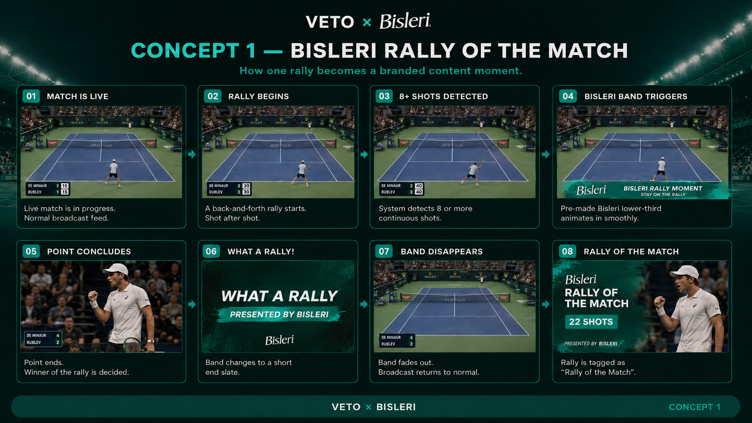

Slide 6
05
Concept 02 · POST-MATCH CONTENT PROPERTY
BISLERI
MATCH REFRESH
Match Highlights presented by Bisleri
Refresh the match. Relive the moments.
VETO × Bisleri · Hydrate the Game

Slide 7
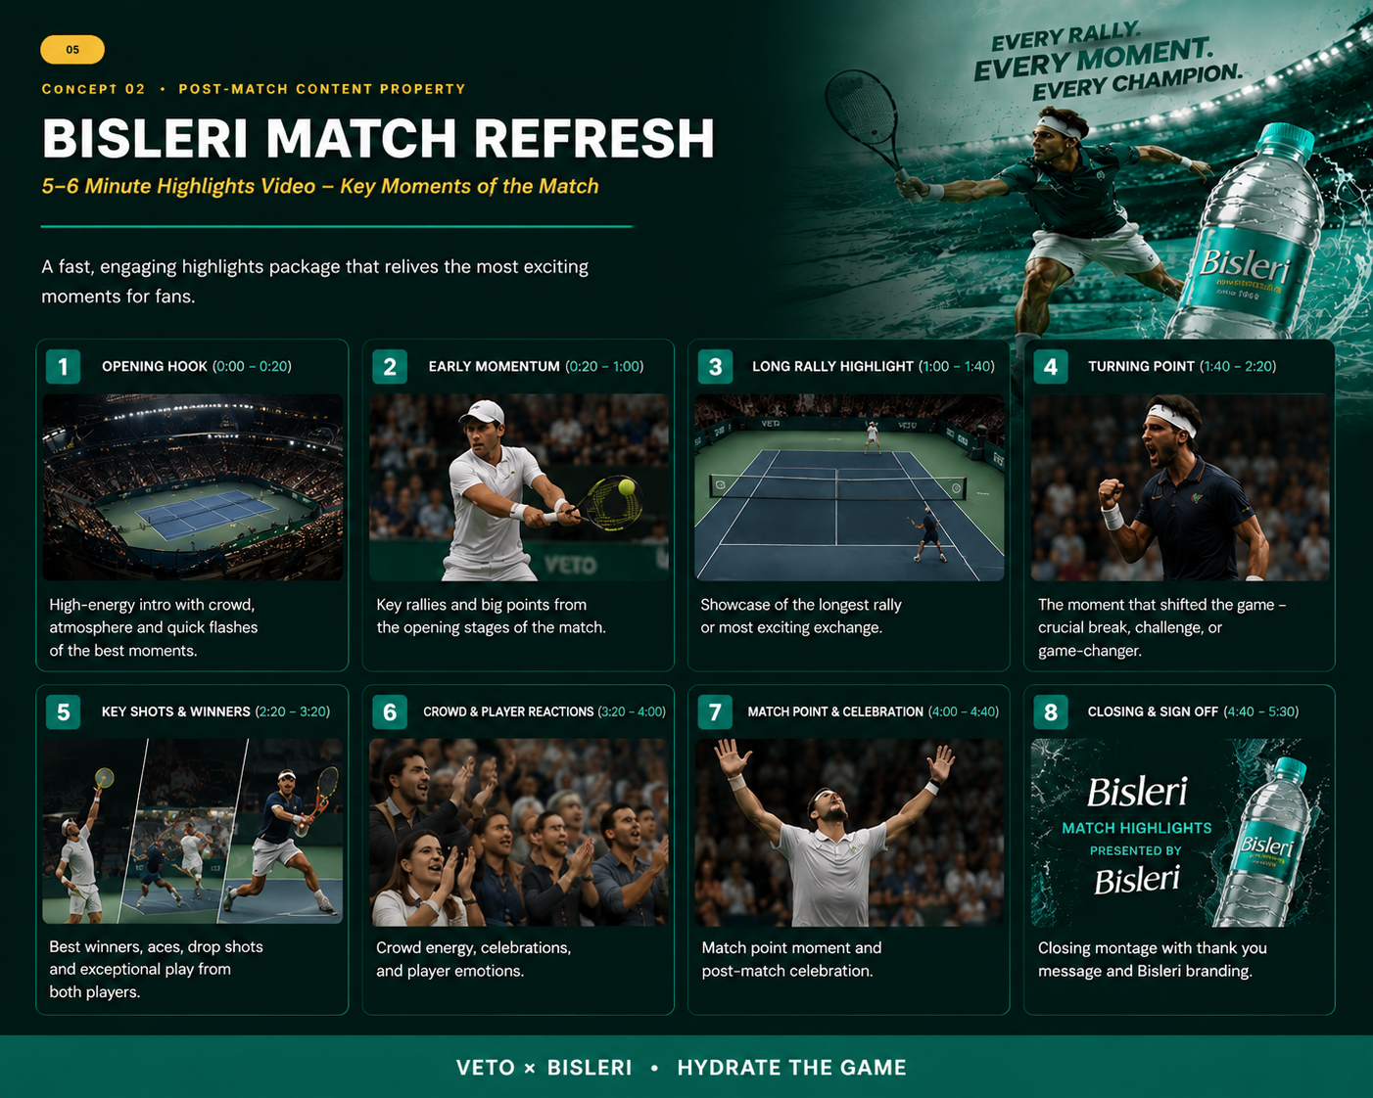

Slide 8
04
Concept 03 · HERO CONTENT PROPERTY
THE BISLERI
RALLY
Rally of the Match, presented by Bisleri
🎬 Best Rally Replay Graphic
📊 Longest Rally Counter — Powered by Bisleri
⚡ Shot of the Match branded sting
📱 Social clip + Tournament compilation
Own the moment that keeps the game alive.
VETO × Bisleri · Hydrate the Game

Slide 9
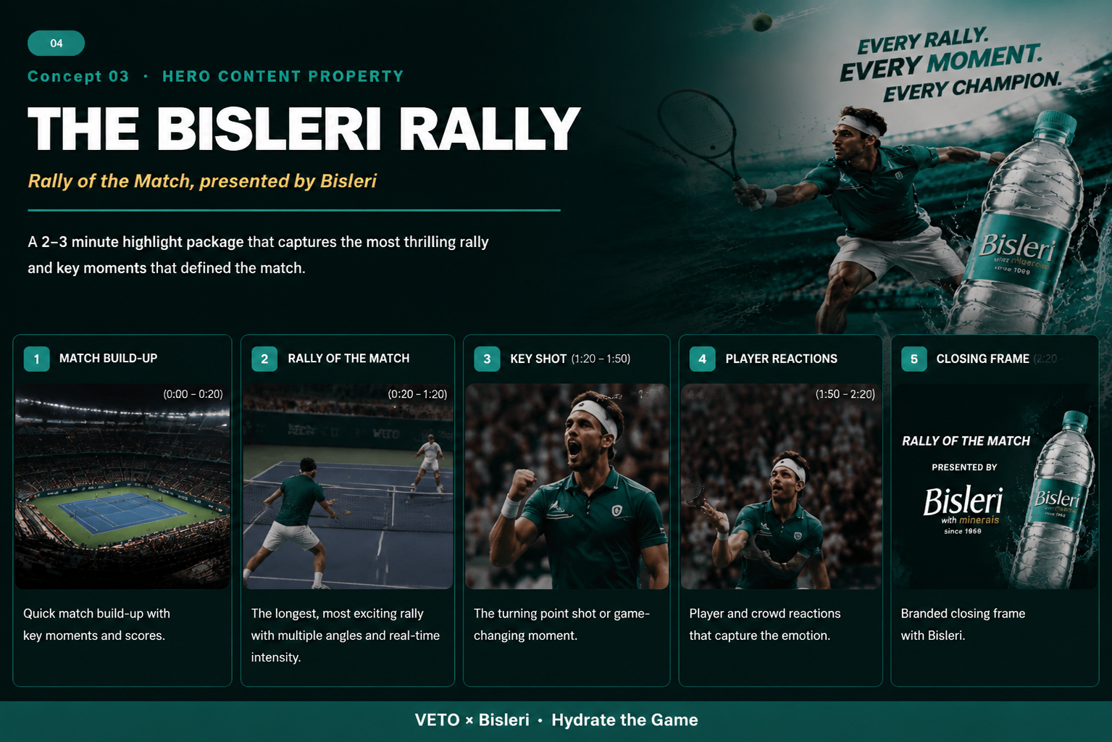

Slide 10
08
VETO Ecosystem
One partnership. Every touchpoint.
🏠
📡
🎬
📲
BEFORE MATCH
DURING MATCH
AFTER MATCH
BEYOND MATCH
Homepage,
Match Page,
Promos
Live Branding,
Graphics
Highlights,
Thumbnails,
Recap Cards
Social Clips,
Short Videos,
Compilations
Wherever the fan follows the game, Bisleri follows the fan.
VETO × Bisleri · Hydrate the Game

Slide 11
09
Content Amplification
One match. Multiple content moments.
ONE MATCH
📺 VETO
📸 Instagram
Live + Highlights
▶️ YouTube
Reels + Stories
Highlights + Shorts
📡 India TV
𝕏 X (Twitter)
Promos + Sports
Real-time Moments
Create once. Amplify everywhere.
VETO × Bisleri · Hydrate the Game

Slide 12
10
Hero Film + Cutdowns
One story. Multiple formats.
🎬
⚡
💧
🏆
60-SEC HERO FILM
THE RALLY
THE RESET
THE MATCH POINT
Pressure → Rally → Pause
→ Refresh → Return
20s Cutdown
20s Cutdown
20s Cutdown
The full arc of the game
Bisleri — Keep the Game Going.
VETO × Bisleri · Hydrate the Game

Slide 13
11
Impact & KPIs
From visibility to measurable ownership
📊 AWARENESS
💬 ENGAGEMENT
Reach, Impressions, Views
Watch Time, Shares, Comments
🎬 CONTENT
🏆 BRAND
Highlight Views, Rally Views
Recall, Association, Recognition
Success is not how often Bisleri appears, but what moment Bisleri owns.
VETO × Bisleri · Hydrate the Game

Slide 14
12
Don't just sponsor the game.
Own a part of it.
⚡ The Bisleri Rally
Live content property
🎬 Bisleri Match Refresh
Post-match content property
📺 VETO Ecosystem
Before, during & after match
🌐 Cross-platform Reach
VETO + India TV + YouTube + Instagram + X
BISLERI × VETO
HYDRATE THE GAME · From First Serve to Final Highlight.

