Slide 1
Generating Music with ML
Generating music with four machine-learning models
Naive Bayes
Neural Network
LSTM
Encoder-Decoder
Meghana Rayudu PES2UG24CS398
Ronak Thamaran PES2UG24CS410

Slide 2
Problem and output
Input: public piano MIDI files
Task: learn event patterns and continue a seed phrase
Output: a standard MIDI file written directly to artifacts/generated
Evaluation: same prepared corpus and held-out pieces for every model

Slide 3
Three-stage pipeline
1 Preprocess
src/preprocess.py
2 Train
src/train_all.py
3 Generate
src/generate.py
INPUT
data/raw: 24 public MIDI files
OUTPUT
artifacts/preprocessed: corpus, vocabulary, manifest
INPUT
artifacts/preprocessed
OUTPUT
Four checkpoints and metrics.json
INPUT
Prepared corpus and one checkpoint
OUTPUT
One .mid file and a .generation.json trace

Slide 4
Dataset and preprocessing
24 public classical-piano MIDI files
Preprocessing chordifies simultaneous notes and quantizes duration to a sixteenth-note grid
Each piece is transposed to a shared C tonal centre before training
Fixed split: 20 whole pieces for training and 4 for testing
One vocabulary and one reproducible seed support every model

Slide 5
Four model approaches
Naive Bayes
Smoothed probability of the next event conditioned on the last three events
Neural network
Fixed 40-event context mapped to the next event
LSTM
Recurrent state models longer sequential dependencies
Encoder-decoder
GRU encodes a 40-event phrase and decodes an eight-event continuation

Slide 6
Fair training protocol
Same prepared corpus, vocabulary, train/test split, and random seed
Neural models: 500 epochs, context 40, batch size 64, AdamW, learning rate 0.0005, gradient clipping
Naive Bayes: one closed-form count fit on the identical training events
Compact comparable neural parameter budgets
Feed-forward 468,290 LSTM 281,890 Encoder-decoder 297,602

Slide 7
Held-out evaluation
Model | Accuracy | Cross-entropy
Naive Bayes | 7.45% | n/a
Neural network | 5.62% | 2.4141
LSTM | 7.54% | 2.2687
Encoder-decoder | 2.40%* | 2.2971
Exact next-event accuracy is strict for diverse classical pieces. Lower cross-entropy for the recurrent models indicates better distribution calibration. Listening tests remain essential for musical phrasing and harmony.
* Encoder-decoder accuracy is scored over eight-event continuations, so it is not directly comparable.

Slide 8
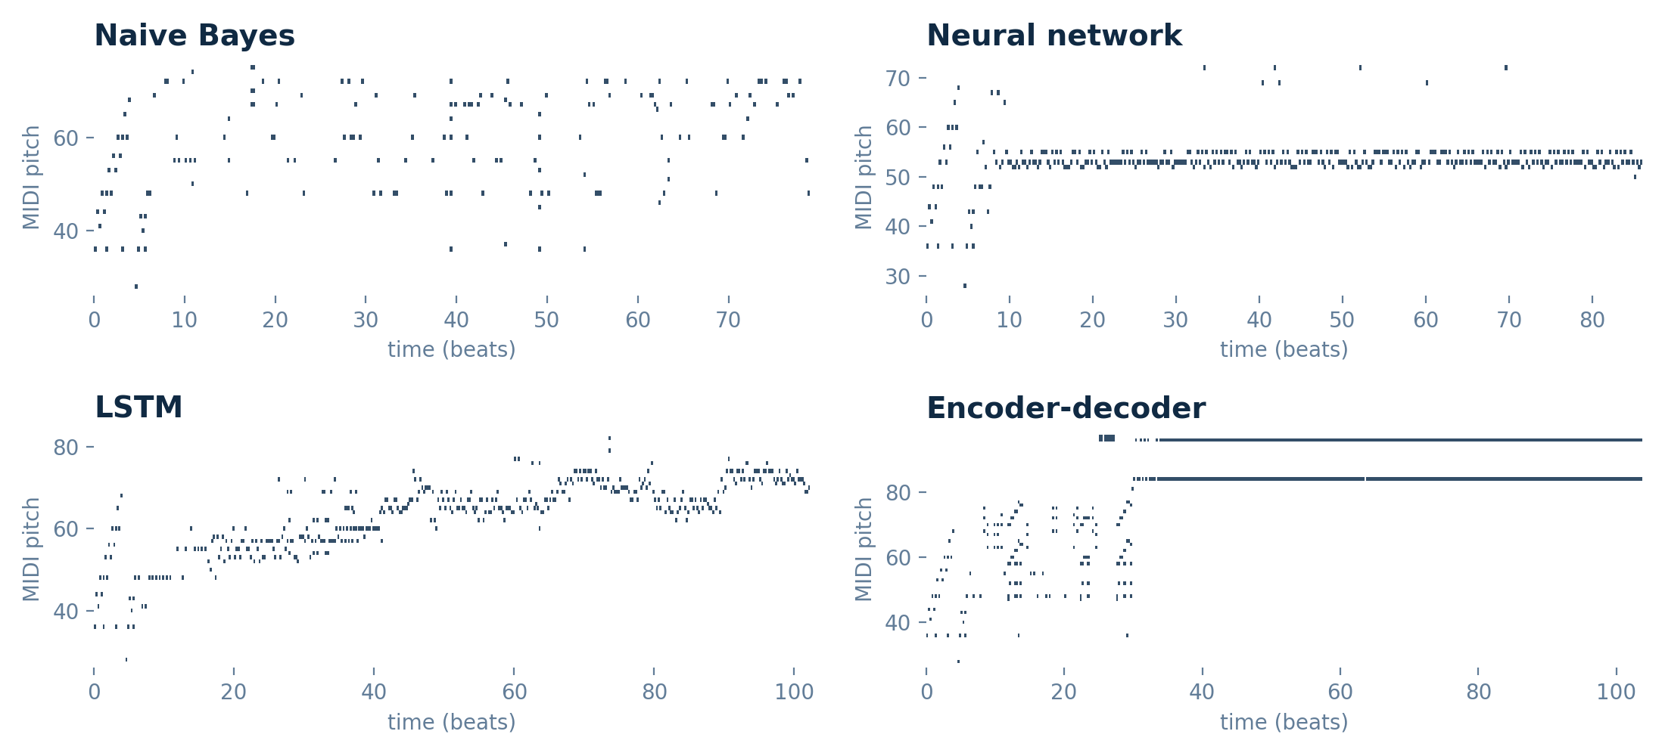
Generated output

Slide 9
Conclusions
LSTM performs best overall: lowest cross-entropy (2.2687) and highest accuracy among the neural models (7.54%).
Naive Bayes is a strong baseline (7.45% accuracy, no gradient training); the feed-forward network trails the recurrent models (5.62%, cross-entropy 2.4141).
Encoder-decoder has the second-lowest cross-entropy (2.2971); its 2.40% accuracy is scored on eight-event continuations.
The LSTM output keeps developing across the piece, while the encoder-decoder locks onto two repeated pitches late in the sample and the neural network stays in a narrow pitch band.
Next steps: a larger, stylistically consistent solo-piano corpus (48 to 80 pieces) and longer training.

Slide 10
Demonstration workflow
1. python -m src.preprocess
Creates artifacts/preprocessed
2. python -m src.train_all --preset production
Creates all model checkpoints and metrics
3. python -m src.generate --model lstm --events 384 --temperature 0.74 --top-k 10
Writes artifacts/generated/lstm_generated.mid
Open the MIDI in MuseScore or a DAW with a piano soundfont.

