Slide 1






Attack on Distance Predictor by Mimicking
Target’s Optical Sample Distribution
Alex Ferrando Víctor Novelle Marc Ruiz Luis Velasco

Slide 2
Index
1. Introduction
Motivation
Basic Concepts & Notation
Defense proposal
Scenario 1: Advanced Knowledge (AK)
Scenario 2: Limited Knowledge (LK)
2. Feature Mimic Attack
Our Proposal
Results
3. Symbol-to-symbol modification attack
Our Proposal
Z-Score
Gradient Descent
Results
4. Conclusions

Slide 3
INTRODUCTION

Slide 4




Motivation
Performance reporting
Problem diagnosis
Traffic growth prediction
Reactive human-based analysis
Sec. 1

Slide 5



Motivation
Limiting factor in size and scale of new networks
Fully automated management
Sec. 1

Slide 6
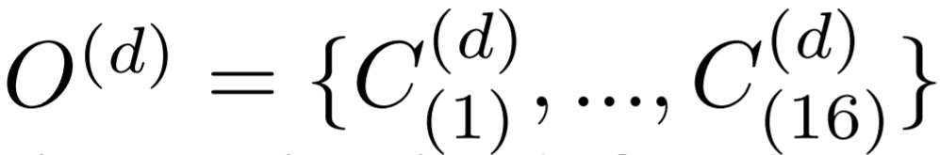
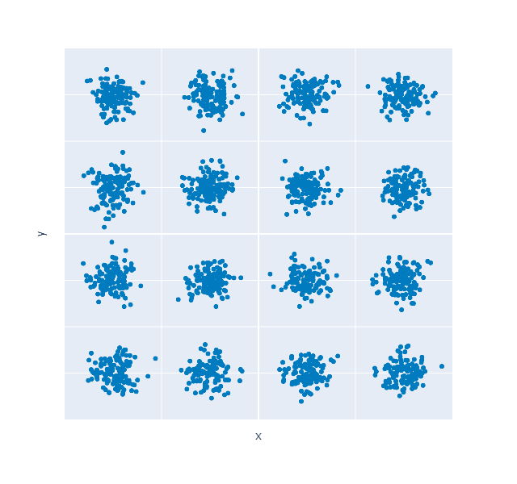
Basic concepts & Notation
Sec. 3.1

Slide 7
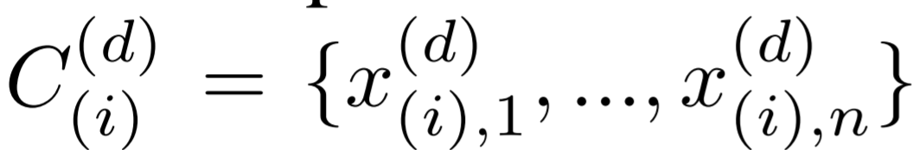
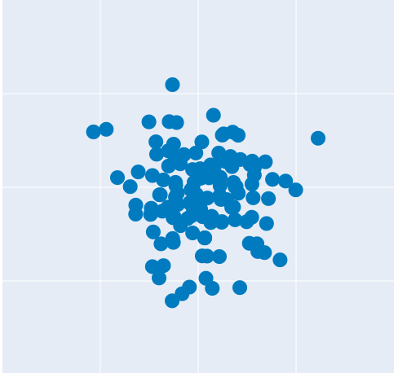
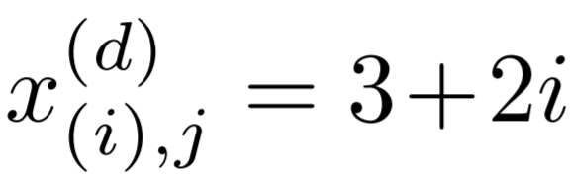
Basic concepts & Notation
Sec. 3.1

Slide 8
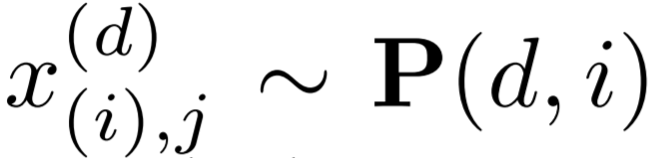

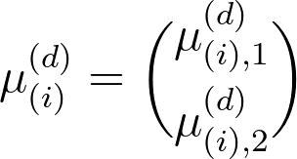
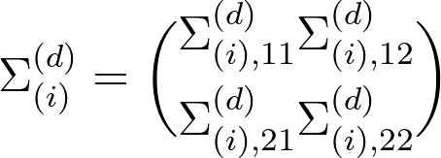
Basic concepts & Notation
Sec. 3.1

Slide 9



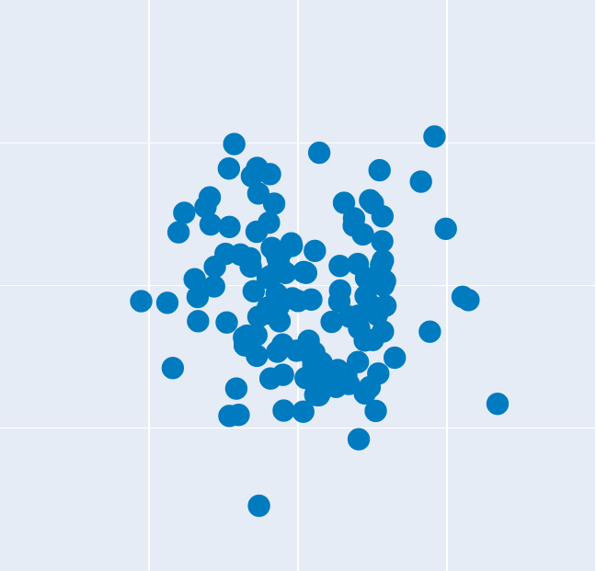

Basic concepts & Notation
≈
Sec. 3.1

Slide 10






Defense proposal
d*
Sec. 3

Slide 11

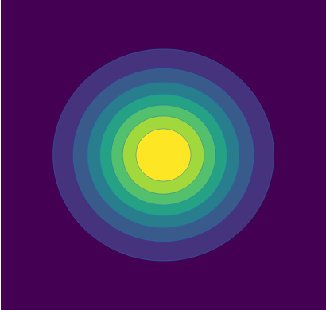

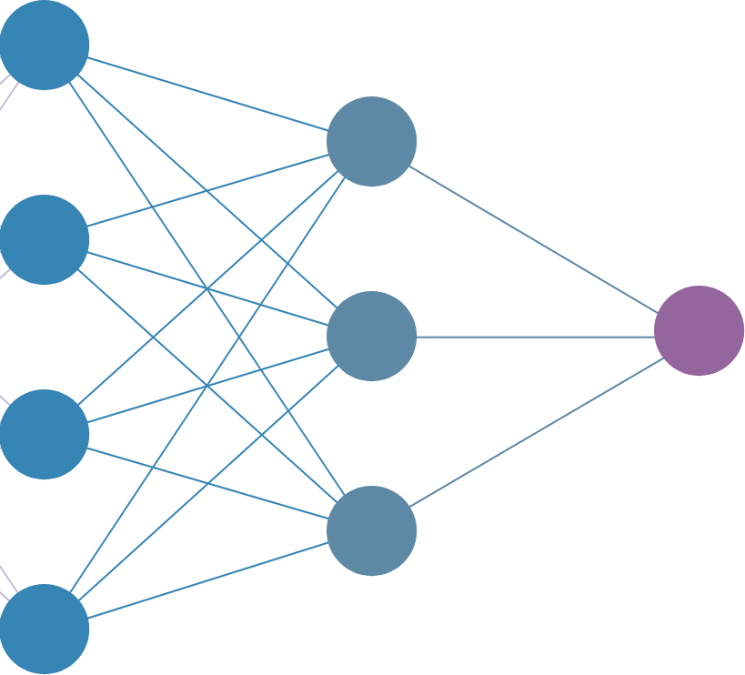



Defense proposal
1 1
dpred ≈ d*
Sec. 3

Slide 12


Defense proposal
d*
d
Sec. 3

Slide 13
Defense proposal
1 1
dpred ≠ d*
Sec. 3

Slide 14
Defense proposal
The attack must be proposed considering the attacker’s level of knowledge:
Advanced Knowledge Scenario
Limited Knowledge Scenario
Sec. 3.2

Slide 15

Scenario 1: Advanced Knowledge (AK)
1 1
?
dpred ≈ d*
Sec. 3.2

Slide 16
Scenario 2: Limited Knowledge (LK)
1 1
?
dpred ≈ d*
Sec. 3.2

Slide 17
2. FEATURE MIMIC ATTACK
Advanced Knowledge Scenario

Slide 18

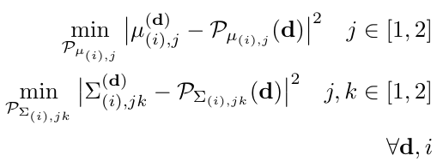
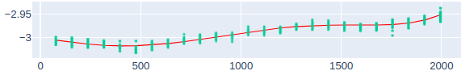






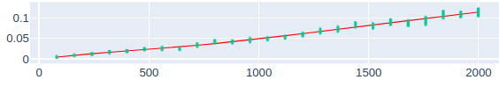

Our proposal (1)
Sec. 3.3
Eq. 3
Notes:
Poner gif de todas las aproximaciones.

Slide 19
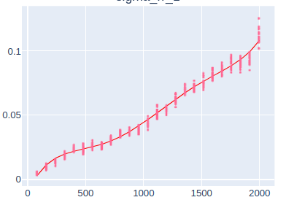
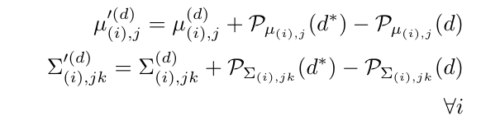
Our proposal (2)
Sec. 3.3
Eq. 4

Slide 20


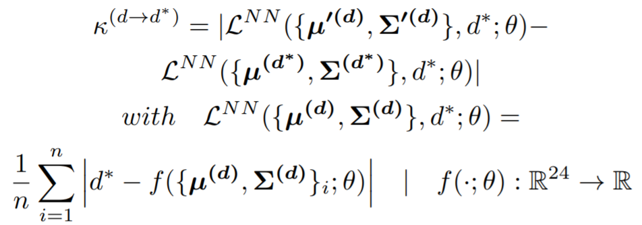


Results (1)
Evaluation metric
Sec. 4.1
Eq. 11

Slide 21

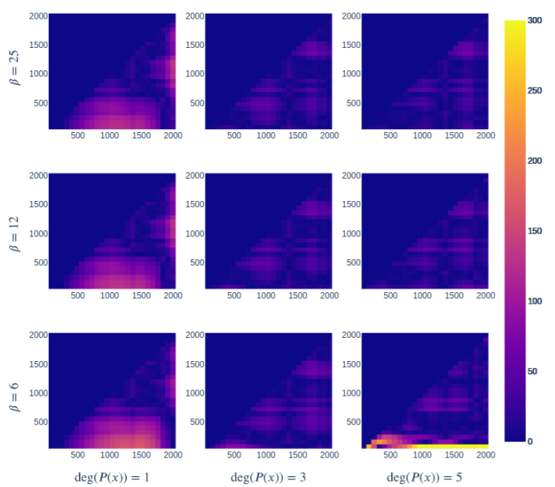
Results (2)
Sec. 4.2
Fig. 2

Slide 22
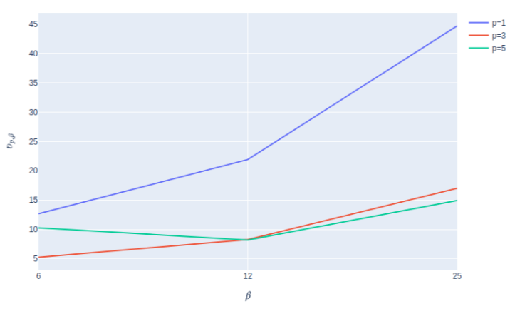
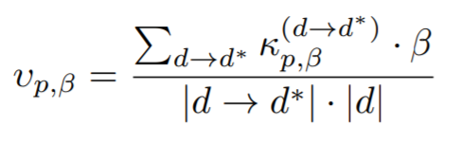
Results (3)
Sec. 4.2
Fig. 3, Eq. 12

Slide 23
3. SYMBOL-TO-SYMBOL MODIFICATION ATTACK
Limited Knowledge Scenario

Slide 24

Our proposal (1)
≈
Sec. 3.4
Eq. 5
Notes:
Poner gif de todas las aproximaciones.

Slide 25
Our proposal (2)
Two different approaches with the same goal:
Z-Score (Defense System Specific)
Gradient Descent (Generic)
Sec. 3.4
Notes:
Poner gif de todas las aproximaciones.

Slide 26
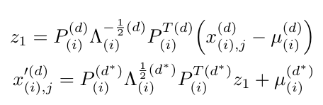


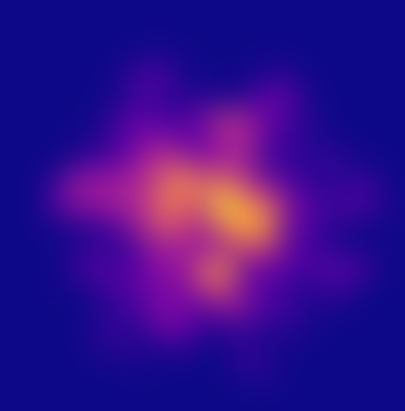
Z-Score
Sec. 3.4
Sec. 3.4
Eq. 5
Eq.7
Notes:
Poner gif de todas las aproximaciones.

Slide 27




Gradient Descent (1)
Z-Score is excellent at mimicking target distribution’s mean and covariance.
The attack works well due to the structure of the proposed system.
However, it would fail if any other measures are used in the security system → A more generalized procedure is needed.
Sec. 3.4
Notes:
Poner gif de todas las aproximaciones.

Slide 28
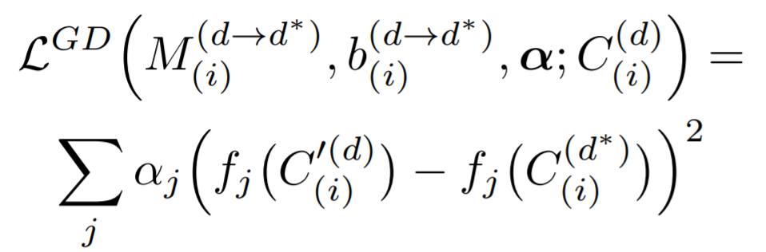
Gradient Descent (2)
Loss function
Sec. 3.4
Eq. 8
Notes:
Poner gif de todas las aproximaciones.

Slide 29
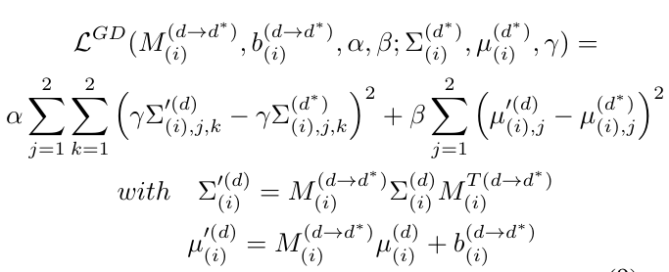
Gradient Descent (3)
Loss function in the proposed setup
Sec. 3.4
Eq. 9
Notes:
Poner gif de todas las aproximaciones.

Slide 30
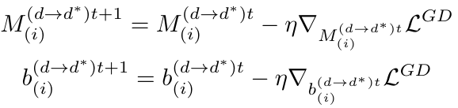
Gradient Descent (4)
Sec. 3.4
Sec. 3.4
Eq. 10
Notes:
Poner gif de todas las aproximaciones.

Slide 31
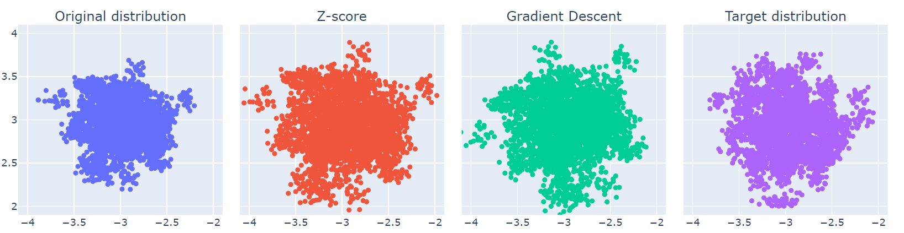
Results (1)
Sec. 4.3
Fig. 4
Notes:
Poner gif de todas las aproximaciones.

Slide 32
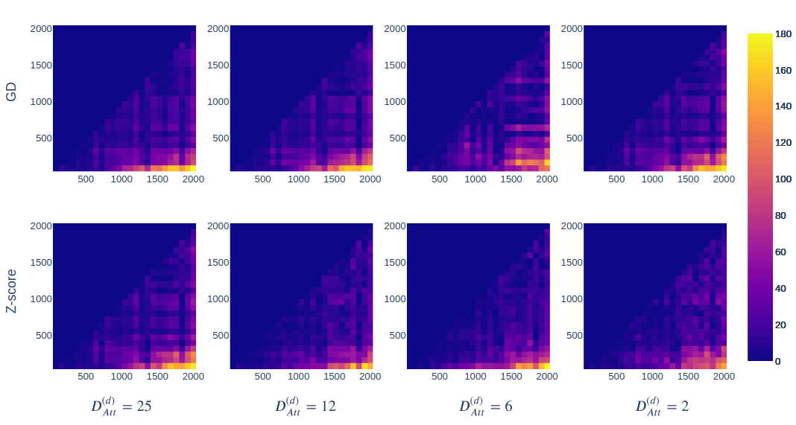

Results (2)
 | 25 | 12 | 6 | 2
GD | 22.70 | 23.86 | 25.46 | 27.41
Z-Score | 19.42 | 19.65 | 21.62 | 25.13
Sec. 4.3
Fig. 5, Table 1
Notes:
Poner gif de todas las aproximaciones.

Slide 33
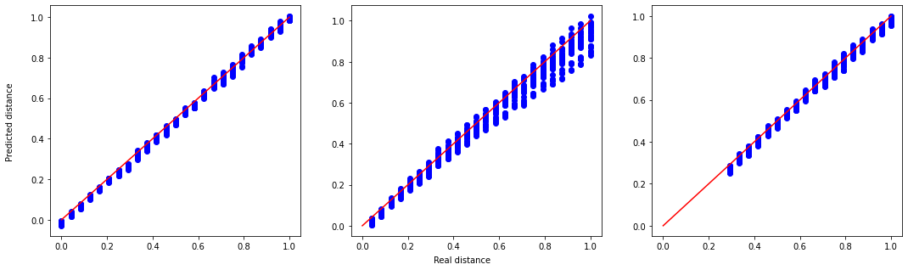
Results (3)
Normalized NN predicted distances vs normalized real ones
Clean Samples
Z-Score modified samples
(d = 80)
Z-Score modified samples
(d = 560)
Sec. 4.3
Fig. 6
Notes:
Poner gif de todas las aproximaciones.

Slide 34
4. CONCLUSIONS

Slide 35
Conclusions
In this paper we have proposed two main attack strategies depending on the attacker’s knowledge of the security system.
AK Scenario (Mean kappa error → 14.95)
LK Scenario (Mean kappa error → 19.42)
Z-Score: Highly setup-dependent.
GD: More generalizable method.
We have been able to demonstrate the effectiveness of our attacks showing a clear security vulnerability in the target defense system.
Further research is necessary to cover these vulnerabilities of the system.
Sec. 5
Notes:
Poner gif de todas las aproximaciones.

Slide 36
Thank you!
Attack on Distance Predictor by Mimicking
Target’s Optical Sample Distribution

