Slide 1






Defending Against Tampering Attacks by
Received Optical Signals Comparison
Alex Ferrando Víctor Novelle Marc Ruiz Luis Velasco

Slide 2
Index
1. Introduction
Motivation
Basic Concepts & Notation
Feature mimic attack
Symbol-to-symbol modification attack
2. Feature Mimic defense
Our Proposal
Results
3. Symbol-to-symbol modification defense
Our Proposal
Chamfer distance
Hausdorff distance
Robust Hausdorff distance
Results
4. Conclusions

Slide 3
INTRODUCTION

Slide 4
Motivation
Several innovative defense proposals against fiber optics tampering have been proposed.
However, most of them rely in hardware components and physic-based approaches.
New proposals have been made to substitute physical-based security systems with software-based ones.
Easier and cheaper to build and distribute on a large scale.
Enable fast and low-cost upgrades if novel attacks appear exploiting the vulnerabilities of the already implemented systems
Propose a software-based security system for the attacks proposed in Attack on Distance Predictor by Mimicking Target’s Optical Sample Distribution.
Sec. 1

Slide 5
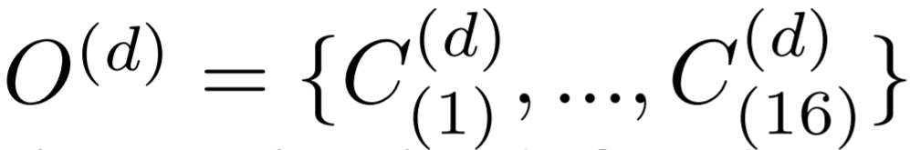
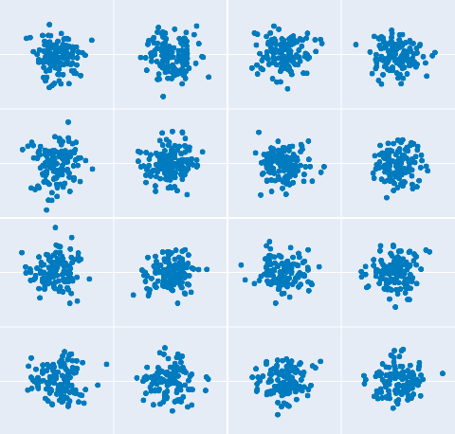
Basic concepts & Notation
Sec. 3

Slide 6
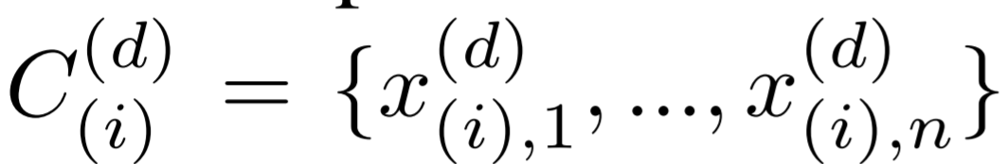
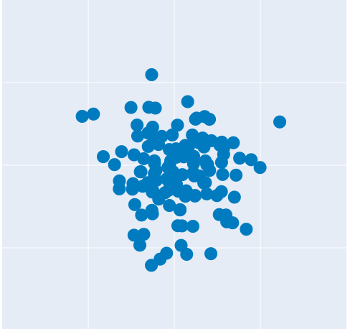
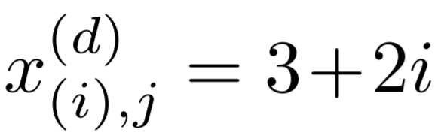
Basic concepts & Notation
Sec. 3

Slide 7

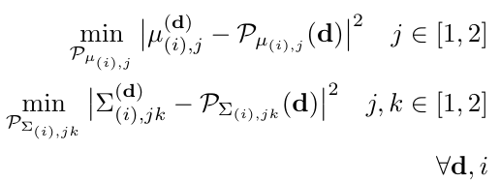
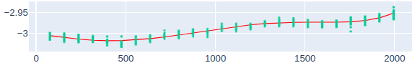






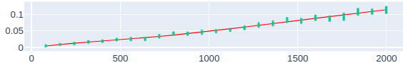

Feature mimic attack (1)
Sec. 3
Sec. 3.3
Eq. 3

Slide 8
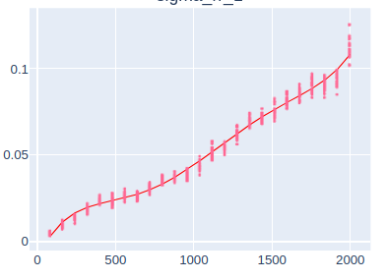
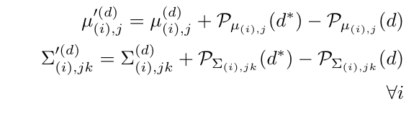

Feature mimic attack (2)
Sec. 3

Slide 9


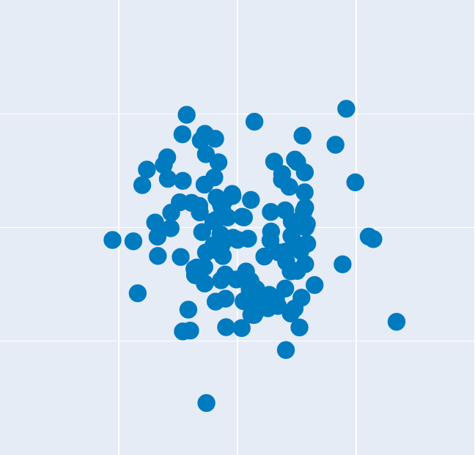

Symbol-to-symbol modification attack
≈
Sec. 3

Slide 10
2. FEATURE MIMIC DEFENSE
Advanced Knowledge Scenario

Slide 11

Our proposal (1)
The attacker is able to modify directly the features inputted to the network.
Most difficult scenario to defend .
Defense will consist in exploiting the unique disadvantage the attacker may have concerning the victim: the available data.
Our defense proposes to find little deviations in the mimicked features from the victim’s train data (in most cases ).
Sec. 3.1

Slide 12
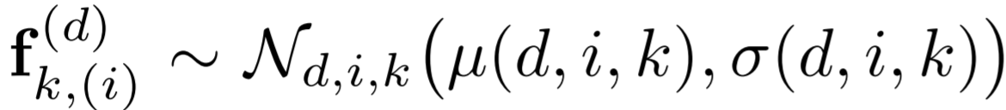

Our proposal (2)
Sec. 3.1

Slide 13


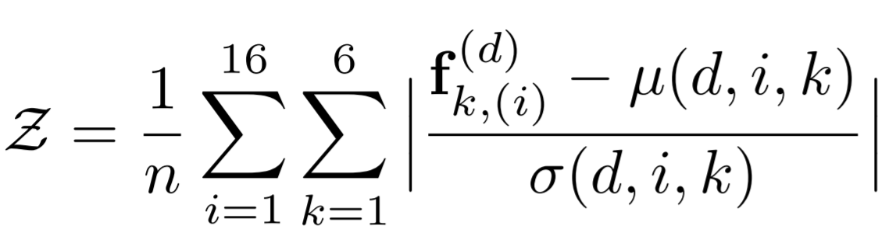
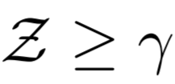

Our proposal (3)
Sec. 3.1
Eq. 1

Slide 14
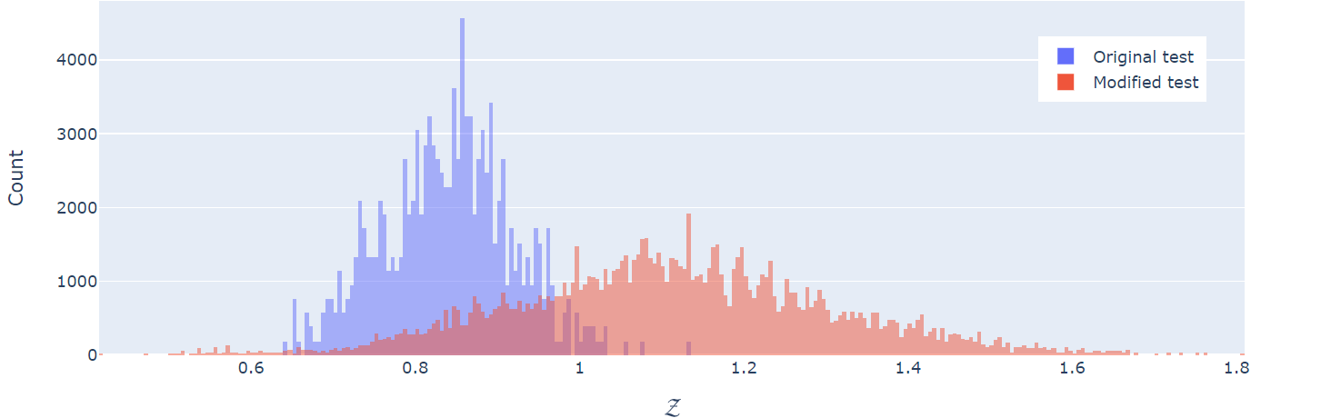
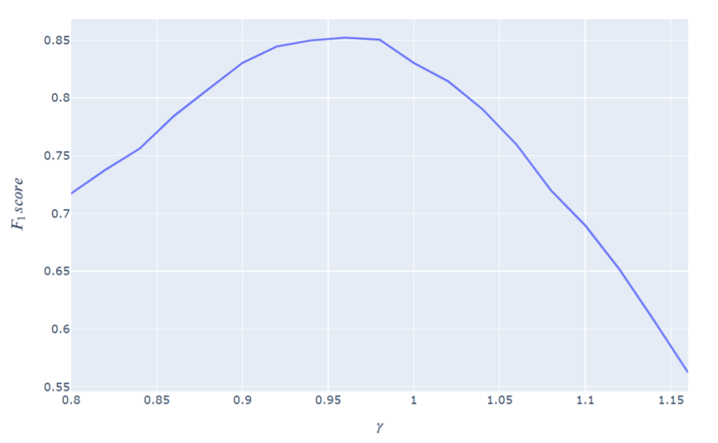
Results (1)
tp = 79.17% fp = 6.67%
Sec. 4.2
Fig. 1. Fig 2.

Slide 15
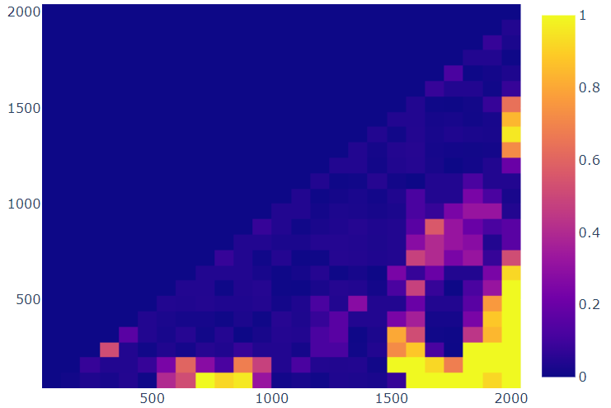
Results (2)
% of false negative per d → d*
Sec. 4.2
Fig. 3

Slide 16
3. SYMBOL-TO-SYMBOL MODIFICATION DEFENSE
Limited Knowledge Scenario

Slide 17
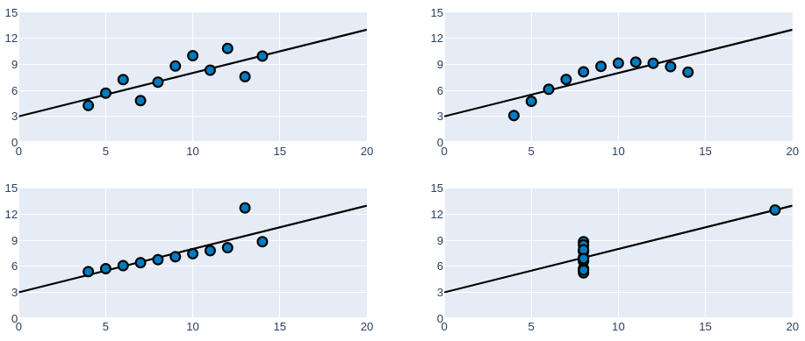






Our proposal (1)
Metric | Value
 | 9
 | 11
 | 7.5
 | 4.12
 | 0.816
Regression line
Sec. 3.2

Slide 18
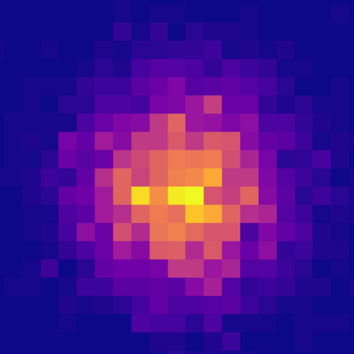
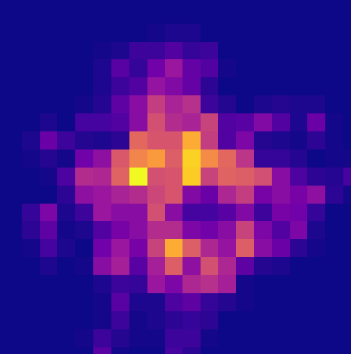





Our proposal (2)
Modified (Z-Score)
Real
Metric | Value
 | -2.960
 | 2.931
 | 0.106
 | 0.113
 | -0.002
Sec. 3.2

Slide 19
Our proposal (3)
The attacker is only able to modify the raw symbols that will later be processed for the GMM and the network respectively.
More information available to perform comparisons.
Defense will consist in exploiting the (dis)similarity between the constellation points of modified and non-modified signals.
Three distance metrics have been proposed to defend this scenario.
Sec. 3.1
Sec. 3.2

Slide 20
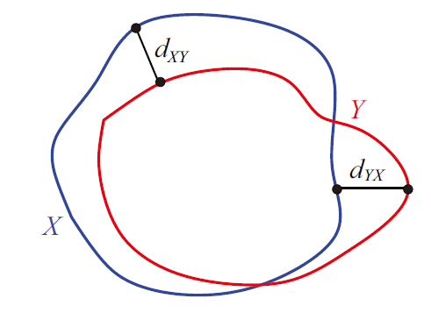
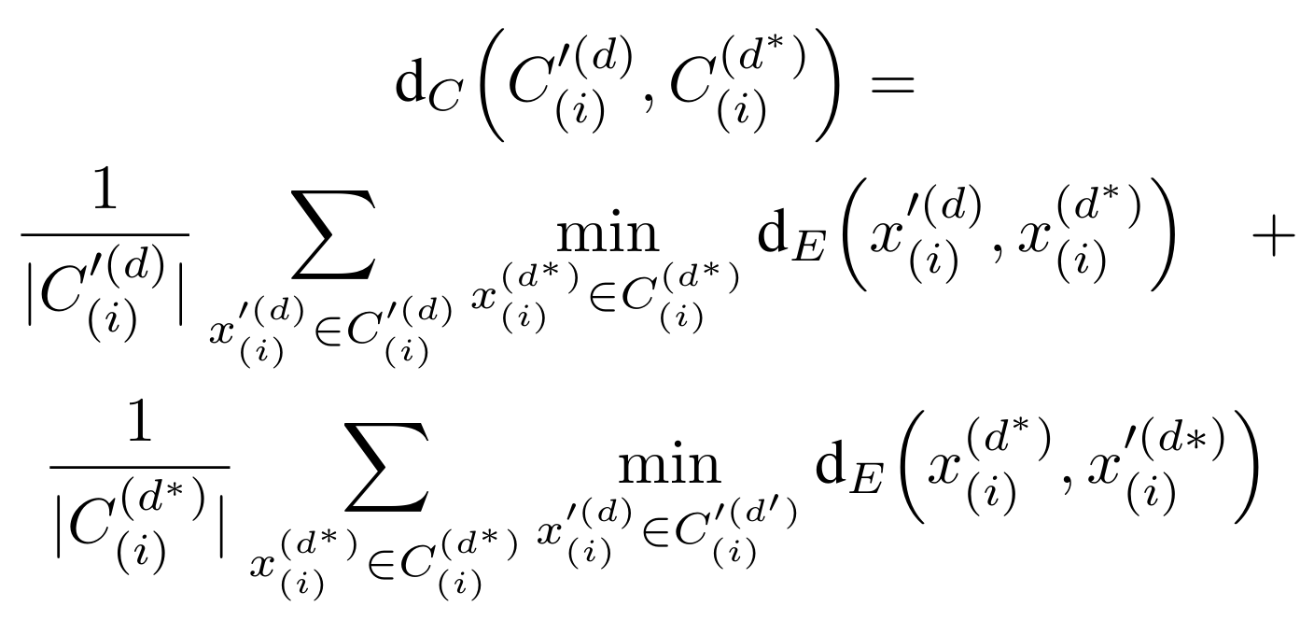


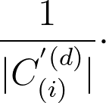

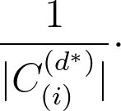

Chamfer distance
Sec. 3.2
Sec. 3.2
Eq. 3

Slide 21
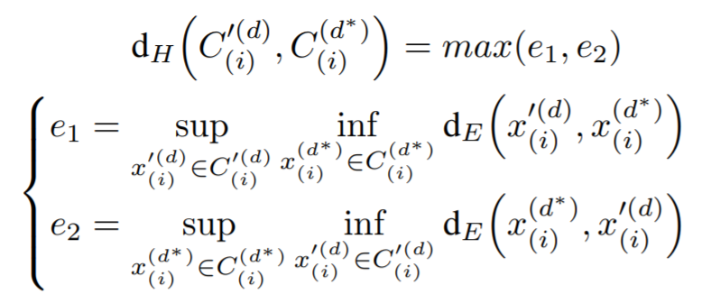
Hausdorff distance
Sec. 3.2
Sec. 3.2
Eq. 2

Slide 22
Robust Hausdorff distance
Robust Hausdorff with K% implies considering only the K% of the infimum distances for the supremum computation.
Sec. 3.2

Slide 23


Results (1)
Sec. 4.3

Slide 24
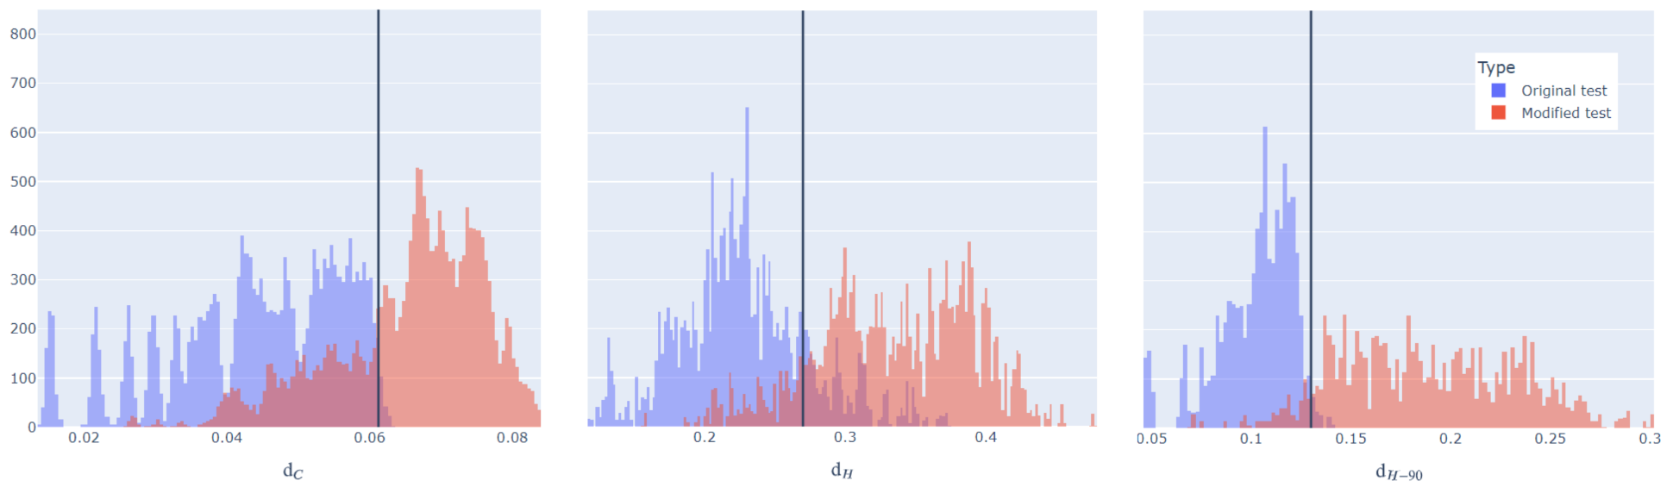
Results (2)
Distance | F1 Score | TP(%) | FP(%)
Chamfer | 0.8328 | 72.21 | 1.20
Hausdorff | 0.8605 | 89.82 | 18.95
Robust Hausdorff (90%) | 0.9537 | 93.68 | 2.78
Sec. 4.3
Fig. 4, Table 2

Slide 25
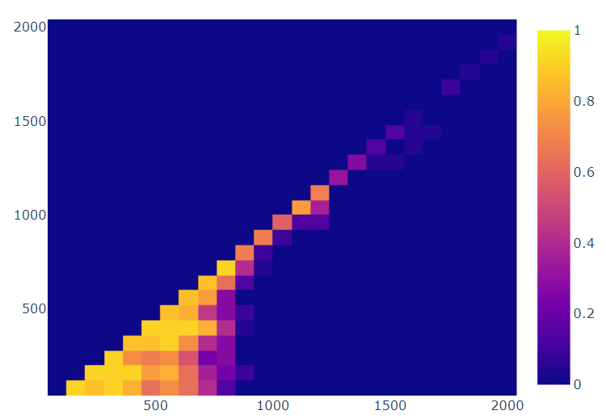
Results (3)
% of false negative per d → d*
Sec. 4.3
Fig. 5

Slide 26
4. CONCLUSIONS

Slide 27
Conclusions
In this paper we have proposed several defense strategies that allow to effectively detect the tampering attacks that bypassed the NN-based previous defensive system.
Feature mimic : 79.17% detection rate.
Symbol-to-symbol: 93.68% detection rate.
As expected, having more information available improves detection capability.
However, further research is necessary to improve detection in certain modification ranges in both scenarios.
Sec. 5
Notes:
Poner gif de todas las aproximaciones.

Slide 28
Thank you!
Defending Against Tampering Attacks by Received Optical Signals Comparison

