Slide 1


ATH Blue, ATH Plus, and ATH Premium Process Improvement Case Study
Ronald Rivera Torres

Slide 2


Process
Total Process Time: ATH Blue (50 mins) | ATH Plus (55 mins) | ATH Premium (59 mins)

Slide 3

Transactions Analysis
Card Type | Num Transactions | Transaction Ratio | Process Time (Hr) | Process Time Ratio
ATH Blue | 1,132 | 57% | 943.78 | 55%
ATH Plus | 855 | 43% | 784.06 | 45%
ATH Premium | 0 | - | 0 | -
Total | 1,987 | - | 1,727.84 | -
Key takeaways:
Even while ATH Blue has a quick processing time, compared to ATH Plus, its high demand makes it take more process time.
No ATH Premium request during the evaluation time frame.
Data gathered from May 3, 2021 to June 30, 2021

Slide 4

Resources Analysis
Resources | Avg Transaction (Daily) | Utilization Ratio (Daily)
1 | 7.705 | 0.838
2 | 8.136 | 0.885
3 | 8.341 | 0.906
4 | 7.659 | 0.837
5 | 7.841 | 0.854
6* | 6.477 | 0.697
Key takeaways:
The utilization for all dedicated resource is 0.864.
The average transactions completed daily is 7.936 for each dedicated resource.
With the resources available , ATH cards services are produced at a rate of 46 each day.
* Resources 6 is a non-dedicated resource that in occasions helps the team

Slide 5
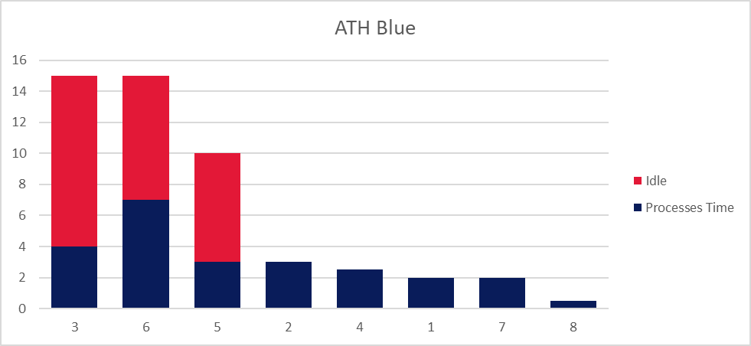
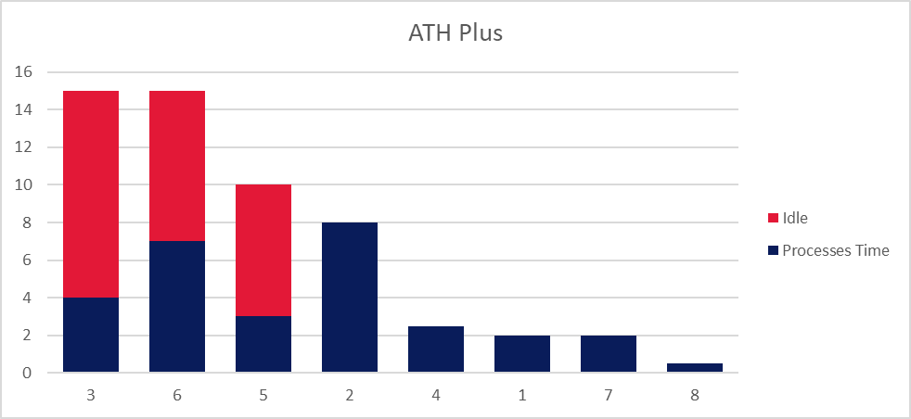
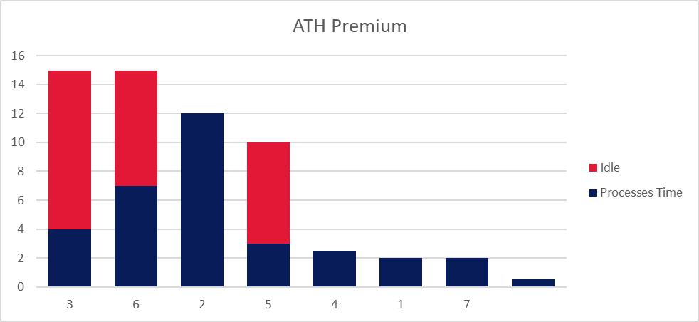
Process Time Distribution
Card Type | Idle Ratio
ATH Blue | 52%
ATH Plus | 47%
ATH Premium | 44%

Slide 6
Improvement Recomendations
3 - Acquire the digital signature. | 5 - Acquire the signed hardcopy of the ATH Request Form. | 6 - Print ATH card.
Current process: Process Time: 1 mins Idle Time: 11 mins Walk time: 3 mins | Current process: Process Time: 1 mins Idle Time: 7 mins Walk time: 2 mins | Current process: Process Time: 7 mins Idle Time: 8 mins Walk time: Not available
Observations: Only 1 digital signature device Signature device used for other processes | Observations: Only 1 printer available Printer used in other processes | Observations: 2 ATH card printer 1 used for printing Blue and Plus cards. Second device used only for Premium card. In the analyzed time frame, no Premium card requested.
Recommendations: Conduct a digital signature device utilization analysis. In order to reduce wait times, collect additional data for establishing the ideal number of equipment to employ. Relocate the device location with the aim of reducing walk distance. | Recomendations: | Recommendations: Rearrange the card printers so that printer 1 only prints Blue cards and printer 2 prints Plus and Premium cards. Additional utilization analysis should be conducted.
Current capacity: 46 cards daily | Capacity with recommendations: 90 cards daily
Notes:
Blue take 55% of the process time

Slide 7
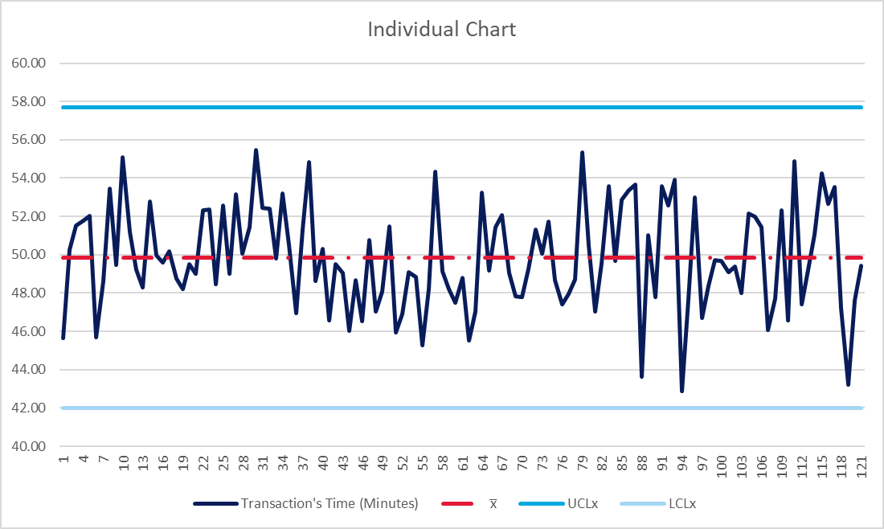
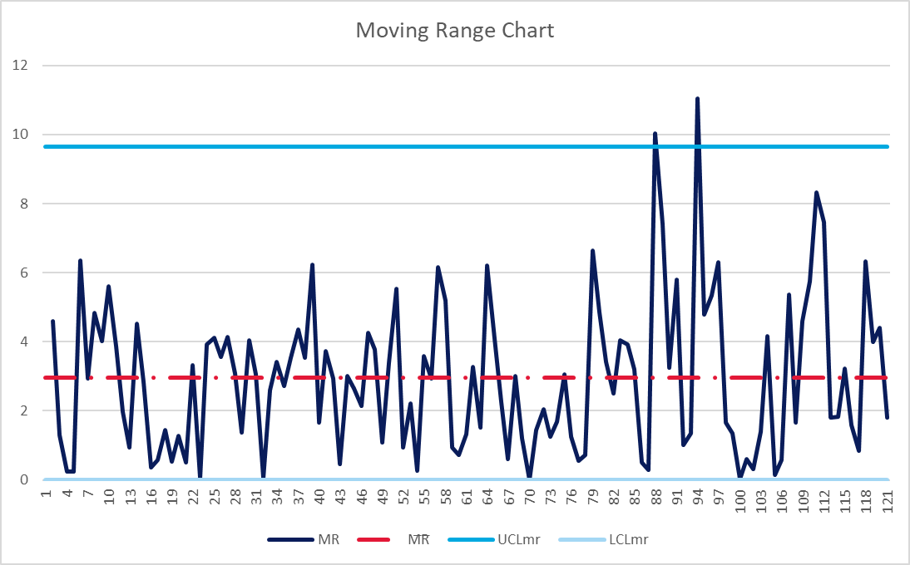
Sustainability of the Improvements
Assess the ROI for additional equipment added to the process.
To guarantee a smooth transition, keep in touch with the staff performing the tasks.
Implement monitoring process through control chart.
I-MR Control Chart

Slide 8
Any Questions
ATH Blue, ATH Plus, and ATH Premium Process Improvement Case Study

