Slide 1


ATH Blue, ATH Plus, and ATH Premium Process Improvement Case Study
Ronald Rivera Torres

Slide 2


Process
Total Process Time: ATH Blue (50 mins) | ATH Plus (55 mins) | ATH Premium (59 mins)

Slide 3

Transactions Analysis
Card Type | Num Transactions | Transaction Ratio | Process Time (Hr) | Process Time Ratio
ATH Blue | 1,132 | 57% | 943.78 | 55%
ATH Plus | 855 | 43% | 784.06 | 45%
ATH Premium | 0 | - | 0 | -
Total | 1,987 | - | 1,727.84 | -
Key takeaways:
Even while ATH Blue has a quick processing time, compared to ATH Plus, its high demand makes it take more time.
No ATH Premium request during the evaluation time frame.
Data gathered from May 3, 2021 to June 30, 2021

Slide 4

Resources Analysis
Resources | Avg Trans (Daily) | Utilization Ratio (Daily)
1 | 7.705 | 0.838
2 | 8.136 | 0.885
3 | 8.341 | 0.906
4 | 7.659 | 0.837
5 | 7.841 | 0.854
6* | 6.477 | 0.697
Key takeaways:
The utilization for all dedicated resource is 0.864.
The average transactions completed daily is 7.936 for each dedicated resource.
With the resources available , ATH cards services are produced at a rate of 46 each day.
* Resources 6 is a non-dedicated resource that in occasions helps the team

Slide 5
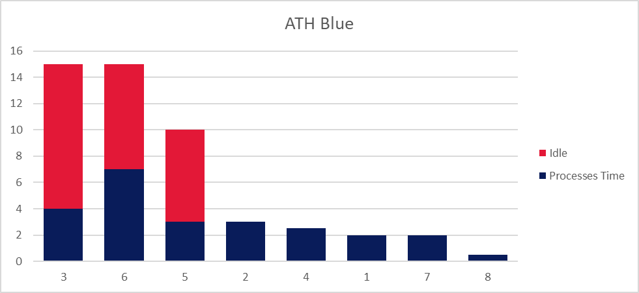
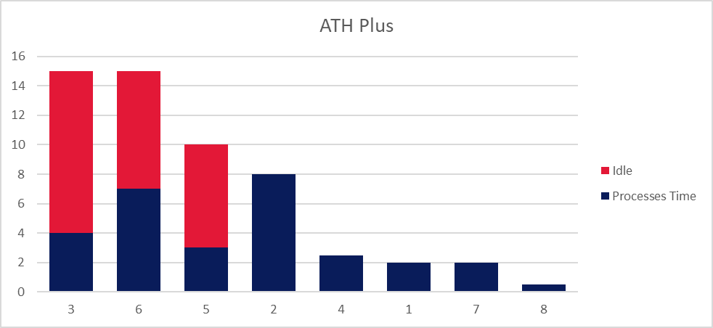
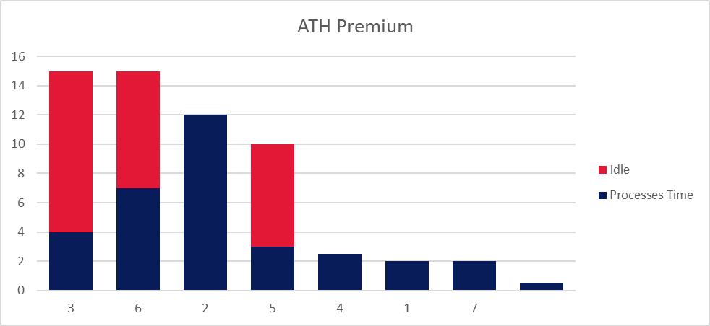
Process Time Distribution
Card Type | Idle Ratio
ATH Blue | 52%
ATH Plus | 47%
ATH Premium | 44%

Slide 6
Recomendations
Several innovative defense proposals against fiber optics tampering have been proposed.
However, most of them rely in hardware components and physic-based approaches.
New proposals have been made to substitute physical-based security systems with software-based ones.
Easier and cheaper to build and distribute on a large scale.
Enable fast and low-cost upgrades if novel attacks appear exploiting the vulnerabilities of the already implemented systems
In light of this, we suggest a Deep Learning-based security solution for optical spectrum analysis-based anomaly detection.

Slide 7
Control Chart
Several innovative defense proposals against fiber optics tampering have been proposed.
However, most of them rely in hardware components and physic-based approaches.
New proposals have been made to substitute physical-based security systems with software-based ones.
Easier and cheaper to build and distribute on a large scale.
Enable fast and low-cost upgrades if novel attacks appear exploiting the vulnerabilities of the already implemented systems
In light of this, we suggest a Deep Learning-based security solution for optical spectrum analysis-based anomaly detection.

Slide 8
Any Questions
ATH Blue, ATH Plus, and ATH Premium Process Improvement Case Study

