Slide 1
Airbnb
-”Connecting travelers with local hosts”
Name: Parekh Yash Nimish Kumar

Slide 2
introduction
Airbnb is an online marketplace that connects people who want to rent out their homes with people who are looking for accommodations.
Provides a variety of property types:
homes, apartments, villas, cabins, and more.

Slide 3
tech stack
React
Sqlite
Dajngo

Slide 4
Features
01
02
03
Authorization
Filter Search
OTP Verification
04
05
06
Map Location View
Chat Integration
Image-Based Place Search

Slide 5
JWT-token Authorization
Secure, stateless authentication for users
Eliminates need for server-side sessions
oken issued during login, verified for each request

Slide 6
Filter Search
location
Price range
User reviews
Property type
rooms

Slide 7
OTp verification
Enhances security during signup
User enters email → OTP sent → OTP input → Verification
Email service integration

Slide 8

Map Location View
Allows users to view listings on a map for better location context
Interactive map with markers for property locations
Zoom and pan functionality
Map APIs (Google Maps, Map box)

Slide 9
Chat for user Information
Instant messaging between users and hosts. In-app support chat with bots or admins
Text chat, media sharing
Chatbot integration for FAQs and booking information

Slide 10
Chat for user Information
Instant messaging between users and hosts. In-app support chat with bots or admins
Text chat, media sharing
Chatbot integration for FAQs and booking information

Slide 11
Flow of project
User signup with OTP verification
View on map and chat with hosts
Image search demo
Secure booking with JWT authentication

Slide 12
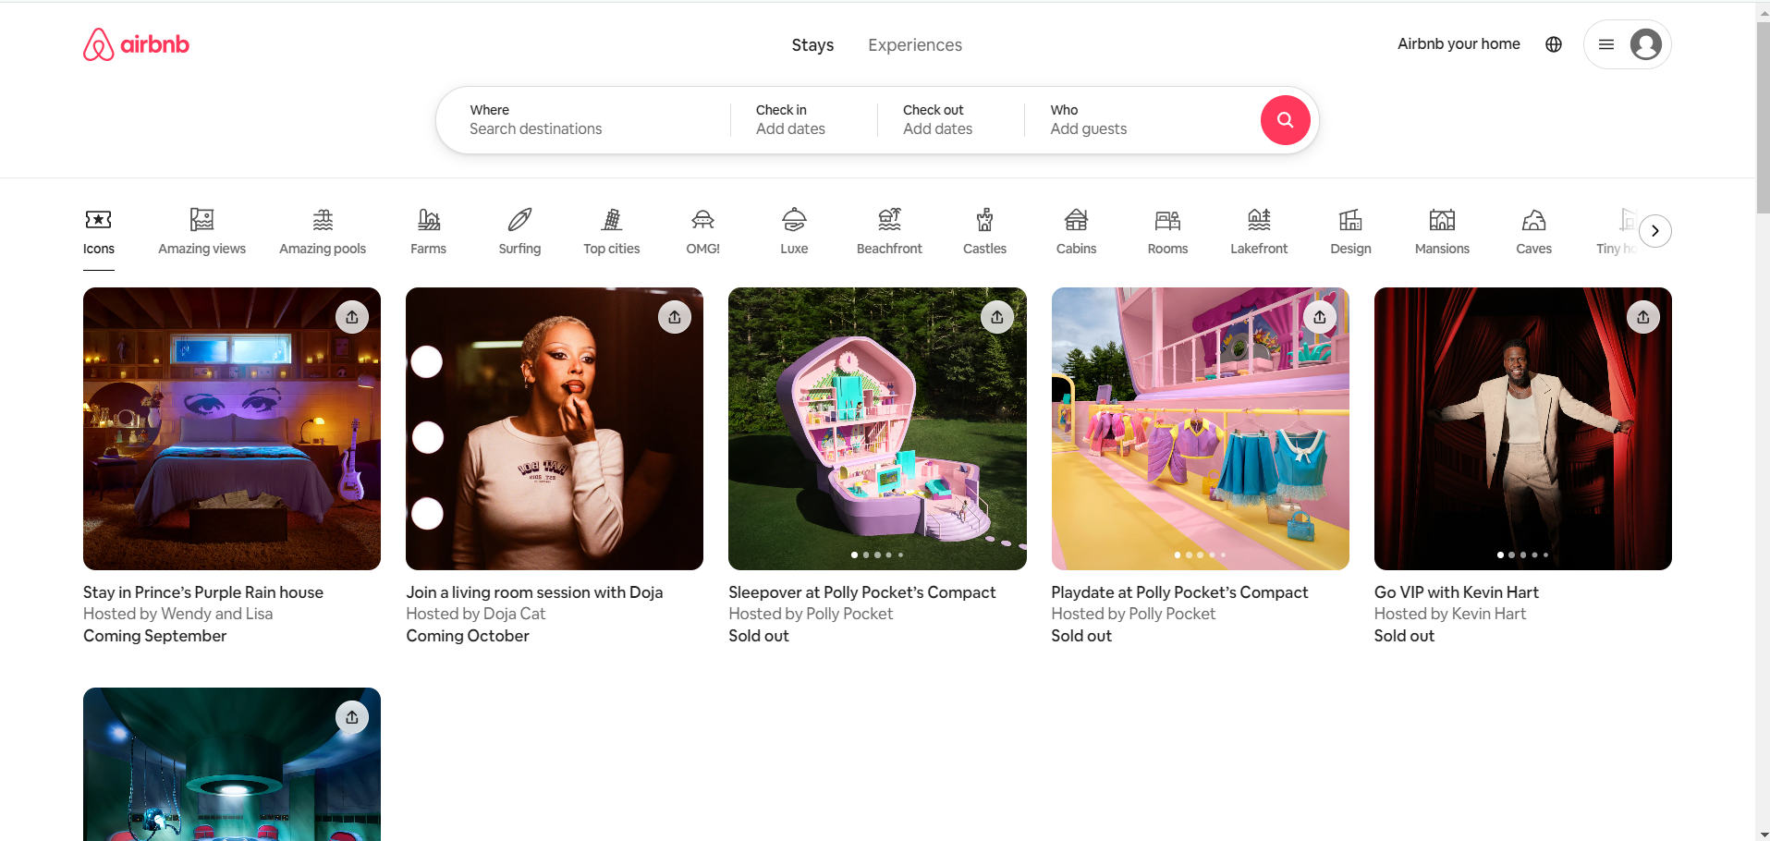
DESKTOP view

Slide 13
Thanks!

