Slide 1
WeaveNYC
Local-First Storage
Data stays on device by default
Privacy-First Mutual Aid Platform
P2P via GossipSub
Decentralized community sync
Progressive Auth
Connecting NYC's underserved communities
with resources and neighbors they can trust
4-level identity trust model
Multi-Cloud (×3)
Kairan Shen ks8385@nyu.edu
Biao Chen bc4159@nyu.edu
AWS + GCP + Azure PaaS
1.5M+
food insecure in NYC
2.5M
limited English proficiency
300K+
undocumented at risk
WeaveNYC · Midterm Proposal
1

Slide 2
Part 1: Cloud Migration — MediaWiki
Legacy Application → Docker → Cloud VM — deployment changes, not code changes
①
②
③
④
Manual LAMP Install
Verify & Test
Docker Compose
Cloud VM Deploy
Apache + MariaDB
+ PHP on Ubuntu
(bare-metal server)
▶
Application runs
identically — same
logic, same output
▶
Official MediaWiki
image + MariaDB
container
▶
Same containers
on cloud infrastructure
(AWS / GCP / Azure)
WHY MEDIAWIKI?
CLOUD-BASED MIGRATION
Clean Migration Story
Deployment Model, Not Code
✓ Traditional LAMP install path (Apache, MariaDB, PHP)
Cloud-Based
✓ Docker Official Image with docker-compose.yml
Change deployment only — same app, new infra
✓ Identical app logic across all three environments
Cloud-Enabled
✓ Rich admin UI makes verification easy
Adapt code for cloud features (e.g. auto-scale)
✓ Well-documented — no ambiguity in setup process
Cloud-Native
Built for cloud from scratch (microservices, K8s)
→ Both paths exist natively — perfect for cloud migration demo
→ Our approach: cloud-based — application logic stays identical
MediaWiki
LAMP Stack
Docker Compose
Cloud VM
Cloud-Based
WeaveNYC · Midterm Proposal
2

Slide 3
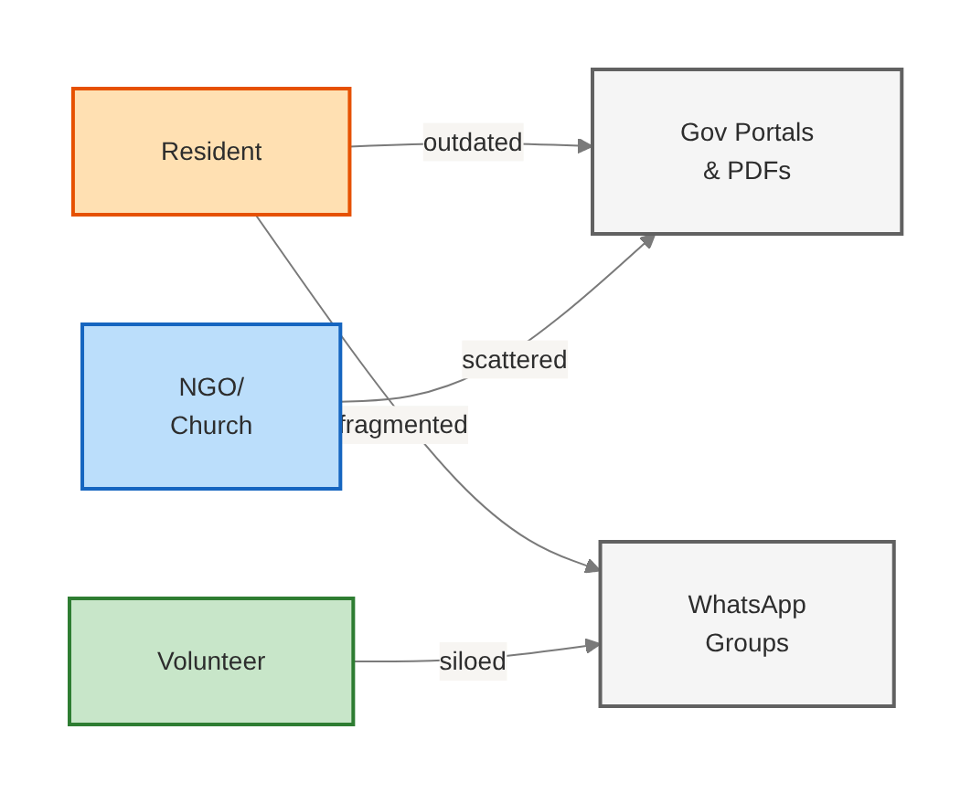
Problem: Fragmented, Opaque, Siloed
Fragmented Resources
Trust Deficit
Official info scattered across agencies, PDFs, and phone lines
Undocumented populations fear data exposure to authorities
Language & Digital Barriers
Siloed Mutual Aid
200+ languages in NYC, low digital literacy, poor connectivity
WhatsApp/WeChat groups: limited reach, unsearchable, no governance
Current As-Is Flow: Manual, fragmented, no single system of record
WeaveNYC · Midterm Proposal
3

Slide 4
Solution: Five Value Pillars
01
02
03
Zero Cold Start
Privacy by Default
Smart Matching
Official resource directory available Day 1 — no community bootstrapping needed
Data stays on device; user explicitly opts in before any sharing; ZIP-only precision
Every request gets Top-3 action plans: neighbor matches + official resource fallback
04
05
Community Governance
Trilingual + Voice
Anchor nodes define rules, moderate content, broadcast decisions via P2P network
Full UI in EN/ES/ZH; 3-tier voice degradation; privacy-first audio processing
WeaveNYC · Midterm Proposal
4

Slide 5
Target Users
Three personas across the WeaveNYC platform
Need Seeker
Helper
Anchor Admin
WHO
WHO
WHO
Low-income, immigrant, elderly, single parent, temporarily unemployed
Volunteer, neighbor, student, church / community group member
NGO staff, church coordinator, pantry operator, mutual aid organizer
GOAL
GOAL
GOAL
Find food, childcare, translation, transportation help ASAP
Post offers, screen suitable matches, complete delivery safely
Configure rules, moderate content, post announcements, handle reports
OUR VALUE
OUR VALUE
OUR VALUE
Actionable plan in <1 min; anonymous by default; minimal data exposure
Smart matching; risk alerts; witness mechanism builds trust
Visual review queue + audit log; community governance toolkit
Seeker requests help → Helper fulfills → Anchor Admin governs
WeaveNYC · Midterm Proposal
5

Slide 6
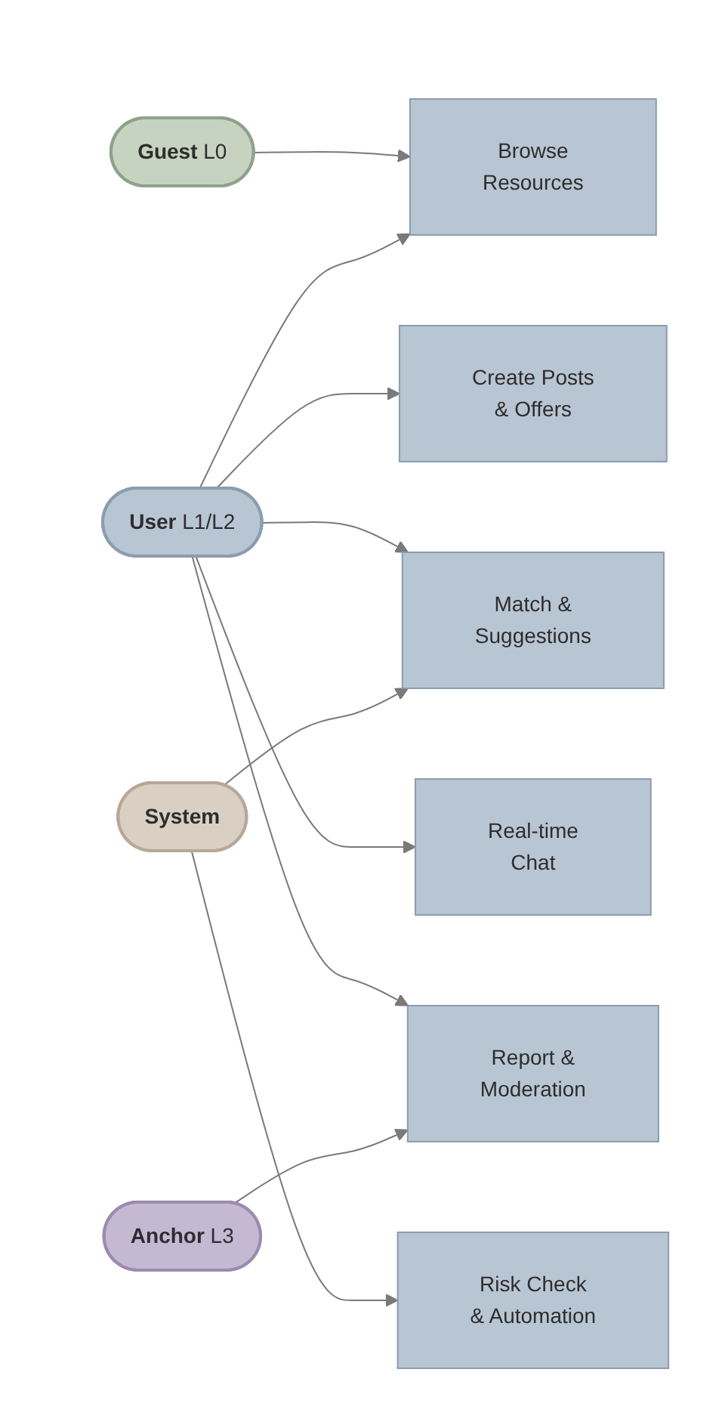
MVP Use Cases
Five core workflows from browse to governance
01
Browse Resources
ZIP search, 'open now' filter, one-tap call/navigate
02
Post Request / Offer
Voice or text, category, privacy level, auto-expire
03
Smart Matching
Top-3 action plans: distance, language, trust signals
04
Safe Communication
Double opt-in chat, PII detection, block/report
05
Anchor Governance
Review queue, SLA priority, audit trail, P2P broadcast
WeaveNYC · Midterm Proposal
6

Slide 7
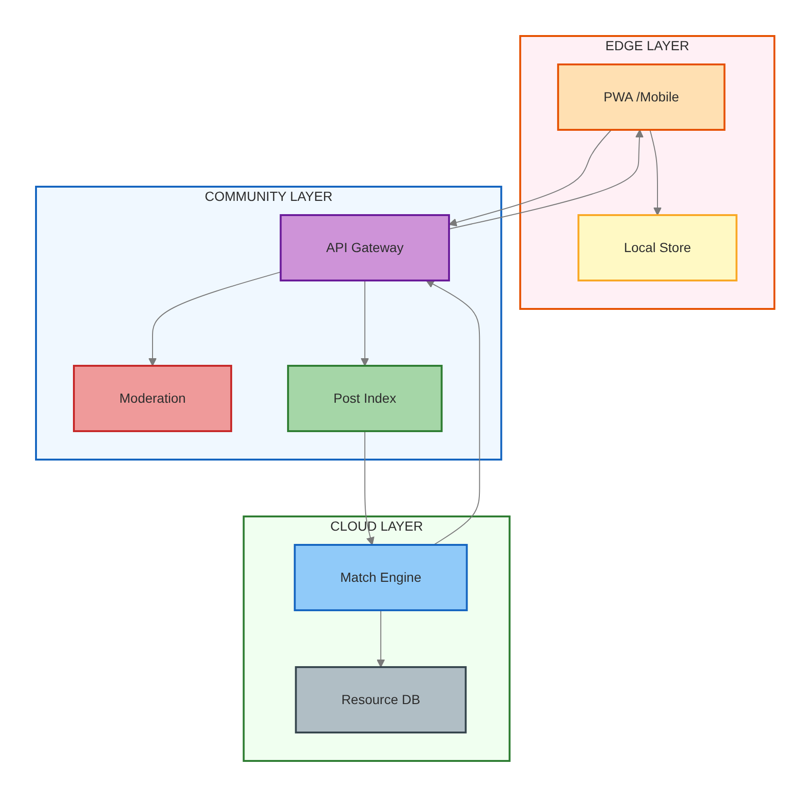
System Architecture
Four-layer separation from client to storage
Edge Layer
Community Layer
PWA / Client
P2P / Anchor
Next.js + IndexedDB + i18n
Map + Voice; offline-first
libp2p + Anchor Node
GossipSub + IPFS pin + mod
Cloud Layer
Data Layer
6 Microservices
Storage
API GW, Resource Dir, Posts
Match Engine, Chat, Notify
PostgreSQL+PostGIS | Redis
IPFS/Helia | S3/GCS/Blob
WeaveNYC · Midterm Proposal
7

Slide 8
P2P Architecture: True Peer-to-Peer
GossipSub direct node communication — no central broker, no Kafka, no PubSub
WHY TRUE P2P — NOT KAFKA
GOSSIPSUB P2P STACK
Our Stack (GossipSub)
Kafka / PubSub
Protocol: libp2p v1.1 + GossipSub v1.1
✓ Edge ↔ Anchor direct
✗ All msgs via broker
Transport: WebRTC (direct) + WebSocket (relay)
✓ Edge ↔ Edge via WebRTC
✗ No direct peer link
Storage: IPFS Helia (content-addressed, 30-day pin)
✓ Anchor relays, not gates
✗ Broker = single point of failure
Identity: Ed25519 keypair + event signing
✓ Works if Anchor offline
✗ Broker down = network down
Local: IndexedDB (offline-first, zero-knowledge)
→ Each node gossips directly to peers — no central message queue
→ Production-grade: same stack as Ethereum & Filecoin
EDGE NODE
ANCHOR NODE
CLOUD INTELLIGENCE
Edge Node
Anchor Node
Cloud Layer
PWA / Browser (libp2p-js)
Community Org (Node.js, libp2p v1.1)
AWS / GCP / Azure (Serverless)
• libp2p in WebWorker, max 10 connections
• GossipSub relay + IPFS pin (not a broker)
• Match engine + risk detection + geo-search
• Create posts offline, publish on opt-in
• Content moderation + community rule engine
• Optional relay (Anchor offline fallback)
• WebRTC direct + WebSocket fallback
▶
• Signature verification + audit log
▶
• No PII stored — metadata indexing only
Users create & sign posts locally, then gossip to peers via GossipSub
Relays events & enforces rules; Anchor-wins for moderation decisions
Heavy compute only; supplements P2P, never replaces it
True P2P
GossipSub v1.1
libp2p
WebRTC
IPFS Helia
Ed25519
WeaveNYC · Midterm Proposal
8

Slide 9
P2P Engineering: Bootstrap & Failover
How new nodes join, how coordinators stay resilient, and how data stays consistent
BOOTSTRAP: NEW NODE JOINS
ANCHOR FAILOVER
DISTRIBUTED vs DECENTRALIZED
① Load Known Anchors
Primary
Sec #1
Sec #2
Distributed (✓ Our system):
Hardcoded addresses + local cache
→
→
Different nodes do different tasks
Edge: create | Anchor: govern | Cloud: compute
Leader
Hot Standby
Cold Standby
② Connect via WebSocket
Edge → Anchor /bootstrap endpoint
sync 30s sync 60s
Decentralized (Partial):
③ Receive Snapshot
#1 auto-promotes if Primary unreachable
Intentional Anchor authority for
community safety & content moderation
Last-100 posts + peer list (Ed25519)
WHY FIXED, NOT DYNAMIC ELECTION?
④ Subscribe & Sync
✓ No split-brain (no Raft/Paxos needed)
Our Model:
Join 3 GossipSub topics (~500ms)
✓ Community trust: Anchor = known org
"Governance-Layered Hybrid"
P2P msg layer (decentralized)
+ Anchor governance (centralized trust)
+ Cloud compute (centralized service)
→ Same pattern as Bitcoin DNS seeds
✓ Edge ↔ Edge still works without Anchor
EVENTUALLY-CONSISTENT MODEL
Event Dedup
Version Chain
Conflict Rule
Tombstone
UUIDv7 unique ID
drop duplicates
CID → prev_cid
immutable audit trail
Posts: last-write-wins
Mod: Anchor-wins
Irreversible delete
broadcast to all nodes
→ No split-brain: Anchor decides conflicts | Works offline: versioning + local cache | Hybrid: cloud supplements, never replaces P2P
Bootstrap Protocol
Fixed Failover
Eventually Consistent
Anchor-Wins
Ed25519 Verified
WeaveNYC · Midterm Proposal
9

Slide 10
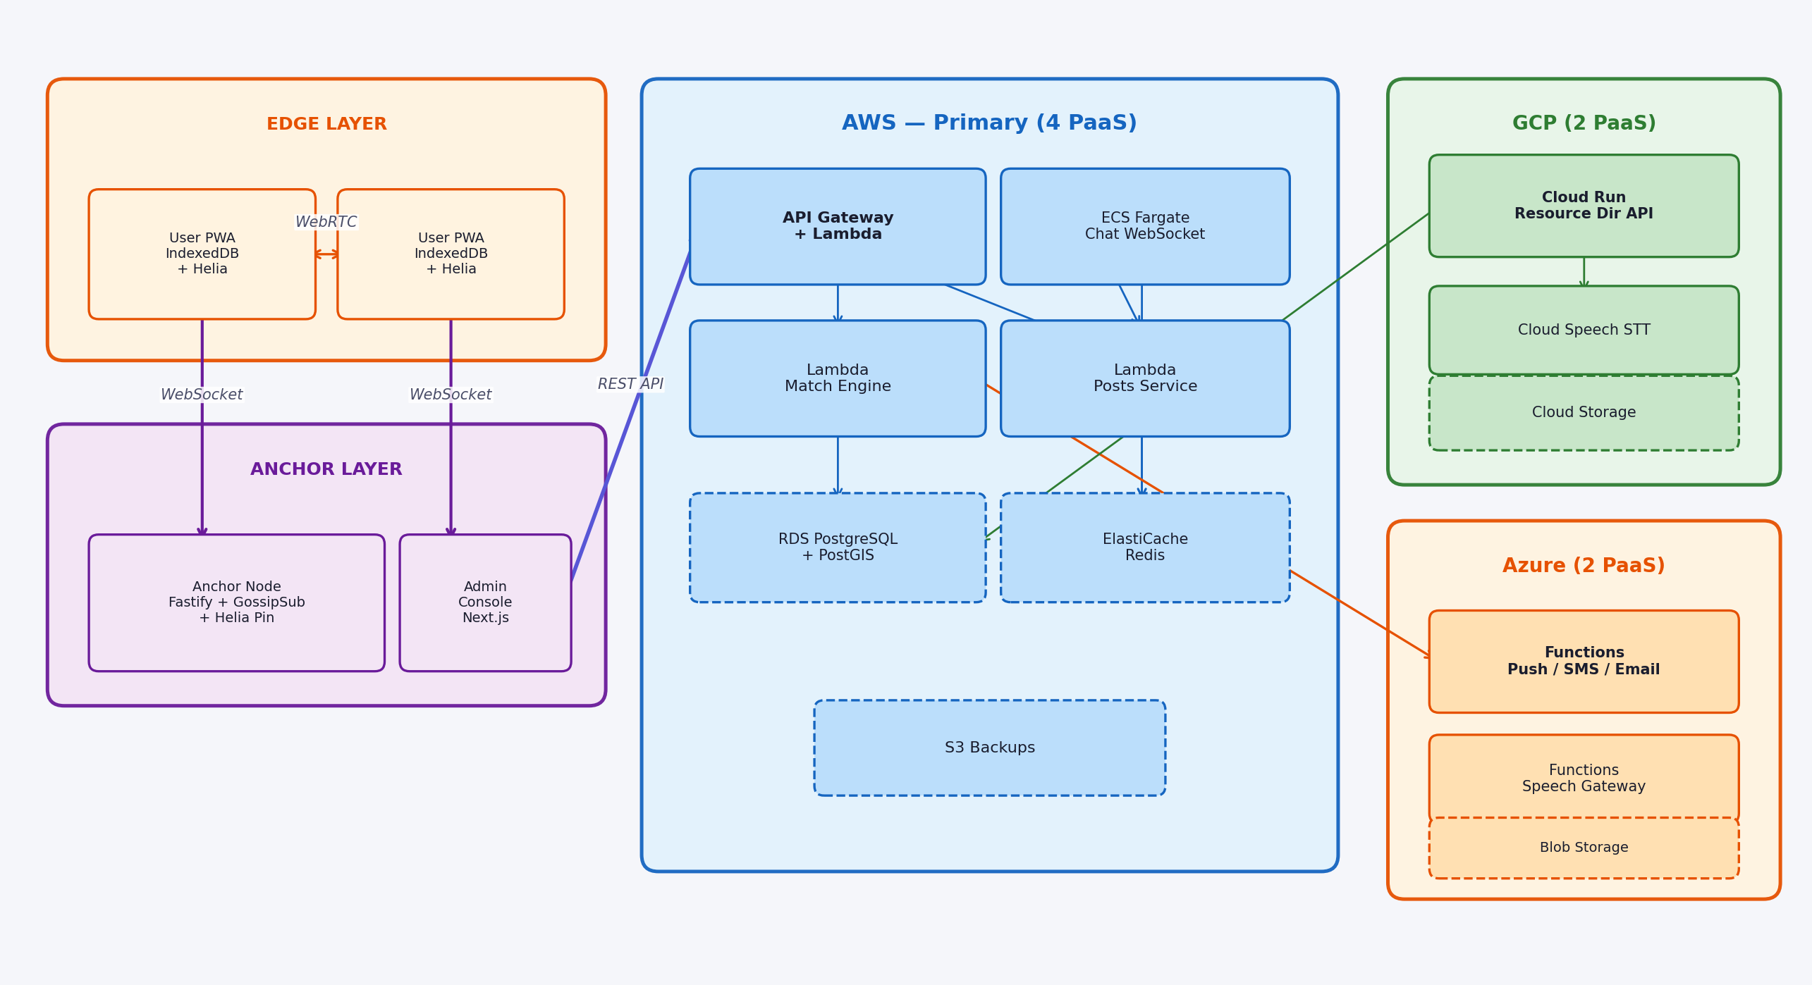
Multi-Cloud Deployment
8 PaaS services across AWS, GCP & Azure — each chosen for a specific technical advantage
AWS Primary Backend · 4 PaaS
GCP Resource Layer · 2 PaaS
Azure Notify + Voice · 2 PaaS
Lambda + API GW for sub-100ms serverless API. RDS PostGIS for geo-fenced community search. Fargate for persistent WebSocket chat connections.
Cloud Run auto-scales to zero — isolates Resource Directory from main API blast radius. Cloud Speech STT for voice-to-text accessibility.
Functions (Push / SMS / Email) for real-time notification hub. Functions (Speech Gateway) for lowest-latency Tier-3 voice accessibility.
WeaveNYC · Midterm Proposal
10

Slide 11
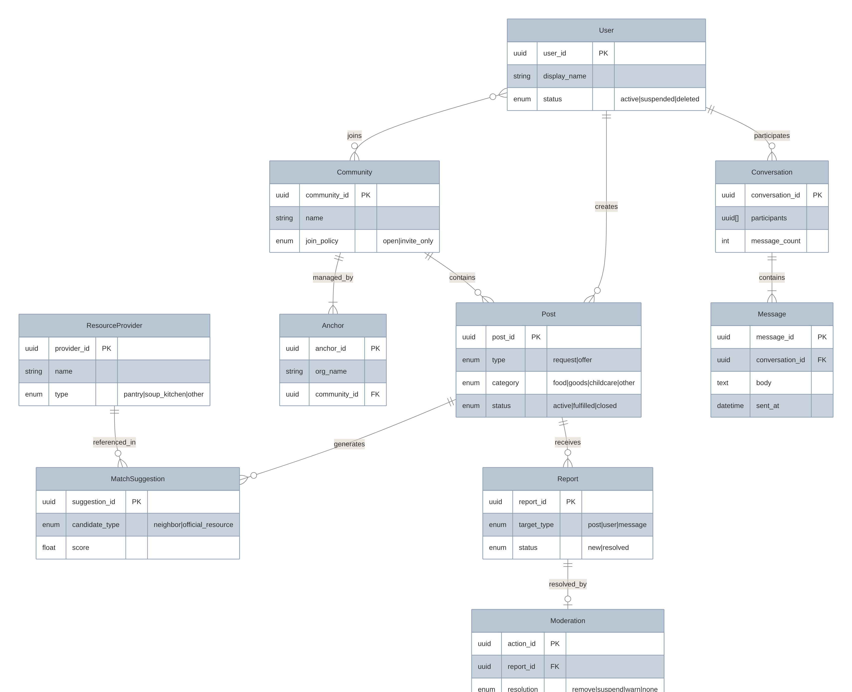
Data Model & Privacy Tiers
Three-tier storage: local-first for privacy, P2P for community, cloud for indexing
Local-Only
IndexedDB (Dexie.js): settings, drafts, favorites, encryption keys. Data never leaves the device — zero-knowledge by design.
Community-Shared
IPFS (Helia) + GossipSub: post summaries, version chains, reputation signals. Peers replicate only within their community.
Cloud Index
PostgreSQL+PostGIS + Redis: resources, post indexes, match results, chat, audit logs. Encrypted at rest, geo-fenced queries.
WeaveNYC · Midterm Proposal
11

Slide 12
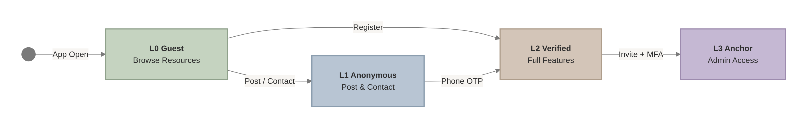
Security & Trust
Progressive trust ladder + STRIDE threat model + community governance
Threat Model (STRIDE)
Spoofing
Tampering
Repudiation
Anchor MFA; signed resource directory
Import version hash; post version chain
Minimal audit log (type + time + actor)
Info Disclosure
DoS
Elevation
ZIP-only; no GPS; anonymous nicknames
Rate limit; new-account restrictions; topic quota
RBAC + invite code + MFA for Anchor
Community Governance: Reports → Moderation → Anchor Decision → P2P Broadcast
WeaveNYC · Midterm Proposal
12

Slide 13
Roadmap & Course Alignment
7 milestones across 6+ weeks — MVP-first, iterate on feedback
M0
Day 1-3
M1
Wk 1-2
M2
Wk 2-3
M3
Wk 3-4
Project Skeleton
Resource Directory
Mutual Aid Posting
Matching Engine
Monorepo + CI/CD + DB + JWT + PWA
CFC import + ZIP search + PostGIS
Request/Offer CRUD + voice input
Top-3 action plans + official fallback
M4
Wk 4-5
M5
Wk 5-6
M6
Wk 6+
Chat & Safety
Anchor Admin
P2P Sync (Bonus)
WebSocket RT + PII detect + mod queue
Review queue + announcements + rules
Edge IPFS + Anchor pin + conflict resolution
Course Requirements
Ready to Build
✓ Multi-Cloud (≥2) — AWS + GCP + Azure
Timeline 7 milestones across 6+ weeks
✓ PaaS (≥3) — Lambda, Cloud Run, Azure Functions, Fargate…
✓ P2P / Decentralized — libp2p + Helia + GossipSub
Documentation 20 docs · 14 diagrams · Full API + DB spec
✓ Security — 4-level auth, STRIDE, Anchor moderation
Approach MVP-first, iterate on feedback
✓ Demo + Report — 7 milestones → live demo
WeaveNYC · Midterm Proposal
13

