Slide 1
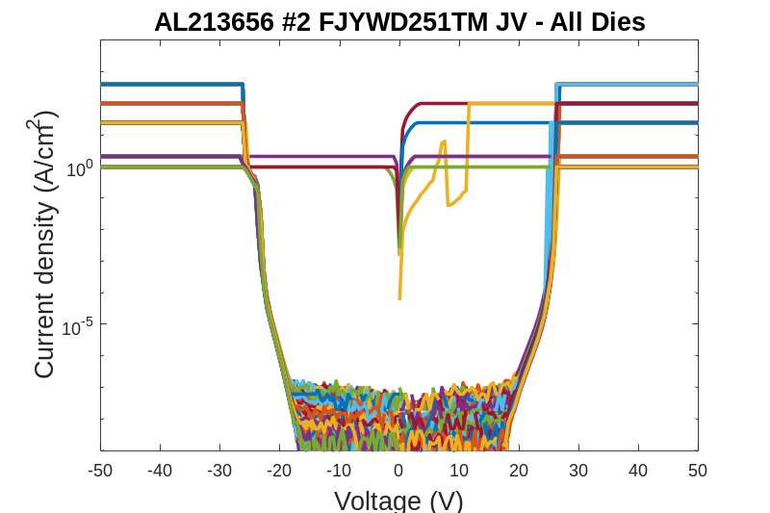
AL213656 #02 FJYWD251TM Raw Data

Slide 2
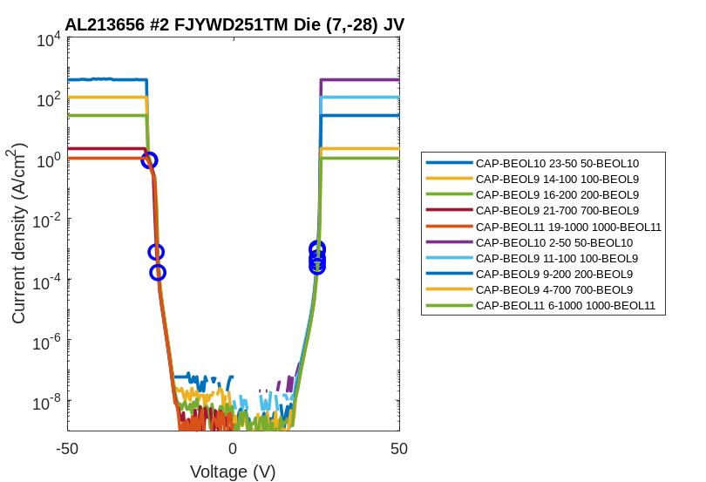
AL213656 #02 FJYWD251TM Raw Data

Slide 3
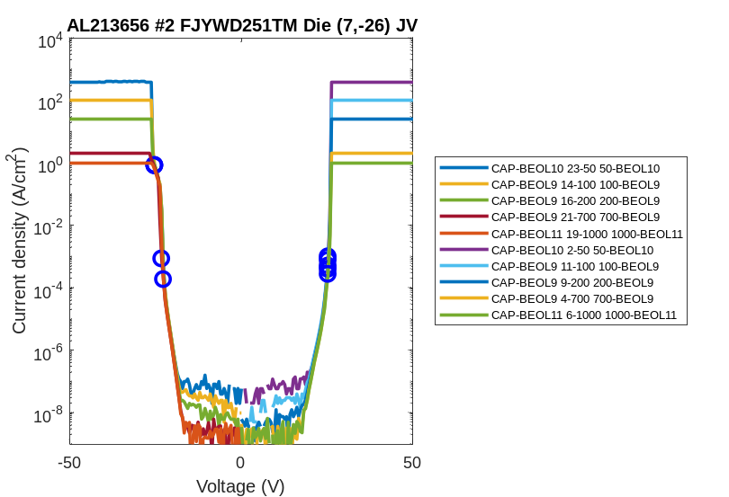
AL213656 #02 FJYWD251TM Raw Data

Slide 4
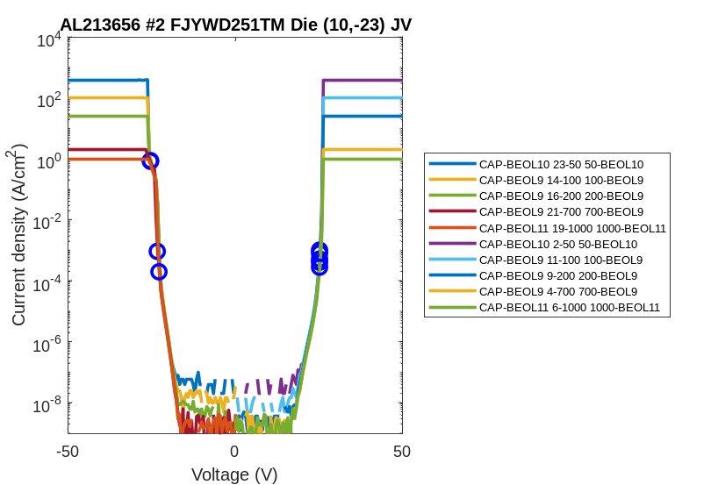
AL213656 #02 FJYWD251TM Raw Data

Slide 5
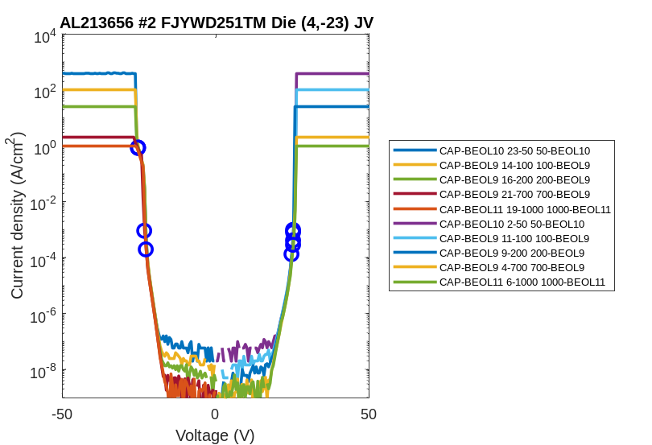
AL213656 #02 FJYWD251TM Raw Data

Slide 6
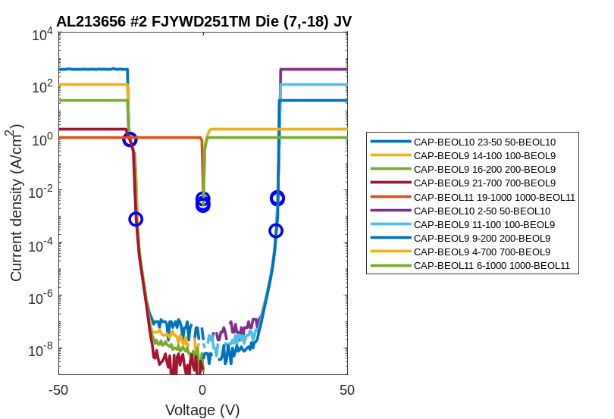
AL213656 #02 FJYWD251TM Raw Data

Slide 7
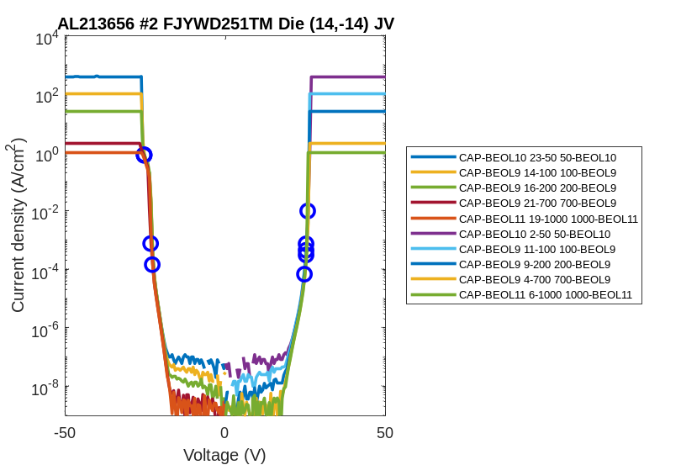
AL213656 #02 FJYWD251TM Raw Data

Slide 8
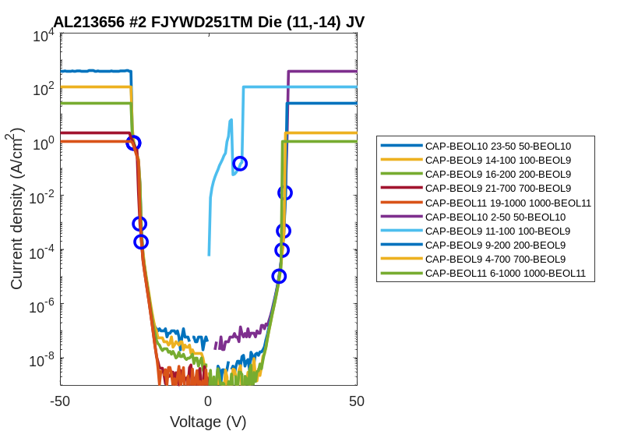
AL213656 #02 FJYWD251TM Raw Data

Slide 9
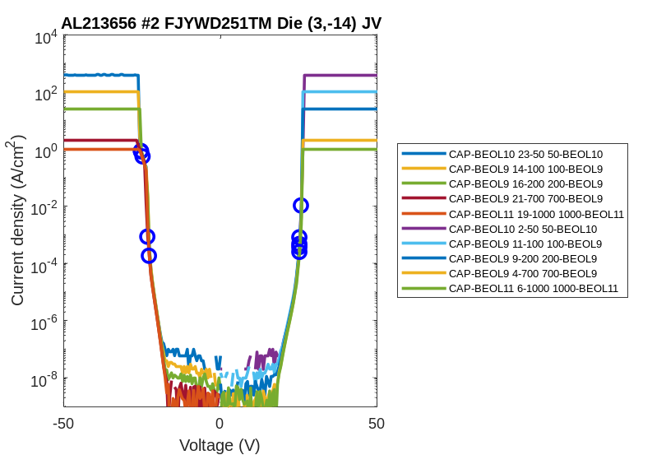
AL213656 #02 FJYWD251TM Raw Data

Slide 10
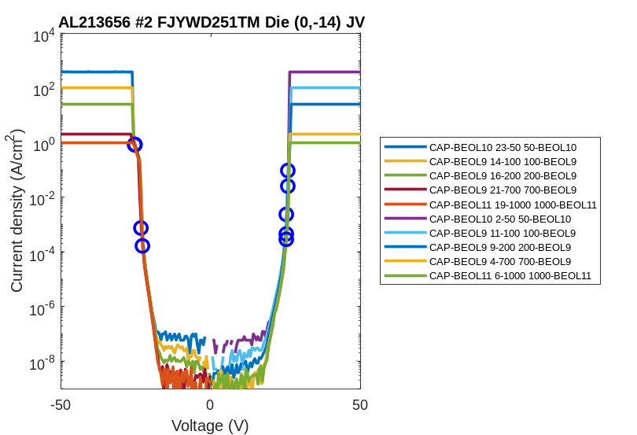
AL213656 #02 FJYWD251TM Raw Data

Slide 11
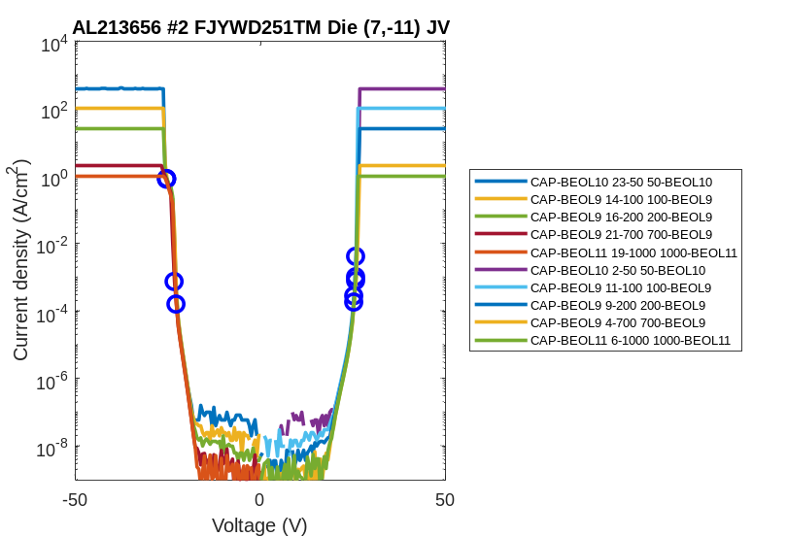
AL213656 #02 FJYWD251TM Raw Data

Slide 12

AL213656 #02 FJYWD251TM Raw Data

Slide 13

AL213656 #02 FJYWD251TM Raw Data

Slide 14
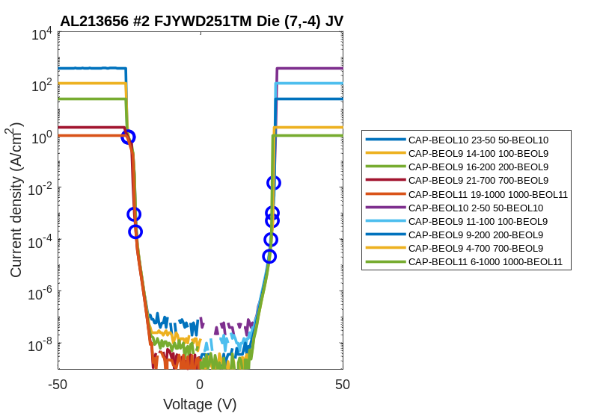
AL213656 #02 FJYWD251TM Raw Data

Slide 15
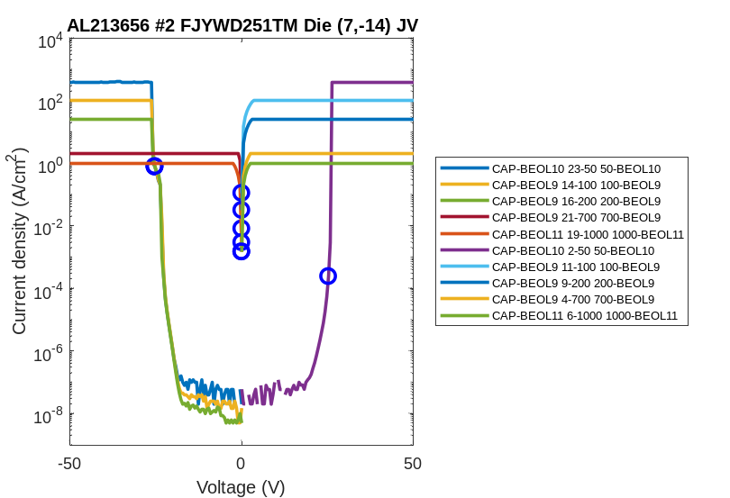
AL213656 #02 FJYWD251TM Raw Data

Slide 16
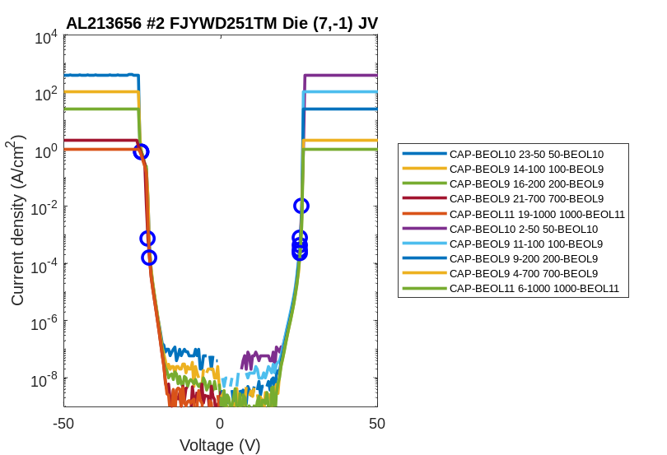
AL213656 #02 FJYWD251TM Raw Data

