Slide 1

CPE393 — INTRODUCTION TO DATA SCIENCE WITH PYTHON
Thailand Road Accident Analysis
2019–2022 · Predicting Accident Severity from Environmental and Contextual Factors
Group BRQ
Baptiste LORTON · Romain BARDET · Quentin COUPÉ
KMUTT · Summer Semester 2026

Slide 2


01 · PROBLEM DEFINITION
Why this project matters
81,735 accidents
12% are fatal
Policy relevance
recorded across Thailand between 2019 and 2022
Fatal outcomes are rare but carry the highest human cost
Knowing which conditions raise severity can target road-safety spending where it helps most.
Goal: predict accident severity : Fatal / Injury / Property Damage Only. From contextual factors available at the scene (vehicle type, weather, road, time, location), and use it to surface, policy-relevant insight.
2

Slide 3
02 · DATASET DESCRIPTION
Thailand Road Accident dataset
81,735
18
Source
Kaggle, originally published by the Office of the Permanent Secretary, Ministry of Transport, Thailand.
ROWS
COLUMNS
Key variables
2019–2022
CSV
incident_datetime, province, agency, vehicle_type
presumed_cause, accident_type, weather_condition
number_of_fatalities / injuries / vehicles_involved
latitude, longitude, road & slope description
TIME SPAN
FORMAT
Engineered target — accident_severity: Fatal (≥1 death) · Injury (≥1 injured, no death) · Property Damage Only
3

Slide 4
02 · DATASET DESCRIPTION
Known data quality issues
Issue | Rows affected | Severity
report_datetime delayed >30 days (median 48.7 days) | ≈48,400 (59%) | Critical
report_datetime earlier than incident_datetime | 1 | Critical
Missing GPS coordinates | 359 (0.44%) | Critical
GPS coordinates outside Thailand | 3 | Critical
0 vehicles involved (impossible) | 109 | Significant
“speeding” dominates presumed_cause | ≈60,000 (74%) | Significant
Bottom line: report_datetime is unusable for temporal analysis — incident_datetime is used instead throughout this project.
4

Slide 5
03 · PREPROCESSING & CLEANING
Cleaning decisions, explained
Duplicates
Data types
0 full duplicates, 0 duplicate acc_code → no deduplication needed.
incident_datetime / report_datetime converted from text to real datetime objects.
Outliers (IQR)
0 vehicles involved
Flagged on fatality/injury counts kept, a multi-fatality pile-up is real, not an error.
109 rows dropped, physically impossible for a road accident.
GPS out of Thailand
Leakage columns dropped
3 rows dropped; 359 rows with missing GPS kept, excluded from maps only.
number_of_fatalities / injuries removed from features, they define the target.
5

Slide 6
04 · EXPLORATORY DATA ANALYSIS
When and where accidents happen
Accidents rise steadily through the day, peaking in the afternoon (14h-16h).
Bangkok and Chon Buri lead in raw accident counts among recorded provinces.
6

Slide 7
04 · EXPLORATORY DATA ANALYSIS
Severity is rare but not negligible
Severity by weather condition (share of each class)
Accidents recorded under “dark” conditions show a strikingly higher fatal share (44%, n=368) than clear weather (13%)
7

Slide 8
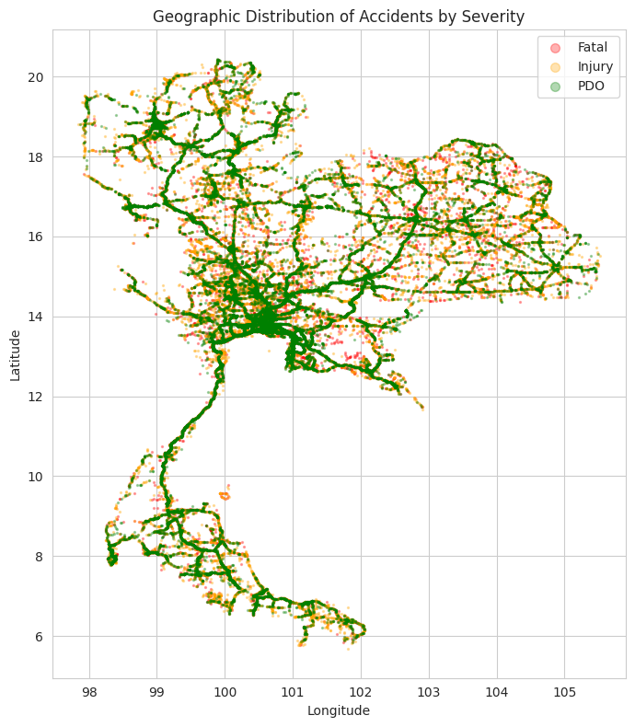
04 · EXPLORATORY DATA ANALYSIS
Where do fatal accidents cluster?
Geographic distribution of accidents by severity
Fatal: Scattered along all major corridors, not confined to one region. Severity is driven more by local conditions than geography alone.
Injury: Dense clusters in central and northern Thailand, mirroring population and traffic density.
PDO: Most concentrated in urban areas and highway hubs, consistent with lower-speed, higher-frequency minor collisions.
359 rows had missing GPS and were excluded from this map only, they are kept in all other analyses and the model.
8

Slide 9




05 · FEATURE ENGINEERING
Turning raw columns into model-ready features
Time features
Province grouping
One-Hot Encoding
Scaling
hour, month, day_of_week, is_weekend, extracted from the reliable incident_datetime.
Top 15 provinces kept; remainder grouped as “other_province” to avoid sparse encoding.
vehicle_type, weather, road/slope, agency, accident_type, nominal, no natural order.
StandardScaler on numeric features for Logistic Regression.
Excluded by design: presumed_cause (likely reporting bias toward “speeding”), and fatality/injury counts
8

Slide 10

06 · MACHINE LEARNING MODEL TRAINING
Three models, one fair comparison
Logistic Regression
Decision Tree
Random Forest
Linear baseline simple and interpretable.
max_depth=10 captures non-linear interactions.
200 trees, max_depth=15 ensemble for robustness.
Shared pipeline for a fair comparison
Clean data
Encode + Scale
(fit on train only)
80/20 stratified
split (seed=42)
Train each
model
Evaluate on
untouched test set
10

Slide 11
07 · EVALUATION METRICS & RESULTS
Model comparison, macro-averaged metrics
Random Forest leads on accuracy & precision · Decision Tree leads on macro recall & F1. Differences are modest, within 1–2 points.
11

Slide 12

07 · EVALUATION METRICS & RESULTS
The honest finding: Fatal accidents are hard to catch
Recall on the Fatal class: only 9–19% across all three models.
Model | Fatal Precision | Fatal Recall | Fatal F1
Logistic Regression | 0.53 | 0.11 | 0.18
Decision Tree | 0.55 | 0.19 | 0.28
Random Forest | 0.62 | 0.09 | 0.16
Why: what separates Injury from Fatal often depends on factors not in the data impact speed, helmet/seatbelt use, time to medical response. We report this honestly rather than hide it behind overall accuracy.
12

Slide 13
07 · EVALUATION METRICS & RESULTS
What drives the Random Forest's predictions
Vehicle type (especially motorcycle) and time-based features outweigh province or weather in predicting severity.
13

Slide 14


08 · RESPONSIBLE AI PRACTICES
Using this data and model responsibly
Bias
Reliability
“Speeding” dominates presumed_cause (74%), likely reporting convenience, not ground truth. Excluded from the model.
Reporting coverage differs across agencies/provinces. Low counts may reflect weak monitoring, not fewer accidents.
Honest limits
Disclosure
All models miss most fatal accidents (recall 9–19%). Not suitable for real-time triage or insurance decisions.
Generative AI used as a learning aid for structuring, debugging, and writing clarity.
14

Slide 15
09 · CONCLUSION & FUTURE WORK
What we learned, what's next
Main findings
Future work
Severity splits cleanly into 3 usable classes (44% / 44% / 12%)
Random Forest best accuracy/precision; Decision Tree best recall/F1
Fatal accidents remain hard to detect from context alone
Crash dynamics matter more than weather or geography
Add speed limits / traffic volume / road quality data
Try SMOTE / class weighting to boost Fatal recall
Build proper province-level hotspot maps (KDE)
Test a binary Fatal vs. non-Fatal reframing
15

Slide 16
10 · TEAM CONTRIBUTION
Who did what
Baptiste LORTON
Romain BARDET
Quentin COUPÉ
CODE
CODE
CODE
Data quality check, cleaning, target engineering, correlation heatmap
EDA (temporal, spatial, severity/weather, severity/vehicle), feature engineering
Train-test split, ML pipelines, metrics, confusion matrix, feature importances
REPORT
REPORT
REPORT
Sections 2, 3, 9 (Responsible AI)
Sections 4, 5
Sections 6, 7
SLIDES
SLIDES
SLIDES
Slides 3, 4, 5, 14
Slides 6, 7, 8, 9
Slides 10, 11, 12, 13
ORAL
ORAL
ORAL
Introduction + données + Responsible AI
EDA + Feature Engineering
Models + Results + Evaluation
16

Slide 17

Thank you
Questions & discussion welcome
Baptiste LORTON
Romain BARDET
Quentin COUPÉ
Group BRQ · CPE393 · KMUTT · Summer 2026

