Slide 1
01 / PROBLEM
Find the law behind the question
Adilet Search · Kazakhstan legislation
Russian and Kazakh questions → articles with sources
Daniil Talyzin · Yernur Kazhyakpar · Kuanysh Murat
ADILET SEARCH / AI ESSENTIALS / EVIDENCE DRAFT
01/10
Notes:
Keyword search misses everyday wording. Our prototype combines lexical and semantic retrieval, then can generate a source-cited answer. Team: Daniil Talyzin, Yernur Kazhyakpar, Kuanysh Murat. This is a course prototype for the Legal Service use case; production integration is not claimed. Source: README.md; docs/PROJECT_PLAN.md §1.

Slide 2
02 / DATASET
Official text, a bounded snapshot
8 Tier-1 code documents · RU + KK
9,259 article-language records · 16,264 chunks
Snapshot: 17 September 2026
ADILET SEARCH / AI ESSENTIALS / EVIDENCE DRAFT
02/10
Notes:
AdiletCodex v1.0, CC BY 4.0; see ml/MODEL_CARD.md and ml/scripts/download_data.py. A fresh rebuild reproduced 16 document-language rows, 9,259 articles and 16,264 chunks. These counts include both languages; do not say 9,259 distinct bilingual articles. Text is preserved; amendment notes are separate. The snapshot does not establish current legal validity.

Slide 3
03 / MODEL
Test models, fusion and LLM rewriting
Does a newer embedder improve retrieval?
Does hybrid reranking help RU and KK?
Does an LLM rewrite justify its extra cost?
ADILET SEARCH / AI ESSENTIALS / EVIDENCE DRAFT
03/10
Notes:
Research sources: docs/report/RESEARCH_PROTOCOL.md; ml/experiments/research-*/results.json. Title-derived proxy labels, not human gold.

Slide 4
04 / EXPERIMENTAL RESULTS
Newer models must earn their place
Method
Val
Test
RU test
KK test
E5 baseline
0.706
0.703
0.802
0.605
Project hybrid + reranker
0.856
0.846
0.855
0.836
Hybrid without reranking
0.778
0.770
0.816
0.724
Qwen3 Embedding 0.6B
0.539
0.548
0.667
0.430
BGE-M3
0.830
0.822
0.833
0.812
EmbeddingGemma 2 (Oct 2026)
0.710
0.716
0.802
0.630
PROXY STUDY · 1318 test queries · title-derived labels · nDCG@10
ADILET SEARCH / AI ESSENTIALS / EVIDENCE DRAFT
04/10
Notes:
Research sources: docs/report/RESEARCH_PROTOCOL.md; ml/experiments/research-*/results.json. Title-derived proxy labels, not human gold. Full corpus: 16,264 body-only chunks. Validation: 1,311; test: 1,318. Same 512-token budget, language filtering and article collapse. The hybrid reproduction uses local BM25, RRF k=60 equal weights and top-20 reranking; Qdrant IDF differs. Scores compare practical pretrained configurations; no project-specific fine-tuning or isolated architecture effect is claimed.

Slide 5
05 / FINAL MODEL
Hybrid remains the measured candidate
Hybrid − E5 test nDCG@10: +0.142
Paired 95% interval: [+0.123, +0.162]
LLM rewrite: small pilot; no benefit established
ADILET SEARCH / AI ESSENTIALS / EVIDENCE DRAFT
05/10
Notes:
Research sources: docs/report/RESEARCH_PROTOCOL.md; ml/experiments/research-*/results.json. Title-derived proxy labels, not human gold. Validation selects the candidate; test estimates performance. Intervals group parallel RU/KK article families. This is a fixed-cohort proxy study; no multiple-comparison correction or human-gold claim. EmbeddingGemma 2 uses supported BF16, other embedding models FP16. The served pipeline remains version 0.2.0: multilingual-e5-base plus cross-encoder/mmarco-mMiniLMv2-L12-H384-v1, with pinned checkpoints. See RESEARCH_FINDINGS.md and ml/models/model_manifest.json.

Slide 6
06 / SYSTEM ARCHITECTURE
One API joins retrieval and the UI
React UI
Search + source viewer
FastAPI
Search + answer API
ML service
E5 + reranker
→
→
↓ ↓
PostgreSQL
Articles + query logs
Qdrant
Dense + sparse index
OBSERVABILITY Prometheus → Grafana
ADILET SEARCH / AI ESSENTIALS / EVIDENCE DRAFT
06/10
Notes:
Search: embed query, dense/sparse retrieval, RRF fusion, article collapse, cross-encoder rerank. Answer: retrieve sources, stream generation via SSE, validate citation references. Frontend source drawer supports RU/KK. Architecture sources: docker-compose.yml; docker-compose.final.yml; backend/app/state.py; frontend/src/App.tsx. Monitoring additions require runtime verification; planned components must not be described as deployed until that succeeds.

Slide 7
07 / DEPLOYMENT
The prototype runs in Docker
Live UI + API + real model inference
Prometheus targets up · Grafana healthy
Local access verified · public HTTPS pending
ADILET SEARCH / AI ESSENTIALS / EVIDENCE DRAFT
07/10
Notes:
Use docs/tech/final_project.md. Local build and public hosting are separate claims. An accessible local demonstration is the immediate target; the project plan also asks for public HTTPS. There is no verified public URL in the repo. Do not expose admin stubs or database ports to the public internet. No VPS purchase or account action is performed by this script. Verified in this session: UI http://127.0.0.1:18080, API proxy, source drawer and RU/KK switch. Source: docs/report/final_browser.json.

Slide 8
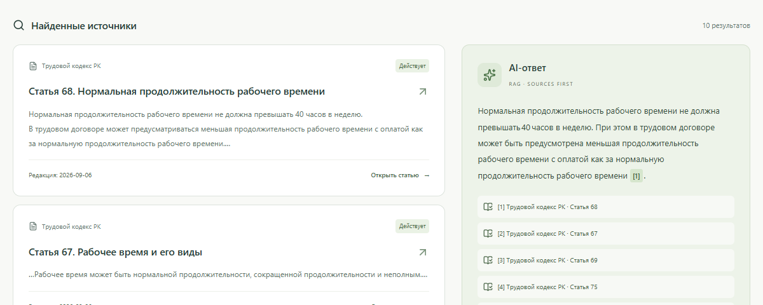
08 / DEMONSTRATION
Follow the answer back to the article
Ask about working hours or annual leave
Inspect ranked articles and exact source text
Switch RU ↔ KK; compare keyword and hybrid
ADILET SEARCH / AI ESSENTIALS / EVIDENCE DRAFT
08/10
Notes:
Rehearse using the actual indexed corpus. Start with 'Какова нормальная продолжительность рабочего времени?' and 'Сколько дней ежегодного оплачиваемого отпуска?'. Confirm the retrieved sources before showing generation. Current local generation uses externally pretrained openai/gpt-oss-120b; a fresh checkout defaults to extractive fallback. Try an unsupported question and show the limitation. Prepare a backup recording only after a successful live rehearsal. Sources: docs/presentation/demo_script.md; frontend/src/App.tsx.

Slide 9
09 / PERFORMANCE
Load testing exposes the CPU limit
100 requests · 10 concurrent users
HTTP errors: 0 · degraded: 60
Complete-response p95: 2,531 ms · target not met
ADILET SEARCH / AI ESSENTIALS / EVIDENCE DRAFT
09/10
Notes:
The latency target is from docs/PROJECT_PLAN.md §8 and is not a measured result. Current checks: 49 ML, 258 backend unit/contract, 34 storage/integration and 6 real-ML checks; 12 frontend unit tests and 4 browser scenarios. Updated totals and runtime results belong in docs/report/final_readiness.md. Measure non-degraded coverage, error rate, model IDs and hardware alongside latency. A fast degraded response is not evidence that full semantic search met the target. Latest source: docs/report/final_load.json. This is a repeated-question sample-corpus load test. No full-corpus generalization is claimed.

Slide 10
10 / LIMITATIONS & FUTURE WORK
The next step is stronger evidence
Independent human-labelled RU/KK questions
Long-context and prompt-sensitivity experiments
Scale LLM pilot; measure faithfulness and API load
ADILET SEARCH / AI ESSENTIALS / EVIDENCE DRAFT
10/10
Notes:
The full frozen proxy experiment now compares recent pretrained models. No project-specific fine-tuning is claimed. Do not generalize title-query metrics to legal advice or generated-answer correctness. Public hosting and CPU load acceptance remain outstanding. Research sources: docs/report/RESEARCH_PROTOCOL.md; ml/experiments/research-*/results.json. Title-derived proxy labels, not human gold.

