Slide 1
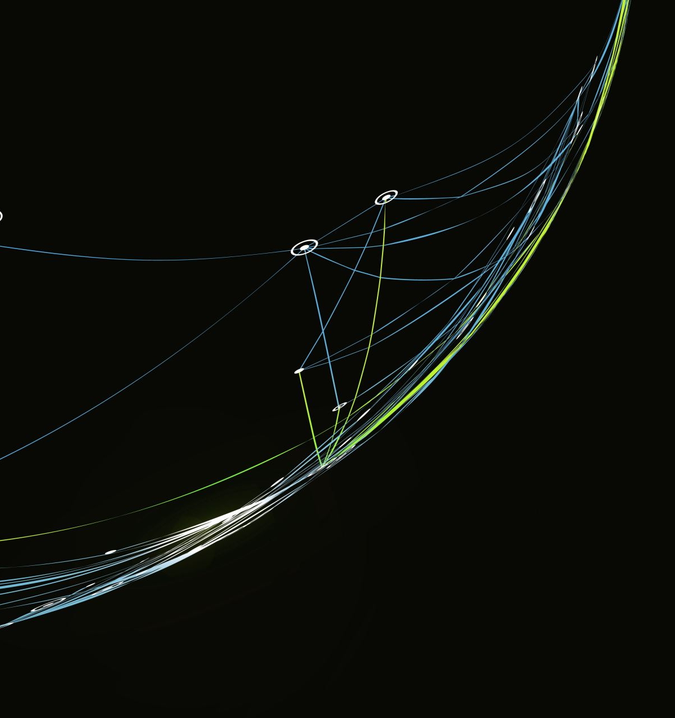
Can we use Machine learning to predict maternal mortality from socioeconomic and health systems data?

Slide 2
What is Maternal Mortality?
“death of a woman while pregnant or within 42 days of termination of pregnancy, irrespective of the duration and the site of the pregnancy, from any cause related to or aggravated by pregnancy or its management, but not from accidental or incidental causes”

Slide 3
Goals for Maternal Mortality
Sustainable Development Goal 3.1:
“By 2030, reduce the global maternal mortality ratio to less than 70 per 100,000 live births.”
Only a few countries are projected to meet this goal.

Slide 4
Trends in Maternal Mortality
~95% of maternal deaths occur in low/lower-middle income countries.
These deaths are considered preventable.
Analysis of region-specific causes of mortality indicate extreme inequity in access to obstetric-related care.
The WHO has highlighted the importance of accurately and comprehensively recording maternal deaths, particularly in lower-income regions, to better inform interventions and monitor trends.
Notes:
https://www.thelancet.com/action/showPdf?pii=S2214-109X%2824%2900560-6

Slide 5
Research Questions
Can machine learning methods be used to estimate maternal mortality ratios based on socioeconomic and health-related indicators?
Using these trained predicted machine learning models, can we identify the factors most predictive of maternal mortality?
Can these trained models be used to predict the performance of interventions to reduce maternal mortality?
Notes:
https://www.thelancet.com/action/showPdf?pii=S2214-109X%2824%2900560-6

Slide 6
Project Pipeline
Data exploration to understand trends in missing data.
Data pre-processing and imputation
Testing different combinations of machine learning models and imputation methods
Fine-tuning
Notes:
https://www.thelancet.com/action/showPdf?pii=S2214-109X%2824%2900560-6

Slide 7
Data Sources
Prevalence of different illnesses
WHO Data Observatory: Health Inequality Data Repository
World Bank Group Gender Data Portal
WHO Data Observatory: Health Inequality Data Repository
WHO Data Observatory: Health Inequality Data Repository
WHO reported Health Determinants from World Bank catalogue
WHO Women’s Empowerment Index
Environmental context
Economic indicators
Indicators about the health system
Literacy and education rates
Model Inputs

Slide 8
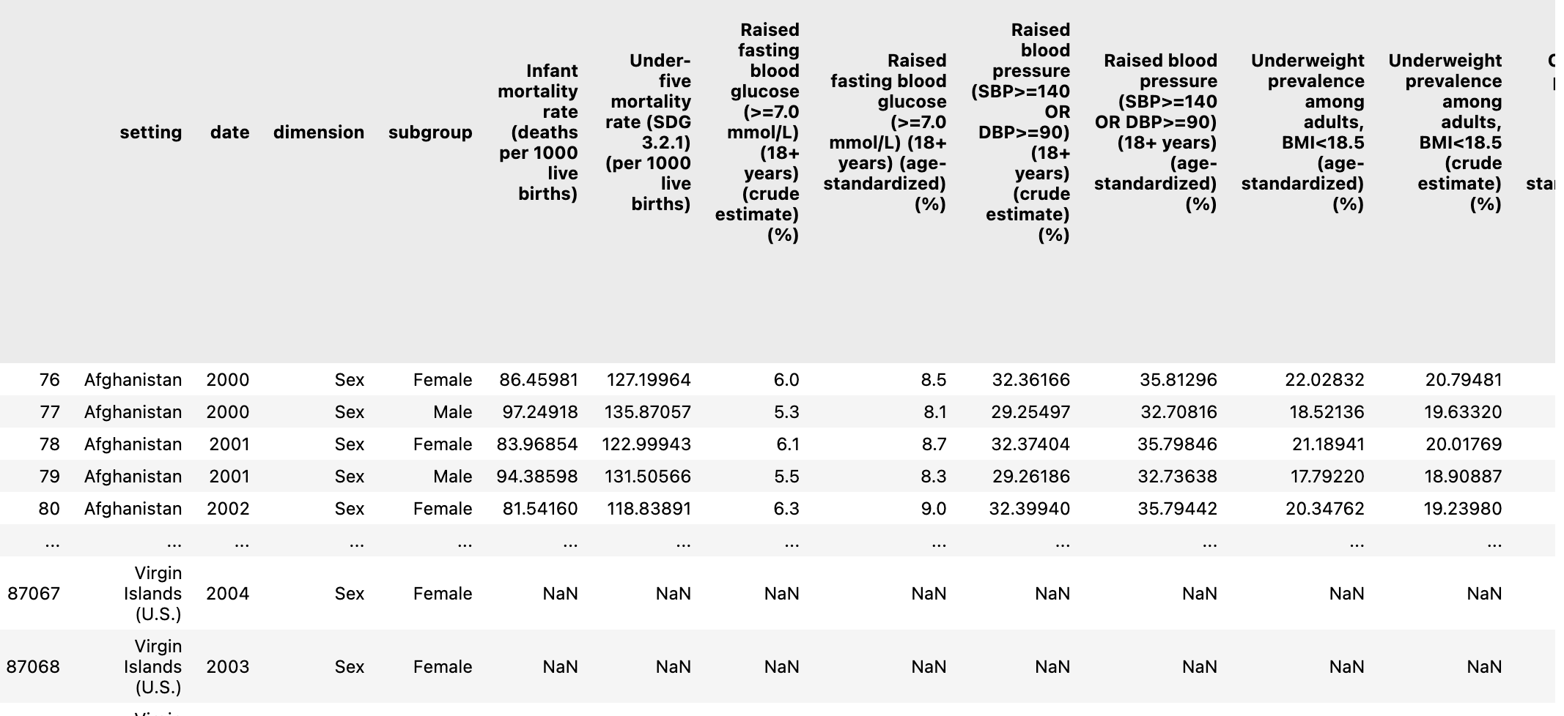
Data Sources

Slide 9
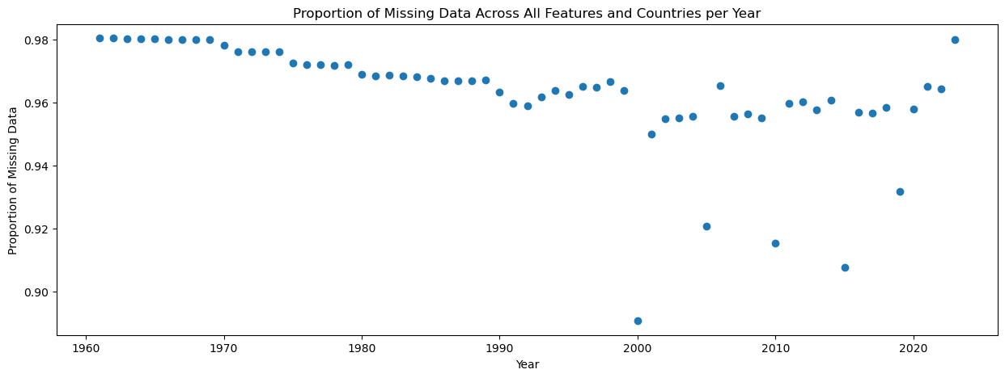
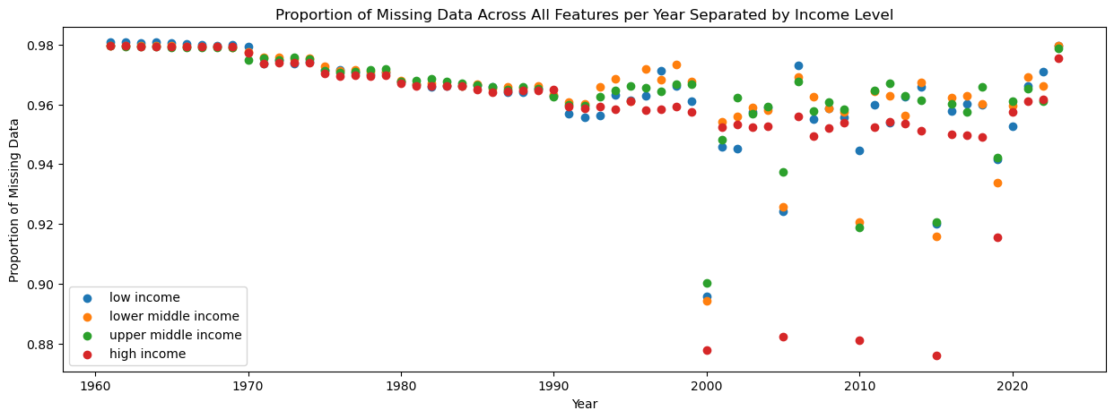
Trends in Missing Data
Notes:
High proportion of missing data throughout the recorded time period
I decided to focus on 2000-2019
After the majority of indicators were being regularly recorded but before recording dropped off due to covid
Can see that some indicators are reported at regular intervals
Less missing data for high income countries, highlighting the utility of this study to provide information about low income countries

Slide 10
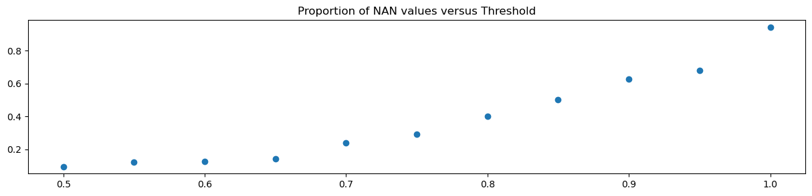
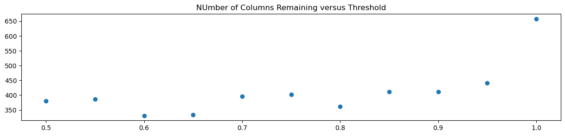
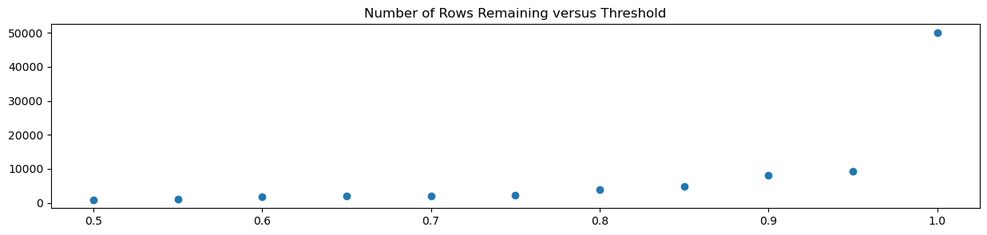
Experimentation Methodology
Original Data
(50115, 657)
Merged datasets
Iterative thresholding
95%
(9259, 441)

Slide 11
Experimentation Methodology
K-Nearest Neighbours
Split within year:
75:25, stratified by year to maintain same distribution
Imputation methods
Miss Forest
Correlation imputation
Train/Test Split
Polynomial: Orders 1, 2, 3
Split by year:
Train: 2000-2012
Test: 2013:2019
Standardisation

Slide 12
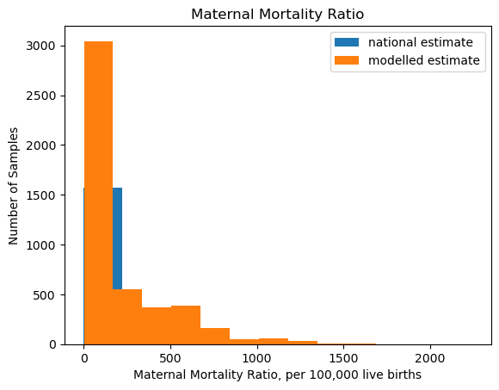
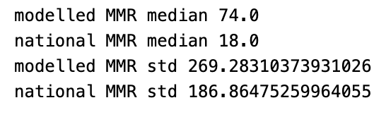
Imputation for Labels: More Detail
National estimate drawn from survey and census data, suffering from inaccuracy due to missing records, misclassified deaths and pregnancy status, recall bias, etc.
Modelled estimates aimed to reduce these errors by applying a multi-level regression model to predict MMR from socioeconomic and mortality information.
Both included in the datasets with extremely similar trends
Notes:
Fertility, skilled birth attendants, GDP, available national maternity mortality data
Potential difference due to lack of data in lower income countries, whereas modelled data can project data for these countries

Slide 13
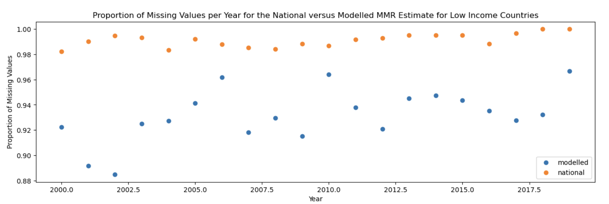
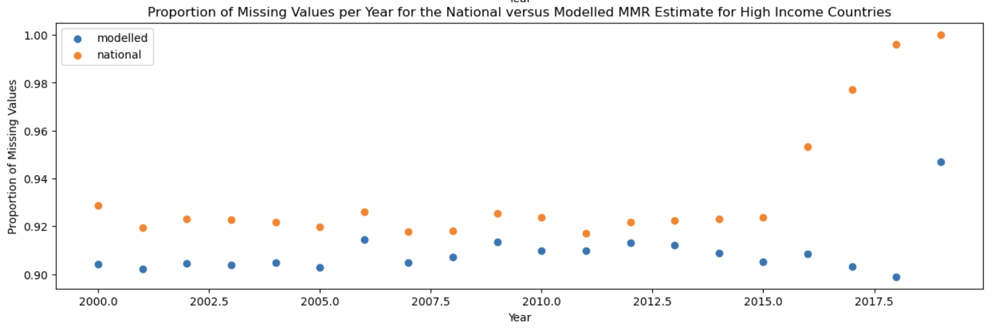


Imputation for Labels: More Detail
Notes:
Fertility, skilled birth attendants, GDP, available national maternity mortality data

Slide 14
Imputation for Labels: Procedure
Split original and 95% datasets into train/test sets.
Create 5 sets of test data (all comparisons will be made on same test set), one for each imputation method
Scale the imputed national and modelled estimates to have a mean of zero and unit standard deviation.
Take the average of the scaled modelled and national estimates.
Scale the average back to a meaningful scale (deaths per 100,000 live births) using the average of the original values’ medians and standard deviations
Notes:
Fertility, skilled birth attendants, GDP, available national maternity mortality data

Slide 15
Data Imputation and Model Building Overview
Scikit Learn’s Random Forest
LightGBM
K-Nearest Neighbours
XGBoost
AdaBoost
Miss Forest
K-Nearest Neighbours Regressor
Support Vector Machine
Polynomial: Orders 1, 2, 3
Multi-Layer Perceptron
Recurrent Neural Network

Slide 16
Model Results Interpretation
Reminder:
The different imputation methods all correspond to different test/train sets and so cannot be directly compared in the following analysis
Notes:
Remember that the test sets are different, so they the imputation methods cannot be directly compared, just models within them.
Ensemble based methods all do very well, with very similar performance.
Polynomial imputation getting worse as we increase order (potentially due to overfitting)
KNN is the best, potentially because it uses more sophisticated correlation imputation than I implemented

Slide 17

Results: Techniques

Slide 18

Model Performance Metric
$$MAPE= \frac{1}{n}∗\sum_{t=1}^{n}{\left|\frac{actual−predicted}{actual}\right|}$$
0.1 MAPE = difference between prediction and ground truth is, on average, 10% of the value of the ground truth.
The lower the better

Slide 19
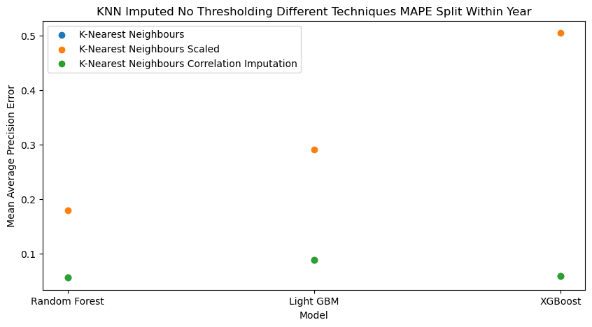
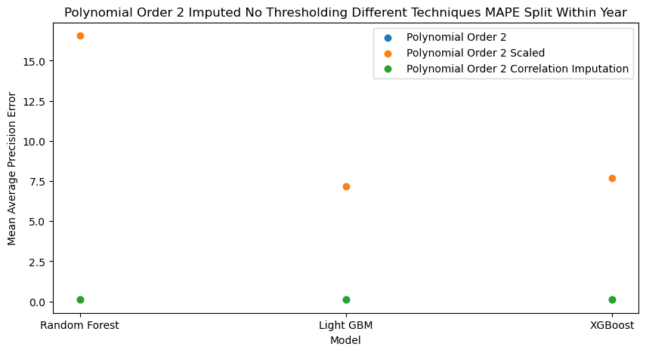
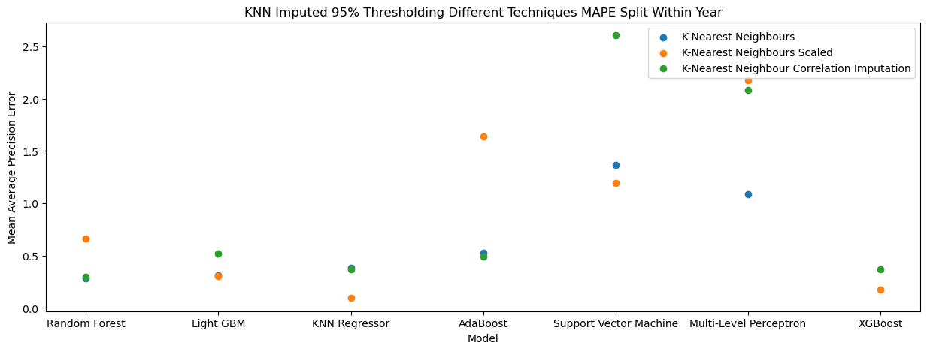
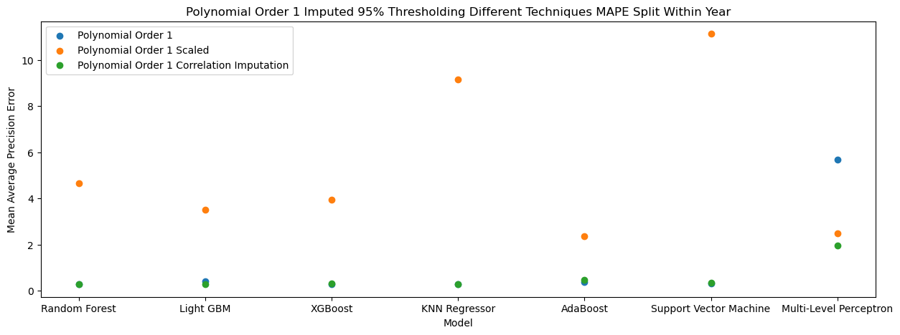
Results: Standardisation
Notes:
Standardisation does more poorly for all imputation methods on the non-thresholded data (showing examples for KNN and polynomial order 2
It sometimes does more poorly on the Miss Forest and KNN methods for 95% thresholded data
It always does more poorly for polynomial imputation for the 95% thresholded data

Slide 20
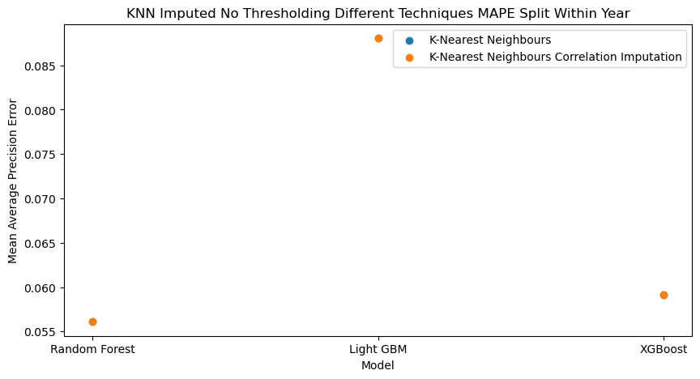
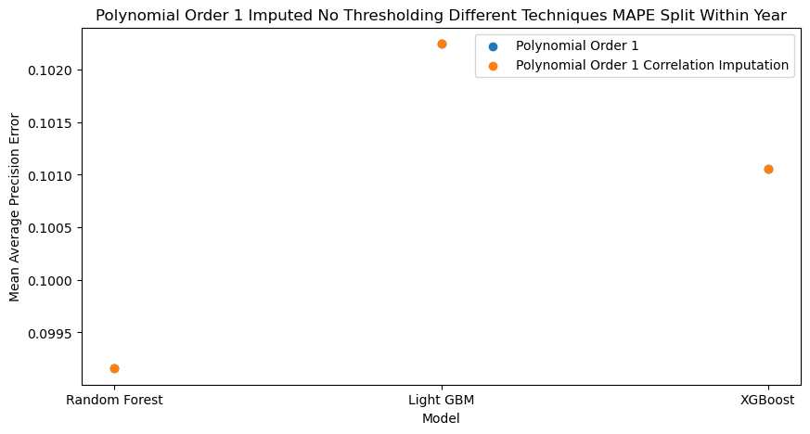
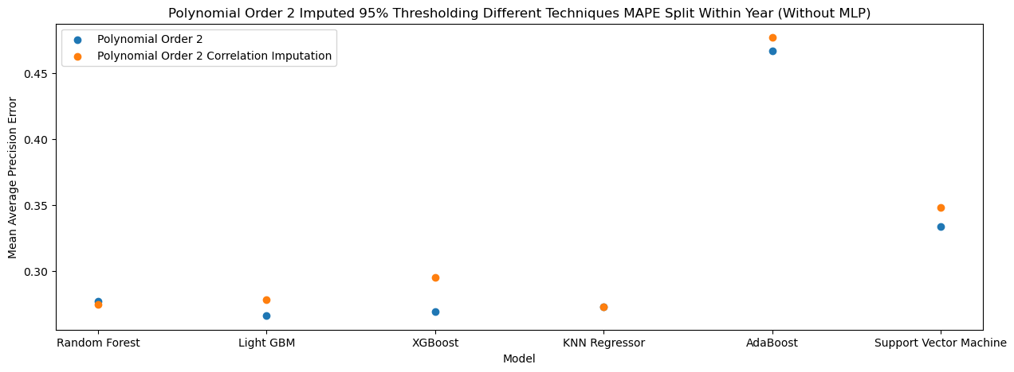
Results: Correlation Imputation
Notes:
No difference for any imputation method on the non-thresholded data
Its performance is model dependent for KNN and MF 95%
It generally does a bit worse for polynomial based methods

Slide 21
Results: Models
Presenting results without standardisation or correlation imputation

Slide 22
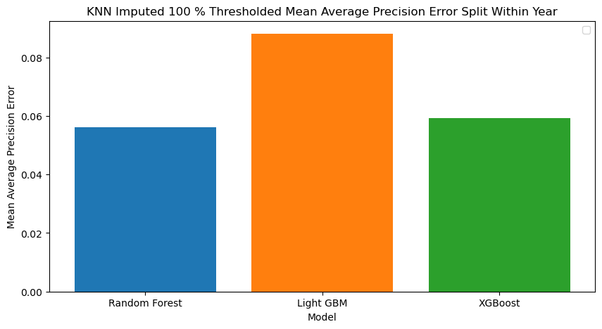
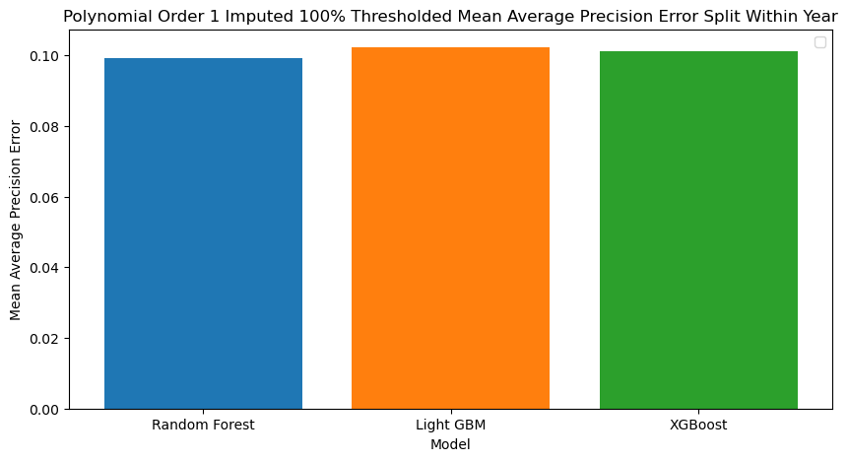
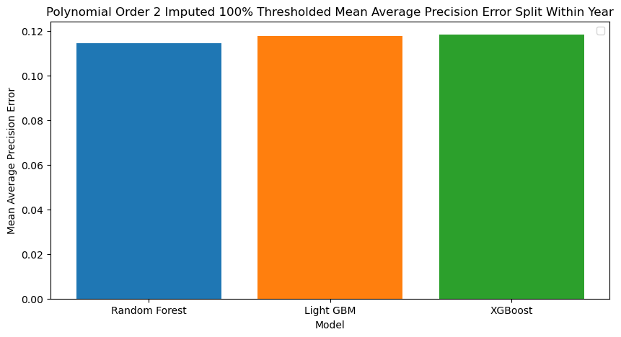

Model Results: No Thresholding
Very small and similar MAPE scores for all imputation methods
Random Forest model tended to do the best
Notes:
Polynomial Order 3 was very similar to polynomial order 2

Slide 23
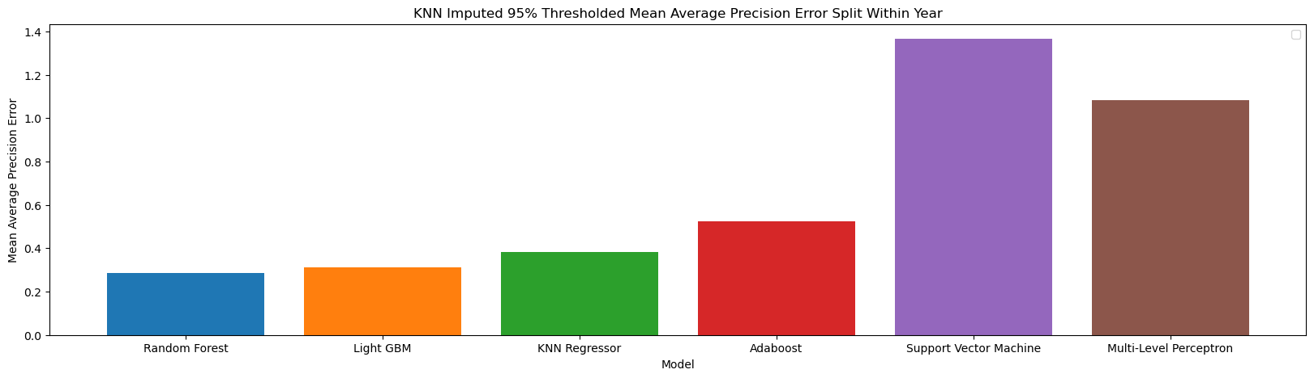
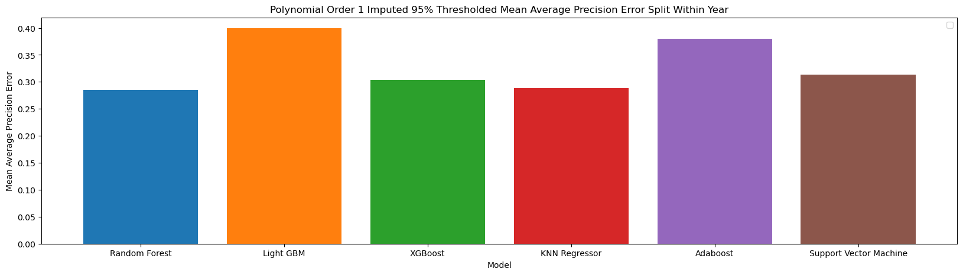
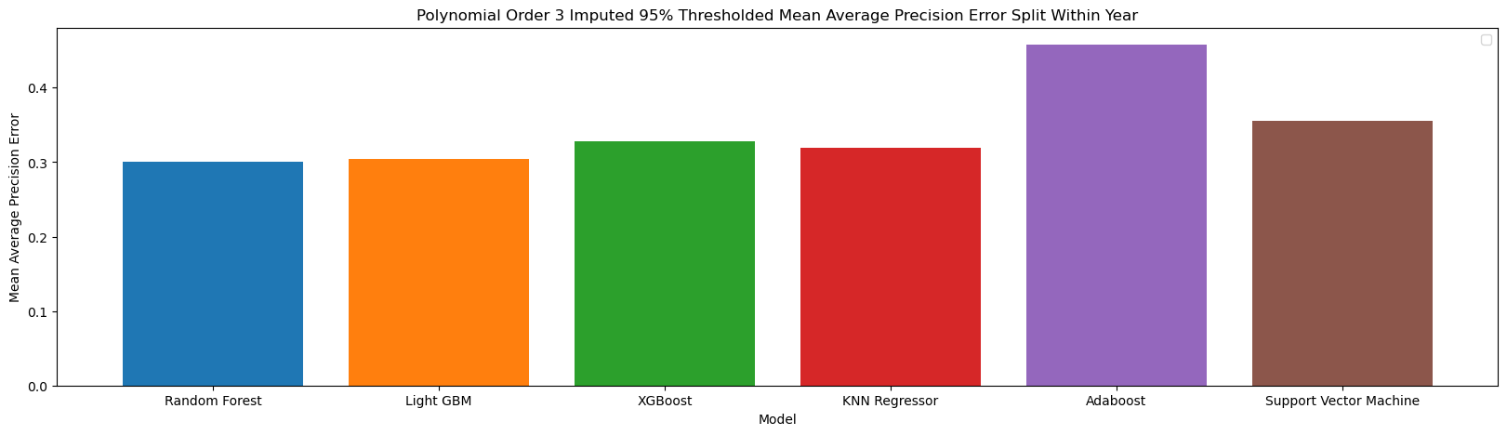
Model Results: 95% Thresholding
Ensemble based methods performed the best for KNN and Miss Forest based imputation
Ensemble methods + KNN regressor had highest performances for polynomial
Similar trends for polynomial 2 and 3 imputation
Imputation methods did similarly*
Notes:
Outliers removed and under investigation
Caveat that MLP is being fine=tuned
Miss Forest similar to or up to ~double KNN

Slide 24
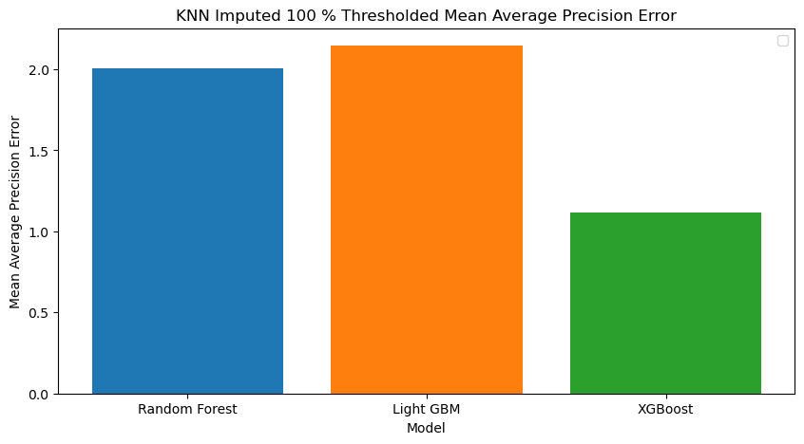
Split within Year versus Split by Year
Generally had higher error with all imputation methods, but most noticeable for KNN.
It had one to two times (approximately) the MAPE score for polynomial based.
Potentially less additional error for polynomial methods because of the need to extrapolate.
While scaling generally helped (or had little effect) on KNN imputed values, it almost always had worse performance for polynomial imputed values (substantially for non-thresholded data)
For data with no thresholding, correlation imputation substantially helped KNN methods but showed no effect for other methods. Had model specific, small effects of 95% thresholding.
Notes:
Fertility, skilled birth attendants, GDP, available national maternity mortality data

Slide 25
Current Research Stage: Neural Nets Finetuning
Using Optuna to fine-tune the parameters of a Multi-Layer Perceptron Network and a Recurrent Neural Network.
Often find that the activation function and learning rate are the most important hyper-parameters to tune.
Getting MAPE scores comparable to, or less than, current best MAPES for the datasets with 95% thresholding.
Notes:
Fertility, skilled birth attendants, GDP, available national maternity mortality data

Slide 26
Pathways Forward
Hyperparameter tuning for imputation methods and model instantiations
Use of SHAP method to better understand difference in feature contributions
Application of model to predict effect of different interventions
Notes:
Fertility, skilled birth attendants, GDP, available national maternity mortality data

