Slide 1
Pollify : Building Interactive Polls

Slide 2
TABLE OF CONTENT
INTRODUCTION
WHAT IS DJANGO
SETTING UP THE PROJECT
CREATING THE POLL MODEL
CREATING VIEWS AND TEMPLATES
ADDING USER AUTHENTICATION
TECHNOLOGIES USED IN THE PROJECT
FLOWCHART
CONCLUSION

Slide 3
INTRODUCTION
In this poll application, users will first need to sign up and log in to access the features of the site. Once logged in, users can create new polls, vote on existing polls, and view the results of previous polls. Additionally, users will have the ability to change their passwords if needed. It is important to note that only the user who created a poll will be able to delete it; no other user will have the ability to delete a poll. The application will also have an admin section, where the admin user can add and manage questions in the application.

Slide 4
WHAT IS DJANGO?
Django is a Python framework that makes it easier to create web sites using Python.
Django takes care of the difficult stuff so that you can concentrate on building your web applications.
Django emphasizes reusability of components, also referred to as DRY (Don't Repeat Yourself), and comes with ready-to-use features like login system, database connection and CRUD operations (Create Read Update Delete).

Slide 5
SETTING UP THE PROJECT
To get started with our poll application, we first need to set up a new Django project.
This involves creating a new virtual environment, installing Django, and creating a new project using the 'django-admin startproject’ command.
Once we have our project set up, we can create a new app within the project using the python manage.py startapp' command.
This app will contain all of the code necessary to create our poll application.

Slide 6
CREATING THE POLL MODEL
The first step in creating our poll application is to define the data model.
In Django, this is done using Python classes that inherit from the ‘django.db.models.Model’ class.
For our poll application, we will define a ‘Poll’ model that has a question field and a pub_date field.
We will also define a ‘Choice’ model that has a text field and a votes field, and is related to the ‘Poll' model through a foreign key relationship.

Slide 7
CREATING VIEWS AND TEMPLATES
Creating the Views and Templates with our data model defined, we can now create the views and templates that will allow users to interact with our poll application.
In Django, views are Python functions that handle HTTP requests and return HTTP responses.
We will create two views for our poll application: one to display the list of polls, and another to display the details of a specific poll.
We will also create templates for each of these views, using Django's built-In templating language

Slide 8
ADDING USER AUTHENTICATION
To make our poll application more secure and user-friendly, we can add user authentication functionality.
In Django, this is done using the built-in ‘auth’ app, which provides user registration, login, and logout views.
By adding user authentication to our poll application, we can ensure that only registered users can create new polls or vote on existing polls. We can also provide a personalized experience for each user, such as displaying their previous poll vote.
Additionally, users will have the ability to change their passwords if needed.

Slide 9
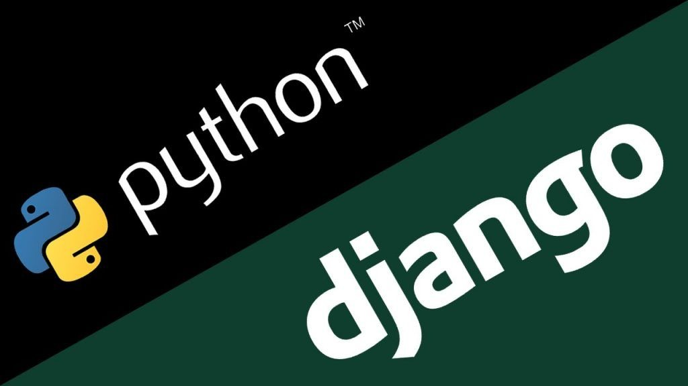
TECHNOLOGIES USED IN THE PROJECT
Python Programming Language.
Django framework and SQLite database which comes by default with Django.

Slide 10
CONCLUSION
In conclusion, creating a poll application using Django is a straightforward process that leverages the power of Django's built-in components.
A poll application can be created that allows users to create new polls, vote on existing polls, and view the results of each poll, as well as deleting polls only for those who created them.
Whether you are building a simple poll application for personal use or a more complex application for your business, Django provides the tools and resources you need to get the job done quickly and efficiently.

Slide 11


