Slide 1
Stock price prediction

Slide 2
Introduction:
Stock price prediction is an analysis technique used to forecast the future value of a company's stock based on historical data, market trends, and various quantitative models

Slide 3
Exploratory data Analysis
EDA is an approach to analyzing the data using visual techniques. It is used to discover trends, and patterns, or to check assumptions with the help of statistical summaries and graphical representations.
While performing the EDA of the Tesla Stock Price data we will analyze how prices of the stock have moved over the period of time and how the end of the quarters affects the prices of the stock.

Slide 4
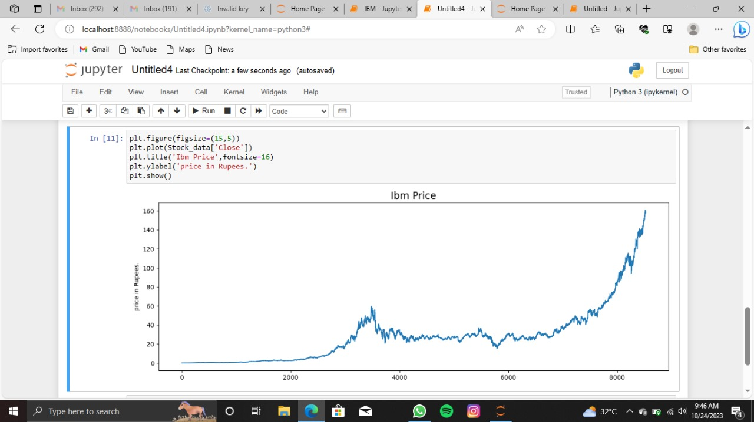

Slide 5
Data visualization
Data visualization is the graphical representation of data to help people understand the significance of data by placing it in a visual context. It involves using charts, graphs, and other visual elements to communicate patterns, trends, and insights from data. Data visualization is a key component of data analysis and plays a crucial role in fields such as business, science, and academia.

Slide 6
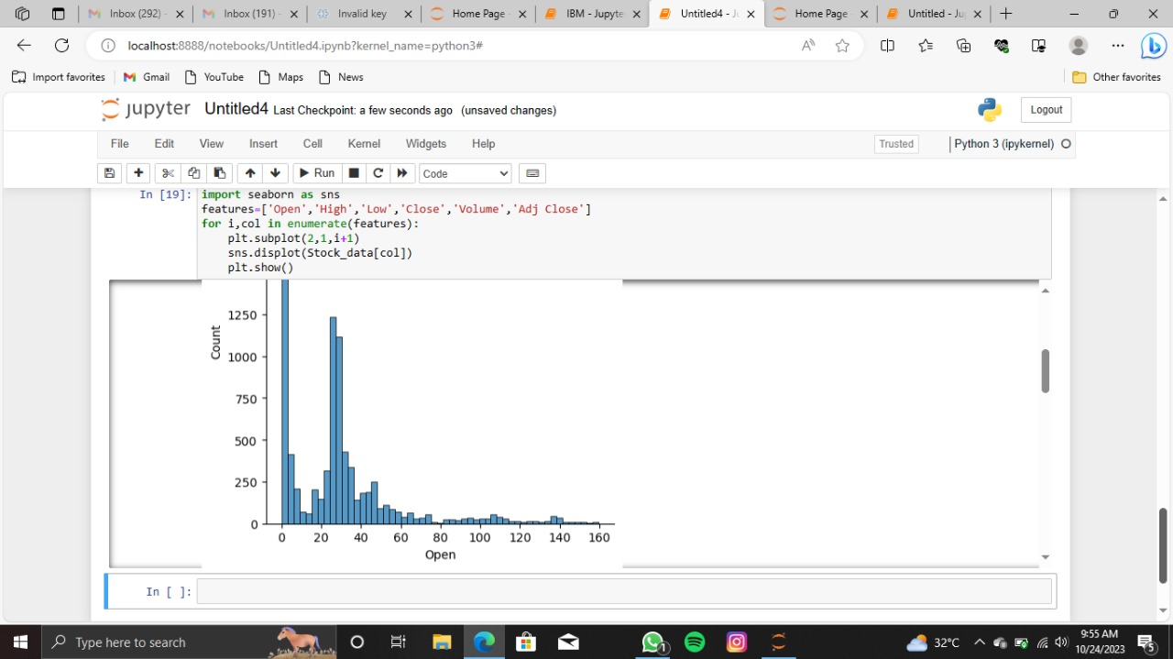

Slide 7
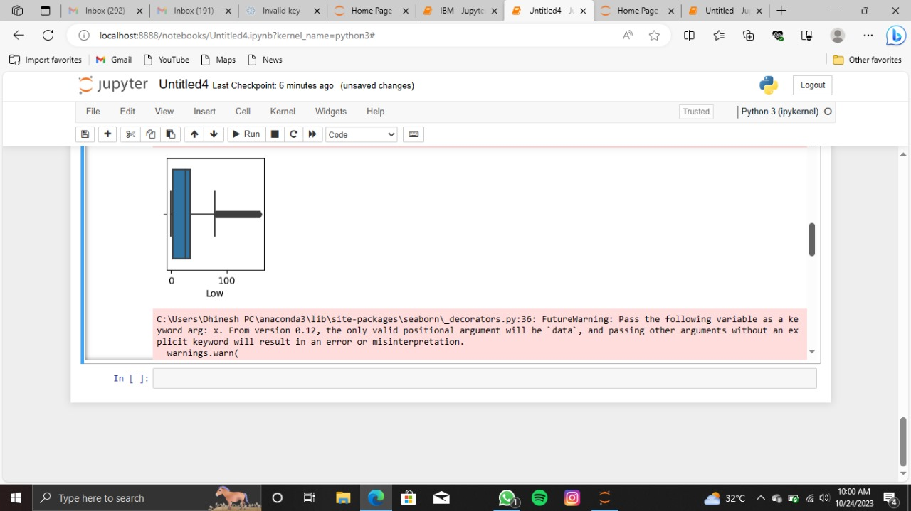

Slide 8
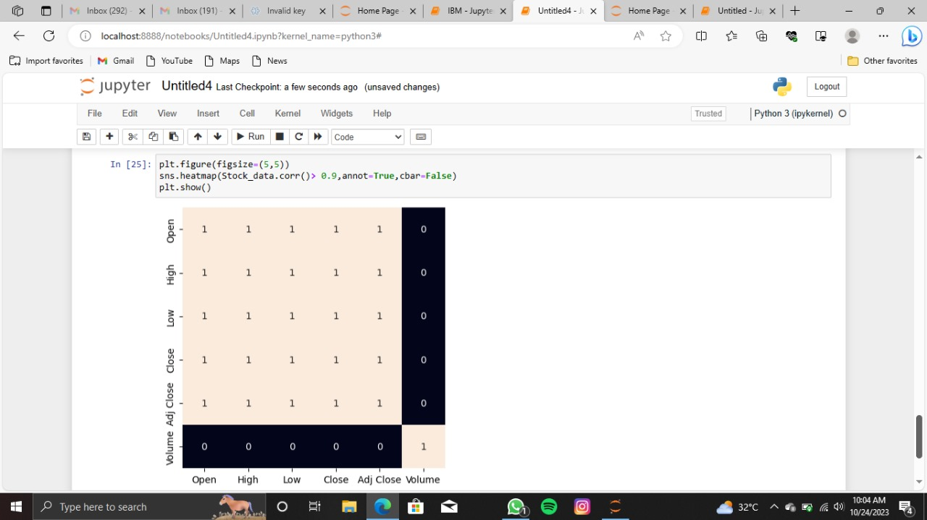

Slide 9
Feature Engineering
Feature Engineering helps to derive some valuable features from the existing ones. These extra features sometimes help in increasing the performance of the model significantly and certainly help to gain deeper insights into the data.

Slide 10
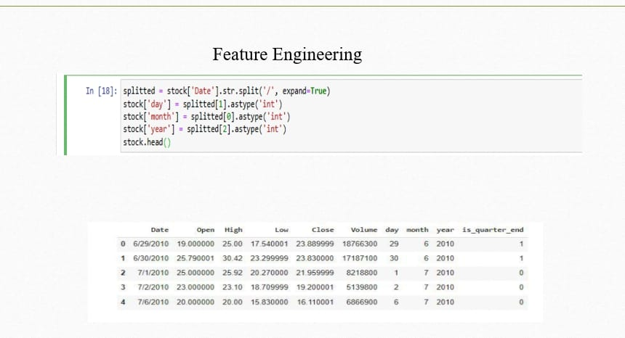

Slide 11
Predictive modelling
Predictive modeling in Python involves using machine learning and statistical techniques to build models that make predictions based on data. Python is a popular language for predictive modeling due to its extensive libraries and frameworks designed for machine learning and data analysis.

Slide 12
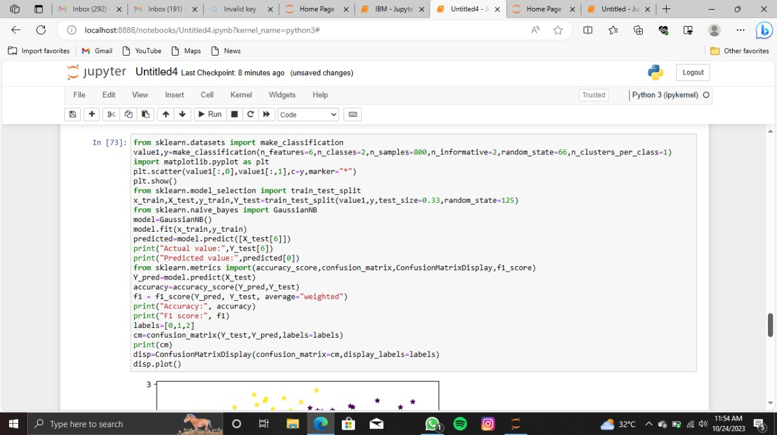

Slide 13
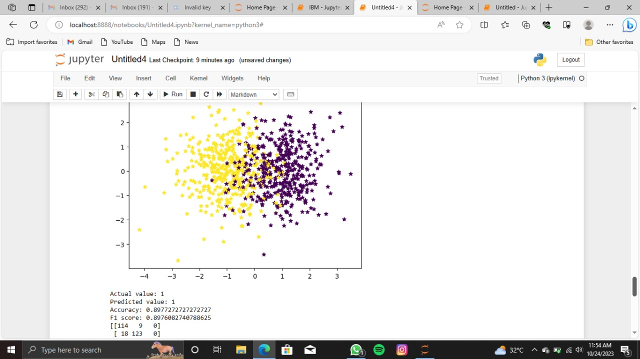

Slide 14
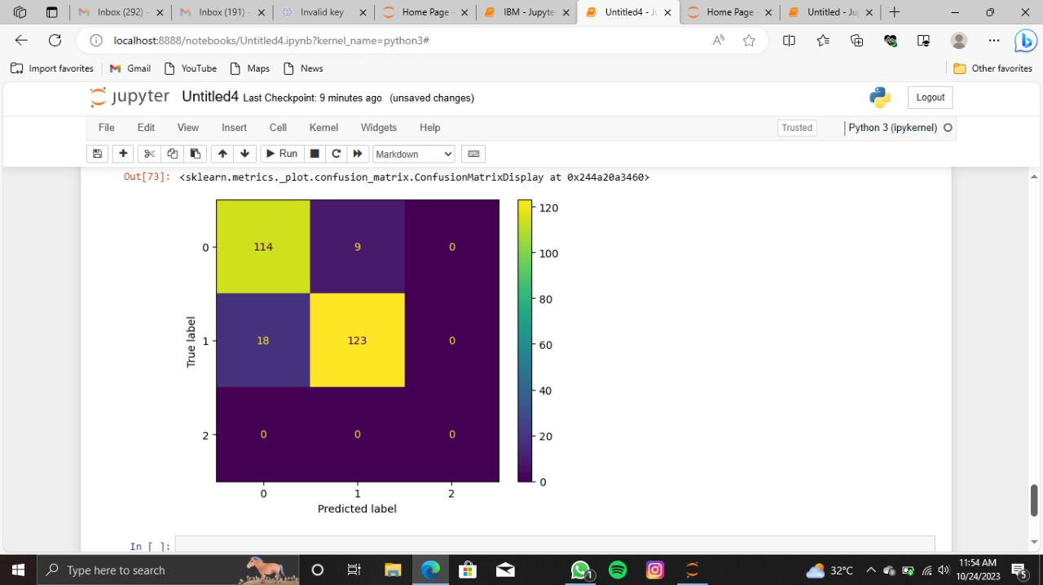

Slide 15
Conclusion
To preprocess the dataset for stock price prediction, you can consider steps like removing duplicates, handling missing values, scaling the data, and splitting it into training and testing sets. We can observe that the accuracy achieved by the state-of-the-art ML model is no better than simply guessing with a probability of 50%. Possible reasons for this may be the lack of data or using a very simple model to perform such a complex task as Stock Market prediction.

