Slide 1
STOCK PRICE PREDICTION
Stock price prediction is the process of using historical stock price data and various modeling techniques to estimate the future price of a particular stock, helping investors make informed decisions.

Slide 2
PHASE-2 PROJECT OVERVIEW
INTRODUCTION
Stock price prediction
Dataset
Dataset columns
Libraries
Train and test
Rest of the explanation
Accuracy test

Slide 3



STOCK PRICE PREDICTION
Stock price prediction is a complex and challenging task that involves using various techniques and data sources to forecast the future prices of stocks or other financial assets. While it is possible to make predictions, it's important to understand that the stock market is influenced by a multitude of factors, many of which are unpredictable.

Slide 4
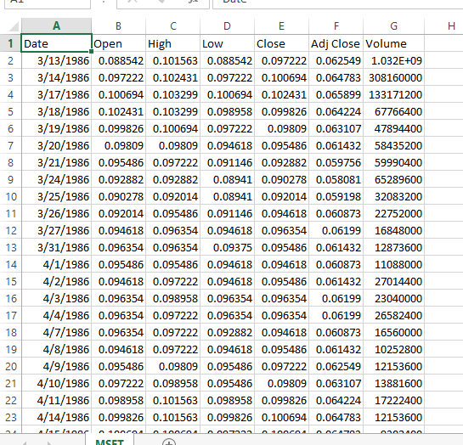
DATASET
IMPORTED DATA SET

Slide 5
DATA SET SOURCE
DATA SET SOURCE
The Dataset for the above mentioned project was obtained from kaggle websites.
Kaggle is an popular dataset providing source,where obtained datasets are highly quality and less errors.

Slide 6
DETAILS ABOUT THE COLUMNS
The above dataset contains the following dataset:
Date: Contain the stock of the date.
Open: The opening price is the price at which a particular stock begins trading at the start of a trading session or trading day. It's the price at which the first transaction for the day occurs.
High: The high price is the highest price that a stock reaches during the trading day.
Low: The low price is the lowest price that a stock reaches during the trading day.
Close: The closing price is the last traded price of a stock at the end of the trading day. It's the price at which the final transaction for the day occurs.
Adjust Close: The adjusted closing price accounts for events like dividends, stock splits, and other corporate actions. It reflects the closing price adjusted for these factors, providing a more accurate representation of the stock's value over time.
Volume: Volume refers to the total number of shares or units of a stock that are traded during a particular trading day.

Slide 7
DATA CLEANING
Filling missing value:
Identify and decide how to deal with missing data point(e.g.,imputation,Removal or Interpolation).
Removing Duplicate Records:
Identify and remove identical or redundant rows in the dataset.
Handling Outliners:
Identify and decide whether to remove,transform, or keep outliers based on their impact on the analysis.
Standardizing Formats:
Ensure consistents formats for data(e.g., date formats,units of measurement) to avoiddiscrepancies.
Find out more at the PowerPoint Getting Started Center
(Click the arrow when in Slide Show mode)
Notes:
In Slide Show mode, click the arrow to enter the PowerPoint Getting Started Center.

Slide 8
TIME SERIES FOR FORECASTING TECHNIQUES
Forecasting Techniques like LSTM (LONG SHORT TERM MEMORY) and prophet are used for predicting stock price values or trends based on historical data.
They are particularly effective in time series analysis ,where data point for collected at regular interval over time.

Slide 9
LSTM (LONG SHORT-TERM MEMORY)
Long Short-Term Memory (LSTM) is a type of recurrent neural network (RNN) architecture that is particularly well-suited for sequential data, making it a popular choice for stock price prediction and other time series forecasting tasks. LSTMs can capture complex patterns and dependencies in time series data, which makes them valuable for modeling the non-linear and dynamic nature of stock prices.
It's important to note that while LSTM models can capture temporal patterns in stock price data, they cannot predict with certainty because financial markets are influenced by a wide range of unpredictable factors.

Slide 10
CNN (CONVOLUTIONAL NEURAL NETWORKS)
Convolutional Neural Networks (CNNs) are primarily designed for image analysis tasks where spatial relationships between pixels are important. However, using CNNs directly for stock price prediction is not common because stock price data does not have a spatial structure like images. Instead, recurrent neural networks (RNNs), especially Long Short-Term Memory (LSTM) networks, are more commonly used for sequential data like time series, including stock price prediction
It's worth noting that this approach is more complex and less common than directly using LSTM or other sequential models for stock price prediction. The choice of architecture and data representation should be carefully considered based on the characteristics of your data and the specific problem you are trying to solve.

Slide 11
LIBRARIES USED
1)PANDAS:
The Pandas library in Python is an open-source data manipulation and analysis tool built on top of the Python programming language. It provides easy-to-use data structures and data analysis tools, making it an essential library for working with structured data.
Data Structures(dataframe and series)
Data Manipulation
Data Loading and Saving
Data Indexing and Selection
Handling Missing Data
Pandas is a powerful tool that simplifies many aspects of data handling and analysis in Python, making it an essential library for data scientists, analysts, and researchers.

Slide 12
2)Numpy
NumPy (Numerical Python) is an open-source Python library that provides support for large, multi-dimensional arrays and matrices, along with a collection of high-level mathematical functions to operate on these arrays. It forms the foundation for numerical and scientific computing in Python
Efficient Numerical Operations
Mathematical and Logical Operations
Efficient Memory Handling
NumPy is a fundamental library in the Python ecosystem and plays a crucial role in scientific computing, data analysis, and various other numerical applications. It's a cornerstone for many other libraries in the data science and scientific computing stack.

Slide 13
Matplotlib
Matplotlib is an open-source Python library used for data visualization. It provides a wide range of tools for constructing plots, graphs, histograms, and other visual representations of data. Matplotlib is widely used in scientific computing, data analysis, machine learning, and various other fields where visualizing data is crucial.
Flexible Data Visualization
High-Quality Output
Wide Range of Plot Styles
Matplotlib is a powerful library that provides the tools necessary for creating a wide range of high-quality data visualizations in Python. It's a cornerstone in the data science and scientific computing stack, often used in conjunction with libraries like NumPy, Pandas, and Seaborn.

Slide 14
Matplotlib
Matplotlib is an open-source Python library used for data visualization. It provides a wide range of tools for constructing plots, graphs, histograms, and other visual representations of data. Matplotlib is widely used in scientific computing, data analysis, machine learning, and various other fields where visualizing data is crucial.
Flexible Data Visualization
High-Quality Output
Wide Range of Plot Styles
Matplotlib is a powerful library that provides the tools necessary for creating a wide range of high-quality data visualizations in Python. It's a cornerstone in the data science and scientific computing stack, often used in conjunction with libraries like NumPy, Pandas, and Seaborn.

Slide 15
Process to download libraries
Step1:Go to settings
Step2:Click on the python interpreter
Step3:Click on the “+” the package column
Step4:Search for the required package
Step5:Click on the “install package”
Step6:the required package is installed

Slide 16
How to train and test Data
To split your data into training and testing sets, you can use the
train_test_split function from the sklearn.model_selection module. This
function randomly shuffles and partitions your data into two subsets,
typically one for training and one for testing.
Code:
from sklearn.model_selection import train_test_split
# Assuming 'X' is your input data and 'y' is your target variable
X_train, X_test, y_train, y_test = train_test_split(X, y, test_size=0.2, random_state=42)

Slide 17
X: Input features (independent variables).
y: Target variable (dependent variable).
test_size: The proportion of the dataset to include in the test split.
In this example, it's set to 20%, meaning 80% will be used for training.
random_state: Seed for the random number generator.
Setting this ensures that the split is reproducible.
After running this code, you will have X_train, X_test, y_train, and
y_test containing the training and testing sets for both your input
features and target variable.

Slide 18
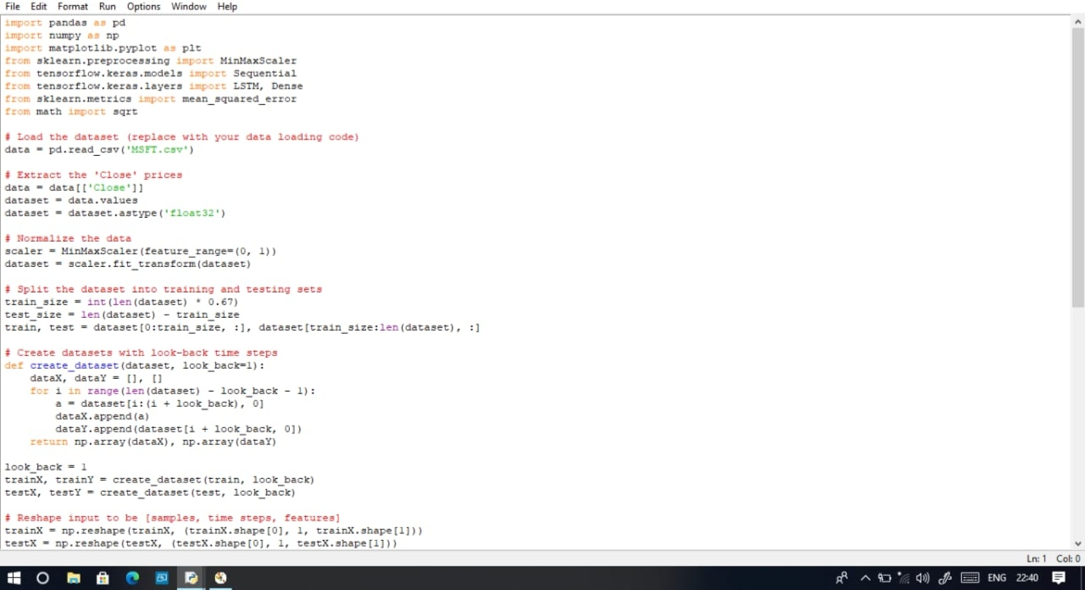

Slide 19
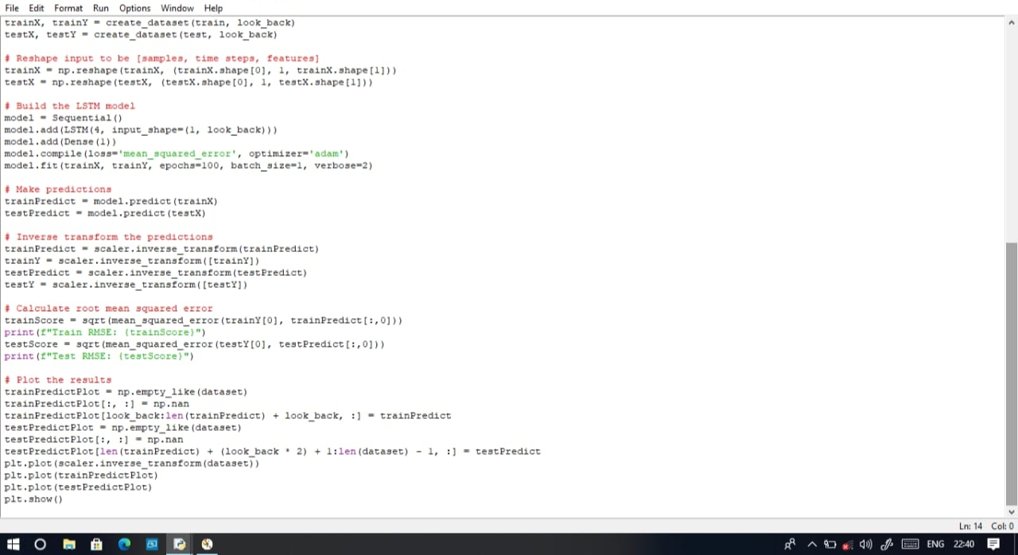

Slide 20
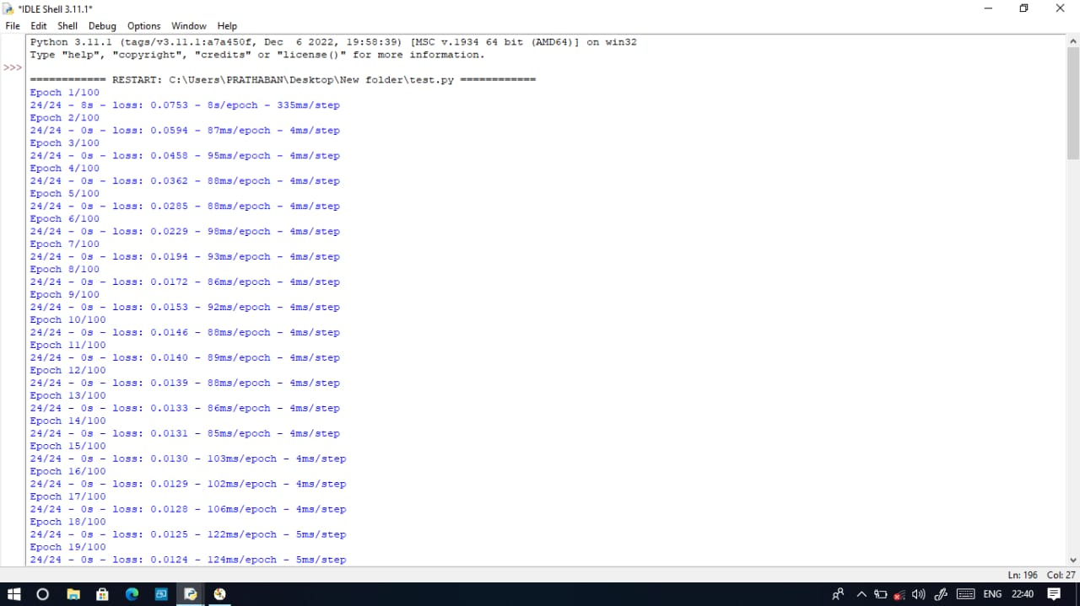

Slide 21
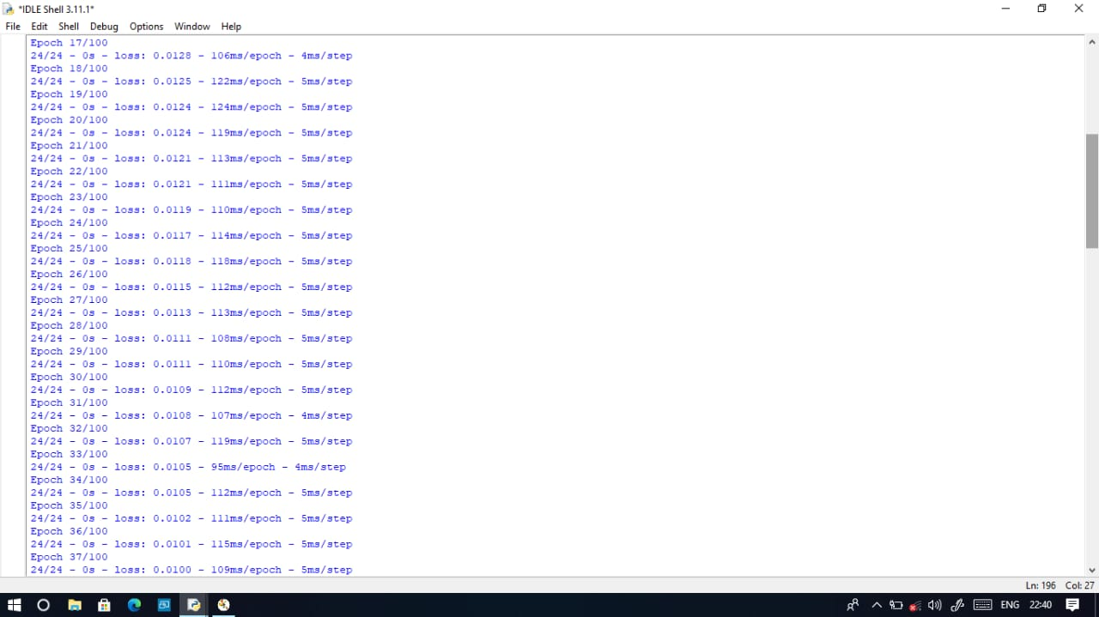

Slide 22
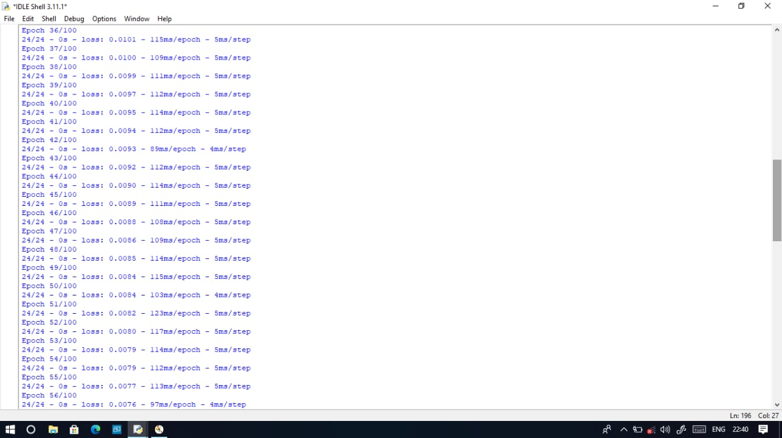

Slide 23
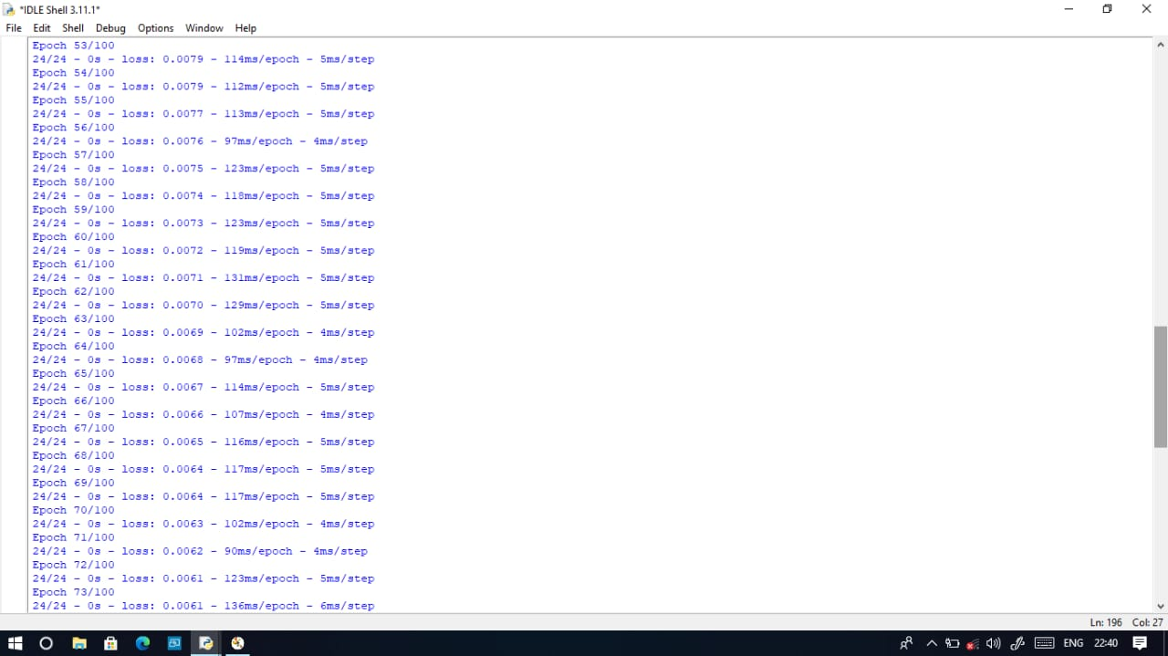

Slide 25
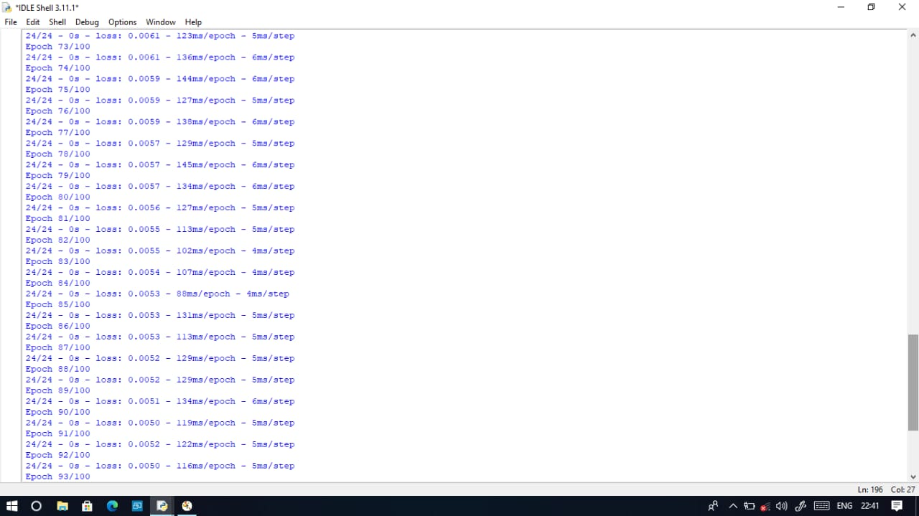

Slide 27
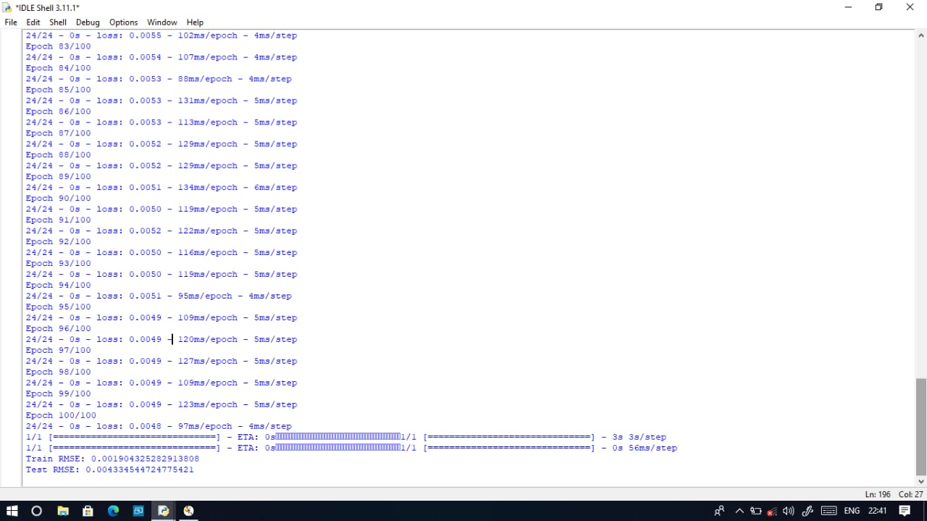

Slide 28
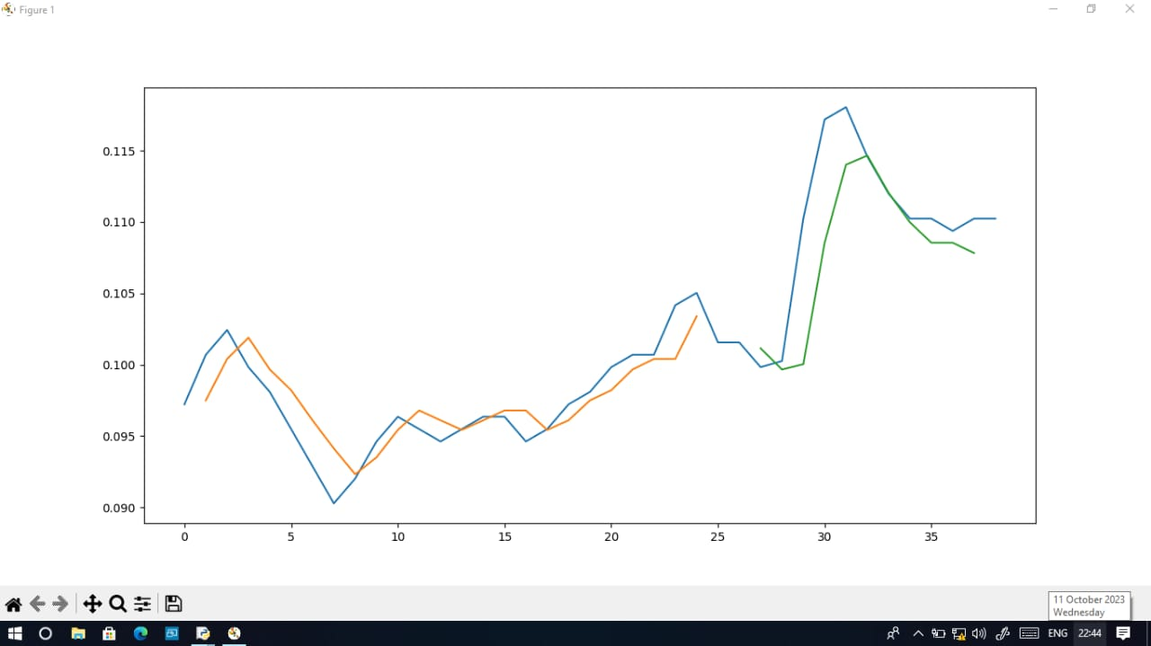

Slide 29
Regression Metrics
Mean Absolute Error (MAE)
Measures the average absolute differences between actual and predicted values. It gives you an idea of how far off your predictions are on average.
Mean Squared Error (MSE):
Similar to MAE, but squares the differences, which can amplify the impact of large errors.
Root Mean Squared Error (RMSE):
The square root of MSE. It gives you an interpretable measure in the same units as the target variable

Slide 30
Model selection and training
Choose a machine learning algorithm or model that is appropriate for
your task.
Train the model on the training data using the fit method.
Model evaluation
Evaluate the model's performance on the testing data using appropriate metrics (e.g., accuracy, mean squared error, etc.). This step helps you understand how well your model is likely to perform on new, unseen data

