Slide 1

Modelling and Simulation
Computer Science – ALT3

Slide 2
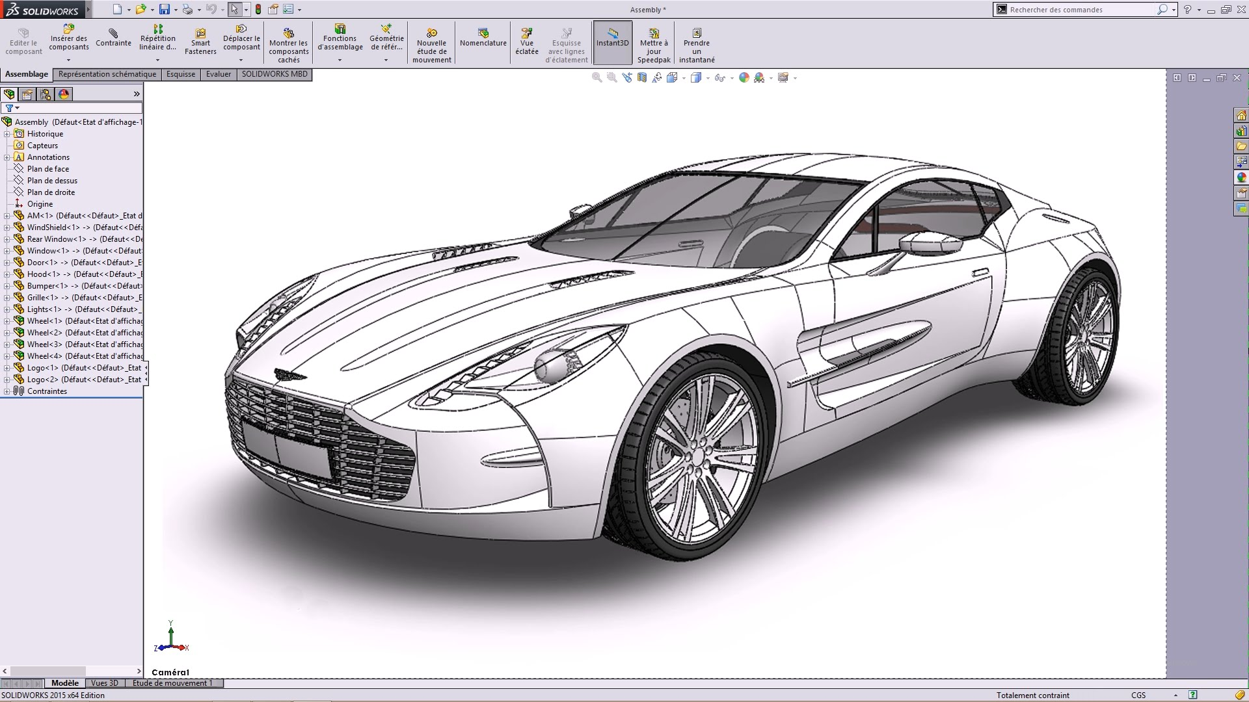
What is a computer Model?
A model is a representations of a real-world event, system, behavior, or natural phenomenon, such as the workings of a nuclear reactor or the evacuation of a football stadium.

Slide 3
What is a computer model?
A collection of rules is created to study what would happen in real-life situations. Changes are made to see how they affect the outcome. For example, before a new football stadium is built, a computer model could be used to see if there are enough fire exits and if they’re in the safest places.

Slide 4
What is a computer model?
A collection of rules is created to study what would happen in real-life situations. Changes are made to see how they affect the outcome. For example, before a new football stadium is built, a computer model could be used to see if there are enough fire exits and if they’re in the safest places.

Slide 5
Simple Models can be built on a spreadsheet (excel)
Simple models can be built in a spreadsheet. A spreadsheet model could be used to plan a school prom. To make sure it came in on budget the spending on food, drinks, entertainment, and the price of tickets could be varied.
It could also be used to see how much money would be made from ticket sales. These are called 'what if…' questions, for example:
What if only 20 people attend?
What if costs go up by 10 per cent?

Slide 6
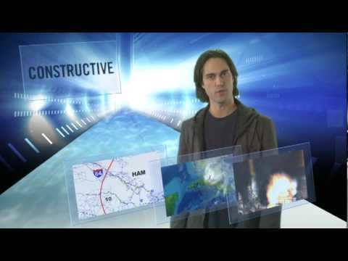
https://www.youtube.com/watch?v=M0iZ52kUOiQ

Slide 7
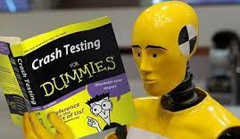
What is simulation?
Simulation is a type of computer model. A simulation imitates a particular environment. It can be used for research or training
They allow different scenarios to be tested. These scenarios can be an actual or probable real-life events that:
  find a cause of a past occurrence (such as an accident),
  forecast future effects (outcomes) of assumed circumstances or factors.

Slide 8


Simulation in real-life?
Ever wonder how pilots practice flying before climbing into the cockpit?
Well they use very advanced simulation software to train in all sorts of conditions.

Slide 9
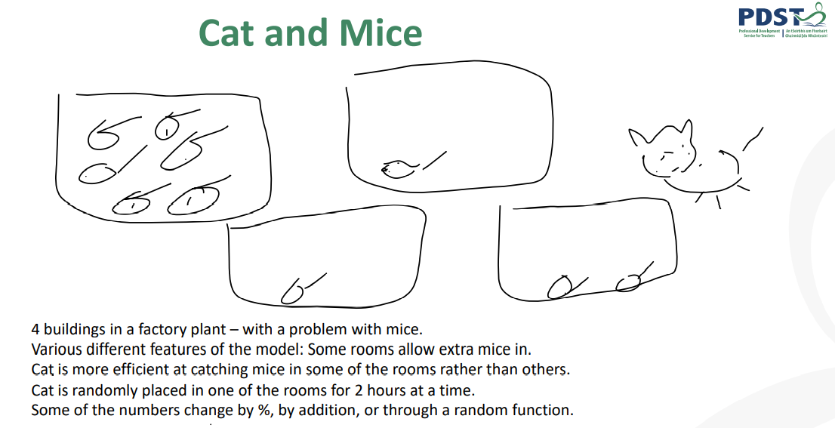

Slide 10
Building a basic model in python
According to the Census 2021 Northern Ireland Population is 1,903,175 and :
  45.7% of inhabitants are Catholic / Catholic background
  43.48% from Protestant or other Christian background
The 2011 census figures were 45% Catholic and 48% Protestant
Prepare a model for the increase and decrease in population over the next 10 years, 20 years, 50 years

Slide 11
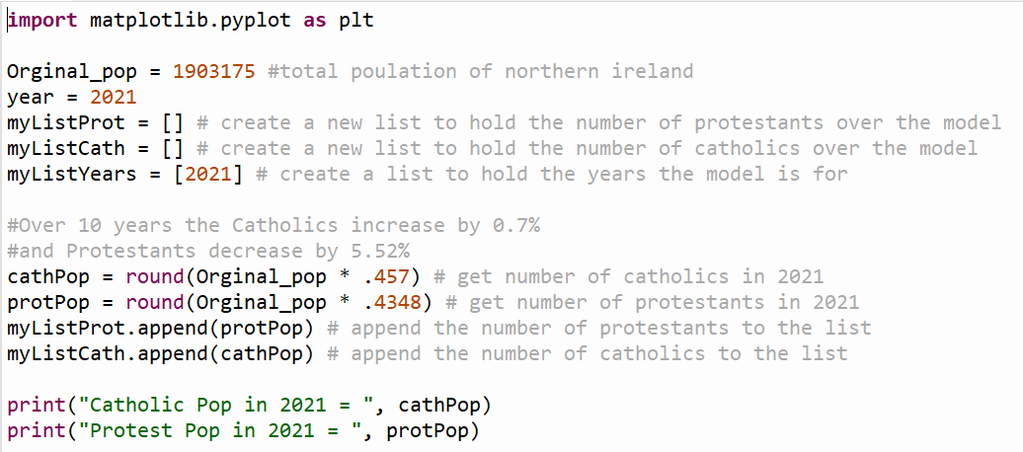
Solution to the previous problem – Pg 1

Slide 12
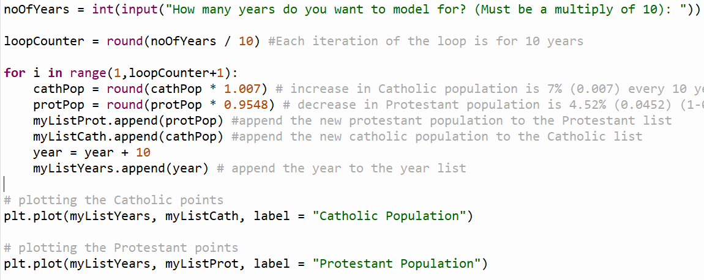
Solution to the previous problem – Pg 2

Slide 13
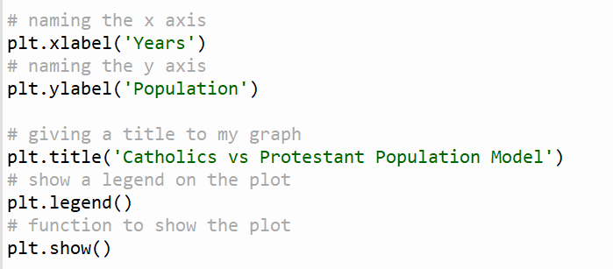
Solution to the previous problem – Pg 3

Slide 14
Model of the population of a town
Carrick Population
Prepare a model for the increase and decrease in population of Carrick (current population 1,535) year-by-year. Given the following details:
  Births: 3% of the population per year
  Deaths 2% of the population per year
  The model can be an interactive Python program.
When you have completed the above you may extend the problem: People leaving: 3 equally likely scenarios depending on Economic factors:
  1. 100 net people coming in.
  2. 50 net people coming in.
  3. 200 net people leaving.)
Use the previous example’s code and modify it

Slide 15
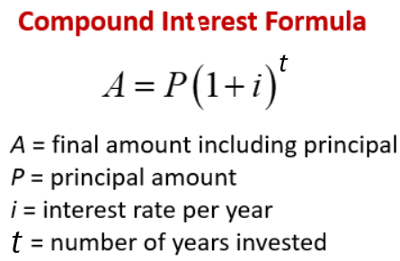
Evaluating a compound interest model
The next model has a mathematical core and is used to calculate the compound interest

Slide 16
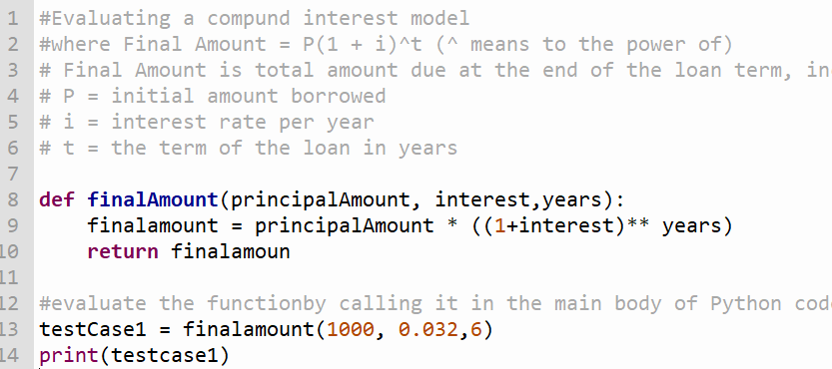
Running Simulations and evaluating models

Slide 17
Evaluate the model
When developing a model, careful consideration should be taken with
the units used in the input
the format of the output
This makes the model easier for the user to analyse and interpret the model’s results.
Both of these can be improved on the previous model
We can return the monthly repayment amount in order to determine whether the loan applicant can afford it
Display the result to 2 decimal points only

Slide 18
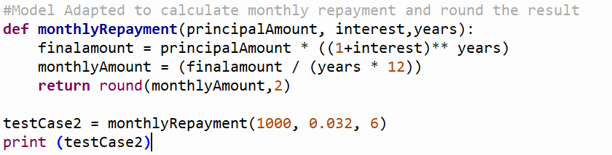
Running Simulations and evaluating models

Slide 19
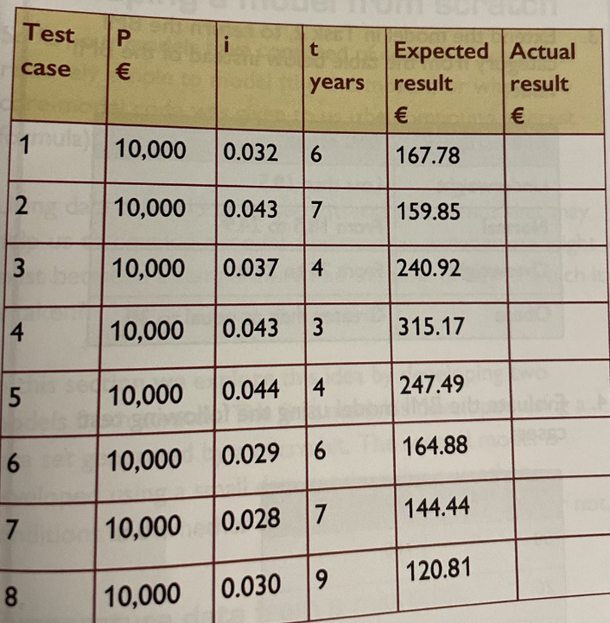
Running Simulations and evaluating models

Slide 20
Improving this compound interest model
Further modification of the model would allow us to find the most suitable loan deal for a user, given the user’s salary as a representation of their ability to pay back the loan.
Front-end Debt To Income measures how much of your monthly gross (pre-tax) income goes toward your mortgage payment (both principal and interest. Mortgage lenders want their borrowers to be able to keep this below 28%.
Improve the previous model by inputting the yearly gross salary, calculate the monthly gross income and check if the Debt to Income is below 28%. Print the result to screen in a user friendly format

Slide 21
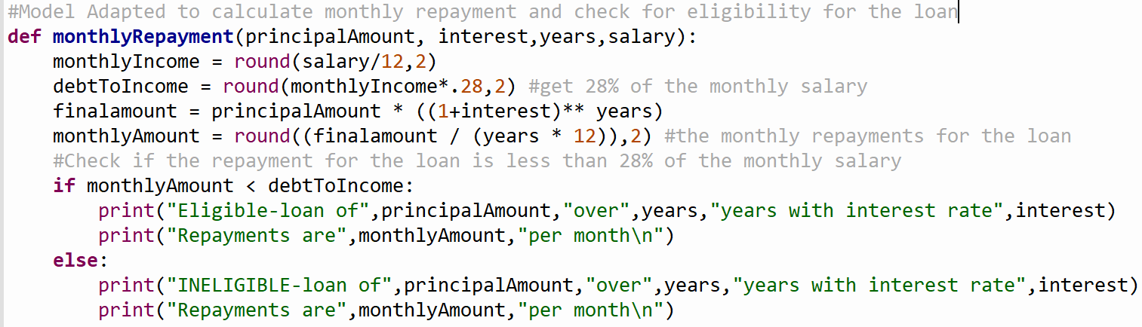
Model extended to check for loan eligibility

Slide 22
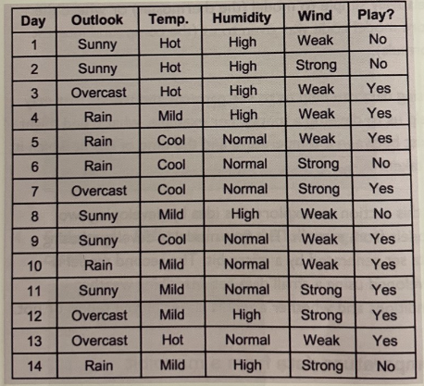
Decision Making Models
This tennis data set comes from a famous introductory model problem.
It shows the weather conditions on different days and whether or not it is suitable for playing tennis
We will use this data to model a tennis player’s decision making based on a weather scenario.
This model has FOUR attributes involved in the decision
  Outlook
  Temperature
  Humidity]
  Wind

Slide 23
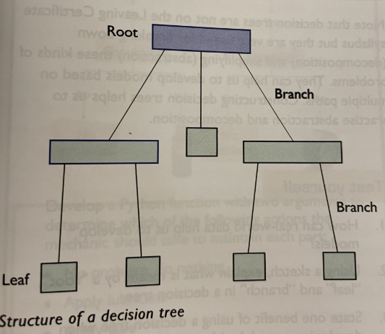
Decision Trees
In the tennis data set, it is not easy to identify the scenarios. The logic is not clear. One way to approach this problem is with a Decision Tree
A Decision tree allows us to identify all possible decision making paths, making it easier to write the conditions in the code
Each branch from the from the root at the top to a leaf at the bottom represents the decision that lead to a particular outcome

Slide 24
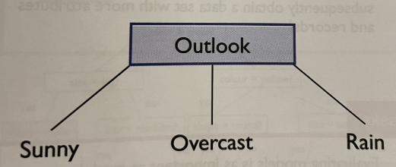
Tennis Decision Tree
Start by putting the first attribute outlook at the top. There are 3 possible values for outlook: sunny, overcast, rain
The next step is examine the data to find out what happens for each of these outlook values
If sunny, sometimes the player plays and sometimes not. The decision must depend on some other attribute
If overcast, the player plays tennis. The other attributes do not affect the decision
If raining, sometimes the player plays and sometimes not. The decision must depend on some other attribute

Slide 25
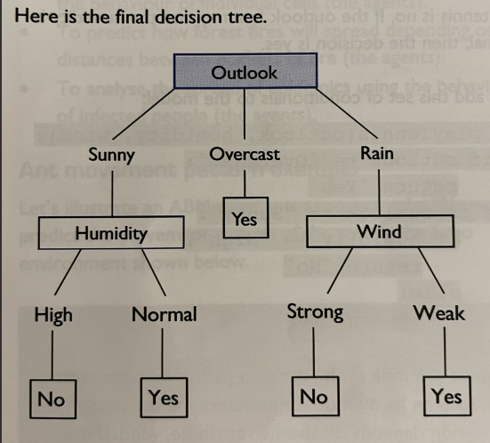
Tennis Decision Tree
When raining, the player plays what ever the temperature. There is no data for when it is hot so we can ignore this
When raining, when humidity is high or not the player may or may not play. We can ignore this
When raining, when the wind is weak, the player plays but if wind is strong the player does not play. This variable is significant for player decision

Slide 26
Decision Tree
The starting point of the tree is always the root. It contains the first attribute, outlook. The other attributes are in the boxes below. The values for each attribute are connected from the root to the leaves using branches.
Each branch from root to leaf represents a decision making path
A major benefit of Decision Trees are they are easy to understand and follow.
It is now possible to write python code for this decision tree. We can use conditionals (if, elif, else) with and or or operators, or nested conditionals.

Slide 27
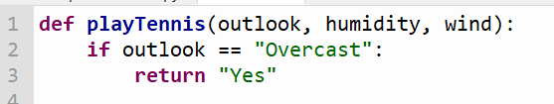
The code for the decision tree
Start with the function definition and it has 3 attributes : outlook, humidity and wind
we can start with the most straight forward conditional, overcast:

Slide 28
The code for the decision tree
Start with the function definition and it has 3 attributes : outlook, humidity and wind
we can start with the most straight forward conditional, overcast:

Slide 29
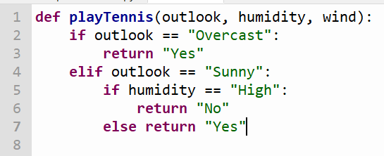
The code for the decision tree
Next, we look at when the outlook is sunny. The decision to play also depends on another attribute humidity.
If outlook is sunny and humidity high, the decision to play is no
If outlook is sunny and humidity low, the decision to play is yes.

Slide 30
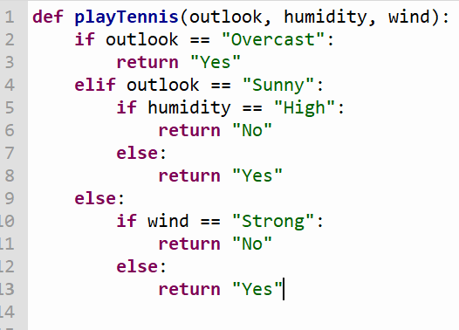
The code for the decision tree
Finally look at the decision path for raining. Rain is affected by another attribute wind.
If outlook is rain and wind is strong, decision to play is no
If outlook is rain and wind is weak, decision to play is yes

Slide 31
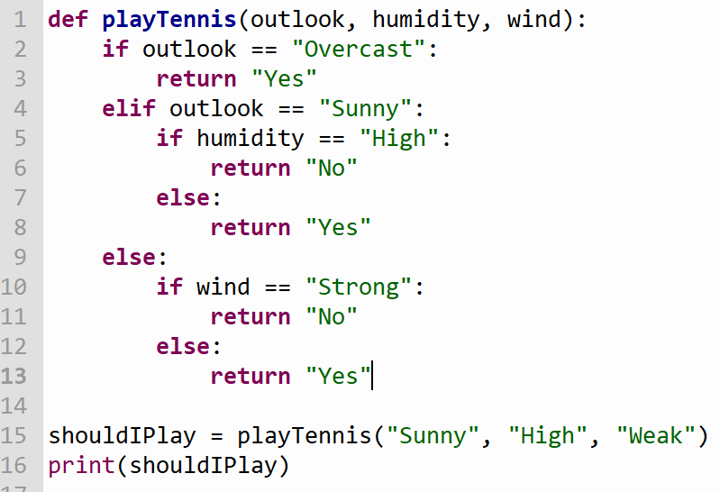
The code for the decision tree
Evaluate the model using one example with an expected result of no

Slide 32
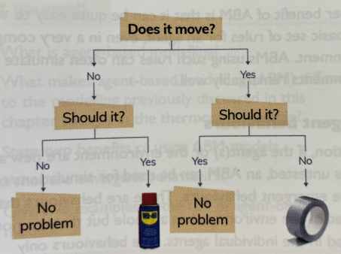
Task 1
A mechanic has to check the parts in a machine. They must decide what to do about each part in terms of maintenance. The problem is described in the decision tree.
Develop a python function with two arguments to determine which of the following actions to take:
  No problem, do nothing
  Apply lubricant
  Apply tape

Slide 33
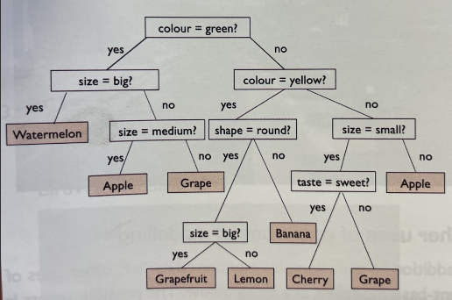
Task 2
This decision tree was developed for automatically classifying fruit, based on several attributes.
Use a python function, develop a computer model for automatic classification of fruit, based on this decision tree

Slide 34
Agent Based Modelling (HL)
Agent based modelling(ABM) involves building models to simulate the actions and interactions of individual “agents” within an environment.
These agents are autonomous and independent of each other and the environment. This means that the environment contains multiple models, each of which is an agent.
ABM allows us to simulate the behaviours of the agents to investigate how specific attributes of an agent may affect other agents or the environment as a whole.
https://www.youtube.com/watch?v=Z8Wf1vF_xgQ
https://www.youtube.com/watch?v=n6h3WiRLmp8

Slide 35
Real World ABM Exampes - HL
To investigate how cancer tissues develop as a result of the behaviour of individual cells (the agents)
To predict how forest fires will spread depending on the distances between pockets of fire (the agents)
To analyse the spread of epidemics using the behaviour of infected people (the agents)

Slide 36
Ant Model Pattern Example
Each ant is an individual agent. Lets try to build a simple model to simulate the behaviour of an ant using these attributes:
Hungry? (Yes / No)
Work to be done (Yes / No)
The output is an action taken by an ant. There are 3 options:
Find food and eat
Go to work
Move with the other ants “in an army”

Slide 37
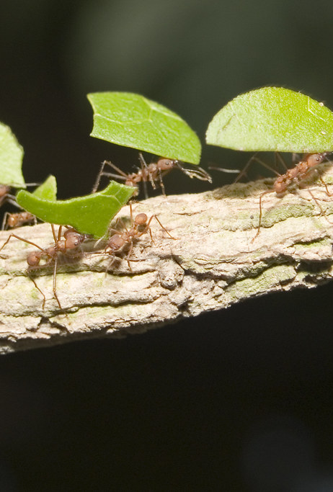
Ant Model
Each ant must have an initial state, which could be randomly generated or have a default value e.g work to be done set to yes or no.
The rules might be as follows:
  If ant is hungry the ABM will get the ant to go find food
  If ant is Not hungry and there is work to be done, the ant must go to work
  If there is no work to do and the ant is not hungry it will join another group of ants and will walk around in an army
Therefor each ant is responsible for his own actions -> it is autonomous
Next we can add models for multiple agents
This Photo by Unknown Author is licensed under CC BY-NC-ND

Slide 38
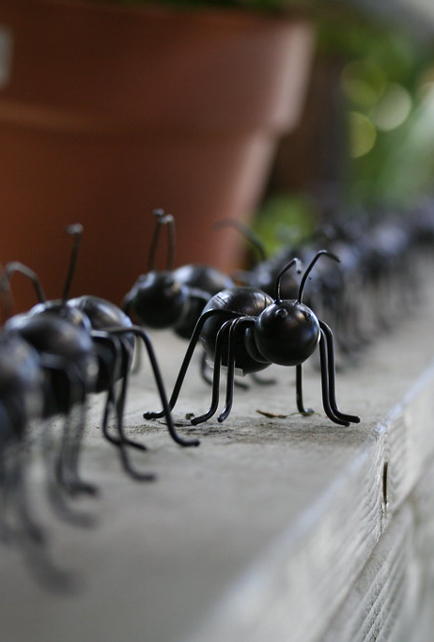
Ant Model continued
The starting conditions for the environment could be set, or generated at random. E.g. if there is plenty of food close to an ant, I will not take long to find the food so it can spend more time working.
This could be used to simulate the productivity of the environment when food is plentiful and widely dispersed. This could be compared to productivity when food is scare and concentrated in just one location
This Photo by Unknown Author is licensed under CC BY

Slide 39
Benefits of Agent Based Modelling
Helps to describe complex environments, from swarms of locusts to motorists in traffic, by applying a simple set of rules to an individuals behaviour
Companies or governments can develop ABMs to test specific scenarios before they happen and this is particularly valuable when the outcome may be negative e.g spread of covid-19 at a rate that could not be managed by the health service
It can be quite easy to work out the basic set of rules for an agent, even in a very complex environment. ABM using such rules can often simulate real environments remarkably well.

Slide 40
ABM and Emergent Behaviour
If an agent or an environment are new and perhaps untested, an ABM can be used for simulations to examine emergent behaviours. These are the behaviours that are observed in the environment as a whole but are not observed in the individual agents. The behaviours only emerge when the agents interact with the environment.
E.g if you build a model for commuters (the agents) and their preferences, an ABM could be built of a proposed new road or traffic control system and then simulations to examine whether it might help to get more commuters to work on time

Slide 41
Examples of ABM
https://traffic-simulation.de/
http://www.natureincode.com/code/various/ants.html

Slide 42
Excellent introduction to Agent Based Modeling (its 2 hours long)
https://www.youtube.com/watch?v=clPu6wMuLfg

Slide 43
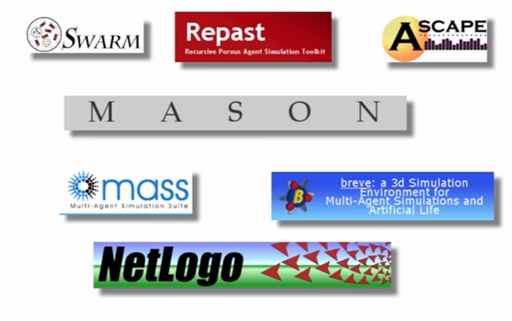
Agent Based Modelling Toolkits
https://www.youtube.com/watch?v=QtZ3M5UNKhI

