Slide 1






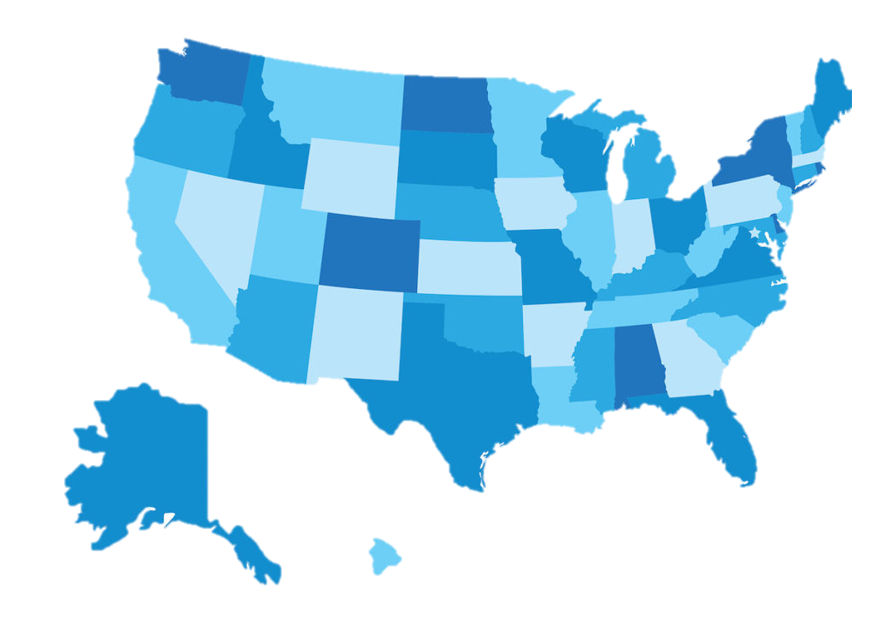



ticket
Reasons in Peru that young adults have to move
studies
you will learn a different language and education abroad is more complete than in our country
Careers such as arts are more accessible abroad than in our country
The dream of many is to be able to leave the country, but why now do young adults decide to make that decision?
Better opportunities
unemployment
you could have even more job opportunities. It may be easier to find a job.
high unemployment rates in Perú
Due to the hight Price increase, some decided to migrate to other countries
Countries like Canada have the lowest unemployment rate in the world.
you learn to better master the language of the place
economic crisis

