Slide 1
Computer science Practical File
By: Rishabh Arora

Slide 2
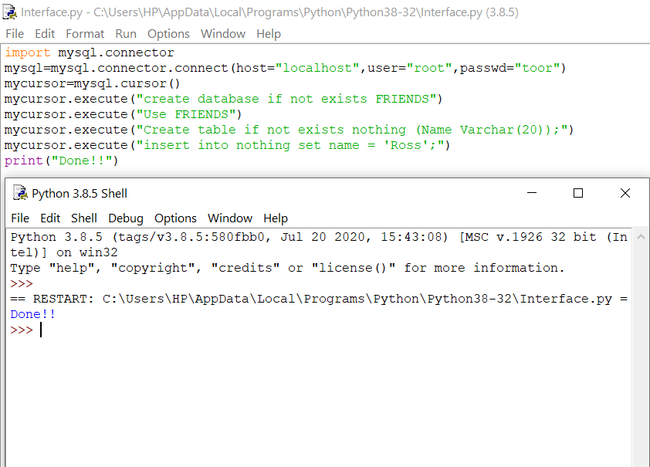
Inserting records in the table.

Slide 3
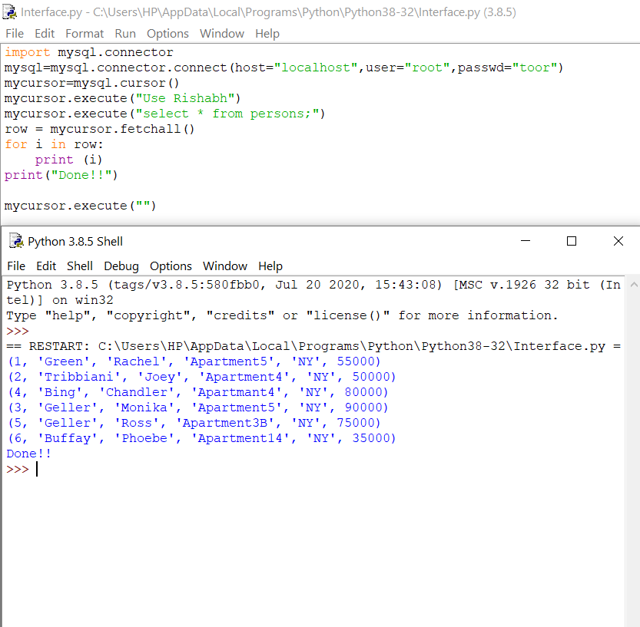
Fetching all the records from the table.

Slide 4
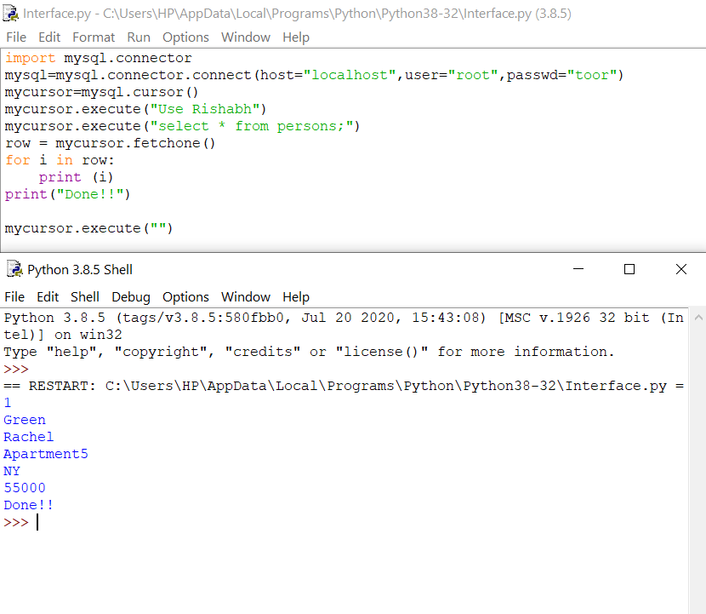
Fetching records from the table based on the condition.

Slide 5
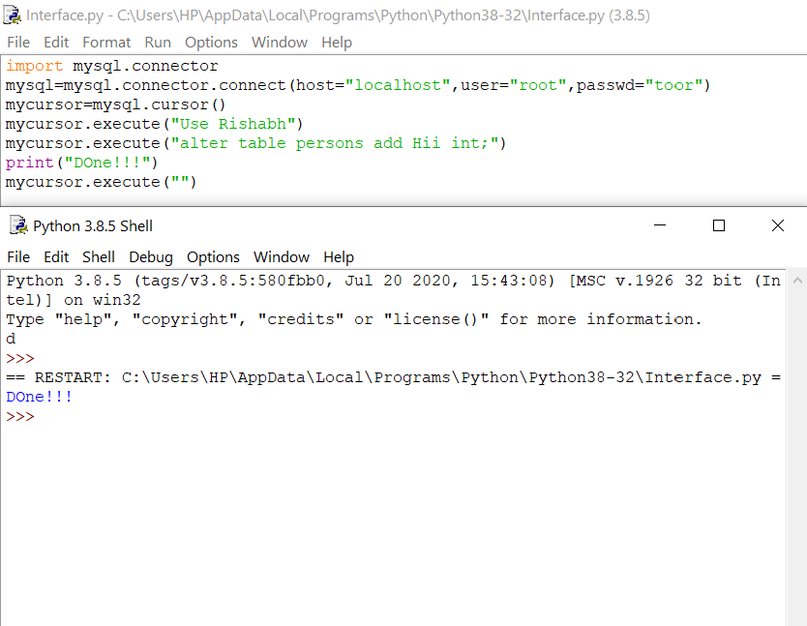
Adding a column in the table using ALTER command.

Slide 6
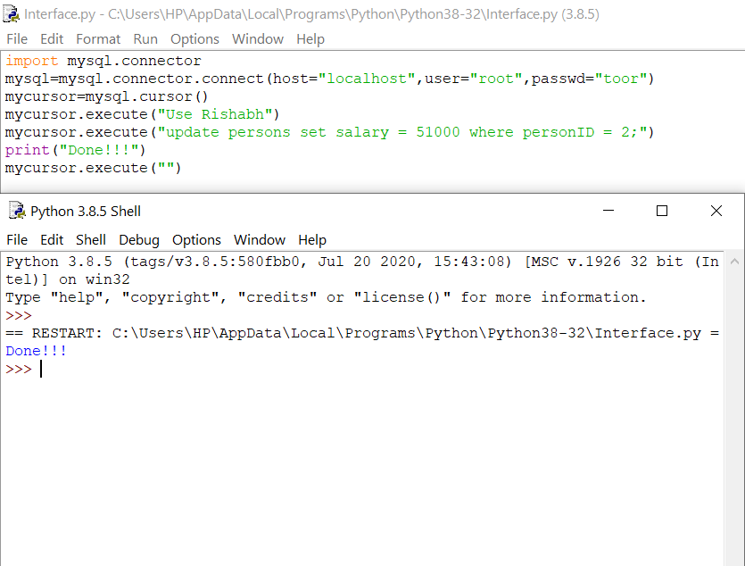
Updating records of the table using UPDATE command.

Slide 7
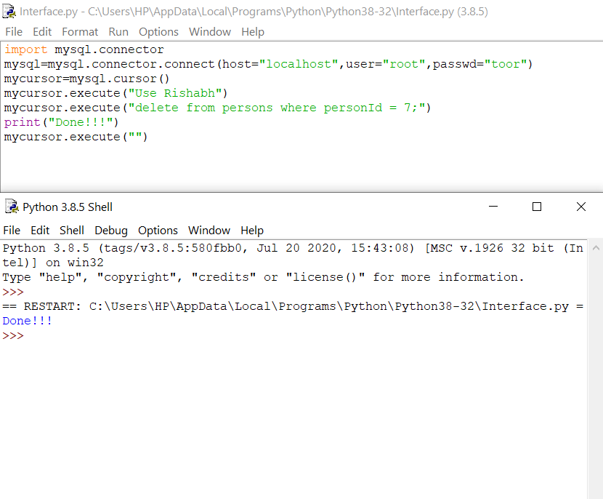
Deleting records from the table.

