Slide 1
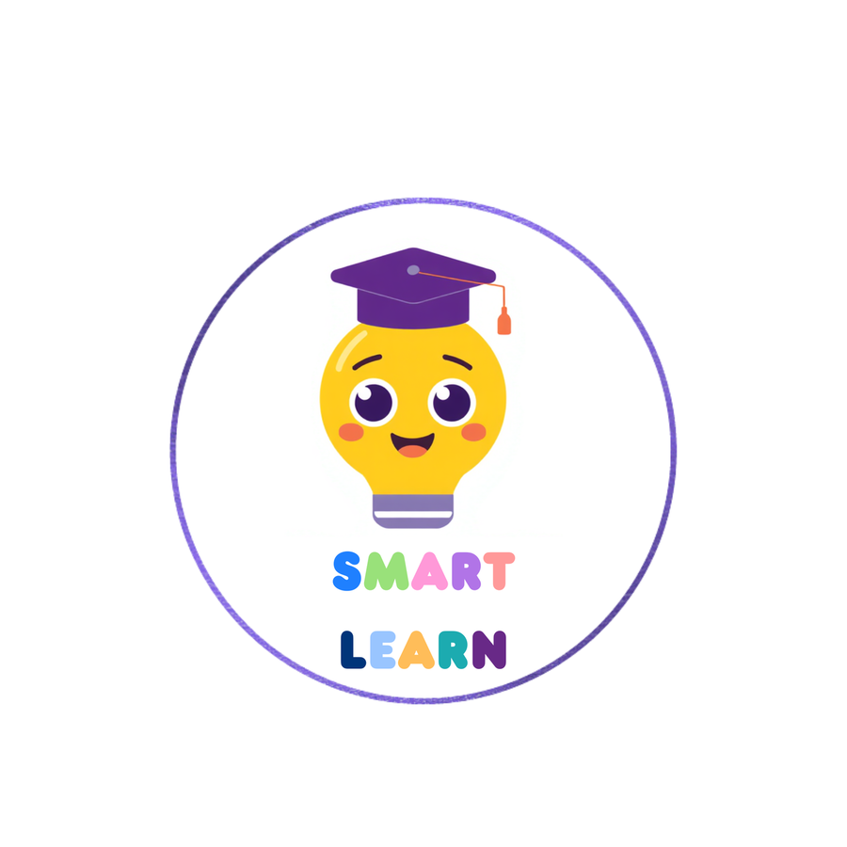


SMART LEARN:
An Adaptive Mobile Platform for Neurodevelopmental Learning Disorders
R26-IT-114

Slide 2

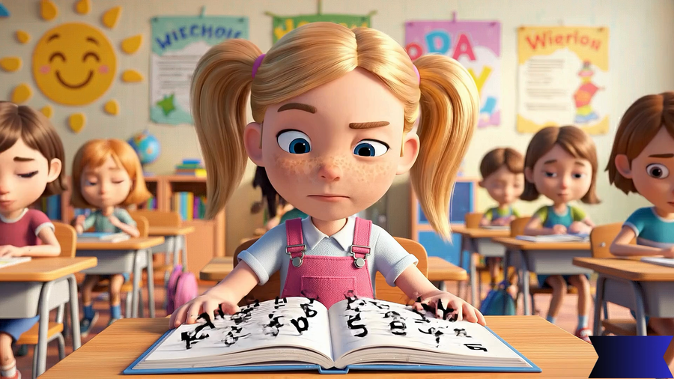
INTRODUCTION
VIDEO
R26-IT-114

Slide 3
PROBLEM
  No Sinhala digital apps support therapists, most tools focus only on detection, not adaptive treatment
  Current NLD interventions rely on costly therapist-led programs, limiting access for low- and middle-income families
  Most apps use text-based instructions, which are difficult for young children with limited reading skills
  No single digital tool supports multiple conditions like Dyslexia, Dyscalculia, Dysgraphia, and Working Memory Disorder
IMPACT
  Leads to poor academic performance, low self-confidence, and reduced motivation to learn
  Parents lack affordable and accessible tools to support learning at home
  Absence of Sinhala-based digital learning systems creates barriers for many children in Sri Lanka
  Overall limits early intervention and effective support for children with learning difficulties
R26-IT-114

Slide 4
PEOPLE WHO BENEFIT FROM THE SOLUTION
  Children with neurodevelopmental disorders
  Parents of children with neurodevelopmental disorders
  People in rural areas
  People who cannot afford therapy sessions for neurodevelopmental disorders
  Therapists
DESIGN EXCELLENCE OF THE OVERALL SOLUTION
  Sinhala-medium web-based learning support system for children aged 6–8 with neurodevelopmental learning disorders.
  Voice-guided learning activities with Reward systems and progress tracking
  Multiple disorder support
  Child-friendly colorful UI/UX
  Learning through play approach
  Personalized learning modules
R26-IT-114

Slide 5

H.A.P.D MADHURANGI
IT22252418
GAME BASED DYSLEXIA INTERVENTION MODULE
Specialization :- Information Technology
IT22252418 | H.A.P.D.Madhurangi | R26-IT-114

Slide 6
GAME BASED DYSLEXIA INTERVENTION MODULE
COMMENTS FOR THE PROPOSAL
Comments | Action
Support for Dyslexia children. Have a good understanding about the individual scope. | Clearly defined the project scope specific to Dyslexia learning challenges. Designed features such as: Text-to-speech support ,Audio-assisted reading,Letter and word recognition activities ,Phonics-based exercises Used dyslexia-friendly fonts, spacing, and color combinations to improve readability. Developed adaptive reading exercises based on the learner’s performance level.
IT22252418 | H.A.P.D.Madhurangi | R26-IT-114

Slide 7
GAME BASED DYSLEXIA INTERVENTION MODULE
How the Solution Addresses the Sub-Problem
  Developed a game-based learning system for Sinhala-speaking children with Dyslexia.
  Designed interactive games for letter recognition, sound matching, word reading, and pronunciation practice.
  Added voice-guided Sinhala instructions and pronunciation accuracy checking.
  Includes progress tracking for parents, teachers, and therapists.
User Requirements Addressed
  Easy navigation
  Child-friendly interface
  Audio guidance
  Gamified learning
  Mobile responsiveness
IT22252418 | H.A.P.D.Madhurangi | R26-IT-114

Slide 8
GAME BASED DYSLEXIA INTERVENTION MODULE
Design Excellence/Contribution
  Sinhala language support
  Gamified learning experience
  Interactive educational games
  Voice-guided activities
  Reward and progress tracking system
  Jungle-themed colorful interface
  Take sinhala voice inputs
User Feedback
  Parents: “Children stayed engaged longer than traditional exercises.”
  Teachers: “The voice guidance and visuals improve student interaction.”
  Children: “Fun and easy to play!”
IT22252418 | H.A.P.D.Madhurangi | R26-IT-114

Slide 9

A.H.M.P.D ABEYSINGHE
IT22062574
GAME BASED DYSCALCULIA INTERVENTION MODULE
Specialization :- Information Technology

Slide 10
GAME BASED DYSCALCULIA INTERVENTION MODULE
COMMENTS FOR THE PROPOSAL
Comments | Action
Support for children with Dyscalculia. Might need to analyze the emotion of the child. Need to think about emotional support and HCI. Include sort of reward system. | • Designed child-friendly UI/UX with Sinhala voice guidance and interactive numeracy games. • Developed activities such as number tracing, balloon pop, and number sorting to improve number recognition and counting skills. • Added reward systems, animations, and positive feedback to improve motivation and engagement. • Collected feedback from children and guidance from the external supervisor to identify usability and HCI improvements.
IT22062574 | Abeysinghe A H M P D | R26-IT-114

Slide 11
GAME BASED DYSCALCULIA INTERVENTION MODULE
How the Solution Addresses the Sub-Problem
  Developed a game-based adaptive numeracy intervention system for Sinhala-speaking children with Dyscalculia.
  Designed interactive activities for:(Number recognition, Counting, Quantity identification, Number sequencing, Number tracing)
  Integrated Sinhala audio guidance and visual learning support.
  Added adaptive game difficulty based on child performance.
  Included progress monitoring dashboards for parents, teachers, and therapists.
User Requirements
  Child-friendly colorful interface
  Sinhala voice guidance
  Mobile responsive design
  Interactive touch-based games
  Gamified learning experience
  Progress tracking and performance monitoring
IT22062574 | Abeysinghe A H M P D | R26-IT-114

Slide 12
GAME BASED DYSCALCULIA INTERVENTION MODULE
Design Excellence
  Developed Math Carnival themed learning environment for children.
  Added multisensory learning using:(Audio, Visual objects, Touch interaction)
  Designed adaptive games such as:(Balloon Pop Quantity Game, Number Sorting Game, Number Listening Game, Interactive Number Tracing)
  Created reward systems using stars, badges, and animations.
  Integrated performance analytics dashboard for monitoring learning improvement.
User Feedback on prototype
  Parents:
“Children stayed engaged and enjoyed learning numbers through games.”
  Teachers:
“The visual activities and Sinhala audio guidance improved numeracy interaction.”
  Children:
“Fun and easy to play!”
IT22062574 | Abeysinghe A H M P D | R26-IT-114

Slide 13
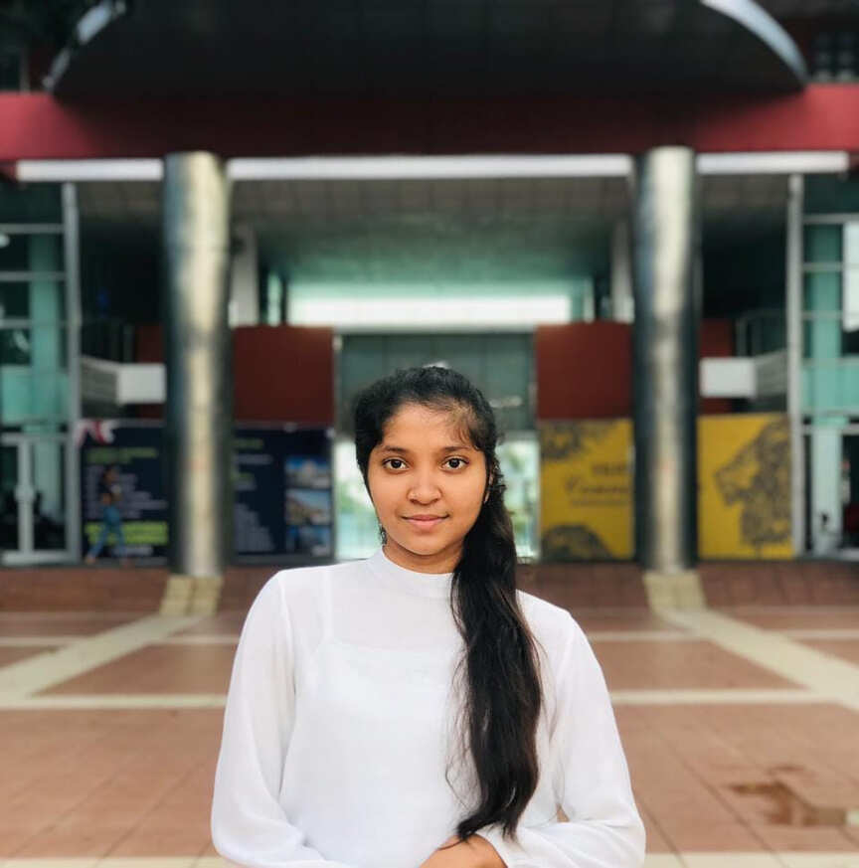
B.W.J.D SENAVIRATHNA
IT22128836
GAME BASED DYSGRAPHIA INTERVENTION
MODULE
Specialization :- Information Technology

Slide 14
GAME BASED DYSGRAPHIA INTERVENTION MODULE
COMMENTS FOR THE PROPOSAL
Comments | Action
Find the suitable data sets for sinhala letters. | Collect selected Sinhala handwritten letters from Grade 1 to Grade 3 school children and create a handwriting dataset
Break down the Sinhala character alphabet to few levels | Break down the selected Sinhala letters into three levels based on the ease of writing, under the guidance of the external supervisor and primary school teachers.
Need to think about the validation plan | Discussed the validation plan with the external supervisor. She is currently verifying the possibility of involving a child under her consultation for system validation.
IT22128836 | Senavirathna B.W.J.D | R26-IT-114

Slide 15
GAME BASED DYSGRAPHIA INTERVENTION MODULE
How the Solution Addresses the Sub-Problem
  Developed a game-based adaptive handwriting intervention system for Sinhala-medium children.
  Design games for letter practice that start with simplified tracing steps and gradually progress up to three-letter words.
  Integrated voice-guided Sinhala instructions to support children with limited reading ability.
  Supports progress monitoring dashboards for parents, teachers, and therapists.
User Requirements
  Interactive and colorful UIs for handwriting assessment tasks.
  Real-time handwriting capture and analysis.
  Different difficulty levels for gradual learning improvement.
  Sinhala voice-guided instructions.
  Mobile responsiveness.
  Supports progress monitoring dashboards for parents, teachers, and therapists.
IT22128836 | Senavirathna B.W.J.D | R26-IT-114

Slide 16
GAME BASED DYSGRAPHIA INTERVENTION MODULE
Design Excellence
  Added interactive animations to improve engagement.
  Combines: Game-based learning , Sensory learning,
  Innovative mirror-letter training to improve visual discrimination skills.
  Integration of AI-based handwriting evaluation for personalized learning support.
  Created reward system (stars, gems) to motivate learning.
User Feedback
  Children show high engagement with audio-based interaction
  Children are attracted to watching animated letter writing.
  Writing canvas helps improve interest compared to paper-based practice
  Some users may need clearer guidance at first use (on how to draw or proceed to next step)
IT22128836 | Senavirathna B.W.J.D | R26-IT-114

Slide 17

H.A.P.N SENADEERA
IT22502360
SUPPORT AND IMPROVEMENT OF WORKING MEMORY SKILLS IN CHILDREN WITH WORKING MEMORY DISORDER
Specialization :- Information Technology
IT22502360 | H.A.P.N Senadeera | R26-IT-114

Slide 18
GAME BASED WORKING MEMORY INTERVENTION
MODULE
COMMENTS FOR THE PROPOSAL
Comments | Action
Support for children with working memory disorder. Have a good understanding about the scope. | Developed different game activities such as Sequence recall games, Memory matching games, video story game Included Sinhala audio and visual instructions for children Added cognitive performance tracking such as accuracy level, memory performance, attention performance, response time. Added rewards and progress tracking features. Developed adaptive game difficulty based on child performance. Created an engaging learning environment to support children with working memory difficulties.
IT22502360 | H.A.P.N Senadeera | R26-IT-114

Slide 19
GAME BASED WORKING MEMORY INTERVENTION
MODULE
How the Solution Addresses the Sub-Problem
  Helps children improve memory and attention skills through interactive games.
  Provides activities to practice remembering sequences, patterns, and objects.
  Integrated Sinhala audio and visual guidance to support children with memory and attention difficulties.
  Supports progress tracking and performance monitoring for parents, teachers, and therapists.
User Requirements
  Easy-to-use and child-friendly game interface.
  Visual guidance to support non-readers or early learners.
  Mobile responsive.
  Progress tracking system for monitoring child performance.
  Dashboard access for parents, teachers, and therapists to view progress.
IT22502360 | H.A.P.N Senadeera | R26-IT-114

Slide 20
GAME BASED WORKING MEMORY INTERVENTION
MODULE
Design Excellence/Contribution
  Designed colorful and engaging UI for children.
  Added interactive animations to improve engagement.
  Integrated Sinhala voice instructions for better accessibility.
  Built adaptive game levels based on child performance.
  Created reward system (stars, badges) to motivate learning.
  Developed progress dashboard for monitoring improvemen
User Feedback
  Parents:
“Children stayed focused and enjoyed the memory games more than normal exercises”
  Teachers:
“The app helps students improve attention and memory with simple visuals and voice guidance.”
  Children:
“It is fun and easy to play. I like the games!”
IT22502360 | H.A.P.N Senadeera | R26-IT-114

Slide 21
COMMERCIALIZATION/SUSTAINABILITY OF SOLUTION
Customer Persona
Market Size
  Parents of children with learning difficulties
  Special education teachers
  Educational institutions
  Therapy centers
  Growing EdTech industry
  Increasing awareness of neurodevelopmental disorders
  High demand for accessible educational platforms
Unique Features
How will be the cost covered?
  Sinhala language support
  Gamified therapy-based learning
  Multi-disorder support in one platform
  Child-friendly accessible UI
  AI-powered voice interaction
  Subscription-based premium features
  School partnerships
  Therapy center licensing
  Freemium mobile app model
R26-IT-114

Slide 22
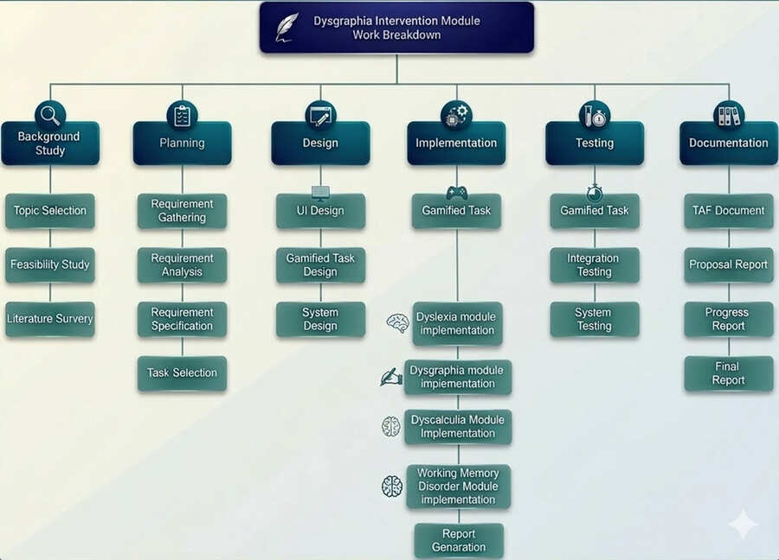

Work Breakdown Chart
R26-IT-114

Slide 23
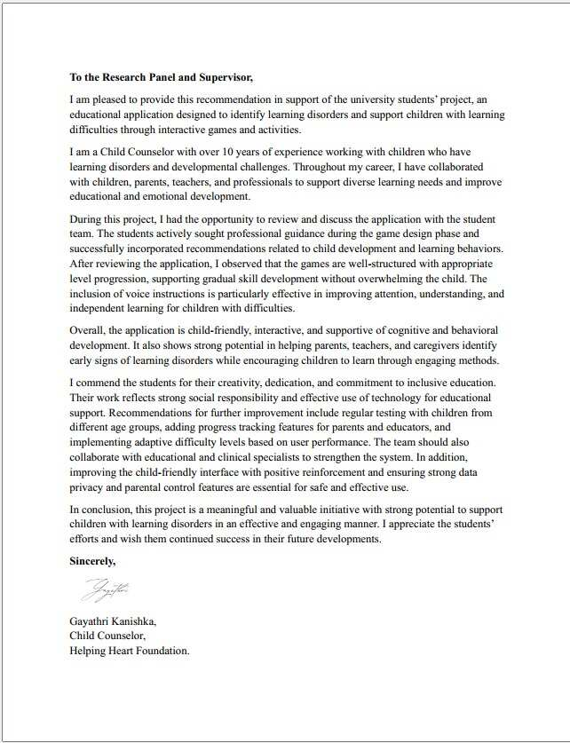
RECOMMENDATION LETTER FROM EXTERNAL SUPERVISOR
R26-IT-114

Slide 24

SMART LEARN
THANK YOU

