Slide 1


Smart Learn:
An Adaptive Mobile Platform for Neurodevelopmental Learning Disorders
R26-IT-114

Slide 2
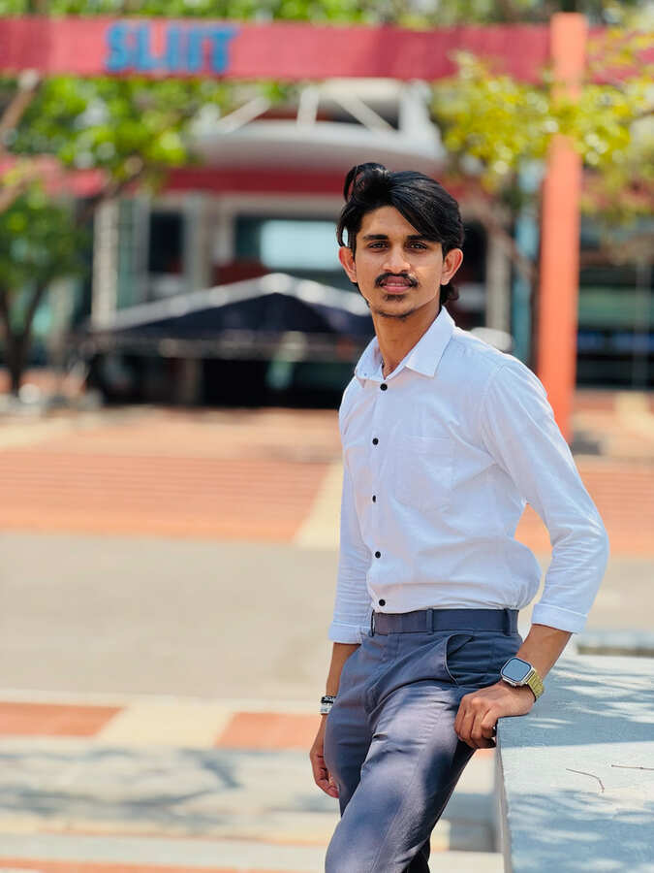
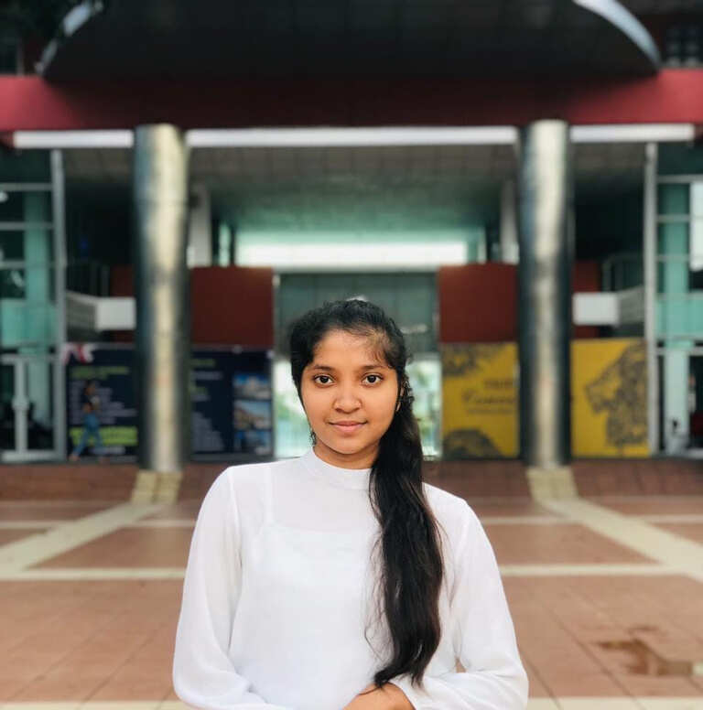
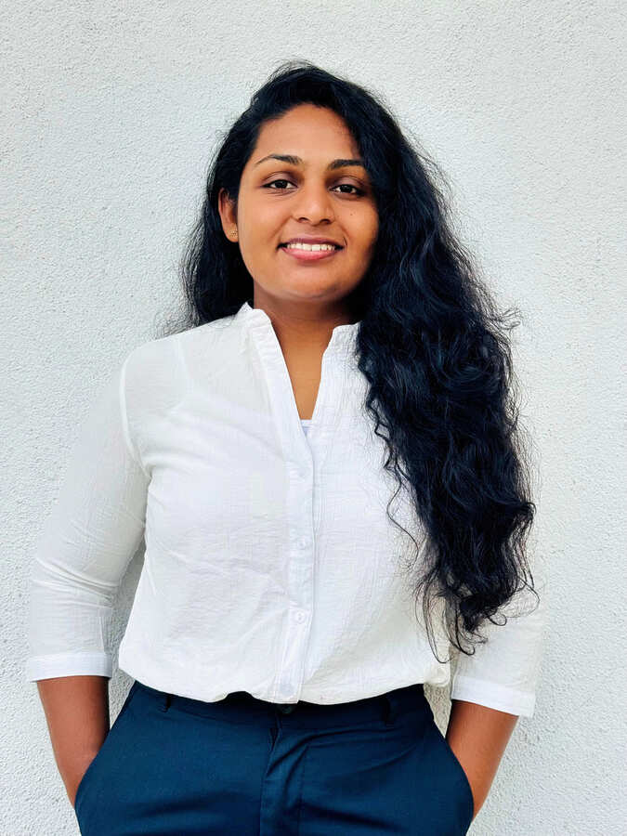
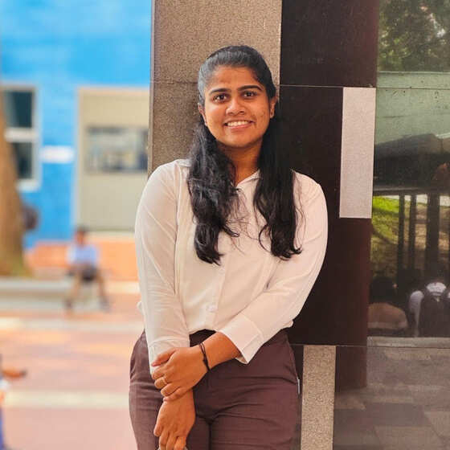
Our Team
A.H.M.P.D ABEYSINGHE
B.W.J.D SENAVIRATHNA
IT22062574
IT22128836
Game based dyscalculia intervention
module
Game based dysgraphia intervention
module
H.A.P.D MADHURANGI
H.A.P.N SENADEERA
IT22252418
IT22502360
Game based dyslexia intervention module
Game based working memory disorder
intervention
module
R26-IT-114

Slide 3
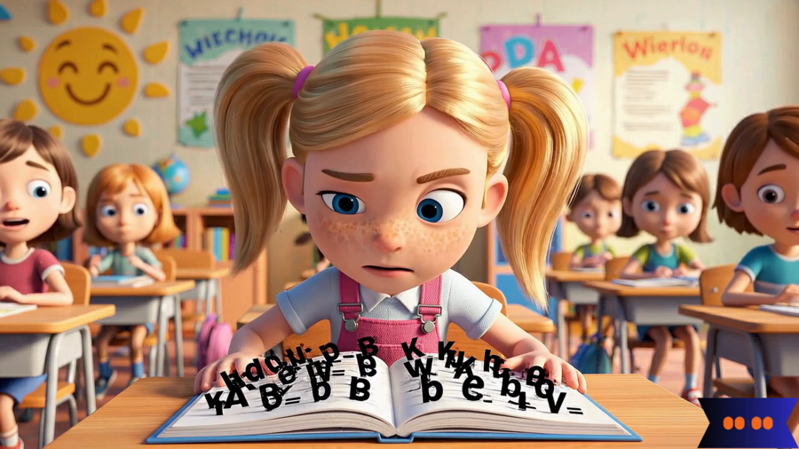
Introduction Video
R26-IT-114

Slide 4
Problem, Stakeholders & Measurable Pain Point
Problem
Sinhala-speaking children with learning disorders have limited access to affordable, home-friendly, adaptive intervention support.
  Existing supports are often therapist-led and costly for low- and middle-income families.
  Most digital tools focus on detection and English language , not ongoing adaptive support.
  Text-heavy instructions are difficult for young learners with limited reading ability.
  There is no single Sinhala platform covering dyslexia, dyscalculia, dysgraphia, and working memory disorder.
Who is affected?
  Children
  Parents
  Rural families
  Therapists
  Teachers
R26-IT-114

Slide 5
Research Gap + Objectives
Research gap
Sinhala accessibility gap
Intervention gap
Integration gap
Few Sinhala-first digital systems support young children with neurodevelopmental learning disorders.
Many tools screen or detect issues, but do not provide adaptive game-based therapy practice.
Separate activities exist, but not a unified platform for four disorders with shared progress tracking.
Project objectives
  Build a Sinhala-medium adaptive web based mobile learning platform for children aged 6–8.
  Provide four game-based modules: dyslexia, dyscalculia, dysgraphia, and working memory.
  Use sinhala voice-guided activities, rewards, and child-friendly UI to reduce reading dependency.
  Track progress for parents, teachers, and therapists through dashboards.
R26-IT-114

Slide 6
PP1 Comments and Actions took
Member | Comment | Actions
IT22062574 | Good progress. UI's need to be consistent with the other members. Better to add voice commands to guide the student | Standardized the UI design across all modules and added voice instructions to guide children through the activities.
IT22128836 | Good progress. Better to add voice guidance to get the kid's attention. and add a reward when the kid successfully completes the task. | Added voice guidance to improve children’s attention and implemented a reward system for successful task completion.
IT22252418 | Good progress. Nice UI's. Most of the features were implemented to some extent. Can design a pre-test combining questions from all the games and customize the levels accordingly. | Designed a pre-test covering all game areas and used the results to customize the difficulty levels according to the child’s performance.
IT22502360 | Good progress. | Designed and implemented a new progress dashboard and developed additional games to enhance the overall system.
R26-IT-114

Slide 7
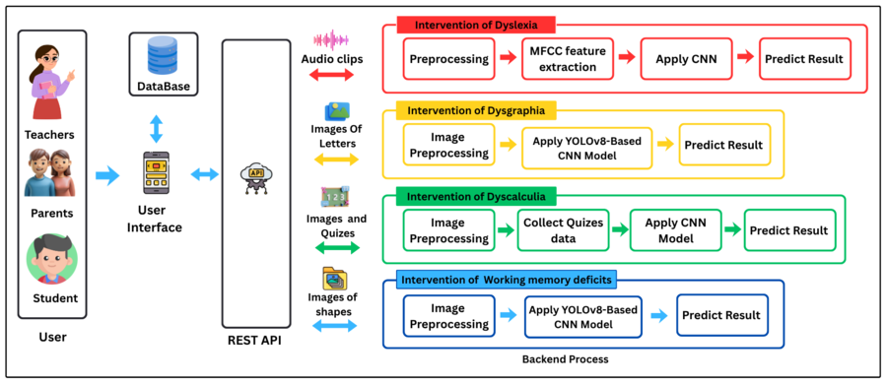
Solution Overview + Architecture
Smart Learn platform
A Sinhala, game-based adaptive platform combining four disorder-specific modules, child app activities, and progress dashboards.
R26-IT-114
4

Slide 8
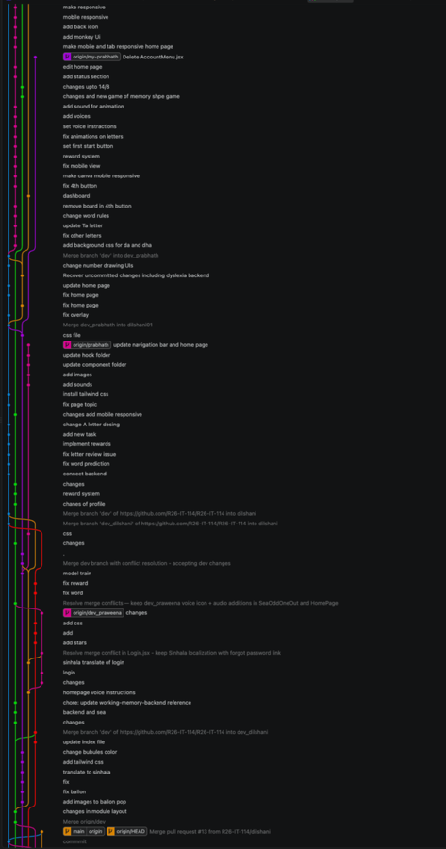
Integration and Completion Status
Git Graph
Module
Implemented evidence
Dyslexia
voice recognition, sound matching, reading + pronunciation practice,Dashboard,Pre -assesment
Dyscalculia
number recognition, quantity, tracing, sorting + adaptive difficulty
Dysgraphia
tracing to Sinhala letters/words, handwriting capture + analysis,
letter recognition, Dashboard
Working Memory
Sequence Recall, Memory Matching, Shape Drawing Prediction, Puzzle Activities, and Dashboard.
IT4010 Research Project | PP2 Final Readiness
R26-IT-114

Slide 9
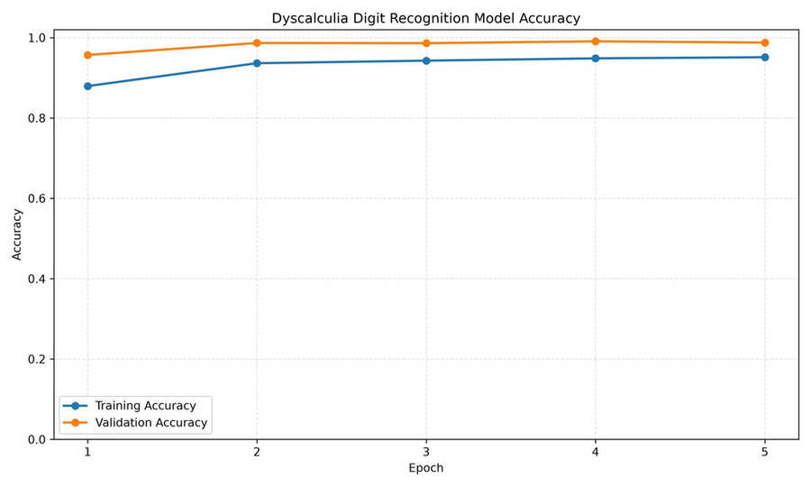
Evaluation Evidence
Learning Difficulty | Model Accuracy
Dyscalculia | 98.5%
Dyslexia | 89%
Dysgraphia | 93%
Working Memory | 96%
Result on the digit recognition model
IT4010 Research Project | PP2 Final Readiness
R26-IT-114

Slide 10
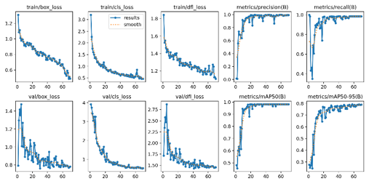
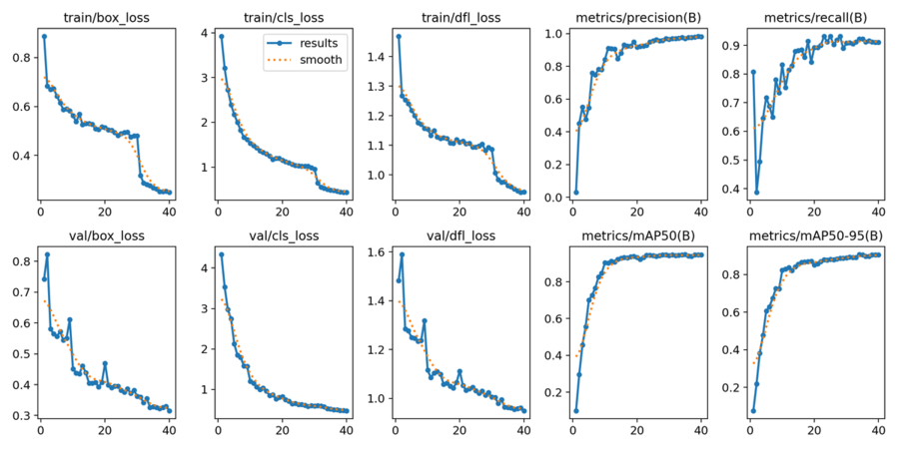
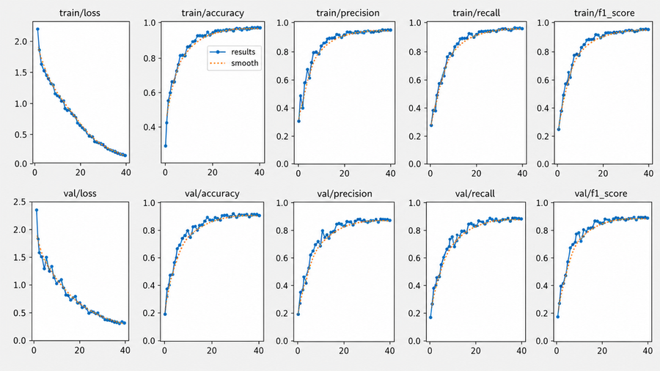
Evaluation Evidence
Result on the working memory CNN model
Result on the dysgraphia CNN model
Result on the voice recognition model
IT4010 Research Project | PP2 Final Readiness
R26-IT-114

Slide 11
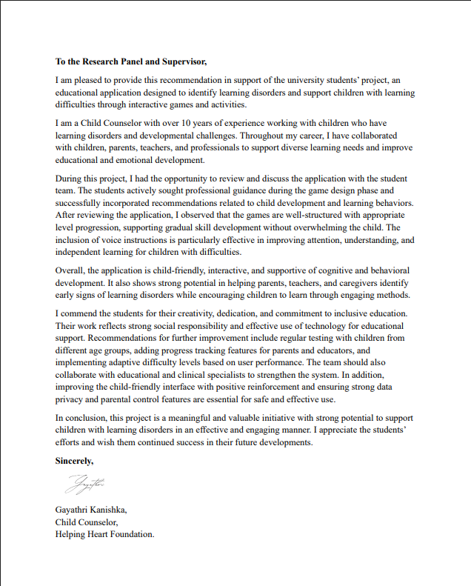
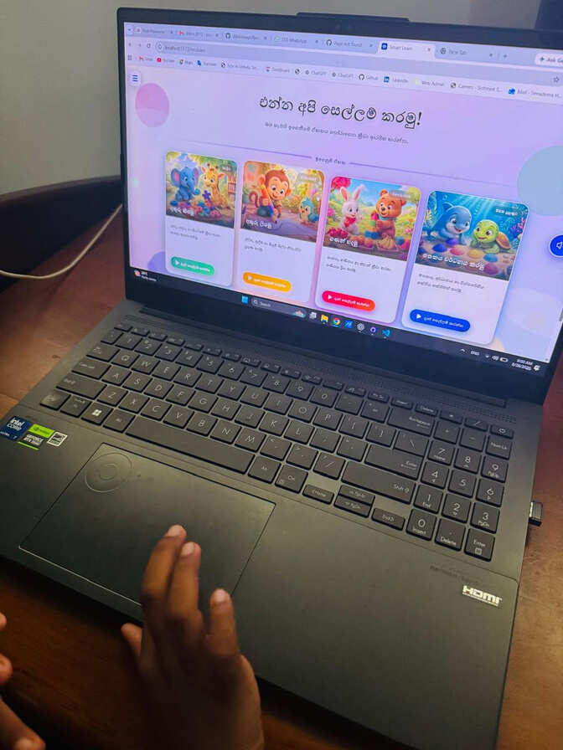
Evaluation Evidence
User Feedback
Recommandation Letter
App Tested with the child
IT4010 Research Project | PP2 Final Readiness
R26-IT-114

Slide 12
Non-Functional Requirements
Usability
child-friendly navigation and simple task flow
Accessibility
Sinhala voice guidance and visual instructions
Responsiveness
mobile-friendly screens for children and adults
Reliability
progress stored and visible after activity completion
Engagement
reward feedback through stars, badges or animation
IT4010 Research Project | PP2 Final Readiness
R26-IT-114

Slide 13
Commercialization
Target Market
Subscription Model
Language Expansion
Primary schools,
Special education centers,
Therapy centers,
Parents,
Educational institutions in Sri Lanka
Affordable monthly or annual plans for parents, schools, and therapy centers.
Future versions can support Tamil, English, and other languages, increasing the potential market.
User Benefits
  Sinhala-based Learning: Activities and voice instructions designed for Sinhala-medium children.
  Engaging Intervention: Game-based activities encourage children to participate continuously.
  Adaptive Learning: Activities are adjusted according to each child's performance and progress.
  Accessible Support: Provides a more accessible digital option for continuous learning support outside specialized centers
R26-IT-114

Slide 14
AI Use
Code Support — ChatGPT & Claude
  Supported code development and debugging
  Helped identify and resolve implementation errors
  Assisted with code optimization and restructuring
  Provided guidance for frontend–backend integration
1
Introduction Video — google flow
  Used AI tools to support video content creation
R26-IT-114

Slide 15
Demo Roadmap
Login / child profile
Select one module activity
Show voice guidance + gameplay
Complete task and reward
Open progress dashboard
R26-IT-114

Slide 16

THANK YOU

