Slide 1
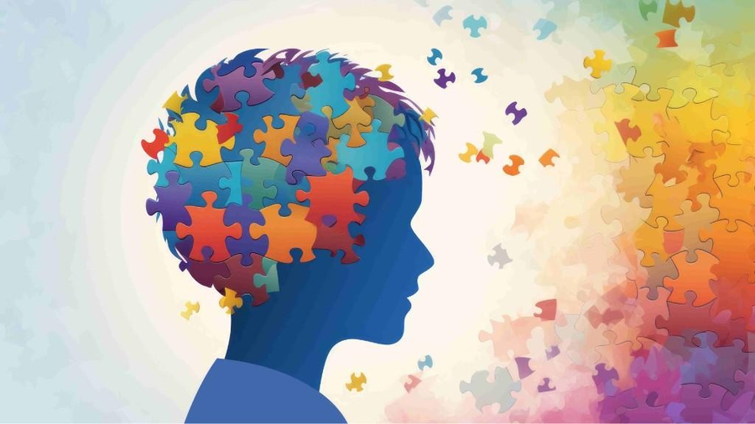

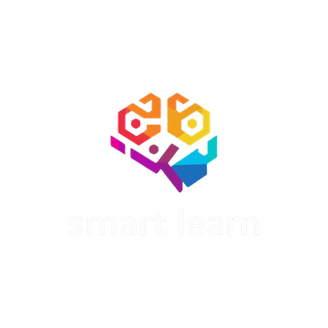

SMART LEARN
SMART LEARN:
An Adaptive Mobile Platform for Neurodevelopmental Learning Disorders
R26-IT-114

Slide 2

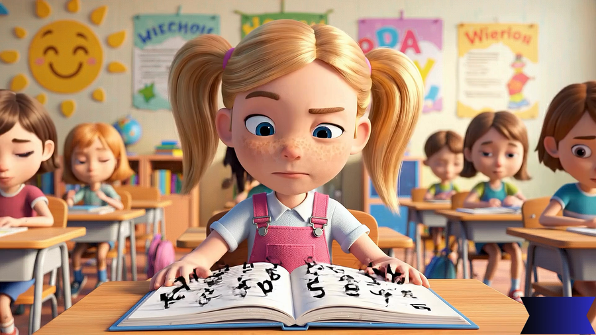
INTRODUCTION
VIDEO

Slide 3

INTRODUCTION
No supportive digital apps exist in Sinhala to assist therapists, and existing tools focus mainly on detection rather than adaptive, comprehensive treatment.
Current NLD interventions depend on costly therapist-guided assessments and clinical programs, often inaccessible to low- and middle-income families.
Most apps use text-based instructions, which young children with limited reading skills may struggle to understand, making task completion difficult.
No single digital tool currently supports Dyslexia, Dyscalculia, Dysgraphia, and Working Memory Disorder together.

Slide 4



USER &STAKEHOLDERS
Users
  Children (6–8 years)
  Parents / Guardians
  Teachers / Therapists
Stakeholders
  Schools
  Therapy centers
  Researchers

Slide 5


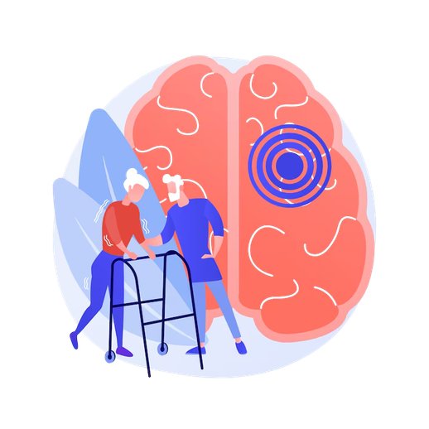


IMPACT OF THE PROBLEM TO USER AND SOCIETY
Children with neurodevelopmental learning disorders such as dyslexia, dysgraphia, dyscalculia, and working memory disorders face difficulties in reading, writing, and basic mathematical skills during early education.
These challenges can lead to poor academic performance, low self-confidence, and reduced motivation to learn.
Parents often lack affordable and accessible tools to support their children’s learning at home.
Teachers and therapists have limited ability to monitor and guide children outside therapy sessions or classrooms.

Slide 6
EXISTING SOLUTIONS AND THEIR LIMITATIONS
Learning Challenge | Existing Solution (App) | Medium / Language | What It Focuses On | Limitations
Dyslexia Support | Gall Lalla | Sinhala | Letter recognition, basic reading exercises | Limited literacy support beyond letters, no adaptive difficulty, no comprehension strategies, lacks performance tracking, not suitable for all age ranges.
 | Sinhala Follow | Sinhala | Reading support with audio guidance | Only basic reading support, limited scope (letters/words), not adaptive to individual struggles; lacks integrated tasks for comprehension or working memory.
Dysgraphia Support | The Kio | English | Handwriting practice & fine motor tasks | English only, doesn’t support Sinhala script; limited adaptive feedback, mainly focuses on motor output rather than spelling/cognitive errors.
 | Dyspuzzle | English | Puzzle-based writing/word tasks | English only, difficulty not personalized; no Sinhala support, limited cognitive skill integration.
Dyscalculia Support | Magrid | English | Math grid & logic puzzles | English only, lacks explicit instruction, not adaptive to specific numeracy weaknesses, no Sinhala support.
 | Meister Cody | English | Game-like math skill training | English only, mainly arithmetic practice; limited conceptual numeracy support, no Sinhala interface.
Working Memory Disorder | Lumosity | English | General brain training (memory, attention) | Not tailored for children or clinical deficits; no Sinhala interface, minimal educational content.
 | Mind Games | English | Memory, attention, logic games | Broad cognitive games but not specific to learning difficulties; no Sinhala support; no evidence for transfer to real-life learning skills.

Slide 7




PROPOSED SOLUTION
Solution Overview
  Sinhala-medium web-based mobile learning support system for children aged 6–8 with neurodevelopmental learning disorders.
  Provides interactive activities and educational games to improve reading, writing, mathematics, and memory skills.
  Supports dyslexia, dysgraphia, dyscalculia, and working memory difficulties.
  Usable by therapists, teachers, and parents at home or therapy centers
How the Solution Overcomes Limitations
  Sinhala language support – localized for Sri Lankan children.
  Multiple disorder support – not limited to a single difficulty.
  Adaptive assessment activities – identify the child’s actual skill level.
  Gradually increasing tasks and games – personalized learning path.
  Progress tracking dashboard – monitor improvements by therapists, teachers, and parents.

Slide 8
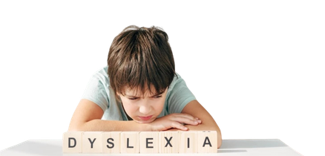

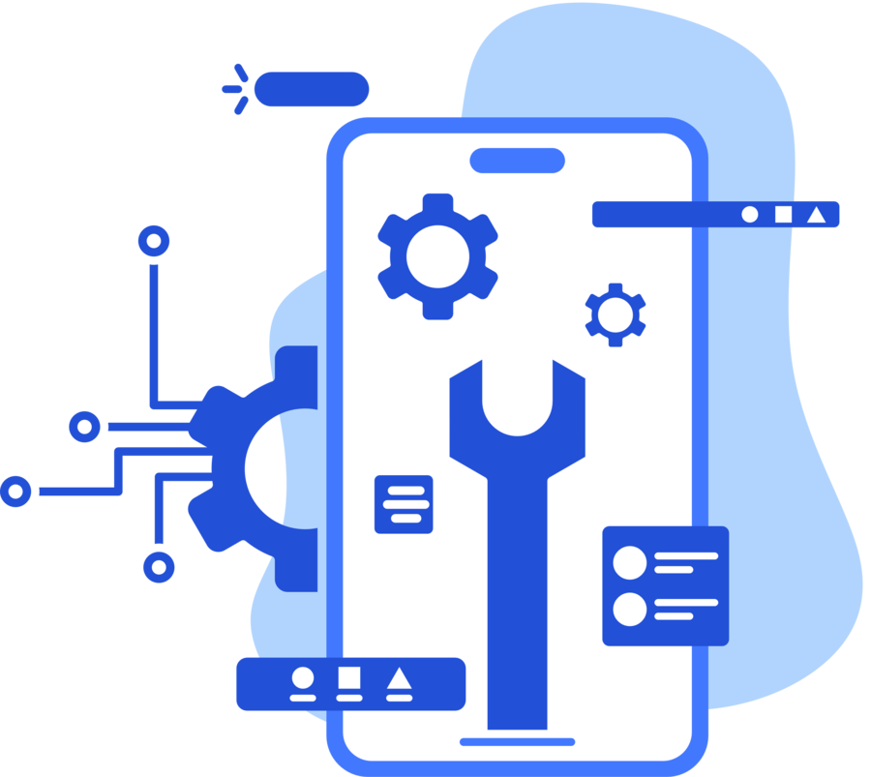


INDIVIDUAL STUDENTS’ COMPONENTS/CONTRIBUTIONS
Game based Dyscalculia intervention module
Game based Dyscalculia intervention module
Adaptive mobile learning and intervention module for children with Dyslexia
Game based dysgraphia intervention module
Support and improvement of working memory skills in children with working memory disorder
Game based Dyscalculia intervention module
Game based Dyscalculia intervention module
Game based Dyscalculia intervention module

Slide 9

SMART LEARN
H.A.P.D MADHURANGI-IT22252418
Adaptive mobile learning and intervention module for children with Dyslexia
  Conducts voice-based reading assessments for Sinhala words.
  Detects pronunciation errors and reading delays.
  Measures reading fluency using pronunciation response time.
  Provides adaptive game-based learning activities based on the child’s performance.
  Enables progress monitoring through parent and therapist dashboards.
  Supports intervention for dyslexia in Sinhala-medium children
The proposed system introduces an AI-based Sinhala voice-interactive dyslexia learning module that evaluates children's pronunciation using speech-to-text and response time analysis to detect reading difficulties.

Slide 10

Adaptive mobile learning and intervention module for children with Dyslexia
THE PROBLEM
MAIN OBJECTIVE
  No early detection tools for Sinhala-speaking children
  High cost of professional dyslexia assessments
  Existing apps focus on English - no Sinhala support
  No voice-based pronunciation evaluation tools
  Delayed diagnosis impacts academic confidence
Design an AI-based Sinhala voice-interactive dyslexia learning module that evaluates pronunciation accuracy and provides adaptive learning activities for children aged 6–8
Sub OBJECTIVES
  Voice-based pronunciation assessment (speech-to-text)
  Reading fluency via response time measurement
  Adaptive game-based learning activities
  Intelligent learner level detection
  Parent & therapist progress dashboard
IT22252418|H.A.P.D.Madhurangi | R26-IT-114

Slide 11







Adaptive mobile learning and intervention module for children with Dyslexia
Domain Knowledge
Technologies
EdTech
Backend:Node.js
Cloud Storage
Frontend:React.js
AI & Speech Recognition
Technologies
Human–Computer Interaction
Speech Processing
Database:Mongo DB
AI Development:Python with TensorFlow
Database:Firebase
IT22252418|H.A.P.D.Madhurangi | R26-IT-114

Slide 12
Adaptive mobile learning and intervention module for children with Dyslexia
Data Availability, Security, and Ethical Clearance
Validation Metrics
  Technical: Compare system vs expert evaluation results
  Educational: Measure fluency, accuracy & phonological awareness
  Usability: SUS scale testing with children, parents & therapists
  Parental consent required before data collection
  Children's identities fully anonymized
  Encrypted data transfer (HTTPS) & restricted access
  Data used exclusively for research purposes
IT22252418|H.A.P.D .Madhurangi | R26-IT-114

Slide 13
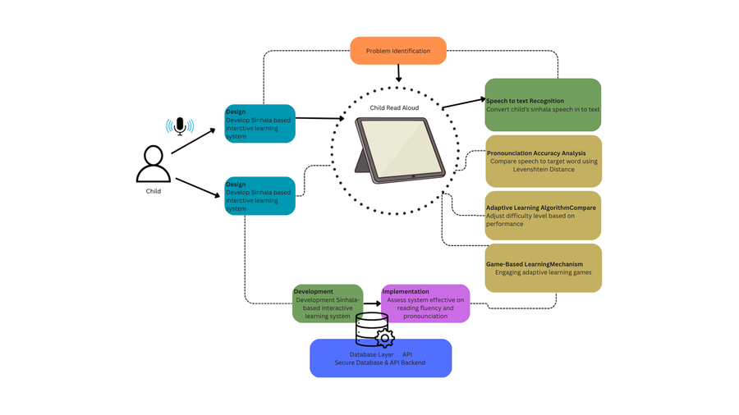
ADAPTIVE MOBILE LEARNING AND INTERVENTION MODULE FOR CHILDREN WITH DYSLEXIA
SYSTEM OVERVIEW
Common components
  Sinhala Instructions- Provides clear voice instructions in Sinhala for all memory games.
  Dashboard- Displays child’s performance trends, progress
  Adaptive Task Adjustment
  Notifications & Reminders – Alerts for incomplete tasks or scheduled practice sessions.
IT22252418|H.A.P.D.Madhurangi | R26-IT-114

Slide 14

SMART LEARN
Adaptive mobile numeracy learning and intervention module for children with Dyscalculia
GAME BASED DYSCALCULIA INTERVENTION MODULE
  Provides adaptive game-based numeracy activities to support children with dyscalculia in learning numbers and basic arithmetic.
  Integrates multisensory learning techniques including visual objects, Sinhala audio guidance, and interactive touch-based activities.
  Uses performance-based adaptive learning to automatically adjust difficulty levels according to the child’s progress.
Novelty:
Integrates dyscalculia screening, adaptive game-based learning, and progress monitoring within a single mobile platform to support personalized numeracy skill development.

Slide 15
GAME BASED DYSGRAPHIA INTERVENTION MODULE
THE PROBLEM
MAIN OBJECTIVE
Children with dyscalculia experience significant difficulties in understanding numbers and basic mathematical concepts.
Many learning applications focus on general mathematics practice but do not address specific numeracy deficits such as number sense and magnitude understanding.
Most available educational tools do not provide adaptive learning support based on the child’s performance.
There is also limited availability of multisensory and engaging digital learning tools designed specifically to support children with dyscalculia.
Design and develop an adaptive, game-based numeracy learning intervention system that identifies dyscalculia-related difficulties and provides personalized learning activities to improve number understanding and arithmetic skills for children aged 6–8 years.
SUB OBJECTIVES
Develop numeracy assessment tasks for number recognition, counting, and basic arithmetic.
Capture performance data (accuracy, response time, error patterns).
Provide adaptive learning activities based on difficulty level.
Support multisensory learning (visual objects, Sinhala audio, touch interaction).
Enable progress monitoring dashboards for parents and teachers.
IT22062574 | Abeysinghe A H M P D | R26-IT-114

Slide 16


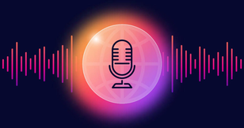
GAME BASED DYSCALCULIA INTERVENTION MODULE
Domain Knowledge
Latest Technologies
Modular design, component-based architecture, and scalable backend development.
Numeracy performance analysis for evaluating number recognition, counting ability, and arithmetic understanding.
Performance data analysis using metrics such as accuracy, response time, and error patterns.
Designing interactive numeracy games and child-friendly interfaces to improve learning engagement.
Backend:Node.js
Frontend:React.js
Database:Mongo DB
Technologies
Cloud Storage
Text-to-Speech
Database:Firebase
AI Development:Python with TensorFlow
IT22062574 | Abeysinghe A H M P D | R26-IT-114

Slide 17
SUPPORT AND IMPROVEMENT OF NUMERACY SKILLS IN CHILDREN WITH DYSCALCULIA
Data Availability, Security, and Ethical Clearance
Validation Metrics
  Accuracy Rate – Number recognition and arithmetic answers the child gets correct.
  Response Time – How quickly the child completes numeracy tasks.
  Task Completion Rate – Percentage of learning activities successfully finished.
  Error Rate – Number of mistakes made during counting or arithmetic tasks.
  Learning Improvement – Improvement in numeracy performance before and after using the system.
  Data collected from numeracy learning activities (accuracy, response time, errors).
  Data stored securely in the system database.
  Secure login and encrypted connections used to protect user data.
  Parent or guardian consent obtained before child participation.
  No sensitive personal data collected.
  Data used only for academic research purposes and kept confidential.
IT22062574 | Abeysinghe A H M P D | R26-IT-114

Slide 18
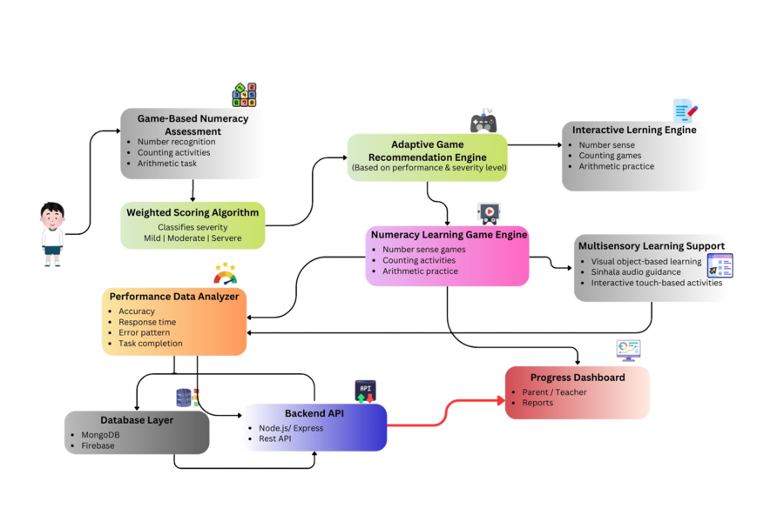
SUPPORT AND IMPROVEMENT OF NUMERACY SKILLS IN CHILDREN WITH DYSCALCULIA
System Overview
Common components
  Game-Based Numeracy Activities – Counting, number recognition, and arithmetic tasks.
  Adaptive Learning Engine – Adjusts task difficulty based on child performance.
  Progress Dashboard – Displays learning progress and performance trends.
  Performance Monitoring – Tracks accuracy, response time, and error patterns.
IT22062574 | Abeysinghe A H M P D | R26-IT-114

Slide 19
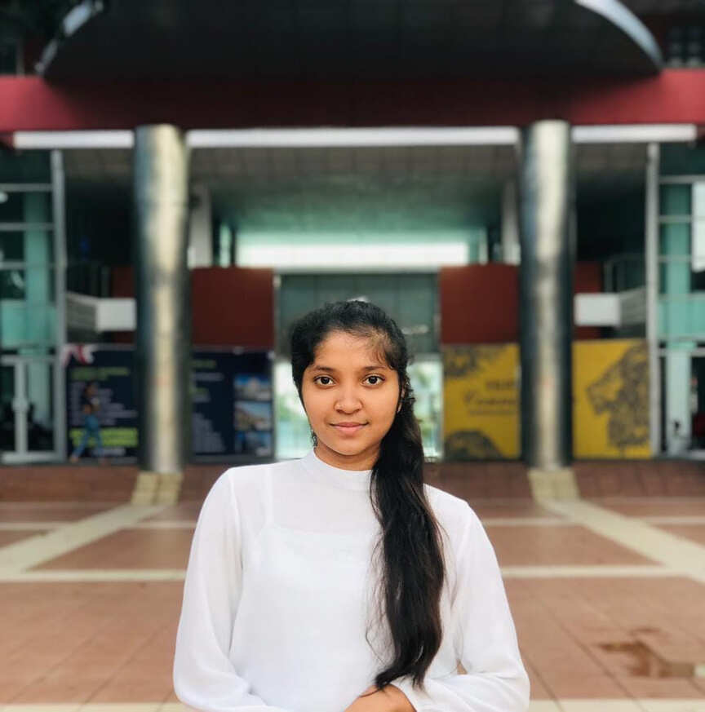
SMART LEARN
B.W.J.D SENAVIRATHNA
IT22128836
GAME BASED DYSGRAPHIA INTERVENTION
MODULE
  Provides game-based handwriting activities to improve letter formation, spacing, alignment, and writing fluency.
  Integrates sensory-based writing activities and voice-guided Sinhala instructions.
  Uses digital ink capture and handwriting analysis to identify handwriting difficulties
Integrates sensory-based handwriting activities with digital verification while providing adaptive guidance when a child struggles with handwriting tasks.

Slide 20
GAME BASED DYSGRAPHIA INTERVENTION MODULE
THE PROBLEM
MAIN OBJECTIVE
Dysgraphia treatment mainly depends on therapist-guided methods, with no Sinhala supportive apps for therapists.
Most handwriting apps are designed for English, and the few Sinhala apps only support basic letter tracing.
Apps repeat the same task when children struggle, without simplified or adaptive support.
Design and develop an integrated, game-based Sinhala handwriting intervention system that assesses dysgraphia severity and provides adaptive digital and sensory-based learning activities with voice instructions for children aged 6–8 years
Sub OBJECTIVES
Sinhala language - specific dysgraphia intervention platform.
Provides simplified guidance and adaptive support when a child struggles with a task.
Integrates sensory-based handwriting activities with digital handwriting verification.
Includes voice-guided instructions in Sinhala to support children during learning.
IT22128836 | B.W.J.D Senavirathna | R26-IT-114

Slide 21



GAME BASED DYSGRAPHIA INTERVENTION MODULE
Domain Knowledge
Latest Technologies
Modular design, component-based architecture, and scalable backend development.
Image processing and pattern recognition for analyzing handwriting in sensory-based activities.
Feature extraction analysis of handwriting metrics.
Designing user-friendly interfaces and gamified interactions to improve engagement.
Backend:Node.js
Frontend:React.js
Cloud Storage
Database:Mongo DB
Technologies
Digital Ink Capture
Database:Firebase
Open CV
MyScript HWR Engine
IT22128836 | B.W.J.D Senavirathna | R26-IT-114

Slide 22
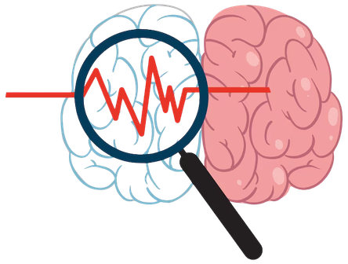
SUPPORT AND IMPROVEMENT OF WORKING MEMORY SKILLS IN CHILDREN WITH WORKING MEMORY DISORDER
Data Availability, Security, and Ethical Clearance
Validation Metrics
  Pre- and post-intervention comparisons of handwriting metrics.
  System validation will be conducted with a small group of 5–6 children to assess technical performance, usability, and intervention effectiveness.
  therapists evaluate the app’s activities and intervention methods.
  Error Rate – How many mistakes occur during tasks.
  Experts knowledge(pediatricians and educational therapists) guide task design, adaptive games to ensure clinical validity.
  Data collected from children’s interaction.
  avoids sensitive personal information.
  Ensuring only authorized users can access information.
  Ensuring activities do not cause harm, stress, or discomfort to children.
IT22128836 | B.W.J.D Senavirathna | R26-IT-114

Slide 23
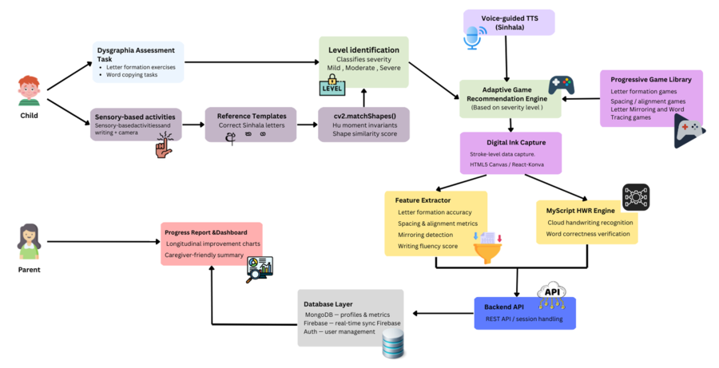
SUPPORT AND IMPROVEMENT OF WORKING MEMORY SKILLS IN CHILDREN WITH WORKING MEMORY DISORDER
System Overview
Common components
  Provides clear Sinhala voice instructions for all handwriting games.
  Dashboard- Displays child’s performance trends, progress
  Adaptive Task Adjustment
  Notifications & Reminders – Alerts for incomplete tasks or scheduled practice sessions.
IT22128836 | B.W.J.D Senavirathna | R26-IT-114

Slide 24

SMART LEARN
H.A.P.N SENADEERA
IT22502360
SUPPORT AND IMPROVEMENT OF WORKING MEMORY SKILLS IN CHILDREN WITH WORKING MEMORY DISORDER
  Provides extra support for children with working memory difficulties.
  Includes puzzles and tasks that adapt to the child’s performance.
  Helps children improve weak areas before moving to new tasks.
  Offers Sinhala instructions and a progress dashboard to track learning.
An AI-assisted adaptive working memory game generation mechanism that creates or configures puzzle activities according to the child’s current memory weakness, performance trend, and task behavior.

Slide 25
SUPPORT AND IMPROVEMENT OF WORKING MEMORY SKILLS IN CHILDREN WITH WORKING MEMORY DISORDER
THE PROBLEM
MAIN OBJECTIVE
  Many children (6–8 years) have working memory difficulties
  Hard to remember instructions and complete tasks
  Existing apps mostly English only
  Many apps do not adapt to child performance
Develop an AI-based Sinhala mobile web application to improve the working memory of children aged 6–8 years.
Sub OBJECTIVES
  Interactive memory games (cards, sequences, shapes, numbers)
  Adaptive puzzles that AI adjust to the child’s level
  Extra practice for tasks the child struggles with
  Track progress with easy-to-read dashboards
  Sinhala instructions for all activities
IT22502360|H.A.P.N Senadeera | R26-IT-114

Slide 26

SUPPORT AND IMPROVEMENT OF WORKING MEMORY SKILLS IN CHILDREN WITH WORKING MEMORY DISORDER
Domain Knowledge
Technologies
AI & Adaptive leaning
Backend:Node.js
Cloud Storage
Frontend:React.js
EdTech
Technologies
Human–Computer Interaction
AI Adaptive Engine
Database:Mongo DB
AI Development:Python with TensorFlow
Database:Firebase
IT22502360|H.A.P.N Senadeera | R26-IT-114

Slide 27
SUPPORT AND IMPROVEMENT OF WORKING MEMORY SKILLS IN CHILDREN WITH WORKING MEMORY DISORDER
Data Availability, Security, and Ethical Clearance
Validation Metrics
  Accuracy Rate – How many answers the child gets correct.
  Response Time – How fast the child completes memory tasks.
  Task Completion Rate – How many tasks the child successfully finishes.
  Error Rate – How many mistakes occur during tasks.
  Learning Improvement – Improvement in performance before and after using the system.
  Data collected from children’s memory game activities (accuracy, response time, errors).
  Data stored securely in the system database.
  Secure login and encrypted connections used to protect data.
  Parent or guardian consent obtained before participation.
  No sensitive personal data collected.
  All data used only for academic research and kept confidential.
IT22502360|H.A.P.N Senadeera | R26-IT-114

Slide 28
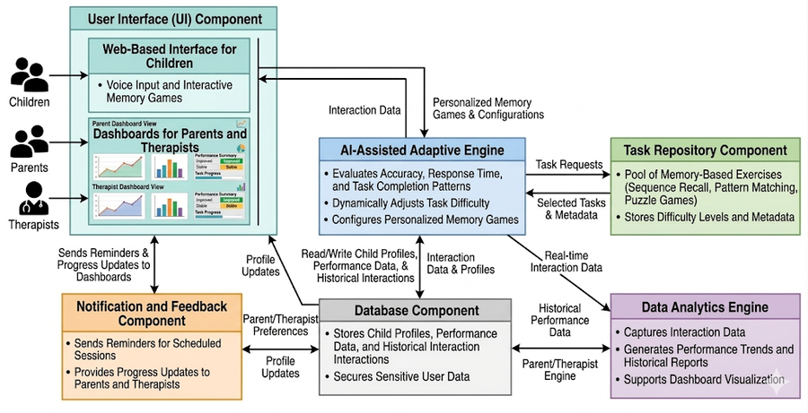
SUPPORT AND IMPROVEMENT OF WORKING MEMORY SKILLS IN CHILDREN WITH WORKING MEMORY DISORDER
System Overview
Common components
  Sinhala Instructions- Provides clear voice instructions in Sinhala for all memory games.
  Dashboard- Displays child’s performance trends, progress
  Adaptive Task Adjustment
  Notifications & Reminders – Alerts for incomplete tasks or scheduled practice sessions.
IT22502360|H.A.P.N Senadeera | R26-IT-114

Slide 29
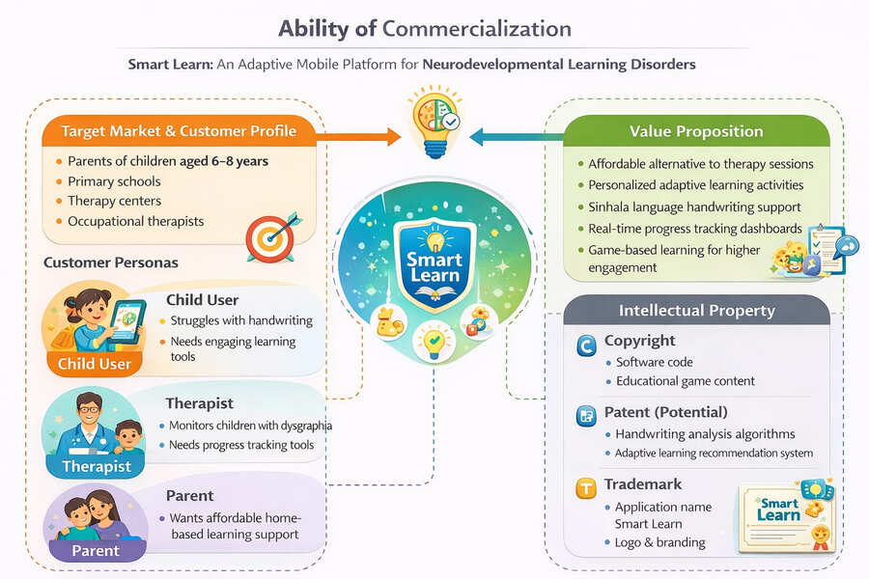
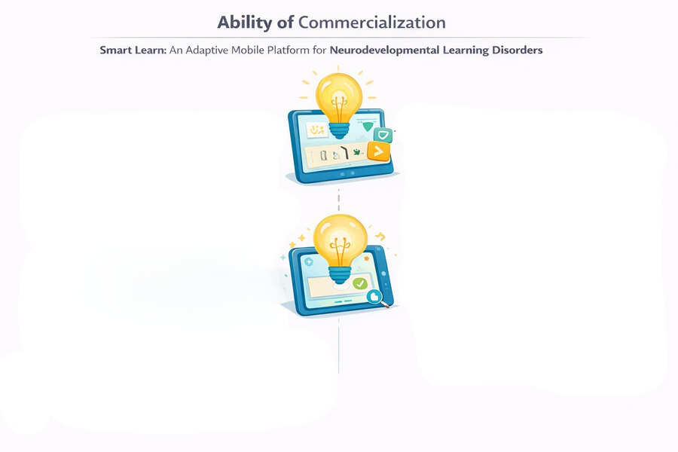
SMART LEARN: AN ADAPTIVE MOBILE PLATFORM FOR NEURODEVELOPMENTAL LEARNING DISORDERS

Slide 30
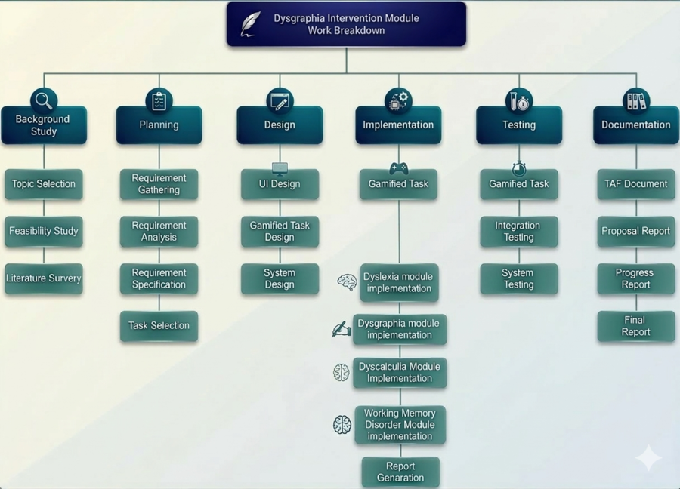
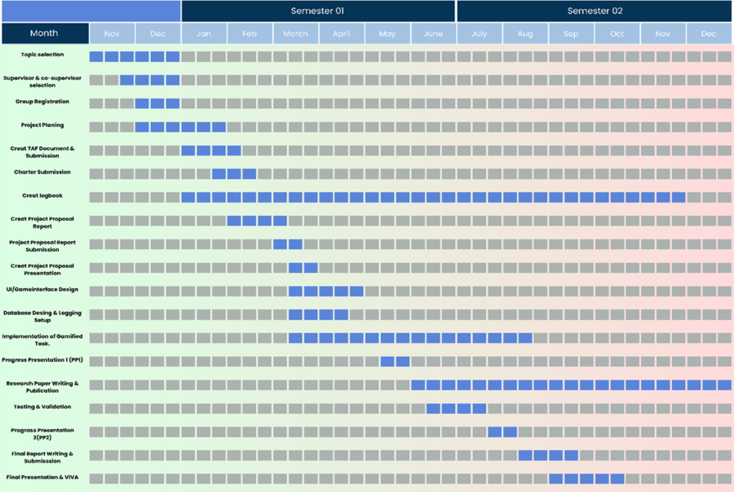
SMART LEARN: AN ADAPTIVE MOBILE PLATFORM FOR NEURODEVELOPMENTAL LEARNING DISORDERS

Slide 31

SMART LEARN
THANK YOU

