Slide 1

Using Machine Learning MoDELS to Perform Predictive Analysis On Flight Ticket PRICING Data
CIS 5560, Spring 2023 Professor Jongwook Woo

Slide 2
Predicting the Flights Ticket Price
Presented by: Group 6
Philip Wong
Phue Thant
Pratiksha Yadav
Ruta Antaliya

Slide 3
Agenda
Introduction
Dataset Specifications
Feature Importance
Technical Specifications
Prediction System Flowchart
Machine Learning Algorithms Used
Regression results Comparison
References
Key Takeaways and Insights

Slide 4
Business CASE for PREDICTING PRICING
Airlines:
Optimize their pricing strategies by:
•pricing trends over time.
•setting appropriate prices for specific routes.
•compare future prices against their competitors.
Customers:
•The analysis can provide unique insights of what specific factors (or features) can impact airline pricing providing an advantage to the savvy traveler.
•Allowed to forecast costs of airfare which can help the consumer plan budgets and find opportunities lower cost opportunities.

Slide 5
Dataset Specifications
Dataset URL: https://www.kaggle.com/datasets/dilwong/flightprices?resource=download
Dataset Description: Expedia purchasable ticket information between 04/2022 & 10/2022
Number Of Files: 1
File Format: CSV
 | Original | Cleaning - Full Dataset | Sample
Fields | 27 | 15 | 15
Records | ~200m | ~20m | ~100k
Size | 29.8GB | 4.68GB | 23.4MB

Slide 6
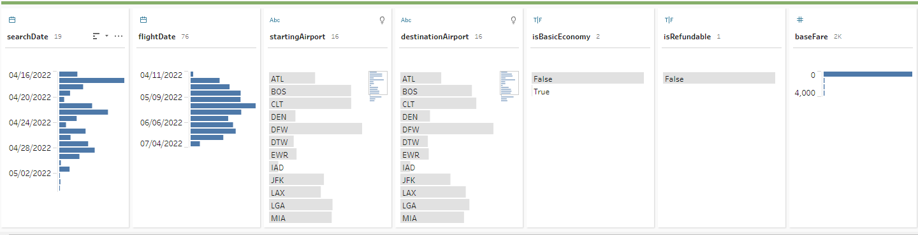
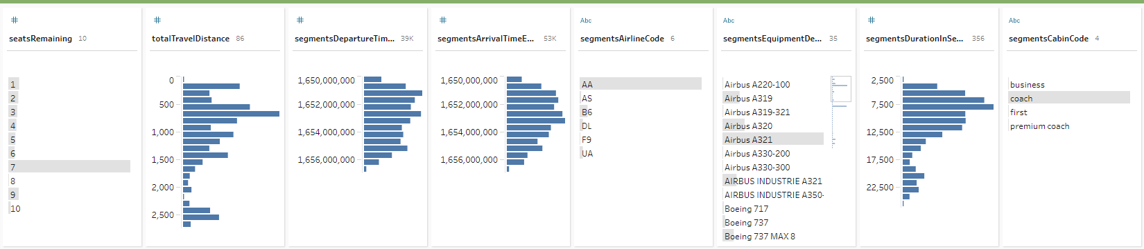

Dataset Summary - 14 Features 1 Label

Slide 7
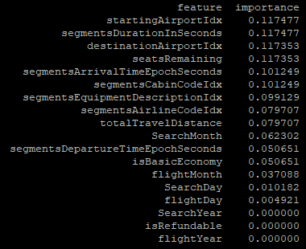
Feature Importance and Feature Engineering
Starting Airport and Flight Duration had the most impact to the model followed by Destination Airport and Seats Remaining.
The type of Airline Equipment (airplane) did have a small impact to price ( both feature importance and consistent r2 evaluation)
Removing features that had lower importance score such as Search Date or Flight Date had little impact on r2 and at times even lowered r2.
Concatenating fields that may have more meaning together than separated had no impact on r2. For example, depart and arrival airport (creating a route column) and separating date into month, day, year.
Date was limited to 3-4 months which limited the predictive pricing

Slide 8



Technical Specifications
Databricks Community Version: 10.4 LTS (includes Apache Spark 3.1.1, Scala 2.12)
File System: DBFS (Data Bricks File System)
Python Version: 3.10.4
Hadoop Version: 3.2.1-amzn-3.1
No. Of CPUs: 8
PySpark version: 3.0
Nodes: 3
Total Storage: 481 GB

Slide 9





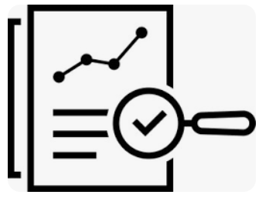
PREDICTION SYSTEM FLOWCHART
Collect Data
Prepare Data
Feature Engineering
Split Data
Train Data
Build Model(ML Algorithms)
Test Data
Measure Accuracy

Slide 10
Machine LEARNING ALGORITHMS USED
Flight Price Prediction:
Random Forest Regression
Gradient Boost Tree Regression
Decision Tree Regression
Factorization Machines

Slide 11
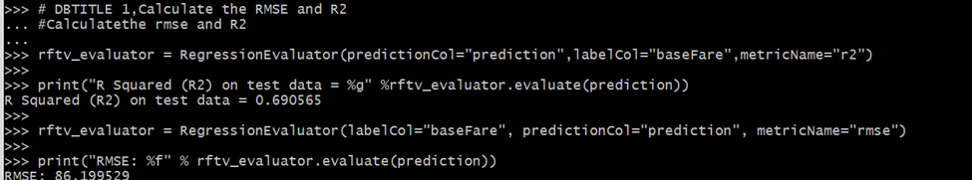
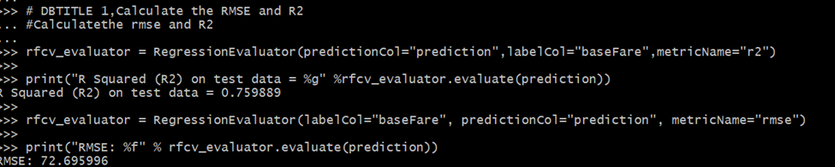
Random Forest Regression (RF)
TrainValidator: R2=0.69, RMSE=86.199
On Sample Dataset, R2 value for CV is higher with difference of .06
On Full dataset, CV and TV has same R2 values but CV has higher run time as compared to TV.
The maxDepth value of (13,16 ) appears to be working well with this model with default being 5 and maxBins of 64 with default being 32 to get higher accuracy.
CrossValidator: R2=0.75, RMSE=72.69​

Slide 12
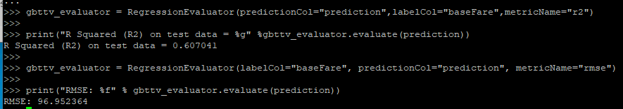
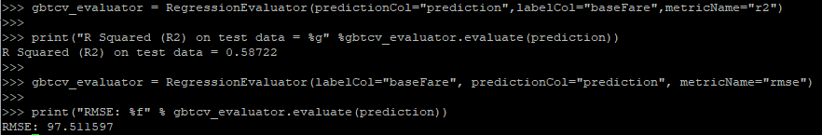
Gradient Boosted Tree (GBT)
TrainingValidator r2=0.607, rmse= 96.95
TrainingValidator provided a consistently higher R2 value than CrossValidator
Applying the GBT TrainValidator on the full dataset provide a 15% increase to r2 versus the sample
MaxIter value of 5 appears to be the most optimal. Default is 20.
CrossValidator r2= 0.587, rmse= 97.51

Slide 13
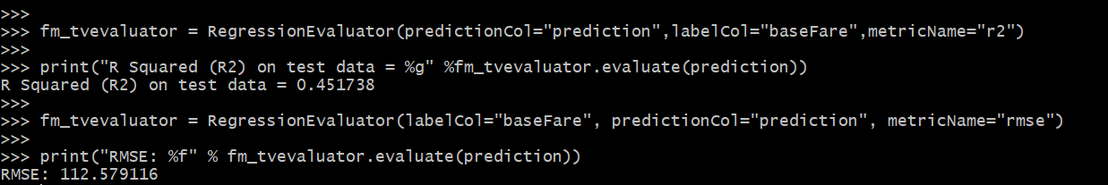
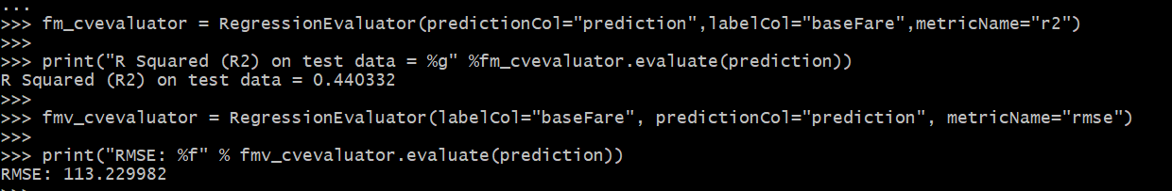
Factorization Machines (FM)
Train Validator R2=0.45, RMSE=112.57
Cross Validator R2=0.44, RMSE=113.07
On the sample dataset Train-Validation has slightly higher r2 value than Cross validation.
On full dataset CV takes more time than TV. And the R2 results are almost the same.
The step size [1, 0.5] was worked well with model to get higher accuracy.

Slide 14
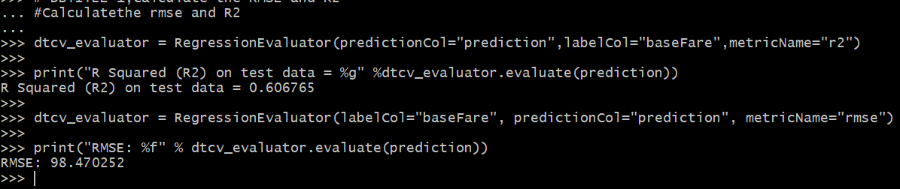
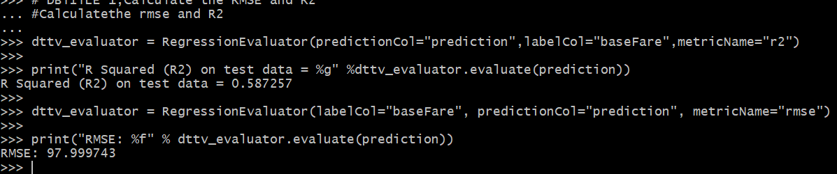
Decision Tree Regression (DT)
Cross Validator R2 = 0.606, RMSE = 98.47
On sample Dataset , R2 value for CV is slightly higher.
On Full dataset, running time on CV takes more than TV. And the R2 results are almost the same.
Train-Validation allows us to control the depth of the tree and enhance its’ ability to generalize.
Train Validator R2 = 0.587, RMSE = 97.99
Notes:
If the decision tree is allowed to grow too deep during cross-validation, it may lead to overfitting. To address this issue, we can use a train-validation split instead, which allows us to control the depth of the tree and enhance its ability to generalize.

Slide 15

Comparison Tables - Full Dataset Results
Cross Validation
Algorithms | R2 | RMSE | Model Training Time
Random Forest | 0.728 | 80.027 | 3 hr 30 mins
Gradient Boost Tree (CV) | 0.708 | 82.80 | 1hr 53mins
Decision Tree | 0.63 | 91.99 | 1 hr 30 mins
Factorization Machines | 0.46 | 111.02 | 5 hrs
Train Validation
Algorithms | R2 | RMSE | Model Training Time
Random Forest | 0.728 | 79.92 | 1 hr 30 mins
Gradient Boost Tree (CV) | 0.706 | 83.17 | 53 mins
Decision Tree | 0.64 | 92.04 | 47 mins
Factorization Machines | 0.46 | 111.23 | 3 hrs

Slide 16
Conclusion
Key Takeaways and Insights
Technical
Learnings from feature importance
Both cross-validation and train-validation split are essential techniques.
Business Case
Helps airlines optimize pricing for specific routes and seasons
Analyzes pricing trends to develop effective strategies
Customers can forecast future flight prices and plan their journeys
Leads to more efficient pricing strategies for airlines
Results in better planning for customers
Notes:
Learning from feature importance help us make better decisions about feature selection, model improvement, and future data collection.
Both cross-validation and train-validation split are essential techniques for evaluating the performance of machine learning models. Cross-validation is useful for selecting the best hyperparameters, while train-validation split can be used to evaluate the model's overall performance on new data.
The airline dataset predicts airline prices and helps airlines optimize pricing for specific routes and seasons. By analyzing pricing trends, airlines can develop effective strategies for specific routes and periods. Customers can use the dataset to forecast future flight prices and plan their journeys. The use of this dataset can lead to more efficient pricing strategies for airlines and better planning for customers, resulting in a streamlined air travel industry.

Slide 17
References
https://github.com/prati-y/PREDICTIVE-ANALYSIS-ON-FLIGHT-TICKET-PRICING-DATA-
https://spark.apache.org/docs/latest/ml-tuning.html
https://www.kaggle.com/datasets/dilwong/flightprices?resource=download.

Slide 18

Thank You!

